Slide 1


Barriers to a Robust Cyber Workforce
CDT Sheyla Street
Advisors: LTC Moore, LTC Fukuzawa, CPT Freeny

Slide 2

Acknowledgements
LTC Moore
LTC Fukuzawa
CPT Freeny
COL Ragsdale
Analiese Wagner
Albert Palacios
A special thanks to you all for making this possible.

Slide 3
Agenda
Motivation
Research Objective
Methodology
Results and Conclusions
Questions
3
Notes:
Pending Objectives

Slide 4


Motivation

Slide 5
Research Objective
Measuring the gap between workforce and unfilled cyber positions.
Quick Pulse Check: Define cyber skills in 1-3 words.

Slide 6








Previous Research

Slide 7
Methodology
Dataset 1: KSAs ~ Occupational Information Network
Level of Expertise
119 distinct KSA ratings
29 job titles
SOC code 15
7

Slide 8

Methodology
Dataset 2: Job Requirements ~ Bureau of Labor Statistics
Employer Projection
17 skill categories
22 job titles
SOC code 15
8

Slide 9
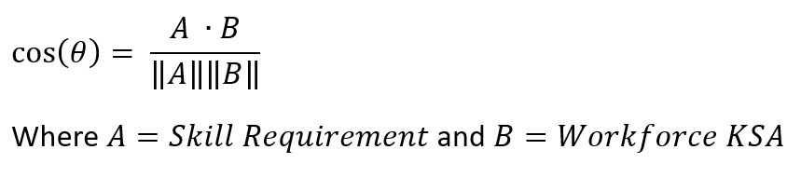

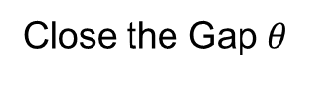
Methodology
Cosine Similarity Test
A
Close the Gap $θ$
$$θ$$
B

Slide 10
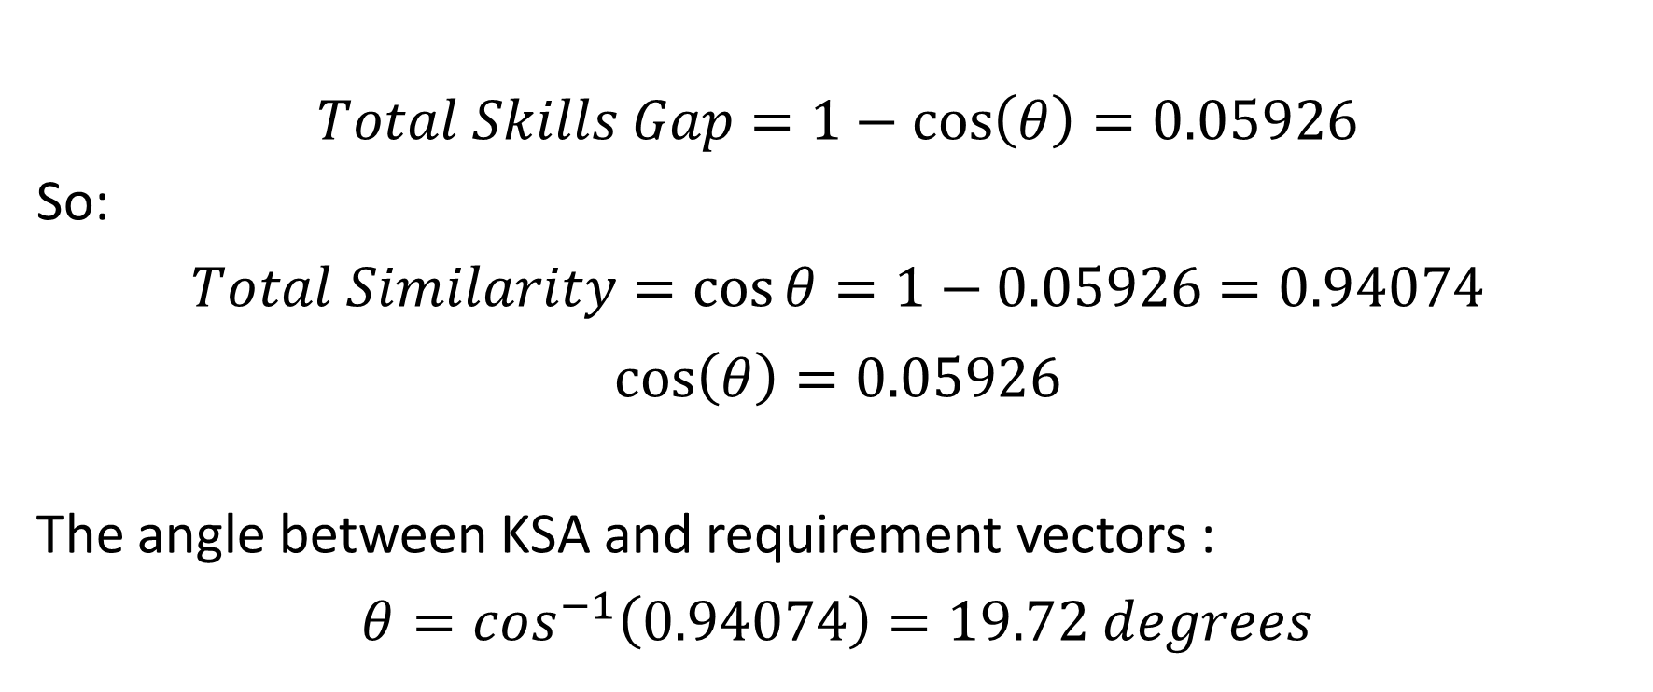
Results
$$Total Skills Gap=1−\cos\left(θ\right)=0.05926$$
So:
$$Total Similarity=cos{θ=1−0.05926=0.94074}$$
$$\cos\left(θ\right)=0.05926$$
The angle between KSA and requirement vectors :
$$θ=\cos^{−1}\left(0.94074\right)=19.72 degrees$$

Slide 11
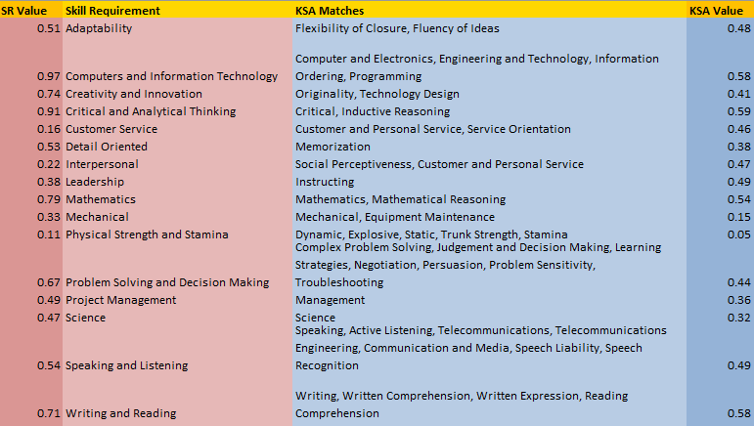
Results

Slide 12
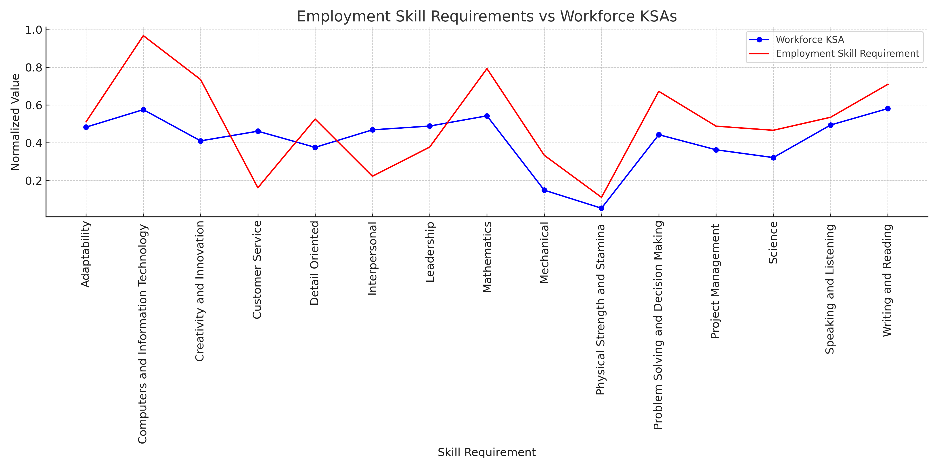
Results

Slide 13
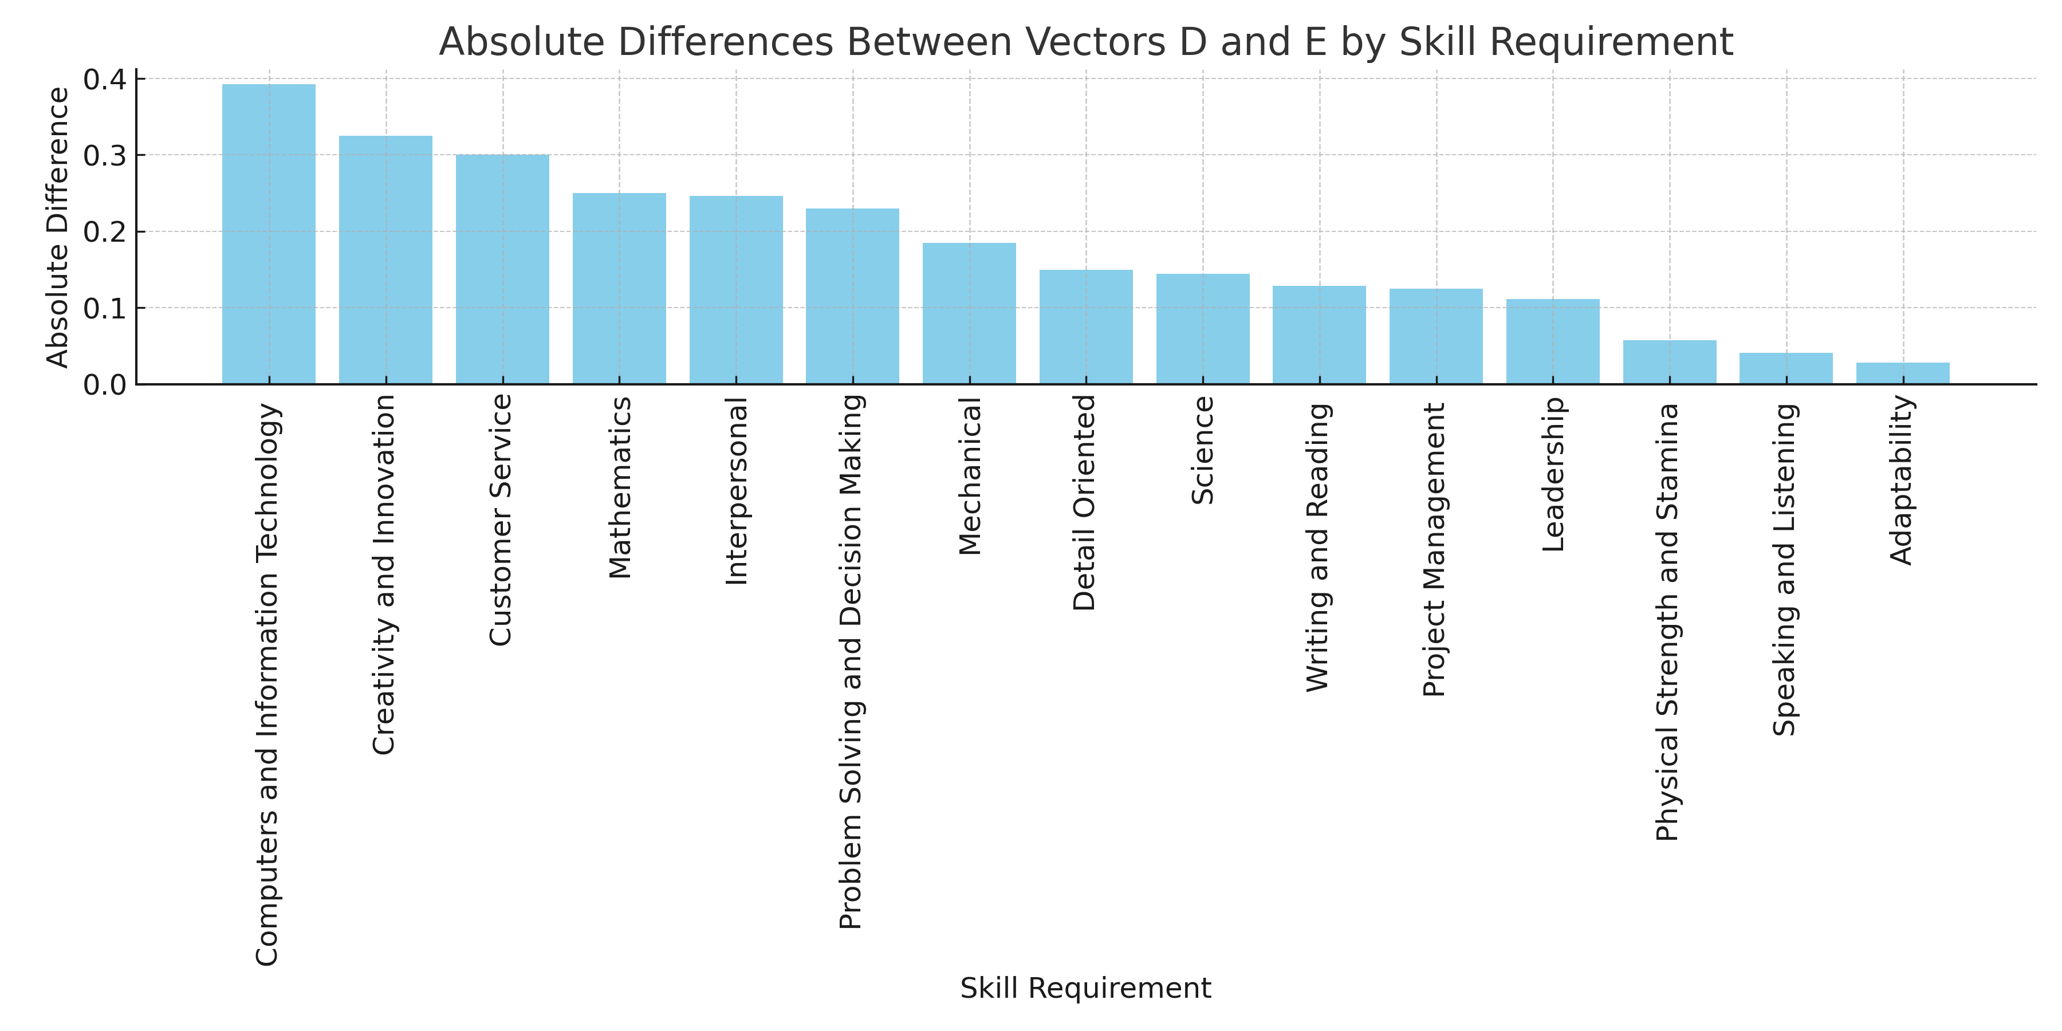
Results

Slide 14
Key Takeaways
The most significant gap is found among technical skills.
Skills with elevated requirement levels show the most significant discrepancies in KSA alignment.
There is no clear standard for defining cyber skills.
14

Slide 15
Thank You
Questions?

Slide 16
Works Cited
Carmichael, Ted, and Stamper, John. Developing a Continuous, Rather Than a Binary, Classification for Measuring STEM Jobs. Career and Technical Education-STEM, 2022, pp. 104-109.
Donovan, Sarah A., Stroll, Adam, Bradley, David H., Collins, Benjamin. (2022, March 31). Skills Gaps: A Review of Underlying Concepts and Evidence (CRS Report No. R47059)
“Look to the STARs.” Opportunity@Work, https://opportunityatwork.org/our-solutions/stars-insights/look-to-the-stars/. Accessed 16 Oct. 2024.
Maurer, Tim, and Arthur Nelson. Priority #4: Cybersecurity Workforce Challenges. Carnegie Endowment for International Peace, 2020, pp. 111–26. JSTOR, https://www.jstor.org/stable/resrep26915.10.
"Skills Gaps: A Review of Underlying Concepts and Evidence." Congress.gov, Library of Congress, 04 March 2025, https://www.congress.gov/crs-product/R47059.
ONET Resource Center. ONET Data Dictionary Version 29.2 – Knowledge Excel File. Accessed March 03, 2025. https://www.onetcenter.org/dictionary/29.2/excel/knowledge.html.

