Slide 1
Digital Engineering and Test and Evaluation: Operation Safe Passage
Presented By: Brandt Sandman
Collaborators: Paul Wach, Geoff Kerr, Alejandro Salado, Tim Sherburne, Joe Gregory, Taylan Topcu
The authors acknowledge support from the US Department of Defense through SERC/AIRC as cited by "Digital Transformation of Testing and Evaluation: Introducing Operation Safe Passage" and "Digital Engineering Testbed For T&E: Operation Safe Passage Status and Lessons Leanred"
Notes:
The template is applied to the entire slide deck

Slide 2
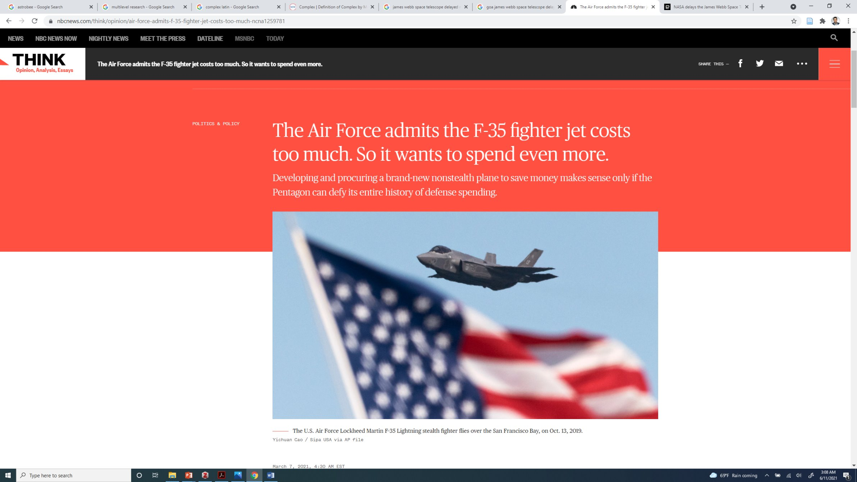
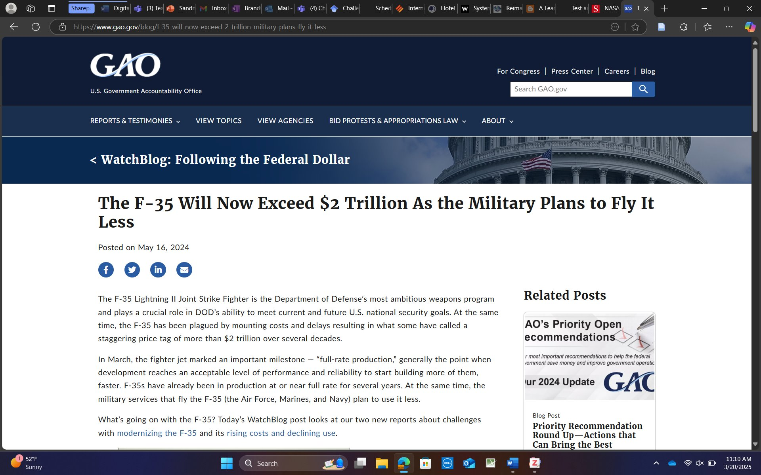
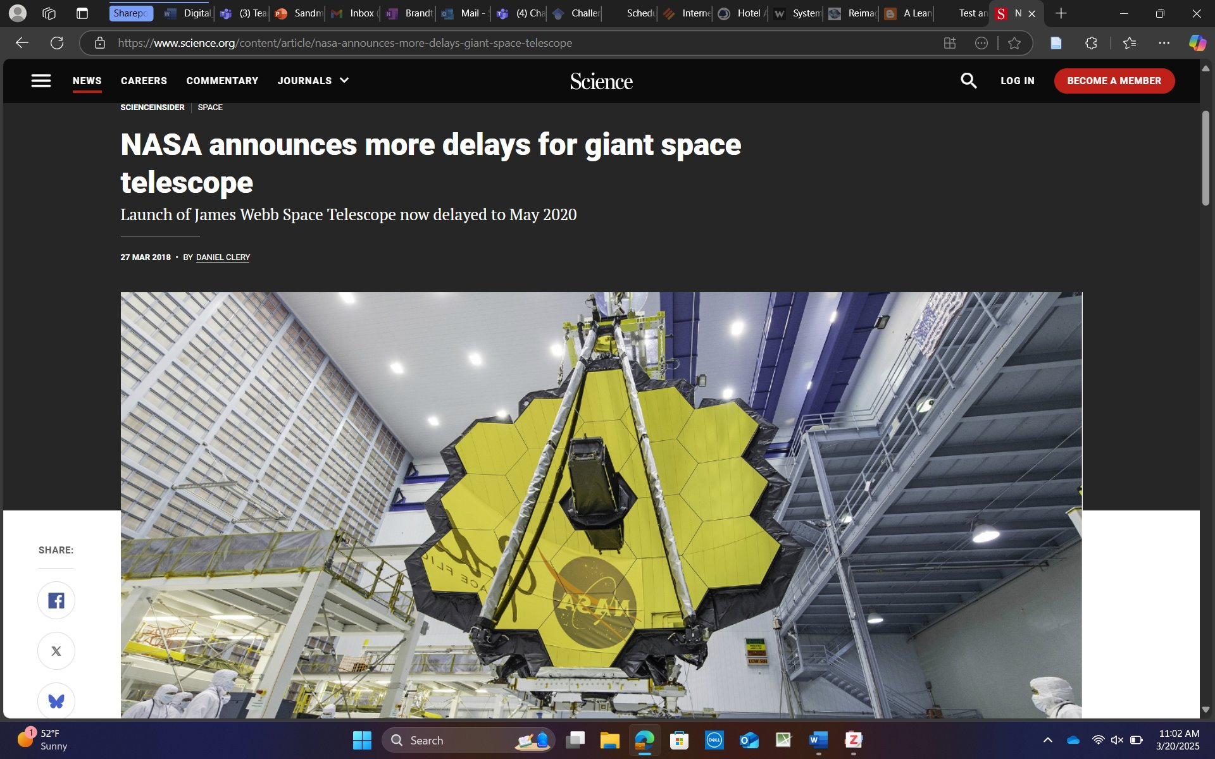
The Challenge
Difficult to use real programs/systems
10+ years, classification, etc.
Changes in technology over time and struggle to stay adapted
Notes:
It is difficult to use real programs and

Slide 3
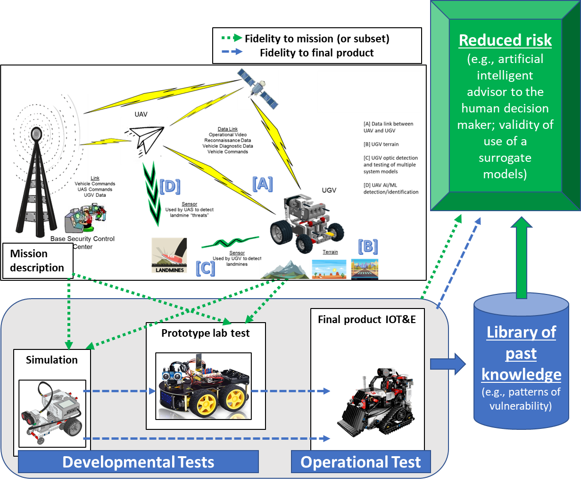
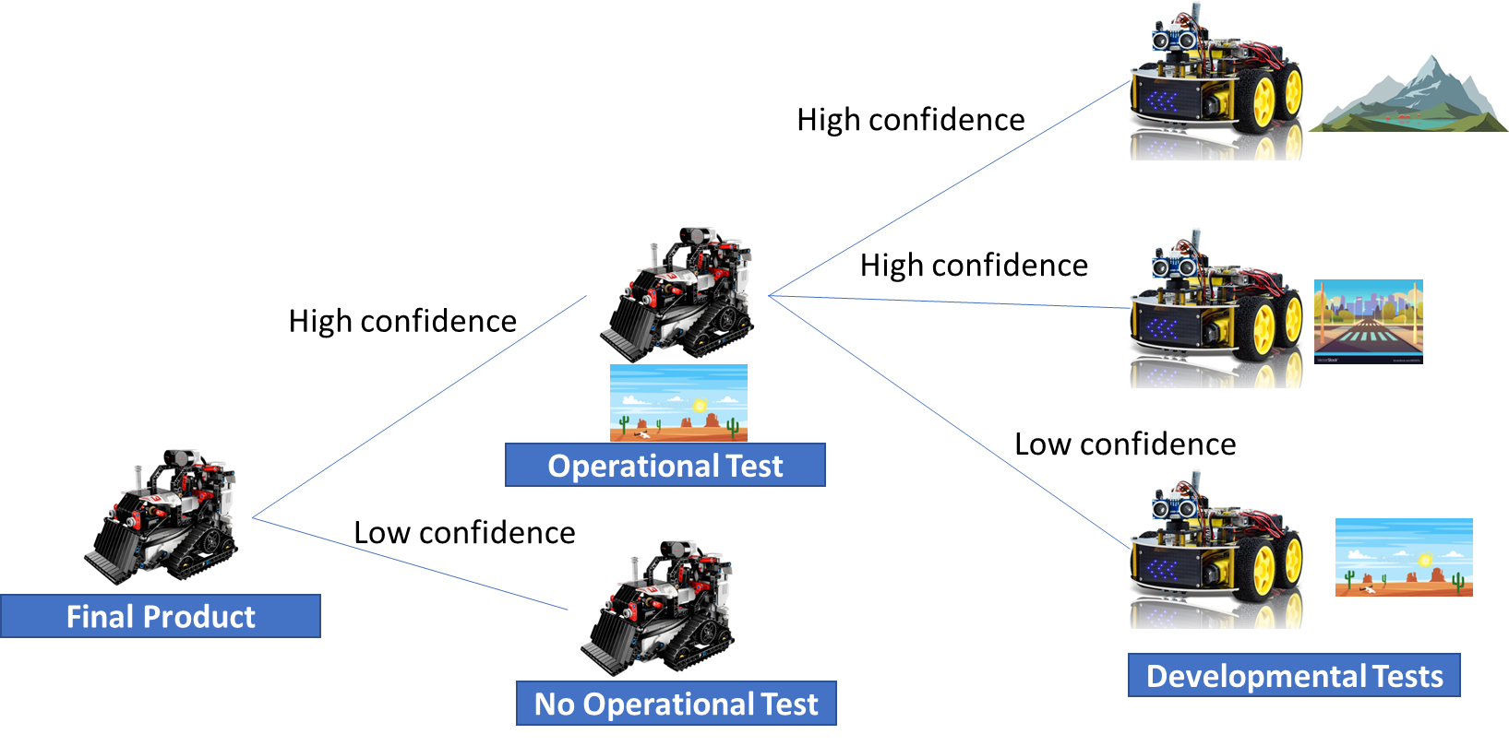
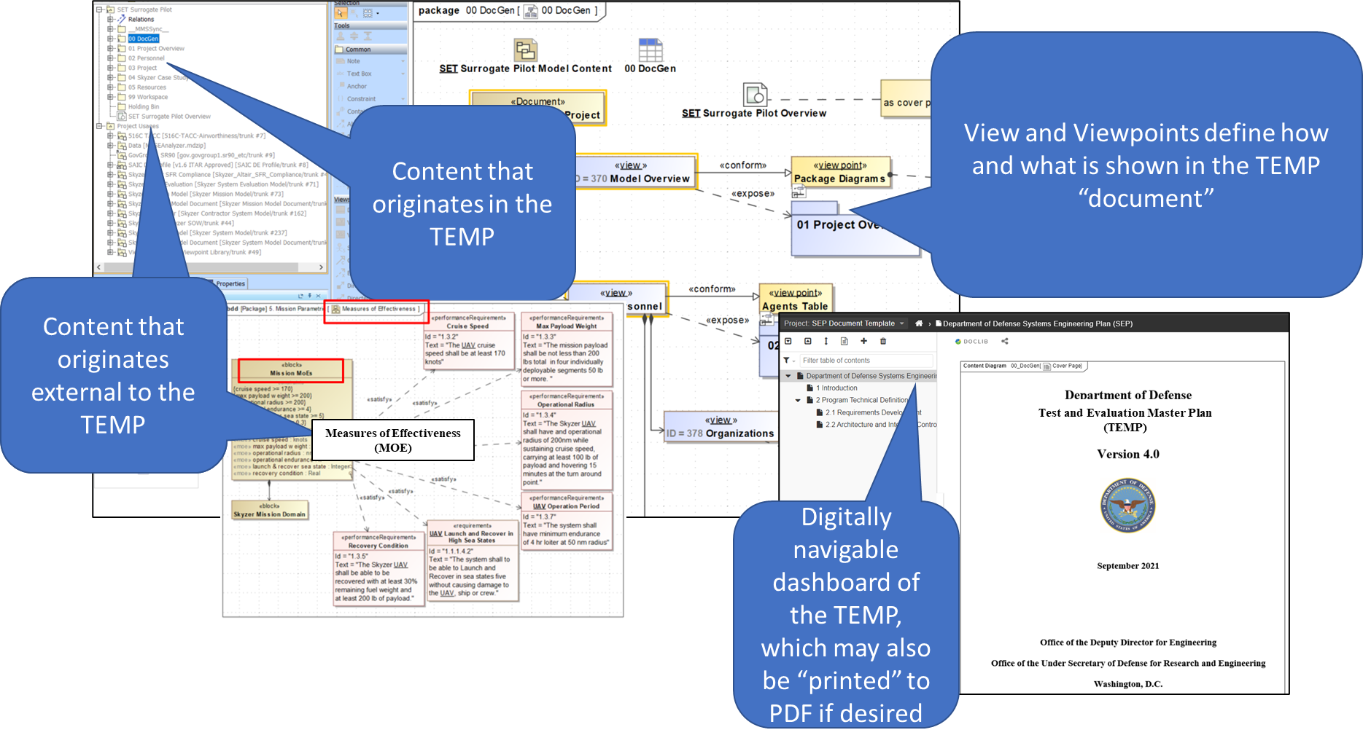

Phased Digital T&E Transformation
The Vision
Phase 3
Phase 2
Phase 1
Decision dependence (e.g., DT>>OT) and metrics
Decision dependence (e.g., DT>>OT) and metrics
Phase 0
Interoperability, reuse, artificial intelligence and machine learning (AI/ML), known fidelity from inception to retirement
Begins conversion to a dynamic data continuum
*Developed with DOT&E
Notes:
The focus of this presentation is largely centered around phase 2, Dynamic T&E planning and execution, where test phases are not only linked descriptively or quantitatively in terms of resource consumption and schedule and cost planning, but the confidence they generate in the accomplishment of mission objectives

Slide 4
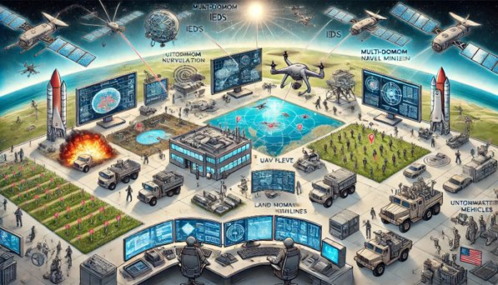
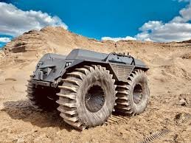

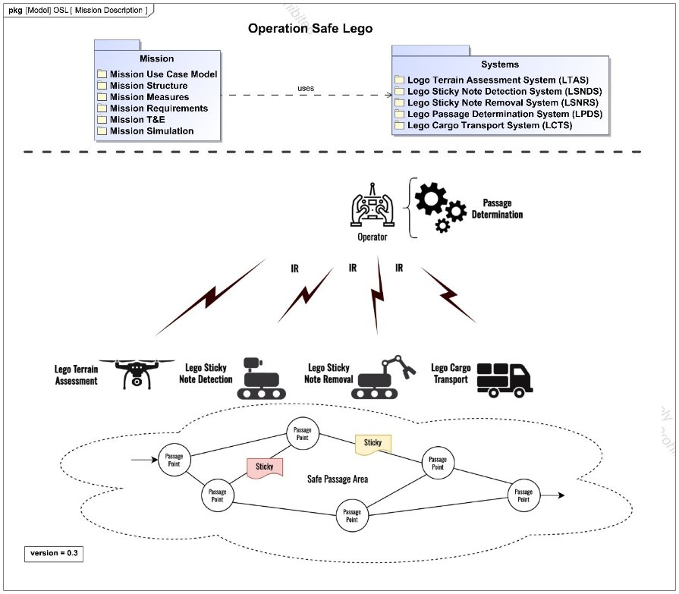
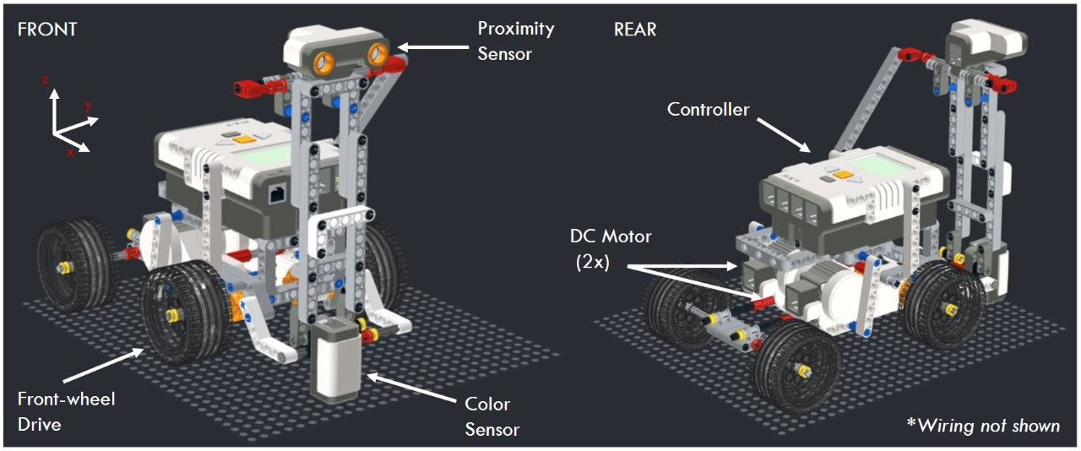
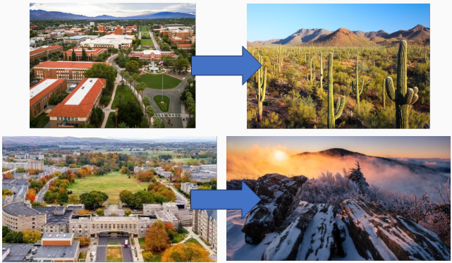
Our Efforts
THE CONTEXT | THE MISSION | THE VEHICLE | THE LOCATION
REALISTIC
PROXY

Slide 5
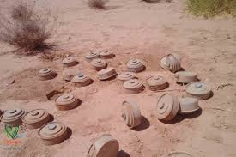
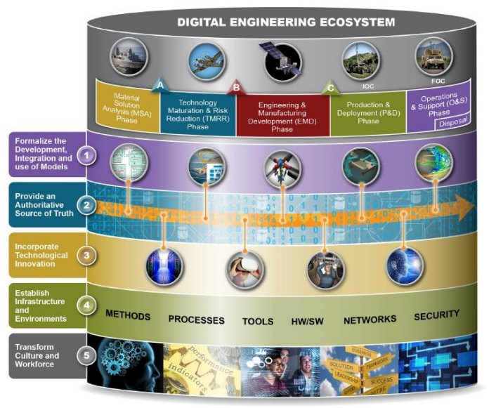
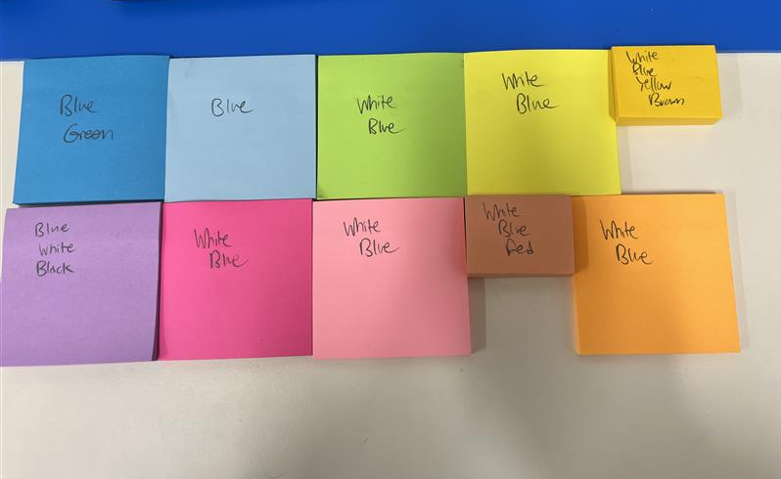
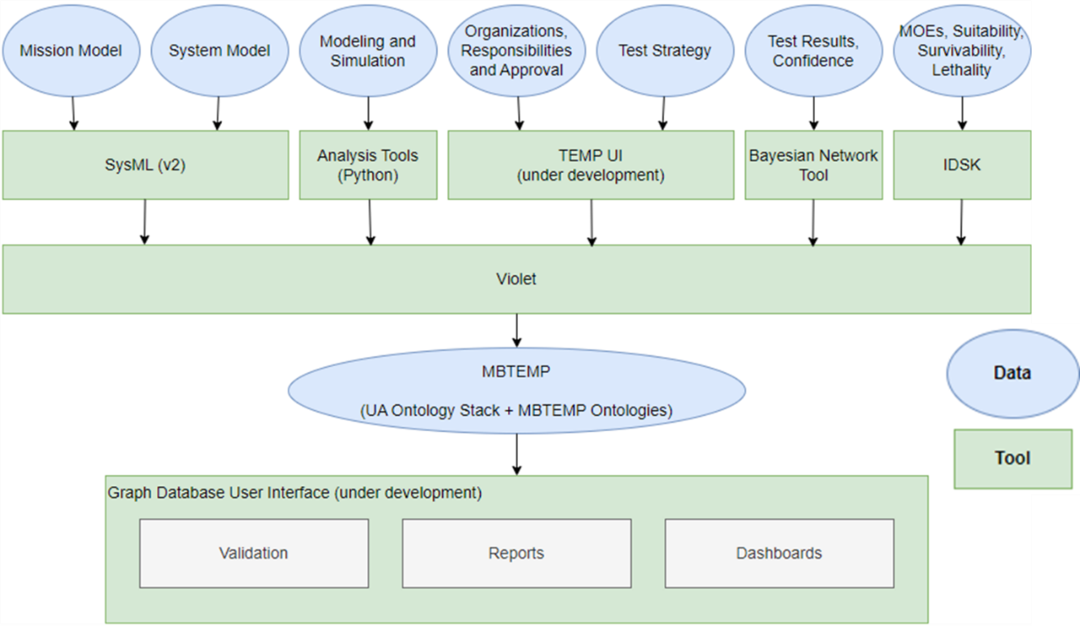
Our Efforts
THE CONTEXT | KEY PERFORMANCE PARAMETERS | THE THREAT | THE ENVIRONMENT
REALISTIC | Threat Detection Threat Classification Safety Battery Performance Threat Neutralization
PROXY

Slide 6
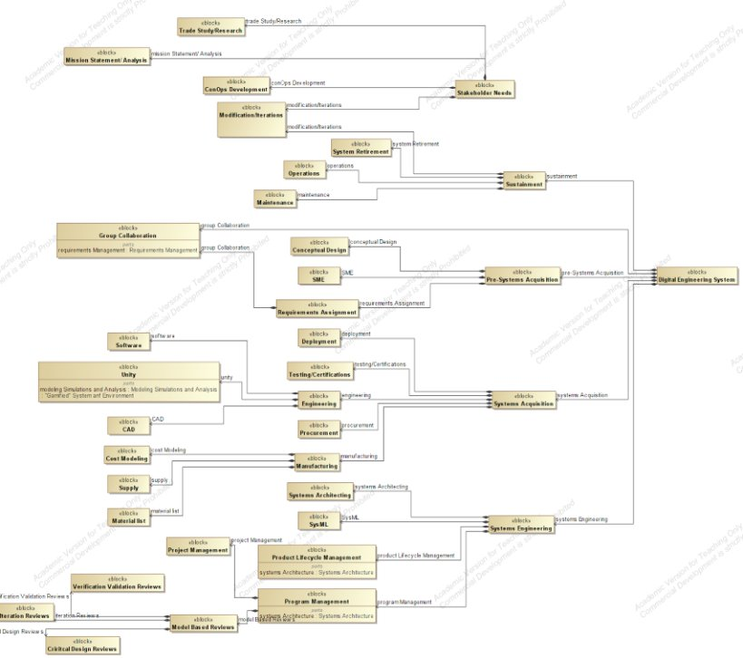
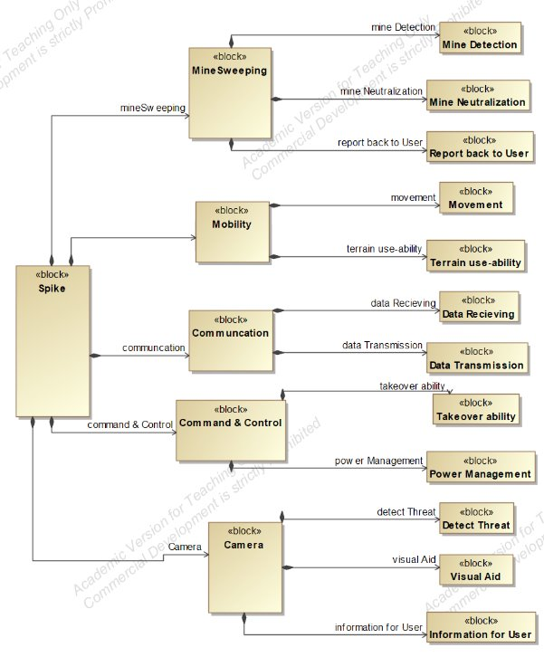
What's happening now
Physical Testing
Model Development
Refinement of Ecosystem

Slide 7

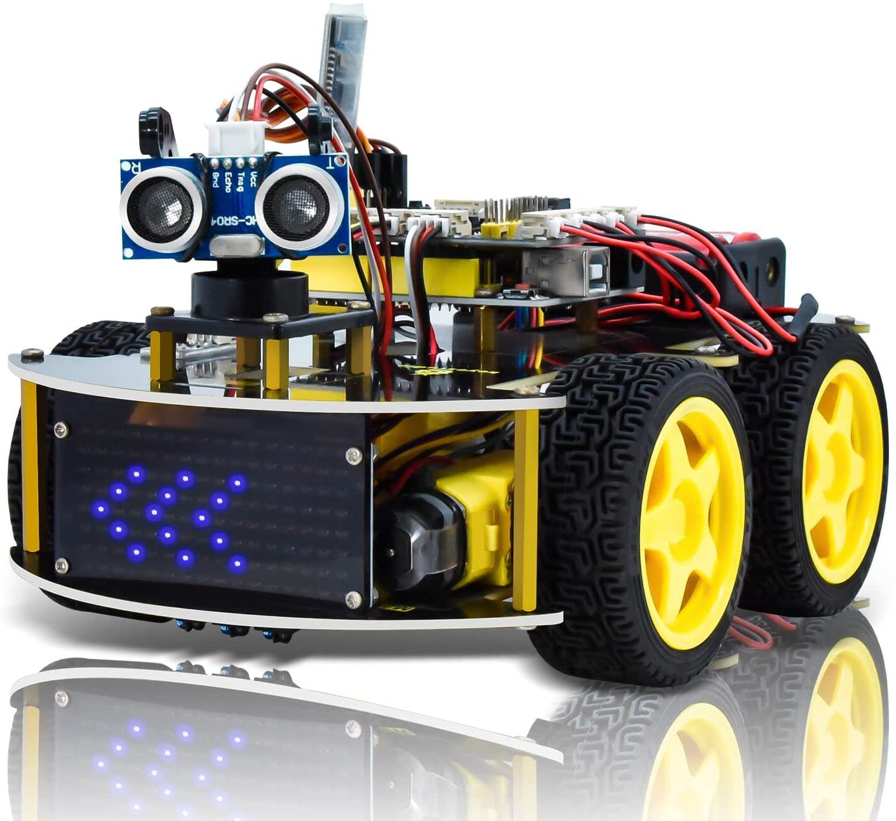

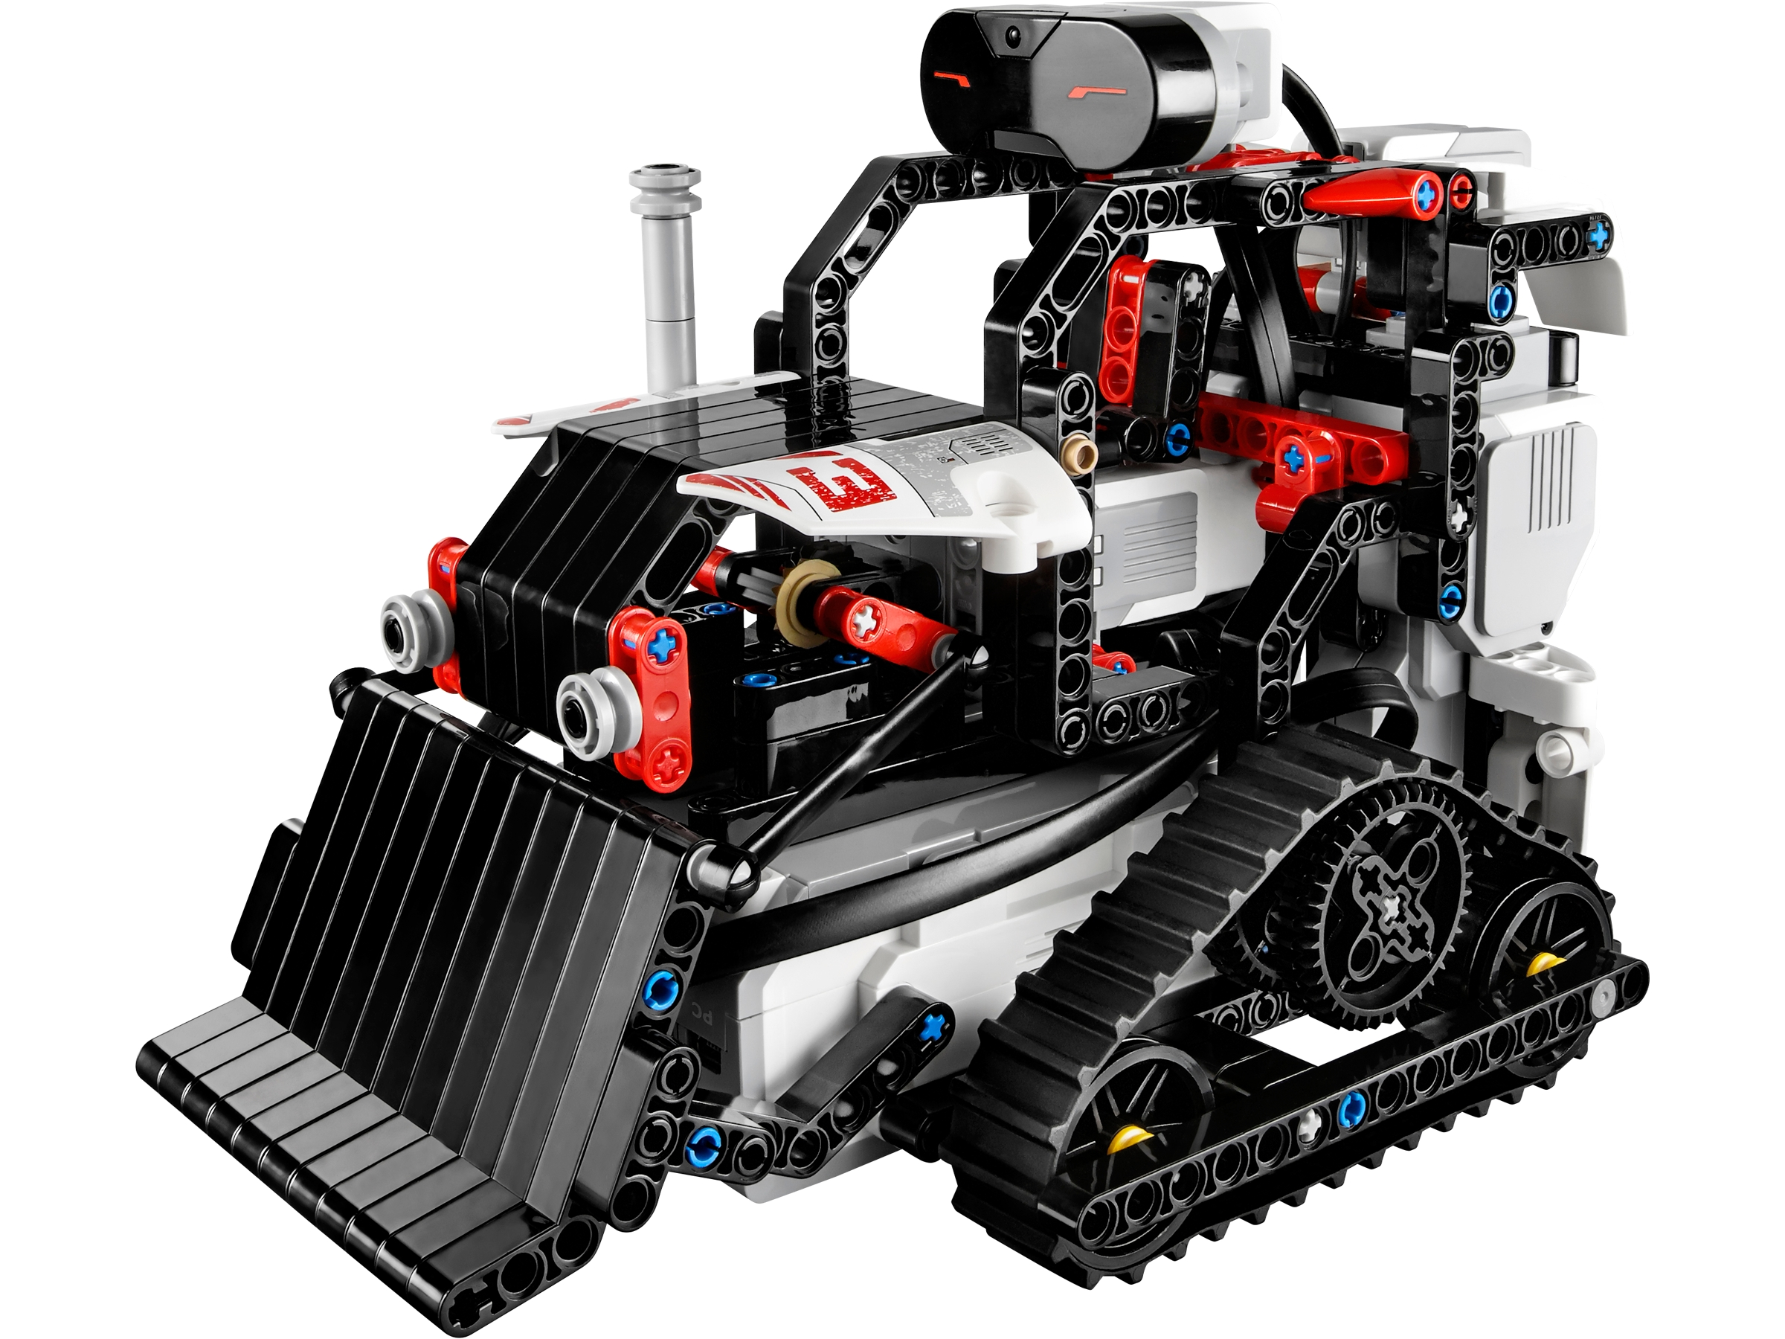


Tie it all together
Dynamic T&E planning, execution, and decisions***
Support by rigorous methods and tooling
Ex: Operational Test (OT) informed by Developmental Test (DT)
Developmental Tests
High confidence
High confidence
High confidence
Low confidence
Operational Test
Low confidence
Final Product
No Operational Test

Slide 8
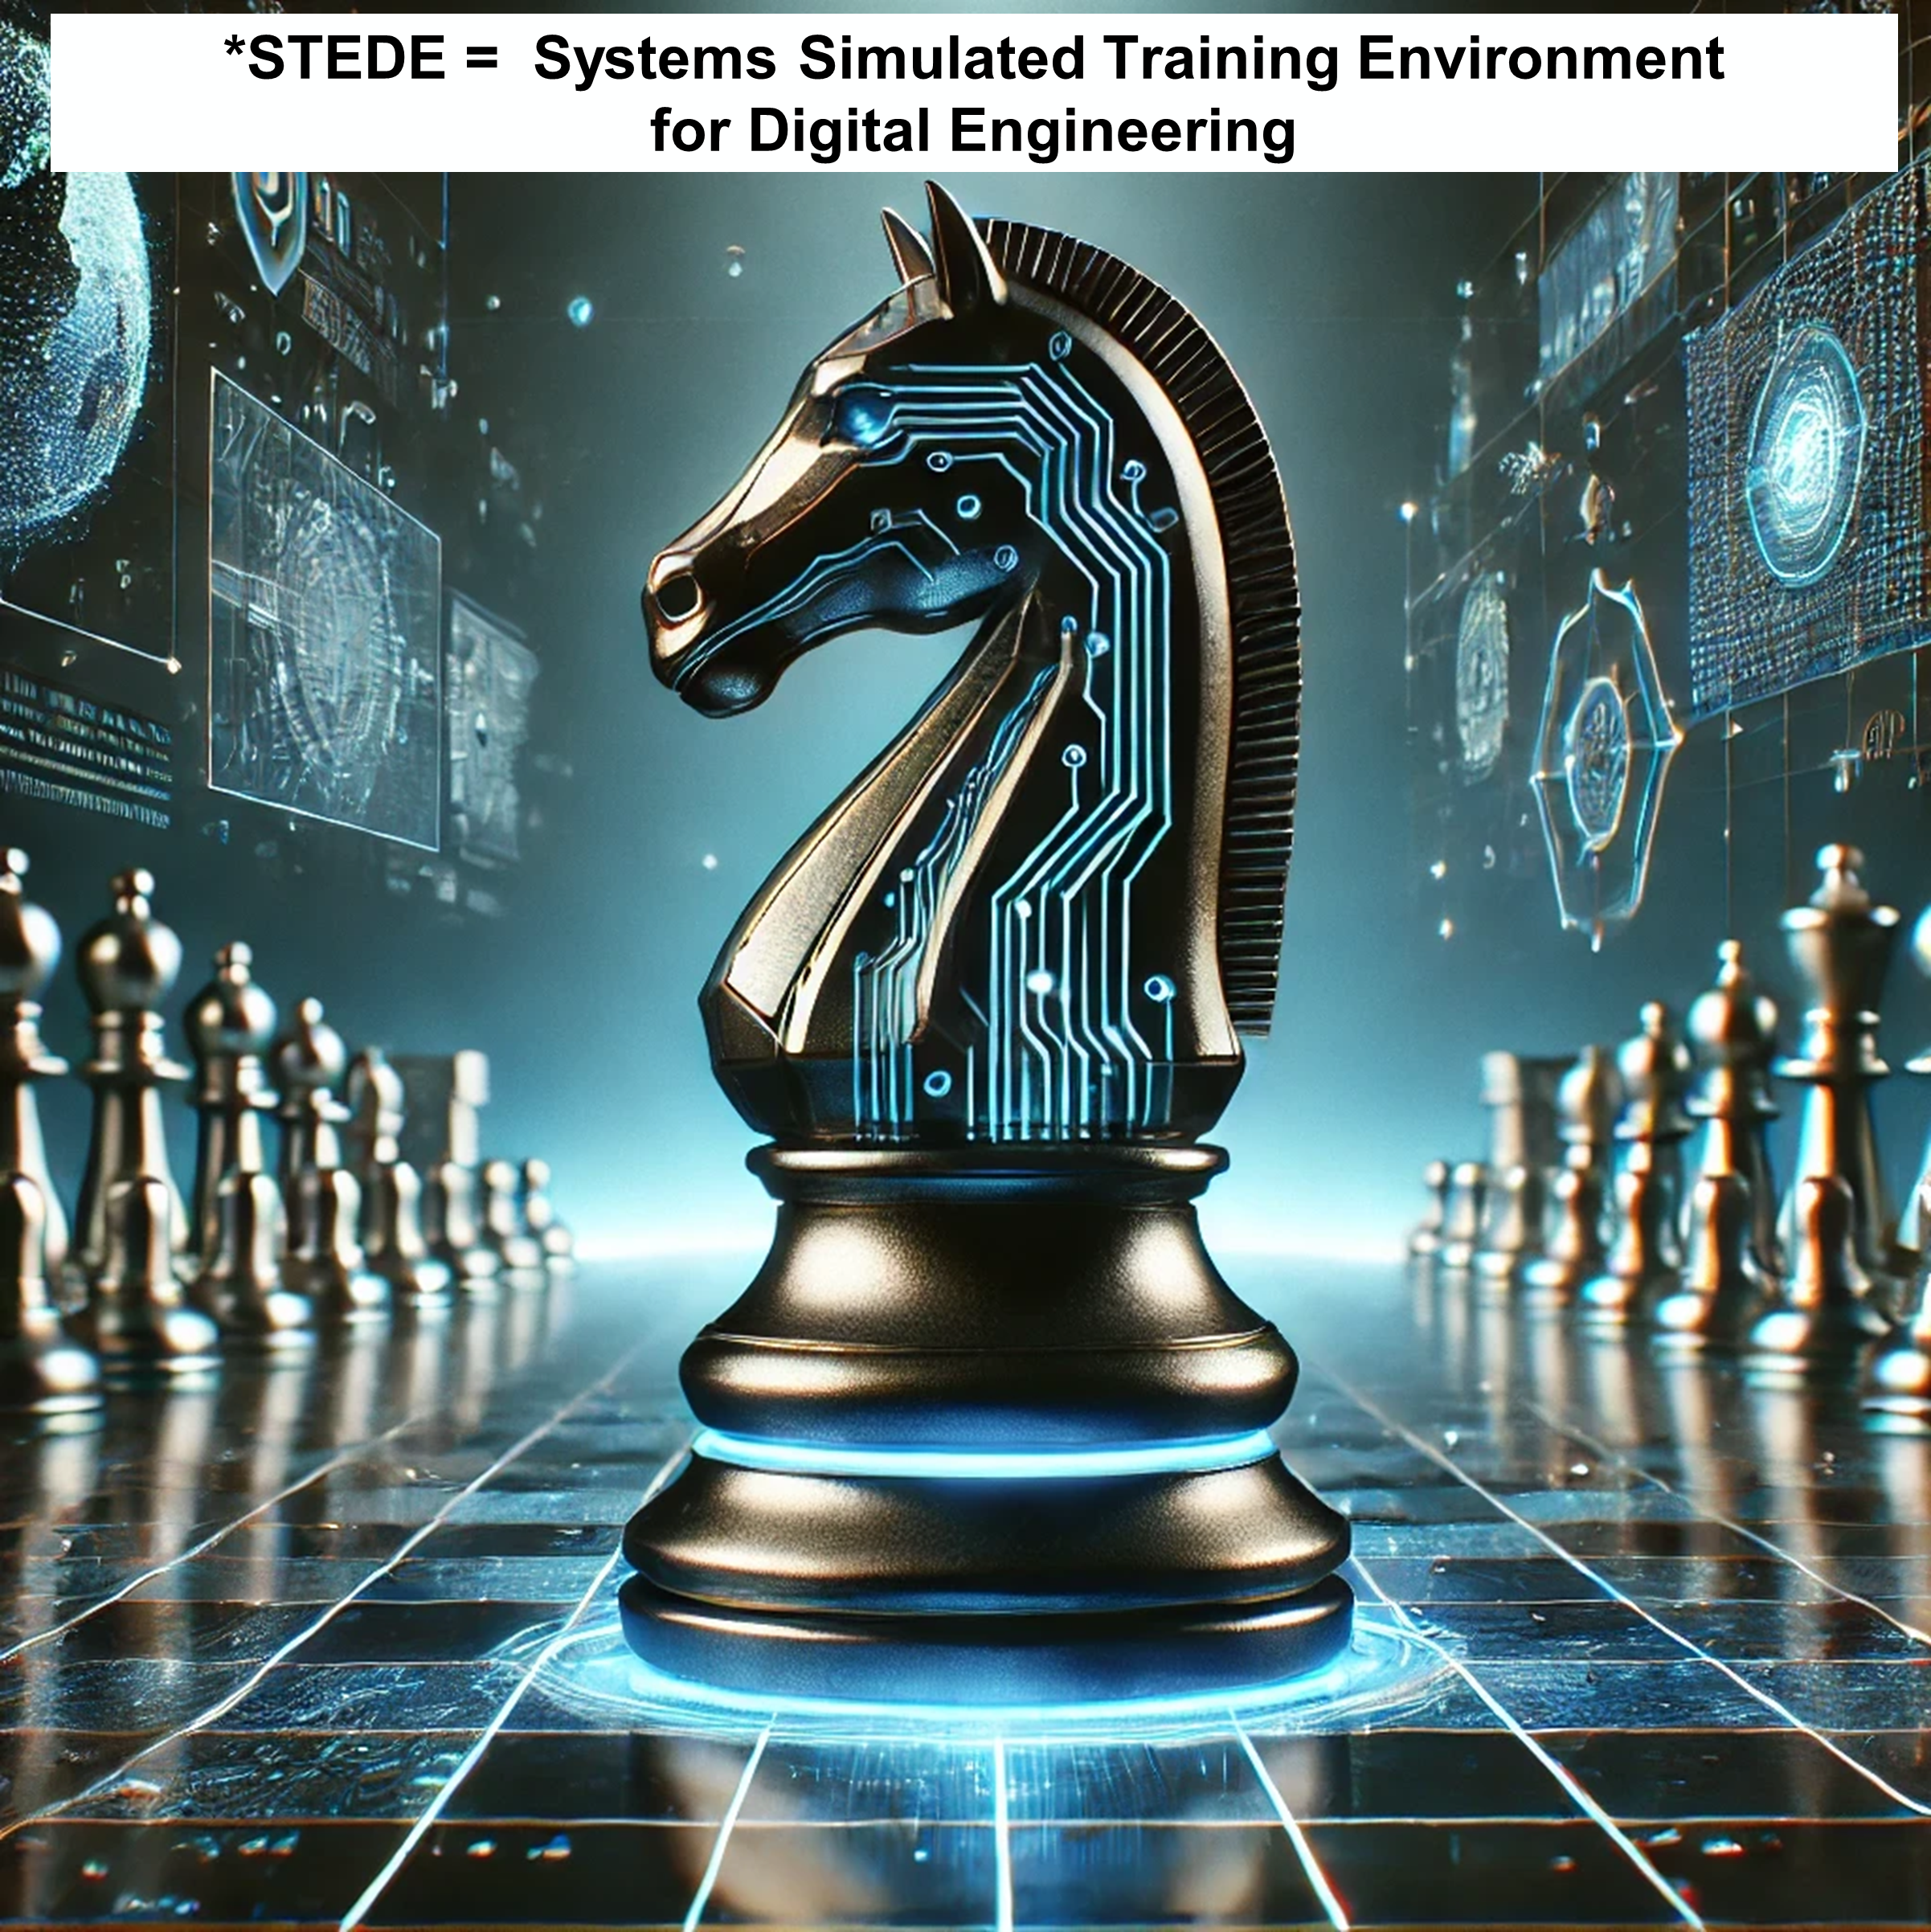

What's Happening Next
Roadmap in development
  Systems Engineering & Acquisition related
  Some stories in consideration
    Threats change
    Manufacturing
    Product Lifecycle Management/Engineering (PLM/PLE)
    Design/gate reviews
    New conflict, new capability
    Sustainment
    Logistics
    Evolution with autonomous capabilities
    Organizational considerations (e.g., contracts)
    Cyber resilience
    Intelligent systems (e.g., Computer Vision aerial detection)
  Prioritize
  Sequence
*generated by ChatGPT-4o

Slide 9
Questions?
Brandt Sandman: bsandman@vt.edu
Paul Wach: paulw86@vt.edu
Geoff Kerr: geoffreykerr@vt.edu
Alejandro Salado: alejandrosalado@arizona.edu
Tim Sherburne: sherburne@vt.edu
Joe Gregory: joegregory@arizona.edu
Taylan Topcu: ttopcu@vt.edu

