Slide 1
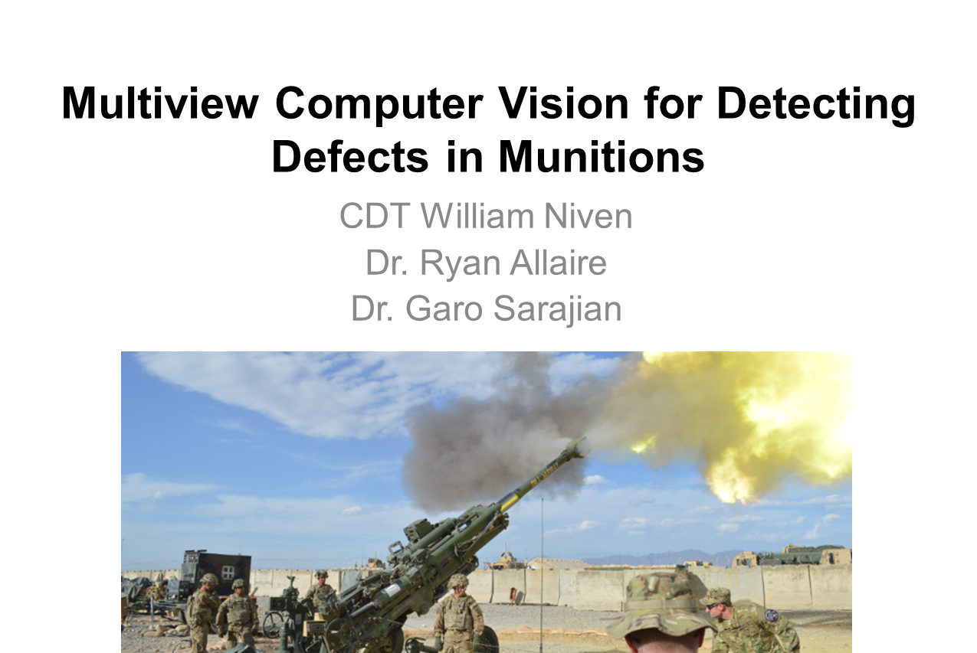


Slide 2
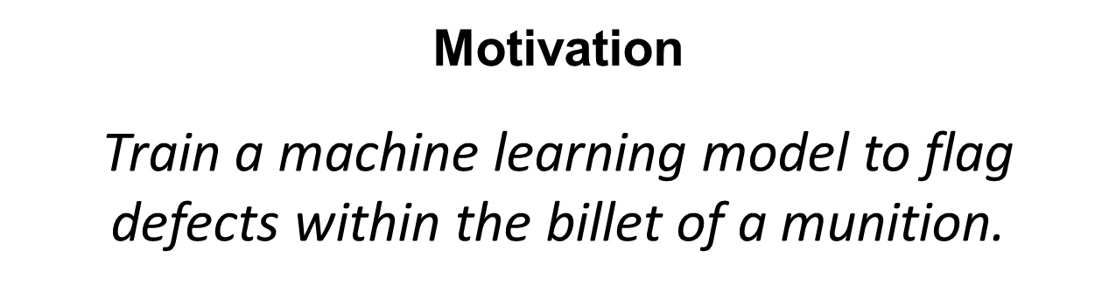
1

Slide 3
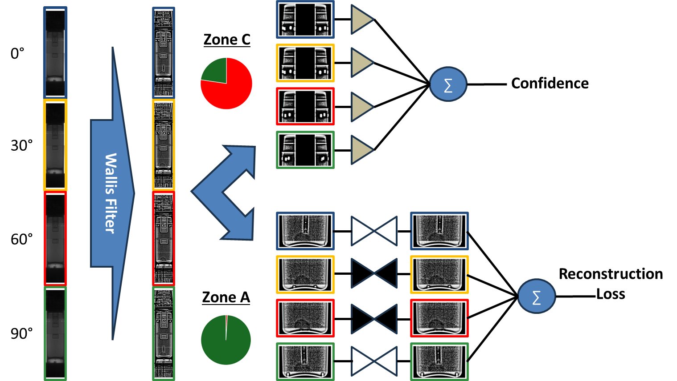
Model Pipeline
Legend
- Convolutional Neural Network
- Autoencoder
2

Slide 4
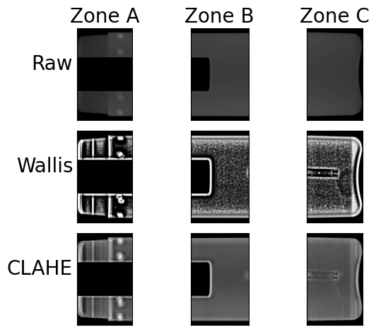
Region of Interest
3

Slide 5
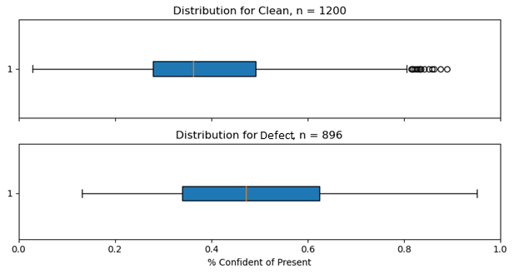
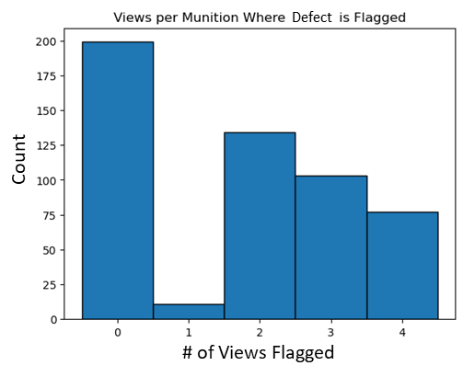
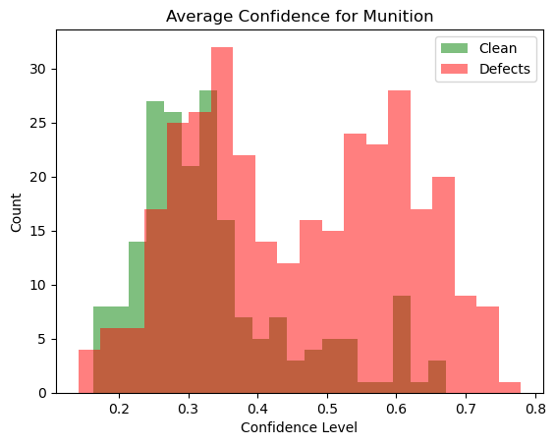
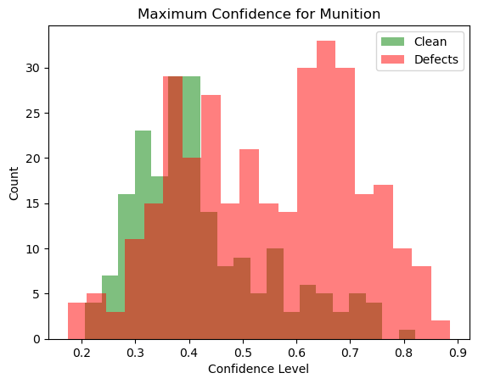
Zone C Convolutional Neural Network
Confidence Level
4

Slide 6
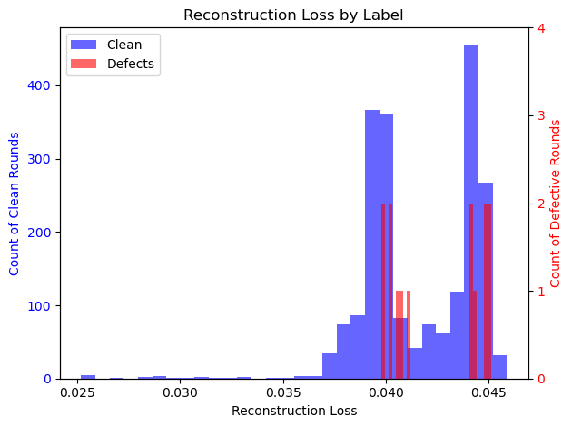
Zone A Autoencoder
5

Slide 7
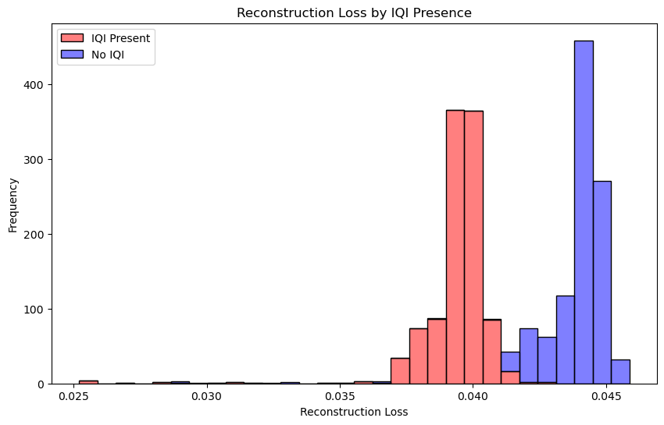
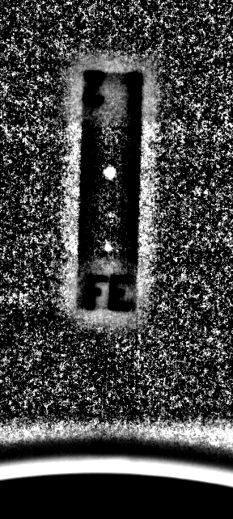
Zone A Autoencoder
IQI Bar
6

Slide 8
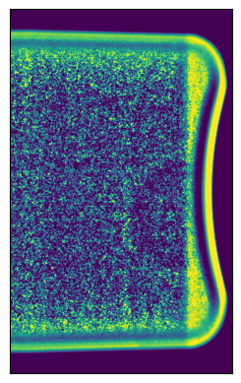
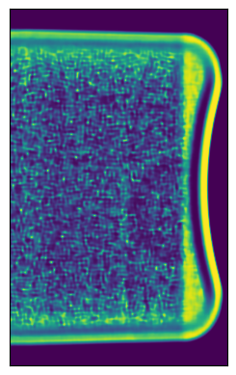
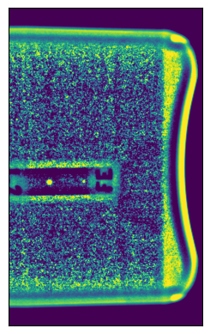
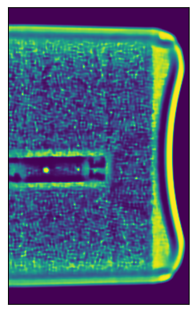
Zone A Autoencoder
Non-IQI Input
Non-IQI Output
IQI Input
IQI Output
7

Slide 9
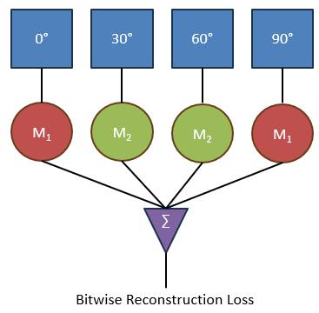
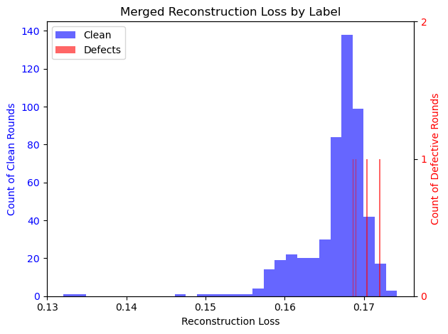
Zone A Autoencoder
M₁ : IQI Trained Model
M₂ : Non-IQI Trained Model
∑ : Sum of all models’ loss
8

Slide 10

Conclusion
9

Slide 11
At a confidence threshold of 0.50:
 | Predicted Defect | Predicted Non-Defect
Actual Defect | 986 (47%) | 214 (10%)
Actual Non-Defect | 455 (21%) | 441 (21%)
Puts accuracy at 68% compared to a 57% base accuracy rate
E1

Slide 12
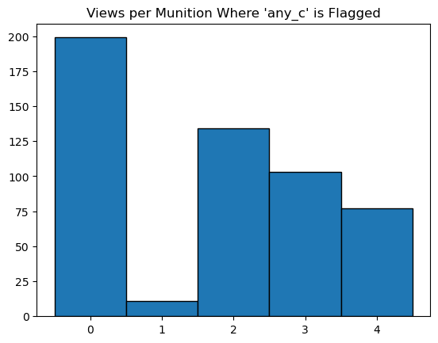
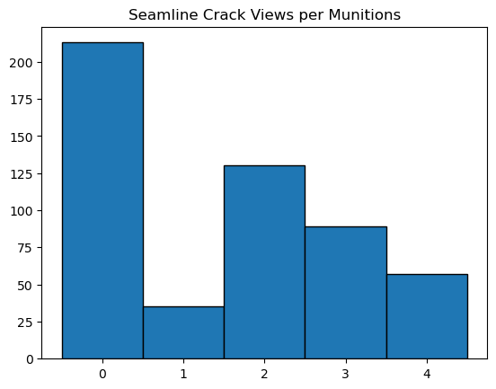
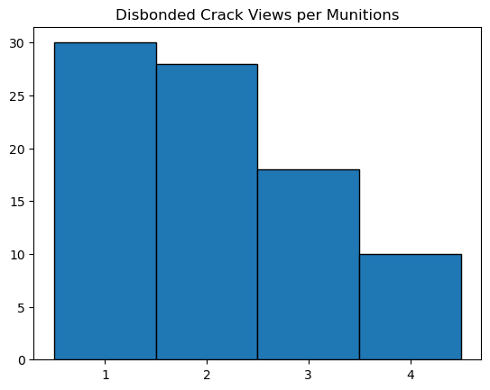
790 examples
180 examples
E2

Slide 13
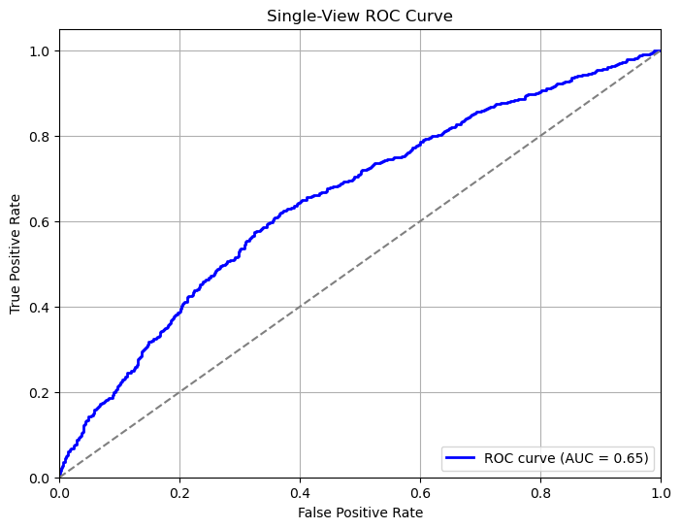
E3

Slide 14
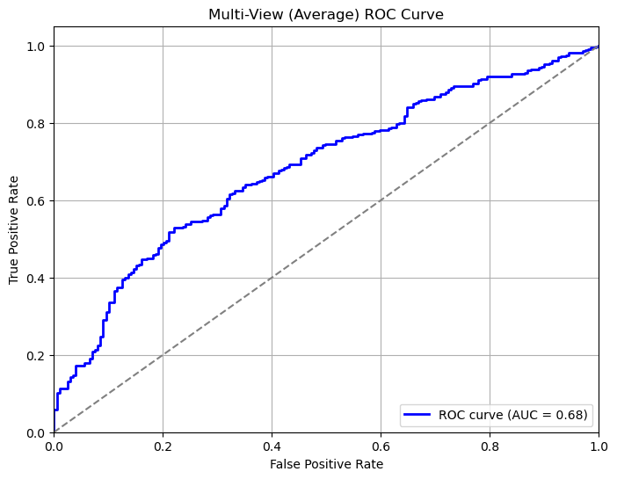
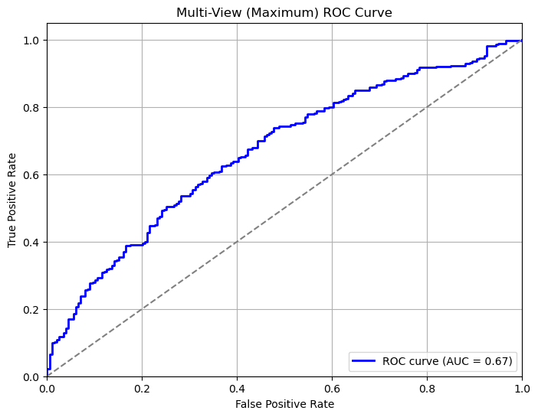
E4

Slide 15
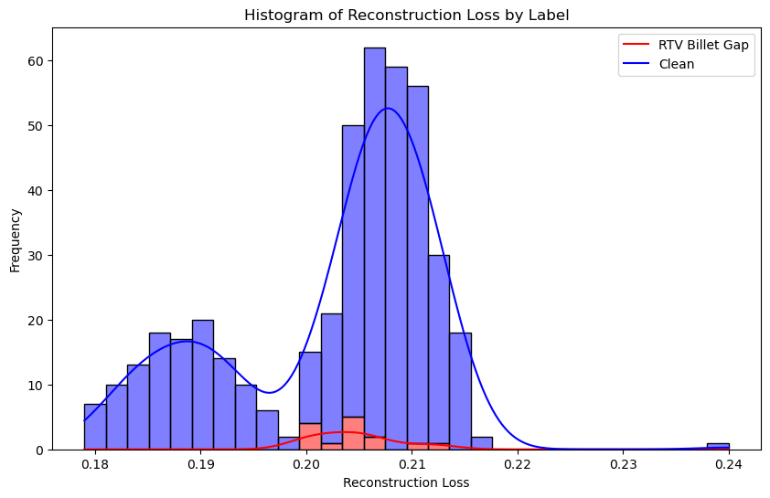
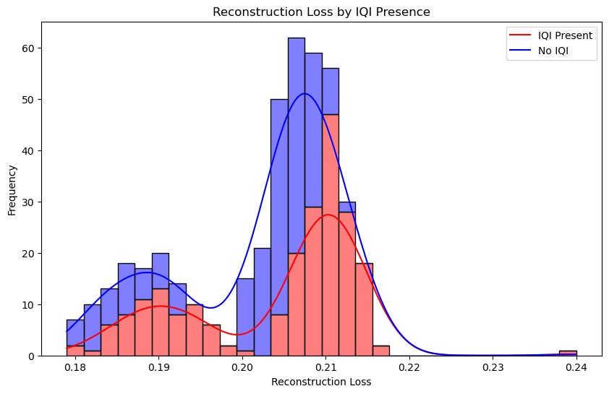
E5

Slide 16
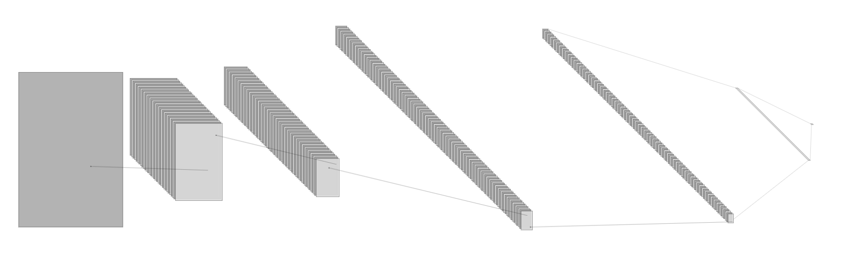
One flattening layer and two dense layers (0.2 dropout)
51 x 30 x 128
851 x 517 x 1
211 x 127 x 64
1 x 32
1 x 195840
424 x 257 x 32
104 x 62 x 128
Four layers of 3x3 convolutions and 2x2 max pooling
E6

Slide 17
Encoder
864 x 528 x 1
432 x 264 x 32
Each Encoder Layer:
3x3 Convolution
0.1 Leaky ReLu
2x2 Max Pooling
216 x 132 x 128
108 x 66 x 128
54 x 33 x 246
Latent Space
54 x 33 x 512
Decoder
108 x 66 x 256
216 x 132 x 128
Each Decoder Layer:
3x3 Convolution
0.1 Leaky ReLu
2x2 UpSampling
432 x 264 x 64
864 x 528 x 32
864 x 528 x 1
E7

