Slide 1
CONFIDENCE-BASED SKIP-LOT SAMPLING
CDT Alex Boarnet
LTC Mike Powell
DISTRIBUTION STATEMENT A: Approved for public release; distribution unlimited. PAO Log# 422-25, 17 Apr 2025

Slide 2
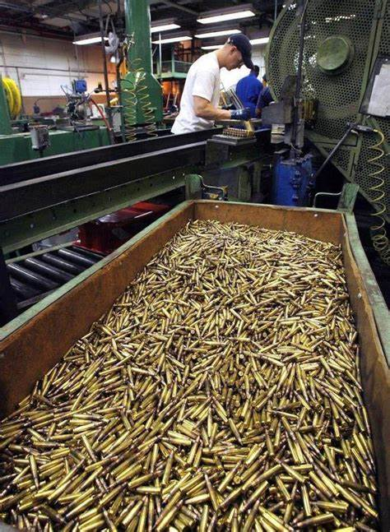
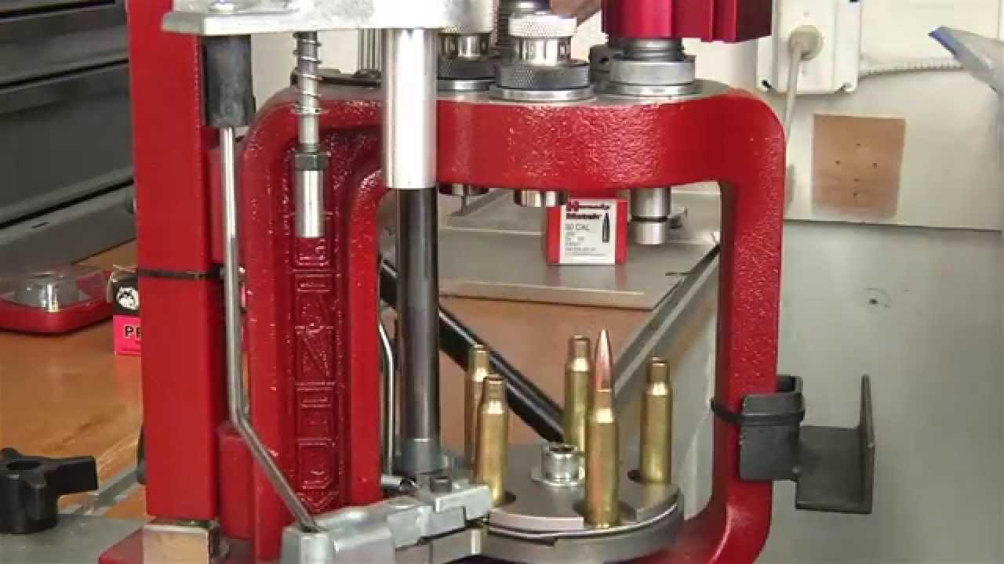

Problem Background
DISTRIBUTION STATEMENT A: Approved for public release; distribution unlimited. PAO Log# 422-25, 17 Apr 2025

Slide 3

Types of Testing
Every-Lot Testing
Every-lot testing until i consecutive lots pass
Every-lot testing until i consecutive lots pass
P P P P F P P F P P P P
…
…
P P P S S P S F P P P P
P: Pass
F: Fail
S: Skip
Skip-lot testing where each lot has
some probability f of being tested
Re-enter skip-lot testing procedures
Risk
Skip-Lot Testing
Savings
DISTRIBUTION STATEMENT A: Approved for public release; distribution unlimited. PAO Log# 422-25, 17 Apr 2025

Slide 4
Problem Statement
How can we implement skip-lot sampling to create as much savings as possible while controlling the amount of risk we are willing to accept?
DISTRIBUTION STATEMENT A: Approved for public release; distribution unlimited. PAO Log# 422-25, 17 Apr 2025
Notes:
Using confidence-based skip-lot sampling we can estimate the overall production quality and predict the performance of lots prior to their testing to reduce risk.
Emphasis on controlling the risk…

Slide 5
Way Forward
The probability that a given lot is tested in skip-lot sampling is currently fixed in the standard skip-lot procedure.
To manage risk while maximizing savings, this probability should vary according to our confidence that production quality is better than the Accepted Non-Conforming Rate (ANCR).
DISTRIBUTION STATEMENT A: Approved for public release; distribution unlimited. PAO Log# 422-25, 17 Apr 2025

Slide 6
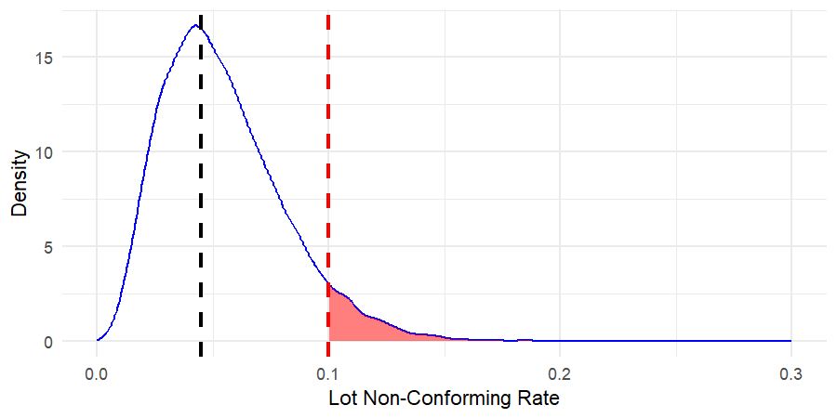
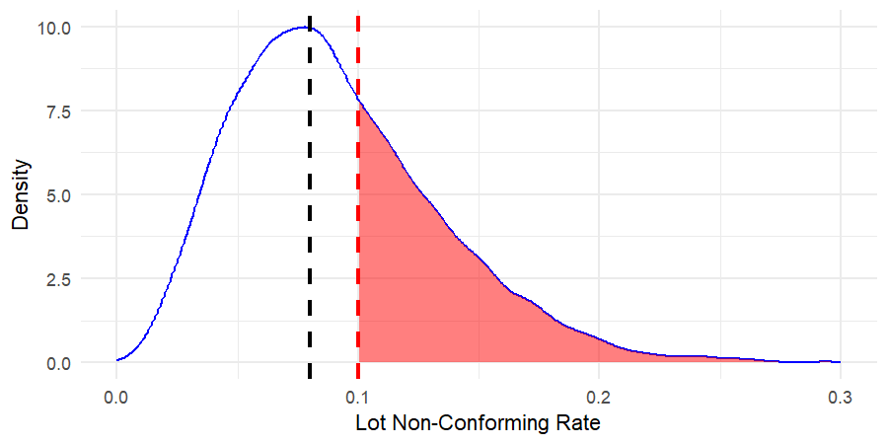
Measuring Uncertainty
Predicted Probability of Lot Performance Far From the ANCR
ANCR
TNCR
TNCR – True Non-Conforming Rate
ANCR – Accepted Non-Conforming Rate
Predicted Probability of Lot Performance Near the ANCR
ANCR
TNCR
DISTRIBUTION STATEMENT A: Approved for public release; distribution unlimited. PAO Log# 422-25, 17 Apr 2025

Slide 7
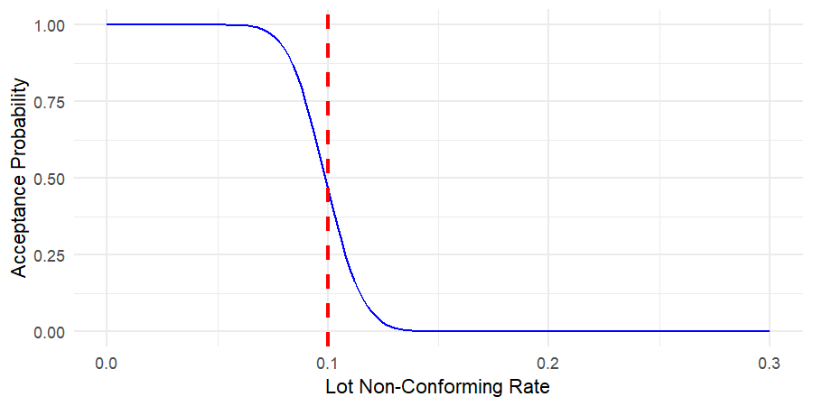
Inherent Risk
Probability of Accepting a Lot Across TNCRs
DISTRIBUTION STATEMENT A: Approved for public release; distribution unlimited. PAO Log# 422-25, 17 Apr 2025
Notes:
Demonstrate that they are already accepting some level of variable risk, we want the compliment to stay below an overall risk level

Slide 8
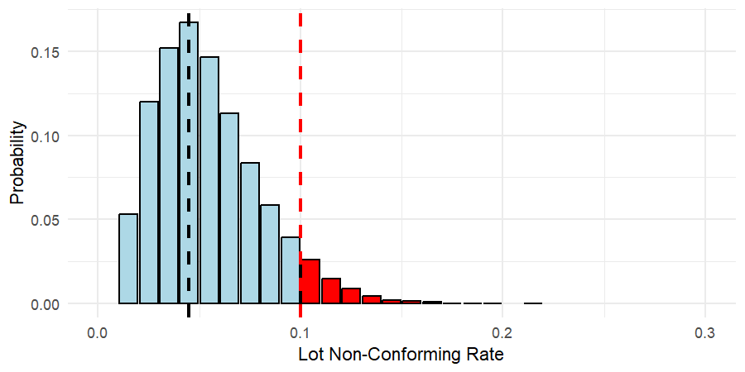
Scenario-Based Risk
Probability of Accepting a Lot Across TNCRs
ANCR
Predicted Probability of Lot Performance
TNCR
ANCR
DISTRIBUTION STATEMENT A: Approved for public release; distribution unlimited. PAO Log# 422-25, 17 Apr 2025

Slide 9
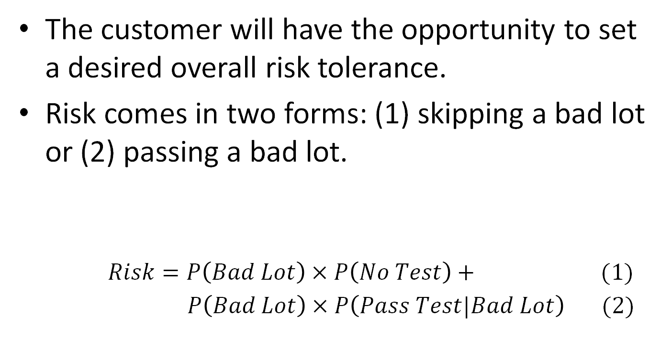
Total Risk
The customer will have the opportunity to set a desired overall risk tolerance.
Risk comes in two forms: (1) skipping a bad lot or (2) passing a bad lot.
$Risk=P\left(Bad Lot\right)×P\left(No Test\right)+$ (1)
$P\left(Bad Lot\right)×P\left(Pass Test|Bad Lot\right) (2)$
Solve For
Estimate
Known
DISTRIBUTION STATEMENT A: Approved for public release; distribution unlimited. PAO Log# 422-25, 17 Apr 2025

Slide 10
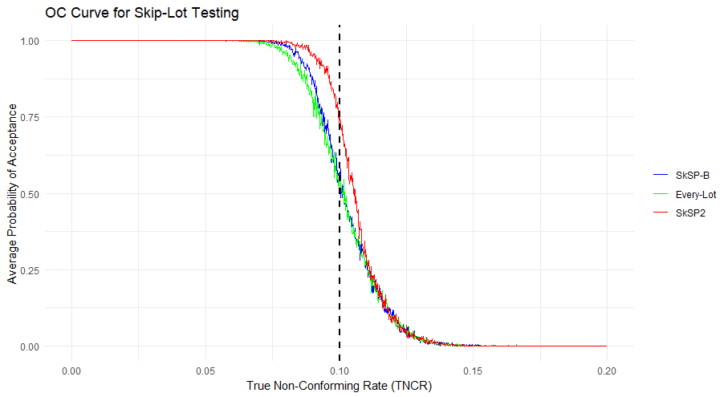
OC Curve Interpretation
SkSP-B accepts more good lots than Every-Lot.
SkSP methods reduce the Average Sample Number (ASN).
SkSP-B accepts fewer bad lots than SkSp2.
SkSP methods converge to Every-Lot.
DISTRIBUTION STATEMENT A: Approved for public release; distribution unlimited. PAO Log# 422-25, 17 Apr 2025
Notes:
Other TNCRs, and other variables we are planning to test it on.

Slide 11
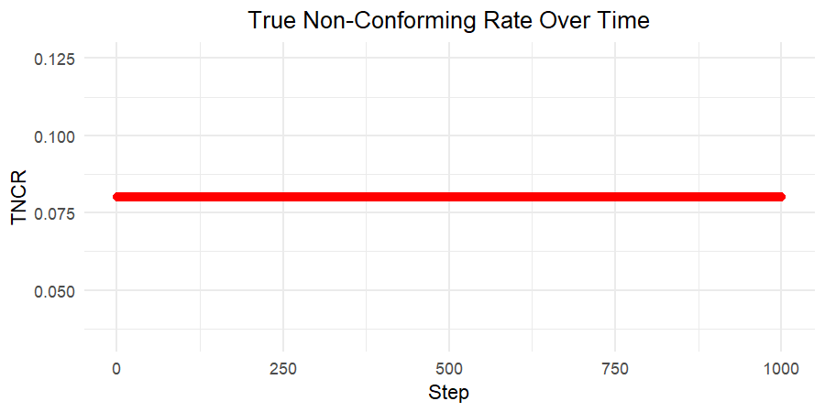
Stable, Acceptable Quality
ANCR
DISTRIBUTION STATEMENT A: Approved for public release; distribution unlimited. PAO Log# 422-25, 17 Apr 2025

Slide 12
Stable, Acceptable Quality
Method | Average Sample Number (% change) | Percent of Good Lots Failed (% change in Type I Error) | Percent of Bad Lots Passed (% change in Type II Error)
Every-Lot Sampling | 500 | 4.38% | 0%
SkSP-2 | 66.14 (86.77%) | 0.57% (86.99%) | 0%
SkSP-Bayesian | 115.27 (76.95%) | 0.98% (77.63%) | 0%
Risk Threshold | i | f
.1 | 6 | .1
DISTRIBUTION STATEMENT A: Approved for public release; distribution unlimited. PAO Log# 422-25, 17 Apr 2025

Slide 13
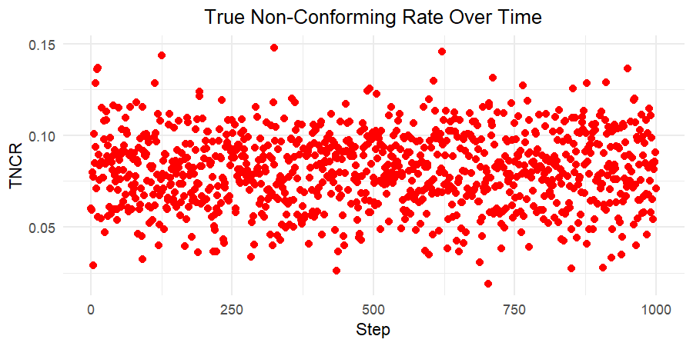
Stable, Variable Quality
ANCR
DISTRIBUTION STATEMENT A: Approved for public release; distribution unlimited. PAO Log# 422-25, 17 Apr 2025

Slide 14
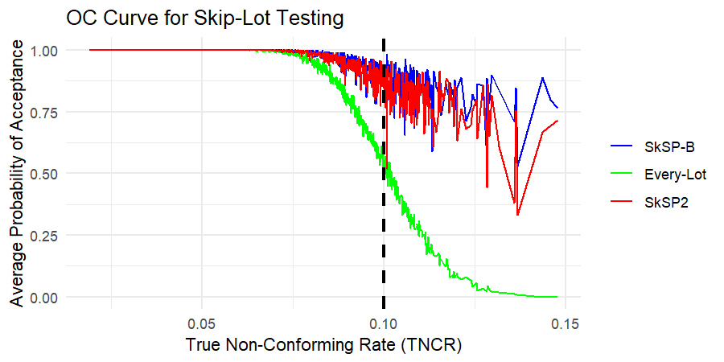
Stable, Variable Quality
DISTRIBUTION STATEMENT A: Approved for public release; distribution unlimited. PAO Log# 422-25, 17 Apr 2025

Slide 15
Stable, Variable Quality
Method | Average Sample Number (% change) | Percent of Good Lots Failed (% change in Type I Error) | Percent of Bad Lots Passed (% change in Type II Error)
Every-Lot Sampling | 500 | 8.85% | 30.32%
SkSP-2 | 150.92 (69.82%) | 2.68% (69.72%) | 79.60% (-162.53%)
SkSP-Bayesian | 119.00 (76.2%) | 2.06% (76.72%) | 84.75% (-179.52%)
Risk Threshold | i | f
.1 | 6 | .1
DISTRIBUTION STATEMENT A: Approved for public release; distribution unlimited. PAO Log# 422-25, 17 Apr 2025

Slide 16
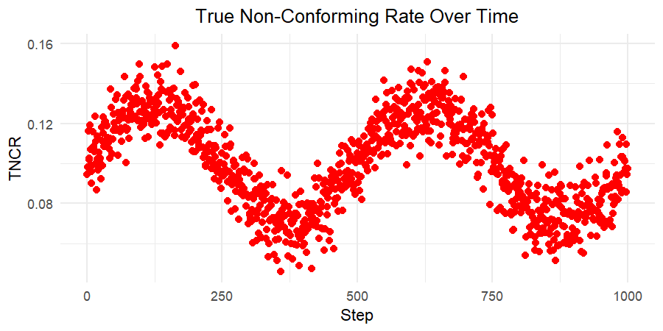
Noisy, Gradual Change
ANCR
DISTRIBUTION STATEMENT A: Approved for public release; distribution unlimited. PAO Log# 422-25, 17 Apr 2025

Slide 17
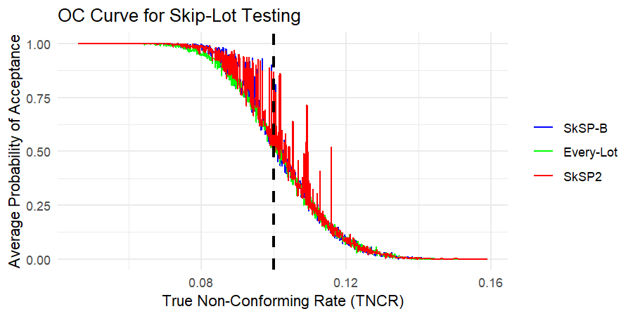
Noisy, Gradual Change
DISTRIBUTION STATEMENT A: Approved for public release; distribution unlimited. PAO Log# 422-25, 17 Apr 2025

Slide 18
Noisy, Gradual Change
Method | Average Sample Number (% change) | Percent of Good Lots Failed (% change in Type I Error) | Percent of Bad Lots Passed (% change in Type II Error)
Every-Lot Sampling | 500 | 11.01% | 16.24%
SkSP-2 | 376.54 (24.69%) | 8.00% (27.34%) | 17.36% (-6.90%)
SkSP-Bayesian | 387.37 (22.53%) | 8.27% (24.87%) | 16.72% (-2.96%)
Risk Threshold | i | f
.01 | 10 | .2
DISTRIBUTION STATEMENT A: Approved for public release; distribution unlimited. PAO Log# 422-25, 17 Apr 2025

Slide 19
Next Steps
Look into a decay rate that varies based on the confidence about the production process rather than a static one.
Verify best values to use for risk, i, and f for ammunition in production based on historical TNCR profiles.
Compare results of different methods using historical LCAAP data.
Determine and implement the best skip-lot testing practice on limited tests (waterproofing).
DISTRIBUTION STATEMENT A: Approved for public release; distribution unlimited. PAO Log# 422-25, 17 Apr 2025

Slide 20
Questions?
DISTRIBUTION STATEMENT A: Approved for public release; distribution unlimited. PAO Log# 422-25, 17 Apr 2025

Slide 21
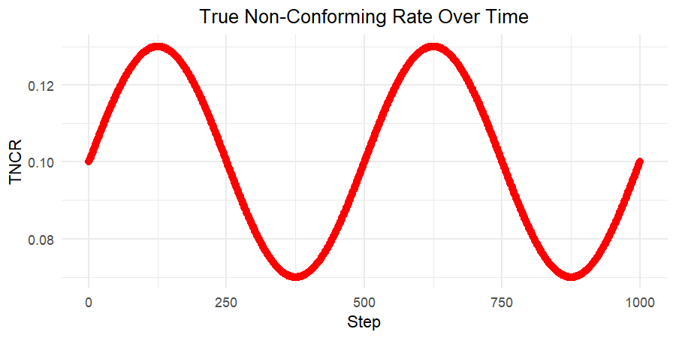
Gradual Change in Quality
ANCR
DISTRIBUTION STATEMENT A: Approved for public release; distribution unlimited. PAO Log# 422-25, 17 Apr 2025

Slide 22
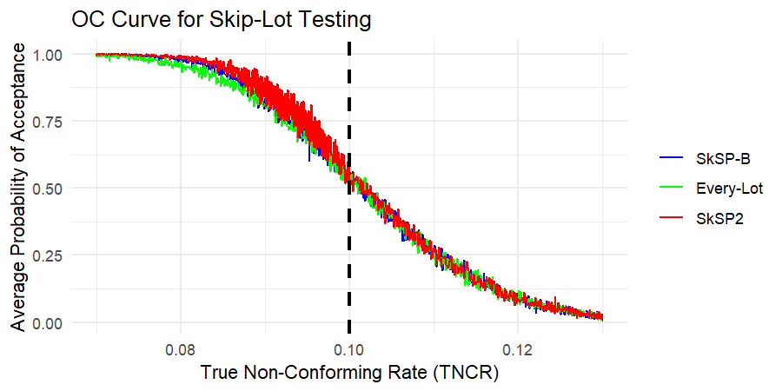
Gradual Change in Quality
DISTRIBUTION STATEMENT A: Approved for public release; distribution unlimited. PAO Log# 422-25, 17 Apr 2025

Slide 23
Gradual Change in Quality
Method | Average Sample Number (% change) | Percent of Good Lots Failed (% change in Type I Error) | Percent of Bad Lots Passed (% change in Type II Error)
Every-Lot Sampling | 500 | 10.08% | 14.78%
SkSP-2 | 354.60 (29.08) | 7.38% (26.79%) | 15.05% (-1.83%)
SkSP-Bayesian | 389.14 (22.17) | 8.80% (12.70%) | 14.86% (-0.54%)
Risk Threshold | i | f
.01 | 10 | .2
DISTRIBUTION STATEMENT A: Approved for public release; distribution unlimited. PAO Log# 422-25, 17 Apr 2025

Slide 24
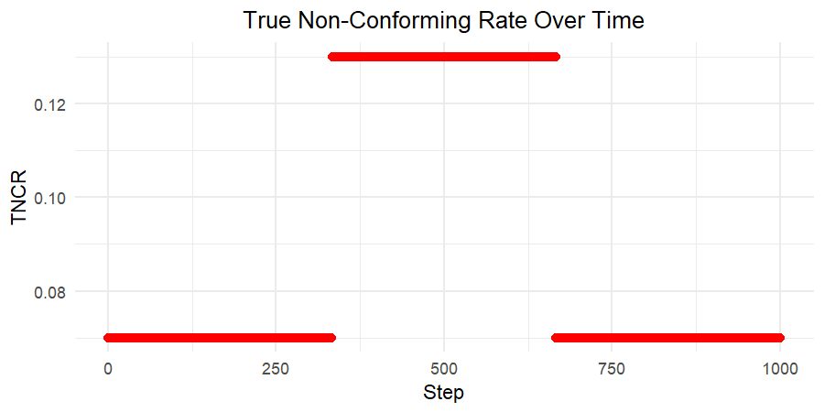
Sudden Change in Quality
DISTRIBUTION STATEMENT A: Approved for public release; distribution unlimited. PAO Log# 422-25, 17 Apr 2025

Slide 25
Sudden Change in Quality
Method | Average Sample Number (% change) | Percent of Good Lots Failed (% change in Type I Error) | Percent of Bad Lots Passed (% change in Type II Error)
Every-Lot Sampling | 500 | 0.44% | 2.26%
SkSP-2 | 237.15 (52.47%) | 0.10% (77.27%) | 3.47% (-53.54%)
SkSP-Bayesian | 260.55 (47.89%) | 0.13% (70.45%) | 2.77% (-22.57%)
Risk Threshold | i | f
.01 | 6 | .2
DISTRIBUTION STATEMENT A: Approved for public release; distribution unlimited. PAO Log# 422-25, 17 Apr 2025

Slide 26
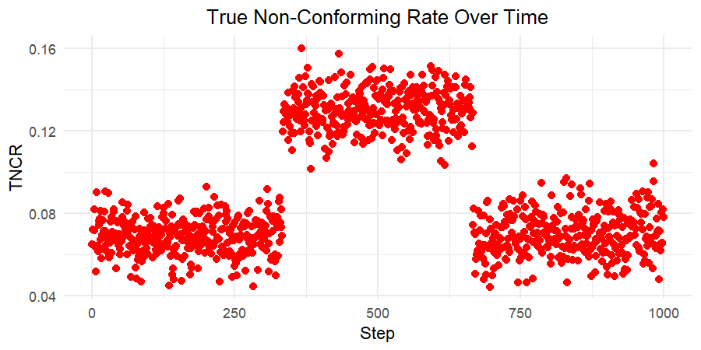
Noisy, Sudden Change
ANCR
DISTRIBUTION STATEMENT A: Approved for public release; distribution unlimited. PAO Log# 422-25, 17 Apr 2025

Slide 27
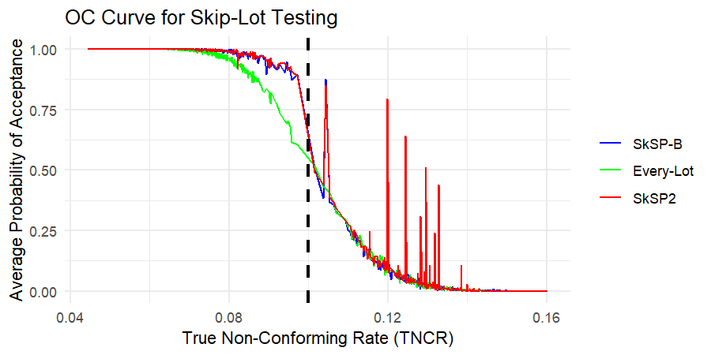
Noisy, Sudden Change
DISTRIBUTION STATEMENT A: Approved for public release; distribution unlimited. PAO Log# 422-25, 17 Apr 2025

Slide 28
Noisy, Sudden Change
Method | Average Sample Number (% change) | Percent of Good Lots Failed (% change in Type I Error) | Percent of Bad Lots Passed (% change in Type II Error)
Every-Lot Sampling | 500 | 2.18% | 4.81%
SkSP-2 | 244.16 (51.17%) | 0.53% (75.69%) | 6.11% (-27.03%)
SkSP-Bayesian | 259.03 (48.19%) | 0.61% (72.02%) | 5.28% (-9.77%)
Risk Threshold | i | f
.01 | 6 | .2
DISTRIBUTION STATEMENT A: Approved for public release; distribution unlimited. PAO Log# 422-25, 17 Apr 2025

