Slide 1





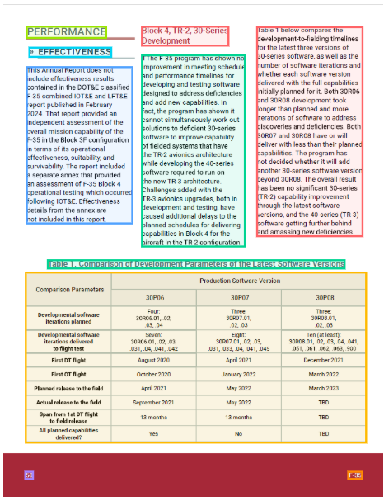
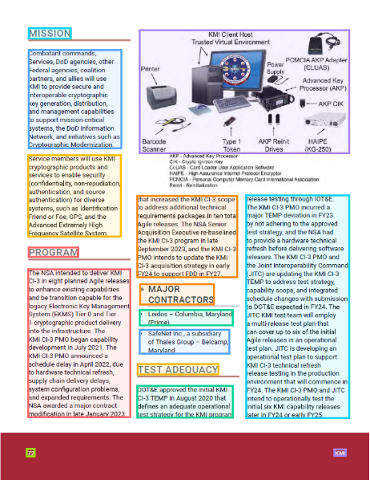
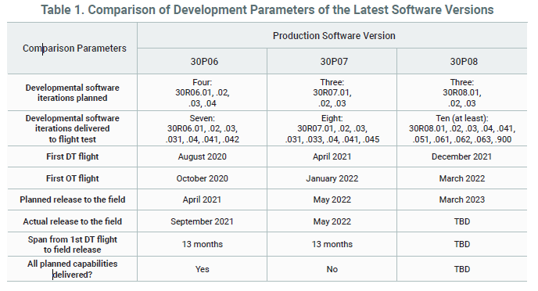
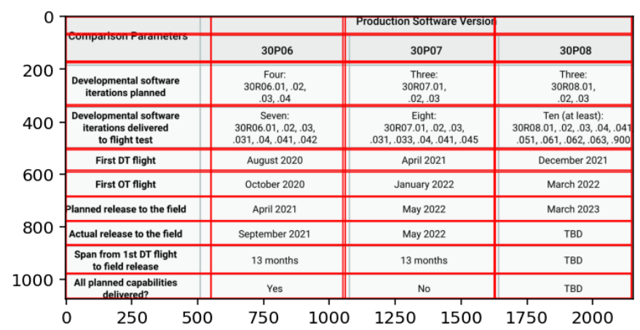
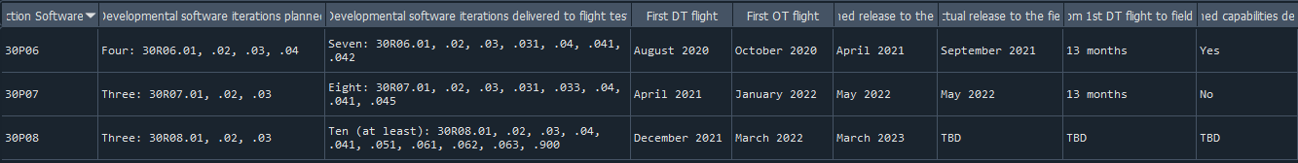
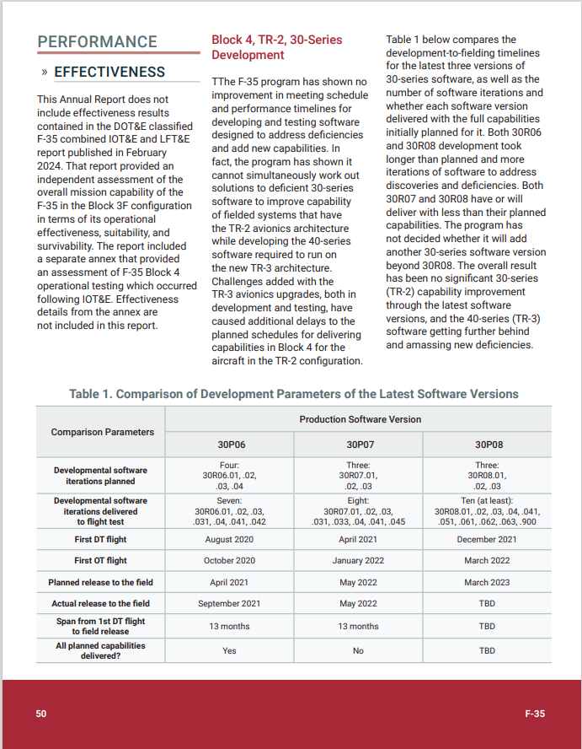
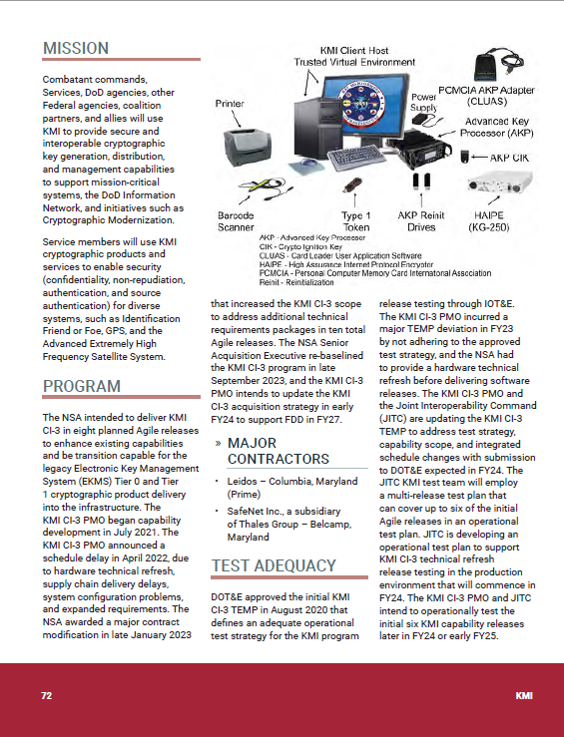
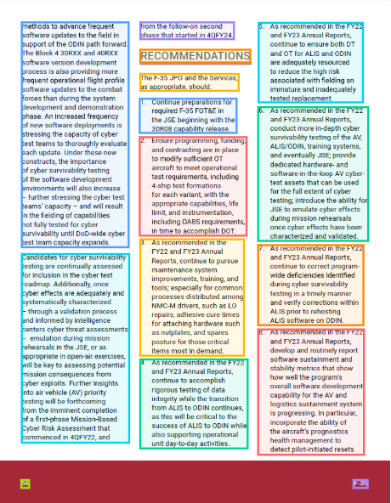
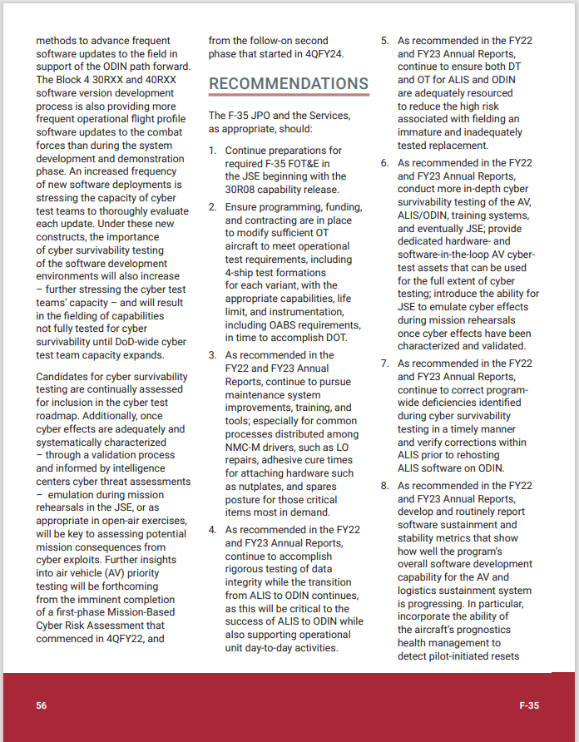

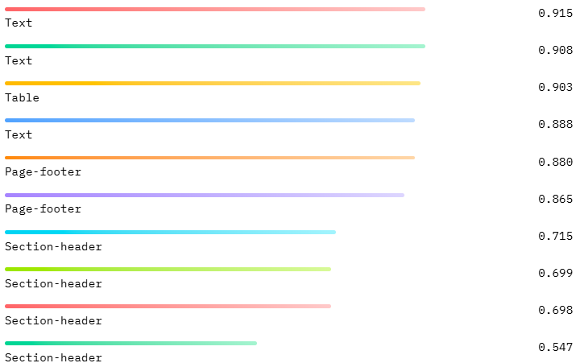
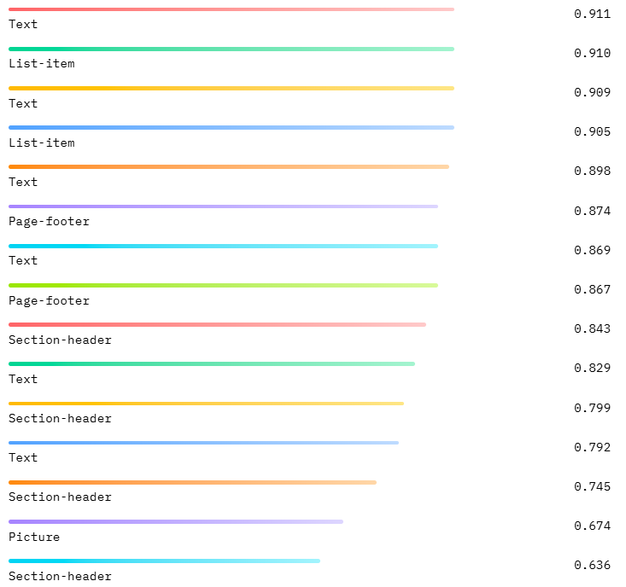
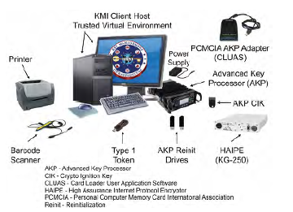
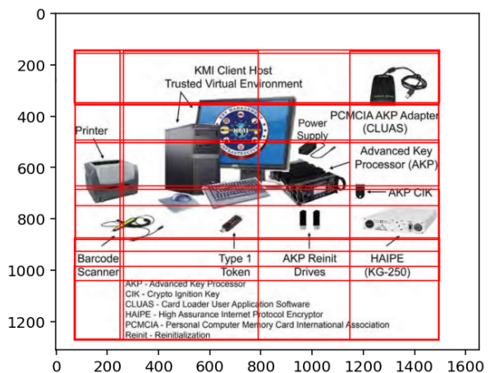
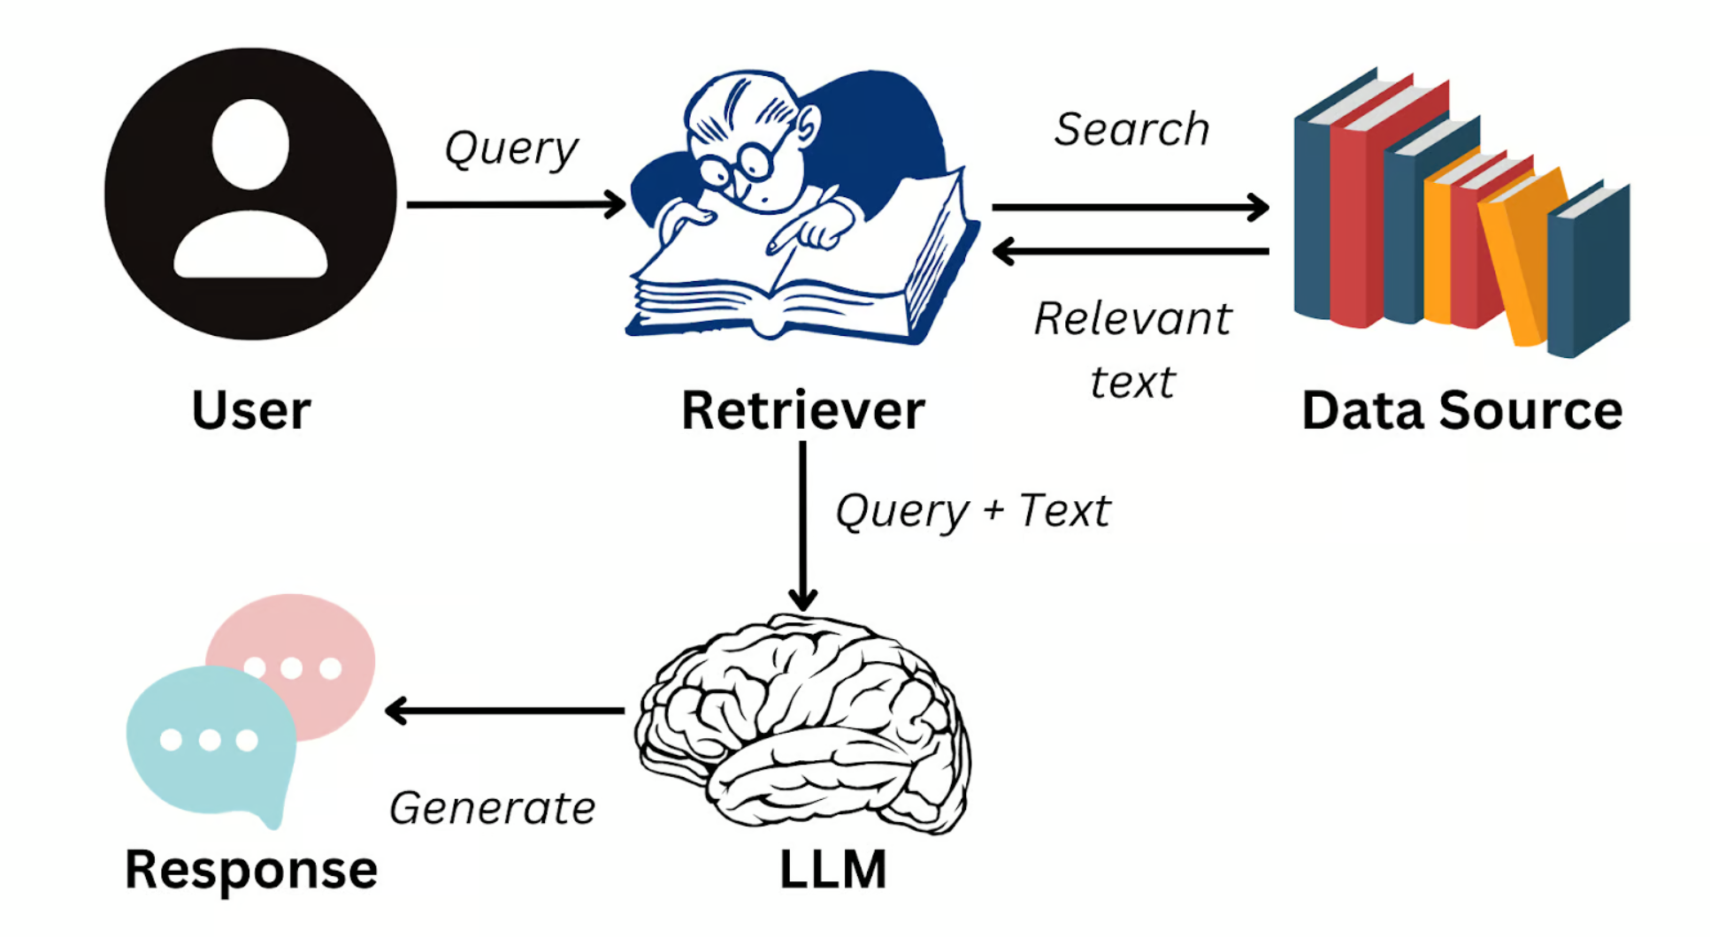
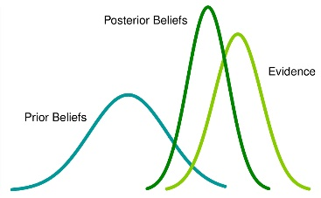
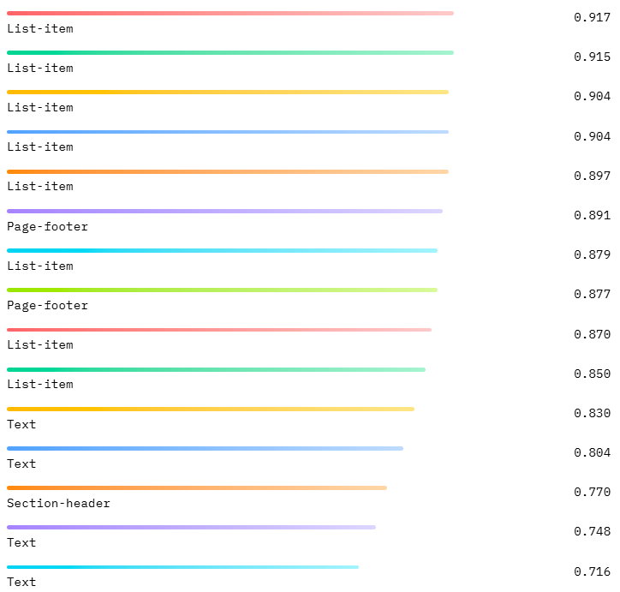
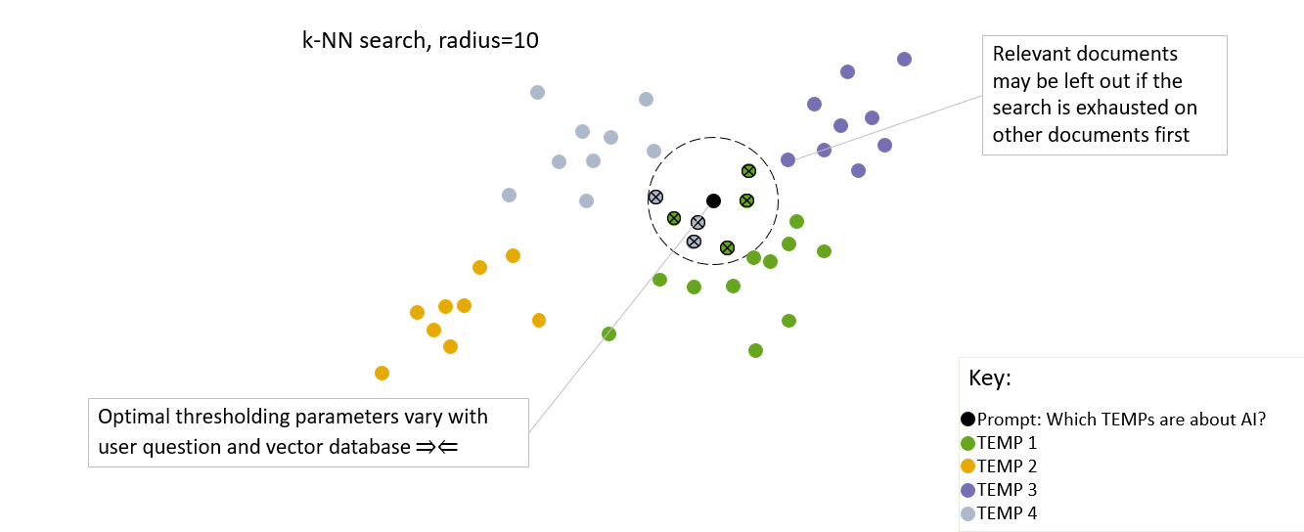
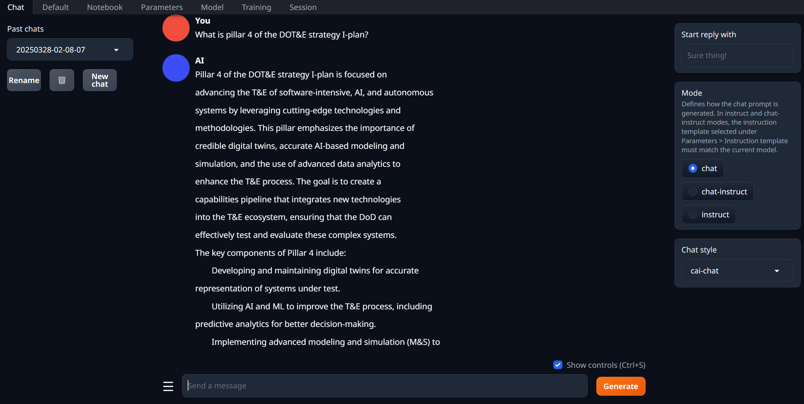

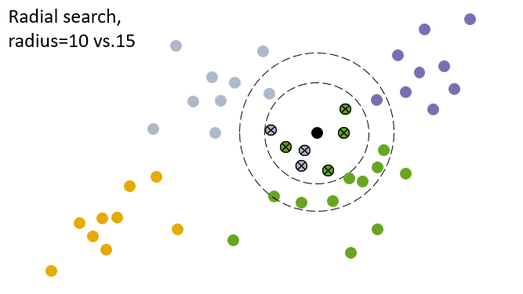
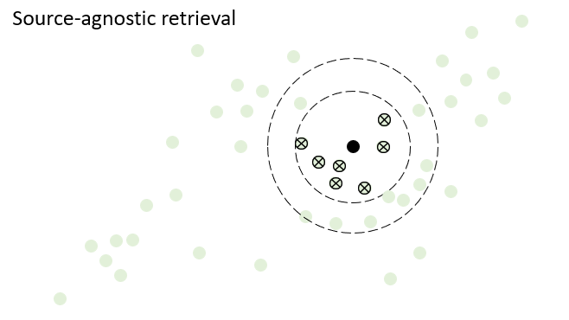

How many pillars are in the DOT&E Strategy I-Plan and what is the fourth one? What are its desired end states?
PDFs to Insights: A Machine Vision and LLM Approach to Test Science
Valerie Bullock, Breeana Anderson
MOTIVATION
ILLUSTRATION THROUGH EXAMPLE: Analyzing DOT&E Annual Reports
At the Institute for Defense Analyses (IDA), we are advancing test science through the use of machine vision and generative AI to process a database of thousands of T&E documents in PDF format. This capability will help in assessing long-term trends and RFIs.
Label and capture structure with Machine Vision
Parse
Ingest documents
Table processing
Images
Text chunks
Doc structure and metadata
Summarize and extract tags
RETRIEVAL-AUGMENTED GENERATION
Embed
Table summaries
Image description
Text summary
Text chunks with metadata
Retrieval-Augmented Generation (RAG) is a software architecture that enhances LLM responses by injecting relevant external knowledge, often stored in databases, into user prompts to provide added context.
Data Pipeline
Multimodal
Model
Updated Belief (posterior)
Most Recent Evidence (Likelihood)
Current Belief (prior)
Semantic search is the most common type of search algorithm used in RAG builds and involves a k-Nearest Neighbors (k-NN) approach, which retrieves datapoints closest in proximity to the user’s prompt.
Common Drawbacks:
Blind to document format and structure, and cannot identify which document text was attributed to
Results are sensitive to search radius
Cannot answer aggregative, quantitative, or exhaustive questions:
How many reports talk about AI?
In the last 5 years, which reports discussed AI?
Was the F-35B Mean Time to Repair (MTTR) longer in 2022 than 2023?
Synthesize retrieved information
Retrieve/Query
Master table:
Vectors
Raw chunks
Metadata
Summaries
Raw tables
Raw images
Answer
output
Non-AI enabled:
Vector
Keyword
Pre and post filtering
Raw table retrieval
AI-enabled:
NL2SQL
Store
Application
Render raw results
REQUIREMENTS
FUTURE RESEARCH
Pre and post filtering on metadata
Aggregative, quantitative, and exhaustive question answering
Source citations
Interoperability with existing relational data stores
Synthesis of tabular data, lists, and images
Local deployment
User and document access controls
Extraction from inaccessible PDFs
Reduced reliance on parameter tuning
Moving to a combination of relational and non-relational data storage
Natural language translation to alternative query languages
Fine tuning on technical terminology
Updating our user interface
Scaling with larger data sets and user testing groups
Integrating alternative search algorithms
User feedback and analytics
Context window constraints
Advanced automation of table reading and tidying for highly complex tables
Notes:
Notes:
Consider moving benefits into the middle / swap with application? Or make sure to highlight the number comparisons.
Highlight that we’ve used these methods too

