Slide 1
Strategy and Tactics to Apply Design of Experiments to Testing of AI Enabled Systems
Presented by Wayne Adams, STAT COE
The views expressed are those of the authors and do not reflect the official guidance or position of the United States Government, the Department of Defense, the United States Air Force or the United States Space Force.
DISTRIBUTION STATEMENT A. Approved for public release; distribution unlimited.
Case number: 88ABW-2026-0262; CLEARED 20 Apr 2026

Slide 2
Objectives
Explain the benefit of continuous versus categorial responses and factors
Outline the differences between an observational study, surveys, and a designed/controlled experiment
Explain the importance of randomizing the order of test points

Slide 3
Why Design a Test?
Information quality
Relationships of variables
Analysis method considerations
Quantification of risk
Design refers to more than just DOE
Notes:
Test design is an important element in the overall planning process. While Design of Experiments (DOE) is a very useful tool in the design toolbox, it is not the only tool. There are many other aspects of design that reach outside of the typical DOE framework. Design should be based around the quality of the information that needs collected and the amount of risk that can be incurred. Tests are purposefully designed so that risks can be quantified and accepted before any testing begins.
We also wish to consider what happens when you cannot design a test, but are instead limited to simply observing.

Slide 4
Definitions: Response and Factor
Responses are the measured outputs of a test event and are used to assess the objective of the test
  There may be several responses measured for a given test and/or in support of a requirement
Factors are inputs to or conditions for a test event that potentially influence the value of and variability in the response
  These can include configurations, physical or ambient conditions, or operator considerations
  A factor can be controlled by setting it to a particular level, measured for its value but not controlled, or a mystery value contributing to unknown variation
Notes:
With the test objectives defined, we can now begin to define the design space made up of the responses, factors, and any test constraints.

Slide 5
What Comprises a Test Design?
The design of the test (STAT that gets applied) is determined by
  Measurability of the responses
  Controllability of the factors
  Constraints of the system under test and test facility
  Analysis product needed to provide insight
  Sequential test triggers for what to next
Notes:
If the initial design’s cost is too high, we trade-off lowering cost with losing information, decreasing sensitivity, and/or increasing risk.

Slide 6

Observational Study
Most factors unable to be manipulated/controlled
Example: Space-based system
  System: Measures ground events from orbit
  AI: Predicts future, ground events to establish warnings
  Test Goal: Is the prediction correct? Do warnings come early enough?
Might need a large sample size to see rare events
Less design work; begets less information
Notes:
So, what if you truly cannot design a test. Consider a system that cannot be controlled such as a weather satellite in space. While a team might be interested in looking at how well the satellite reports the weather data back to Earth, they cannot control any of the factors of interest. The satellite follows a given orbit, it reports on precipitation that cannot be controlled, and it is programmed to report back at regular intervals. In this case, the discussion turns to how long we need to gather data from this observational study to make sure enough relevant data is collected.

Slide 7
Survey
Most of the responses are not directly measurable
Responses are opinions, ratings and/or rankings
Generating a high-response rate without adding bias is the goal
Cluster analysis is a common tool for analysis
Surveys are designed to remove bias, check variation
Testing of AI focuses on understanding human factors
  Is it trustworthy? Useable? More efficient? More effective?
  Can surveys be given TO an AI? BY an AI?

Slide 8
Controlled Experiment
Known as design of experiments (DOE)
Factors can be controlled
Responses can be directly measured (continuous data)
Structure of the design determines the analysis product it can provide
Controlled factor settings are ideally randomized
  Goes further than just determining a relationship
  Can show cause and effect conclusions
versus…
Combinations of multiple STAT
Notes:
If instead, we are able to manipulate the factors, we can perform a controlled experiment. The more control we have, the more we can attribute a change in one factor to a change in our response. The most important part of a controlled experiment is that is can give us these much-desired cause and effect relationships.

Slide 9
Design of Experiment Types
Ruggedness tests treat factor effects as sources of instability
Screening designs determine significant factors in few runs, which can then be augmented into larger complete designs
Response surface methodology (RSM) designs model curvature via quadratic model parameters
Custom designs are used to address constrained space, limited resources, higher-order surfaces, and restricted randomization
Space-filling with a goal to look for anomalies in the outcomes
Notes:
One of the key aspects of Design of Experiments (DOE) is the ability to build up designs. At the bottom of the slide, a design (for three factors, each in one dimension) is shown that can be extended by adding points to create a more complex design. The first cube shows a simple screening design. The second design shows a full factorial design with a center point. The third cube shows a response surface design where axial runs have been added. As the designs become more complex, they also provide additional information.

Slide 10
Algorithm Testing with DOE
Algorithms are components of a larger system
Controllable inputs with measurable outputs
Decision requires modeling the output in terms of input levels
The Define phase of the STAT process indicates a designed experiment is the preferred data gathering method
Do not force a decision through a test method; Create a test method for the decision
Notes:
DOE is often applied to system testing, but the applying a DOE to an algorithms is relatively new. Tests of AI enabled systems will frequently need to decompose algorithm tests and hardware tests before integration. To do that the hardware will need a model to enable simulated factors for the algorithm.

Slide 11
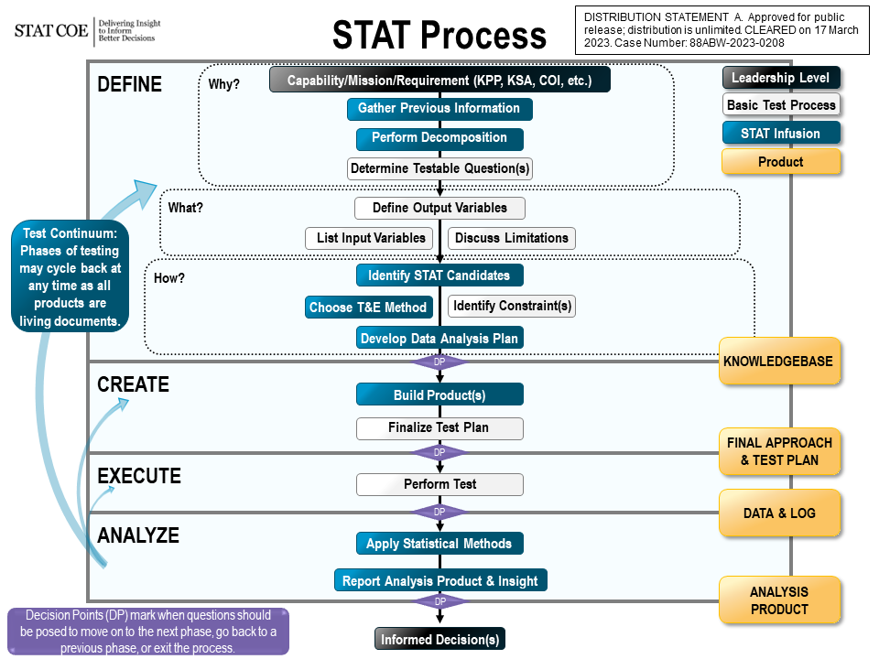
After passing decision point, move to Create
Notes:
STAT drives an iterative procedure that begins with the requirement and proceeds through the generation of test objectives, designs, and analysis plans, all of which may be directly traced back to the requirement. Critical questions at every stage help the planner keep the process on track.
Critical questions are provided to serve as a starting point to ensure rigor is injected throughout the planning process.
The questions are broadly applicable but not all inclusive and serve as a primer for an informed dialogue among the test team.
These questions should be employed by practitioners at the detailed planning level.
These questions can also be used by leadership to provide insight into the rationale for various planning decisions.
System details and situational dependencies should steer the team to create their own questions that will support development of the most affordable, efficient, and effective strategy.
At the end, the test design and plan for analysis are reviewed to ensure that it supports the objective that began the process. The STAT process figure provides a concise process flow diagram that summarizes the application of STAT to the test and evaluation (T&E) process.

Slide 12
Tips to make DOE most informative
Include all relevant factors in initial planning
Choose the right data type
Add common augments
Choose the appropriate analysis method
Perform design evaluation

Slide 13
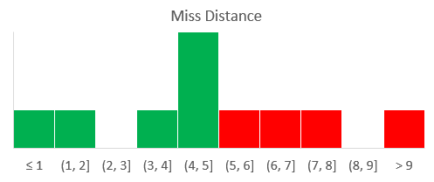
Continuous vs. Categorical Responses
Miss Distance
Hit/Miss (binary)
Strike Coordinates
Continuous responses provide more information for analysis and typically require fewer runs
Notes:
Strike coordinates are better than miss distance which is better than hit or miss. Higher level continuous data can always be converted to lower-level data, but it doesn’t work the other way.
Coordinates can also be used to detect grouping or lack of grouping, something that is lost when miss distance is used. Miss distance is an aggregate of strike coordinates.
Another example of translating a binary response: target killed vs time to kill and distance killed.

Slide 14

Continuous vs. Categorical Responses
Target
Miss Distance
100% hit system;
Change the aim
Hit/Miss (binary)
Strike Coordinates
Continuous responses provide more information for analysis and typically require fewer runs
Notes:
Strike coordinates are better than miss distance which is better than hit or miss. Higher level continuous data can always be converted to lower-level data, but it doesn’t work the other way.
Coordinates can also be used to detect grouping or lack of grouping, something that is lost when miss distance is used. Miss distance is an aggregate of strike coordinates.
Another example of translating a binary response: target killed vs time to kill and distance killed.

Slide 15
Continuous vs. Categorical Factors
Continuous Factor/Levels
Categorical Factor/Levels
1 2 3 4
1 2 3 4
Factor
SLOW
FAST
Factor level is controlled at a value with as much precision as possible
Numeric factor level varies inside a categorical band
Noise/variation/s
0 10 20 30
0 10 20 30
Response
Controlled input reduces variability in the output
Varying input contributes to variation in the output
When you have a choice, using continuous factors is preferred and reduces variability in the response.
Notes:
The same concept of continuous versus categorical applies to factors as well. The range of the factor within the category itself causes more variation. Want to control the factors as much as possible. We want to choose a continuous factor whenever we can. The use of continuous variables gives us more insight in fewer runs than categorical variables do, and this is why we always want to use continuous variables whenever it is possible. Design the testing to be done so that you can measure continuous variables!

Slide 16


Randomization
Randomization avoids bias
Protects against:
  “Background”
    Things that we know are happening in the background but can’t control (e.g. weather, proficiency, crew differences)
  “Unknowns”
    Things that we don’t know are happening in the background and can’t control – Lurking Variables
Randomize the order in which the runs are performed
Randomization ensures a lurking variable doesn’t invalidate the whole test!
Notes:
Randomization simply means to execute your test runs randomly—i.e., don’t do all the tests at the high altitude first then do those at the lower altitude because it is easier. The DAU glossary definition of randomization is: Executing a series of test events in random order to reduce error. Conditions in one run neither depend on the conditions of the previous run nor predict the conditions in the subsequent runs. Randomization spreads out any potential concentration of unknown and uncontrolled factors, which minimizes any influence they might have on the impact that the other factors have on the response. Such unknown factors might include learning, fatigue, and weather changes. When randomization is very difficult, inefficient, or unsafe, split plot designs may be employed to ensure the proper design strategies and analysis techniques are used in a restricted randomization environment. When randomization is not in play, increased attention to calibration, standard procedures, and other test techniques to limit the effects of uncontrolled background variables is required.

Slide 17
Replication
{- +}
{+ +}
Replication means running the same test point (i.e., factor setting combination) more than once in the same test
Increases precision
  Additional measurements estimate a mean response value
  Reduction in error
Allows for the quantification of uncertainty
  Estimation of the background noise
B
{- -}
A
{+ -}
If you can afford it, add replicates to your test
Notes:
If an experiment is run exactly one time, there is no way how tell how far from the truth the single measurement is. However, if it is replicated, there is now a method to observe the variation. The most common use of replication is to allow error or background noise to be estimated.

Slide 18
Projection
Scenario: the analysis of a three-factor (A, B, and C) design shows factor C has no significant effect and is not part of an interaction
The three-factor test matrix can then be projected onto a two-factor test matrix
B
C
A
Notes:
The projection property states that factorial designs ‘project’ into replicated factorial designs in lower dimensions. Empirical evidence suggests that it is quite common to have at least one insignificant main effect when the number of factors is at least 4.

Slide 19
Projection
Factor C is treated as though it was never changed, producing replicates with respect to A and B combinations
Same number of runs for fewer potential effects
Better estimate of unknow variation from the “replication”
{- +}
{+ +}
B
{- -}
A
{+ -}
Notes:
The projection property states that factorial designs ‘project’ into replicated factorial designs in lower dimensions. Empirical evidence suggests that it is quite common to have at least one insignificant main effect when the number of factors is at least 4.

Slide 20
Analysis
Analysis is the last phase of test – it should be considered first
DOE supports numerous types of analysis including
  Analysis of Variance (ANOVA)
  Interval estimation – use to understand adherence to requirements/performance limits
  Hypothesis testing – use to determine significance of factors
  Regression – use for characterization and prediction
  Anomaly detection
DOE was developed to support better analysis – design to analyze!

Slide 21
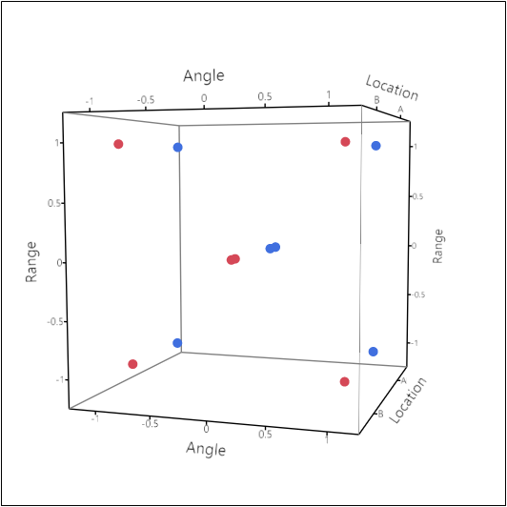
Design Options
Optimal & Response Surface Designs
Factorial or Fractional Factorial Designs
Space Filling Designs
All these design options and more!
Notes:
These are a very small subset of design options, but they are all common for various applications.
Factorial designs have a goal to understand the effects the factors have on the responses.
Response surface designs have a goal to optimize to determine how close to objectives a system can reach and/or find edges and even cliffs where performance drops below thresholds.
Space-filling designs search for anomalies and similar goals to response surface designs. The goal is coverage of a space/volume. Most have the property of having unique levels for every factor in each run, no replicates even when projected.

Slide 22
Optimal Design Criteria
Similar to how travel routes are provided by navigation apps
  Prioritize travel time vs travel distance
  Might get a different route by prioritizing on each criterion
  Chosen criterion should match user objectives
In DOE, most design criteria are based on one of two goals:
  Estimate model parameters (regression coefficients) OR
  Predict future observations
Optimal designs are optimal for a specific case, and are heavily dependent on assumptions (especially the form of the model)
Always evaluate the design
Notes:
JMP will provide the best recommended criterion if you let it.

Slide 23



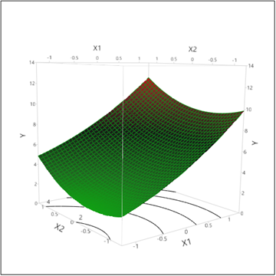
Balancing:
Risk, Constraints, and Resources
n
Statistical Measures of Merit
δ
σ
Relevant difference to detect
α
Inherent response noise
Adequate sample size
“Type I” risk metric
β
“Type II” risk metric
Design Type
Constraints
k
Empirical Model
Number of factors
The goal is to determine the true nature of the system, in all possible scenarios, with a finite number of samples that yield valid conclusions while minimizing the risk of error
Notes:
Sizing a test design requires balance across different considerations. Recall the definitions of type I and type II error from the previous lesson. In the next set of slides, we discuss how sample size, delta, alpha, and beta affect how a design should be selected.

Slide 24
Difference to Detect, δ
Difference to detect delta (δ) is an operationally meaningful difference in the response caused by changes in the factors
Requirements must specify operational goals for δ
Difference is assumed to be caused by factors within the ranges tested
  Stability: No more than a given δ – looking for consistency (OT)
  Screening: At least the given δ – looking for factors with large effects
Who can I ask/where can I look to obtain these values?
  Requirements documents
  System experts; operators (SMEs)
  Decision makers
  Informed guess – Why are you testing without a requirement?
Delta choices are not driven by STAT
STAT defines the need for a choice
Notes:
Most T&E does not have a delta specified for factor effects. They are looking to compare a response surface model. Use the correct test method. It is probably not a factorial design.
This is a difficult statistical concept. You must envision an “alternate” world that is far enough away from the status quo under the null hypothesis that makes a difference in terms of a system performance measure of the response variable. Consider an experiment trying to improve a golf game where the “null” hypothesis is that a factor does not contribute to golf score. If the overall variability in a player’s game is 3 strokes, then a factor (such as golf ball brand) that improves score by an average of ½ of a stroke is probably not that meaningful or worth investing too many resources toward. However, the player may say that any factor that improves his average score by 4 or more strokes is worth investing in. It is this value of 4 that is the δ. $δ$ is driven by subject knowledge and is not statistically driven.

Slide 25
Response Noise, σ
Sigma (σ) is the run-to-run variation in the system if all factors were held constant
The background noise present in the population
How to obtain an estimate for Sigma:
Historical Data Available
Best: | MSE (Mean Square Error) from a previously Designed Experiment
Good: | Overall Standard Deviation from a Non-Designed Experiment
No Historical Data Available:
Good: | Pilot Study prior to official test involving testing at centers of the Test Space.
Fair: | Estimation of variability from a System Expert “could vary from Y₁ to Y₂”,
 | take range and divide by 4
Notes:
The entire DOE process is all about signal to noise. An accurate estimate of σ is essential to accurately plan a test program. $σ$ is the system background noise, such as the ±3 strokes in golf in the above example even though all factors are the same. The run-to-run variability can come from several sources such as the environment (e.g. weather), the actual system under test’s variability, and the test standard operating procedures. The goal is to minimize this variation or impact from nuisance factors prior to test. Dry runs could help hone the test process to eliminate measurement and instrumentation error.
The system σ is rarely known, but can be estimated in a number of ways as shown in the table above. Due diligence is required to narrow in on this value and should be estimated when designing the experiment.

Slide 26
Signal-to-Noise-Ratio
The ratio δ/σ is the signal-to-noise ratio (SNR) it will be used to manage test risks
If and only if, there are no estimates for signal or noise,
a generic ratio may be used
δ = 2, σ =1 – discovery of unanticipated/low severity effects
δ ≤ σ – critical discovery of anticipated/high severity effects
Maximize test efficiency by getting better information up front!
This matters when performing experiments

Slide 27
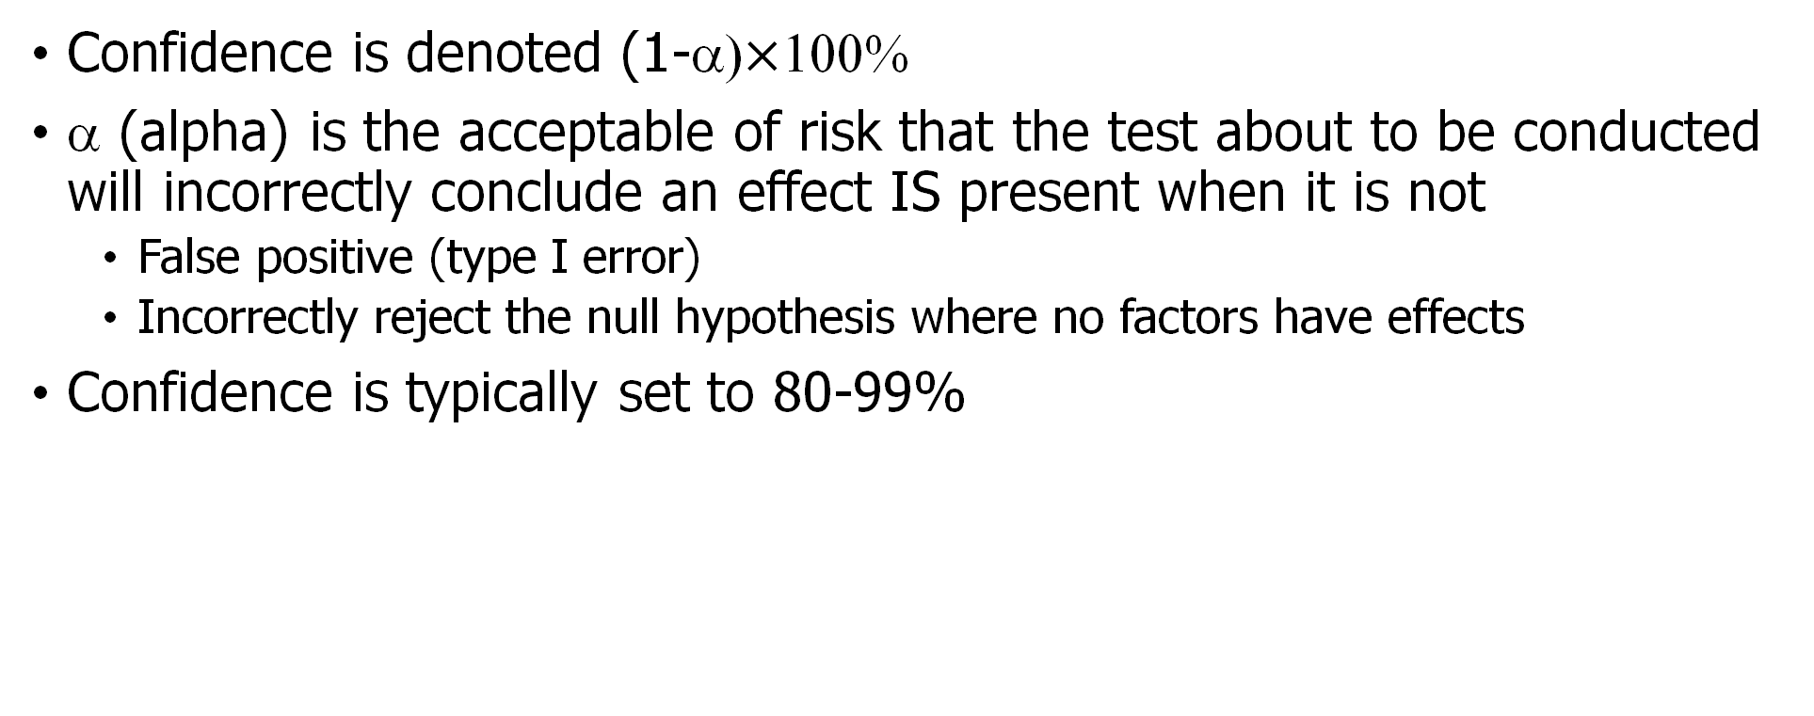
Confidence, (1-α)
Confidence is denoted (1-α)$×$100%
α (alpha) is the acceptable of risk that the test about to be conducted will incorrectly conclude an effect IS present when it is not
  False positive (type I error)
  Incorrectly reject the null hypothesis where no factors have effects
Confidence is typically set to 80-99%
What is the consequence of a type I error?
Notes:
Statistical confidence is different than emotional confidence. It is a numerical value that should be set before any testing is conducted and is directly related to the risk of making a false positive error or concluding that a factor is having an effect on the response when it is in fact not. Statisticians will tend to set confidence to 95% leaving a 5% chance of making an error. 80% is commonly used leaving a 20% chance of making an error as a trade-off to reduce sample size. This risk needs to be balanced with others and sample size.
$$μ=25$$
(in reality unknown)
95% Confidence Interval Example

Slide 28
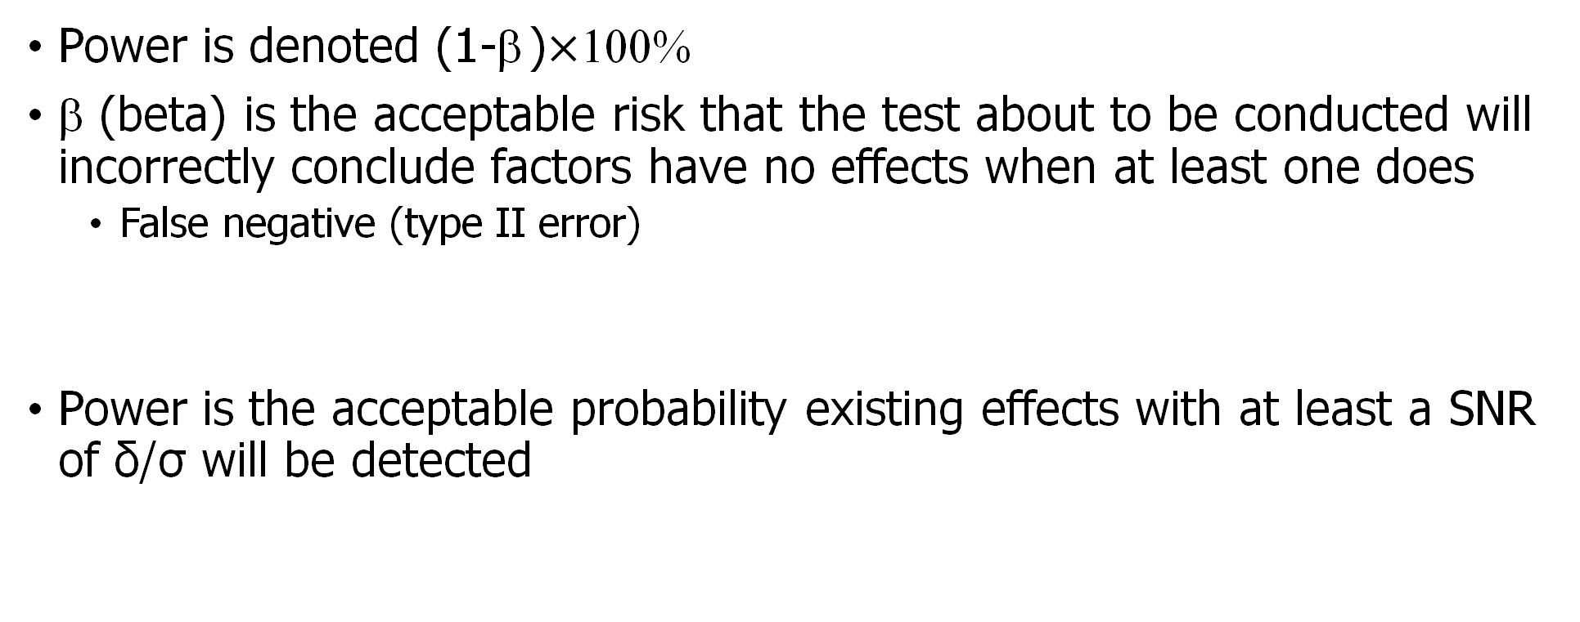
Power, (1-β )
Power is denoted (1-β )$×$100%
β (beta) is the acceptable risk that the test about to be conducted will incorrectly conclude factors have no effects when at least one does
  False negative (type II error)
Power is the acceptable probability existing effects with at least a SNR of δ/σ will be detected
What is the consequences of a Type II error?
Design for at least 80% estimated power
Notes:
While confidence is set, power is estimated. But again, it should be estimated before testing is conducted. Power is related to another error, the error of detecting a false negative or concluding that a factor is not having an effect when it is. Typically, we wish power to be at least 80% meaning that our error rate is at 20%. Is 80% power enough? What will you need to “pay” to increase power?

Slide 29
Decisions – Hypothesis test
After we collect data, we come to two possible outcomes: reject H₀ or fail to reject H₀
Decision is based on a sample, so tester might make the wrong conclusion
Truth
 | Null hypothesis (H₀) is TRUE: | Null hypothesis (H₀) is FALSE:
Reject H₀ Determine statistically significant | Type I error False positive (alpha) Incorrect decision! | Power True positive (1 – beta) Correct decision!
Don't reject H₀ Determine not statistically significant! | Confidence True negative (1 – alpha) Correct decision! | Type II error False negative (beta) Incorrect decision!
Decision
Notes:
Reject the null when the null hypothesis is false. This is called power in statistics.
Fail to reject the null when the null hypothesis is true. This is called confidence.
The null hypothesis is NEVER accepted.
When a decision based on the results of a hypothesis test is made, there is no guarantee it was the correct decision. However, we can characterize the risk of making two possible errors.
The two types of errors are:
Type I error: Reject the null hypothesis when the null is true. As experimenters, we have direct control over this value by setting it equal to a value, the significance level, prior to the analysis. The significance level (the probability of a type I error), denoted as $α$, represents the level of “reasonable doubt” in the data when we decide whether to reject the null hypothesis or fail to reject it.
Type II error: Fail to reject the null hypothesis when the null is false. We do not have direct control over type II error. It is a function of several features of an experiment. We discuss this in more detail throughout the course. The probability of a type II error is denoted as $β$.

Slide 30
Sizing Designs
Type of design, type of analysis, and number of runs in a design determine the type of risks that need to be managed
Power is the correct risk management tool for factorial designs
Power can be managed by trading off against confidence, delta, and sigma, and number of effects to be tested
  Get more power by trading for less confidence, larger delta, smaller sigma, less complex models
Power is more commonly managed with number of runs (n)
  Increasing the number of runs increases power
  Decreasing the number of runs decreases power
Notes:
Number of runs is sometimes called sample size

Slide 31
Additional Metrics to Consider
What if factor effects are not the reason for the test?
  Determine if the system can achieve threshold
  Find limits of system capability
  Search a system’s performance window for anomalies
These type of test goals require different tools than factorial designs

Slide 32
Response Surface Methods (RSM)
The analysis goals
  Get a predictive model
  Optimize multiple response models
    What makes the system work best
    Find out where system begins to fail
  Include uncertainty quantification in the analysis
Can still do screening and factor effects, but those are usually known by the time RSM is appropriate
Notes:
Factorial designs can be augmented into response surface designs by adding the appropriate runs. This is called sequential testing which allows partial tests to be done, interim analysis performed with a plan to use the results of the analysis to trigger what and how to test next.

Slide 33
RSM Evaluation
Rather than power to detect effects, use precision to manage risks
Delta (δ) goes from being an operationally meaningful change in the response acceptable margin of error for predictions
Sigma, confidence, and the planned model play the same role as they do for power
Fraction of design space (FDS) shows how the achievable margin of error is distributed over the whole design space

Slide 34
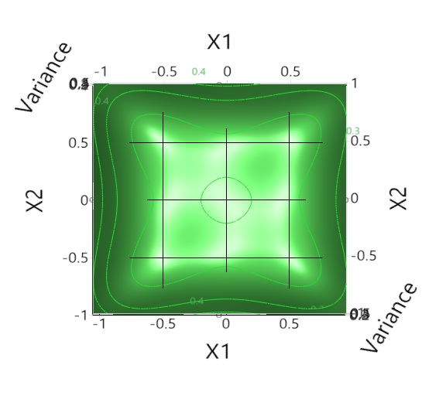
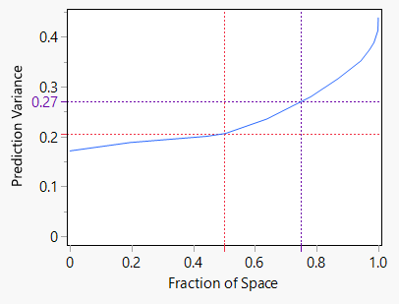
FDS Explanation
The FDS corresponds to a contour of the prediction variance
50% FDS ≈ 0.21
About 50% of this design space has a prediction variance less than 0.21

Slide 35
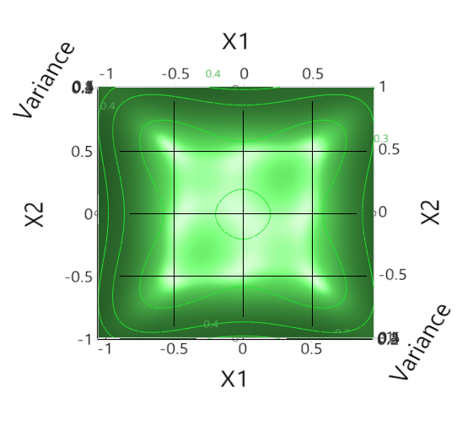
FDS Explanation
The FDS corresponds to a contour of the prediction variance
75% FDS ≈ 0.27
About 75% of this design space has a prediction variance less than 0.27

Slide 36
FDS Usage
Two-factors produce a straight-forward link between FDS and contour
Higher dimensional space requires slicing through contours
FDS reduces any number of dimensions to one curve and a percentage
How do we use it?
What y-axis is
good enough?

Slide 37
FDS Y-axis Needed
The y-axis depends on
  Acceptable precision: +/-
    How large of a δ is good enough to support a decision?
  Estimated standard deviation
  DOE test matrix
  Planned polynomial model (main effects, interactions, quadratic, …)
  Confidence level (e.g. 95%)
  Interval type
Notes:
JMP produces an FDS based upon the confidence interval around the average prediction, but they can be produced for tolerance, prediction as well as other types of intervals

Slide 38
FDS Y-axis Needed
Create link between the precision goal given delta and sigma
Use the standard formula for a confidence interval half-width:
delta = t-value * sigma * sqrt(v),
where v is prediction variance
Rearrange this formula to solve for v:
  sqrt(v) = delta / (t-value * sigma)
  v = (delta / (t-value * sigma))²
Notes:
v is the variance-covariance matrix

Slide 39
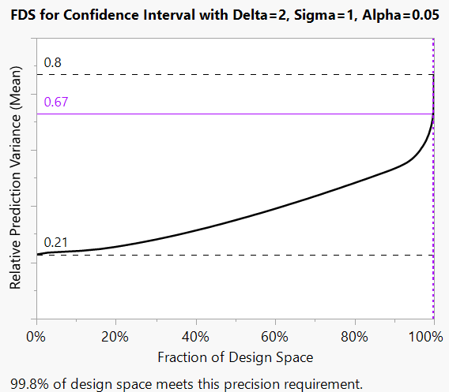
FDS Y-Axis (Example)
With a 16 run design, for three-factors to fit a quadratic model
  Delta = 2
  Sigma = 1
  alpha = 0.05,
  df = 16 (runs) - 9 (terms) - 1 = 6
  t critical value for alpha =
  0.05/2 tails @ 6 df = 2.447
FDS goal = (2 / (2.447 * 1))² = 0.668
Notes:
Terms 3 main, 3 interactions, 3 quadratics

Slide 40
FDS Crosshair X-Axis
The x-axis is the proportion of the design matrix where the model can predict with the prescribed precision
The x-axis requirement is a choice
Suggestions:
  Choose 80% (or more) if searching for optimum conditions and anomalies
  Choose 100% if showing threshold(s) can be met across the tested region

Slide 41
Case Study

Slide 42
Iterative Design Process
Keep objectives and goals in mind throughout
Iterative process
  Define the type of analysis needed
  Define responses
  Define factors/levels
  Define model terms and/or other design criteria
  Define decomposition/sequential test steps
  Create initial design
  Evaluate design metrics
  Repeat until satisfied!
Why is this first?
Will this design deliver the quantitative analysis needed?
Notes:
Creating a design is most importantly an iterative process. One method of design creation is to show serval different designs that offer different options for risk tradeoff.

Slide 43
DOE applied to Algorithm Testing
Biological detector array’s AI algorithm is being tested
Response: Alarm Yes/No to compute probability of detection
Determine the influence of factors on the probability of detection
Initial design choice: Full-Factorial
  Reveals all interactions
  Provides full coverage of all factor levels and factor combinations

Slide 44
Define the factors
Plume Dispersion Model Factors – Particle counts added to the Background
  Weather Parameters
  Release Factors
    Simulant
    Release Type
    Release Location
    Concentration
Environment Factors
  Background – 6-hour chunk of time series measurements of particle counts both biological and non-biological across multiple channels (size, type, etc.)

Slide 45
Test Considerations
The hardware in the array has been tested separately
The test results of the hardware were used to create a detector response function (DRF)
The detector response function converts inputs to the hardware to the format required by the algorithm
Simulated Input to Hardware
Recorded Weather
Plume Dispersion Model
+
Recorded Background
DRF
Alarm Algorithm
Alarm
Yes/No
Simulated Release
Threshold Setting
Sensor Array
Notes:
The recorded weather and recorded background were deemed independent and therefore could be fully-crossed in simulated input to hardware.
Without a detector response function (a.k.a. play back tool; input to output map; activation function; sensor model; etc.) the test would have needed real-world simulated releases that would have impacted the public and taken much longer and been much more expensive than modeling and simulation. Modeling and simulation is far from free, but it is usually less expensive than real-world testing, even when the models need to be developed before testing can begin.

Slide 46
Test Matrix Review
The full-factorial design where all combinations of
  2 simulants x 2 release types x 335 backgrounds x 2927 weather x 111 locations x 10 concentrations
  4,353,619,800 simulations – Exceeds budget
  (Approx. 380 years of simulation)
  {But has nearly 100% power!}
How can the number of test simulations be intelligently reduced
  Is it possible that some backgrounds are like others?
  Is it possible that some weather conditions are like others?
How do we check?
Notes:
The budget is time limited. The full process uses the inputs from the test matrix to create the detector response function which is fed into the algorithm at roughly 10,000:1 speed. 1 second of simulation is equivalent to 3 hours in the real world. 4 billion simulations takes well-over 300 years. 400,000 takes about 2 weeks.

Slide 47
K-Means Clustering
Use for larger data tables; at least 200 observations
Construct specified number (k) of clusters to find background chunks and weather readings with similar conditions
Compare different values of k to best explain the observations
Data comes from day-to-day measurement of conditions
  Particle count chunks (one reading every 10 seconds for 6 hours)
  Weather conditions (one reading every 3 hours)
Clusters can be used to define strata in a population
Testing with AI
Notes:
Cubic Clustering Criterion (CCC)
first-pass to pick the best number of clusters

Slide 48
What Metrics to Cluster With?
Picking the correct clustering metrics is an art
Weather was not difficult:
  Time of day, temperature, humidity, pressure, wind vector
  The science makes sense
Background particle count was much more difficult:
  Varies second to second
  Time series data
  Hundreds of channels in the detector response function (DRF)
  No well-defined distribution
  Needs aggregate measures (means, max, mode, percentiles, etc.)
  Several combination of multiple metrics considered by the test team
Notes:
A channel is a labeled piece of information. In this case the channels are particle size bins and type of particle (biological or non-biological), sensor ID (multiple sensors), and array locations.

Slide 49
Clustering Weather Data
2,927 weather readings gathered
  little more than a year of data gathered every 3 hours
Directly use six weather related variables
  Time of day
  Temperature (K)
  Pressure (Pa)
  Relative Humidity (%)
  uVelocity (m/s) – wind vector
  vVelocity (m/s) – wind vector
33 clusters chosen

Slide 50
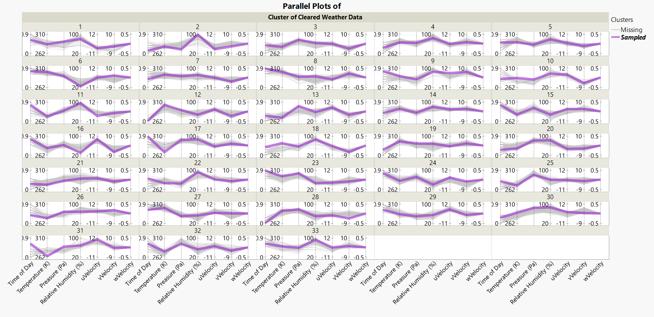
Weather: 33 Clusters on 6 Variables
Notes:
Look at the shape of the parallel plots for each cluster, This is one way to interpret how clusters were chosen

Slide 51
Clustering Background Data
Approximately 3,000 six-hour chunks of background data gathered
Most chunks used for training the algorithm
Data management selected 335 to be used only for testing the algorithm
Several metric packages were attempted
  Compute the Mean Ratios of bio-to-total particle counts
  Multiple sensors with multiple channels
K-Means clustering to compute the optimal number of clusters to be 18
  One chunk had high counts; verified to not have come from a known event
  Provides a good coverage of the types of background data seen over time
Notes:
Metric packages – minimum, maximum, median, mode, interquartile range, repeat for channel to channel ratios, time between peaks, time between next peak maximum and next minimum trough, etc.

Slide 52
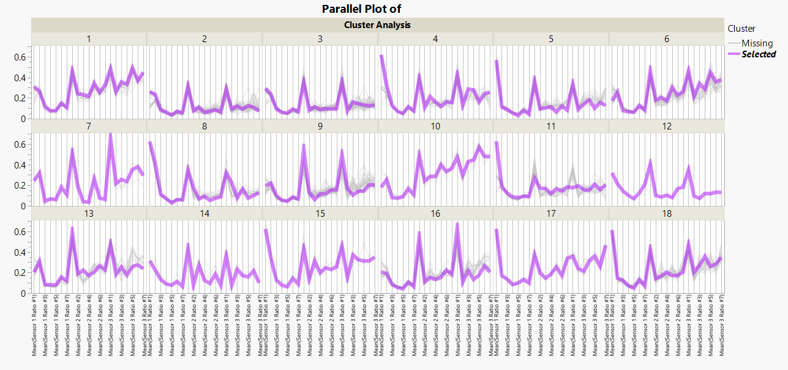
Background: 18 Clusters on 21 Variables over 335
Notes:
Look at the shape of the parallel plots for each cluster, This is one way to interpret how clusters were chosen

Slide 53
Concept: Stratified Sampling
Strata are groups of similar members from within a population
Strata can be considered sub-populations
Better representative coverage of the population
Randomly sampling one observation from each cluster ensures coverage of the population while minimizing the number of test files that need to be built
The clusters can be considered strata

Slide 54
Test Matrix Recommendations
The full-factorial design where all combinations of
  2 simulants x 2 release types x 18 backgrounds x 33 weathers x 111 locations x 10 concentrations
  4,353,619,800 2,637,360 simulations – Still exceeds budget
  (about 3 months of simulation)
Now what? It’s an iterative process
What things are critical to a successful assessment and decision?
  Are all combinations necessary?
  Are important multi-factor interactions expected?
  Is a response surface model of the system performance required?
  Must the deficiencies be characterized (cause and effect) or simply identified?

Slide 55
Design Choices
Type of Design | Goal | Limitations
Full-Factorial | All possible combinations | Too many runs
Fractional-Factorial | Characterize two-factor interactions | 2-level factors
Screening | Reduce the number of factors to characterize | 2-level factors
Optimal | Minimal runs to estimate likely significant polynomial parameters | Can take a long time to build with this many levels
Space-Filling | Cover the space | Requires continuous factors Little to no variation
Covering Array | t-way combinations of factors and levels | Little to no variation Limited to discovery
Hybrids | Combinations of the above

Slide 56
Covering Array Details
Covering arrays use combinatoric methods to find the minimum number of combinations (runs) that provide all t = {1,2,3,…,k} way combinations of factors for every factor level
t is called the strength of the array; t = k is a full-factorial
They are primarily used to test software to find bugs
Machine learning models needed for numerical analysis
Exploratory analysis used to find the areas of deficiency and capability

Slide 57
Test Matrix Recommendations
Hybrid Test Matrix
  Full-Factorial (2x2)
    2 simulants x 2 release types for full coverage = 4 combinations
  Covering Array of Strength t=3
    18 background x 33 weather x 111 locations x 10 concentrations
    65,934 combinations (18 x 33 x 111 – concentration has 8 repeated levels)
  The two matrices are crossed
    4 x 65,934 = 263,736
    4,353,619,800 3,245,640 263,736 fits the simulation budget (about 2 weeks)
    {And it still has nearly 100% power}
What other trades can be made for even fewer runs?
Notes:
Why so many concentrations? Given the use of logistic regression as few as three levels would have produced a similar model to the one shown below on a later slide
Why so many release locations. With 111 some of them were in the same room, hallway or entrance; they could have been clustered and sampled like the weather and background.
From the STAT point of view always question the need for multiple levels of any factor. In this case the test team wanted full coverage.

Slide 58
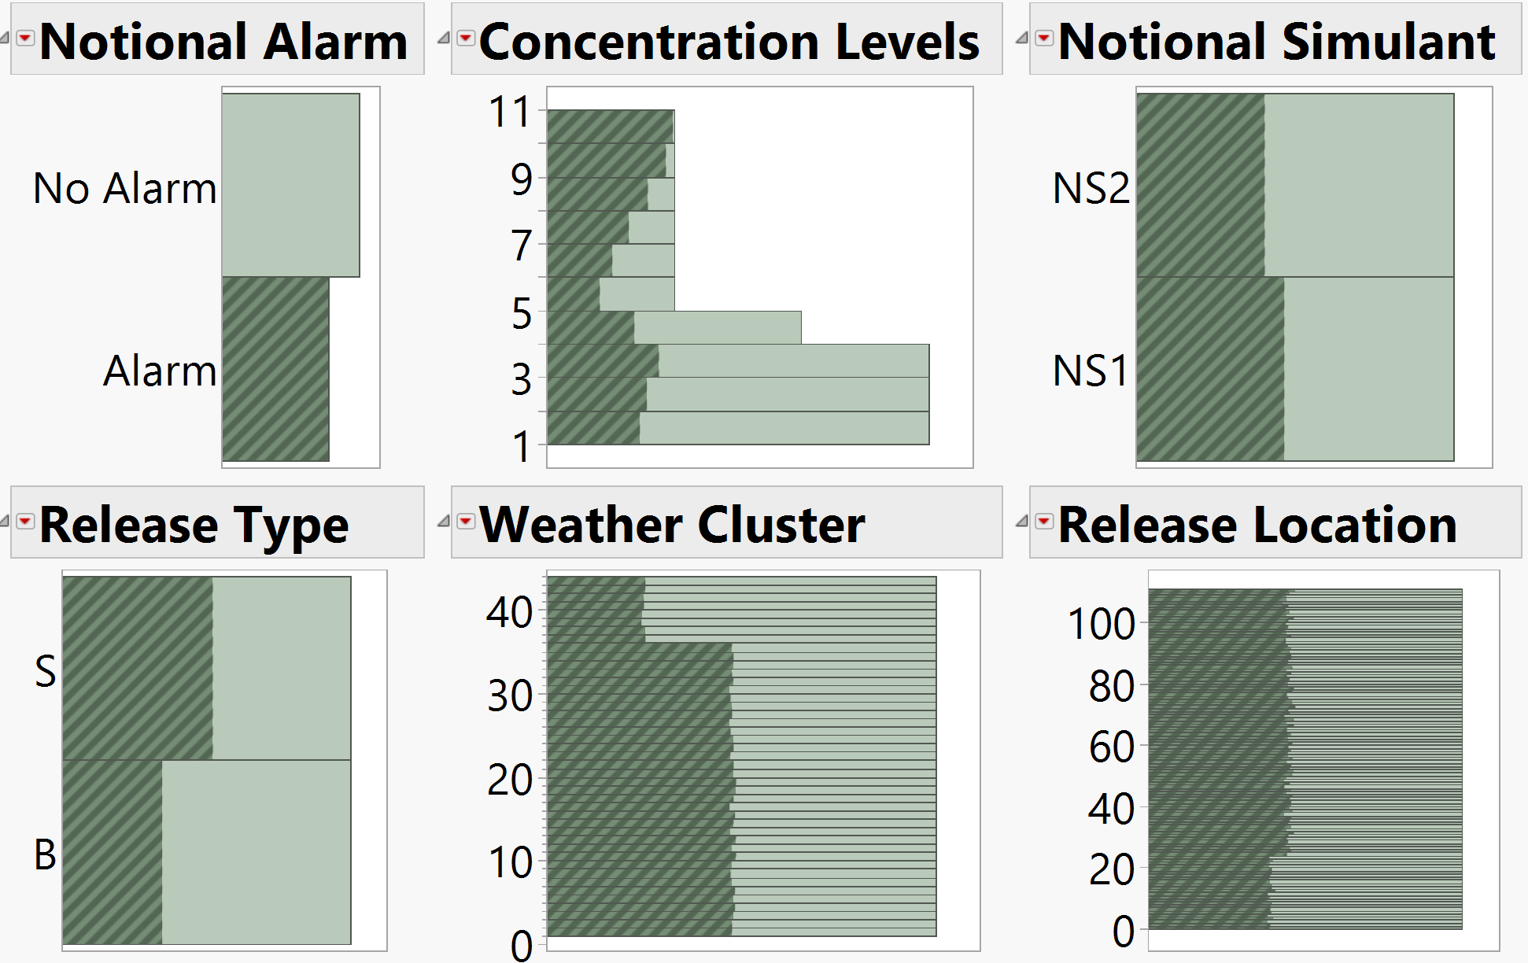
Exploratory Analysis
Every simulation will have something to detect;
A perfect system would always alarm in this test
Except for concentration, conditions were tested equally
More testing conducted at lower concentrations to help find limit of detection (LOD)
NS2 alarmed slightly less than NS1
Release type B is missed more than S
Low concentrations have a higher probability not alarming; there are some detects at lower concentrations
Both weather and release location influence alarms
All Data is Notional
1
3
2
4
Background has little to no effect in this example
Notes:
The notional data was managed such that the effect patterns were easy to see. In practice cleaning up the data, including filtering, sorting, and coping with missing data is necessary before EDA is likely to produce interpretable. results.

Slide 59
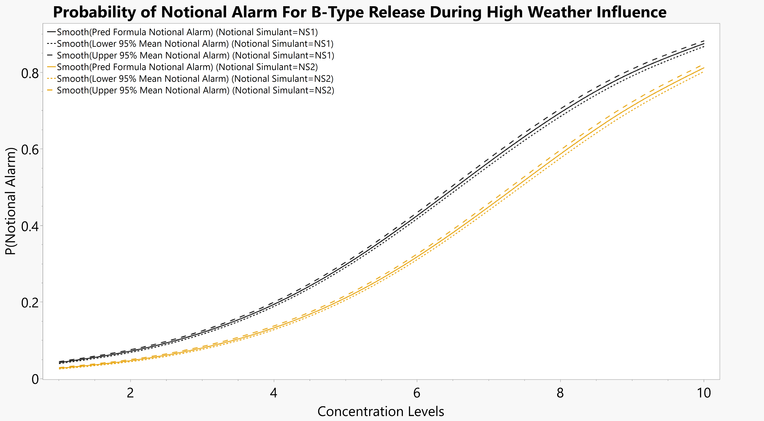
Analysis
All Data is Notional
There are multiple analysis techniques that can be applied
The data was filtered to the B release type and the weather conditions that produced the worst performance
Filtering and other types of data cleaning are common
The curves were fit using logistic regression
The small interval estimates are due to the volume of data
Notes:
The test team wanted know the concentration and other factors where the system could not reliably detect a biological attack
The final model used a

Slide 60
DOE for Testing Algorithms
DOE requires a controllable factor (input) to the system under test
AI’s often handle work considered “4D”
dangerous, dreary, dirty, dear
Real-world factors for testing AI’s are likewise 4D
Real-world testing of AI algorithms may not be practical
Example: testing a real biological release in the in a busy public location just to test the sensor algorithm
Notes:
The example presented earlier, a real-world, end-to-end test would require multiple releases of an infectious agent in a public location with some way to artificially control the weather and background counts.
A few weeks of modeling and simulation replaced 60 years of everyday testing without endangering anyone.
The test team had to develop a safe to release simulant with dispersion properties similar to an infectious agent that shows up as a biological particle of the correct size to a sensor.
Dangerous, dreary, and dirty, are fairly self-explanatory. "Dear" is an alliterative way to describe something very costly and/or requiring precision beyond human capability.

Slide 61
DOE for Testing Algorithms
Can the factors be changed real-world?
Can they be changed fast enough to inform decisions?
Is there a sensor model?
Can simulated input be used as factors?
Do the analysis products generated by DOE match the analysis products needed for the decision?

Slide 62
Type of DOE
Assuming DOE is the correct STAT
Space-filling design are talked about for AI testing
  Advantage: finds anomalies throughout an input space
  Advantage: controls the number of runs more directly
  Disadvantage: each run is completely unique across all the factors
    The plume dispersion model was run as part of a covering array
    2 simulants x 2 release types x 33 weather x 111 release locations = 14,652 unique sims
  Disadvantage: Recorded inputs are incompatible with space-filling designs
    Every run requires unique input (simulation) – and –
    High fidelity background particle count, and weather simulations do not exist
Simulated Input to Hardware
Recorded Weather
Plume Dispersion Model
+
Recorded Background
DRF
Alarm Algorithm
Alarm
Yes/No
Simulated Release
Threshold Setting
Sensor Array
Notes:
Space-filling design minimum setup is ten (10) unique runs per factor. However, this recommendation is for a system with deterministic outcomes, with the ability to set all numeric factors with no-error and modeled by a Gaussian process model. A more realistic sample size able to manage the test risks for a stochastic system is perhaps 100+ runs per factor with structure set to over-cover factors believed to be more important to the system. Modeling techniques such as neural networks and gradient boosters (tree) are used in place of Gaussian process models to correctly handle the variation and even missing data. Nothing stops the use of a hybrid space-filling + optimal design.
And don’t forget mixture designs!

Slide 63
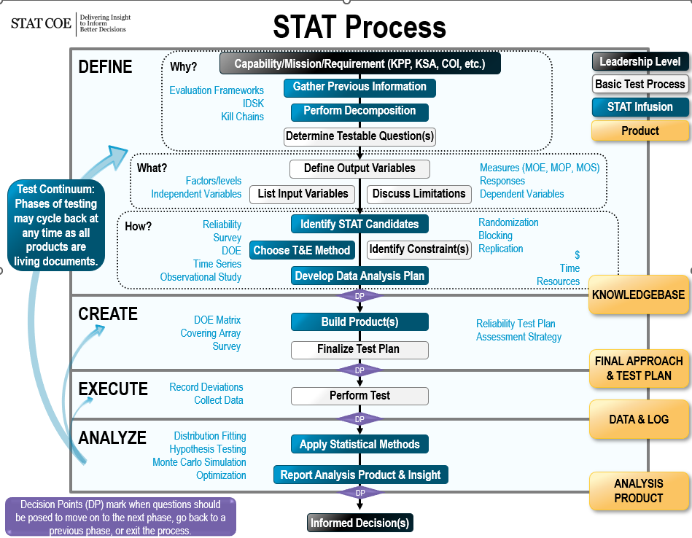
STAT Process: Building a DOE
STAT is picking the right SET of tools to create solutions
  Cluster analysis used to find similar weather and background patterns
  Stratified random sample used to select factor levels
  Hybrid design used to combine the factors
  Appropriate evaluation metrics for the analysis
STAT takes actions
  Ask what is needed for the decision
  Find the right solution(s)
  Be flexible and informative
STAT ensures a successful test, not a successful SUT
Notes:
This was not the only solution for the test scenario, but it was the one that no one disliked that provided the analysis product the test team needed.

Slide 64
Summary
Design of Experiments (DOE) is used to better understand the performance of a system, algorithm or process in terms of its input space
Use of continuous data leads to better precision and stronger insights
Confidence and Power (Type I and Type II error respectively) trade against each other, sample size, uncertainty, precision, and effect size
Randomization protects the analysis from lurking variables, even with modeling and simulation

Slide 65
Sources
Jensen, W.A. Statistics = Analytics? Quality Engineering Vol 32, No 2, 133-144.
https://www.jmp.com/content/dam/jmp/documents/en/support/jmp152/multivariate-methods.pdf
https://support.sas.com/kb/22/addl/fusion_22540_1_a108_5903.pdf
De Gryze, S., Langhans, I., & Vandebroek, M. (2007). Using the correct intervals for prediction: A tutorial on tolerance intervals for ordinary least-squares regression. Chemometrics and Intelligent Laboratory Systems, 87(2), 147–154. https://doi.org/10.1016/j.chemolab.2007.03.002

Slide 67
BACKUP

Slide 68
Calculation of FDS
Prediction variance is a function of the design and planned model
X is the model matrix
  First column is all 1’s to represent the intercept term
  The next k columns are for the main effects and match the test matrix
  The remaining columns expand to cover the model encompassing the combinations of interactions and curvature terms of the planned model
  Number of columns match the p parameters in the model
  including the intercept
x is a vector expanded the same way as the model matrix
  Sometimes called point vector/matrix

Slide 69
Expanding X
Row
1
2
3
4
5
6
7
8
Intercept
1
1
1
1
1
1
1
1
X1 | X2
1 | -1
-1 | -1
-1 | 1
1 | 1
0 | 1
0 | 0
1 | 1
-1 | 0
X1*X2
-1
1
-1
1
0
0
1
0
X1*X1 | X2*X2
1 | 1
1 | 1
1 | 1
1 | 1
0 | 1
0 | 0
1 | 1
1 | 0
k = 2
p = 6
n=16*
*8 rows not shown
Actual test matrix is 16 rows

Slide 70
FDS Mathematical Details
Prediction Variance, v = σ² * x’ (X’X)⁻¹ x for a particular x
The x’ (X’X)⁻¹ x part is the geometric multiplier (hat matrix)
x near the center have a lower multiplier than x near the edge
Margin of Error = t * sqrt(v)
You supply the maximum acceptable margin of error (δ), confidence level for t, degrees of freedom for t comes from the design and model

Slide 71
Intervals and Thresholds
If thresholds need to be outside the interval
The test threshold must be > T + Sigma * Interval multiplier
– OR –
If the interval contains the threshold, the predictions from the model is not significantly different than threshold

Slide 72
FDS Cross Hair Interval Type
Tolerance is used to compare to requirements
Confidence is for comparing averages
Difference is used to check for stability
  Similar to power
These choices change the FDS curve’s shape and location
JMP produces a confidence based FDS curve

Slide 73
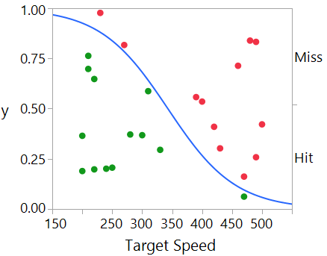
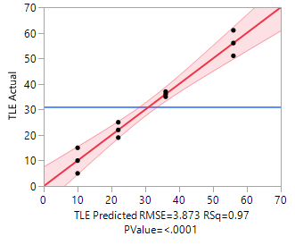
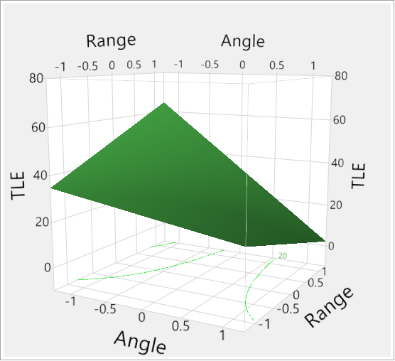
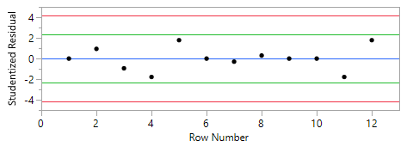


Logistic vs. Linear Regression
Linear Regression
Logistic Regression
$$y=β_{0}+β_{1}x_{1}+β_{2}x_{2}+β_{12}x_{1}x_{2}+ε$$
Term | β Est | Std Err | SNR | p-value
Intercept | 31 | 1.12 | 27.73 | <.0001
Angle | -15 | 1.12 | -13.42 | <.0001
Range | 2 | 1.12 | 1.79 | 0.1114
Angle* Range | -8 | 1.12 | -7.16 | <.0001
Both support characterization, modeling, significance tests, and inference

Slide 74
Logistic vs. Linear Regression
Logistic Regression
Linear Regression
Use with categorical responses
Produces confusion matrix and broad confidence intervals
Allows prediction of likelihood of being in a particular state
Coarse-grained analysis
Takes more data to reduce risk
Use with continuous responses
Produces regression equation and surface map
Allows prediction of specific response values based on expected factor levels
More informative analysis
Gives less risk for the same data
When possible, use continuous responses to support linear regression

