Slide 1
DATAWorks 2022 ATEC AI Challenge
MAJ David Niblick
ATEC Solutions to ATEC Problems with ATEC Data!

Slide 2
Agenda
Purpose
Format
Problem and Data
Metrics
Challenges
Solution
Deployment

Slide 3

Deployable Tool
Education
TE of AI
Ends
Ways
Accessible
Flexible
Problem Oriented
ATEC Solutions to ATEC Problems with ATEC Data!

Slide 4
Challenge Format
Accessible
Flexible
Problem Oriented
ATEC Data Mesh, AzureML Studio
Starter Templates
Microsoft SME Support
Asynchronous Execution

Slide 5
Problem and Data
Aberdeen Test Center (ATC)
Body Armor Lot Acceptance
Defect Detection in Xrays

Slide 6

Choosing the Right Metric
F-Beta Score balances precision (too many false positives) vs recall (missed defects).
Higher Beta = fewer missed defects, but more forgiving for false positives
For Challenge, we chose Beta = 5 to skew heavily towards catching every defect

Slide 7
Challenge Challenges
Data Mesh Early Adopter Tax
CAR Accounts
The Golden Ticket
Network Configurations
IP Addresses for EVERYTHING
User Permissions
AzureGov vs AzureCommercial
Challenge Format
Starting Template Issues
“Problem Oriented” Pillar Crumbles…
Data / Code Access
Open source is good, right?
Version Control
STOP EDITING FILES AT ROOT!
Compute and Endpoint Quotas
Read the fine print
Communication
One way street! The missing pillar?
Never Underestimate Admin Overhead

Slide 8
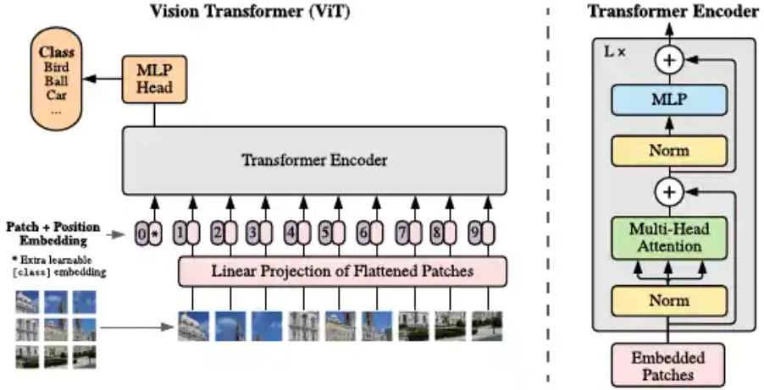

Winning Solution
Winning Team: ATC, F5=0.86
Pretrained Vision Transformer (VitBasePatch16_224)
Techniques
Trained custom MLP on pretrained encoder, then fine-tuned entire model
Image Preprocessing
Blend background and armor pixels
Smoothing
Hyperparameter optimization
Training Data Augmentation
Noise
Occlusions
Hot spots
Affine transforms

Slide 9
Deployment and Outcomes
Currently spend 80hr/mo. finding defects
Goal – reduce workload to 20hr/mo. without loss of accuracy (focus on False Negative Rate)
No current estimate on human accuracy – will conduct Gage Repeatability and Reproducibility
Transition Patch-Based Solution to Full Images
Integrate Into User Workflow
Refine for User Needs
Test and Maintain Process

