Slide 1
April 17, 2024
Andrei Gribok
Distinguished Scientist
Jet Propulsion Laboratory
California Institute of Technology
Regularization Approach to Learning Bioburden Density for Planetary Protection
Andrei Gribokª, Mike DiNicola^{b} ,and Lisa Guan^{b}
ª Idaho National Laboratory, Idaho Falls, ID, USA
^{b} Jet Propulsion Laboratory, California Institute of Technology, Pasadena, CA, USA
The Defense and Aerospace Test and Analysis (DATA) Workshop,
IDA's Potomac Yard Location, Alexandria, VA, 22305, April 16-18, 2024

Slide 2


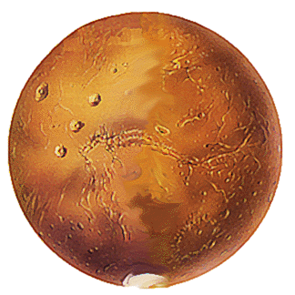
What is Planetary Protection?
Planetary protection (PP) aims to:
  Protect other worlds from microorganisms found on Earth.
  Prevent both forward and backward contamination.
PP requirements per NASA Procedural Requirements 8020.12D:
For category IV missions to Mars:
  ≤5×10⁵ total spores (colony forming unit [CFU]) at launch
  ≤3×10⁵ total spores on the planned landing hardware
  ≤300 spores/m² on exposed surfaces.
For the outer planets:
  Inadvertent contamination of an ocean or other liquid water body is kept at a probability of less than 1 x 10⁻⁴ per mission.
Monitoring and/or verification of biological cleanliness is conducted using direct wipe and swab samples extracted and processed via a cultivation-based technique (NASA standard assay) that measures heat-tolerant organisms.
The total number of spores/CFUs at launch is a parameter in PP probabilistic models.
Forward Contamination
Mars
Backward Contamination
Why?
  How can we look for life on other planets if we bring our own?
  Prevent non-terrestrial biocontamination of Earth.
  Meet NASA planetary protection requirements for launch approval.
  Comply with international treaty obligations.

Slide 3
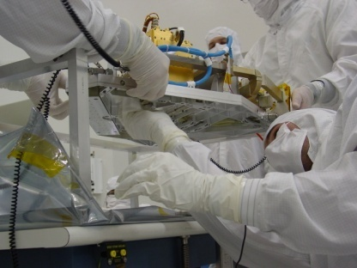

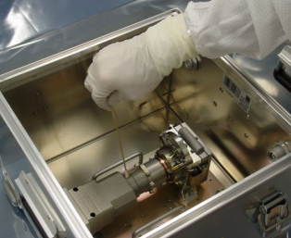
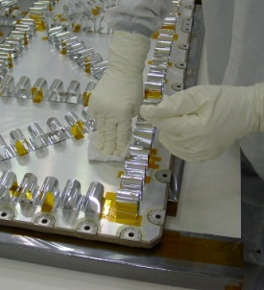

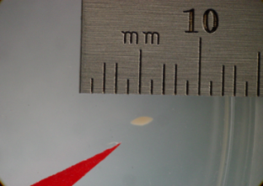
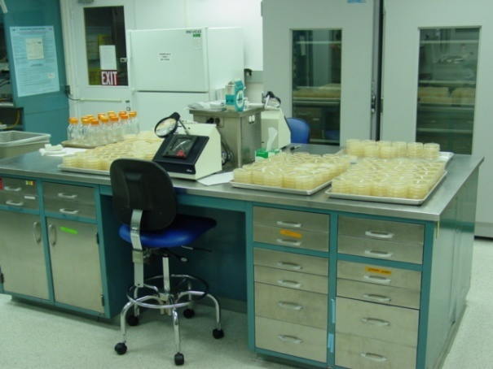


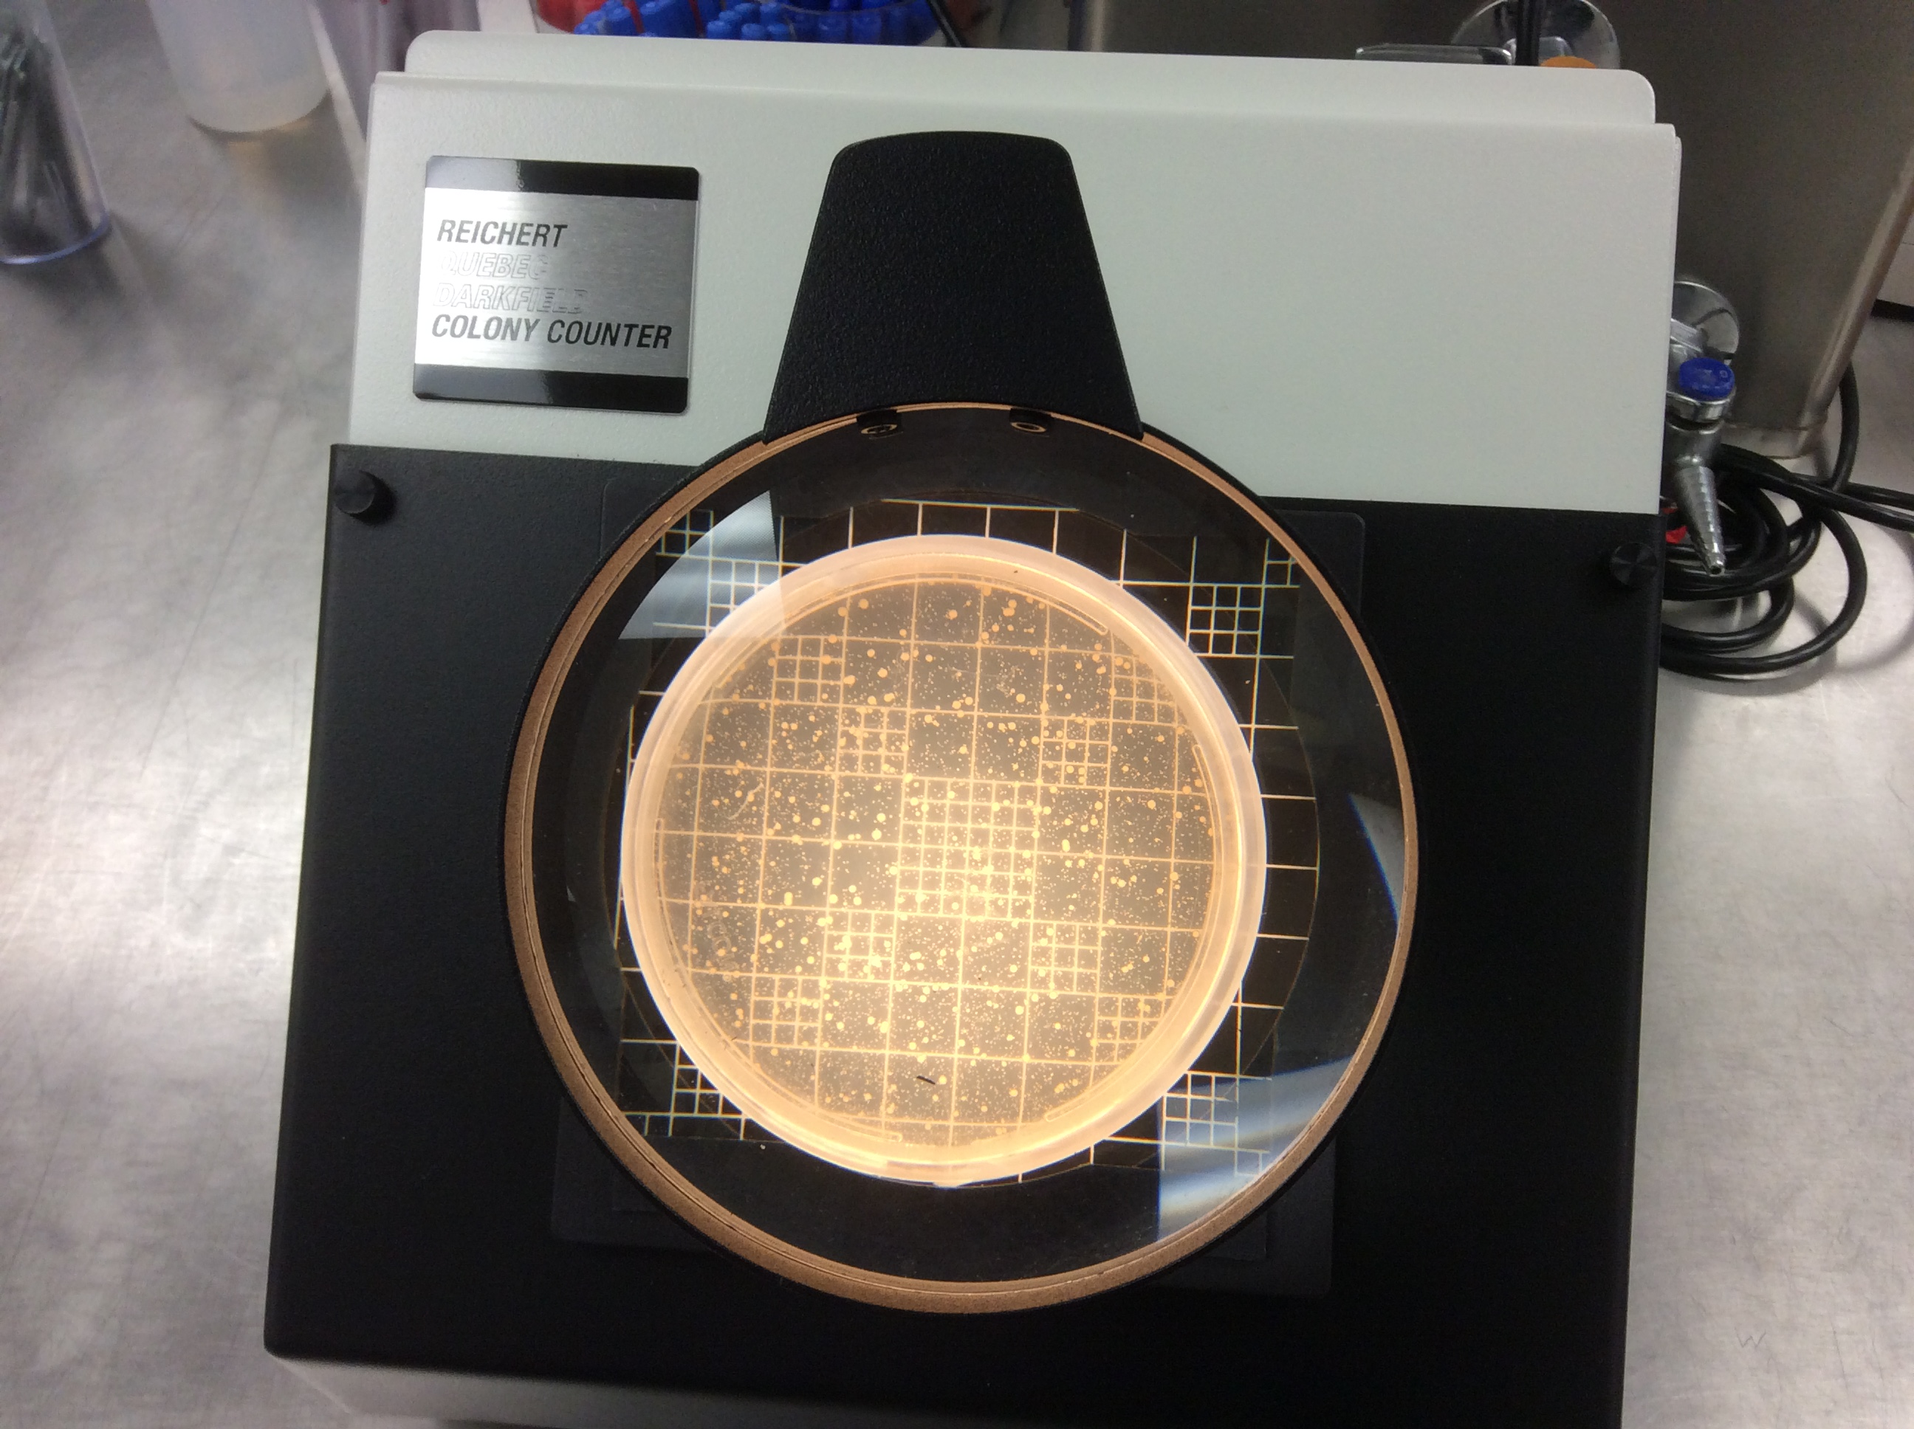
Planetary Protection Biological Cleanliness
Verification Sampling
Swabs sampled a 0.0025 m² surface area maximum.
Wipes sampled up to a 1.0 m² surface area.
Due to the experimental procedure, the swabs assume a pour fraction of 0.8 and the wipes 0.25, representing the portion of the total sample solution plated and analyzed for CFU counts.
Exposure is the sampled area multiplied by the pour fraction (i.e., for swabs it would be E= 0.0025 m² ∙0.8=0.002 m²).
Clean hardware (and table or bag) with a solvent wipe prior to sampling or installation
Sample with swab or wipe
(water is used as the solvent)
Count plates – 24 h, 48 h, and 72 h
Process swabs and wipes,
up to 24 hours required post-assay
Spore/CFU, a heat-tolerant reproductive cell capable of developing into a new individual without fusion with another reproductive cell.

Slide 4
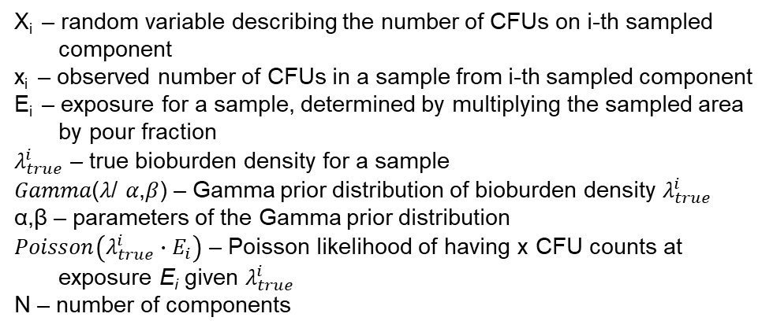
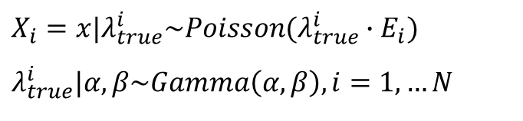

Data Generating Model and Parameter Estimators
$$X_{i}=x|λ_{true}^{i}\sim Poisson(λ_{true}^{i}∙E_{i})$$
$$λ_{true}^{i}|α,β\sim Gamma\left(α,β\right),i=1,…N$$
Component 261 Sample No. | CFUs Observed | Area Sampled, m² | Pour Fraction | Exposure, m²
1 | 1 | 0.0025 | 0.8 | 0.0020
2 | 0 | 0.0025 | 0.8 | 0.0020
3 | 0 | 0.0025 | 0.8 | 0.0020
4 | 0 | 0.0025 | 0.8 | 0.0020
5 | 0 | 0.0025 | 0.8 | 0.0020
6 | 0 | 0.0025 | 0.8 | 0.0020
7 | 0 | 0.0025 | 0.8 | 0.0020
8 | 0 | 0.0025 | 0.8 | 0.0020
9 | 0 | 0.0025 | 0.8 | 0.0020
10 | 0 | 0.0025 | 0.8 | 0.0020
11 | 0 | 0.0025 | 0.8 | 0.0020
12 | 0 | 0.0025 | 0.8 | 0.0020
13 | 0 | 0.0025 | 0.8 | 0.0020
14 | 0 | 0.0025 | 0.8 | 0.0020
15 | 0 | 0.0025 | 0.8 | 0.0020
16 | 0 | 0.0025 | 0.8 | 0.0020
17 | 0 | 0.0025 | 0.8 | 0.0020
18 | 0 | 0.0025 | 0.8 | 0.0020
19 | 0 | 0.0025 | 0.8 | 0.0020
20 | 6 | 0.0025 | 0.8 | 0.0020
21 | 8 | 0.0025 | 0.8 | 0.0020
22 | 10 | 0.0025 | 0.8 | 0.0020
23 | 10 | 0.0025 | 0.8 | 0.0020
24 | 14 | 0.0025 | 0.8 | 0.0020
Total | 52 | 0.0600 | 0.8 | 0.0480
$\hat{λ_{i}}\left(x_{i}\right)=\frac{x_{i}}{E_{i}}$ – Maximum Likelihood Estimator (MLE)
$\hat{λ_{i}}\left(x_{i}\right)=\frac{x_{i}+α}{E_{i}+β}$ – Conjugate prior Bayes Estimator
$\hat{λ_{i}}=d$ – Deterministic Estimator
X_{i} – random variable describing the number of CFUs on i-th sampled component
x_{i} – observed number of CFUs in a sample from i-th sampled component
E_{i} – exposure for a sample, determined by multiplying the sampled area by pour fraction
$λ_{true}^{i}$ – true bioburden density for a sample
𝐺𝑎𝑚𝑚𝑎(𝜆/ 𝛼,𝛽) – Gamma prior distribution of bioburden density $λ_{true}^{i}$
α,β – parameters of the Gamma prior distribution
$Poisson\left(λ_{true}^{i}∙E_{i}\right)$ – Poisson likelihood of having x CFU counts at exposure E_{i} given $λ_{true}^{i}$
N – number of components

Slide 5
Learning from Noisy Data
In 1923, the French mathematician Hadamard introduced the notion of well-posed problems.
According to Hadamard, a problem is called well-posed iff:
A solution to the problem exists (existence).
This solution is unique (uniqueness).
This unique solution is stable under small perturbations in the data, in other words small perturbations in the data should cause small perturbations in the solution (stability).

Slide 6
Learning from Noisy Data

Slide 7
Learning from Noisy Data

Slide 8
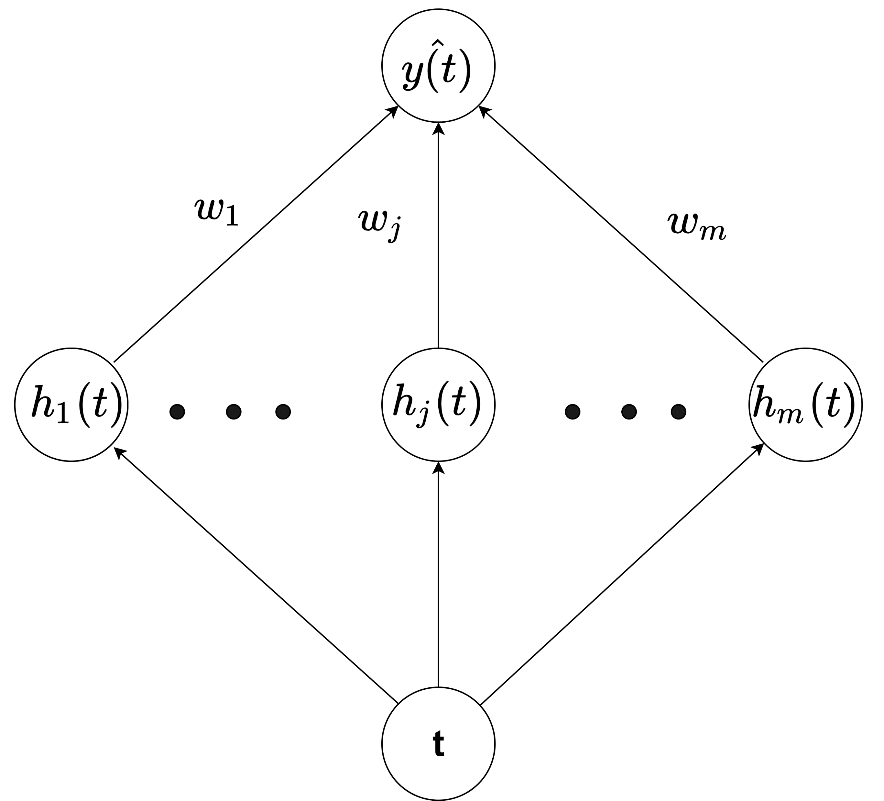

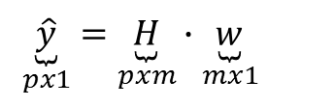
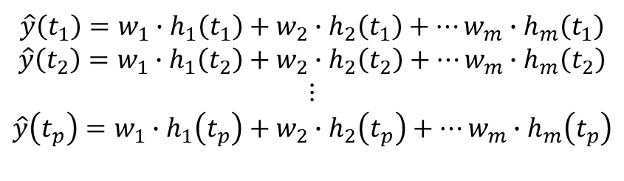
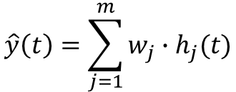
Radial Basis Function Network and Regularization
$$\hat{y}\left(t_{1}\right)=w_{1}∙h_{1}\left(t_{1}\right)+w_{2}∙h_{2}\left(t_{1}\right)+…w_{m}∙h_{m}\left(t_{1}\right)$$
$$\hat{y}\left(t_{2}\right)=w_{1}∙h_{1}\left(t_{2}\right)+w_{2}∙h_{2}\left(t_{2}\right)+…w_{m}∙h_{m}\left(t_{2}\right)$$
$$⋮$$
$$\hat{y}\left(t_{p}\right)=w_{1}∙h_{1}\left(t_{p}\right)+w_{2}∙h_{2}\left(t_{p}\right)+…w_{m}∙h_{m}\left(t_{p}\right)$$
$$\hat{y}\left(t\right)=\sum_{j=1}^{m}{w_{j}∙h_{j}(t)}$$
$$\underset{px1}{\underbrace{\hat{y}}}=\underset{pxm}{\underbrace{H}}∙\underset{mx1}{\underbrace{w}}$$
$$h\left(t\right)=e^{\left(−\frac{{\left(t−c\right)}^{2}}{r^{2}}\right)}$$

Slide 9
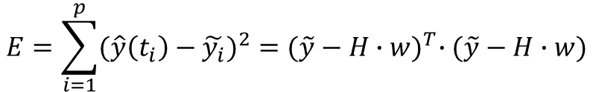


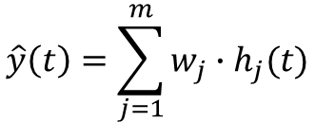
Ordinary Least Squares
$$E=\sum_{i=1}^{p}{{(\hat{y}\left(t_{i}\right)−\tilde{y_{i}})}^{2}}={(\tilde{y}−H∙w)}^{T}∙(\tilde{y}−H∙w)$$
$$w={(H^{T}∙H)}^{−1}H^{T}∙\tilde{y}$$
$$\hat{y}\left(t\right)=\sum_{j=1}^{m}{w_{j}∙h_{j}(t)}$$
$${\left\{(t_{i},\tilde{y_{i}})\right\}}_{i=1}^{p}$$

Slide 10
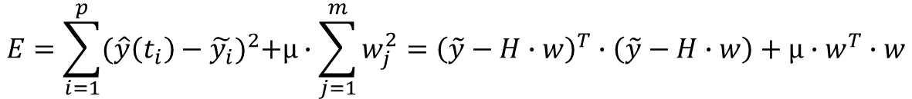
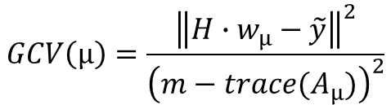



Regularized Least Squares and
Generalized Cross-Validation (GCV)
$$E=\sum_{i=1}^{p}{{(\hat{y}\left(t_{i}\right)−\tilde{y_{i}})}^{2}+μ}∙\sum_{j=1}^{m}{w_{j}^{2}}={\left(\tilde{y}−H∙w\right)}^{T}∙\left(\tilde{y}−H∙w\right)+μ∙w^{T}∙w$$
$$w_{μ}={(H^{T}∙H+μ∙I_{m})}^{−1}H^{T}∙\tilde{y}$$
$$\underset{px1}{\underbrace{\hat{y}}}=\underset{pxm}{\underbrace{H}}∙\underset{mx1}{\underbrace{{\left(H^{T}∙H+μ∙I\right)}^{−1}H^{T}∙\tilde{y}}}=A_{μ}∙\tilde{y}$$
$${A_{μ}=H∙(H^{T}∙H+μ∙I)}^{−1}H^{T}$$
$$GCV\left(μ\right)=\frac{{\left\|H∙w_{μ}−\tilde{y}\right\|}^{2}}{{\left(m−trace(A_{μ})\right)}^{2}}$$

Slide 11

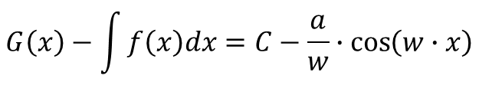
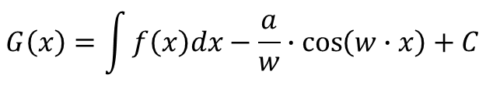


The Problem of Differentiation
$$g\left(x\right)=f\left(x\right)+a∙\sin\left(ω∙x\right);g′\left(x\right)=f′\left(x\right)+ω∙a∙\cos\left(ω∙x\right)$$
$$g^{′}\left(x\right)−f^{′}(x)=ω∙a∙\cos\left(ω∙x\right)$$
$$G\left(x\right)=\int{f\left(x\right)dx−\frac{a}{w}∙\cos\left(w∙x\right)+C}$$
$$G\left(x\right)−\int{f\left(x\right)dx=C−\frac{a}{w}∙\cos\left(w∙x\right)}$$
$$F\left(x\right)+ε=\int_{0}^{x}{F^{′}\left(t\right)dt, F\left(0\right)=0}$$
$\frac{d[F\left(x\right)+ε]}{dx}=\frac{d}{dx}\int_{0}^{x}{F^{′}\left(t\right)dt=F′(x)}$ $+\frac{dε}{dx}$
Notes:
Finding derivative requires solving an integral equation
Solving an integral equation requires differentiation
High-frequency noise is amplified preferentially
Difference between derivatives is diverging

Slide 12
Naïve Differentiation of the Sampled Data
$$y\left(t\right)=t+0.3∙\sin\left(2π∙t\right)+ε; \overline{ε}=0,σ_{ε}=0.05;σ_{Residuals}=3.6;\frac{σ_{Residuals}}{σ_{ε}}=72$$
$$y^{′}\left(t_{1}\right)=\frac{y\left(t_{2}\right)−{y(t}_{1})}{t_{2}−t_{1}},y^{′}\left(t_{2}\right)=\frac{y\left(t_{3}\right)−{y(t}_{2})}{t_{3}−t_{2}},…,y^{′}\left(t_{n−1}\right)=\frac{y\left(t_{n}\right)−{y(t}_{n−1})}{t_{n}−t_{n−1}}$$
Notes:
Forward differencing

Slide 13
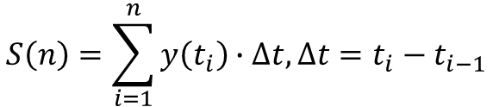
Integration of the Noisy Data
$$y\left(t\right)=t+0.3∙\sin\left(2π∙t\right)+ε; \overline{ε}=0,σ_{ε}=0.05;σ_{Residuals}=0.004;\frac{σ_{Residuals}}{σ_{ε}}=0.08$$
$$S\left(n\right)=\sum_{i=1}^{n}{y\left(t_{i}\right)∙∆t, ∆t=t_{i}−t_{i−1}}$$
$$S\left(1\right)=y\left(t_{1}\right)∙∆t;S\left(2\right)=\left[y\left(t_{1}\right)+y\left(t_{2}\right)\right]∙∆t;S\left(n\right)=[y\left(t_{1}\right)+y\left(t_{2}\right)+…+y\left(t_{n}\right)]∙∆t$$
Notes:
The noise in the integral is about 12.5 times less than in the original function
Right rule Riemann sum

Slide 14



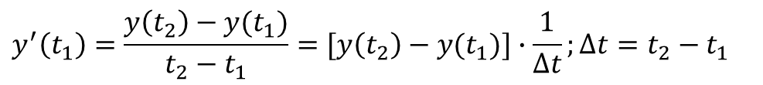
Frequency Response of Integration and Differentiation
$$y^{′}\left(t_{1}\right)=\frac{y\left(t_{2}\right)−{y(t}_{1})}{t_{2}−t_{1}}=[y\left(t_{2}\right)−{y(t}_{1})]∙\frac{1}{∆t};∆t=t_{2}−t_{1}$$
$$h_{diff}=\left[1 −1\right],∆t=1$$
$$S=\left[y\left(t_{1}\right)+y\left(t_{2}\right)\right]∙∆t$$
$$h_{int}=[1 1],∆t=1$$
Amplitude response is the absolute value of the Fourier transform of the filter’s coefficients (impulse response).
Notes:
Differentiation is a high-pass filter
Integration is a low-pass filter

Slide 15
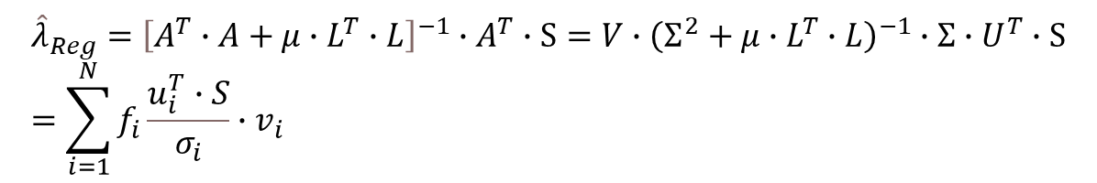


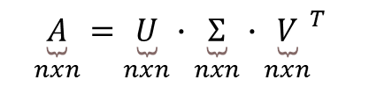
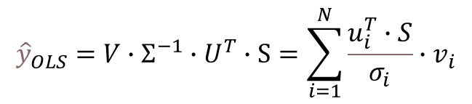
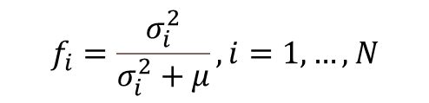
Regularized vs Naïve Derivatives
$$\underset{nxn}{\underbrace{A}}=\underset{nxn}{\underbrace{U}}∙\underset{nxn}{\underbrace{Σ}}∙{\underset{nxn}{\underbrace{V}}}^{T}$$
$${\left\|S−A∙y\right\|}^{2}→min$$
$${\hat{y}}_{OLS}=V∙Σ^{−1}∙U^{T}∙S=\sum_{i=1}^{N}{\frac{u_{i}^{T}∙S}{σ_{i}}∙v_{i}}$$
$${\left\|S−A∙y\right\|}^{2}+λ∙{\left\|L∙\hat{y}\right\|}^{2}→min$$
$${\hat{λ}}_{Reg}={\left[A^{T}∙A+μ∙L^{T}∙L\right]}^{−1}∙A^{T}∙S=V∙{\left(Σ^{2}+μ∙L^{T}∙L\right)}^{−1}∙Σ∙U^{T}∙S=\sum_{i=1}^{N}{f_{i}\frac{u_{i}^{T}∙S}{σ_{i}}∙v_{i}}$$
$$f_{i}=\frac{σ_{i}^{2}}{σ_{i}^{2}+μ},i=1,…,N$$

Slide 16
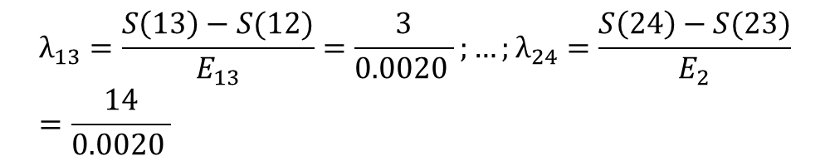

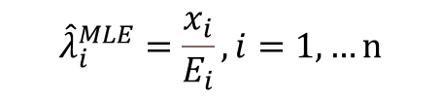

Regularized Differentiation for Bioburden
Density Estimation
Component 261 Sample No. | CFUs Observed | Area Sampled, m² | Pour Fraction | Exposure, m² | Cumulative CFU Count, S
0 |  |  |  |  | 0
1 | 1 | 0.0025 | 0.8 | 0.0020 | 1
2 | 0 | 0.0025 | 0.8 | 0.0020 | 1
3 | 0 | 0.0025 | 0.8 | 0.0020 | 1
4 | 0 | 0.0025 | 0.8 | 0.0020 | 1
5 | 0 | 0.0025 | 0.8 | 0.0020 | 1
6 | 0 | 0.0025 | 0.8 | 0.0020 | 1
7 | 0 | 0.0025 | 0.8 | 0.0020 | 1
8 | 0 | 0.0025 | 0.8 | 0.0020 | 1
9 | 0 | 0.0025 | 0.8 | 0.0020 | 1
10 | 0 | 0.0025 | 0.8 | 0.0020 | 1
11 | 0 | 0.0025 | 0.8 | 0.0020 | 1
12 | 0 | 0.0025 | 0.8 | 0.0020 | 1
13 | 0 | 0.0025 | 0.8 | 0.0020 | 4
14 | 0 | 0.0025 | 0.8 | 0.0020 | 4
15 | 0 | 0.0025 | 0.8 | 0.0020 | 4
16 | 0 | 0.0025 | 0.8 | 0.0020 | 4
17 | 0 | 0.0025 | 0.8 | 0.0020 | 4
18 | 0 | 0.0025 | 0.8 | 0.0020 | 4
19 | 0 | 0.0025 | 0.8 | 0.0020 | 4
20 | 6 | 0.0025 | 0.8 | 0.0020 | 10
21 | 8 | 0.0025 | 0.8 | 0.0020 | 18
22 | 10 | 0.0025 | 0.8 | 0.0020 | 28
23 | 10 | 0.0025 | 0.8 | 0.0020 | 38
24 | 14 | 0.0025 | 0.8 | 0.0020 | 52
Total | 52 | 0.0600 | 0.8 | 0.0480 | -
$${\left\|S−A∙y\right\|}^{2}+μ∙{\left\|L∙\hat{y}\right\|}^{2}→min$$
$${\hat{λ}}_{i}^{MLE}=\frac{x_{i}}{E_{i}}, i=1,…n$$
$$λ_{1}=\frac{S\left(1\right)−S(0)}{E_{1}}=\frac{1}{0.0020 };λ_{2}=\frac{S\left(2\right)−S(1)}{E_{2}}=\frac{0}{0.0020 }$$
$$λ_{13}=\frac{S\left(13\right)−S(12)}{E_{13}}=\frac{3}{0.0020 };{…;λ}_{24}=\frac{S\left(24\right)−S(23)}{E_{2}}=\frac{14}{0.0020 }$$
Notes:
There is noise in CFU count and in cumulative CFU count
The MLE of lambda is a naïve differentiation of the cumulative CFU count

Slide 17



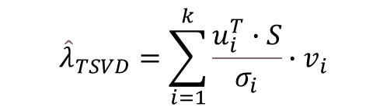
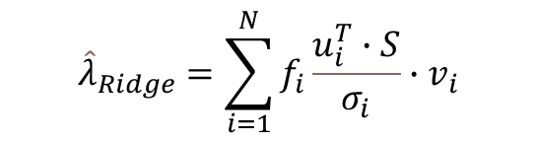
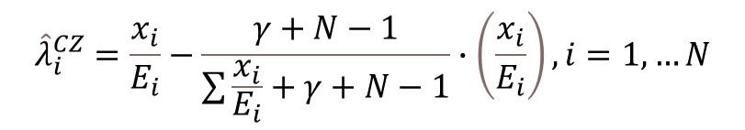
Simulated Data
$\hat{λ_{i}}\left(x_{i}\right)=\frac{x_{i}}{E_{i}}$
$\hat{λ_{i}}\left(x_{i}\right)=\frac{x_{i}+0.5}{E_{i}}$
$${\hat{λ}}_{TSVD}=\sum_{i=1}^{k}{\frac{u_{i}^{T}∙S}{σ_{i}}∙v_{i}}$$
$\hat{λ_{i}}\left(x_{i}\right)=\frac{x_{i}+α_{MOM}}{E_{i}+β_{MOM}}$
$${\hat{λ}}_{i}^{CZ}=\frac{x_{i}}{E_{i}}−\frac{γ+N−1}{\sum{\frac{x_{i}}{E_{i}}+γ+N−1}}∙\left(\frac{x_{i}}{E_{i}}\right), i=1,…N$$
$${\hat{λ}}_{Ridge}=\sum_{i=1}^{N}{f_{i}\frac{u_{i}^{T}∙S}{σ_{i}}∙v_{i}}$$
$P\left(X=x | λ_{true}\right)=\frac{{\left(λ_{true}∙E\right)}^{x}}{x!}e^{−λ_{true}∙E},x=0,1,2,…{,λ}_{true}∈\left(0,∞\right),$ E$∈(0,∞)$
$$Gamma\left(λ_{true} | α=1.8,β=0.001\right),\hat{λ}=179.5$$

Slide 18
Component 261

Slide 19
Conclusions
MLE of bioburden density is a naïve derivative of CFUs cumulative count.
There are two sources of noise: sampling noise and differentiation noise
Regularized differentiation prevents differentiation noise amplification
Regularized differentiation does not make any assumptions about sampling noise
The variance of the sampling noise is a very important variable for selection of the regularization parameter and can be obtained from sampling efficiency studies
The regularized differentiation approach integrates estimation and noise filtering into a single framework which may produce a better bioburden density estimate
Regularized least squares does not work if ALL CFU data are zeros.

Slide 20
Acknowledgements
This work was supported by U.S. DOE-NASA Strategic Partnership Project (SPP) #19701.
The authors are grateful to Dr. J. Nick Benardini and Dr. Elaine E. Seasly for their contribution to this project.

Slide 22



Integration vs Differentiation
$$f^{′}\left(x\right)=\lim_{x→a}{\frac{f\left(x\right)−f(a)}{x−a}=\lim_{h→0}{\frac{f\left(a+h\right)−f(a)}{h}}}$$
$$F\left(x\right)=\int_{0}^{x}{F^{′}\left(t\right)dt, F\left(0\right)=0}$$
$$\frac{dF\left(x\right)}{dx}=\frac{d}{dx}\int_{0}^{x}{F^{′}\left(t\right)dt=F′(x)}$$

Slide 23

Naïve Differentiation of the Sampled Data
$t_{1},t_{2},t_{3}…{,t}_{n−1},t_{n};∆t=t_{n}−t_{n−1}$
$${y(t}_{1}),y(t_{2}),y(t_{3})…{,y(t}_{n−1}),y(t_{n})$$
$$y^{′}\left(t_{1}\right)=\frac{y\left(t_{2}\right)−{y(t}_{1})}{t_{2}−t_{1}},y^{′}\left(t_{2}\right)=\frac{y\left(t_{3}\right)−{y(t}_{2})}{t_{3}−t_{2}},…,y^{′}\left(t_{n−1}\right)=\frac{y\left(t_{n}\right)−{y(t}_{n−1})}{t_{n}−t_{n−1}}$$

Slide 24

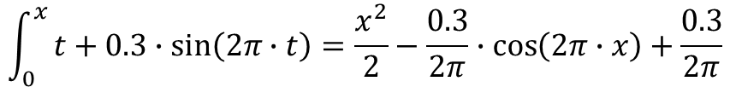

Naïve Differentiation of the Sampled Data
$$y\left(t\right)=t+0.3∙sin⁡(2π∙t)$$
$$y′\left(t\right)=1+0.3∙2π∙cos⁡(2π∙t)$$
$$\int_{0}^{x}{t+0.3∙\sin\left(2π∙t\right)=\frac{x^{2}}{2}−\frac{0.3}{2π}}∙\cos\left(2π∙x\right)+\frac{0.3}{2π}$$

Slide 25


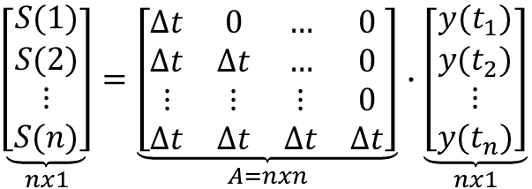

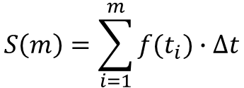


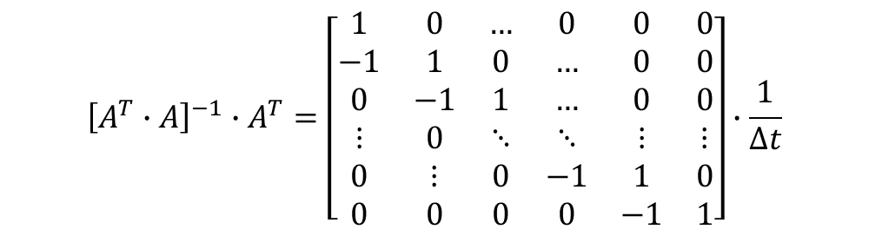


Integration and Differentiation in Matrix Form
$t_{1},t_{2},t_{3}…{,t}_{n−1},t_{n};∆t=t_{n}−t_{n−1}$
$$\hat{y}={\left[A^{T}∙A\right]}^{−1}∙A^{T}∙S$$
$${y(t}_{1}),y(t_{2}),y(t_{3})…{,y(t}_{n−1}),y(t_{n})$$
$$m=1,2,…n$$
$${\left[A^{T}∙A\right]}^{−1}∙A^{T}=\left[\begin{matrix}1 & 0 & … & 0 & 0 & 0 \\ −1 & 1 & 0 & … & 0 & 0 \\ 0 & −1 & 1 & … & 0 & 0 \\ ⋮ & 0 & ⋱ & ⋱ & ⋮ & ⋮ \\ 0 & ⋮ & 0 & −1 & 1 & 0 \\ 0 & 0 & 0 & 0 & −1 & 1\end{matrix}\right]∙\frac{1}{∆t}$$
$$S\left(m\right)=\sum_{i=1}^{m}{f(t_{i})∙∆t}$$
$\underset{nx1}{\underbrace{\left[\begin{matrix}S(1) \\ S(2) \\ ⋮ \\ S(n)\end{matrix}\right]}}=\underset{A=nxn}{\underbrace{\left[\begin{matrix}∆t & 0 & … & 0 \\ ∆t & ∆t & … & 0 \\ ⋮ & ⋮ & ⋮ & 0 \\ ∆t & ∆t & ∆t & ∆t\end{matrix}\right]}}$ $∙\underset{nx1}{\underbrace{\left[\begin{matrix}{y(t}_{1}) \\ {y(t}_{2}) \\ ⋮ \\ {y(t}_{n})\end{matrix}\right]}}$
$$\frac{dF\left(x\right)}{dx}=\frac{d}{dx}\int_{0}^{x}{F^{′}\left(t\right)dt=F′(x)}$$
$$F\left(x\right)=\int_{0}^{x}{F^{′}\left(t\right)dt}$$
$${\left\|S−A∙y\right\|}^{2}+μ∙{\left\|L∙\hat{y}\right\|}^{2}→min$$

Slide 26

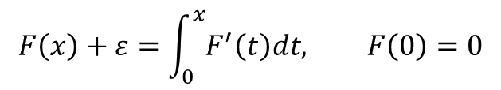
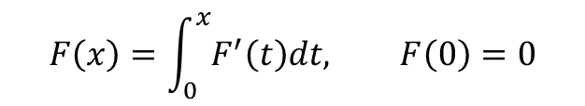
Naïve Differentiation of the Sampled Data
$$F\left(x\right)=\int_{0}^{x}{F^{′}\left(t\right)dt, F\left(0\right)=0}$$
$$\frac{d[F\left(x\right)+ε]}{dx}=\frac{d}{dx}\int_{0}^{x}{F^{′}\left(t\right)dt=F^{′}\left(x\right)+\frac{dε}{dx}}$$
$$F\left(x\right)+ε=\int_{0}^{x}{F^{′}\left(t\right)dt, F\left(0\right)=0}$$

