Slide 1
DATAWorks 2025
Multiple System Estimation:
Estimating Under-Reported Events From Multiple Data Sources
Greg Chesterton and Jim Rhoads
April 2025

Slide 2
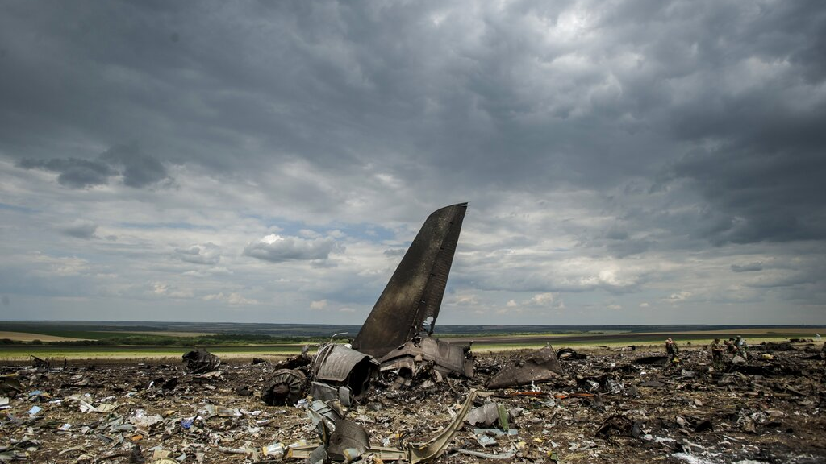
Image courtesy of Associated Press. Copyright 2014. All rights reserved.
1

Slide 3
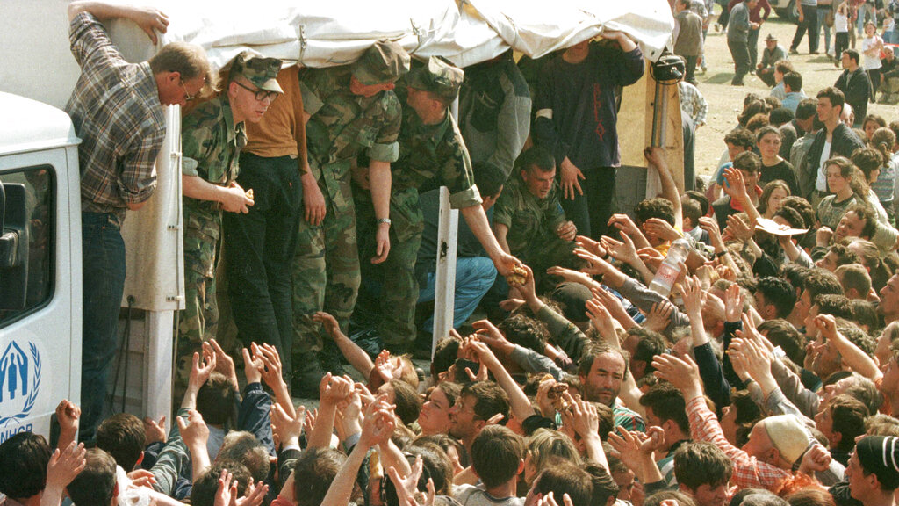
Prologue
Image courtesy of Associated Press. Copyright 2001. All rights reserved.
2

Slide 4



Suppose events of interest are recorded across multiple sources, and we need to estimate the total number of events.
A
B
C
N=493
N=297
N=65
How many total events actually occurred?
In other words, how many events were not recorded in any of the lists?

Slide 5
Each list has only partial information. What is the best estimate?
A
B
C
N=493
N=297
N=65
493 + 297 + 65 = 855. Is that a good estimate?
Suppose within these 855 we identify 688 unique events. Is that a good estimate?

Slide 6
Hard-to-find events may be recorded in one list and absent from others.
Total population of events of interest.
A
B
Event missing from all datasets.
Event recorded only in set B.
C
Event recorded in sets B and C but not in A.

Slide 7
To develop your intuition, consider two different outcomes.
Scenario 1
Scenario 2
List A
List B
List A
List B
286
500
783
732
999
286
500
783
732
999
594
715
460
812
974
513
239
386
165
704
Event ID numbers
Two independent lists have captured the same events.
Two independent lists have captured different events.
What does your intuition tell you about the number of missing events in these two separate scenarios?

Slide 8

Ecologists refer to “mark and recapture.”
Image courtesy of Associated Press. Copyright 2011. All rights reserved.
7

Slide 9

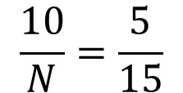
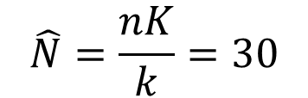
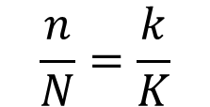
We can apply mark and recapture to estimate a fish population.
Capture 1
N?
Capture 2
n=10
K=15
$$\frac{n}{N}=\frac{k}{K}$$
$$\frac{10}{N}=\frac{5}{15}$$
k=5
$$\hat{N}=\frac{nK}{k}=30$$

Slide 10
With only two lists, a valid estimate requires very strong assumptions.
Closed system: For each list, N must refer to the same overall population.
Homogeneity: For each list, each individual has the same probability of being included (“captured”).
Independence: The probability that an individual is on list A does not affect the individual’s probability of being on list B (or vice versa).
Perfect matching: Each individual is correctly categorized as being within list A, list B, or both lists A and B.
Good news! These assumptions can be relaxed with a greater number of lists.

Slide 11
De-duplication and matching

Slide 12
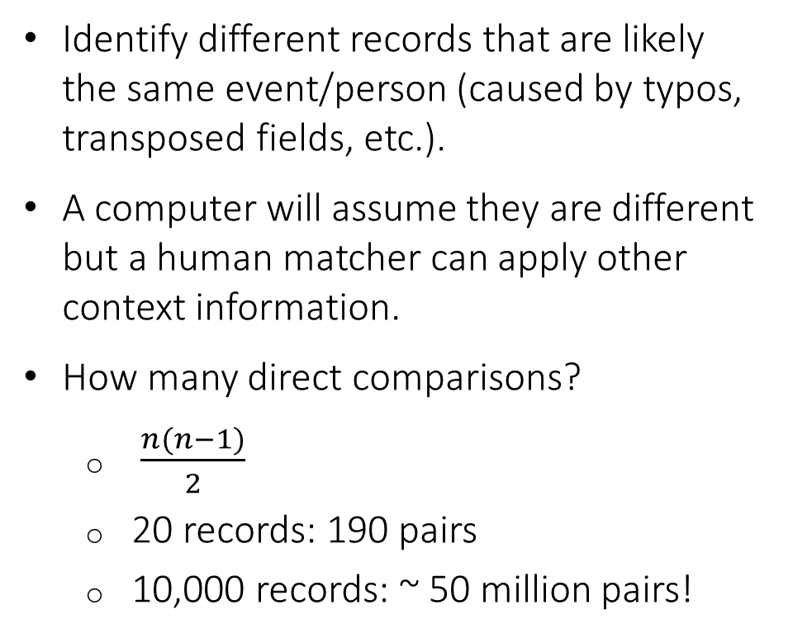
ID | First Name | Last Name | Birth Year | Sex
1 | John | Smith | 1970 | M
2 | Jane | Doe | 1985 | F
3 | Michael | Johnson | 1990 | M
4 | Emily | Davis | 1980 | F
5 | David | Brown | 1975 | M
6 | John | Smith | 1970 | M
7 | Jane | Doe | 1985 | F
8 | Sarah | Miller | 1992 | F
9 | Emily | Davies | 1980 | F
10 | Michael | Jonson | 1990 | M
11 | Sarah | Millar | 1992 | F
12 | David | Brown | 1976 | M
13 | Chris | Wilson | 1988 | M
14 | Christine | White | 1993 | F
15 | Michael | Johnson | 1990 | M
16 | Emily | Davis | 1980 | F
17 | Chris | Wilson | 1988 | M
18 | David | Braun | 1975 | M
19 | Sarah | Miller | 1992 | F
20 | Jennifer | Lee | 1990 | F
De-duplication and matching is a difficult problem.
Identify different records that are likely the same event/person (caused by typos, transposed fields, etc.).
A computer will assume they are different but a human matcher can apply other context information.
How many direct comparisons?
$\frac{n(n−1)}{2}$
20 records: 190 pairs
10,000 records: ~ 50 million pairs!
?

Slide 13
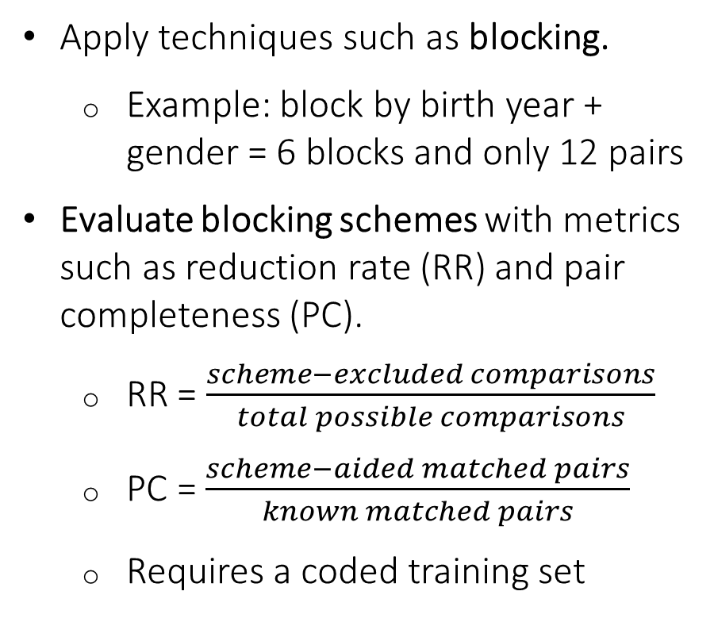
ID | First Name | Last Name | Birth Year | Sex
3 | Michael | Johnson | 1990 | M
10 | Michael | Jonson | 1990 | M
15 | Michael | Johnson | 1990 | M
Techniques make the problem tractable.
3 pairs
Apply techniques such as blocking.
Example: block by birth year + gender = 6 blocks and only 12 pairs
Evaluate blocking schemes with metrics such as reduction rate (RR) and pair completeness (PC).
RR = $\frac{scheme−excluded comparisons}{total possible comparisons}$
PC = $\frac{scheme−aided matched pairs}{known matched pairs}$
Requires a coded training set
4 | Emily | Davis | 1980 | F
9 | Emily | Davies | 1980 | F
16 | Emily | Davis | 1980 | F
3 pairs
8 | Sarah | Miller | 1992 | F
11 | Sarah | Millar | 1992 | F
19 | Sarah | Miller | 1992 | F
3 pairs
13 | Chris | Wilson | 1988 | M
17 | Chris | Wilson | 1988 | M
1 pair
2 | Jane | Doe | 1985 | F
7 | Jane | Doe | 1985 | F
1 pair
5 | David | Brown | 1975 | M
18 | David | Braun | 1975 | M
1 pair

Slide 14
The goal is to remove duplicate records within a set (de-duplicate) and link duplicate records across datasets (match).
ID | First Name | Last Name | Birth Year | Sex
1 | John | Smith | 1970 | M
2 | Jane | Doe | 1985 | F
3 | Michael | Johnson | 1990 | M
4 | Emily | Davis | 1980 | F
5 | David | Brown | 1975 | M
6 | Sarah | Miller | 1992 | F
7 | Emily | Davies | 1980 | F
8 | Michael | Jonson | 1990 | M
9 | Sarah | Millar | 1992 | F
10 | David | Brown | 1976 | M
11 | Chris | Wilson | 1988 | M
12 | Christine | White | 1993 | F
13 | David | Braun | 1975 | M
14 | Jennifer | Lee | 1990 | F
ID | First Name | Last Name | Birth Year | Sex
1 | Robert | Turner | 1972 | M
2 | Olivia | Harris | 1986 | F
3 | Daniel | Martinez | 1990 | M
4 | Megan | Cooper | 1982 | F
5 | Anthony | Clark | 1975 | M
6 | Emily | Davis | 1980 | F
7 | David | Brown | 1975 | M
8 | Michael | Johnson | 1990 | M
9 | Sarah | Miller | 1992 | F
10 | Chris | Wilson | 1988 | M
11 | Laura | Garcia | 1989 | F
12 | William | Adams | 1978 | M
13 | Michelle | Evans | 1991 | F
14 | Andrew | Thompson | 1983 | M
15 | Kevin | Moore | 1994 | M
16 | Jessica | Parker | 1987 | F
17 | Brian | White | 1979 | M
18 | Samantha | Lee | 1985 | F
19 | Ryan | Edwards | 1990 | M
20 | Nicole | Collins | 1993 | F

Slide 15


The inclusion history (or capture history) is a compact data form that records inclusion across multiple datasets.
B
ID | Age | Sex | Date | List A | List B | List C | History
… | … | … | … | … | … | …
451 | 32 | M | 1999 | 0 | 1 | 0 | 010
452 | 45 | M | 1995 | 1 | 1 | 0 | 110
453 | 30 | F | 1990 | 0 | 0 | 1 | 001
454 | M |  | 1991 | 1 | 1 | 0 | 110
… | … | … | … | … | … | …
A
454
451
452
453
???
C
One row per unique ID

Slide 16
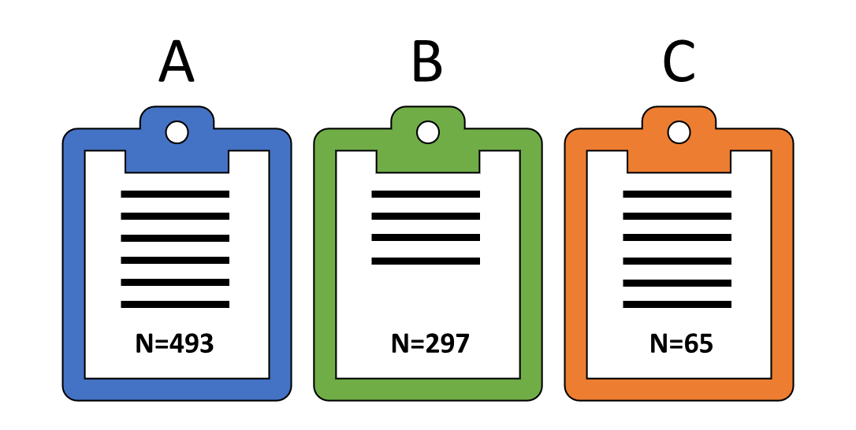
Inclusion histories can be aggregated into inclusion patterns.
Observation histories of 688 events
Aggregated by inclusion pattern
Event 1 found only in dataset A.
Unobservable number of records missed by each list.
Event 4 found only in datasets A and B.
13 records in pattern ‘011’ (in lists B and C, absent from list A).
…
…
23 records in pattern ‘111’ (present in each list).
688
688 observation histories
2³ − 1 = 7 observable inclusion patterns

Slide 17
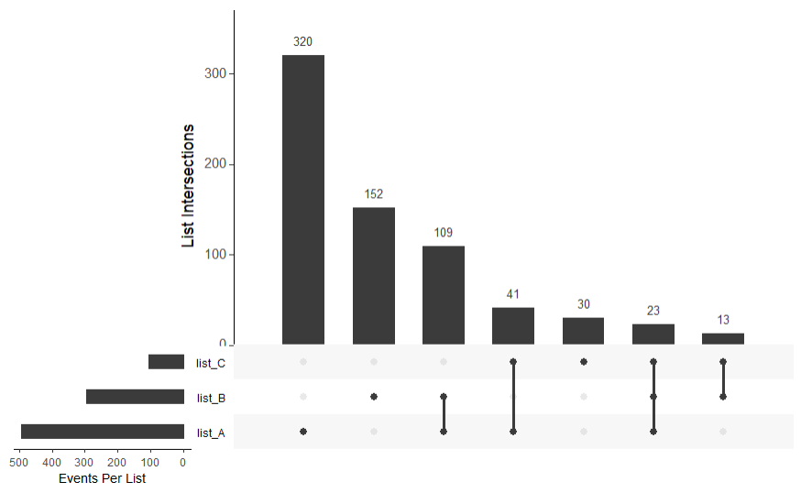

UpSet plots are useful alternatives to Venn diagrams when we have more than three sets. The R package UpSetR can create such plots.
A
B
320
109
152
23
41
13
C
30
Jake R. Conway, Alexander Lex, and Nils Gehlenborg, “UpSetR: An R Package for the Visualization of Intersecting Sets and Their Properties,” Bioinformatics 33, no. 18 (2017): 2938–2940, https://doi.org/10.1093/bioinformatics/btx364.

Slide 18

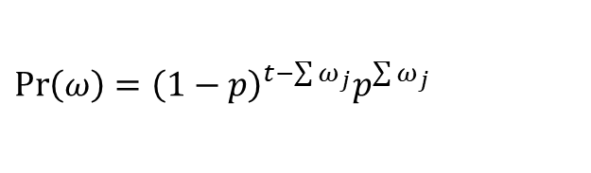


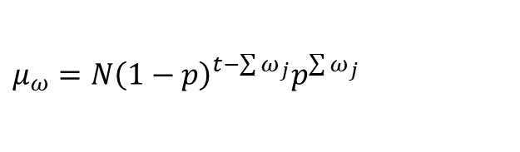
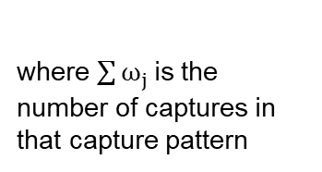
We can structure the problem as a Poisson log-linear regression.
Simplest case: all items have the same probability of capture p. Probability for a unit to experience a capture pattern ω is
ω | Σ(ω) | Pr(ω) | Expected Count μ_{ω} | Observed Count
000 | 0 | (1−p)³ | N∙(1−p)³ | n/a
100 | 1 | p(1−p)² | N∙p(1−p)² | 320
010 | 1 | p(1−p)² | N∙p(1−p)² | 152
001 | 1 | p(1−p)² | N∙p(1−p)² | 30
110 | 2 | p²(1−p) | N∙p²(1−p) | 109
101 | 2 | p² (1−p) | N∙p² (1−p) | 41
011 | 2 | p² (1−p) | N∙p² (1−p) | 13
111 | 3 | p³ | N∙p³ | 23
$${\operatorname{Pr}\left(ω\right)=\left(1−p\right)}^{t−\sum{ω_{j}}}p^{\sum{ω_{j}}}$$
where $\sum{ω_{j} }$is the number of captures in that capture pattern
Main effects
So, the expected number of units in the population having capture pattern ω is
$${μ_{ω}=N\left(1−p\right)}^{t−\sum{ω_{j}}}p^{\sum{ω_{j}}}$$
2-way inter’ns
This can be expressed in the form of a loglinear model:
3-way inter’n
$$μ_{ω}=e^{\left(log\left(N{\left(1−p\right)}^{t}\right)+\sum{ω_{j}}log\left(\frac{p}{1−p}\right)\right)}$$
$$γ$$
$$β$$
Sophie Baillargeon and Louis-Paul Rivest, “Rcapture: Loglinear Models for Capture-Recapture in R,” Journal of Statistical Software 19, no. 5 (2007): 1–31, https://doi.org/10.18637/jss.v019.i05.

Slide 19
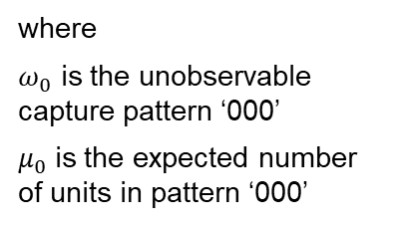

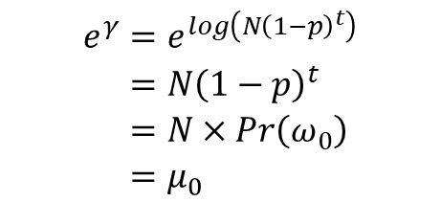

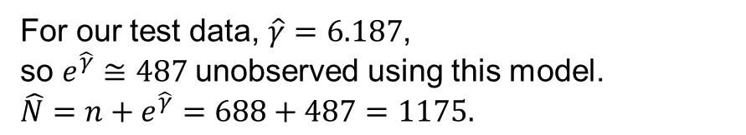

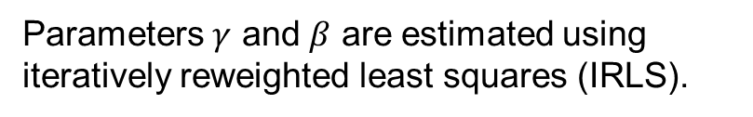

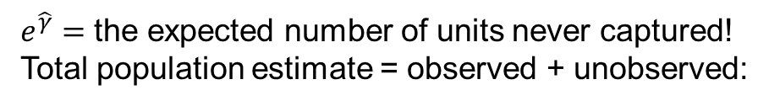
We can structure the problem as a Poisson log-linear regression.
$$μ_{ω}=e^{\left(log\left(N{\left(1−p\right)}^{t}\right)+\sum{ω_{j}}log\left(\frac{p}{1−p}\right)\right)}$$
ω | Σ(ω) | Pr(ω) | Expected Count μ_{ω} | Observed Count
000 | 0 | (1−p)³ | N∙(1−p)³ | n/a
100 | 1 | p(1−p)² | N∙p(1−p)² | 320
010 | 1 | p(1−p)² | N∙p(1−p)² | 152
001 | 1 | p(1−p)² | N∙p(1−p)² | 30
110 | 2 | p²(1−p) | N∙p²(1−p) | 109
101 | 2 | p² (1−p) | N∙p² (1−p) | 41
011 | 2 | p² (1−p) | N∙p² (1−p) | 13
111 | 3 | p³ | N∙p³ | 23
$$γ$$
$$β$$
Parameters $γ$ and $β$ are estimated using iteratively reweighted least squares (IRLS).
We can use the fact that
Main effects
$$e^{γ}=e^{log\left(N{\left(1−p\right)}^{t}\right)} \\ =N{\left(1−p\right)}^{t} \\ =N×Pr\left(ω_{0}\right) \\ =μ_{0}$$
where
$ω_{0}$ is the unobservable capture pattern ‘000’
$μ_{0}$ is the expected number of units in pattern ‘000’
2-way inter’ns
$e^{\hat{γ}}=$ the expected number of units never captured!
Total population estimate = observed + unobserved:
3-way inter’n
$$\hat{N}=n+e^{\hat{γ}}$$
For our test data, $\hat{γ}=6.187$,
so $e^{\hat{γ}}≅487$unobserved using this model.
$$\hat{N}=n+e^{\hat{γ}}=688+487=1175.$$

Slide 20
Leveraging R packages

Slide 21
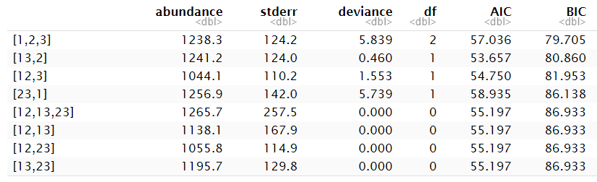
Rcapture estimates the unobserved count from all possible log-linear models. “Abundance” is the estimate of the population, which includes both observed (“captured”) and unobserved events.
Candidate models sorted by BIC.
[1,2,3] indicates the main effects model:
log(m₀₀₀ ) ~ α + β₁*m₁₀₀ + β₂*m₀₁₀ + β₃*m₀₀₁
Estimates of total population for each model.

Slide 22
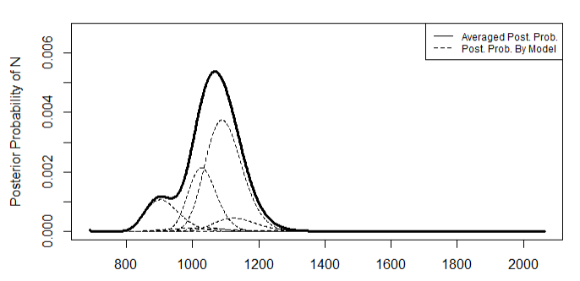
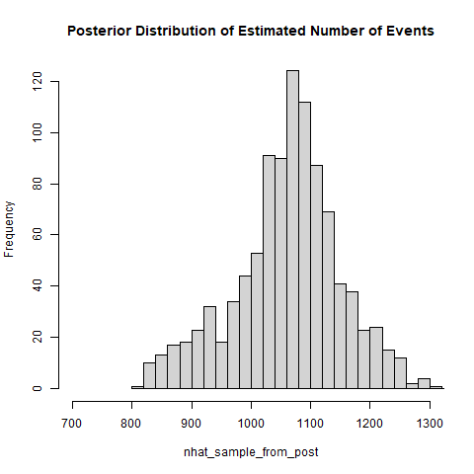
Bayesian model averaging produces a weighted average of the candidate models; we can sample from this “posterior.”
902
1184
90% C.I.

Slide 23
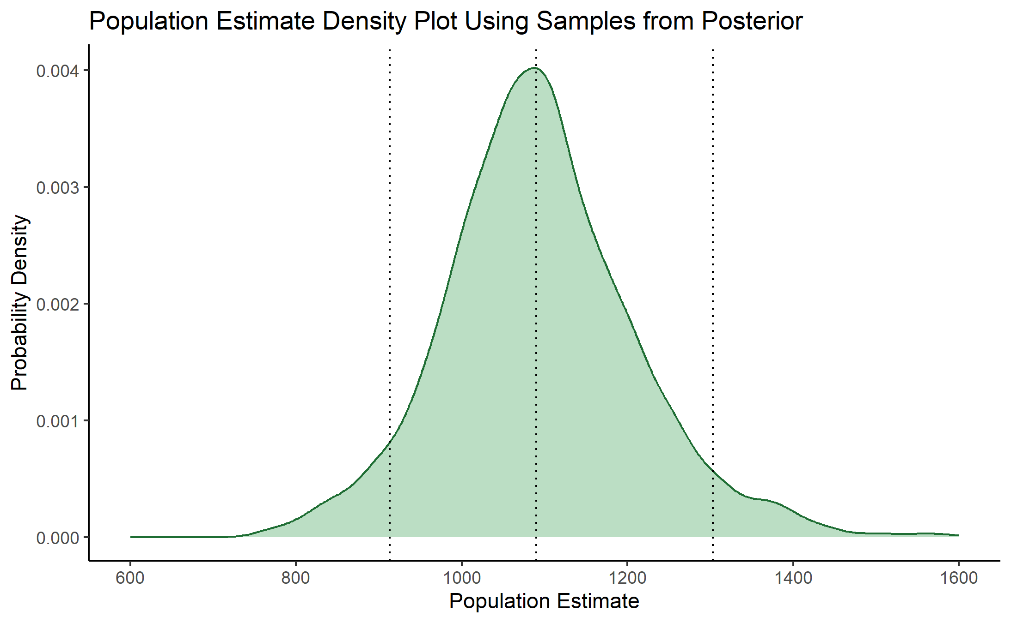
LCMCR: A Bayesian application using non-parametric latent class models.
R package “LCMCR” uses latent class models.
Distribution is the histogram from a large sample from the posterior distribution.
90% credible interval from the posterior: [913, 1303]
912.9
1090.0
1303.0

Slide 24
Applying MSE to the combat loss/damage data

Slide 25
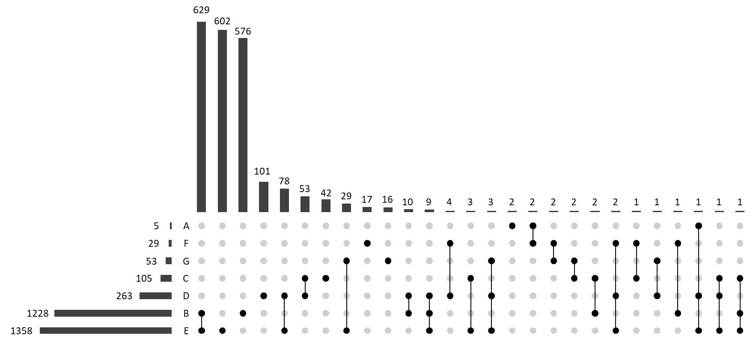
The UpSet plot shows the data sources overlap.
2190 unique events across 7 lists
2⁷ – 1 = 127 possible inclusion patterns; our data fell into 27 patterns

Slide 26
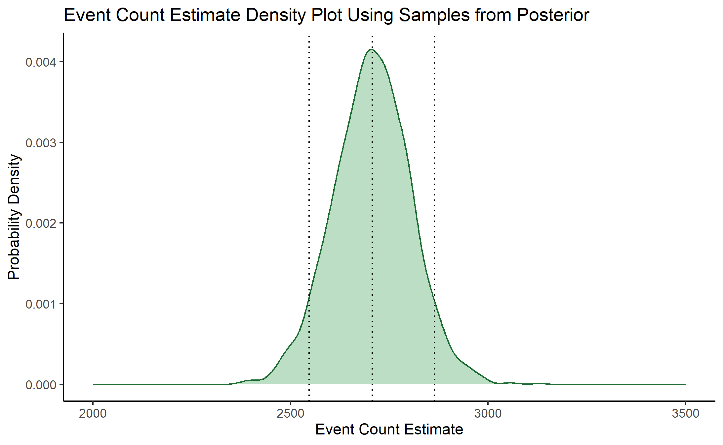
2547
90% CI
2864
2190 observed
2707

Slide 27
Summary
Multiple system estimation (MSE) is a technique that leverages events’ inclusion/absence histories across datasets.
MSE techniques depend on our ability to de-duplicate and match.
Bayesian applications are readily available.
Unconstrained by assumptions
Produce distributions and credible intervals of the population estimate

Slide 28
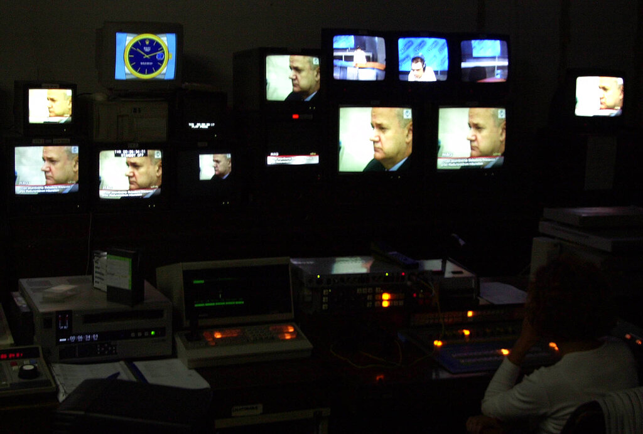
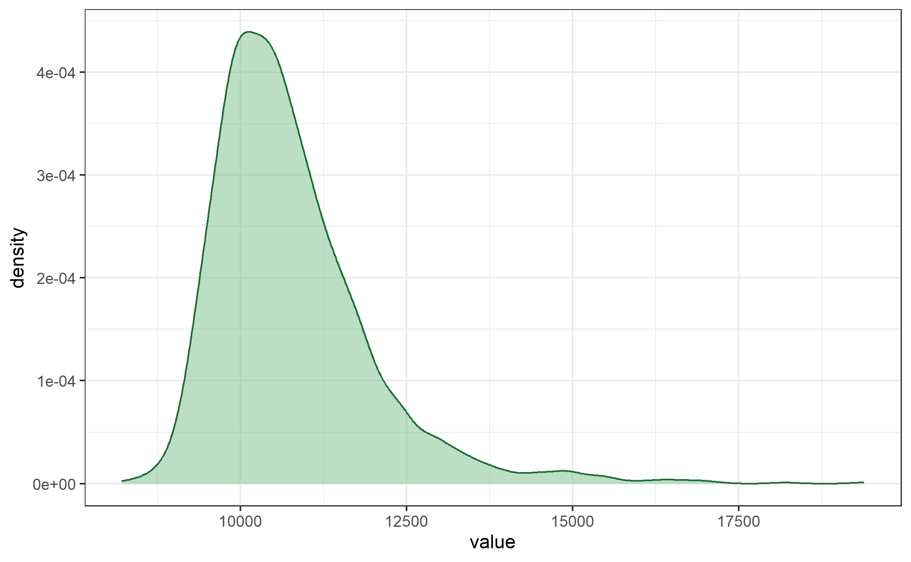
Epilogue
2.5% | 50% | 97.5%
9233 | 10531 | 13806
Image courtesy of Associated Press. Copyright 2001. All rights reserved.
27

Slide 29
References
American Bar Association and American Association for the Advancement of Science, eds. Political Killings in Kosova/Kosovo, March-June 1999: A Cooperative Report by the Central and East European Law Initiative of the American Bar Association and the Science and Human Rights Program of the American Association for the Advancement of Science. American Bar Association, 2000.
Baillargeon, Sophie, and Louis-Paul Rivest. “Rcapture: Loglinear Models for Capture-Recapture in R.” Journal of Statistical Software 19, no. 5 (2007): 1–31. https://doi.org/10.18637/jss.v019.i05.
Bishop, Yvonne Millicent Mahala, Stephen E. Fienberg, Paul W. Holland, and Richard J. Light. Discrete Multivariate Analysis: Theory and Practice. Theory and Applications. Springer, 2007. Originally published in 1975 by MIT Press.
Conway, Jake R., Alexander Lex, and Nils Gehlenborg. “UpSetR: An R Package for the Visualization of Intersecting Sets and Their Properties.” Bioinformatics 33, no. 18 (2017): 2938–2940. https://doi.org/10.1093/bioinformatics/btx364.
Cormack, R. M. “Log-Linear Models for Capture-Recapture.” Biometrics 45, no. 2 (1989): 395–413. https://doi.org/10.2307/2531485.
Fienberg, Stephen E., and Daniel Manrique-Vallier. “Log-Linear Model Methods.” In Modern Analysis of Customer Surveys, edited by Ron S. Kenett and Silvia Salini. Jon Wiley & Sons, 2011. https://doi.org/10.1002/9781119961154.ch12.
Human Rights Data Analysis Group. “Multiple Systems Estimation: Stratification and Estimation.” Last modified March 20, 2013. http://hrdag.org/2013/03/20/mse-stratification-estimation/.
Krüger, Jule, and Patrick Ball. Evaluation of the Database of the Kosovo Memory Book. Human Rights Data Analysis Group, 2014. https://hrdag.org/wp-content/uploads/2015/04/Evaluation_of_the_Database_KMB-2014.pdf.
Lum, Kristian, Megan Emily Price, and David Banks. “Applications of Multiple Systems Estimation in Human Rights Research.” The American Statistician 67, no. 4 (2013): 191–200. https://doi.org/10.1080/00031305.2013.821093.
Manrique-Vallier, Daniel. “Bayesian Population Size Estimation Using Dirichlet Process Mixtures.” Biometrics 72, no. 4 (2016): 1246–54. https://doi.org/10.1111/biom.12502.

Slide 30
DATAWorks 2025
Multiple System Estimation:
Estimating Under-Reported Events From Multiple Data Sources
Greg Chesterton and Jim Rhoads
April 2025

