Slide 1
DRAFT
Missing data: Motivations, Methods and Examples
Tony Sgambellone, PhD,
Jim Theimer, PhD
CTR STAT COE
Feb 19, 2026
DISTRIBUTION STATEMENT A. Approved for public release; distribution is unlimited.
CLEARED on 25 March 2026. Case Number: 88ABW-2026-0193
The views expressed are those of the authors and do not reflect the official guidance
or position of the United States Government, the Department of Defense, the
United States Air Force or the United States Space
DATAWorks 2026
Notes:
Updated: February 22, 2023

Slide 2
What is Meant by Missing Data
Data which would have helped with inference, but was not collected
Data that you planned not to collect
  Example: Random sampling
Data which you planned to collect, but did not
  Survey questions which were not answered
  Administrative records which were not filled out
  Parts in a reliability test which had not failed when the test ended
Observational data under treatments not in the dataset
  Bombers that did not come back can not be examined to see where they were hit

Slide 3
Why This is a Problem
If samples are random, then the estimates are unbiased
If the samples are not taken at random, then the estimates will be biased
  If unsatisfied customers are more likely to respond to a survey, customer satisfaction will be underestimated
  If administrative records are not filled out when staff are very busy, whatever conditions make them very busy will be underrepresented
  If we stop doing reliability testing before a part fails, we only know that the time to failure is greater than some level and could underestimate time to failure
Under some circumstances missing data can be dealt with

Slide 4
Example: Average Vehicle Passengers per Month Through Port of Entry
Smaller ports more likely to have missing data
Replace missing data with
  Zero
  Maximum/minimum observed value for that port
  The average value for the port based on observed data weighted to compensate for missing data at the port
All these are less than if missing data are ignored

Slide 5
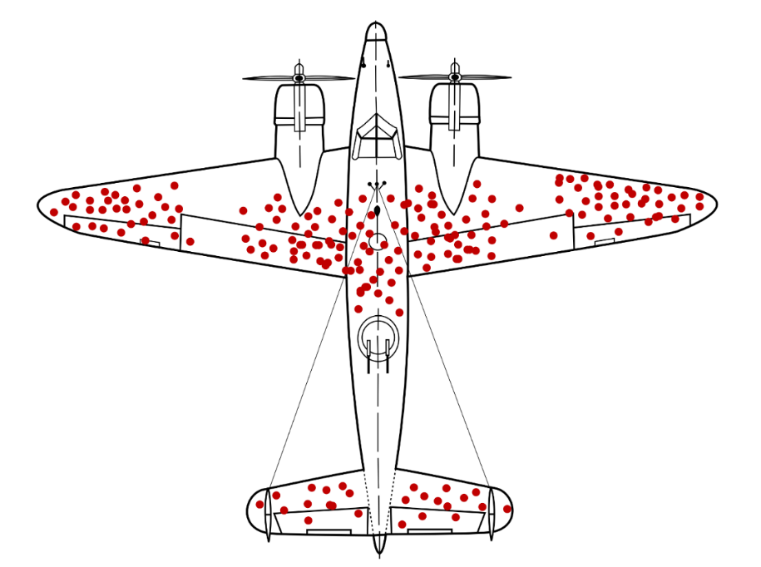
Solutions
Emphasize the importance of complete data
Try to find the missing data
Follow up to get the missing responses, if possible
Apply possible solutions based on a model of the missing data
We want to know where aircraft that went down were hit
We can’t examine the aircraft that went down because they didn’t come back
Image from https://commons.wikimedia.org/wiki/File:Survivorship-bias.svg

Slide 6
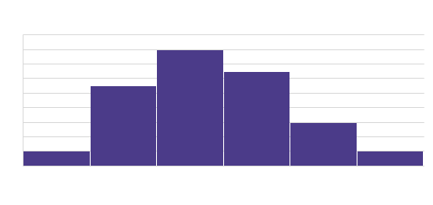
Missing Completely at Random (MCAR)
The probability distribution of the missingness of the data is conditionally independent of any predictor variable
One can simply analyze the data that were obtained as with a random sample
Unless the data are measured with a randomized method one can’t prove MCAR

Slide 7
Missing at Random (MAR)
If the probability of missingness is conditionally dependent on fully observed variables it is missing at random
Inference can be improved if missingness can be modeled based on fully observed variables
  If data can be stratified into groups within which data are MCAR then the results can be improved by weighting data from the different strata
  Simulate responses for missing data based on a model of the observed data; called multiple imputation – example follows

Slide 8
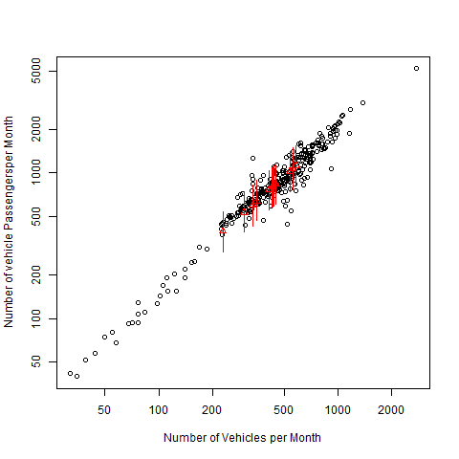
Border Crossing Data
Fit a Bayesian model of vehicle passenger per month vs. vehicles per month; missing values of passengers per month
The R library rjags treats the missing data as additional parameters of the model
Markov Chain Monte Carlo (MCMC) simulates random draws from the posterior distribution of the parameters (including missing data)
Red lines are 95% credible interval for missing data - they fall where the observed values fall

Slide 9
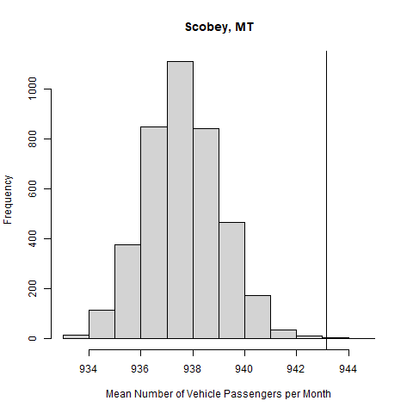
Example of Inference
Add the simulated data to the observed data to obtain PDF of mean vehicle passengers per month
Bayes uses subjective probability so width of PDF reflects the range where we think the mean value will fall
Multiple imputation lets us see the uncertainty due to missing data
Vertical line is mean without missing data
Missing data is from months with lower number of vehicles, so the missing data reduces the estimated mean; imputation gives a mean that better reflects the data

Slide 10
Missing Not at Random (MNAR)
Data are not missing based on any fully observed covariate
It is possible that the observations that matter the most are not present
  You can’t see where bombers shot down in combat were hit, because they don’t come back
If you have missing responses from a survey
  If you know demographics of all subjects of the survey, you could assume that response are MNAR within the groups
  But how can you ever prove this?
Sometimes you can use data you have to analyze MNAR data such as with censored data

Slide 11
Censored Data
Censored data is a type of missing data
Censored data is MNAR – not at random
  The missing values cannot be ignored without biasing the results
  The values cannot be predicted effectively as a function of the other variables
Censored data is common in reliability testing, survival analysis, and concentrations with a meaningful minimum detection threshold

Slide 12
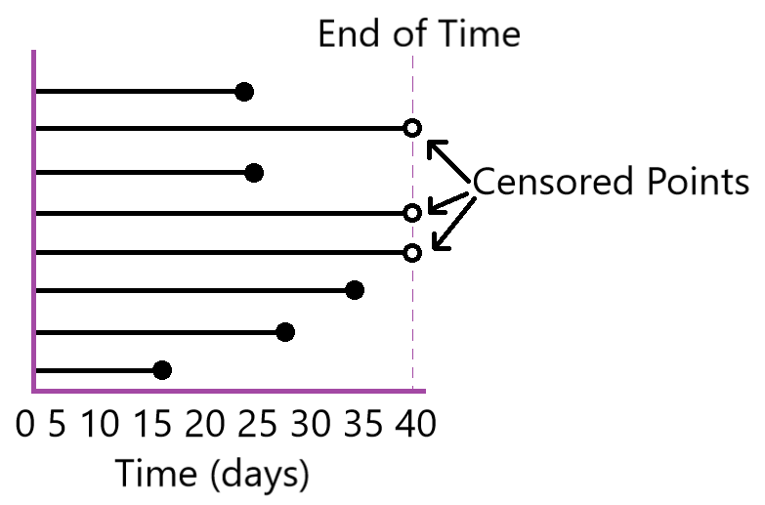
The Value of Information
Even though the exact value of a censored observation is not known, some information is known and can be used to improve the analysis
Right-censored
  Data that is right-censored are known to have a value at least as large as the censoring value
  Common in reliability analysis

Slide 13
More Types of Censoring
Left-censored
  Data that is left censored are known to be no larger than the censoring value
  This may appear in analyses regarding detection, whether of a chemical compound or electronic signal (lack of detection does not mean the quantity is truly 0)
Interval-censored
  Data that is interval censored has known upper and lower bounds for what the true value could be
  This commonly occurs when the status of a test item is periodically checked rather than continuously monitored

Slide 14
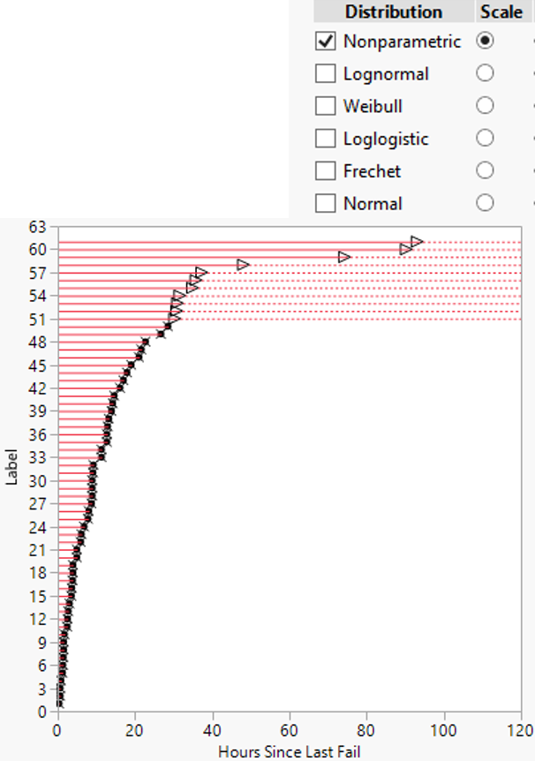
Analysis of Censored Data
The Kaplan-Meier method is a versatile approach to analyze censored data
It is nonparametric
  It makes no assumptions about the distribution of the data
  Its conclusions will always be valid to control the false positive rate

Slide 15
Censored Analysis Example
A program needs to detect the concentration of hazardous contaminants in the air
  There is a minimum threshold for detection: lack of detection does not mean the concentration is 0
  Several factors influence the minimum detection threshold, such as humidity and temperature
  The program must ensure with 95% confidence that the concentration is below 10μg 90% of the time

Slide 16
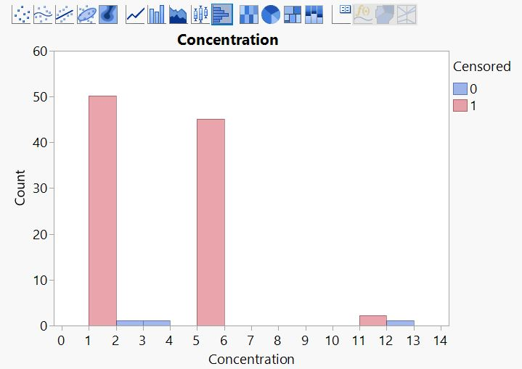
Censored Analysis Data
The program manages to collect the following data:
  Detections at 2, 3, and 12μg
  Non-detections with the following thresholds
    50 non-detections with a threshold of 1μg
    45 non-detections with a threshold of 5μg
    2 non-detection with a threshold of 11μg

Slide 17
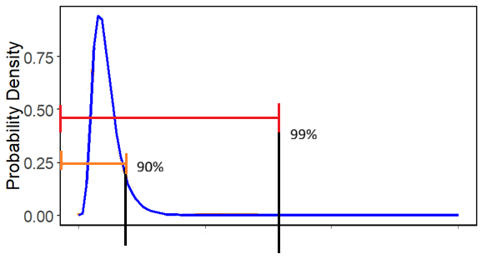
Kaplan-Meier Method
By the existing the Kaplan-Meier method, it is only possible to estimate the distribution at the observed values, 12, 3, and 2
  The point estimate for the proportion of the distribution below each of those concentrations is 99%, 97.1%, and 95.1%, respectively
The Kaplan-Meier method can have substantial difficulty in the presence of few uncensored observations
  The 99th percentile is exceptionally conservative for what the study needs
The estimates for 2 and 3ug do not sufficiently account for the safety concerns of half of the values potentially being higher.

Slide 18
Extension of the Kaplan-Meier Method
With 100 observations, the 10th largest concentration would be the most direct estimate for the 90th percentile
We don’t know the exact value of the 10th largest concentration
  Detections at 12, 3, and 2μg
  Non-detections with the following thresholds
    50 non-detections with a threshold of 1μg
    45 non-detections with a threshold of 5μg
    2 non-detection with a threshold of 10μg
  But we do know that the tenth largest concentration can’t be any larger than 5μg

Slide 19

Program Decision
The estimate of 5μg is still conservative, as that is the largest value possible for the tenth-largest concentration
  It may have been much less
The use of this additional information provides sufficient evidence to rigorously conclude that the environment is safe
Existing methods would have been inconclusive, or possibly providing greater confidence than warranted.

Slide 20
Summary
This extension of the Kaplan-Meier method for survival analysis amidst missing data provides the same estimates as the traditional method at uncensored values
Its strength lies in expanding the application of existing information to make estimates at censoring values as well
  Enabling more powerful conclusions from the same data

Slide 21
Summary
Not all missing data can be simply ignored: treated like MCAR
Ignoring the cause of missing data can lead to biased results
When data are MAR the you may be able to fit a model to the missing data that will improve results
With MNBAR data
  Sometimes you simply lose the ability to make inferences; you can’t say how nonrespondents differ from respondents because you don’t have the responses
  Sometimes you can use the fact that the response has to be greater than some value, or between values to improve inference

Slide 22
Conclusions
Missing data often trips up standard analysis practices
  Ignoring the missingness can result in a biased conclusion with false measures of confidence
  Methods exist to address missingness for most situations, protecting the integrity of conclusions and measures of risk
The analysis of missing data is still a developing field with the discovery of methods to provide more powerful conclusions in more scenarios than in the past

