Slide 1


Assessing the Calibration and Performance of Attention-based Spatiotemporal Neural Networks for Lightning Prediction
Nathan Gaw, Brian Popick
Department of Operational Sciences
Air Force Institute of Technology
Wright-Patterson Air Force Base, OH

Slide 2
Overview
Introduction
  Literature Review
  Contribution
Methodology
  Novel Model Designs
  Loss function
Experimental Procedure
Toy Problem Application
  Moving MNIST
Real-world Application
  Storm Event Imagery (SEVIR) Dataset
Results
Discussion

Slide 3
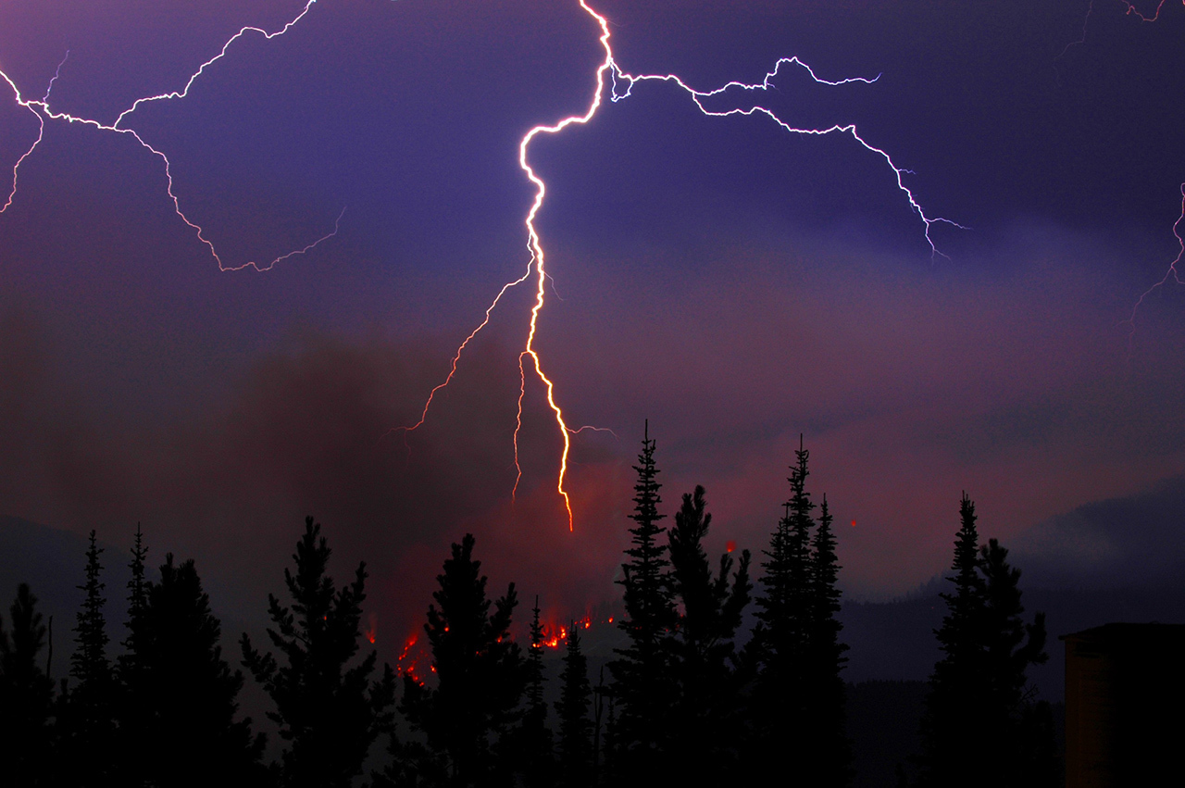
Introduction
Lightning poses a significant threat to life, property, and commercial industry
In the United States, lightning strikes caused:
  22,600 building fires, estimated $451M in damages (2007-2011)^{[1]}
  9,000 wildfires (2008-2012)^{[1]}
  418 fatalities from direct strikes (2006 – 2019)^{[2]}
~75% of air traffic delays are due to weather, including thunderstorms (2017 – 2022)^{[3]}
  Estimated economic impacts is the loss of billions to airlines, passengers, and other business^{[4]}
Location and timing of lightning strikes is extremely difficult to accurately forecast
https://climate.nasa.gov/news/2602/lightning-sparking-more-boreal-forest-fires/
Notes:
Lightning is a naturally occurring phenomenon associated with thunderstorms, and it poses a significant threat to personal life, property, and commercial industry.
In the United States alone, lightning strikes were responsible for millions of dollars in damages to property, the cause of thousands of wildfires, and resulted in hundreds of fatalities.
Furthermore, weather delays, which include thunderstorms, cause a significant number of delays to air traffic, which the Federal Aviation Administration estimates to cost billions of dollars when considering the cost to the passengers, airlines, and businesses that rely on air transportation for shipping.
To compound these issues, forecasting the location and timing of lightning strikes is extremely difficult to do, given its chaotic nature.
---------------------------------------------------------------------
NCEI (2023a), ‘U.s. billion-dollar weather and climate disasters’.
URL: https://www.ncei.noaa.gov/access/billions/summary-stats
[1] Holle, R. L. (2014), Some aspects of global lightning impacts, in ‘2014 International Conference on Lightning Protection (ICLP)’, IEEE, pp. 1390–1395.
[2] Jensenius Jr, J. S. (2015), ‘A detailed analysis of lightning deaths in the united states from 2006 through 2014’, Executive Summary. United States: National Weather Service.
[3] Federal Aviation Administration (2023), 'NextGen Weather', URL: https://www.faa.gov/nextgen/programs/weather/faq
[4] Federal Aviation Administration (2020), 'Cost of Delay Estimates', URL: https://www.faa.gov/sites/faa.gov/files/data_research/aviation_data_statistics/cost_delay_estimates.pdf

Slide 4
Literature Review
Deep learning models
Convolutional Neural Networks
Recurrent Neural Networks
Attention-based Neural Networks
Model Calibration
LeCun et al, 1998
Ronneberger et al, 2015
…
Hochreiter et al, 1997
Cho et al, 2014
…
Bahdanau et al, 2014
Vaswani et al, 2017
Lin et al, 2020
Niu et al, 2021
…
Gneiting et al, 2014
Guo et al, 2017
Kumar et al, 2019
…
Weather Prediction
Non-attention-based models
Attention-based models
Radar
Lightning
Radar
Lightning
Shi et al, 2015
Li et al, 2023
…
Cintineo et al, 2022
Brodehl et al, 2022
Li et al, 2023
…
Yao et al, 2022
…
Geng et al, 2019
…
Our contribution
Develop novel spatiotemporal deep learning models for lightning prediction
Tornadoes
Marzban et al, 1995
Lagerquist et al, 2020
…
Notes:
In the past few decades, researchers have turned to deep learning models to try and tackle this prediction problem. There are numerous branches within this tree, but the branches that are of primary concern to this research are those relating to
Convolutional Neural Networks, Recurrent Neural Networks, Attention-based networks, and in a slightly different vein, the calibration of models and neural networks.
Looking specifically at the neural network branches, we see that they tie directly into the common branch of weather prediction, as all the model types have been used in weather prediction research. Weather prediction itself entails forecasting many different events and phenomena, such as radar extrapolation, lightning, and tornadic prediction.
In this research , we leverage the four branches of the deep learning family tree to develop novel spatiotemporal deep learning models that are designed to forecast the time and location of lightning strikes.

Slide 5
Contribution
Develop three novel sequence-to-sequence spatiotemporal deep learning models that:
  Ingest a time series of remotely-sensed weather modalities
  Predict the location of lightning strikes over a time series
Integrate and investigate the uncertainty associated with model predictions and performance throughout the model development process
  Deliberately include model error into the tuning and training process
  Quantify error associated with final model predictions
Notes:
More specifically, we develop three novel sequence-to-sequence spatiotemporal neural networks that ingests a time series of multiple remotely sensed weather modalities to predict the timing and location of lightning strikes across given area.
Furthermore, to produce more reliable models, this research integrates the uncertainty associated with model predictions throughout the model development process by including model error into the tuning and training process. We also quantify the error associated with our trained model predictions.
---------------------------------------------------------------------------------------------------------
## Models based around the ConvLSTM and U-Net style seen in previous atmosphere prediction research

Slide 6


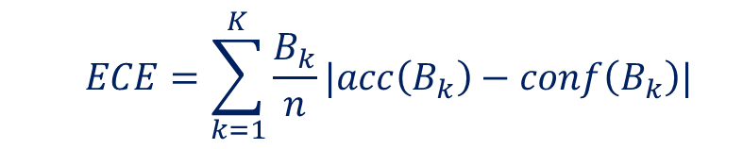
Contribution
Quantify model error by assessing the model’s calibration
Calibration is evaluated through both qualitative and quantitative methods
  Qualitative method: Analyze the model’s calibration curve^{[5]}
  Quantitative method: Calculate the model’s Expected Calibration Error (ECE)^{[6]}
  $$ECE=\sum_{k=1}^{K}{\frac{B_{k}}{n}|acc\left(B_{k}\right)−conf\left(B_{k}\right)|}$$
$$acc(B_{k})=\frac{1}{{|B}_{k}|}\sum_{i∈B_{k}}{1(\hat{y_{i}}=y_{i})}$$
$$conf(B_{k})=\frac{1}{{|B}_{k}|}\sum_{i∈B_{k}}{\hat{p_{i}}}$$
Notes:
In this research, model error is quantified by assessing a model’s calibration through qualitative and quantitative methods.
The qualitative method consists of analyzing a model’s calibration curve, which allows us to visually if a model is over or underconfident depending on whether the mean predicted probabilities fall below or above the perfect calibration line, which represents when the mean predicted probability equals the observed frequency of occurrence.
The quantitative method is calculating a model’s Expected calibration error, or ECE. ECE is a measure of how well a model’s estimated probability of occurrence matches the occurrences of events, which provides a summary statistic of a model’s calibration.
-----------------------------------------------------------------------------------------------------------
##Extra info: a model’s calibration curve is produced by binning model predictions and known event occurrences into a defined number of bins and comparing the mean prediction of a bin to the frequency of event occurrence. Ideally, the predicted probability and the frequency of occurrence will be the same.

Slide 7
Methodology
Develop three novel deep learning architectures
  Two attention-based and one non-attention-based models
Attention-ConvLSTM (A-CLSTM)
ConvLSTM-Conv U-Net (CCU)
Attention-ConvLSTM-Conv U-Net (A-CCU)
Notes:
Moving onto the methodology, we’ll look at the novel models, with are the Attention-ConvLSTM, the ConvLSTM-Conv U-Net and the Attention-ConvLSTM-Conv U-Net.

Slide 8
































Methodology: Attention Mechanisms
Two attention developed to incorporate into various model architectures
  Single Self Attention Mechanism (S-SAM) and Dual Self Attention Mechanism (D-SAM)
S-SAM
D-SAM
$1×1$ Conv
$$q$$
Transpose
$n×1×1$
Conv
$$q$$
Transpose
Softmax
Attention Weights
$$⊗$$
$$⊗$$
Softmax
Attention Weights
$$H_{t}$$
$$1×1$$
Conv
$$k$$
$$X_{t}$$
$n×1×1$
Conv
$$k$$
$1×1$ Conv
$$v$$
$$⊗$$
$$1×1$$
Conv
$n×1×1$
Conv
$$v$$
$$⊗$$
$$1×1$$
Conv
$$⊕$$
$⊗$: Matrix Multiplication
$⊕$: Matrix Addition
$$H_{t}^{′}$$
$$⊕$$
$⊙$: Hadamard Product
$⊗$: Matrix Multiplication
$$X_{t}^{′}$$
$$O_{t}$$
S-SAM
$$O_{t}^{′}$$
$$⊙$$
$$X_{t}^{′}$$
$⊕$: Matrix Addition
Notes:
But before we get into the model designs, we have to look at the attention mechanisms that are developed for the models.
The first attention mechanism, which we call the Single Self Attention Mechanism (or S-SAM), applies self-attention to the initial model input sequence, X sub t.
Being that it’s self-attention, the query (q), key (k), and value (v) vectors are all generated using three-dimensional convolutions on the input. Once the q, k, and v vectors are generated, a series of matrix multiplication, softmax, and addition operations are used to produce the attended output, X sub t prime.
The second attention mechanism is the Dual Self Attention Mechanism or D-SAM. This mechanism is specifically designed to follow a ConvLSTM layer, as it ingests the ConvLSTM’s output, o sub t, and the ConvLSTM hidden state, h sub t.
O sub t is passed through the S-SAM to produce the attended output feature, O sub t prime.
H sub t is essentially the convlstm’s short-term memory and does not have an ‘n’ deep sequence like O sub t. Thus, the q,k, and v matrices are produced using 1 by 1 convolutions instead of the n by 1 by 1 convolutions seen in the S-SAM. Once these vectors are created, the attended output H sub t prime is produced using the same sequence of events seen in the S-SAM.
Once we have both O sub t prime and H sub t prime, they are combined using a Hadamard product, which produces our dual attended output feature, X sub t prime.
--------------------------------------------------
**Extra info: S-SAM and D-SAM designs are extensions of the attention mechanism from Yao et all 2022.
** In the S-SAM, the convolutions use an n by 1 by 1 kernel, where n is the length of the input sequence. This procedure produces feature mappings for each pixel of the input sequence that contains information for the entire duration of the input sequence.

Slide 9






Methodology: A-CLSTM, CCU, A-CCU
$$X_{t}$$
SS
CL
DS
General A-CLSTM model architecture
$$X_{t}$$
CL
3C
CL
3C
$$\hat{Y_{t} }$$
CL
DS
…
3C
$$\hat{Y_{t} }$$
General CCU model architecture
…
…
SS
CL
CL
3C
S-SAM
ConvLSTM
DS
3C
3D-Convolution
$$X_{t}$$
SS
CL
3C
SS
CL
3C
$$\hat{Y_{t} }$$
D-SAM
…
Additional Layers
Concat
General A-CCU model architecture
Pooling, Normalization, Dropout
…
…
Upsampling, Normalization, Dropout
SS
CL
3C
Notes:
Now that we have seen the attention mechanisms developed in this research, we can briefly look at the novel models designs.
The first is the A-CLSTM, which incorporates both the S-SAM and D-SAM into a general ConvLSTM model design.
The second model is the CCU, which uses stacked ConvLSTM and 3D convolutional layers in a U-Net style, encoder-decoder model.
The third model is the A-CCU. Its design mirrors that of the CCU, but incorporates the S-SAM into every computational layer in the encoder-decoder structure.
Of note, all of these models are designed to ingest a times series of images, X_{t}, and produce the probability of event occurrence in every pixel in every image of the output sequence, $\hat{Y_{t}}$
---------------------------------------------------------------------
Possible question: How are the probabilities produced?
Answer: The probabilities of event occurrence are produced in the final 3d convolutional layer using a sigmoid activation function
**Extra info: U-Net models first presented by Ronneberger, O., Fischer, P. and Brox, T. (2015), U-net: Convolutional networks for biomedical image segmentation, in ‘Medical Image Computing and Computer-Assisted Intervention–MICCAI 2015: 18th International Conference, Munich, Germany, October 5-9, 2015, Proceedings, Part III 18’, Springer, pp. 234–241.

Slide 10
Methodology
Need to compare novel architectures against other architectures seen in previous literature
ConvLSTM and U-Net architecture inspired by previous lightning prediction research^{[7,8,9,10]}
  Modified U-Net to include 3D convolutional layers
CNN architecture motivated from a 3D CNN seen in tornadic prediction^{[11]}
  Third dimension is time
Attention U-Net (A-UNet) architecture seen in medical research^{[12]}
  Modified to include 3D convolutional layers
Attention CNN (A-CNN) is a 3D CNN with the S-SAM incorporated into the model architecture
Notes:
To determine if the models are any good, they are compared against models architectures seen in previous weather prediction research.
This primarily included U-Nets, ConvLSTM, and CNN models.
To compare out attention based models against other attention based models, an Attention-U-Net seen in medical research is used, and the S-SAM is added to a general 3D CNN frame work to produce the attention CNN.

Slide 11


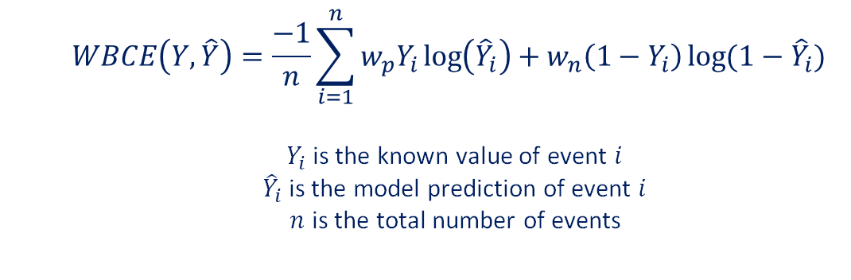
Methodology: Loss Function
Utilize Weighted binary cross entropy (WBCE) loss function for all architectures
  Data will be imbalanced; in a given area, the non-occurrence of a lightning strike is far greater than the number of times a lightning strike occur
  WBCE address this issue by setting Positive, $w_{p}$, and Negative, $w_{n}$, class weights
    Positive (Negative) class weight corresponds to the minority (majority) class
    Penalizes model more for making incorrect predictions when a positive event occurs
    Encourages model to predict the minority class more frequently
  Label smoothing incorporated to attempt to improve model calibration and accuracy^{[13]}
  $$WBCE\left(Y,\hat{Y}\right)=\frac{−1}{n}\sum_{i=1}^{n}{w_{p}Y_{i}\log\left({\hat{Y}}_{i}\right)+w_{n}\left(1−Y_{i}\right)\log{(1−{\hat{Y}}_{i})}}$$
  $Y_{i}$ is the known value of event $i$
  ${\hat{Y}}_{i}$ is the model prediction of event $i$
  $n$ is the total number of events
$$Y_{i}=Y_{i}^{0}\left(1−f\right)+\frac{f}{c}$$
$Y_{i}$ is the new label
$Y_{i}^{0}$ is the original label
$f$ is the smoothing factor
$c$ is the number of classes
Notes:
Now that the model architectures are established, it is determined that the best loss function to train the models with is Weighted Binary Cross Entropy (WBCE).
The need to use this loss function comes from the fact that our target data is imbalanced. In general, given an area over a set amount of time, when a thunderstorm is present, the amount of time that lightning is present in that area will be far less than the amount of time when there is no lightning present. In discrete terms, the number of lightning strikes in the area will be far less than that of no lightning strikes.
WBCE addresses this imbalance through the use of positive and negative class weighting. The positive weight corresponds to the minority class, while the negative weight corresponds to the majority class. The effect of this weighting is that the model is penalized more for predicting a non-event when an event occurs than when the model predicts an event occurrence when a non-event occurs. In other words, the models are penalized more for predicting a non-strike when a strike is observed than predicting a strike when no strike is observed.
This penalty encourages the models to predict the minority class more frequently, as less loss is incurred when a predicted strike is incorrect.
To improve model accuracy and calibration, we also incorporated label smoothing into the loss function. Essentially, label smoothing takes the original target outputs, such as 0 and 1, and forces them to be more similar, say 0.1 and 0.9. By making the targets more similar, the models can be forced into distributing the probability of occurrence across both labels, as opposed to putting a 100% probability of occurrence onto one label.

Slide 12
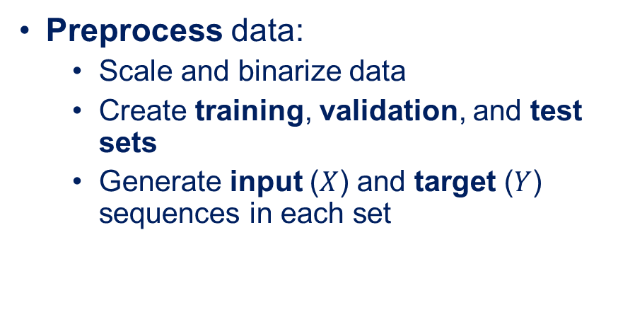
Experimental Procedure
Preprocess data
Tune models
Evaluate & score tuner trial models
Train models
Evaluate models
Compare models
Fix HPs
Preprocess data:
  Scale and binarize data
  Create training, validation, and test sets
  Generate input ($X$) and target ($Y$) sequences in each set
Tune model architectures:
  Find optimal hyperparameters (HPs) for each architecture
  Utilize Bayesian Optimization method within KerasTuner^{[14]}
  Every model tuned to maximize Critical Success Index (CSI)
Notes:
Moving onto the experimental procedure that is implemented on both datasets in this study, the data is first preprocessed. This entails any data scaling and binarization that is needed. Additionally, the dataset is split into the training, validation, and test sets, and the input and target sequences in each set are generated.
Following preprocessing, all model architectures undergo a tuning process to determine their optimal hyperparameters. All of the models in this research are developed in TensorFlow, so KerasTuner is utilized as the tuning algorithm. Within KerasTuner, the Bayesian Optimization search method is used to find the optimal hyperparameters. All of the models are tuned to maximize the critical success index, or CSI, which will be defined momentarily, but it is a measure of model accuracy for imbalanced datasets.
-------------------------------------------------------------------------------
**Extra Info: In short, Bayesian optimization uses probabilistic information learned in previous trials to choose the hyperparameters for the subsequent trial.

Slide 13
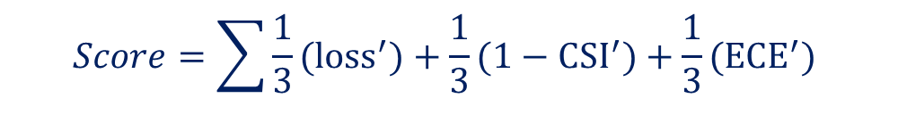
Experimental Procedure
Preprocess data
Tune models
Evaluate & score tuner trial models
Train models
Evaluate models
Compare models
Fix HPs
Evaluate tuner models:
  Loss function, CSI, and ECE values for the predictions of every tuner trial model are stored
  Three-dimensional Pareto Front used to identify which trial models produce minimal Loss, ECE, and maximal CSI values; these models are Pareto solutions
Score tuner models:
  Scale the Loss, ECE, and CSI values of the Pareto solutions
  Scaled values evaluated with the scoring function; HPs from trial model with lowest score maintained for training
$$Score=\sum{\frac{1}{3}(loss^{′})+\frac{1}{3}(1−CSI^{′})+\frac{1}{3}(ECE^{′})}$$
Notes:
However, an issue with tuning models to maximize accuracy is that there is no guarantee that those hyperparameters will also produce optimal values in other important model measures, like loss, or the most reliable models, which can be represented by an optimal ECE value.
To find hyperparameters that find a balance between accuracy, loss, and error, every trial model from the tuner is asked to generate predictions on the validation set, which are used to determine the loss function, CSI, and ECE values for all trial models.
These values are then used to create a 3 dimensional pareto frontier, which seeks to minimize the loss function and ECE values, while maximizing the CSI value.
Trial models which achieve these conditions along the pareto frontier are identified as pareto solutions.
The loss function, ECE and CSI values for the pareto solutions are then min-max scaled. Then, the scaled solutions are scored using the weighted sum seen here. The hyperparameters from the trial model with the lowest resulting score are selected as the optimal hyperparameters and are carried forward into the model training process.
--------------------------------------------------------------------------------
**Extra Info: We have to take 1 minus the scaled CSI value for all of our variables to be optimized in the same direction (in this case, minimized).

Slide 14
Experimental Procedure
Preprocess data
Tune models
Evaluate & score tuner trial models
Train models
Evaluate models
Compare models
Fix HPs
Train models:
  15 models of each archetype
  Each model is randomly initialized
Evaluate trained models:
  Calculate CSI, BIAS, Precision, Recall, and ECE
Compare model performances:
  Compare calibration curves
  Use Mann-Whitney U-test^{[15]} for pairwise model comparisons
$CSI=\frac{TPs}{TPs+FPs+FNs}$, $BIAS=\frac{TPs+FPs}{TPs+FNs}$, $Precision=\frac{TPs}{TPs+FPs}$, $Recall=\frac{TPs}{TPs+FNs}$
Notes:
Those hyperparameters are fixed, and we train 15 models of each. Each model is initialized differently, though, so each training procedure produces a different model. Once a given model is finished training, the model is saved and carried into the evaluation process.
To evaluate the models, all of the trained models make predictions on the test set using the test set input data. Those predictions are then compared against the test set target data to determine the number of true positives (TPs), false positives (FPs), and false negatives (FNs). These values are then used to calculate CSI, BIAS, Precision, Recall, and ECE, defined by the equations listed at the bottom of the slide, for each model.
In order to compare the model architectures for statistical differences, all models metrics are compared against one another in a pairwise fashion using the Mann-Whitney U-test, which is a non-parametric version of the Student T-test. Additionally, a calibration curve is generated for every model to determine if any model architecture attains better calibration than the others.
---------------------------------------------------
** Extra info: During the training process, early stopping criteria and an adaptive learning rate are utilized to prevent model overfitting and excessive training.
** The U-test is used instead of the T-test because not all the model metrics are normally distributed for every model (as determined through a Shapiro-Wilk test)

Slide 15
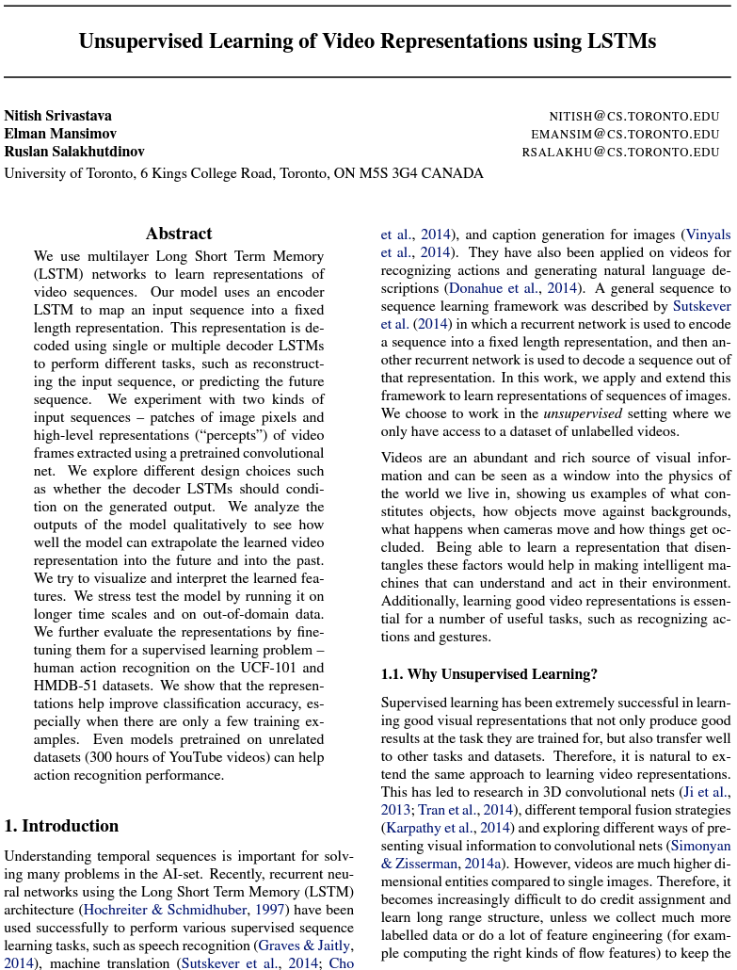


Toy Problem Application
Validate our methodology using a well known, spatiotemporal dataset: Moving MNIST^{[16]}
10,000 image sequences
Each sequence is 20 images
  Depict movement of two hand-drawn numbers around the image
First 10 images used to predict location of numbers in the last 10 images
http://www.cs.toronto.edu/~nitish/unsupervised_video/
Notes:
Now that we have seen the experimental procedure, we’ll briefly go over the datasets used in this work. The first of which is the Moving MNIST dataset, which we use as a toy problem to validate our methodology and ensure our model architectures worked properly. Moving MNIST contains 10,000 image sequences, where each sequence consists of 20 images that depict the movement of two hand-drawn numbers moving around the image.
In this study, we train our models to use the first 10 images to predict the location of the numbers in the images on the last 10 images.

Slide 16
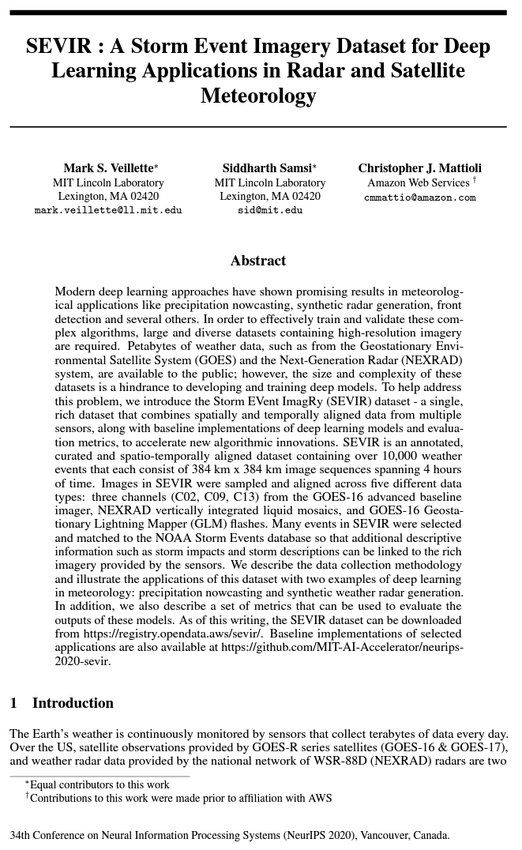
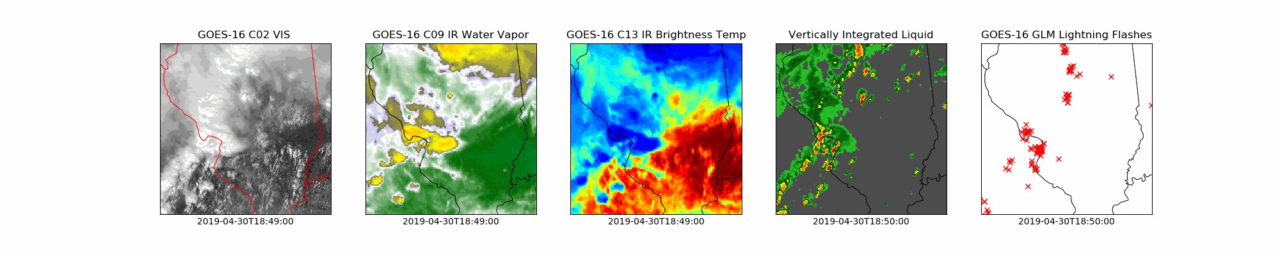

Real-world Application
Storm Event Imagery (SEVIR) dataset^{[17]}
  Three years of thunderstorm data across the United States; contains 10K+ storm events
  4 hours of remotely sensed data for each storm, measured in 5-minute increments
  Five remotely sensed modalities
    Three satellite
    modalities
    Vertically Integrated Liquid (VIL)
    Lightning flash count
Use 30 minutes of satellite and VIL to predict the location of lightning strikes over the next 30 minutes
https://nbviewer.org/github/MIT-AI-Accelerator/eie-sevir/blob/master/examples/SEVIR_Tutorial.ipynb
Notes:
For our real world application of lightning prediction, we use the SEVIR weather dataset from MIT Lincoln Labs. It contains over 10,000 thunderstorm events spanning three years across the continental United States. Every storm event contains four hours of five types of remotely sensed imagery, measured in 5-minute increments, supplying 49 images of each modality for every event.
In this research, we use 30 minutes, or 6 images, of satellite and radar data to predict the location of lightning strikes over the next 30 minutes.
**Extra info: VIL is a radar derived product

Slide 17
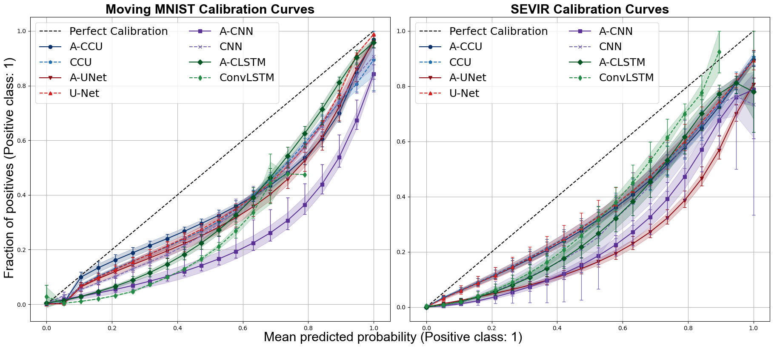
Results: Calibration Comparison
All models are overconfident in their predictions
A-CCU, CCU and U-Net architectures display very similar calibration, and are generally the best among all model architectures
Notes:
Looking at the calibration curves of our trained models, we see that all of the models are overconfident in predicting the positive class in both experiments. With that said, we do see that in general, the A-CCU, CCU and U-Net architectures displayed the best calibration, particularly in the lower probability bins, among the 8 architectures in both experiments.
----------------------------------------------------------------
**Extra info/specifics: In the toy experiment, the A-CCU displays the best calibration in the lower probability bins. The A-CLSTM exhibits the best calibration in the upper probability bins, though the U-Net, A-UNet, CCU, and A-CCU display similar calibrations. In the real-world experiment, the A-CCU, CCU, and U-Net display remarkably similar calibration through all probability bins and are the best-calibrated models through the lower to mid-probability bins. The ConvLSTM shows better calibration in the higher probability bins, but it also displays a broader spread in its minimum and maximum values and a larger standard deviation.

Slide 18

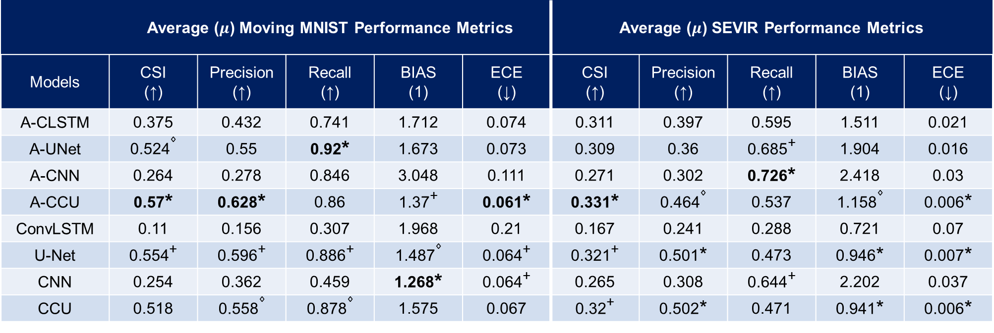
Results: Average Performance Metrics
Bold values depict values that are significantly better at the 95% confidence level in all pairwise comparisons. *,+,$⋄$ superscripts depict 1st, 2nd, and 3rd best models
 | Average ($μ$) Moving MNIST Performance Metrics |  |  |  |  | Average ($μ$) SEVIR Performance Metrics
Models | CSI (↑) | Precision (↑) | Recall (↑) | BIAS (1) | ECE (↓) | CSI (↑) | Precision (↑) | Recall (↑) | BIAS (1) | ECE (↓)
A-CLSTM | 0.375 | 0.432 | 0.741 | 1.712 | 0.074 | 0.311 | 0.397 | 0.595 | 1.511 | 0.021
A-UNet | 0.524$⋄$ | 0.55 | 0.92* | 1.673 | 0.073 | 0.309 | 0.36 | 0.685⁺ | 1.904 | 0.016
A-CNN | 0.264 | 0.278 | 0.846 | 3.048 | 0.111 | 0.271 | 0.302 | 0.726* | 2.418 | 0.03
A-CCU | 0.57* | 0.628* | 0.86 | 1.37⁺ | 0.061* | 0.331* | 0.464$⋄$ | 0.537 | 1.158$⋄$ | 0.006*
ConvLSTM | 0.11 | 0.156 | 0.307 | 1.968 | 0.21 | 0.167 | 0.241 | 0.288 | 0.721 | 0.07
U-Net | 0.554⁺ | 0.596⁺ | 0.886⁺ | 1.487$⋄$ | 0.064⁺ | 0.321⁺ | 0.501* | 0.473 | 0.946* | 0.007*
CNN | 0.254 | 0.362 | 0.459 | 1.268* | 0.064⁺ | 0.265 | 0.308 | 0.644⁺ | 2.202 | 0.037
CCU | 0.518 | 0.558$⋄$ | 0.878$⋄$ | 1.575 | 0.067 | 0.32⁺ | 0.502* | 0.471 | 0.941* | 0.006*
Notes:
Moving onto the performance metrics from each model design in both experiments, this table displays the average metrics from the test set evaluation for the 15 models of each model architecture. The up arrow, down arrow, or 1 represent the desired value of the metric. Bold values indicate that that value is significantly better at the 95% confidence value in all seven of the pairwise model comparisons. The *,+, and diamond symbols depict the first, second, and third best models for that metric. Metrics that have duplicate symbols indicate that there a tie for that position, meaning that there is not enough evidence to conclude a statistical difference between those model metrics.
To summarize the results in this table, the A-CCU, U-Net, and CCU architectures are the top-performing architectures across both experiments. The A-CCU achieves the best average CSI, Precision, and ECE values on the toy test set and is in the top three performing models for its average BIAS value. The A-CCU attains the highest average CSI value on the real-world test set and is in the top three performing models for the Precision, BIAS, and ECE metrics. The U-Net is in the top three models for all metrics in the toy experiment and is in the top three models in four of the five metrics on the real-world data. The CCU is in the top three models on two toy test set metrics and, like the U-Net, is a top-performing model on four of the five metrics in the real-world experiment. Of note, the A-CCU was not a top-performing model regarding Recall in either experiment, while the U-Net and CCU were in the toy experiment. However, both of these architectures attain higher BIAS values than the A-CCU, indicating that they predict the positive class more, leading to higher Recall values. A similar observation can be made on the real-world metrics, as none of the above models are in the top three models regarding Recall. However, all the models that attain better Recall values than the A-CCU, U-Net, and CCU have higher BIAS values.

Slide 19
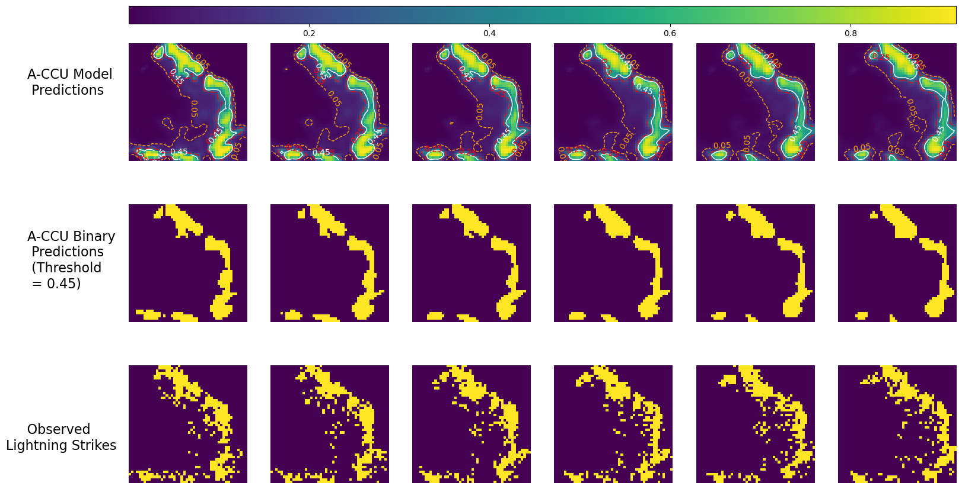
Results: Model Output
Notes:
Now we’ll briefly look at a couple examples of what the models output, and how it compares to our observed targets. This is the output from one of the 15 A-CCU models. The top row is the raw model output, which depicts the probability of a lightning strike by pixel over the forecast sequence, where the left image represents 5 minutes into the future, and the right represents 30 minutes. The color of the pixel represents the probability of occurrence, and there are contours to distinguish between 5, 25, and 45 percent probability of occurrence. The middle row represents the binary transformation, with a threshold of 0.45. The bottom row represents the known lightning strike locations for the forecast period.
From this we see that the model captures the shape of the event well, though it tends to broad brush areas a bit too much where as the actual strike locations are more sporadic. Additionally, there are some areas towards the center of the picture where there are lightning strikes, but they are sparser in comparison to the rest of the image. The model did not forecast these strikes, though they do lie in an area where the model predicted some probability of occurrence, albeit a small one.

Slide 20
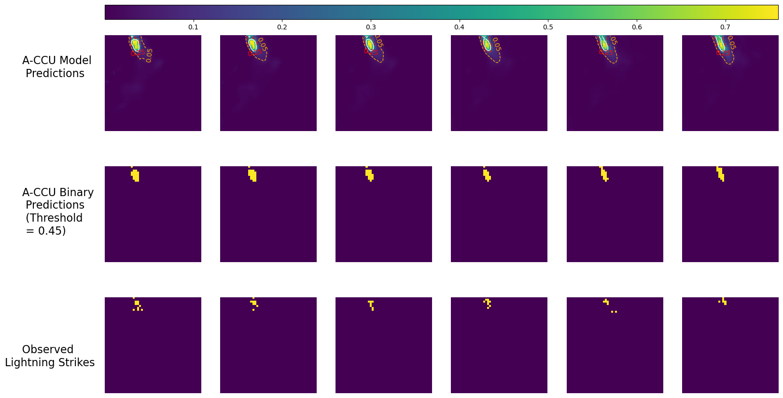
Results: Model Output
Notes:
Here is an example where there are far fewer strikes for the model to predict. Again we see that the model predicts the location of the strikes very well, though it still broad brushes the locations a bit more than what is observed. However, all of the observed strikes still lie within the area where the model assigned some probability of strike occurrence.

Slide 21
Discussion
A-CCU model architecture
  Attained the highest accuracy in both experiments
  A top performing model in most of the other metrics (except Recall)
  Lightning prediction capabilities comparable to models seen in previous literature^{[6,33]}
CCU model architecture
  Generally, a top performing model in both experiments
  Outperformed non-U-Net style models in both experiments
A-CLSTM model architecture
  Most modest of the three novel architectures; was never the best performing model but never the worst in either experiment
  Significantly better than the ConvLSTM in both experiments; suggests that the attention mechanisms aided model performance and stability
Notes:
In summary, the A-CCU architecture attained the highest accuracies in both experiments, displayed decent calibration (though it was still overconfident), and was a top performing model in most of the remaining metrics. Furthermore, the performance of the A-CCU in terms of its lightning prediction capabilities are comparable to the performance of models seen in previous literature
The CCU model also performed very well in both experiments as it was generally in the top three performing models on most metrics.
In terms of overall performance, the A-CLSTM exhibited the most modest performance of all the novel model architectures, as it was never a top performing model. The A-CLSTM achieved far superior performance than its non-attention-based counterpart though, suggesting that the inclusion of the attention mechanisms into the model design provided dramatic increases to model performance and stability.

Slide 22
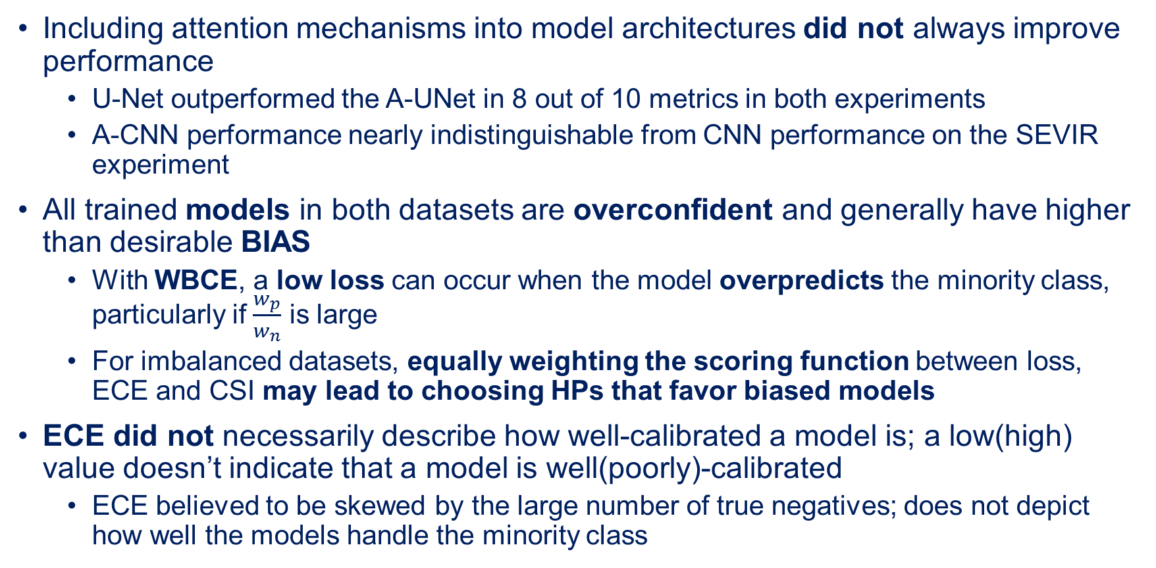
Discussion
Including attention mechanisms into model architectures did not always improve performance
  U-Net outperformed the A-UNet in 8 out of 10 metrics in both experiments
  A-CNN performance nearly indistinguishable from CNN performance on the SEVIR experiment
All trained models in both datasets are overconfident and generally have higher than desirable BIAS
  With WBCE, a low loss can occur when the model overpredicts the minority class, particularly if $\frac{w_{p}}{w_{n}}$ is large
  For imbalanced datasets, equally weighting the scoring function between loss, ECE and CSI may lead to choosing HPs that favor biased models
ECE did not necessarily describe how well-calibrated a model is; a low(high) value doesn’t indicate that a model is well(poorly)-calibrated
  ECE believed to be skewed by the large number of true negatives; does not depict how well the models handle the minority class
Notes:
With that said, it was also observed that including attention mechanisms did not always improve model performance, which counters the prevailing thought that attention generally improves model performance. For instance, the U-Net outperformed the A-UNet in all metrics except the Recall metrics in both experiments. Furthermore, in the real-world experiment, there is not evidence to conclude at the 95% confidence level that there is a significant difference between the performance of the A-CNN and CNN in eight of the 10 metrics.
Furthermore, we saw that, in totality, all of our trained models in both datasets were overconfident and generally attained higher than desirable biases. The overconfidence and high bias are both linked to the models overpredicting the positive, or minority, class. More specifically, with weighted binary cross entropy, a low loss function value can still occur when the model overpredicts, or is biased towards, the positive or minority class, especially if the ratio between the positive and negative class weights is large. Thus, during our tuning process, models which achieve minimal loss, and that are Pareto solutions, may do so by being bias. These low loss value are then equally weighted in the scoring function, which may lead to choosing optimal hyperparameters that inherently favor a bias model. This suggests that in future works which utilize this approach and an imbalanced dataset, a different weighting in the scoring function should be explored.
Finally, we saw that with these imbalanced datasets, ECE didn’t describe how well calibrated a model was, indicating that a different calibration method may be preferable when dealing with such datasets.
-----------------------------------------------------------------------
Question: Why doesn’t ECE describe model calibration well?
Answer: In the cases here, we believe it’s due to the nature of the imbalanced data. Part of the ECE calculation is model accuracy, which inherently includes when a model correctly predicts the non-occurrence of an event (ie a true negative). With a large number of true negatives, ECE may be skewed and depict the error associated with the model’s ability to predict the non-occurrence of events.

Slide 23
Future Work
Investigate the effect of attention mechanisms on model calibration
  Do attention mechanisms inherently improve model calibration?
  Where in model design do attention mechanisms provide the most benefit to the model?
Develop better Pareto scoring function
  Find combination of metrics that will produce inherently unbiased models
Apply methodology to other dangerous weather phenomena that are difficult to predict
  Tornadoes are of particular interest
Notes:
Moving forward with this research, we plan in investigating the affect that attention mechanisms have on model calibration and performance.
Additionally, we are working on developing a better scoring function for our Pareto analysis, which entails exploring other metrics to use to determine a models reliability
Finally, lightning isn’t the only dangerous weather phenomenon that people have to live with, so we plan on applying this methodology to other severe weather events that are hard to predict. Tornadic events are of particular interest.

Slide 24
Questions
?
Notes:
Pending any questions, this concludes the presentation.

Slide 25
References
[1] Holle, R. L. (2014), Some aspects of global lightning impacts, in ‘2014 International Conference on Lightning Protection (ICLP)’, IEEE, pp. 1390–1395.
[2] Jensenius Jr, J. S. (2015), ‘A detailed analysis of lightning deaths in the united states from 2006 through 2014’, Executive Summary. United States: National Weather Service.
[3] Federal Aviation Administration (2023), 'NextGen Weather', URL: https://www.faa.gov/nextgen/programs/weather/faq
[4] Federal Aviation Administration (2020), 'Cost of Delay Estimates', URL: https://www.faa.gov/sites/faa.gov/files/data_research/aviation_data_statistics/cost_delay_estimates.pdf
[5] Lichtenstein, S., Fischhoff, B. and Phillips, L. D. (1977), Calibration of probabilities: The state of the art, in ‘Decision Making and Change in Human Affairs: Proceedings of the Fifth Research Conference on Subjective Probability, Utility, and Decision Making, Darmstadt, 1–4 September, 1975’, Springer, pp. 275–324.
[6] Guo, C., Pleiss, G., Sun, Y. and Weinberger, K. Q. (2017), On calibration of modern neural networks, in ‘International conference on machine learning’, PMLR, pp. 1321–1330.
[7] Brodehl, S., M¨uller, R., Sch¨omer, E., Spichtinger, P. and Wand, M. (2022), ‘End-to-end prediction of lightning events from geostationary satellite images’, Remote Sensing 14(15), 3760.
[8] Cintineo, J. L., Pavolonis, M. J. and Sieglaff, J. M. (2022), ‘Probsevere lightningcast: A deep-learning model for satellite-based lightning nowcasting’, Weather and Forecasting 37(7), 1239–1257.

Slide 26
References
[9] Geng, Y.-a., Li, Q., Lin, T., Jiang, L., Xu, L., Zheng, D., Yao, W., Lyu, W. and Zhang, Y. (2019), Lightnet: A dual spatiotemporal encoder network model for lightning prediction, in ‘Proceedings of the 25th ACM SIGKDD international conference on knowledge discovery & data mining’, pp. 2439–2447.
[10] Li, Y., Liu, Y., Sun, R., Guo, F., Xu, X. and Xu, H. (2023), ‘Convective storm vil and lightning nowcasting using satellite and weather radar measurements based on multi-task learning models’, Advances in Atmospheric Sciences pp. 1–13.
[11] Lagerquist, R., McGovern, A., Homeyer, C. R., Gagne II, D. J. and Smith, T. (2020), ‘Deep learning on three-dimensional multiscale data for next-hour tornado prediction’, Monthly Weather Review 148(7), 2837–2861.
[12] Oktay, O., Schlemper, J., Folgoc, L. L., Lee, M., Heinrich, M., Misawa, K., Mori, K., McDonagh, S., Hammerla, N. Y., Kainz, B. et al. (2018), ‘Attention u-net: Learning where to look for the pancreas’, arXiv preprint arXiv:1804.03999.
[13] Pereyra, G., Tucker, G., Chorowski, J., Kaiser, L. and Hinton, G. (2017), ‘Regularizing neural networks by penalizing confident output distributions’, arXiv preprint arXiv:1701.06548.
[14] O’Malley, T., Bursztein, E., Long, J., Chollet, F., Jin, H., Invernizzi, L. et al. (2019), ‘Kerastuner’, https://github.com/keras-team/keras-tuner.
[15] Mann, H. B. and Whitney, D. R. (1947), ‘On a test of whether one of two random variables is stochastically larger than the other’, The annals of mathematical statistics pp. 50–60.
[16] Srivastava, N., Mansimov, E. and Salakhudinov, R. (2015), Unsupervised learning of video representations using lstms, in ‘International conference on machine learning’, PMLR, pp. 843–852.
[17] Vaswani, A., Shazeer, N., Parmar, N., Uszkoreit, J., Jones, L., Gomez, A. N., Kaiser, L. and Polosukhin, I. (2017), ‘Attention is all you need’, Advances in neural information processing systems 30.

