Slide 1
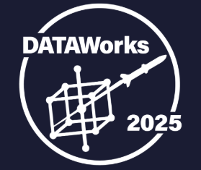
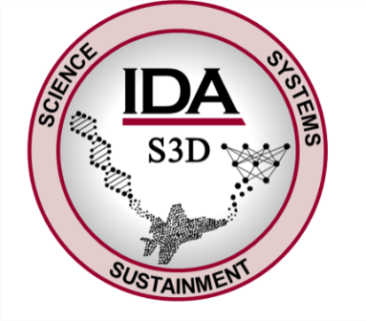
SERPENS: Assessing the Operational Impacts of
Orbital Debris
Cameron Liang
Benjamin Skopic
Hannah Yi
April 23, 2025

Slide 2
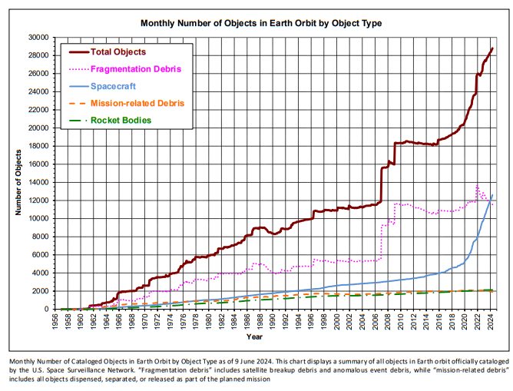
The number of objects in space is growing rapidly.
Orbital debris grows when existing debris strikes satellites.
What is the probability of a conjunction (or collision) between a satellite and debris?
How much debris is generated from a collision?
2. Collisions of Kosmos 2251 with Iridium 33 (~1330 fragments)
4. Russian A-SAT: Destruction of Kosmos 1408 (~1500 fragments) in November 2021
1. Chinese A-SAT: Destruction of Fengyun-1C (~2600 fragments)
3. Commercial Launches (e.g., SpaceX)
Assessment of current and future risks of orbital debris requires modeling and simulation of the entire space environment
A-SAT – anti-satellite

Slide 3
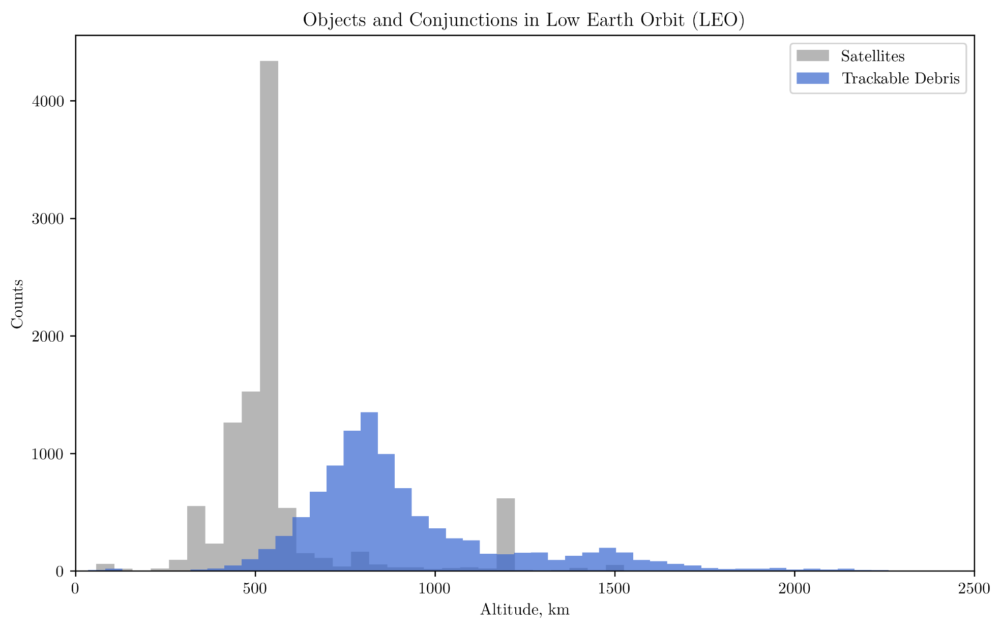
How do we operate in an extreme debris environment?
The mission effectiveness of current and future satellites is threatened by the increasing need for orbit maneuvering.
Starlink
Iridium
NOAA
SDA
Kuiper
Existing and planned constellations need to operate in areas with high debris density
OneWeb
NOAA – National Oceanic and Atmospheric Administration; SDA – Space Development Agency
Notes:
Iridium: 780 km
NOAA: 800 km
SDA Tranche 0: 950 km
SDA Tranche 1*: 750 – 1000 km

Slide 4
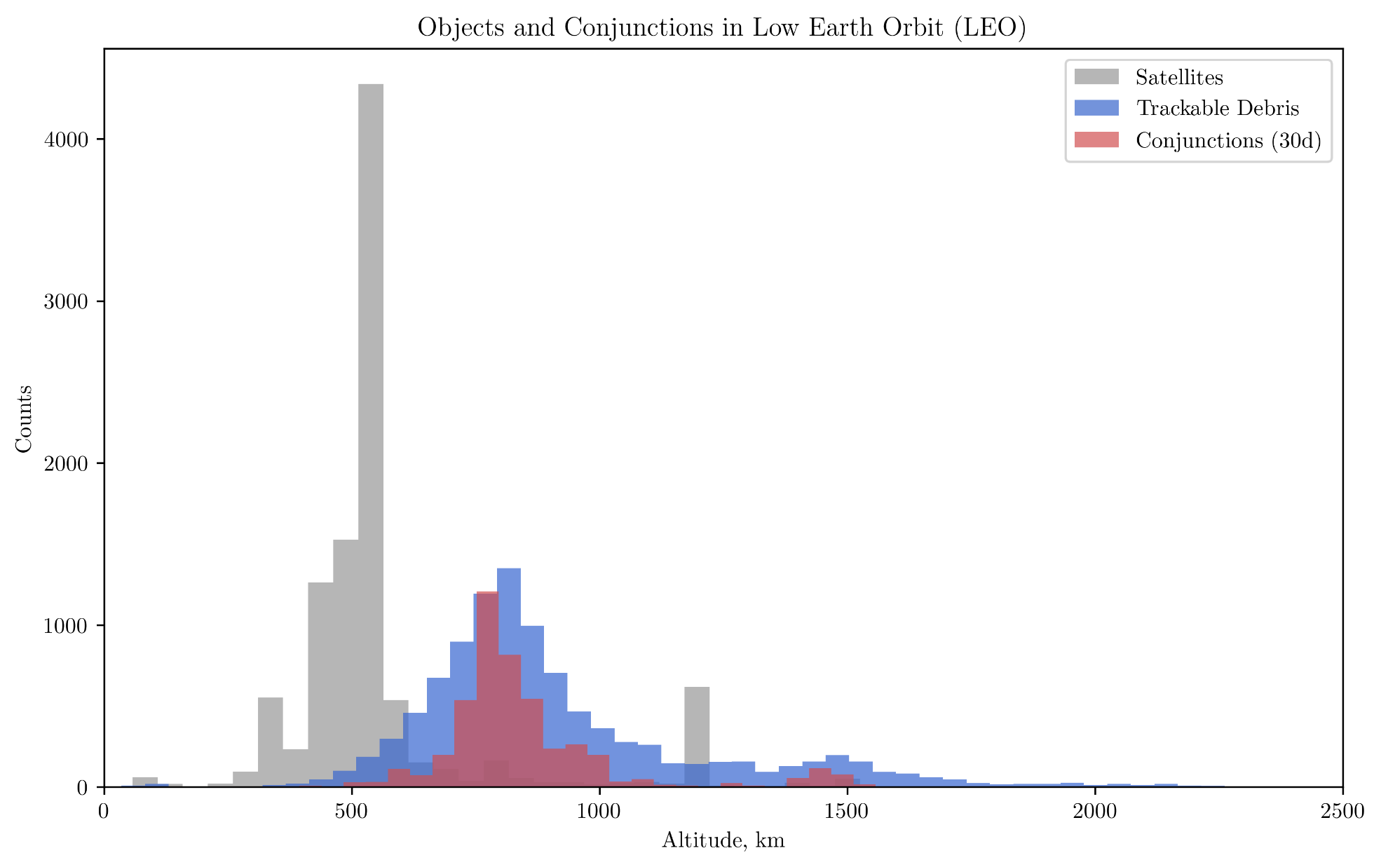
How do we operate in an extreme debris environment?
The mission effectiveness of current and future satellites is threatened by the increasing need for orbit maneuvering.
Satellite operators receive conjunction messages when a collision between debris and satellites is predicted
Make a decision:
maneuver and affect mission coverage
risk a collision, kill satellite, generate debris
Notes:
Iridium: 780 km
NOAA: 800 km
SDA Tranche 0: 950 km
SDA Tranche 1*: 750 – 1000 km

Slide 5
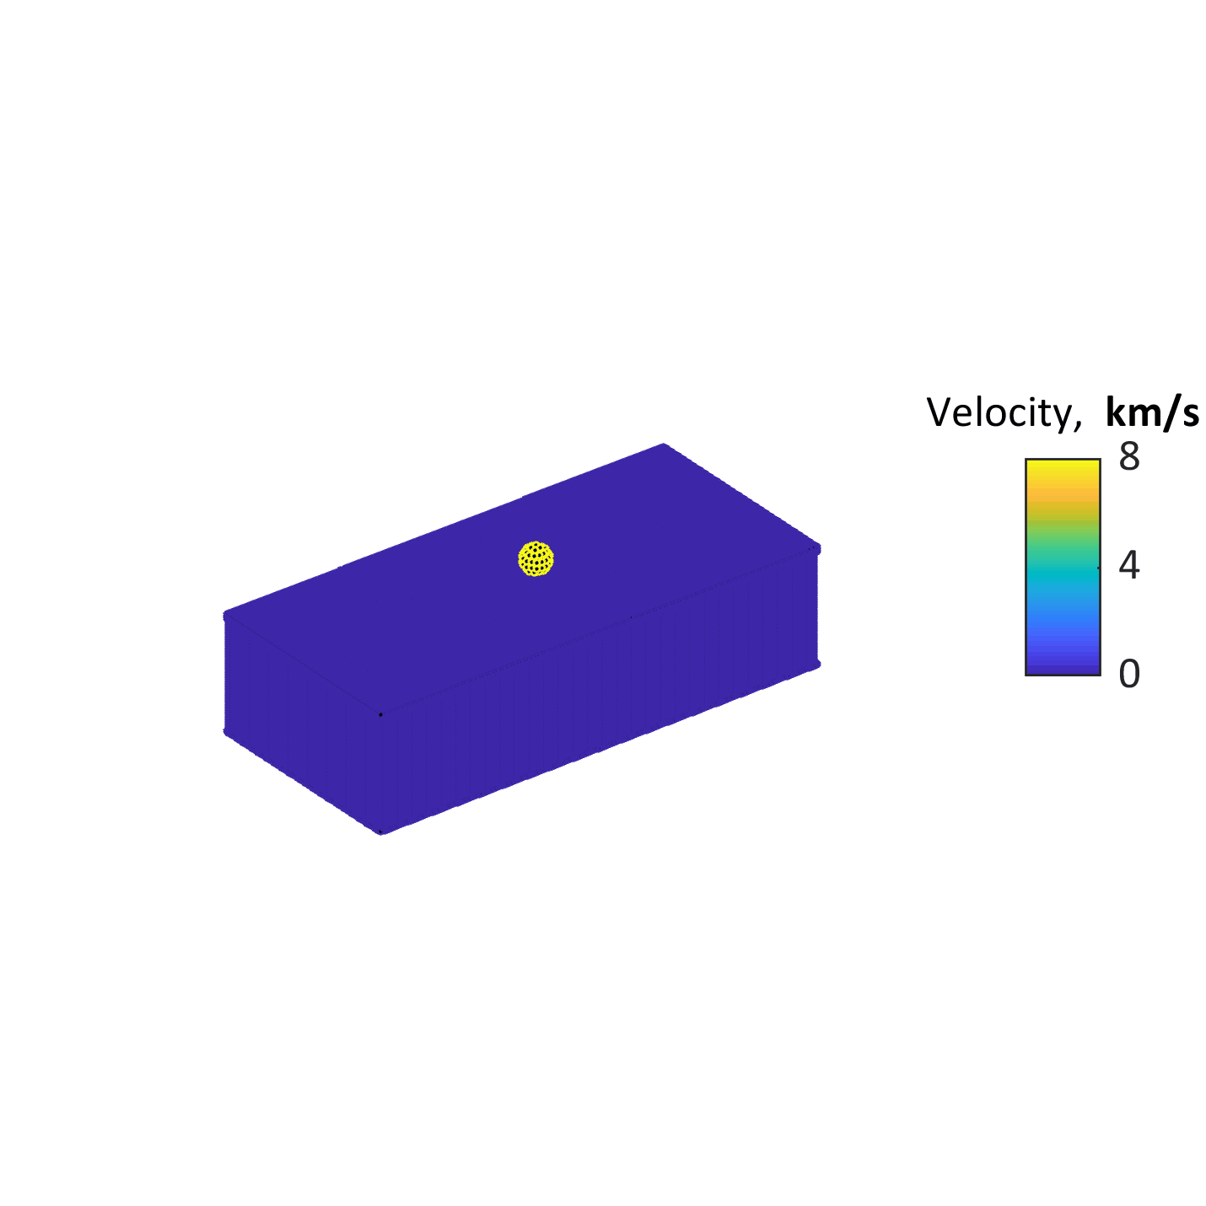
How do we operate in an extreme debris environment?
The mission effectiveness of current and future satellites is threatened by the increasing need for orbit maneuvering.
Failure to successfully maneuver after a conjunction message can lead to satellite failure and massive debris generation

Slide 6
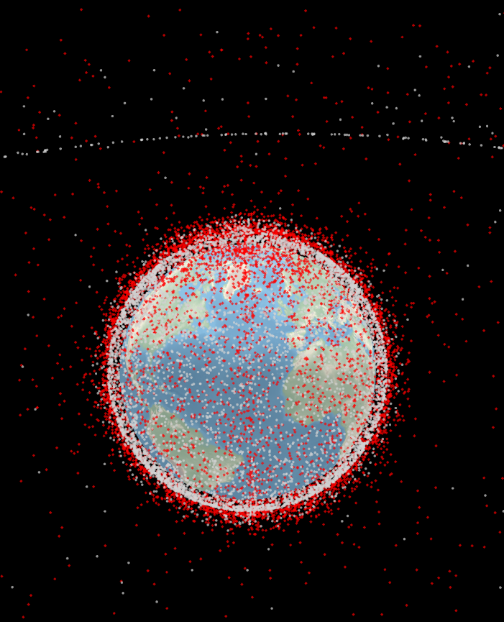
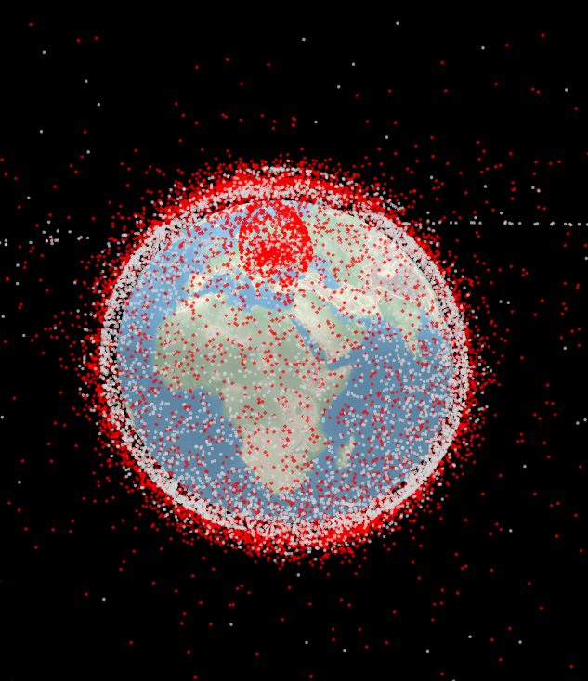
IDA built SERPENS, a space simulation tool, to model the effects of space threats and evaluate the mission impact.
Current near-Earth environment:
10832 active satellites
11683 tracked debris
SERPENS (Space Environment Risk Prediction by Evaluating Numerical Simulations)
Mission capabilities:
Orbit propagation
Probability of collision
Active maneuvering
Payload (radar, electro-optical, infrared)
Modeled scenarios:
Debris
Anti-satellite weapons (A-SATs)
Natural radiation
Jamming
Cyber takeover
Mission impacts:
Mission availability
Satellite field-of-regard or ground coverage
Fuel consumption
Operational lifetime
Notional Scenario: Space station explosion
Topics of this brief

Slide 7
Choosing an orbit propagator to predict debris position over time needs to balance development flexibility with computation efficiency.
F(x)
F(x)
F(x)
F(x)
Analytic Propagation
Numerical Propagation
Pro: Closed-form solution
Con: Complex F(x) – difficult to customize additional perturbations
Pro: Easy to customize additional time-dependent perturbations
Con: Can be computationally slow

Slide 8
SERPENS uses a numerical propagator for dynamic mission assessments.
Capability | SGP4 (Analytic) | SERPENS (Numerical)
Easy to implement | Yes | Custom code development
Community trust and acceptance of algorithm | Yes, used in operations | Similar numerical methods are trusted
Flexible framework for adding adequate perturbations for custom scenarios | No | Yes
Ability for dynamic orbit modifications and maneuvering | No | Yes
Timely orbit predictions for fast computations and research cadence | Better | Adequate
Modularity for building in mission-specific constellations and threat effects | Post-propagation | During propagation
Potential for non-Earth orbiting or exotic scenarios | No | Yes
SGP4 – Simplified Perturbation Model 4
Notes:
Numerical propagators provide a flexible framework for

Slide 9
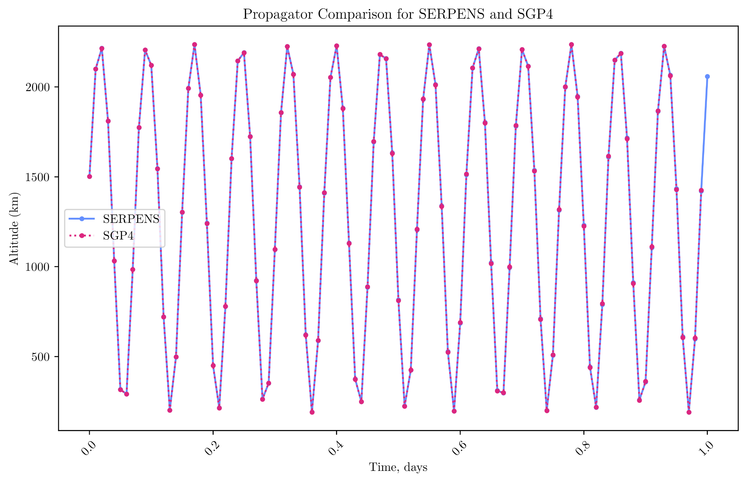
Orbit prediction using the numerical propagator in SERPENS is comparable to the performance of an industry standard analytical propagator.

Slide 10
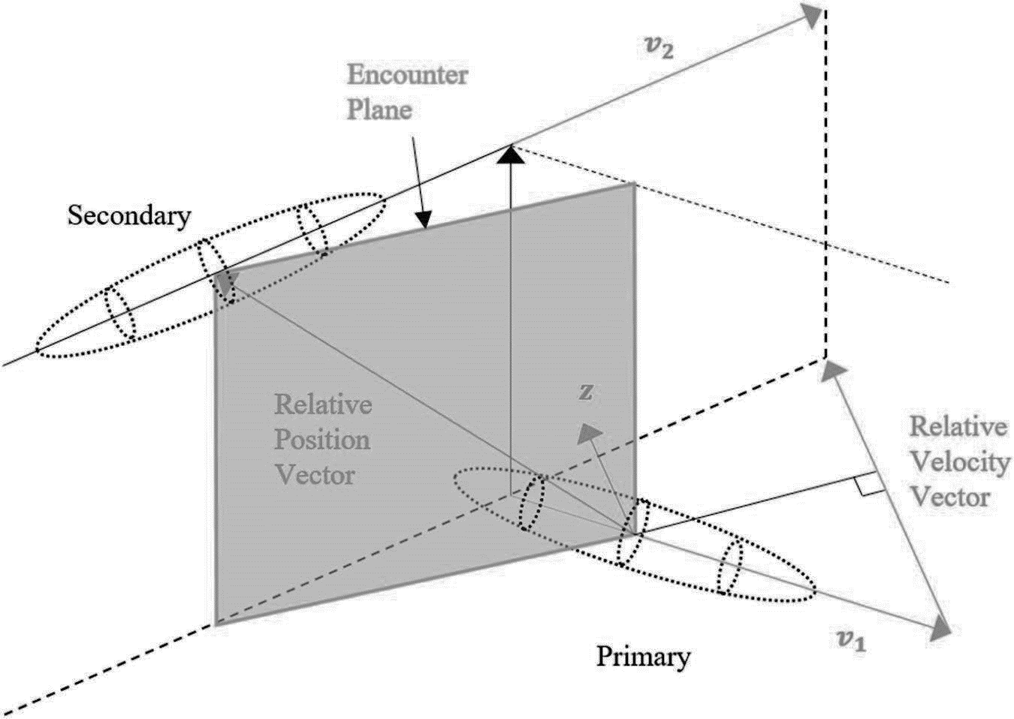
SERPENS calculates the probability of collisions (P_{c}).
19th Space Defense Squadron (SDS) near-Earth conjunction calculation:
Integrate overlap of the 3D positional uncertainty bubbles of each object.
Linear approximation within one minute of the time-of-closest-approach (TCA) and radius-of-closest-approach (RCA).
Limit conjunction assessments to:
Satellite – satellite
Satellite – debris
Objects that are within 700 km of each other at the start of each timestep

Slide 11
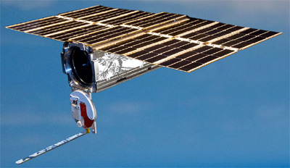
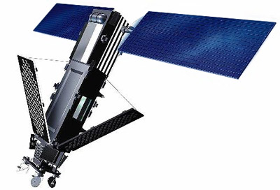
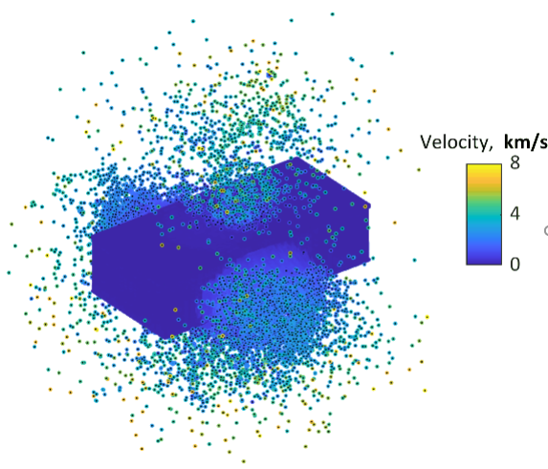
We model a coordinated A-SAT attack on the FLOCK constellation.
Constellation | Mission | Population | Altitude (km) | Inclination
FLOCK | Ground Observation | 96 | 400 – 515 | 97°
IRIDIUM | Satellite Communications | 80 | 780 | 86.4°
Notional A-SAT scenario:
All 96 satellites explode simultaneously.
Debris generation modeled by NASA breakup model.
Sampled 50 debris each explosion: ~5000 new debris.
Use SERPENS to analyze mission impacts on IRIDIUM.

Slide 12
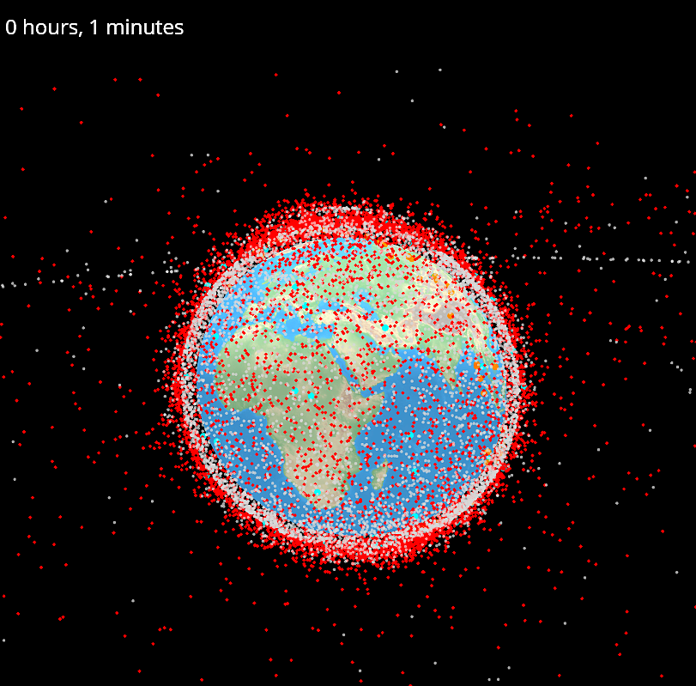

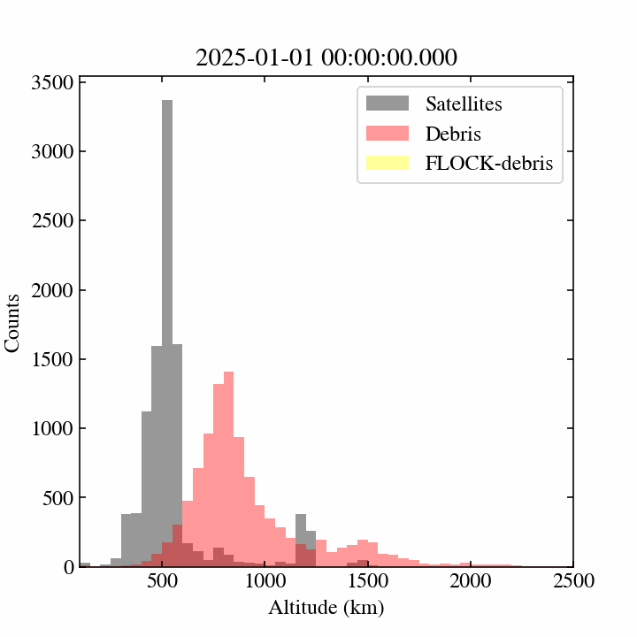

Notional Scenario: Coordinated A-SAT attack on the FLOCK constellation
FLOCK
IRIDIUM
Satellites
Debris
FLOCK-debris

Slide 13
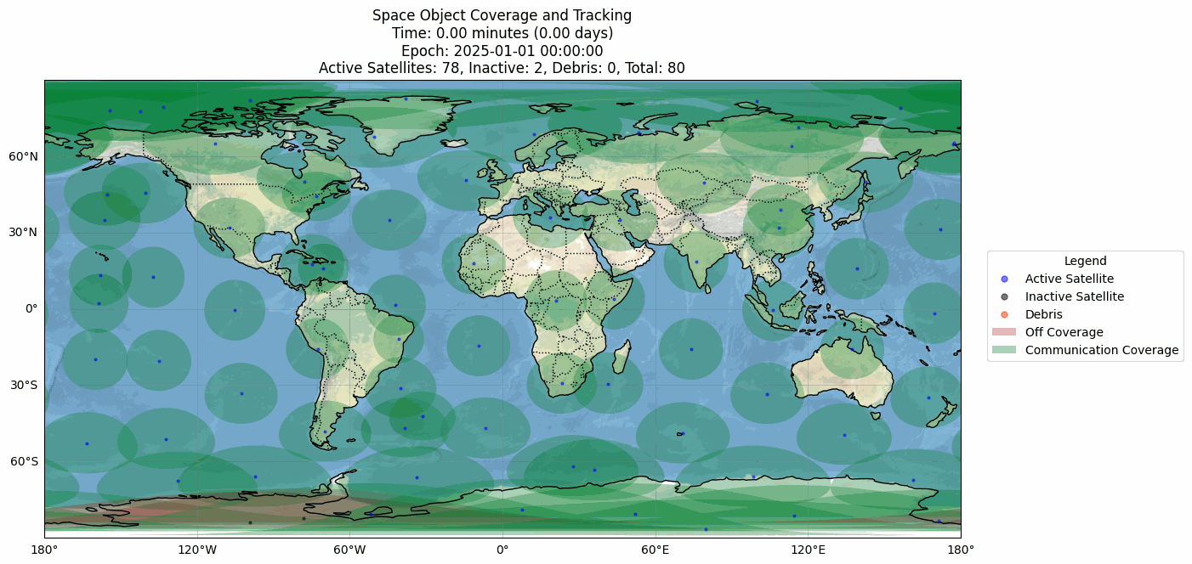
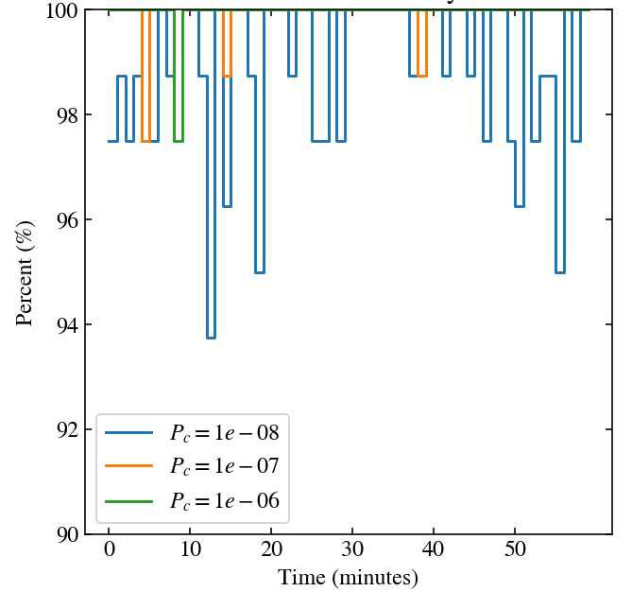
Iridium satellites are less available due to the extreme debris environment.
Num. Active: 80
Altitude: 780 km
Inclination: 86.4°
Iridium Mission Availability
Note: Off (red) when Pc > 10⁻⁸

Slide 14

SERPENS is growing to become a versatile testbed for future space operations.
Future capabilities include:
Simulate effectiveness of future improvements to our space domain awareness (SDA) infrastructure
Mission and orbit planning of future systems
Operational test and evaluation (T&E) of future systems
T&E algorithms for automated collision avoidance
Classified threat analyses
High-fidelity electro-optical/infrared (EO/IR) & RADAR modeling

Slide 15
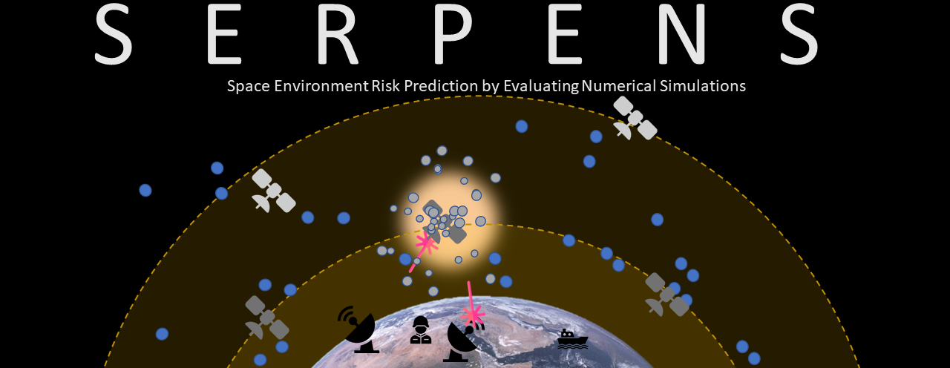

Questions?

Slide 16
Backup Slides

Slide 17
References
Zhang, Yan, Bin Li, Hongkang Liu & Jizhang Sang. “An Analysis of Close Approaches and Probability of Collisions Between LEO Resident Space Objects and Mega Constellations.” Geo-Spatial Information Science, 25(1), 104–120. https://doi.org/10.1080/10095020.2022.20313132022.
Hesar, Siamak. Coordinate Frame, Ephemeris & Covariance File Formats. SSA Operators’ Workshop 2018.
Frisbee, Joseph H., Jr. An Upper Bound On High Speed Satellite Collision Probability When Only One Object Has Position Uncertainty Information. AAS/AIAA Astrodynamics Specialist Conference, Vail, Colorado, 2015.

Slide 18

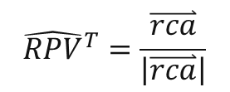
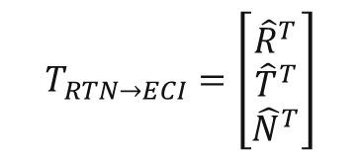
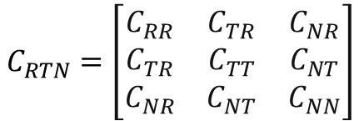

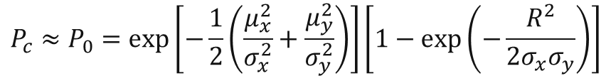

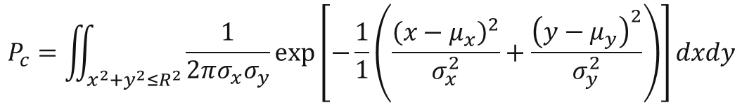

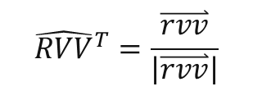
SERPENS calculation of the probability of collisions (P_{c})
$$P_{c}=\iint_{x^{2}+y^{2}≤R^{2}}{\frac{1}{2πσ_{x}σ_{y}}\exp\left[−\frac{1}{1}\left(\frac{{\left(x−μ_{x}\right)}^{2}}{σ_{x}^{2}}+\frac{{\left(y−μ_{y}\right)}^{2}}{σ_{y}^{2}}\right)\right]dxdy}$$
$$P_{c}≈P_{0}=\exp\left[−\frac{1}{2}\left(\frac{μ_{x}^{2}}{σ_{x}^{2}}+\frac{μ_{y}^{2}}{σ_{y}^{2}}\right)\right]\left[1−\exp\left(−\frac{R^{2}}{2σ_{x}σ_{y}}\right)\right]$$
$$C_{RTN}=\left[\begin{matrix}C_{RR} & C_{TR} & C_{NR} \\ C_{TR} & C_{TT} & C_{NT} \\ C_{NR} & C_{NT} & C_{NN}\end{matrix}\right]$$
$$C_{CP}=T_{ECI→CP}T_{RTN→ECI}C_{RTN}T_{RTN→ECI}^{T}T_{ECI→CP}^{T}=\left[\begin{matrix}σ_{x} & σ_{xy} \\ σ_{xy} & σ_{y}\end{matrix}\right]$$
$$T_{RTN→ECI}=\left[\begin{matrix}{\hat{R}}^{T} \\ {\hat{T}}^{T} \\ {\hat{N}}^{T}\end{matrix}\right]$$
$$\hat{R} =\frac{\overset{⃑}{r}}{\left|\overset{⃑}{r}\right|}$$
$$\hat{N} =\overset{⃑}{r}×\overset{⃑}{v}$$
$$\hat{T}=\hat{N}×\hat{R}$$
$$T_{ECI→CP}=\left[\begin{matrix}{\hat{RPV}}^{T} \\ {RVV}^{T}\end{matrix}\right]$$
$${\hat{RPV}}^{T}=\frac{\overset{⃑}{rca}}{\left|\overset{⃑}{rca}\right|}$$
$${\hat{RVV}}^{T}=\frac{\overset{⃑}{rvv}}{\left|\overset{⃑}{rvv}\right|}$$

Slide 19

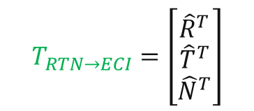
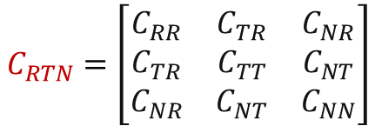
SERPENS calculation of the probability of collisions (P_{c})
$$P_{c}=\iint_{x^{2}+y^{2}≤R^{2}}{\frac{1}{2πσ_{x}σ_{y}}\exp\left[−\frac{1}{1}\left(\frac{{\left(x−μ_{x}\right)}^{2}}{σ_{x}^{2}}+\frac{{\left(y−μ_{y}\right)}^{2}}{σ_{y}^{2}}\right)\right]dxdy}$$
$$P_{c}≈P_{0}=\exp\left[−\frac{1}{2}\left(\frac{μ_{x}^{2}}{σ_{x}^{2}}+\frac{μ_{y}^{2}}{σ_{y}^{2}}\right)\right]\left[1−\exp\left(−\frac{R^{2}}{2σ_{x}σ_{y}}\right)\right]$$
$$C_{RTN}=\left[\begin{matrix}C_{RR} & C_{TR} & C_{NR} \\ C_{TR} & C_{TT} & C_{NT} \\ C_{NR} & C_{NT} & C_{NN}\end{matrix}\right]$$
$$C_{CP}=T_{ECI→CP}T_{RTN→ECI}C_{RTN}T_{RTN→ECI}^{T}T_{ECI→CP}^{T}=\left[\begin{matrix}σ_{x} & σ_{xy} \\ σ_{xy} & σ_{y}\end{matrix}\right]$$
$$T_{RTN→ECI}=\left[\begin{matrix}{\hat{R}}^{T} \\ {\hat{T}}^{T} \\ {\hat{N}}^{T}\end{matrix}\right]$$
$$\hat{R} =\frac{\overset{⃑}{r}}{\left|\overset{⃑}{r}\right|}$$
$$\hat{N} =\overset{⃑}{r}×\overset{⃑}{v}$$
$$\hat{T}=\hat{N}×\hat{R}$$
$$T_{ECI→CP}=\left[\begin{matrix}{\hat{RPV}}^{T} \\ {RVV}^{T}\end{matrix}\right]$$
$${\hat{RPV}}^{T}=\frac{\overset{⃑}{rca}}{\left|\overset{⃑}{rca}\right|}$$
$${\hat{RVV}}^{T}=\frac{\overset{⃑}{rvv}}{\left|\overset{⃑}{rvv}\right|}$$

Slide 20
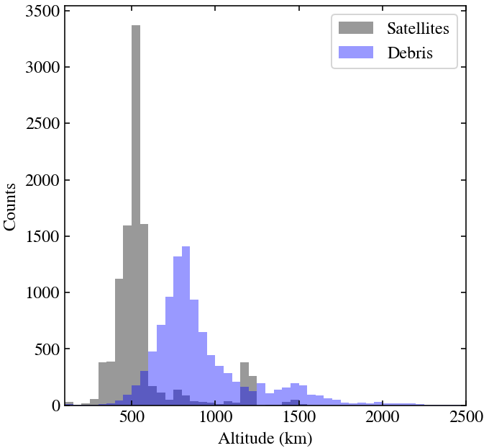
How do we operate in an extreme debris environment?
Current and future satellites are threatened by an extreme debris environment.
Iridium: 780 km
NOAA: 800 km
SDA Tranche 0: 950 km
SDA Tranche 1*: 750 – 1000 km
Must consider orbit location, mission requirements, fuel requirements, maneuver capabilities, etc.
1
2
3
* Planned constellation

Slide 21
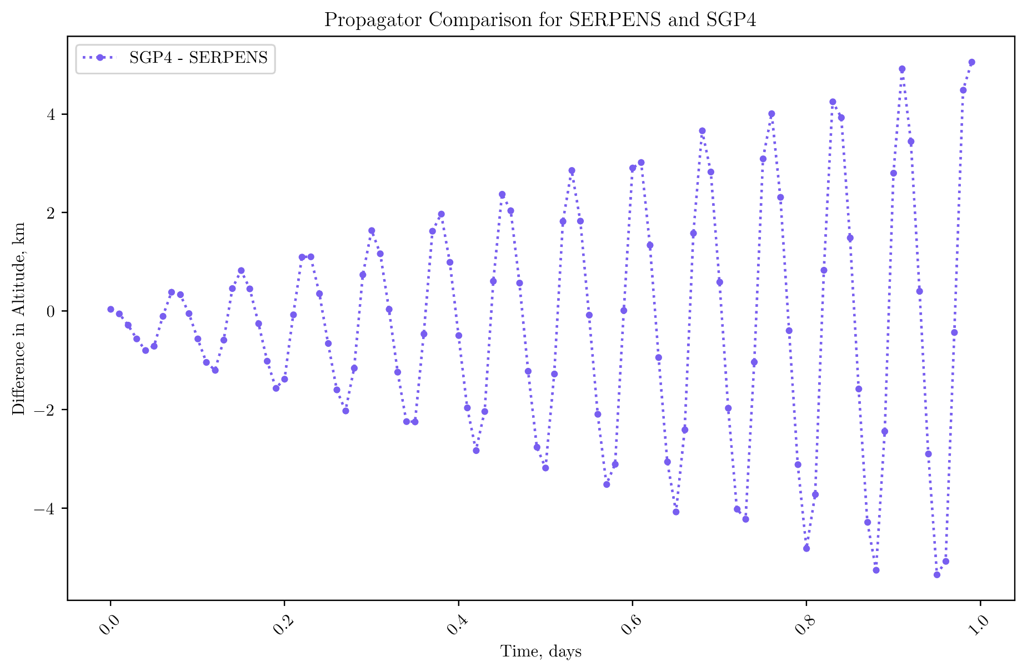
Difference in SGP4 and SERPENS prediction. No drag. 1 LEO orbit

