Slide 1
Mission Engineering
Gabriela Parasidis
Lead Systems Engineer
MITRE Labs
Systems Engineering Innovation Center
gparasidis@mitre.org
Approved for public release. Distribution unlimited PR_23-03761-6
©2024 The MITRE Corporation. ALL RIGHTS RESERVED

Slide 2
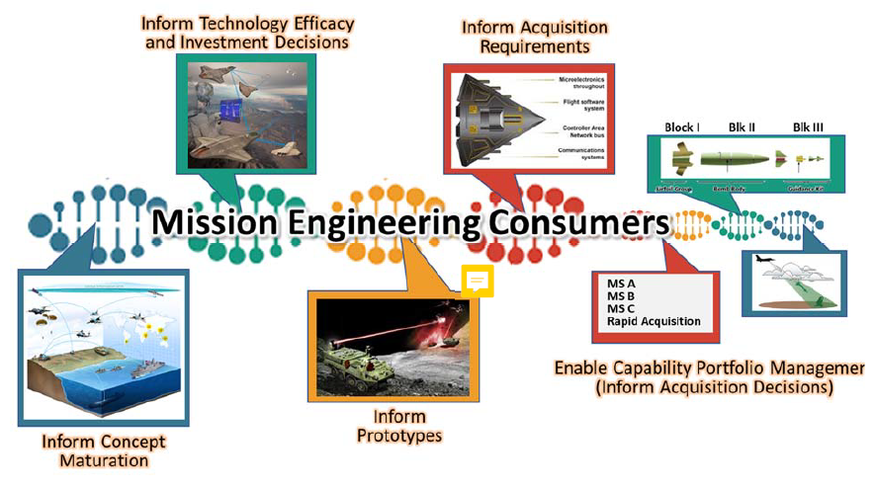
DoD Mission Engineering Defined
ME Guide 2.0 defines ME as
a top-down interdisciplinary approach and process encompassing the entire technical effort to analyze, design, and integrate current and emerging operational needs and capabilities to achieve desired mission outcomes.
ME is a top-down approach that delivers engineering results to identify
enhanced capabilities, technologies, system interdependencies, and architectures
to guide
development, prototypes, experiments, and SoS to achieve reference missions and close mission capability gaps.
The goal of mission engineering is to engineer missions by identifying the right things (i.e., technologies, systems, SoS, or processes) to achieve the intended mission outcomes and provide mission-based inputs into the systems engineering process to aid the Department in building things right.
DoD ME Guide 2.0, 2023, p3
Consumer of ME Results
DoD ME Guide 2.0, 2023, p4

Slide 3
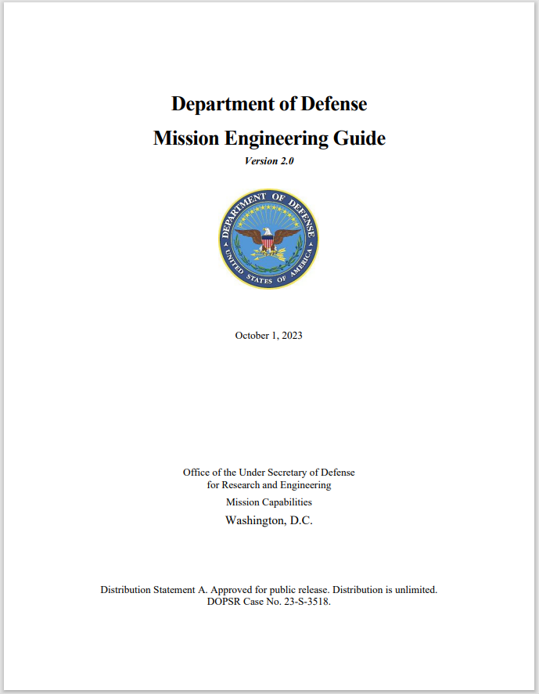
Mission Engineering Guide (MEG)
OUSD (Research and Engineering) published V 1.0 of the Mission Engineering Guide in December 2020 and V2.0 in October 2023
The MEG speaks to a novice that is required to conduct ME
Invokes critical thinking throughout the ME process
Provides overarching guidance and information on ME by:
Explaining what is and what is not ME
Describing the best practices, principles, and attributes for ME
Elaborating on the benefits of using ME
Establishing a set of common terms and definitions
Enables practitioners to formulate problems and build a firm understanding of the main principles involved in performing analysis in a mission context
Obtain a copy of the DoD ME Guide https://ac.cto.mil/wp-content/uploads/2023/11/MEG_2_Oct2023.pdf

Slide 4

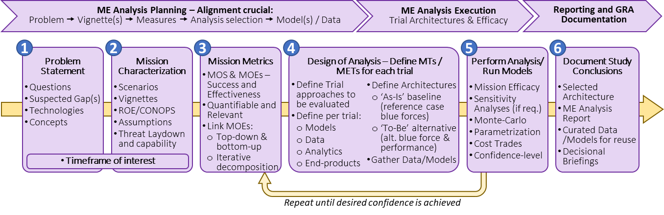
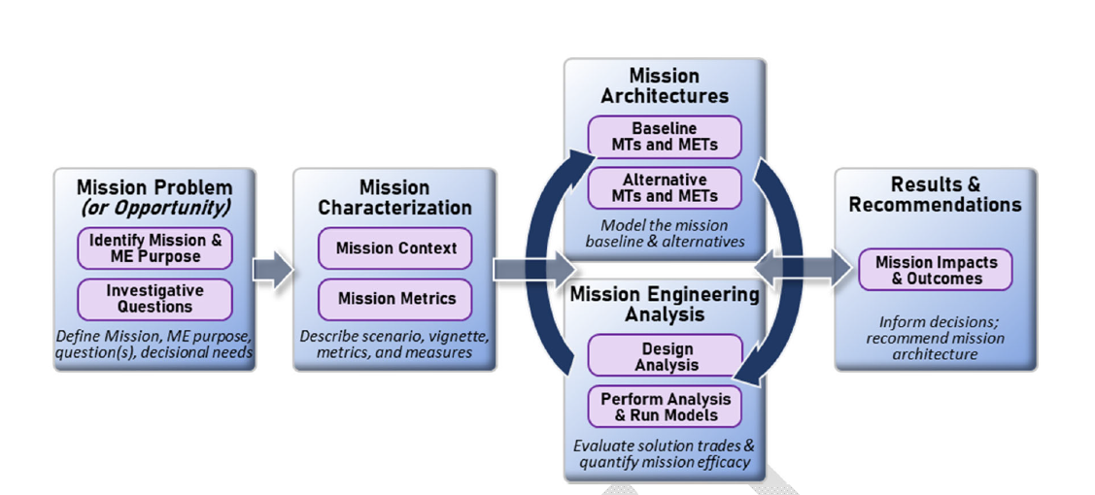
DoD Mission Engineering Methodology
ME Methodology (MET 1.0)
DoD ME Guide 1.0, 2020, p5
DoD ME Guide 2.0, 2023, p5
Notes:
ME process begins with the end in mind, a carefully articulated problem statement, the characterization of the mission and identification of metrics, and working through the collection of data and models needed to analyze the mission and document the output results.

Slide 5
DoD Mission Engineering Methodology (MEG 2.0)
Mission Context
Scenarios
Vignettes
CONOPs
Threat
Develop MTs & METs
Baseline
Alternative
Problem Statement
Questions
Gaps
Concepts
Results
Document
Inform decisions
Mission Metrics
Define mission outcome measures
Operational Analysis
Implement baseline
Implement alternatives
Assess impact on mission metrics
DoD ME Guide 2.0, 2023, p5
Notes:
ME process begins with the end in mind, a carefully articulated problem statement, the characterization of the mission and identification of metrics, and working through the collection of data and models needed to analyze the mission and document the output results.

Slide 6
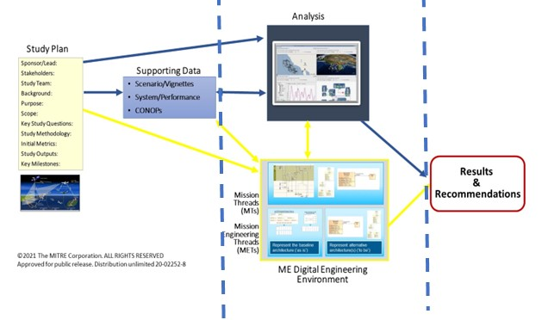

Implementing ME Methodology
Study Plan (Terms of Reference)
The scope: stakeholders, background, problem statement, key questions, hypothesis, methodology/approach, mission context, products/deliverables
Supporting Data
Mission Characterization: Detailed data on the mission scenario and vignette (context for the analysis), threat, systems and their role in execution the mission, etc., assumptions
Digital Mission Modeling
Digital representation of the mission architecture (MTs, METs) for baseline and the alternatives
Mission (Operational) Analysis
Implementation of scenario, systems and activities in operational analysis tool(s)
Simulation runs for baseline and alternatives; outputs quantitative metrics
Results
Results, trends, observations, and recommendations based on mission analysis
6

Slide 7
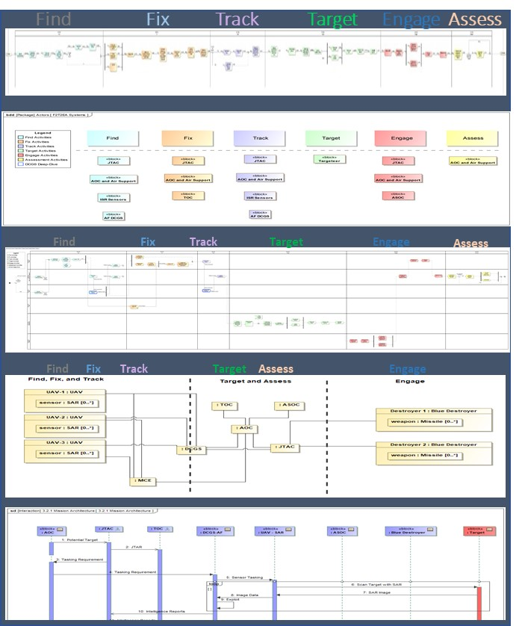
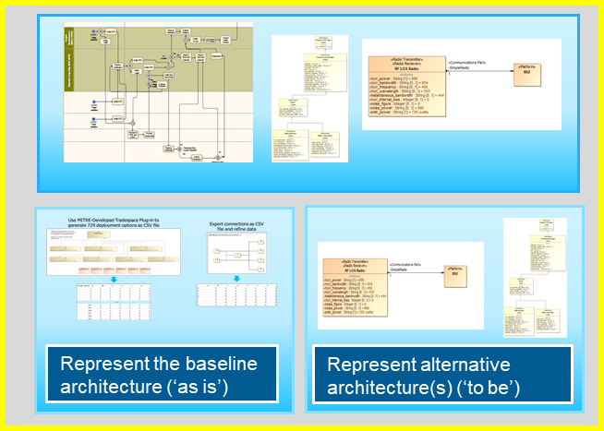
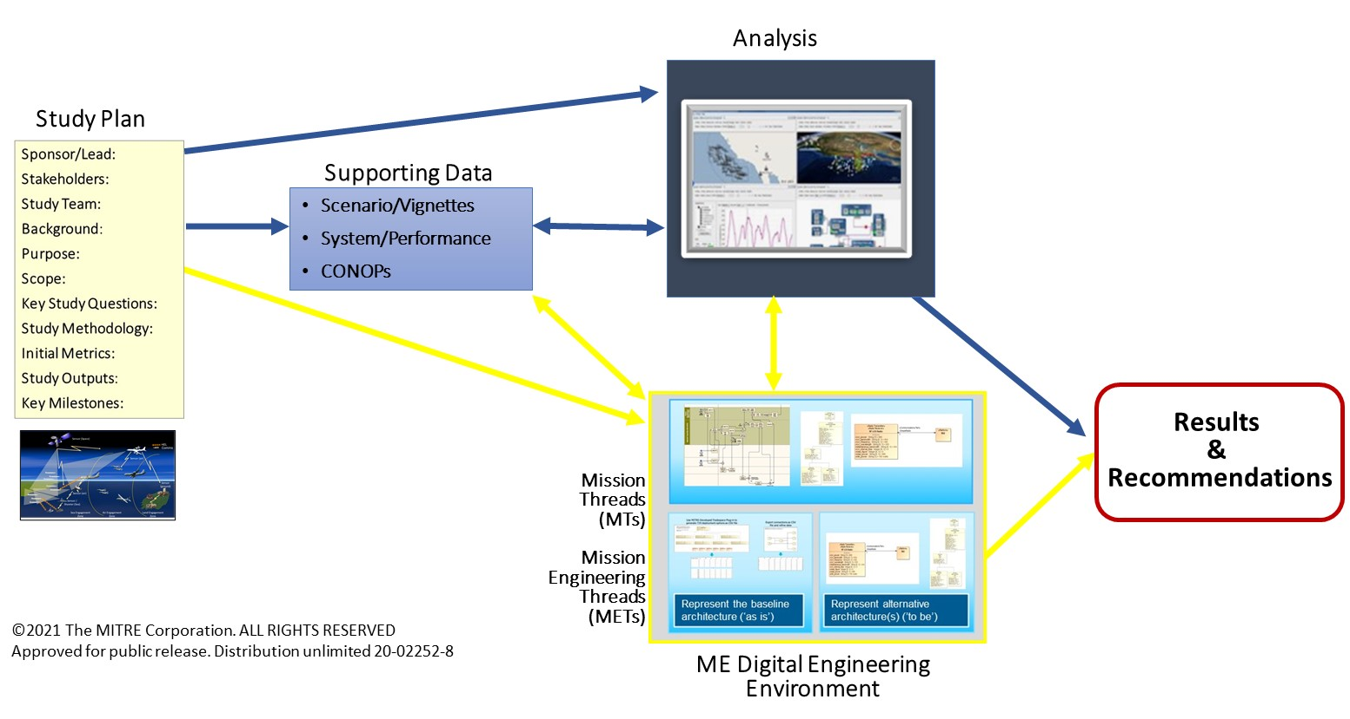
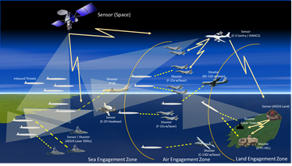
Mission Engineering Activities and Products
Lines of Effort
Mission Models
Operational Simulation
Tool: CAMEO/SysML
Tool: AFSIM
Digital representation of the baseline Mission Threads (MTs) scenario independent activities and Mission Engineering Threads (METs) adding scenario specific organizations and activities
Updated MTs and METs to include new Concepts with associated changes
Representation of the baseline MTs/METs within scenario including threat, systems’ attributes and behaviors – conduct baseline analysis of mission metrics
Update the systems’ attributes and behaviors as specified in RDER concepts and assess impact on mission metrics
Baseline
Alternatives
MISSION THREAD ALIGNMENT
[TRACEABILITY]
QUANTITATIVE ANALYSIS
[MISSION METRICS – OUTPUTS]
7

Slide 8
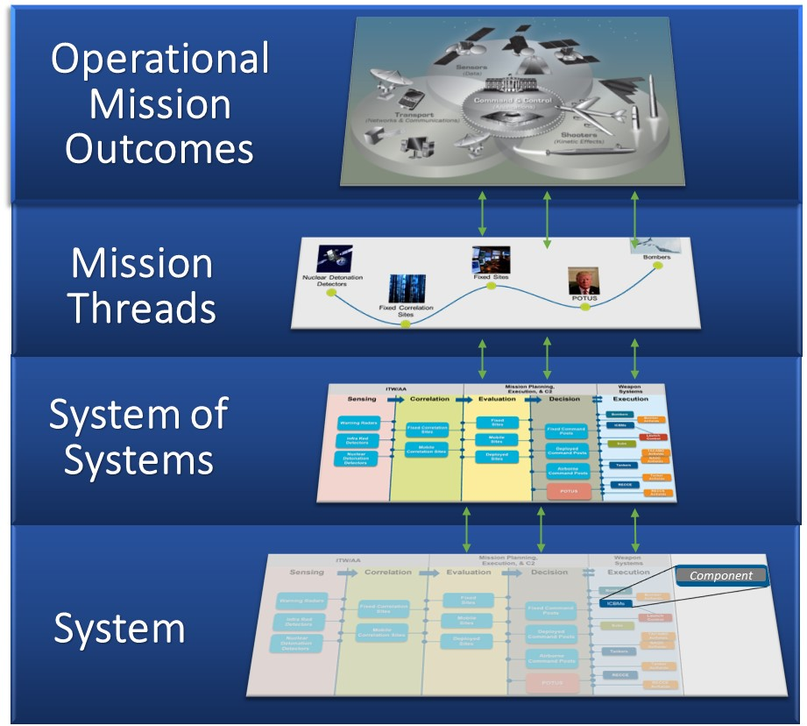
ME Methodology and Role of Mission Engineering Threads (METs)
Mission Threads and Mission Engineering Threads
SoS Architectures for Baseline and Alternatives
Mission Engineering Threads
SoS Architecture
For Mission Scenario
Mission Engineering Guide, 2.0, p5

Slide 9
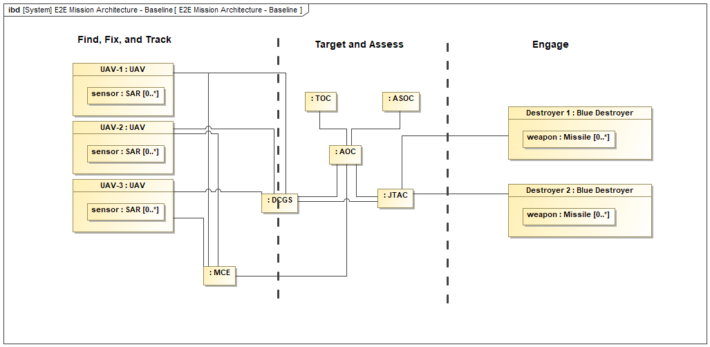
Mission Models
Mission Threads (MTs) and Mission Engineering Threads (METs)
Mission Thread (MT): An end-to-end sequence of tasks, activities and events to execute a mission.
In executing ME
MTs define the essential sequence of activities in the execution of the mission
key elements of the operational mission architecture
METs are used to define the systems / SoS in the execution of the mission activities
key elements of the systems of systems architecture
Find
Fix
Track
Target
Engage
Assess
Mission Engineering Thread (MET): Mission threads that include technical details of the capabilities and systems required and utilized to execute the tasks and activities for a mission.
Find
Fix
Track
Target
Assess
Engage
MTs and METs provide an organizing construct across RDER proposal selection, concept maturation, experimentation, and transition

Slide 10
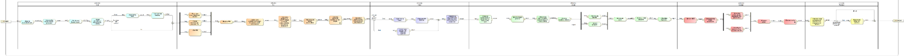
Baseline Mission Thread – Joint Targeting
Mission Thread – lays out the set of actions needed to accomplish the mission
Find
Fix
Track
Target
Engage
Assess
Unclassified model
This core mission thread provides context for representing the activities and systems
Found in the baseline scenario – the mission thread (MT) becomes a mission engineering thread (MET) when activities are allocated to systems
Changes are made to the baseline mission activities and systems when the concept is introduced into the scenario
10

Slide 11
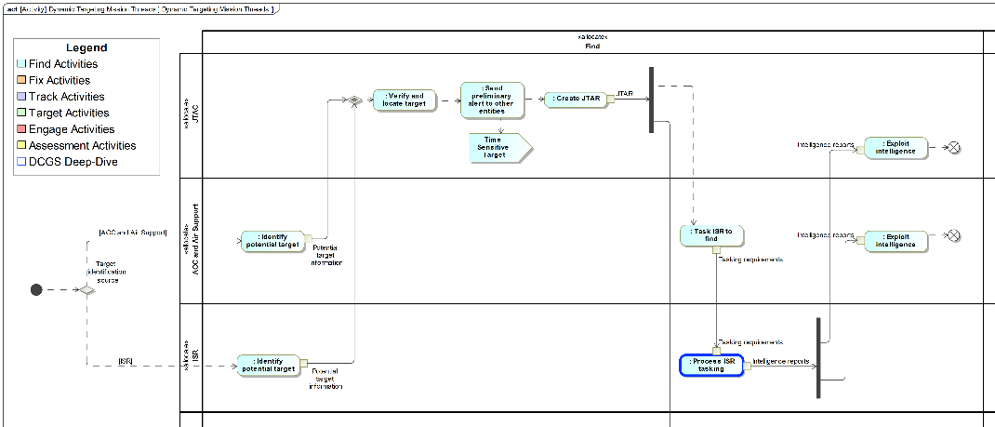
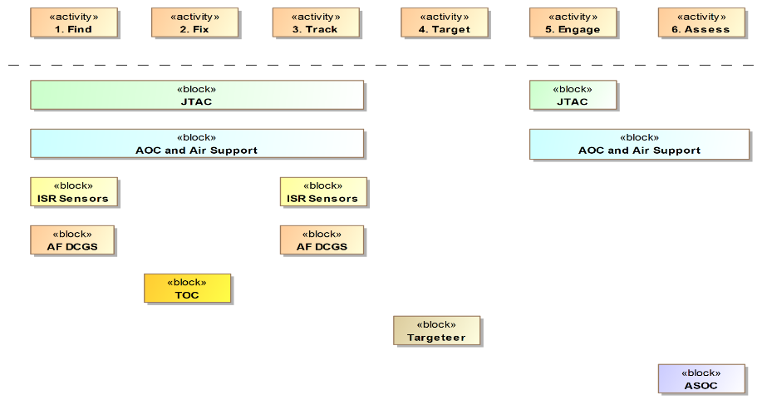
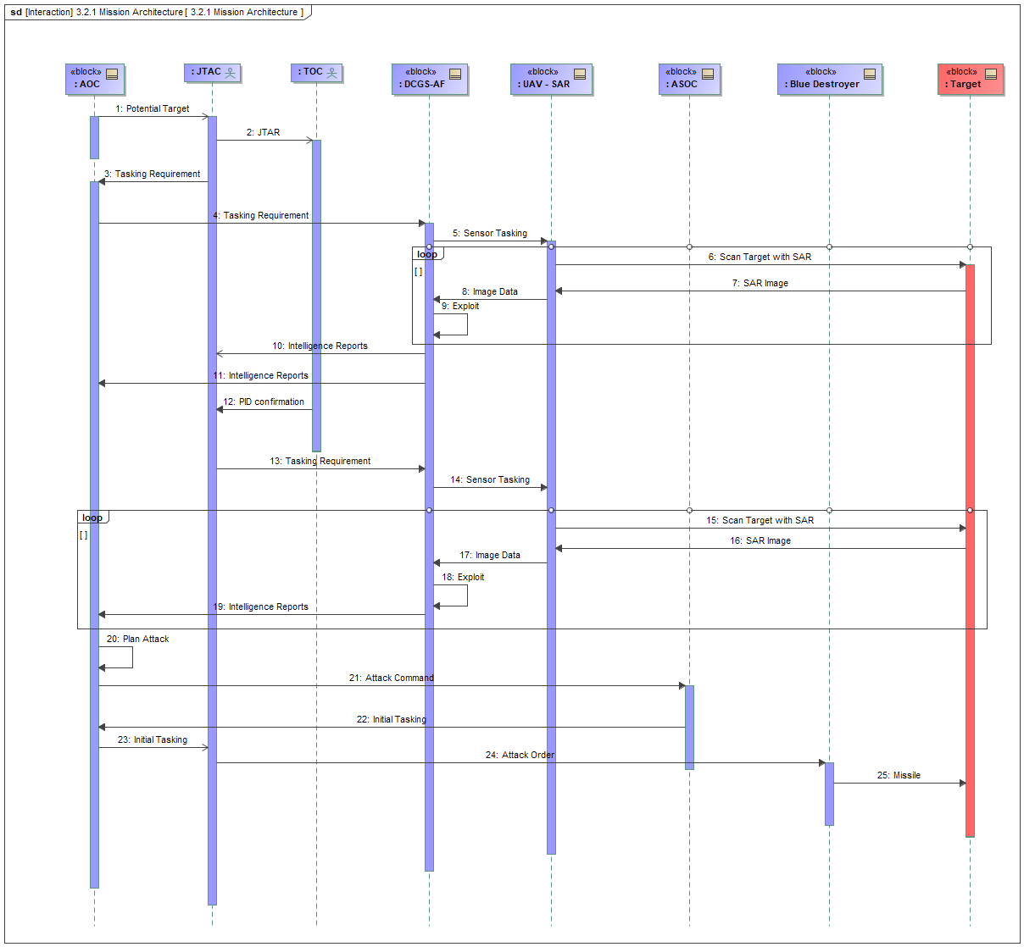
Views of Digital Mission Models
Unclassified model
Apply systems and organizations to base MT
Systems employed to execute MT activities
End-to-end flow of systems interaction
Sequence of system to system interactions
11

Slide 12
Digital Mission Architecture Development Process
Graphic or Textual Source Depictions of Individual Kill Chains (METs)
Integrated Kill Web (includes multiple Kill Chains that can execute in parallel)
Digital Representations of Individual Kill Chains (METs)
12

Slide 13
ME Digital Mission Models
Baseline MT and MET Models
New Concepts
How would BLUE fight in this scenario?
Identify BLUE kill chains – develop BLUE mission engineering threads (Baseline METs)
How will these change when we introduce new concepts?
Update the baseline METs to add concepts (Alternative METs)
Activities
What new activities are now needed to execute the mission?
Systems supporting
Activities
What new systems does the concept require?
Organizations executing
activities
What different organizations are now part of mission execution? Which activities do they execute?
End-to-end flow of SoS
How does this change the execution of the End-to-end (E2E) SoS?
Sequence of actions
How does this change the sequence of actions?
13

Slide 14
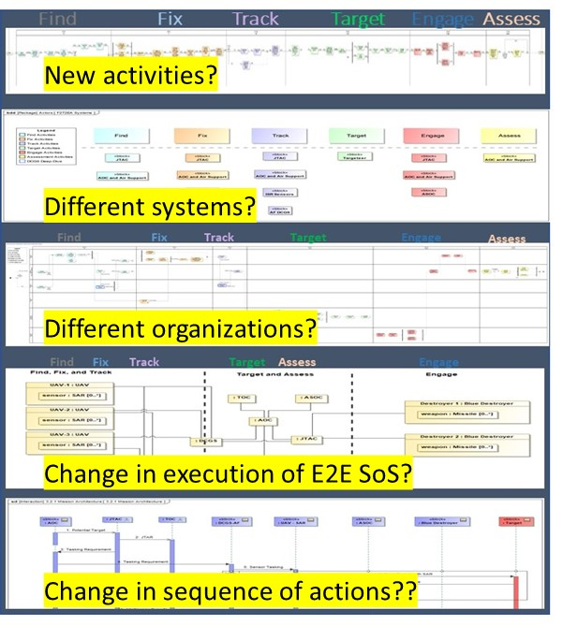
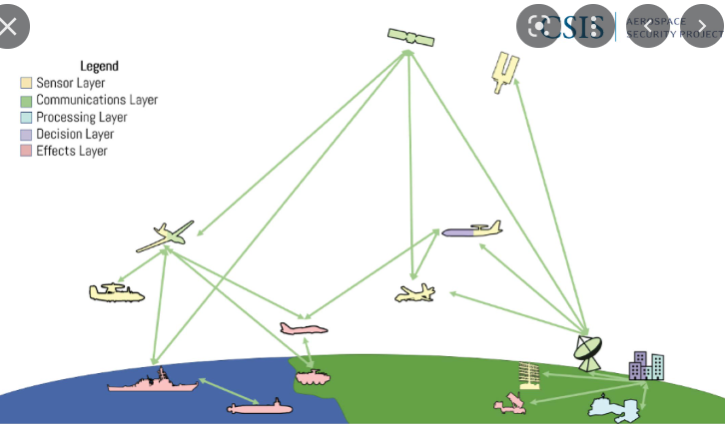
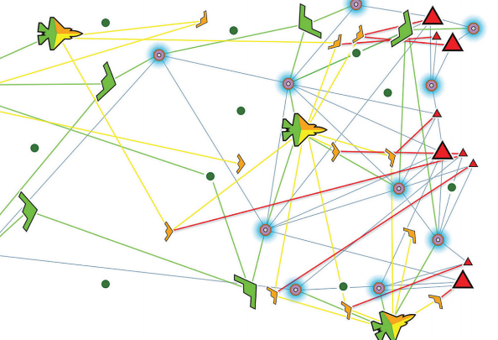
Mission Engineering Modeling Workflow
Obtain Kill Chain Source Information (i.e., OPLAN)
For selected Scenario
Baseline METS
(Digital SysML Model)
Alternatives Represented as Changes in the METs
(Digital SysML Model)
Baseline
Kill Web
Alternative
Kill Web
Informs Digital Model
Provides basis for
Represented in AFSIM
Represented in AFSIM
Alignment with Scenario Documentation (i.e., JFOS)
Analysis of Baseline Compared to Concept on Mission Outcome Metrics In Selected Scenario (Operational Analysis)
Informs
Baseline
Alternative
14

Slide 15
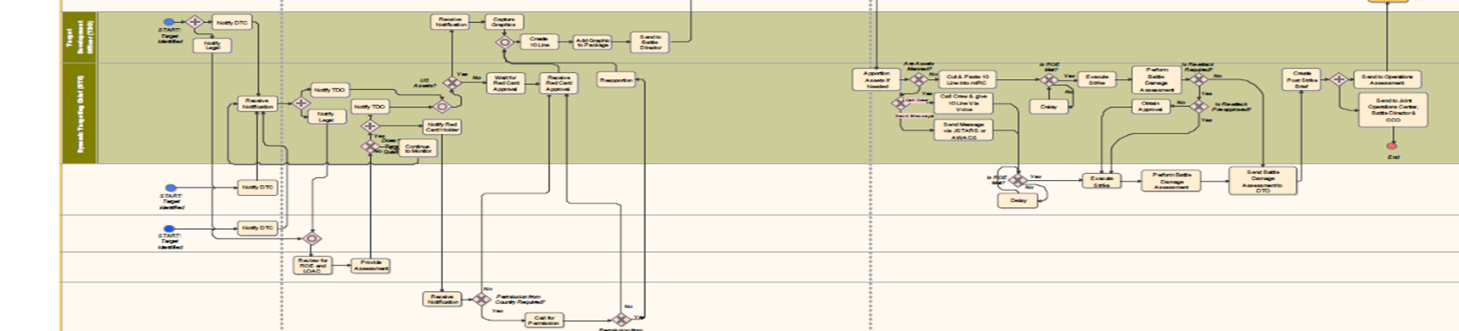
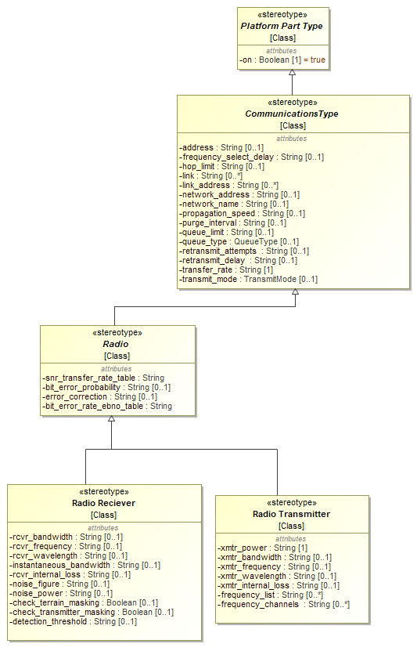
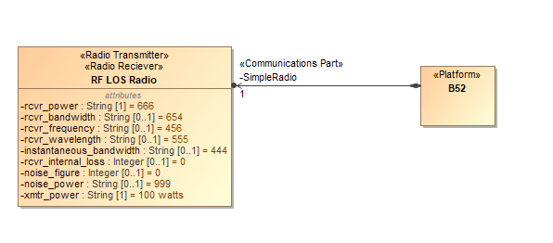
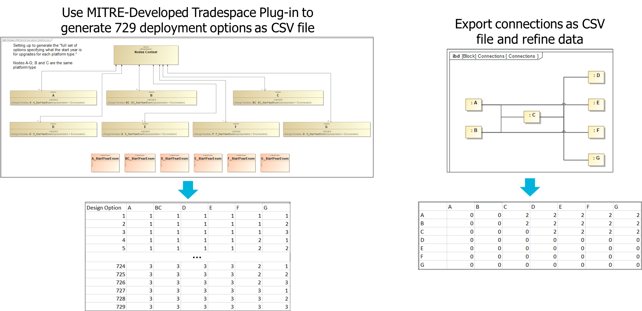
ME Digital Engineering
A digital environment to develop, retain and reuse mission architectures across R&E ME studies based on authoritative data for scenario of interest
Models represented in DEE are instantiated in selected analysis tools to address specific goals of each ME study – architecture products for studies
Standard repeatable, accessible digital representation of architectures separate from specific instantiations in selected analysis tools (e.g., embedded in AFSIM scripts)
`
Represent the baseline architecture (‘as is’)
Represent alternative architecture(s) (’to be’)
SysML models
CAMEO Magic Draw
Digital representation of mission models (mission threads and mission engineering threads) value is rapid generation of consistent, reusable digital representations of mission architectures across ME initiatives, independent of specific analysis approaches
15

Slide 16
Shared Modeling Framework
The Digital Engineering Environment (DEE) is a SySML model developed in CAMEO built on the MITRE Enterprise Shared Modeling Framework
Reusable model elements are maintained in the base model as building blocks and top-level mission threads
Mission models use the base model and other data to address different ME studies
The framework supports data feeds to operational simulations and tools for specific analyses
Mission Model 1
Mission Model 2
Mission Model 3
Operational Simulation Analysis
Mission Architecture
Mission Architecture
Mission Architecture
Dependence
Base Model
Data Feeds
Building Blocks
Top-Level Mission Threads
Data Source 1
Data Source 1
…
Seed Model
Common Elements
Shared Modeling Framework is a configuration managed reusable capability underpinning R&E ME DEE
16

Slide 17
Data Support for R&E MI Digital Mission Architectures
Mission
Characterization
Mission
Architecture
ME Methodology - Context for Mission Threads (MTs) and Mission Engineering Threads (METS)
Begin with description of the operational mission context – scenario, including
E.g., Epoch, Physical environment, Threat, Blue force mission objectives, laydown and CONOPs
Sources: COCOM OPLANs, Policy, etc. Intel Community
ME analysis: Extract from the scenario data
Primary targets, platforms and weapons slated for target types, ISR assets and processing, C2 notes and roles, communications networks and connectivity
Use these data elements and relationships to support the MT and MET modeling
Mission Threads activities, systems, systems of systems
Develop baseline model: Model baseline MT and MTs
Drawing on data extracted from the scenario data using the process described above, adding data to complete E2E
Sources: Services, COCOMs, proponents
Integrate multiple METs into baseline Kill Web – Review with SMEs/Iterate
Update models to incorporate alternative
Sources: Services, COCOMs, proponents
Integrate multiple METs into alternative Kill Web and review with SMEs/iterate
Mission
Context
MTs
&
METs
17

Slide 18
Overview of Operational Mission Analysis
MTs and METs provide blueprint for operational analysis
Represent baseline in the operational context for analysis and generate the baseline mission metrics
Operational laydown
Threat representation
Systems performance and behavior
Represent the changes made in the baseline to represent each concept to:
Compute the impact on mission metrics of the concept
Compute metrics on the performance of the particular concept as represented in the scenario and analysis
Use appropriate analysis tool (e.g., AFSIM)
Mission Engineering Guide, 2.0, p5
Operational analysis is key to Mission Engineering – provides quantitative assessment of mission outcomes
18

Slide 19
ME Analytical Approach
Example Run Matrix
How is the mission executed in the baseline case? (mission and supporting metrics)
How is the new concept to be implemented in the scenario (across METs)?
What is the objective of the concept (e.g., increased ISR coverage, increased weapons, platform survivability)? How is this expected to impact the mission and supporting metrics?
Under what conditions do we expect the concept to impact mission outcomes (e.g., day without space)?
What are the concept dependencies on baseline systems?
What is the performance of each element in the concept?
Case
Baseline A - Uncontested (run once) | Do nothing to respond to adversary
Baseline B - Baseline Scenario (run once) | Implement the baseline METs
Baseline C - Tailored Scenario (for each concept) | Conditions addressed by concept (e.g., no space)
Alternative 1 - Baseline Scenario (B) with New Concept | Concept implemented in updated METs (specific for each Concept)
Excursions to explore tradespace
Alternative 2 - Tailored Scenario (C) with New Concept
Excursions to explore tradespace
Drive the run matrix
19

Slide 20
Summary
Mission engineering provides a disciplined approach to assessing options for improving mission outcomes
Digital mission architectures (Mission Threads (MTs) and Mission Engineering Threads (METs)) are developed for the scenario/vignette of interest and provide a blueprint for the ME analysis
MTs/METs represent the baseline and new concepts and put the concepts into a mission context
Use of digital engineering to represent MTs/METs allows for clarity, transparency and reusability
Mission Engineering (ME) operational analysis represents the concepts in an operational environment (AFSIM) to assess and evaluate the mission effectiveness of concepts (excursions from the baseline mission architecture)
ME operational analysis outputs quantitative results in terms of mission metrics
20

Slide 21
Discussion
21

