Slide 1

Developing Model-Based Flight Test Scenarios
Dr. Thomas H. Bradley
Colorado State University, Ft. Collins, Colorado
thomas.bradley@colostate.edu
Jose L. Alvarado Jr.
AFOTEC Det 5, Edwards AFB, California
Jose.alvarado.2@us.af.mil
Notes:
Welcome to my presentation on enhancing flight testing by leveraging software testing techniques implemented in MBSE.
This presentation will focus on seeking and adapting novel ways to incorporate the long-standing structured process of flight testing into the MBSE paradigm. By leveraging tools and processes implemented in MBSE, the hope is to advance the process of flight test planning by improving the understanding of the design by testers, streamlining communications and the sharing of information, and taking advantage of reuse for re-planning due to changes or improvements to a system under test. My vision aims to realize and implement practices that free technical experts from performing their duties in the late stages of the acquisition process to the beginning of the design process.

Slide 2
Background: Motivation
The Department of Defense (DoD) defines the Test and Evaluation (T&E) process as the planning, conduct, and reporting of a system under test (SUT) to independently evaluate system performance through developmental and operational T&E with minimal contractor influence.
T&E is essential in verifying and validating systems using representative articles and ensuring that models created to represent the SUT are well-positioned to meet future production and sustainment needs.
Acquisition programs benefit from integrating developmental and operational T&E including testers both earlier in the acquisition process and through the end of the acquisition life cycle.
Notes:
The DoD defines the T&E process as the planning, conduct, and reporting of a SUT to independently evaluate system performance with minimal contractor influence.
T&E is essential in verifying and validating systems using representative articles and ensuring that models created to represent the SUT are well-positioned to meet future production and sustainment needs.
Furthermore, acquisition programs can benefit from integrating both developmental and operational T&E by including testers early in the acquisition process as well as throughout the acquisition life cycle.

Slide 3
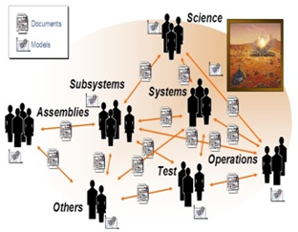
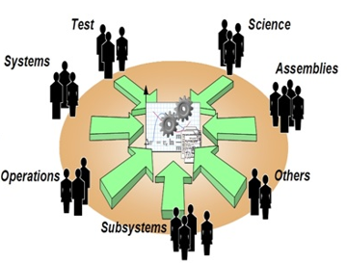

Document-centric SE vs. MBSE
Future: Shared system model with multiple views and connected to discipline models. Reusable, model-based engineering with virtual product development and simulation capability.
Today: Standalone models related through documents
Model-Based Systems Engineering Readiness for Complex Product Development
Louie, C., & Louie, C. (2014, May 22). The sysene blog. https://www.engineeringnewworld.com/?p=240

Slide 4
High Level Baseline Definitions
DoD Digital Engineering Strategy defines Digital Engineering as:
  “An integrated digital approach that uses authoritative sources of systems’ data and models as a continuum across disciplines to support lifecycle activities from concept through disposal.” [3]
A Digital Transformation as seen by business organizations:
  “Digital transformation is the integration of digital technology into all areas of a business, fundamentally changing how you operate and deliver value to customers.” Business organization
INCOSE describes Model-based Systems Engineering as:
  The “formalized application of modeling to support system requirements, design, analysis, verification, and validation activities beginning in the conceptual design phase and continuing throughout development and later life cycle phases.” [6]
Notes:
Effective digital engineering aims to [4]:
Formalize the development, integration, and use of models to inform enterprise and program decision-making.
It is an authoritative source of truth so that stakeholders have current, authoritative, and consistent information for use.
It establishes an environment that allows for collaboration and communication across stakeholders.
Supports digital engineering across the lifecycle of the SUT.
We can define digital transformation as the integration of digital technology into all areas of a business enterprise that changes how a business operates and delivers value to its customers. This paradigm shift allows for the moving away from using current business methods in favor of new processes that need to be defined. [5]
MBSE puts models as the focus of the design rather than depending on documents to provide a single source of truth or point of access that defines the SUT. MBSE is often realized as a component of implementing digital engineering strategy.

Slide 5
Software Model-Based Testing Definitions
Paul Ammann and Jeff Offutt in the Introduction to Software Testing textbook define the following concepts.
Model-based Testing:
  “Model-based testing is an application of model-based design for designing and optionally also executing artifacts to perform software testing or system testing. Models can be used to represent the desired behavior of a system under test (SUT), or to represent testing strategies and a test environment. The picture on the right depicts the former approach.” [7]
Model Driven Test Design:
  “The Model Driven Test Design (MDTD) process breaks testing into a series of small tasks that isolate and allow for work to be conducted at the design abstraction level using mathematical engineering structures to propose test values independently of software or design artifacts, test automation, or test execution.” [7]
Notes:
Model-Based Testing (MBT) is the process of designing software tests from abstract models that represent one or more characteristics of the software usually representing some aspects of the behavior. This allows for the design of tests from abstract models that represent some behavior of the system and generate expected outputs with SysML diagrams. Because test suites are derived from models and not from source code, model-based testing is usually seen as one form of black-box testing and is considered an evolving field.
The Model Driven Test Design (MDTD) process helps small groups of technical experts isolate and work at the design abstraction level independently of software or design artifacts, test automation, or test execution, while less experienced testers work at the implementation level.
By leveraging MDTD, the capability to isolate and test individual components independently, is a powerful approach to optimizing system test design. Through MDTD, relationships and dependencies that govern the creation of solutions ensure a comprehensive understanding of the repercussions of any changes made at any stage of the process by highlighting the broken relationships [18]. MDTD has demonstrated the ability to aid in efficient testing and significantly enhance the overall development process of software [7].

Slide 6
Types of Software Testing Techniques
Model-based testing allows test engineers to concentrate on evaluating software behavior models to determine their acceptability, considering factors like reliability, maintainability, and efficiency [8].
  White box – Everything is known about the system or code.
  Black box – Nothing is known about the system or code.
  Grey box – Combines aspects of both white and black box testing to take advantage of the benefits of both processes.
Coverage criteria are a set of conditions and rules imposed on a set of test requirements [10].
  Several coverage criteria are available for testing and are based on data flows.
  Test coverage criteria enhance the generation of comprehensive test cases based on the number of elements visited within a diagram.
Notes:
White box testing involves a meticulous examination of the internal logic and structure of the source code, necessitating the tester to possess comprehensive knowledge of the source code and the application's internal workings [7].
Black box testing is conducted when access to internal design or source code is not possible. Black box testers only understand the intended functionality of the software and have access solely to requirements specifications [7].
Grey box testing combines the benefits of both black-box and white-box testing where the tester possesses limited knowledge of the internal structure or underlying code and understands the fundamental aspects of the system [9].
All these types of testing techniques require an underlying process in which the techniques are executed. Among the most common processes used for test case generation from SysML diagrams is coverage criteria. There are eight common transition-based coverage criteria used in test case generation, of which all-paths coverage specifies that each executable path should be followed at least once, and all-configuration coverage is required to visit every configuration of the MBSE models at least once [11].
Leveraging some of these model-based testing techniques and tools to plan flight tests, the T&E community can gain new approaches to better evaluate flight test programs, verify system functionality, ensure compliance with specifications, and ascertain that SUTs can consistently deliver the intended performance in operational scenarios.

Slide 7
The Flight Test Application
Redefined requirements/test specifications
Reuse of defined requirements/test specifications
Design
Abstraction
Level
Model/ Structure
Test Requirements
Test Design
Test artifact
Input Values
Implementation
Abstraction
Level
Test Scripts
Reuse Test Cases
Pass/Fail
Test Results
Test Cases
Test Evaluation
Test Execution
Test Planning
Notes:
Traditional flight testing commences once a program manufactures a representative prototype SUT. DT&E flight testing is primarily overseen by the Air Force Flight Test Center (AFTC) which assembles and authors comprehensive test plans "to communicate technical detail and logistics required to execute and report results of flight, ground, and laboratory tests of air vehicles, subsystems, and components" [12]. AFOTEC is responsible for conducting integrated operational T&E (OT&E) throughout program development, with dedicated OT&E after the program enters Low-Rate Initial Production [13] [14] [15].
The challenge with this established test planning practice is its document-centric approach and the relationships between stakeholders.
<click slide>
The flight test planning process can take advantage of the parallelism afforded by the MDTD process directly, as depicted by the yellow boxes.
Successful test planning is based on relationships that are actual human relationships between stakeholders that are difficult to abstract and control. The process requires experienced individuals with in-depth knowledge of the system to create test scenarios.
The process is usually accomplished through numerous meetings and iterations to ensure that all air vehicle behaviors are identified and addressed.
The relevant MOP/S correspond to the achievement of mission objectives and convey information about the SUT structure and how it will perform in its operational environment.

Slide 8
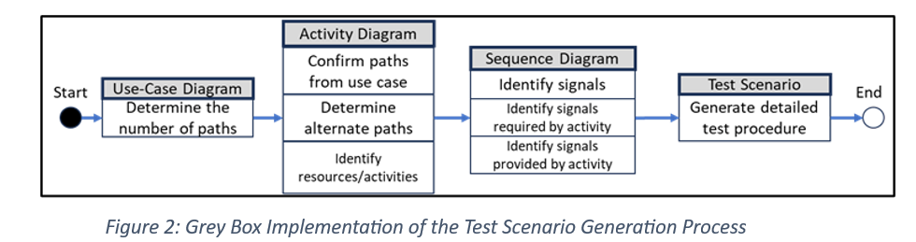
Innovative Test Scenario Generation Process
A practical approach to creating test scenarios can be realized by beginning with the use case diagram to generate scenarios, followed by the activity diagrams to define flows, and finally, the sequence diagrams to provide the detail required by the test plan.
Notes:
With the knowledge gained from studying the MBT software process, we can translate these concepts to flight-test where the test design process can take advantage of these diagrams to define input values that will effectively test the requirements of a given system. By applying the MDTD process and using a criteria-based approach, the test designer can create test requirements or specifications which can then be incorporated into a test design. This test design will define input values that will effectively test requirements using specified criteria and are combined into a test plan. Once the test plan is created and approved, the tests can now be accomplished, and the required data can be collected. Once the data is collected, it can be analyzed and evaluated to see if the system meets requirements and performs as desired.
Since the focus is primarily on reuse and test scenarios are the single most time-consuming part of test planning, MBT allows for the recycling of test requirements and specifications to reuse test case scenarios from models developed in a previous task and use data and test information from a previous test plan to a new test plan.
In flight testing, the design artifact can be defined as a requirement, function, or capability that is to be evaluated. Flight test design takes a design artifact under evaluation and develops test scenarios at the design abstraction level. The test scenarios create detailed test plans at the implementation abstraction level that will be executed to collect the data required to evaluate the design artifact.
By implementing grey box testing techniques borrowed from software implemented within an MBSE construct, the result provides an alternative to the document-centric test planning process. As a result, these diagrams guide developers in designing the system and provide testers with essential information for conducting thorough testing [10]. Borrowing from the MDTD process and using the grey box test scenario generation process illustrated in Figure 2, along with the use case diagram depicted in Figure 3 shown in the next slide, a basic flow can be generated using the use case diagram to model a series of dialogs.

Slide 9
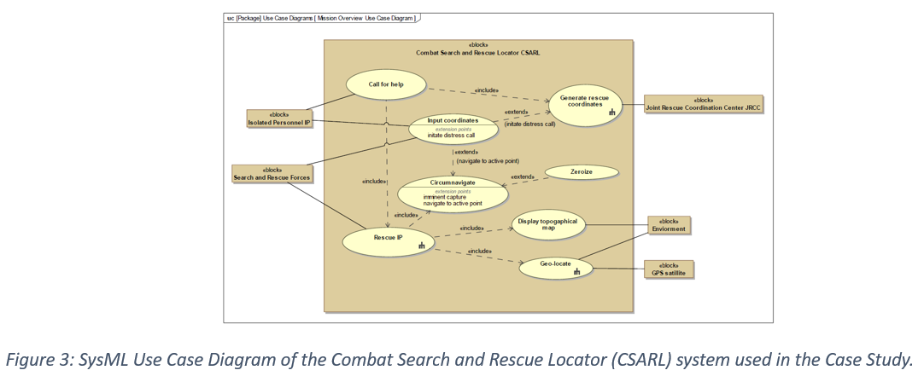
Innovative Test Scenario Generation Process
Notes:
The generation of test scenarios relies on the flow of events, which are divided into two parts:
The main flow of events represents the "normal" happenings, while alternate flows of events encompass optional or exceptional case flows relative to normal behavior [20].
Alternate flows of events encompass optional or exceptional case flows relative to normal behavior [20]. Some alternate flows may return to the basic flow, while others designated as exceptions may reach an endpoint.
Both can be extracted from either a use-case or activity diagram.
To fully specify a use case and define the flows between the system and its actors, a SysML diagram requires a significant amount of detail. These details can be developed into steps, explaining the actions of both the actor and the system in response that are realized in the number of unique test scenarios [10].
Test scenarios are then designed using a structured and practical approach that explores the input space with minimal overlap.

Slide 10
Case Study
The case study focuses on AFOTEC’s Combat Search and Rescue Locator (CSARL) system.
  Is a fictional system that has been developed as a training case for flight test personnel learning to create test plans.
  It is well documented and has a thorough reference test plan that has been redeveloped.
  Serves as an example system upon which to demonstrate the proposed methods for flight-test relevant test plan generation.
  Since the system is well documented and all AFOTEC personnel are familiar with the material.
Makes a good benchmark for applying the grey box-inspired testing technique implemented in an MBSE environment to create a flight test scenario procedure.
Notes:
To execute and assess the proposed MDTD processes, a case study was produced using SysML implemented in MBSE with the Dassault Systems’ Cameo Systems Modeler™ software package following the process illustrated in Figure 2. The model was developed by using the system description document (SDD), capability design document (CDD), and initial capabilities document (ICD) products.
The CSARL system is a portable hand-held Global Positioning System (GPS) receiver system offering enhanced digital moving maps and real-time navigational capabilities. Used by downed aircrew and search and rescue (SAR) forces during combat and peacetime survival scenarios. Its purpose is to complement current GPS-integrated survival radios, enhancing existing survival and rescue navigation capabilities without relying on traditional map-and-compass techniques [22].
Makes a good benchmark for applying the grey box-inspired testing technique implemented in an MBSE environment to create a flight test scenario procedure.

Slide 11
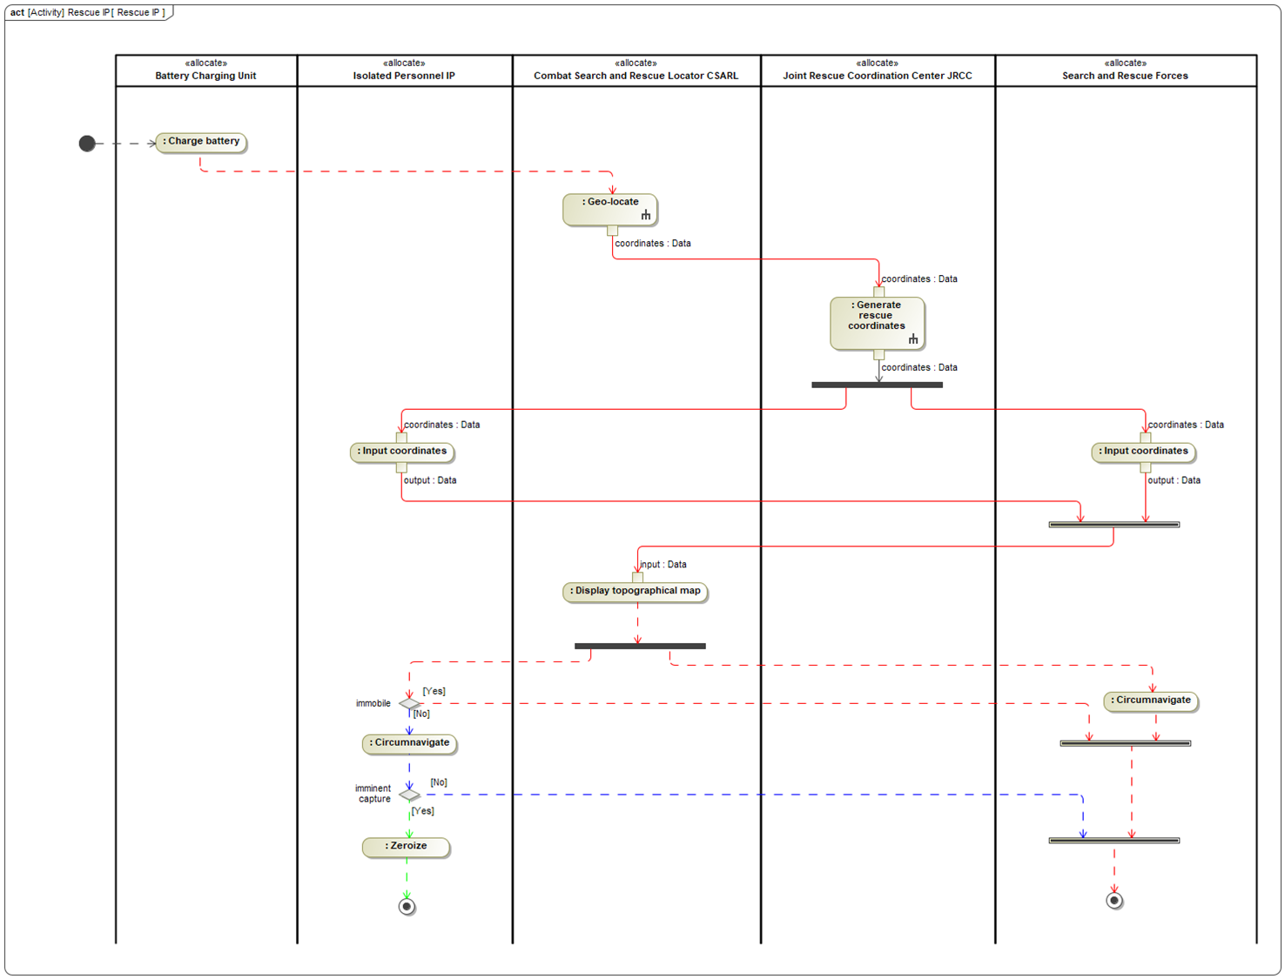
Case Study - Diagrams
Figure 4: SysML Activity Diagram of the Combat Search and Rescue Locator (CSARL) system used in the Case Study with Identified Path Flows.
Notes:
The interaction between the SUT and people engaged in the process (actors) [16] is displayed in Figure 3 and their interactions are documented in an activity diagram shown in Figure 4.
The dialogs explain the actor’s inputs or actions and the system interactions that are created in response [16].
For our CSARL example, the primary or basic flow is illustrated by the red path in Figure 4, which diagrams the situation where an aircraft experiences a critical mechanical failure, and the aircrew must eject.
The basic flow designates the aircrew as being injured and immobile and can be summarized as:
1. Call for help: The aircrew, now designated as isolated personnel (IP), initiates a call for help and provides secured GPS coordinates.
2. Generate Rescue Coordinates: The Joint Rescue Coordination Center (JRCC) authenticates the IP, relays the status, location information, and directs the search and rescue (SAR) forces to the IP’s location.
3. Input coordinates: The SAR forces team enters pre-designated point(s) where the IP has indicated where they are located.
4. Circumnavigate: The SAR forces circumnavigate to the designated IP coordinates for rescue and extraction.
The CSARL case study, has two alternate flows that can be executed
1. The aircrew is able-bodied, having the ability to proceed to a designated pick-up point (PUP) and is illustrated by the blue path in Figure 4. It directs both the IP and the SAR forces to a designated PUP coordinate where both parties circumnavigate for rescue and extraction.
2. In case of imminent capture of the aircrew they must perform a zeroize procedure that renders the handheld radio (HHR) inoperative. This is shown as the green path in Figure 4.

Slide 12
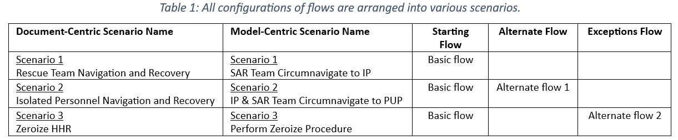
Basic Flow
Notes:
Once all flows have been identified in the SysML activity diagram, a table of all possible flows is created by applying the all-paths and all-configurations coverage criteria to generate all possible combinations using the grey box test scenario generation process and the basic flow and each alternate flow.

Slide 13
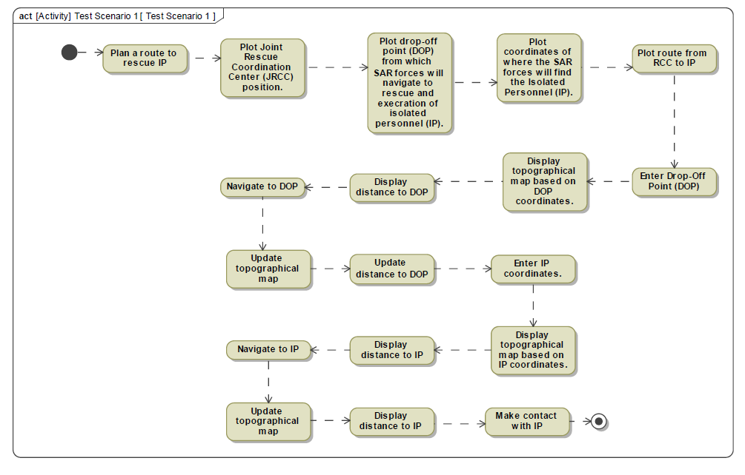
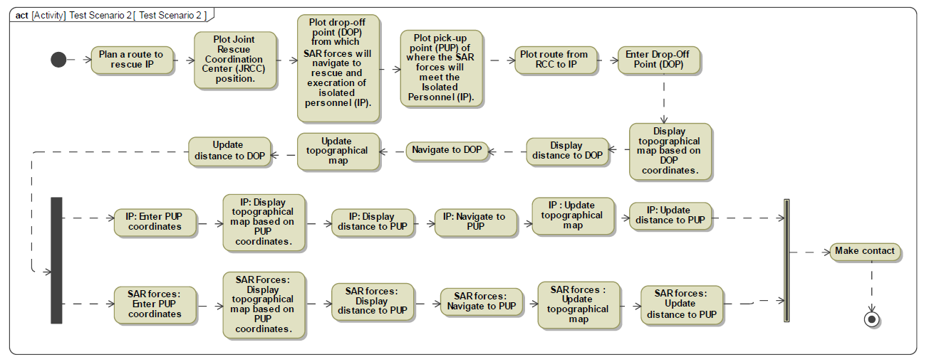
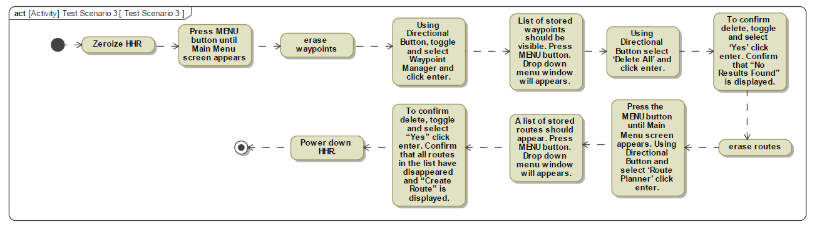
Test Scenario Procedures
Figure 6: Activity diagram of Scenario 2 illustrating the test procedure that outlines the steps required to execute the Isolated Navigation and Recovery test case.
Figure 5: Activity diagram of Scenario 1 illustrating the test procedure that outlines the steps required to execute the SAR Team Circumnavigate to IP test case.
These scenario procedures can be used as input to developing flight test cards used in the validation process
Figure 7: Activity diagram of Scenario 2 illustrating the test procedure that outlines the steps required to execute the Zeroize HHR test case.
Notes:
The scenarios in Table 1 can be used to generate a test procedure that outlines the steps required to execute each test scenario.

Slide 14
Discussion
This case study now allows a comparison between document-centric and model-centric processes.
The results of the model-based test scenario-generating method show that this method is effective in creating detailed test scenarios for use in the generation of detailed test plan documents (DTPs)¹.
  Comparing the results between the document-centric and model-centric processes reveals that the model-based method generates a comparable number of test scenarios as the document-centric process.
Similarities in output between the model-based test scenario approach and the document-centric approach provide confidence that both processes can generate similar documentation for testing SUTs.
¹Because the federal acquisition regulations (FAR) process is dictated by law, any new flight test process must create the equivalent documents for review and signature approval process required by the federal acquisition regulations, including the DTPs that are the output of this process.
Notes:
The results of the model-based test scenario-generating method show that this method is effective in creating detailed test scenarios for use in the generation of detailed test plan documents (DTPs).
Similarities in output between the model-based test scenario approach and the document-centric approach provide confidence that both processes can generate similar documentation for testing SUTs.

Slide 15
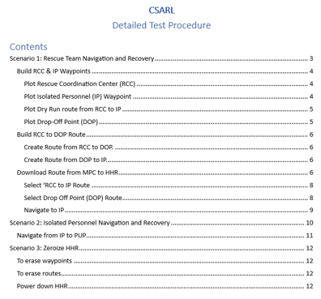
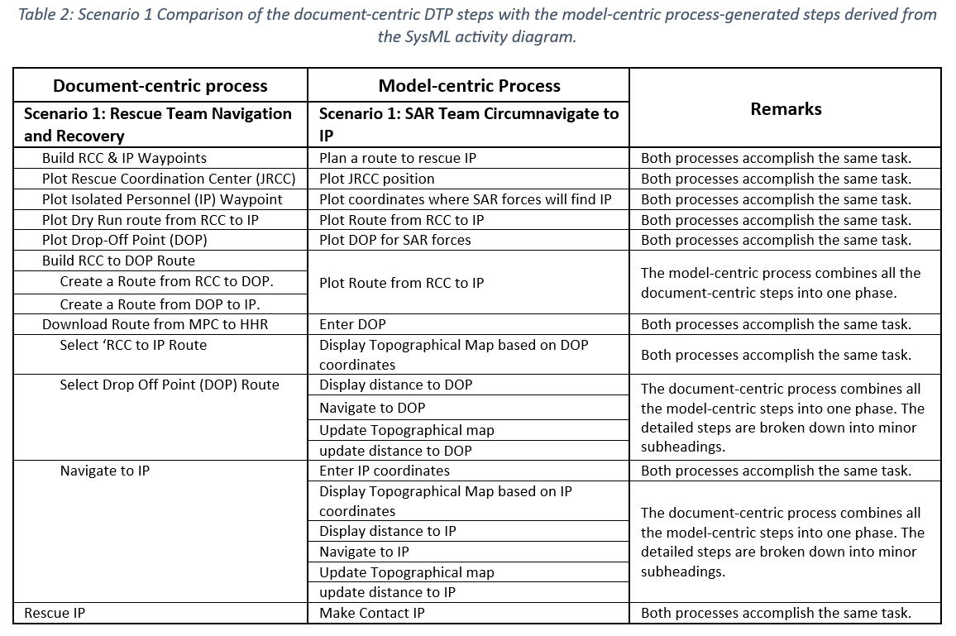
Comparison of Processes
Table 2: Scenario 1 Comparison of the document-centric DTP steps with the model-centric process-generated steps derived from the SysML activity diagram.
Figure 8: Excerpt of Table of Contents from CSARL Detailed Test Plan.
Notes:
Comparing the subheadings from the table of contents in the training DTP shown in Figure 8 with the steps outlined in the activity diagram in Figure 4, it is evident the model-based test scenario-generating method produces similar steps and content to the document-centric process.
All the required steps from the training DTP have been accounted for and there is sufficient detail presented in the SysML activity diagram (Figure 4) to generate a detailed DTP.
As illustrated in Table 2, there is a simple and defensible mapping between the DTP steps generated from each process. Although the number of DTP steps and their level of detail is higher in the results of the model-centric process, Table 2 illustrates that the completeness and coverage of the model-centric test development process can be validated relative to the document-centric test development process.

Slide 16
Conclusion
The CSARL case study example shows that the novel innovative grey-box test scenario generation process can create the required documents at the same fidelity as the document-centric process [7] [17].
The case study shows the potential for efficient and valid use of SysML models for test plan design with MBSE and MDTD [18].
The use of MBSE and grey box testing realizes the promise of digital transformation and constitutes a stride toward modernizing testing methodologies to enhance system evaluation and validation [11] [19].
The CSARL case study exemplifies how adopting the MBSE method aids in the formulation of test scenarios and can contribute to comprehensive test plans for assessing a system's capabilities [11].
Embracing the paradigm shift toward MBSE in flight test planning provides progress toward the successful implementation of DoD’s Defense Digital Engineering Strategy [20] [21].

Slide 17
AFOTEC – The Next Step
Embracing the paradigm shift toward MBSE in flight test planning provides progress toward the successful implementation of DoD’s Defense Digital Engineering Strategy.
AFOTEC Response: Has formed an AFOTEC MBSE OT collaboration group with representatives from all detachments to transform the AFOTEC test planning processes to live in the digital environment.
The potential for efficient and valid use of SysML models for test plan design and adopting MBSE methods to contribute to the comprehensive development of test plans for assessing a system's capabilities.
AFOTEC Response: New acquisition programs are requiring contractors to use SysML to design products and systems. AFOTEC needs to work with program offices and contractors to integrate our AFOTEC process SysML models with the program office’s digital construct of the SUT.

Slide 18


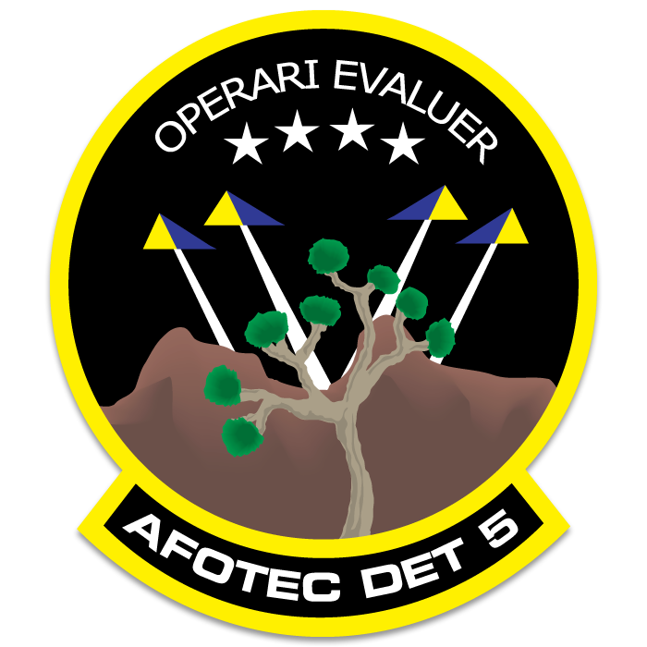
Questions?

Slide 19
References
[1] Van Peteghem, Gerry, and Christpher J. Liebmann, Stephanie S Mailen, Jeffrey D Martin, Kevin L. Peck, 2021. Test Plan Author's Guide. Engineering Directorate, 412th Test Wing, Edwards AFB.
[2] Wu, Quentin, and David Gouyon, Eric Levrat, 2021. Maturity assessment of systems engineering reusable assets to facilitate MBSE adoption. IFAC-PapersOnLine, vol. 54, no. 1, pp. 851-856.
[3] Office of the Deputy Assistant Secretary of Defense for Systems Engineering. Digital Engineering Strategy. Department of Defense, Washington D.C., 2018.
[4] Transition to digital engineering: Case studies and concepts. (n.d.). https://www.engr.colostate.edu/se/wp-content/uploads/2023/04/Transition-to-Digital-Engineering-Case-Studies-and-Concepts-Final.pdf. (Accessed 25 3 2024).
[5] Project, E. (n.d.). What is Digital Transformation? The Enterprisers Project. https://enterprisersproject.com/what-is-digital-transformation. (Accessed 25 3 2024).
[6] Systems Engineering Vision 2020, INCOSE –TP_2004-004-02, ver. 2/03, September 2007. [Online]. Available: http://oldsite.incose.org/ProductsPubs/pdf/SEVision2020_20071003_v2_03.pdf.
[7] Ammann, Paul, and Jeff Offutt, 2016. Introduction to Software Testing. Cambridge University Press.
[8] Beydeda, Sami, and Matthias book, Volker Gruhn, 2005. Model-Driven Software Development. Springer, Germany.
[9] Jan, Syed Roohullah, and Syed Tauhid Ullah Shah, Zia Ullah Johar, Yasin Shah, and Fazlullah Khan, 2016. An innovative approach to investigate various software testing techniques and strategies. International Journal of Scientific Research in Science, Engineering and Technology (IJSRSET), Print ISSN, vol. 23951990.

Slide 20
References
[10] Salman, Yasir Dawood, and Nor Laily Hashim, Mawarny Md Rejab, Rohaida Romli, Haslina Hohd, 2017. Coverage criteria for test case generation using UML state chart diagram. In AIP Conference Proceedings.
[11] Bansal, Anju, 2014. A Comparative Study of Software Testing Techniques. International Journal of Computer Science and Mobile Computing, vol. 36, no. 6, pp. 579-584.
[12] AcqNotes. AcqNotes Program Management Tool for Aerospace. AcqNotes LLC, 5 4 2022. https://acqnotes.com/acqnote/careerfields/development-test-and-evaluation. [Accessed 13 11 2022].
[13] Axiotis, Greg, 2009. A new alpha-omega map for acquisition test and evaluation. The Journal of Test and Evaluation, vol. 30, no. 4, pp. 473-480.
[14] Greer, Edward, 2010. The integrated T&E continuum is the key to acquisition success. The Journal of Test and Evaluation, vol. 31, no. 4, pp. 443-444.
[15] Salman, Yasir Dawood, and Nor Laily Hashim, Mawarny Md Rejab, Rohaida Romli, Haslina Hohd, 2017. Coverage criteria for test case generation using UML state chart diagram. In AIP Conference Proceedings.
[16] AcqNotes. AcqNotes Program Management Tool for Aerospace. AcqNotes LLC, 19 12 2021. https://acqnotes.com/acqnote/acquisitions/emd-phase. [Accessed 28 5 2022].
[17] Wang, Yiwen, and Mao Zheng, 2012. Test case generation from UML models. In 45th annual Midwest Instruction and Computing Symposium, Cedar Falls.

Slide 21
References
[18] Henderson, Kaitlin, and Tom McDermott, Eileen Van Aken, Alejandro Salado, 2023. Towards Developing Metrics to Evaluate Digital Engineering. Systems Engineering, vol. 26, no. 1, pp. 3-31.
[19] Beydeda, Sami, and Matthias book, Volker Gruhn, 2005. Model-Driven Software Development. Springer, Germany.
[20] Collins, Christopher, and Kenneth Senechal, 2003. Test and Evaluation as a Continuum. The Journal of Test and Evaluation, vol. 44, no. 1.
[21] Air Force Digital Transformation. https://usaf.dps.mil/teams/afmcde/SitePages/Functional-Speciality---Test-and-Evaluation.aspx. (Accessed 28 5 2022).
[22] Director of Operational Capability Requirements, 2018. Capability Development Document (CDD) for Combat Search and Rescue Locator (CSARL). Washington D.C.: Department of Defense.
[23] AcqNotes. AcqNotes Program Management Tool for Aerospace. AcqNotes LLC, 5 4 2022. https://acqnotes.com/acqnote/careerfields/development-test-and-evaluation. [Accessed 13 11 2022].

