Slide 1
DATAWorks 2024
Developing AI Trust: From Theory to Testing and the Myths in Between
Yosef S. Razin, IDA
yrazin@ida.org
Dr. Kristen Alexander, DOT&E
kristen.l.alexander5.civ@mail.mil
April 17, 2024
Notes:
My name is.. Establish credibility: I am completing my PhD in Robotics at GaTEch and my dissertation is on how to better characterize human machine trust
Mention the ITEA paper

Slide 2
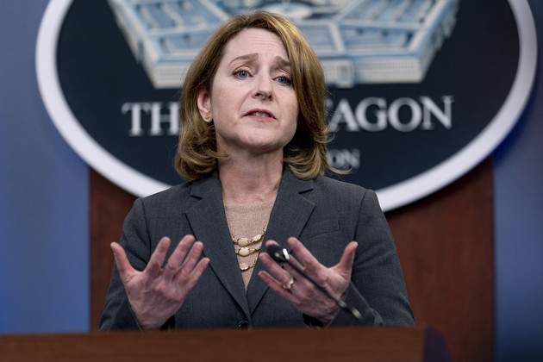
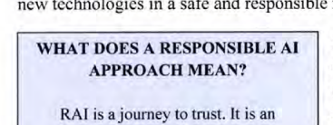
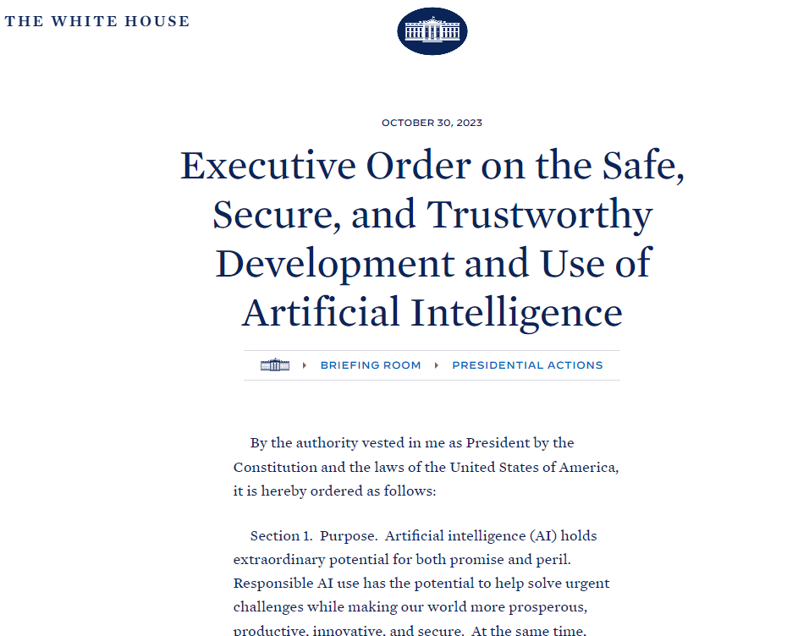
If trusted AI is the DoD’s goal, it is critical to improve the T&E community’s understanding of what trust and trustworthiness mean.
“Our operators must come to
trust the outputs of AI systems,
our commanders must come to
trust the legal, ethical, and moral foundations of explainable AI,
and the American people must come to trust the values their Department of Defense has integrated into every application.”
AP Photo/Andrew Harnik
Deputy Sec. of Defense
Kathleen Hicks
DoD Responsible AI (RAI) Strategy and Implementation Pathway
Executive Order 14110
Notes:
Trusted and trustworthy AI is the goal

Slide 3
If trusted AI is the DoD’s goal, it is critical to improve the T&E community’s understanding of what trust and trustworthiness mean.
“Our operators must come to
trust the outputs of AI systems,
our commanders must come to
trust the legal, ethical, and moral foundations of explainable AI,
and the American people must come to trust the values their Department of Defense has integrated into every application.”
AP Photo/Andrew Harnik
Deputy Sec. of Defense
Kathleen Hicks
DoD Responsible AI (RAI) Strategy and Implementation Pathway
Executive Order 14110
Notes:
Summary 1,2

Slide 4
In this presentation on T&E of AI for trust, we…
Provide clear and more concrete understanding of terms
Motivate the importance of designing and testing for trust
Approaching
Trusted AI
Specify T&E of AI challenges as they relate to trust
Introduce validated
trust measurement
Dispel confusion
and myths
Notes:
R: Rework title for dataworks here, say it’s a walk through
Maybe use this to walk thru
done

Slide 5


Trust is a cognitive state where a trustor is willing to delegate a goal to a trustee
This image generated by ImageFX
Environmentally situated
Context-dependent
Trustworthiness
Goal
Relational
Trust
Vulnerability:
Risk in the face of uncertainty
Notes:
BV: Going into academic, overloaded term
Gradient on bar?
Examples?
Define trust re:uncertainty

Slide 6
Evidence from validated surveys demonstrates that there are three main components of trust.
Capability-based Trust/
Performance
possesses the appropriate competence
to accomplish the trustor’s goal.
Structural Trust/
Integrity
will adhere to norms, morals, laws, standards, and ethics that align with the trustor’s values.
Affective Trust/
Benevolence
supports the trustor’s goal and potentially values the trustor’s general well-being.
The trustor’s expectation that the trustee

Slide 7

Our goal is not to maximize trust but to achieve calibrated trust, to trust as much as the other is trustworthy
Trust too little and you undertrust, meaning the other person or system could be doing more, which is inefficient
Trust too much and you overtrust, meaning the other person or system may fail you.
Failure leaves your goals unfulfilled and can harm your future ability to trust
This image generated by ImageFX
Notes:
Summary 5,6

Slide 8
In this presentation on T&E of AI for trust, we…
Provide clear and more concrete understanding of terms
Motivate the importance of designing and testing for trust
Approaching
Trusted AI
Specify T&E of AI challenges as they relate to trust
Introduce validated
trust measurement
Dispel confusion
and myths
Notes:
R: Rework title for dataworks here, say it’s a walk through
Maybe use this to walk thru
done

Slide 9
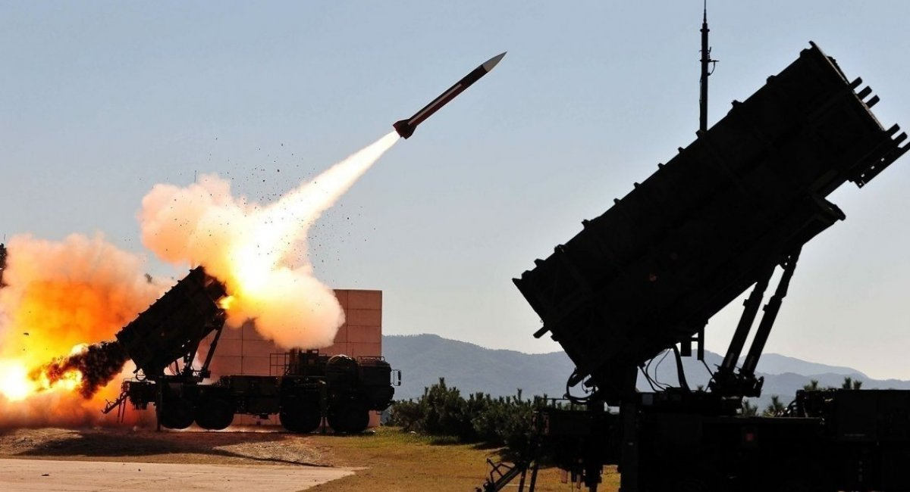
If we do not consider the relationship between trust and trustworthiness, mis-calibrated trust can become a major, even fatal, threat.
Patriot shot down a Royal Air Force Tornado
and a U.S. Navy F/A-18C, killing two allied airmen and one U.S. Navy personnel
Evidence-based Trust vs. Hype
The Patriot Missile System’s reported success against the majority of Iraqi ballistic missiles during Operation Desert Storm created a perception of reliability and effectiveness.
The system's performance was widely praised by the Army and its primary contractor, leading to a misplaced trust in its capabilities.
(Un)Trustworthiness
Notwithstanding known issues, close calls, and warnings with the semi-autonomous mode.
Source Unknown

Slide 10
Patriot demonstrated the danger of mis-calibrated trust and accounting for it in training, doctrine, policy, PR, and interface design
Patriot shot down a Royal Air Force Tornado
and a U.S. Navy F/A-18C, killing two allied airmen and one U.S. Navy personnel
Why?
Despite operators having sufficient time and ability to:
Examine tracks
Conclude the aircraft were not missiles
Halt the engagement
Operators were trained to trust the system and not question even unusual information
Further contributing factors:
Low-probability event
Edge case
Source Unknown

Slide 11



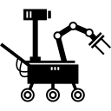
The types of trust and desired trustworthiness differ for different stakeholders and trustees
“Our operators must come to
trust the outputs of AI systems,
our commanders must come to
trust the legal, ethical, and moral foundations of explainable AI,
and the American people must come to trust the values their Department of Defense has integrated into every application.”
AP Photo/Andrew Harnik
How do I know that system is safe with all these people around?
Do these guys know what they are doing?
Will this robot help me diffuse the bomb?
Source Unknown

Slide 12

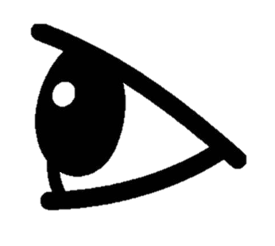
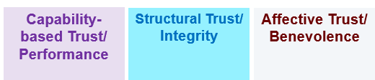
The trustor’s mental model of the trustee forms their expectations, perceptions, and understanding of a system’s trustworthiness.
Mental Model
Understanding
- What a system does
Basics of how it works
Monitoring
Trust
Notes:
Bram: Pull out military mental model, what the system does
R: Animate it

Slide 13
The trustor’s mental model of the trustee forms their expectations, perceptions, and understanding of a system’s trustworthiness.
General Antecedents
System/Situation-Specific
Dispositional faith or anxiety
around technology
Normality of the interaction
Risk Adversity
Emotional response
to the system
Mental Model
Monitoring
Familiarity
(incl. reputation,
recommendation,
training)
Trust
Notes:
Bram: Pull out military mental model, what the system does
R: Animate it
Done

Slide 14
Mental models are powerful but prone to biases
General Biases
System/Situation-Specific Biases
Perfect Automation Schema
Robot-Induced Anxiety
Impersonal Impartiality
Terminator Effect
Anthropomorphism/Zoomorphism
Mental Model
Complacency

Slide 15

Biases arise from heuristic processes, so mitigating them presents a tradeoff.
Tradeoffs
Compliance
Fairness
Complacency
Accuracy
Speed
Quality
Higher Initial Trust
Anthropomorphic
Resilient Trust
Impartial
Notes:
Last two should be done together

Slide 16
In this presentation on T&E of AI for trust, we…
Provide clear and more concrete understanding of terms
Motivate the importance of designing and testing for trust
Approaching
Trusted AI
Specify T&E of AI challenges as they relate to trust
Introduce validated
trust measurement
Dispel confusion
and myths
Notes:
R: Rework title for dataworks here, say it’s a walk through
Maybe use this to walk thru
Done

Slide 17

The power, speed, complexity, and size of AI presents unique challenges to evaluating trust and trustworthiness
Black box algorithms and lack of access to data during T&E
Model complexity and lack of explainability
Edge Cases
Lack of AI and HSI SMEs
Emergent Behavior
AI systems change more rapidly than traditional systems
Learning
Model drift
AI systems can work
faster than humans
India Next

Slide 18
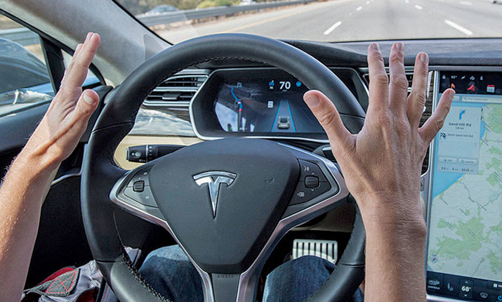
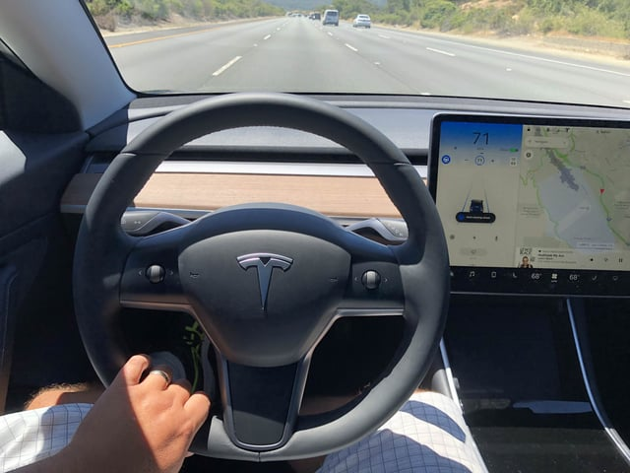
Despite the risks, generally the largest AI-specific bias we face is initial overtrust
Culture
High
Expectations
Brand Reputation
Recommendation
Research
@Worst_Username_Evar
Tesla
Other user experience
Training
Experience
Feedback
Calibrated Trust
Notes:
Make the text non diagonal
done

Slide 19
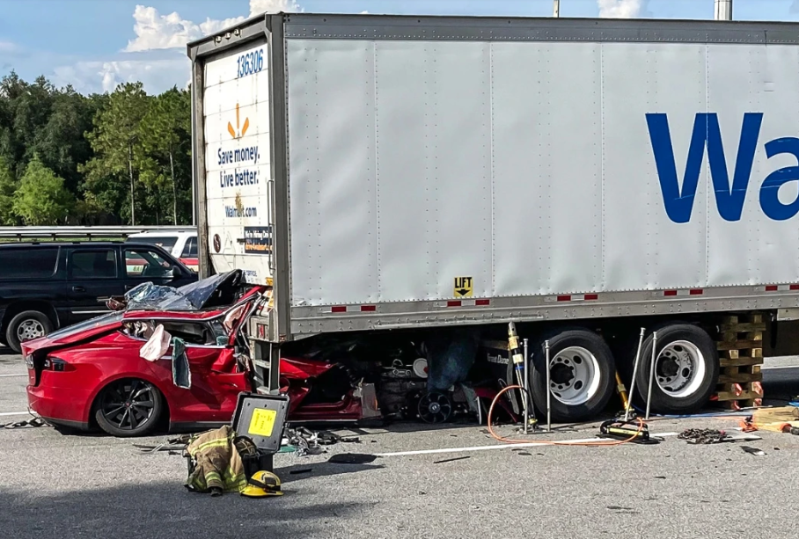
Poorly calibrated high initial overtrust is often very brittle and non-resilient. Once it’s lost, it’s hard to regain.
Sometimes fragility is ok!
Florida Highway Patrol
Again: Our goal is not to maximize trust but to achieve calibrated trust, to trust as much as the other is trustworthy

Slide 20
Some fun research findings: Systems need to be at least 70–85% capable for Capability-based trust to be established
BUT
Once trust is
established, a system can degrade to under 40% before being
abandoned
Trust is contagious,
once it’s established in one part of a system, we tend to generalize it to all the functions
Notes:
Whats the transition here from the previous slide?

Slide 21



Systems must be designed to help support proper trust calibration and testing
Instrumenting systems to assess both system behavior AND also humans and their interactions
Careful design of training
Thoughtful UX design
Notes:
Whats the transition here from the previous slide?

Slide 22
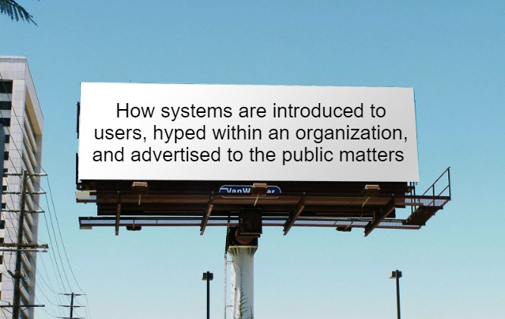
Trust calibration is not only about good design and confidence from T&E
This image generated by Imgflip

Slide 23
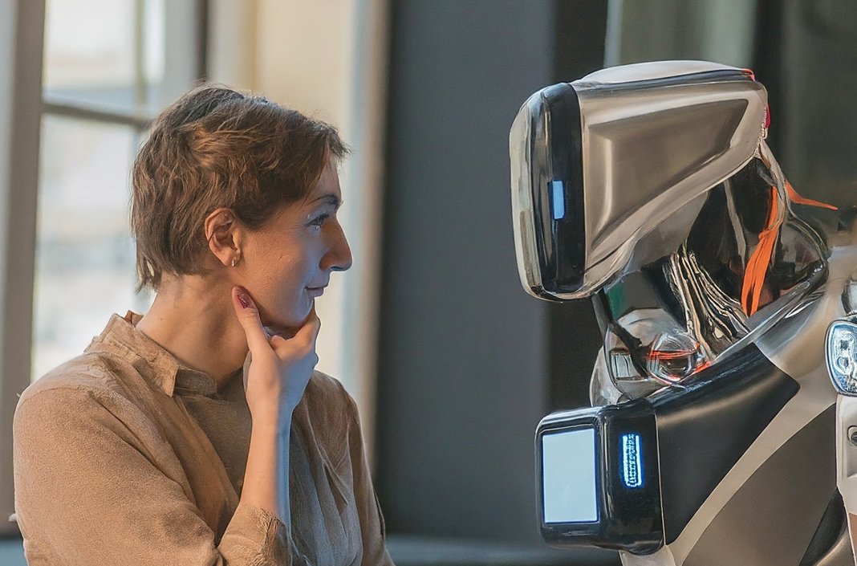
Testing trust in AI systems cannot be ‘one-and-done’ or done without their operators
AI already will require continuous monitoring and ongoing testing
Trust, as dynamic, contextual, and relational, will also need to be iteratively reassessed
Testing system-operator interaction requires sufficient time for
trust to build
This image generated by ImageFX

Slide 24
In this presentation on T&E of AI for trust, we…
Provide clear and more concrete understanding of terms
Motivate the importance of designing and testing for trust
Approaching
Trusted AI
Specify T&E of AI challenges as they relate to trust
Introduce validated
trust measurement
Dispel confusion
and myths
Notes:
R: Rework title for dataworks here, say it’s a walk through
Maybe use this to walk thru
done

Slide 25
Trust calibration requires designing and testing
for both trust AND trustworthiness
This image generated by ImageFX

Slide 26
Trustworthiness
This image generated by ImageFX

Slide 27
If we want to measure system trustworthiness, we need to instrument systems and tests to evaluate whether the system is
• capable of fulfilling the designer’s, operator’s, and commander’s goal when deployed correctly.
• able to be deployed correctly by those who are meant to operate it (Tate 2021).

Slide 28
Many of the factors for establishing trustworthiness in AI are the same as those for trustworthy software…
Instrumentation
Data
Documentation
User-Centric Design
… but some major differences make this more difficult.
Access to training data
Black box models
Programs don’t build the algorithms themselves
Notes:
BV: Too much – hone
Refine the word “needed”
Stress that this trustworthiness VS trust (intro slide to these two)
done
Provenance of models and AI algs

Slide 29
Trust
This image generated by ImageFX

Slide 30
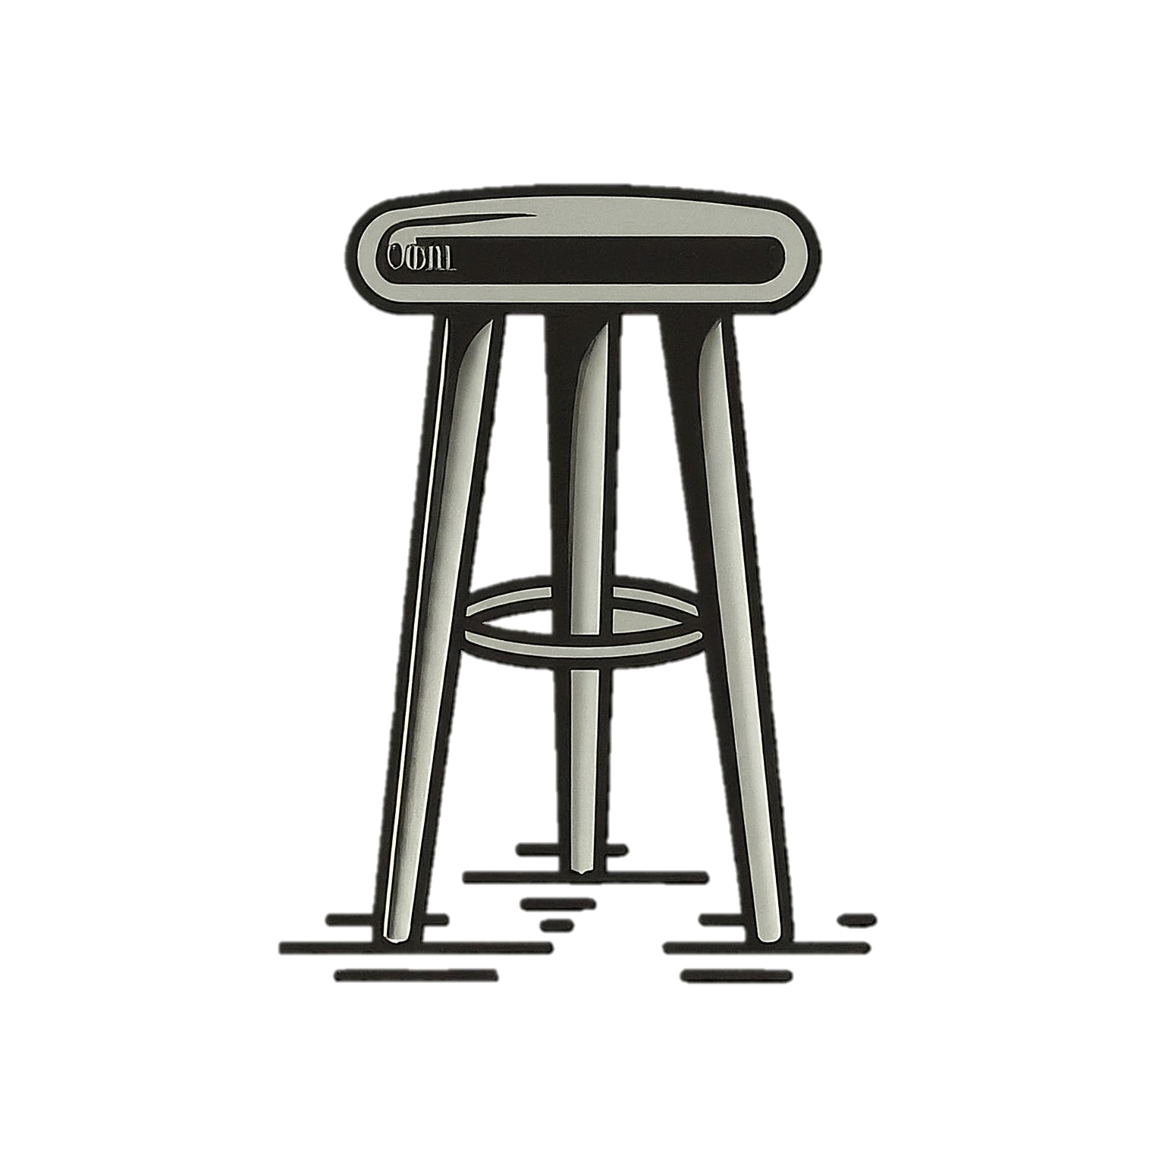
The best practice to capture trust is using
mixed methods in order to triangulate it
Behavioral measures See if they act as if they trust
Physiological measures See if they react as if they trust
Survey measures
See if they believe that they trust
Notes:
Turn this into a recommendation
done
The voiceover on coerced use

Slide 31

Navigating the wide array of available trust surveys and models can be overwhelming, but there are some guideposts
This image generated by ImageFX
Survey Resolution
Single Factor: Do we just care about trust?
Multi-Factor: Do we care what causes that trust or the type of trust?
Survey Quality
Reliability
Validity
Survey Length
Longer capture more
Shorter interrupt less
Notes:
Slow down – let it sink in. “You might not know”

Slide 32
In this presentation on T&E of AI for trust we
Provide clear and more concrete understanding of terms
Motivate the importance of designing and testing for trust
Approaching
Trusted AI
Specify T&E of AI challenges as they relate to trust
Introduce validated
trust measurement
Dispel confusion
and myths
Notes:
R: Rework title for dataworks here, say it’s a walk through
Maybe use this to walk thru
done

Slide 33
Myth Buster
Many trust measures exist and have been validated
Measurement Literature Reviews
Number of measures
Measurement of trust in automation: A narrative review and reference guide.
Kohn, et al. (2023)
Trust Measurement in Human-Autonomy Teams: Development of a Conceptual Toolkit.
Krausman, et al. (2022)
Converging Measures and an Emergent Model: A Meta-Analysis of Human-Automation Trust Questionnaires
Razin and Feigh. (In Process)
25
24
62
Notes:
Middle one et al. These are the reviewers
done
Maybe just title author (year) – hyperlink – NEED TO DO

Slide 34
Myth Buster
Transparency does not Guarantee Trust
It is necessary, if done appropriately, but not sufficient
What level does each stakeholder need?
The wrong level of transparency or wrong kind of explanation can undermine trust calibration and spread trust contagion
Too much transparency can overload the operator to rely on the system even if they do not trust it
Good transparency supports trust calibration, NOT trust
Notes:
Too complicated – remove table. Revamp
done

Slide 35
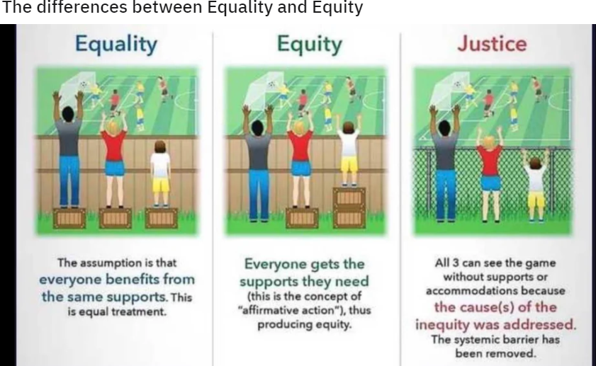
Myth Buster
Fairer AI Does Not Guarantee Trust
There are multiple types of fairness and they are mutually exclusive
We disagree on which form of fairness should be prioritized
r/coolguides original artist unknown
The type of fairness necessary to gain public trust
IS NOT
the type of fairness necessary to gain organizational trust
IS NOT
the type of fairness necessary to gain operator trust

Slide 36





Some concrete recommendations
Publish a shared HSI glossary
Encourage the use of quality trust surveys
Validate new measures for triangulation
Research measuring contextual trust calibration
Notes:
Toast exists. Is on testscience. Place to start.

Slide 37




Some concrete recommendations
Shift Left:
Bring operators and SMEs in earlier
Shift Right: Testing iteratively into sustainment
Budgeting
for trust-related data collection
Train operators, testers, and decision makers
Notes:
Toast exists. Is on testscience. Place to start.

Slide 38
For AI-enabled systems to be trusted
They must be designed from the start to be trustworthy and trusted
And they cannot be fully tested
without their operators
without sufficient time and resources for instrumentation, familiarization, training, and end-to-end operational testing
and such assessments need to be ongoing
This image generated by ImageFX
Notes:
Don’t say trusted in first line – remove?

Slide 39
Trust Me
Yosef S. Razin, IDA
yrazin@ida.org

Slide 40
Back up slides

Slide 41
Developing AI Trust: From Theory to Testing and the Myths in Between
Yosef S. Razin, IDA
yrazin@ida.org
Dr. Kristen Alexander, DOT&E
kristen.l.alexander5.civ@mail.mil
Notes:
Final slide, trust me
Add references
attributions

Slide 42
Why Trust for AI is Particularly Hard

Slide 43
Trust is a cognitive state where a trustor is willing to delegate a goal to a trustee
This image generated by ImageFX
Environmentally situated
Context-dependent
Trustworthiness
Goal
Relational
Trust
Vulnerability:
Risk in the face of uncertainty
Trust
Uncertainty
Distrust
Notes:
BV: Going into academic, overloaded term
Gradient on bar?
Examples?
Define trust re:uncertainty

Slide 44
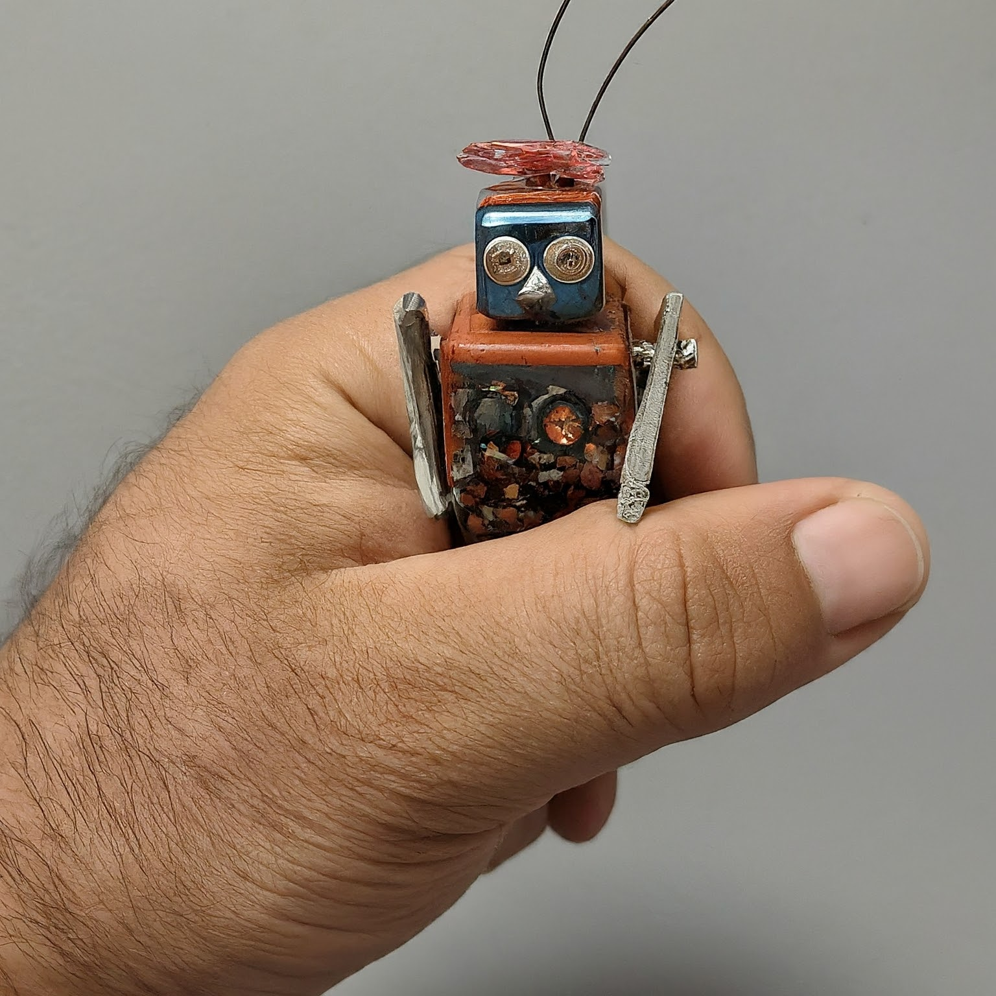



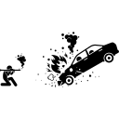
The new uncertainties that AI generates requires both higher assurance of trustworthiness
and more trust
This image generated by ImageFX
Safety Envelope
Assurance Cases
Trust
Uncertainty
Distrust
“Zero-Trust”
Extensive Testing
Is the gap an acceptable risk?
Notes:
Gap – unanimate
Quick examples?
done

Slide 45
Testing trust in AI systems cannot be ‘one-and-done’ or done without their operators
AI already will require continuous monitoring and ongoing testing
Testing system-operator interaction requires sufficient time for
trust to build
Trust, as dynamic, contextual, and relational, will also need to be iteratively reassessed
Each stakeholder
needs appropriate
explainability,
understandability,
and transparency
This image generated by ImageFX

