Slide 1
Using a Bayesian Network of Subsystem Statistical Models to Assess System Behavior
James P. Theimer, PhD
DISTRIBUTION STATEMENT A. Approved for public release; distribution unlimited. Case number: 88ABW-2024-0272; CLEARED 10 Apr 2024
Notes:
Identify the following
Purpose of Meeting:
Participating Organizations:
Briefers:
DISTRIBUTION STATEMENT x. Approved for public release; distribution is unlimited. CLEARED on DD MMM YYYY. Case Number: 88ABW-####-##
Choosing the right Distro Statement: Reference DoDI 5230.24, August 23, 2012 p. 14
“DISTRIBUTION STATEMENT A. Approved for public release. Distribution is unlimited.”
(1) This statement may be used only on unclassified technical documents that have been cleared for public release by competent authority in accordance with References (j) and (k). Technical documents resulting from contracted fundamental research efforts will normally be assigned Distribution Statement A, except for those rare and exceptional circumstances where there is a high likelihood of disclosing performance characteristics of military systems or of manufacturing technologies that are unique and critical to defense, and agreement on this situation has been recorded in the contract or grant.
(2) Technical documents with this statement may be made available or sold to the public and foreign nationals, companies, and governments, including adversary governments, and may be exported.
(3) This statement shall not be used on classified technical documents or documents containing export-controlled technical data as provided in Reference (d).
(4) This statement may not be used on technical documents that formerly were classified unless such documents are cleared for public release in accordance with References (j) and (k).
“DISTRIBUTION STATEMENT B. (Secondary [optional]) Distribution authorized to U.S. Government agencies only (fill in reason) (date of determination). Other requests for this document shall be referred to (insert controlling DoD office).”
(1) This statement may be used on unclassified and classified technical documents.
(2) Reasons for assigning Distribution Statement B are listed in Table 1.
“DISTRIBUTION STATEMENT C. (Secondary [optional]) Distribution authorized to U.S. Government agencies and their contractors (fill in reason) (date of determination). Other requests for this document shall be referred to (insert controlling DoD office).”
(1) Distribution Statement C may be used on unclassified and classified technical documents.
(2) Reasons for assigning Distribution Statement C are listed in Table 2.
“DISTRIBUTION STATEMENT D. (Secondary [optional]) Distribution authorized to the Department of Defense and U.S. DoD contractors only (fill in reason) (date of determination). Other requests shall be referred to (insert controlling DoD office).”
(1) Distribution Statement D may be used on unclassified and classified technical documents.
(2) Reasons for assigning Distribution Statement D are listed in Table 3.
“DISTRIBUTION STATEMENT E. (Secondary [optional]) Distribution authorized to DoD Components only (fill in reason) (date of determination). Other requests shall be referred to (insert controlling DoD office).”
(1) Distribution Statement E may be used on unclassified and classified technical documents.
(2) Any document delivered to DTIC or any other Component information center without a distribution statement automatically will be assigned Distribution Statement E.
(3) Reasons for assigning Distribution Statement E are listed in Table 4.
“DISTRIBUTION STATEMENT F. Further dissemination only as directed by (inserting controlling DoD office) (date of determination) or higher DoD authority.”
Distribution Statement F may be applied under rare and exceptional circumstances when specific authority exists or when need-to-know must be verified.
(1) To promote the free flow of information within DoD, Distribution Statement F will not be used on classified or unclassified scientific and technical documents governed by the DoD Scientific and Technical Information Program described in Reference (e).
(2) Other technical documents (e.g., technical manuals and orders or weapons and munitions documents) may be assigned Distribution Statement F under the condition that the documents will be reviewed on a 5-year cycle to consider a wider secondary distribution audience.
(3) The controlling DoD office must respond within 30 days to a request for release of documents marked with Distribution Statement F. If there is no response, or if the controlling DoD office agrees, the document may be released to any DoD Component as Distribution Statement E.

Slide 2
Problem Statement
There are situations where a total system cannot be tested, or only rarely tested
We have been asked to investigate approaches that would allow decision makers to trust their knowledge of the behavior of the system when only subsystems can be tested
  Bayesian networks (BNs) compute the subjective probability of the output of a system based on a model of the subsystems
  Subjective probability, as determined by Bayesian methods, captures the degree of trust in knowledge

Slide 3
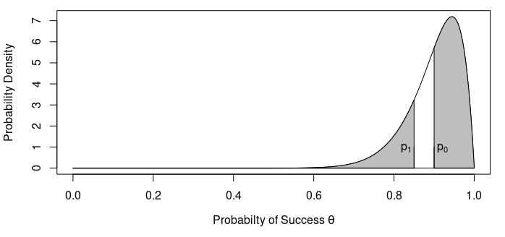
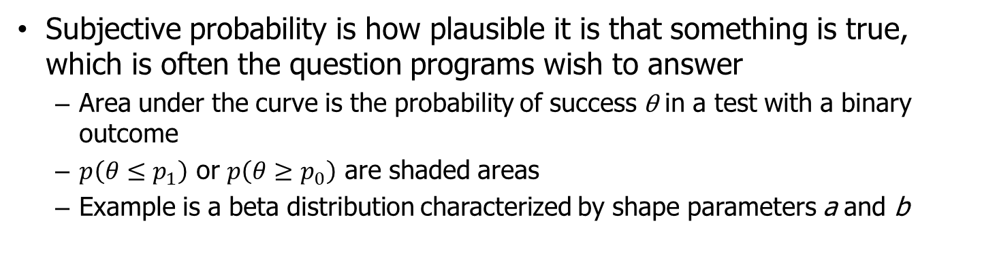
Subjective Probability
Subjective probability is how plausible it is that something is true, which is often the question programs wish to answer
  Area under the curve is the probability of success θ in a test with a binary outcome
  $p\left(θ≤p_{1}\right)$ or $p\left(θ≥p_{0}\right)$ are shaded areas
  Example is a beta distribution characterized by shape parameters a and b

Slide 4
What is a BN?
BN is a directed acyclic graph (DAG) with models of the nodes
DAG describes model interactions through nodes and edges
  Directed edges indicate cause and effect
  Acyclic paths can’t loop back on themselves
  Nodes can be described by the conditional probability of the outputs given the inputs
1
5
3
4
7
8
2
6

Slide 5
Notional System Explained
Reliability is the probability that the subsystem performs as it is intended (i.e. the node is working)
OR nodes declare the system works if either previous node worked
  Previous nodes behave as two subsystems in parallel
Node output data coded “1” for success and “0” for failure
  Order of 1s and 0s matters because of how OR nodes work
  Tests are assumed to be a set of n tests with y successes

Slide 6
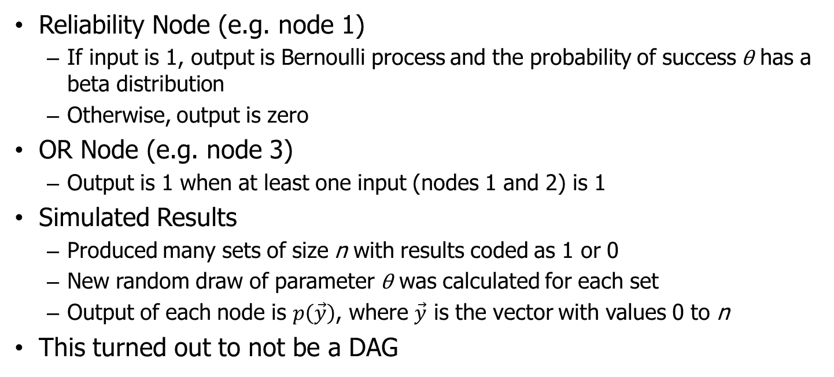
Simple Model
1
OR
5
OR
3
4
7
8
2
6
Reliability Node (e.g. node 1)
  If input is 1, output is Bernoulli process and the probability of success θ has a beta distribution
  Otherwise, output is zero
OR Node (e.g. node 3)
  Output is 1 when at least one input (nodes 1 and 2) is 1
Simulated Results
  Produced many sets of size n with results coded as 1 or 0
  New random draw of parameter θ was calculated for each set
  Output of each node is $p\left(\vec{y}\right)$, where $\vec{y}$ is the vector with values 0 to n
This turned out to not be a DAG

Slide 7
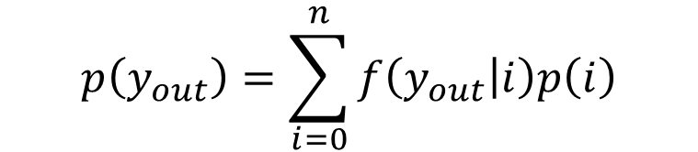
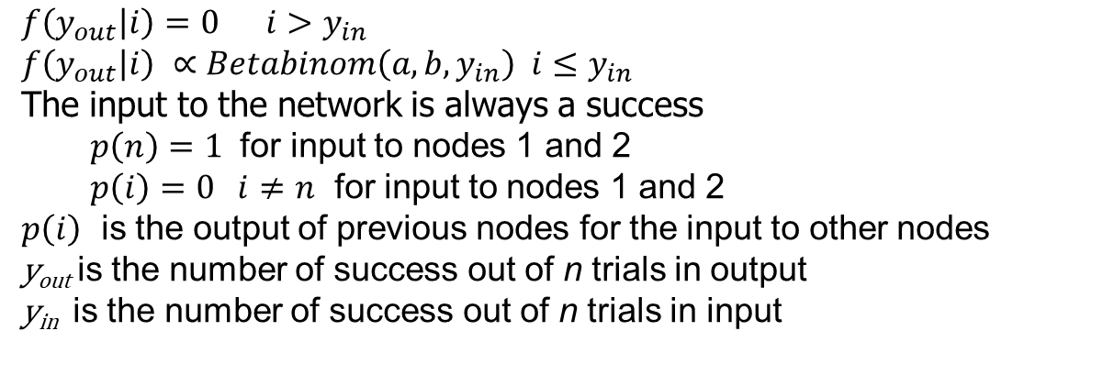
Summation Model
$$p\left(y_{out}\right)=\sum_{i=0}^{n}{f\left(y_{out} | i\right)p\left(i\right)}$$
$$f\left(y_{out} | i\right)=0 i>y_{in}$$
$$f\left(y_{out} | i\right) ∝Betabinom\left(a,b,y_{in}\right) i≤y_{in}$$
The input to the network is always a success
  $p\left(n\right)=1$ for input to nodes 1 and 2
  $p\left(i\right)=0 i≠n$ for input to nodes 1 and 2
$p\left(i\right)$ is the output of previous nodes for the input to other nodes
y_{out} is the number of success out of n trials in output
y_{in} is the number of success out of n trials in input

Slide 8
Summation Model of OR Nodes
Model shown above needed to change to make it a Bayesian network
Output of the OR nodes depended on number of 1s in the input of the preceding node
  The method developed counted number of times both preceding nodes would produce a failure
  It was assumed the test had been a success prior to the preceding nodes
Diagram on the right is the DAG for the model
Nodes A and B are a composite shown in the lower figure
A
4
B
8
y₁
y_{in}
OR
y_{out}
y₂

Slide 9
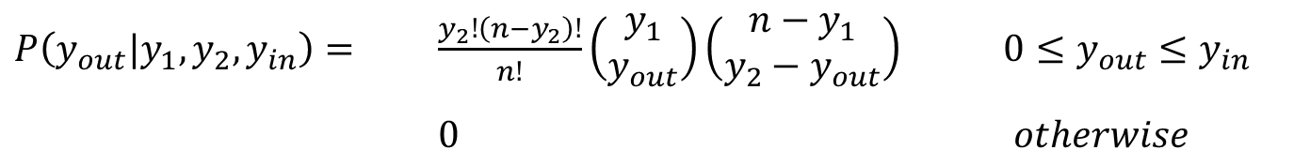
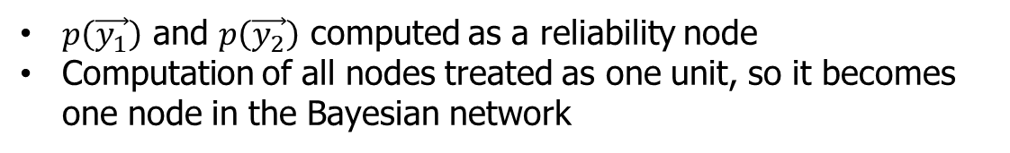
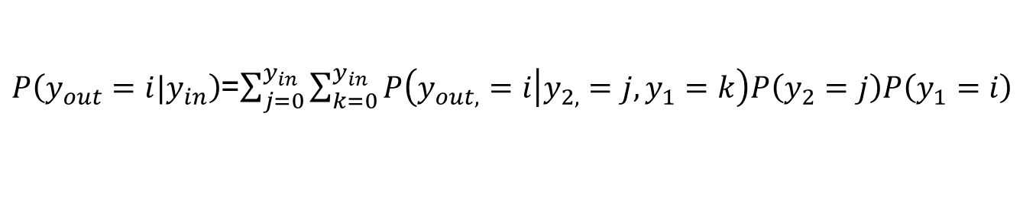
Model of OR Node
y₁
y_{in}
OR
y_{out}
y₂
$P\left(y_{out}|y_{1},y_{2},y_{in}\right)=$ $\frac{y_{2}!\left(n−y_{2}\right)!}{n!}\left(\begin{matrix}y_{1} \\ y_{out}\end{matrix}\right)\left(\begin{matrix}n−y_{1} \\ y_{2}−y_{out}\end{matrix}\right)$ $0≤y_{out}≤y_{in}$
$0$ $otherwise$
$P\left(y_{out}=i|y_{in}\right)$=$\sum_{j=0}^{y_{in}}{\sum_{k=0}^{y_{in}}{P\left(y_{out,}=i | y_{2,}=j,y_{1}=k\right)P\left(y_{2}=j\right)P\left(y_{1}=i\right)}}$
$p\left(\vec{y_{1}}\right)$ and $p\left(\vec{y_{2}}\right)$ computed as a reliability node
Computation of all nodes treated as one unit, so it becomes one node in the Bayesian network

Slide 10
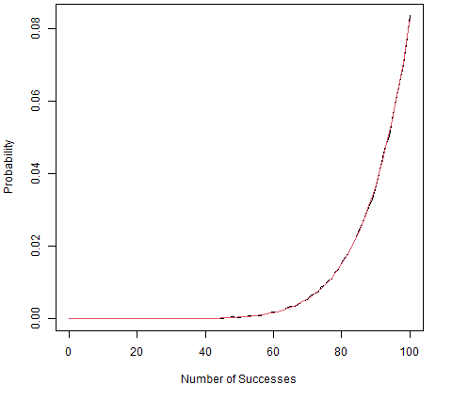
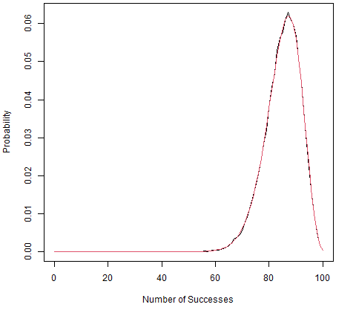
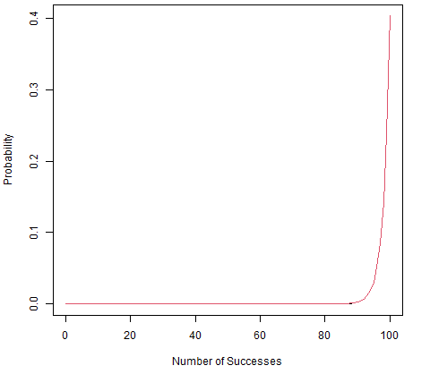
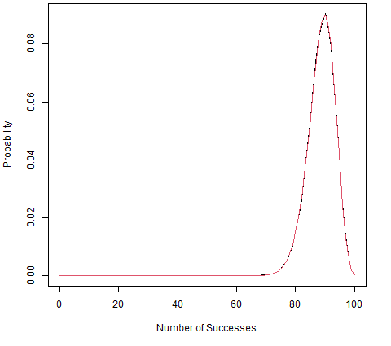
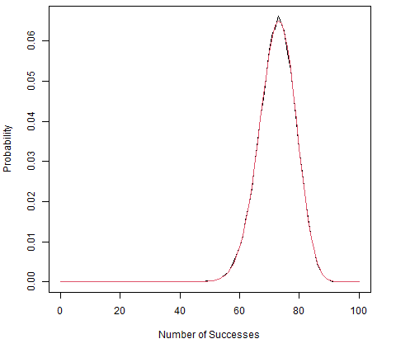

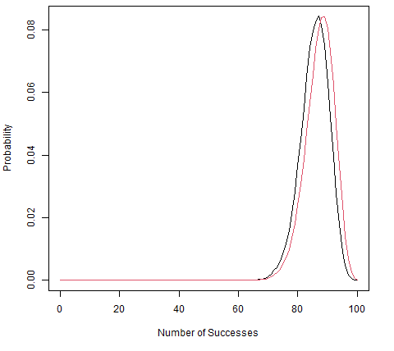
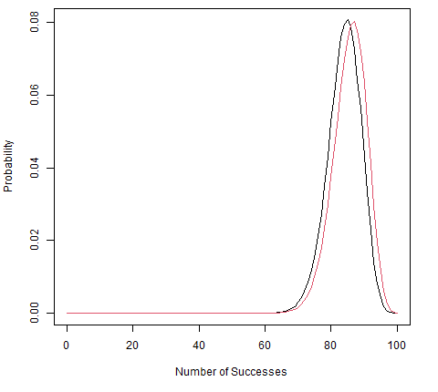
Results of Propagation
1
2
3
4
5
6
7
8
Bayesian probability of outputs for each node are shown
Approximate agreement between the methods
Black lines are simulated, red lines are from summation models

Slide 11
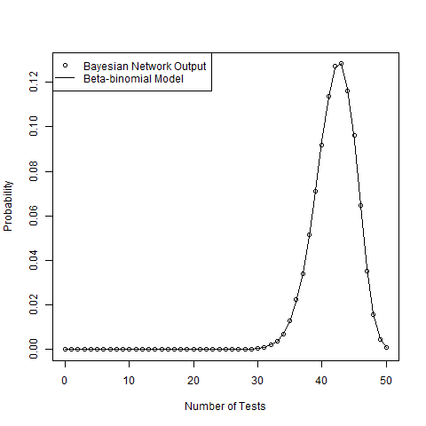
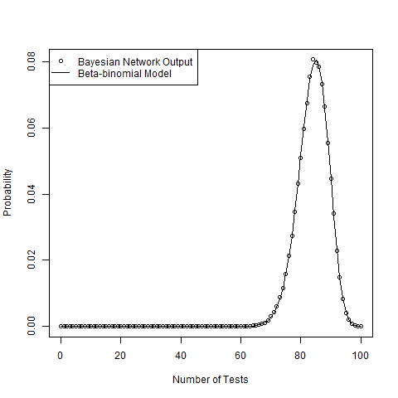
Model Result
Model does not produce an estimate of θ, but of probability of seeing y successes out of n tests
There was no expected model of the PDF of the output, but a beta-binomial fit the data very well
Results are for simulated data

Slide 12
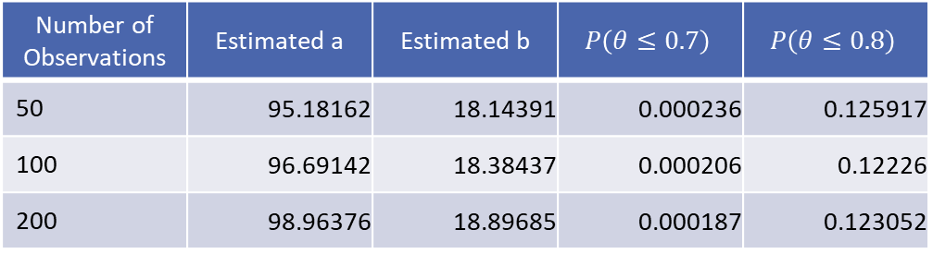
Analysis of Results
The beta-binomial model was fit to estimate parameters
Beta-binomial is the predictive distribution for a beta prior distribution
Beta distribution with those parameters was used to estimate probabilities
Results for the beta distribution do not appear to depend on n
Number of Observations | Estimated a | Estimated b | $$P\left(θ≤0.7\right)$$ | $$P\left(θ≤0.8\right)$$
50 | 95.18162 | 18.14391 | 0.000236 | 0.125917
100 | 96.69142 | 18.38437 | 0.000206 | 0.12226
200 | 98.96376 | 18.89685 | 0.000187 | 0.123052

Slide 13
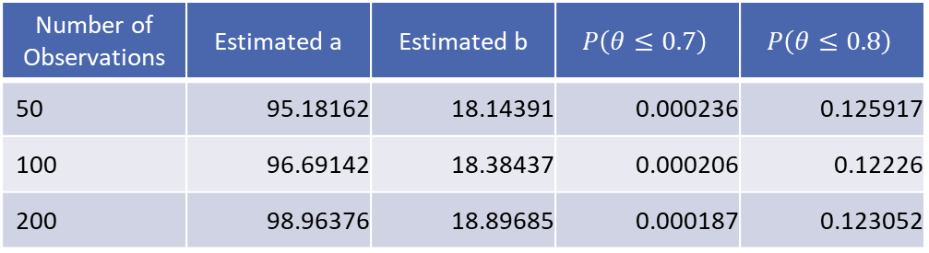
Decision Based on Result
Risk of low values of θ are estimated by the model
  Risk captures uncertainty reflected in the models of the nodes
Results are from different random samples and vary
Results conflate
Is the model good enough?
Is the system good enough?
Number of Observations | Estimated a | Estimated b | $$P\left(θ≤0.7\right)$$ | $$P\left(θ≤0.8\right)$$
50 | 95.18162 | 18.14391 | 0.000236 | 0.125917
100 | 96.69142 | 18.38437 | 0.000206 | 0.12226
200 | 98.96376 | 18.89685 | 0.000187 | 0.123052

Slide 14
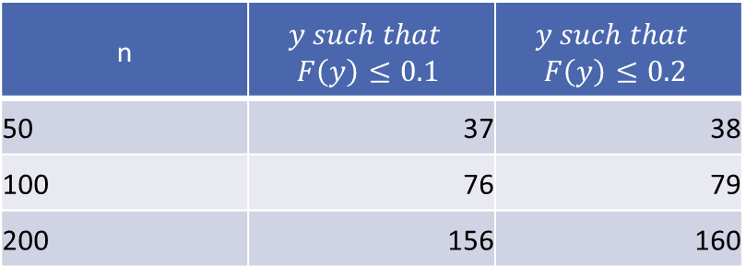
Validation
Model can be run to get the CDF of number of successes out of n
One can estimate the probability of seeing a given number of successes, or fewer
If the number of observed successes is the value shown in the table, or below, one would say that the testing does not support the model
Do the data support the model?
n | $$y such that$$ $$F\left(y\right)≤0.1$$ | $$y such that$$ $$F\left(y\right)≤0.2$$
50 | 37 | 38
100 | 76 | 79
200 | 156 | 160

Slide 15
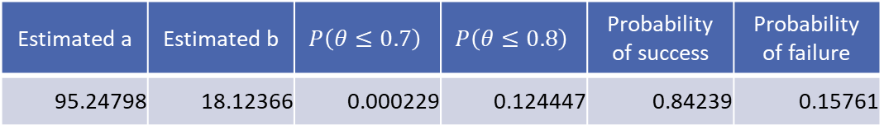
What If You Can Only Run One Test?
The model will still produce estimates of system performance if we fit a beta-binomial to estimate parameters of the beta distribution
Model validation comes down to the probability of seeing any failures
  There is 16% chance of seeing a failure
  If we see a failure, would we reject the model?
Estimated a | Estimated b | $$P\left(θ≤0.7\right)$$ | $$P\left(θ≤0.8\right)$$ | Probability of success | Probability of failure
95.24798 | 18.12366 | 0.000229 | 0.124447 | 0.84239 | 0.15761

Slide 16

What If You Can’t Test the Total System?
The model produces $p\left(\vec{y}\right)$for the total system
The beta distribution can be fit to obtain $p\left(θ\right)$
Individual nodes can be tested and node models validated

Slide 17
What is Not Here?
Unknown unknowns, lurking variables, latent variables…
We are assuming that the DAG reasonably captures cause and effect relationships
Possible fixes
  Look at how responses change with time and at different locations
  SMEs will have to be continuously asked for insight into new models

Slide 18


QUESTIONS?
To enhance T&E science through multidisciplinary collaboration and deliver it to the DHS workforce through independent consultation and tailored resources.
Visit, www.AFIT.edu/STAT
Email, AFIT.ENS.HSCOBP@us.af.mil
THEORY into PRACTICE

