Slide 1

Predicting Cyber Attack Likelihood using Probabilistic Attack Trees
TM
Dr. Bill “Data” Bryant
bill.bryant@mtsi-va.com

Slide 2
What’s the Problem?
Understanding platforms and weapon systems will perform in a cyber contested environment remains critical
The likelihood of a successful cyber attack is one of the most challenging things to assess or measure
Equivalent of kinetic survivability’s P_{H}
Little relevant historical data
No consensus on how, or even if, to measure
Probabilistic Attack Trees scored using historical data, simple models, and direct assessment provides a potential solution

Slide 3
URAMS Risk Spiral
Analyze
Inputs: Documentation, SME knowledge, architectures, potential threats, stakeholder concerns
Outputs: Unscored risk scenarios
Score
Inputs: Unscored risk scenarios
Outputs: Scored risk scenarios
Score
Analyze
Decide
Combine
Decide
Inputs: Scored system level or portfolio risk
Outputs: Structured assurance case, decision documents, reports
Combine
Inputs: Scored risk scenarios
Outputs: Scored system level or portfolio risk
Notes:
Analyze
Utilize System-Theoretic Process Analysis for Security (STPA-Sec) to analyze system
Inputs: System documentation, SME knowledge, architectures, potential threats, stakeholder concerns
Outputs: Unscored risk scenarios
Score
Score the risk from scenarios
Can utilize qualitative or quantitative risk assessment tools
Some tools include the capability to also score uncertainty
Inputs: Unscored risk scenarios
Outputs: Scored risk scenarios
Combine
Utilizes a range of tools to combine risks depending on what tools were used to score the risks
Inputs: Scored risk scenarios
Outputs: Scored system level or portfolio risk
Decide
Presents risk to decision makers in a clearly understandable way
Uses structured assurance cases
Inputs: Scored system level or portfolio risk
Outputs: Structured assurance case, decision documents, reports

Slide 4
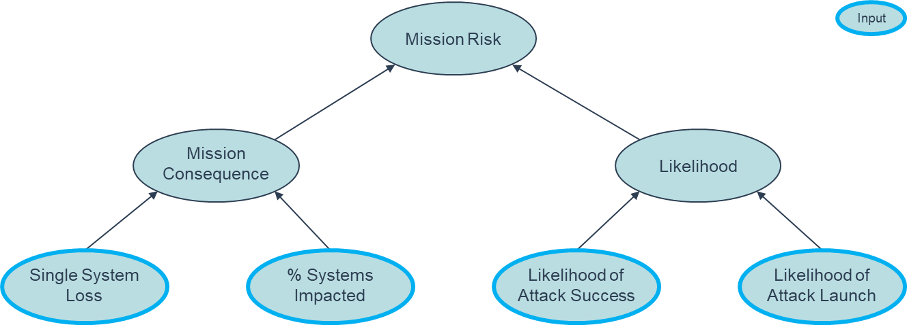
Example Risk Scoring (4-Factor)
Mission Impact: Determined by combination of engineers and operators
Our focus: Combination of engineering, operations, and intelligence
Threat intent: Largely the realm of intelligence

Slide 5
Is Likelihood Helpful?
Likelihood is normally the most difficult factor to estimate
Is the uncertainty so high that likelihood should not be estimated at all? (likelihood=100% for everything)
While I understand the approach, I think it is a mistake
There are ways to estimate likelihood with uncertainty
Some things will be clearly more likely than others
Assuming all things are equally likely will result in the mis-application of resources

Slide 6
Attack Trees Introduction
or
UAS flies to adversary directed location
and
Adversary sends malicious navigation command to UAS
Device on 1553 bus sends adversary spoofed navigation message
Adversary successfully spoofs nav solution
and
Adversary gains control of ground station
Adversary gets into the middle of ground station & UAS communications link
Adversary control of device on 1553 bus via supply chain
Device on 1553 bus successfully sends adversary spoofed navigation message
MIL GPS spoofing
Other NAV sensor spoofing
Adversary gets link to shift into unencrypted mode
Adversary gets encryption key
Nodes can be connected either “or” or “and”
With leaf probabilities, root probability can easily be calculated
Assumes independence
Determining leaf probabilities is not easy
Operator Insider
SIPR connected Traditional-IT cyber attack
Adversary gets insider to give them the key
Adversary breaks encryption to determine the key
Adversary steals key from SIPR connected ground station

Slide 7
1. Start with Known Data
or
UAS flies to adversary directed location
and
Scored Leaf
Adversary sends malicious navigation command to UAS
Device on 1553 bus sends adversary spoofed navigation message
Adversary successfully spoofs nav solution
and
Adversary gains control of ground station
Adversary gets into the middle of ground station & UAS communications link
Adversary control of device on 1553 bus via supply chain
Device on 1553 bus successfully sends adversary spoofed navigation message
MIL GPS spoofing
Other NAV sensor spoofing
Adversary gets link to shift into unencrypted mode
Adversary gets encryption key
Nodes on the bottom need scoring
Start with elements where we have known data to utilize
0.0
Operator Insider
SIPR connected Traditional-IT cyber attack
0.002
Adversary gets insider to give them the key
Adversary breaks encryption to determine the key
Adversary steals key from SIPR connected ground station
Derived from data
0.0005

Slide 8
Examples of Data
Study done by the Defense Personnel and Security Research Center found 83 confirmed cases of insider exfiltration information from 1985-2017¹
Total military and civilian population can be estimated as ranging from 3.1M in 1985 - 2.1M in 2017
Assume worst case that only 1 in 10 spies is caught and the probability any particular individual is an insider is 1:100,000 or 0.00001
Assume 200 people have access the ground station
Probability Operator Insider on Control Station = 0.00001 x 200 = 0.002
Assume 50 people have access to the encryption keys
Probability Operator Insider on Control Station = 0.00001 x 50 = 0.0005
Since the system is specifically designed to return to base if encrypted commands are not received, the probability of an adversary getting unencrypted commands accepted is set to 0.0
It may actually be more prudent to set a low probability as adversaries often will find ways around design features such as this
Notes:
1. Stephanie L. Jaros, Katlin J. Rhyner, Shannen M. McGrath, and Erik R. Gregory, The Resource Exfiltration Project: Findings from DoD Cases, 1985-2017, Defense Personnel and Security Research Center, Office of People Analytics, March 2019.

Slide 9
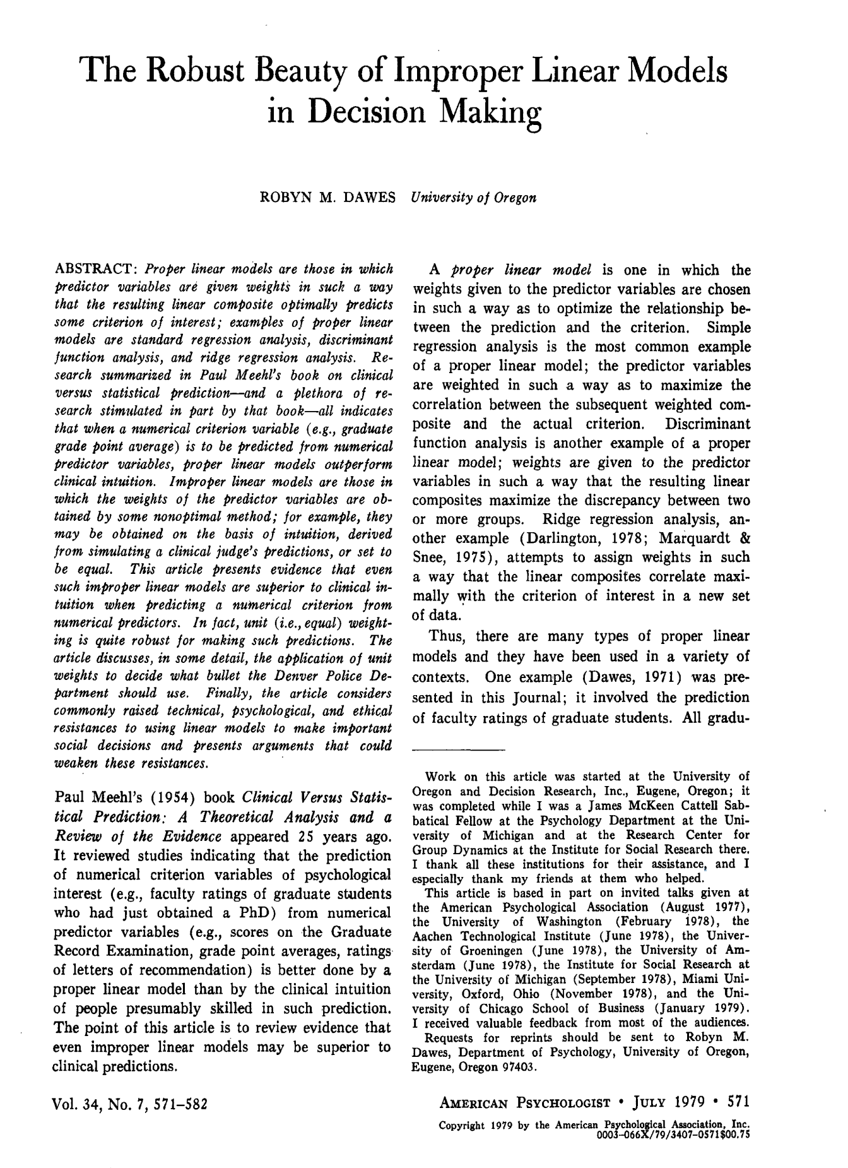
Simple Models
Large body of research showing that simple models, even without weighting, generally outperform humans¹
Humans determine the factors
Simple linear models can be built using
Historical data
Human assessment
AI trained on large sets of data
Human assessment
Research going back to the 1950s postulates that human decision makers utilize a series of cues in decision making²
Models built by humans outperform direct assessment by humans³
Notes:
1. Robyn M. Dawes, “The Robust Beauty of Improper Linear Models in Decision Making”, (American Psychologist, Vol. 34, No7, July 1979), 571-582.
2. Brunswick, Egon. Perception and the Representative Design of Psychological Experiments. (Berkeley: University of California Press, 1956.)
3. Douglas W. Hubbard and Richard Seiersen. (How to Measure Anything in Cybersecurity Risk Hoboken, NJ, Wiley, 2016), 185.

Slide 10
Example Atomic Component Model
Adversary controlled component (privileged)
Connection
Component under attack
Attacker Goal
Write malicious data (including programs)
Execute malicious programs
Maliciously execute authorized programs
Deny authorized data
Obtain system data
Component Cyber Robustness
Fragile
Average
Robust
SSE Process Maturity
None
Compliance focus
Robust SSE
45 questions

Slide 11
Building a Model
A model can be built using Excel
Determine factors (minimize as able)
Build survey including all permutations of factors
Survey SMEs and average responses
Build model using multiple linear regression and check statistics

Slide 12
2. Use Human Informed Models
or
UAS flies to adversary directed location
and
Scored Leaf
Adversary sends malicious navigation command to UAS
Device on 1553 bus sends adversary spoofed navigation message
Adversary successfully spoofs nav solution
and
Adversary gains control of ground station
Adversary gets into the middle of ground station & UAS communications link
Adversary control of device on 1553 bus via supply chain
Device on 1553 bus successfully sends adversary spoofed navigation message
MIL GPS spoofing
Other NAV sensor spoofing
0.30
Adversary gets link to shift into unencrypted mode
Adversary gets encryption key
Adversary was attempting to write malicious data
Average component cyber robustness
Compliance focused SSE process maturity
0.0
Operator Insider
SIPR connected Traditional-IT cyber attack
0.002
Adversary gets insider to give them the key
Adversary breaks encryption to determine the key
Adversary steals key from SIPR connected ground station
Derived from data
Human informed model
0.0005

Slide 13
3. Use SME Assessments
or
UAS flies to adversary directed location
and
Scored Leaf
Adversary sends malicious navigation command to UAS
Device on 1553 bus sends adversary spoofed navigation message
Adversary successfully spoofs nav solution
and
Adversary gains control of ground station
Adversary gets into the middle of ground station & UAS communications link
Adversary control of device on 1553 bus via supply chain
Device on 1553 bus successfully sends adversary spoofed navigation message
MIL GPS spoofing
Other NAV sensor spoofing
0.01
0.30
0.01
0.005
Adversary gets link to shift into unencrypted mode
Adversary gets encryption key
All the normal issues with using SME assessment of probabilities apply
Calibration
Uncertainty
Consistency
Does allow for easier assessment of scoring
0.0
Operator Insider
SIPR connected Traditional-IT cyber attack
0.002
0.07
Adversary gets insider to give them the key
Adversary breaks encryption to determine the key
Adversary steals key from SIPR connected ground station
Derived from data
Human informed model
SME assessment
0.0005
0.02
0.05

Slide 14
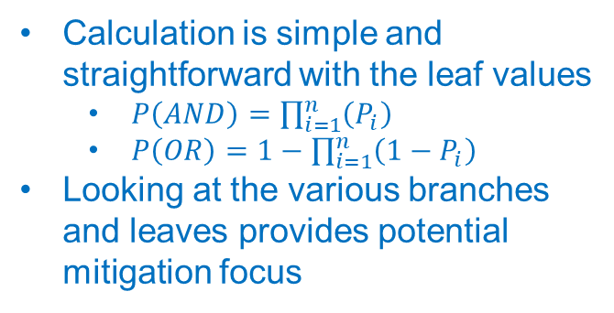
Calculate Results
or
UAS flies to adversary directed location
and
Scored Leaf
0.15
Adversary sends malicious navigation command to UAS
Device on 1553 bus sends adversary spoofed navigation message
Adversary successfully spoofs nav solution
0.136
and
0.015
0.003
Adversary gains control of ground station
Adversary gets into the middle of ground station & UAS communications link
Adversary control of device on 1553 bus via supply chain
Device on 1553 bus successfully sends adversary spoofed navigation message
MIL GPS spoofing
Other NAV sensor spoofing
0.071
0.069
0.01
0.30
0.01
0.005
Adversary gets link to shift into unencrypted mode
Adversary gets encryption key
Calculation is simple and straightforward with the leaf values
$P\left(AND\right)=\prod_{i=1}^{n}{\left(P_{i}\right)}$
$P\left(OR\right)=1−\prod_{i=1}^{n}{\left(1−P_{i}\right)}$
Looking at the various branches and leaves provides potential mitigation focus
0.0
0.069
Operator Insider
SIPR connected Traditional-IT cyber attack
0.002
0.07
Adversary gets insider to give them the key
Adversary breaks encryption to determine the key
Adversary steals key from SIPR connected ground station
Derived from data
Human informed model
SME assessment
Calculated
0.0005
0.02
0.05
Notes:
$$P\left(OR\right)=1−\prod_{i=1}^{n}{\left(1−P_{i}\right)}$$

Slide 15
Look for Opportunities to Improve
or
UAS flies to adversary directed location
and
Scored Leaf
0.15
Adversary sends malicious navigation command to UAS
Device on 1553 bus sends adversary spoofed navigation message
Adversary successfully spoofs nav solution
Data?
Data?
Data?
0.136
and
0.015
0.0045
Adversary gains control of ground station
Adversary gets into the middle of ground station & UAS communications link
Adversary control of device on 1553 bus via supply chain
Device on 1553 bus successfully sends adversary spoofed navigation message
MIL GPS spoofing
Other NAV sensor spoofing
0.071
0.069
0.01
0.30
0.01
0.005
Adversary gets link to shift into unencrypted mode
Adversary gets encryption key
Data?
Find data to answer questions
0.0
0.069
Operator Insider
SIPR connected Traditional-IT cyber attack
Data?
Data?
0.002
0.07
Adversary gets insider to give them the key
Adversary breaks encryption to determine the key
Adversary steals key from SIPR connected ground station
Derived from data
Human informed model
SME assessment
Calculated
0.0005
0.02
0.05

Slide 16
Look for Opportunities to Improve
or
UAS flies to adversary directed location
and
Scored Leaf
0.15
Adversary sends malicious navigation command to UAS
Device on 1553 bus sends adversary spoofed navigation message
Adversary successfully spoofs nav solution
Model?
Data?
Model?
Data?
Model?
Data?
0.136
and
0.015
0.0045
Adversary gains control of ground station
Adversary gets into the middle of ground station & UAS communications link
Adversary control of device on 1553 bus via supply chain
Device on 1553 bus successfully sends adversary spoofed navigation message
MIL GPS spoofing
Other NAV sensor spoofing
0.071
0.069
0.01
0.30
0.01
0.005
Adversary gets link to shift into unencrypted mode
Adversary gets encryption key
Model?
Data?
Find data to answer questions
Build additional models
0.0
0.069
Operator Insider
SIPR connected Traditional-IT cyber attack
Model?
Data?
Data?
0.002
0.07
Adversary gets insider to give them the key
Adversary breaks encryption to determine the key
Adversary steals key from SIPR connected ground station
Derived from data
Human informed model
SME assessment
Calculated
0.0005
0.02
0.05

Slide 17
Look for Opportunities to Improve
or
UAS flies to adversary directed location
and
Scored Leaf
0.15
Adversary sends malicious navigation command to UAS
Device on 1553 bus sends adversary spoofed navigation message
Adversary successfully spoofs nav solution
Model?
Data?
Model?
Data?
Model?
Data?
0.136
and
Test?
0.015
0.0045
Adversary gains control of ground station
Adversary gets into the middle of ground station & UAS communications link
Adversary control of device on 1553 bus via supply chain
Device on 1553 bus successfully sends adversary spoofed navigation message
MIL GPS spoofing
Other NAV sensor spoofing
0.071
0.069
0.01
0.30
0.01
0.005
Adversary gets link to shift into unencrypted mode
Adversary gets encryption key
Test?
Model?
Data?
Find data to answer questions
Build additional models
Focus testing on key nodes
0.0
0.069
Operator Insider
SIPR connected Traditional-IT cyber attack
Test?
Model?
Data?
Data?
0.002
0.07
Adversary gets insider to give them the key
Adversary breaks encryption to determine the key
Adversary steals key from SIPR connected ground station
Derived from data
Human informed model
SME assessment
Calculated
0.0005
0.02
0.05

Slide 18
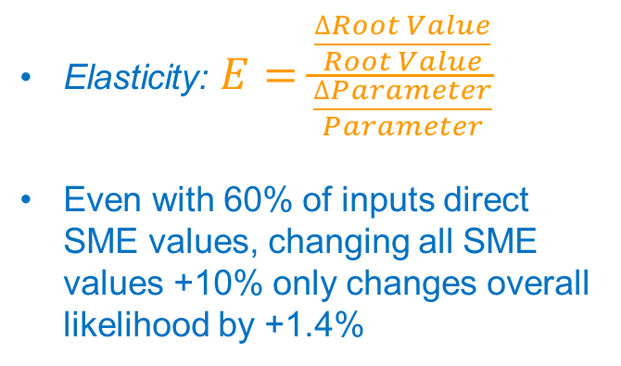
Sensitivity Analysis
or
UAS flies to adversary directed location
and
Scored Leaf
0.15
Adversary sends malicious navigation command to UAS
Device on 1553 bus sends adversary spoofed navigation message
Adversary successfully spoofs nav solution
0.136
and
0.015
0.003
Adversary gains control of ground station
Adversary gets into the middle of ground station & UAS communications link
Adversary control of device on 1553 bus via supply chain
Device on 1553 bus successfully sends adversary spoofed navigation message
MIL GPS spoofing
Other NAV sensor spoofing
0.071
0.069
0.01 1.68%
0.30 1.68%
0.01 5.6%
0.005 2.8%
Adversary gets link to shift into unencrypted mode
Adversary gets encryption key
Elasticity: $E=\frac{\frac{∆Root Value}{Root Value}}{\frac{∆Parameter}{Parameter}}$
Even with 60% of inputs direct SME values, changing all SME values +10% only changes overall likelihood by +1.4%
0.0 N/A
0.069
Operator Insider
SIPR connected Traditional-IT cyber attack
0.002 1.1%
0.07 42.0%
Adversary gets insider to give them the key
Adversary breaks encryption to determine the key
Adversary steals key from SIPR connected ground station
Derived from data
Human informed model
SME assessment
Sensitivity E
0.0005 0.28%
0.02 11.4%
0.05 29.4%
Notes:
$$P\left(OR\right)=1−\prod_{i=1}^{n}{\left(1−P_{i}\right)}$$

Slide 19
Option – 90% Confidence Intervals
or
UAS flies to adversary directed location
and
Scored Leaf
0.083 - 0.24
Adversary sends malicious navigation command to UAS
Device on 1553 bus sends adversary spoofed navigation message
Adversary successfully spoofs nav solution
0.075 - 0.23
and
0.0 - 0.00066
0.0 - 0.016
Adversary gains control of ground station
Adversary gets into the middle of ground station & UAS communications link
Adversary control of device on 1553 bus via supply chain
Device on 1553 bus successfully sends adversary spoofed navigation message
MIL GPS spoofing
Other NAV sensor spoofing
0.013 - 0.15
0.029 - 0.12
0.0001 – 0.05
0.18 - 0.43
0.001 - .02
0.005 - .05
Adversary gets link to shift into unencrypted mode
Adversary gets encryption key
90% Confidence Intervals provide an easy and intuitive way to track uncertainty
With multiple experts, 90CIs can be developed from linear models
0.0 – 0.001
0.028 - 0.12
Operator Insider
SIPR connected Traditional-IT cyber attack
0.0002 - 0.002
0.01 - 0.15
Adversary gets insider to give them the key
Adversary breaks encryption to determine the key
Adversary steals key from SIPR connected ground station
Derived from data
Human informed model
SME assessment
Calculated
0.00005 - 0.0005
0.001- 0.04
0.01 - 0.10
Notes:
$$P\left(OR\right)=1−\prod_{i=1}^{n}{\left(1−P_{i}\right)}$$

Slide 20
Advantages and Disadvantages
Advantages
Focuses on mission risk versus vulnerabilities
Provides specific falsifiable and testable predictions at all levels of the attack tree
Improves consistency and repeatability
Provides ability to calculate ROI for various mitigations
Does not require extensive training and scoring by program engineering teams
Disadvantages
Approach may be seen as too complex compared to 1-5 scoring
Requires detailed analysis of attack pathways
“Medium” feels more comfortable than “40% probability”
Including uncertainty via confidence intervals requires additional computational complexity

Slide 21
MBSE
If a MBSE model and environment are available, it can greatly enhance this approach
Utilize system model to build attack trees
Reusability
Attack tree branches and elements, models, scoring, etc.
Changes in the system model should be replicated through the risk scoring and should be automatically updated
May require scoring for new attack tree leaves

Slide 22
Conclusions
Probabilistic Attack Trees provide a transparent and repeatable way to score a cyber attack’s likelihood of success or P_{H}
A hierarchical approach to scoring maximizes the information and tools we have to provide the best answer right now
Historical Data
Simple Linear Models
Direct Assessment
Over time we should be able to utilize a higher percentage of data and models versus SME assessments

Slide 23
AI Excursion

Slide 24
AI Excursion
Can a generally trained AI Large Language Model (LLM) provide a substitute for human experts in creating models?
Performed a series of experiments with ChatGPT 4o and Llama 3.3
ChatGPT performed somewhat better than Llama 3.3
Great caution is needed, depending on the details of how the LLM was asked for data, often the results were indistinguishable from randomly generated numbers
With the right approach, results were similar to human experts

Slide 25
AI Excursion Trials
A script was used to ensure consistency
Three sets of 10 runs completed individually (e.g. 10I-1)
One set of 10 runs completed individually but inputting the script in sections (10SI)
Three sets of 10 runs as a multiple scenario question (e.g. 10M-1)
Three sets of 100 runs as a multiple scenario question (e.g. 100-1)
One general cyber SME
Three hands-on test cyber SMEs (used as the baseline)

Slide 26
AI Excursion Results 1
Run | Corr Coeff | Mean Abs Error | 90CI Width
Test Average | 1.0 | 0 | 0.54
Random | -0.5-0.25 | 0.25-0.35 | 0.92-0.96
10SI | -0.01 | 0.32 | 0.94
10M-1 | 0.20 | 0.31 | 0.95
10M-2 | -0.10 | 0.32 | 0.92
10M-3 | 0.06 | 0.31 | 0.94
100-1 | 0.16 | 0.31 | 0.94
100-2 | 0.16 | 0.31 | 0.95
100-3 | 0.16 | 0.31 | 0.94
SME 4 | 0.83 | 0.15 | N/A
10I-1 | 0.81 | 0.20 | 0.52
10I-2 | 0.81 | 0.22 | 0.54
10I-3 | 0.78 | 0.22 | 0.47
Pearson correlation coefficient measures the correlation between the run and test average
Mean absolute error is the average delta from each case
90CI width is a calculated 90% confidence interval based on the standard deviation in a normal distribution

Slide 27
AI Excursion Results 2
Run | Corr Coeff | Mean Abs Error | 90CI Width
Test Average | 1.0 | 0 | 0.54
Random | -0.5-0.25 | 0.25-0.35 | 0.92-0.96
10SI | -0.01 | 0.32 | 0.94
10M-1 | 0.20 | 0.31 | 0.95
10M-2 | -0.10 | 0.32 | 0.92
10M-3 | 0.06 | 0.31 | 0.94
100-1 | 0.16 | 0.31 | 0.94
100-2 | 0.16 | 0.31 | 0.95
100-3 | 0.16 | 0.31 | 0.94
SME 4 | 0.83 | 0.15 | N/A
10I-1 | 0.81 | 0.20 | 0.52
10I-2 | 0.81 | 0.22 | 0.54
10I-3 | 0.78 | 0.22 | 0.47
Multiple runs were indistinguishable from random and do not provide value
Even one of the 10 sets of individual runs with the script entered differently failed as well
It is possible that the AI dropped context

Slide 28
AI Excursion Results 3
Run | Corr Coeff | Mean Abs Error | 90CI Width
Test Average | 1.0 | 0 | 0.54
Random | -0.5-0.25 | 0.25-0.35 | 0.92-0.96
10SI | -0.01 | 0.32 | 0.94
10M-1 | 0.20 | 0.31 | 0.95
10M-2 | -0.10 | 0.32 | 0.92
10M-3 | 0.06 | 0.31 | 0.94
100-1 | 0.16 | 0.31 | 0.94
100-2 | 0.16 | 0.31 | 0.95
100-3 | 0.16 | 0.31 | 0.94
SME 4 | 0.83 | 0.15 | N/A
10I-1 | 0.81 | 0.20 | 0.52
10I-2 | 0.81 | 0.22 | 0.54
10I-3 | 0.78 | 0.22 | 0.47
Sets of 10 individual runs with the complete script appeared to approach the performance of the human SME

Slide 29
AI Excursion Results 4
Run | Corr Coeff | Mean Abs Error | 90CI Width
Test Average | 1.0 | 0 | 0.54
Random | -0.5-0.25 | 0.25-0.35 | 0.92-0.96
10SI | -0.01 | 0.32 | 0.94
10M-1 | 0.20 | 0.31 | 0.95
10M-2 | -0.10 | 0.32 | 0.92
10M-3 | 0.06 | 0.31 | 0.94
100-1 | 0.16 | 0.31 | 0.94
100-2 | 0.16 | 0.31 | 0.95
100-3 | 0.16 | 0.31 | 0.94
SME 4 | 0.83 | 0.15 | N/A
10I-1 | 0.81 | 0.20 | 0.52
10I-2 | 0.81 | 0.22 | 0.54
10I-3 | 0.78 | 0.22 | 0.47
With individual runs, meaningful results are possible from a LLM
Human experts are still preferred, but this may be a decent starting point
90CI Width appears to be a good metric to validate if the run is valid
Does not require a baseline for comparison

Slide 30
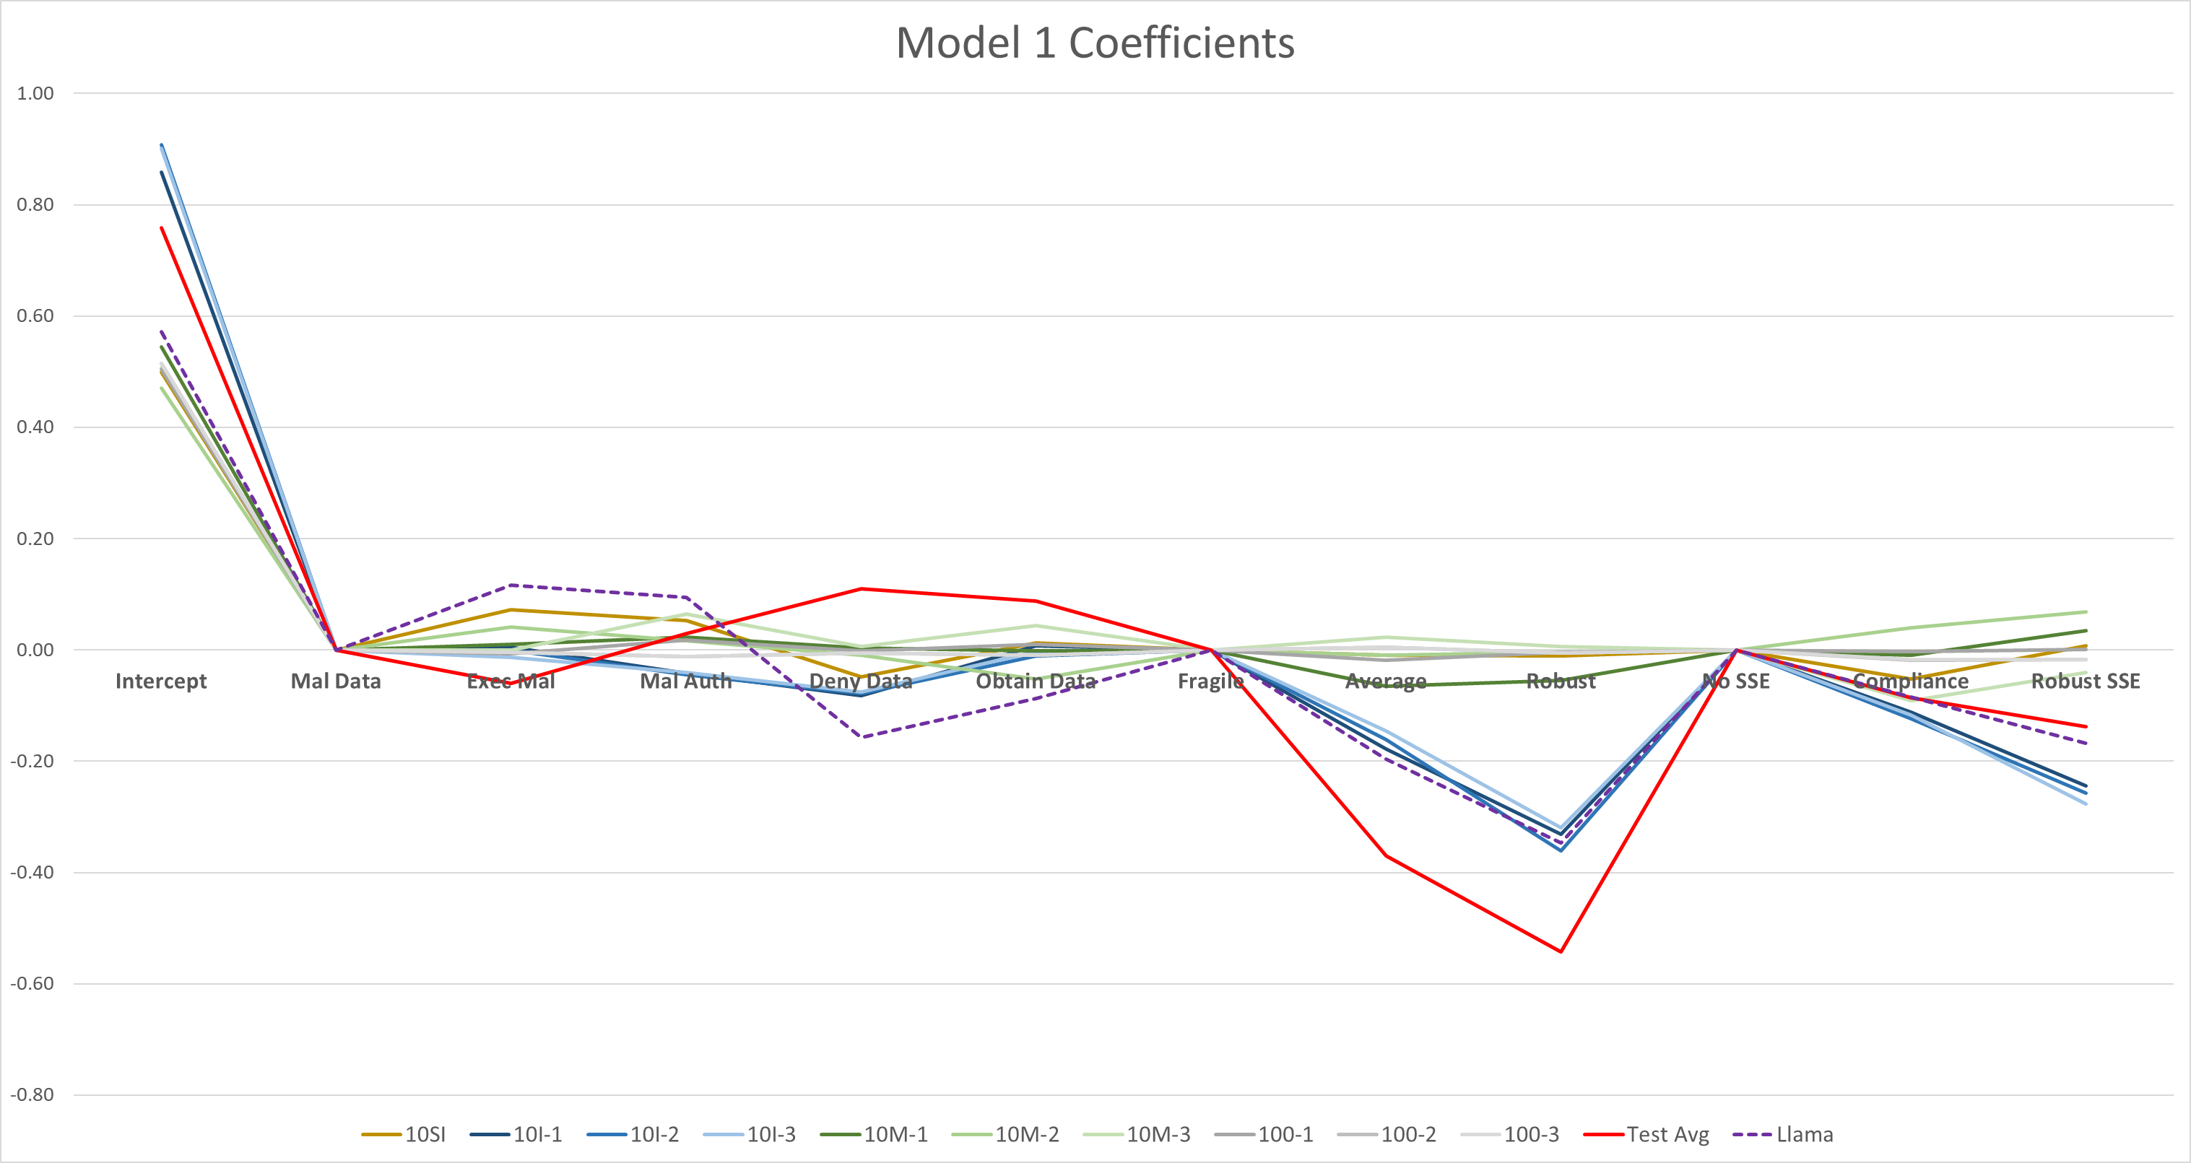

Slide 31
AI Excursion Notes
On only one occasion out of many dozens of trials, ChatGPT gave several results greater than 1.0
When questioned as to how a likelihood could be greater than 1.0, ChatGPT apologized and recreated, reducing the values over 1.0 to 1.0
On another occasion ChatGPT appeared to go “on strike”, the first quarter of the results were normal, the last three quarters were 0.5 for all values
You must carefully watch the output and can’t assume it gave you what you asked for

Slide 32
AI Excursion Direct Assessment
or
UAS flies to adversary directed location
and
Scored Leaf
0.15
0.10
Adversary sends malicious navigation command to UAS
Device on 1553 bus sends adversary spoofed navigation message
Adversary successfully spoofs nav solution
0.136
0.008
and
0.015
0.069
0.003
0.021
Adversary gains control of ground station
Adversary gets into the middle of ground station & UAS communications link
Adversary control of device on 1553 bus via supply chain
Device on 1553 bus successfully sends adversary spoofed navigation message
MIL GPS spoofing
Other NAV sensor spoofing
0.071
0.007
0.069
0.0015
0.07
0.01
0.02
0.05
0.01
0.30
0.64
0.005
Adversary gets link to shift into unencrypted mode
Adversary gets encryption key
Utilized a GPT specifically created to assess probabilities
Reasoning was provided for each assessment that seemed plausible
Ideally I would use human SMEs informed by AI input where hard data is missing
0.0
0.069
0.0015
Operator Insider
SIPR connected Traditional-IT cyber attack
0.002
0.07
0.005
Derived from data
Human informed model
SME assessment
AI assessment
Calculated
Adversary gets insider to give them the key
Adversary breaks encryption to determine the key
Adversary steals key from SIPR connected ground station
0.0005
0.02
0.00
0.05
0.001
Notes:
$$P\left(OR\right)=1−\prod_{i=1}^{n}{\left(1−P_{i}\right)}$$

Slide 33
Questions?
Dr. Bill “Data” Bryant
bill.bryant@mtsi-va.com
www.mtsi-va.com/weapon-systems-cybersecurity/

Slide 34
Questions to Answer
How do we know what an adversary can attack to create an impact?
How do we know how an adversary can attack?
How do we know the likelihood of a particular attack?
How do we know the mission impact of an attack?

Slide 35
A Simple Model of Risk
Q1
What do I not want to happen?
Feeds
How could an adversary do that to me?
Q2
Filters
Measures
Measures
How bad is it if it does happen?
What is the likelihood of an adversary successfully doing that to me?
x
= Risk

Slide 36
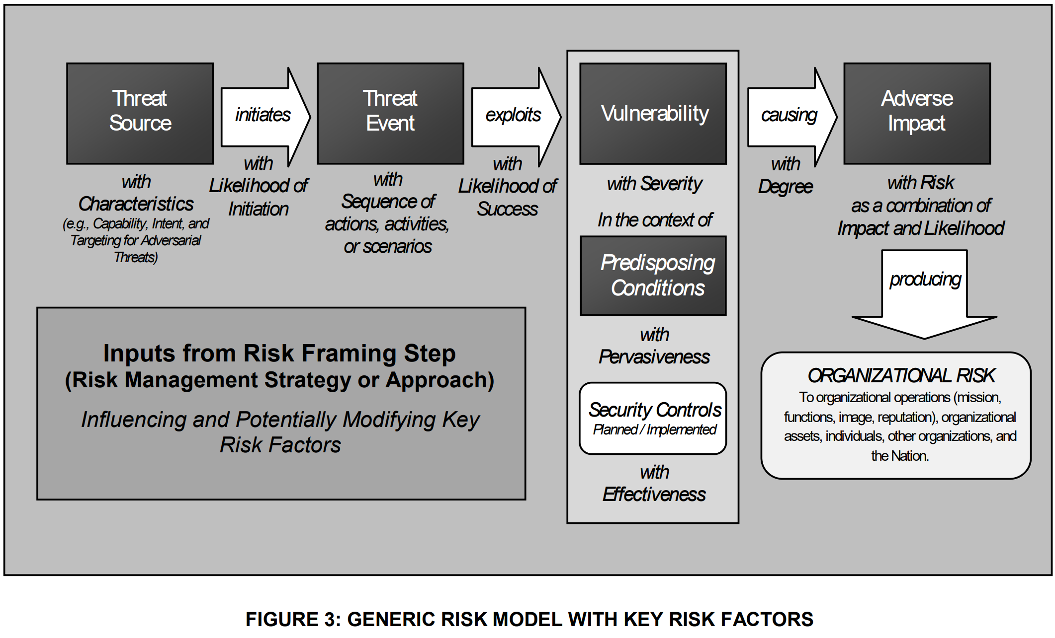
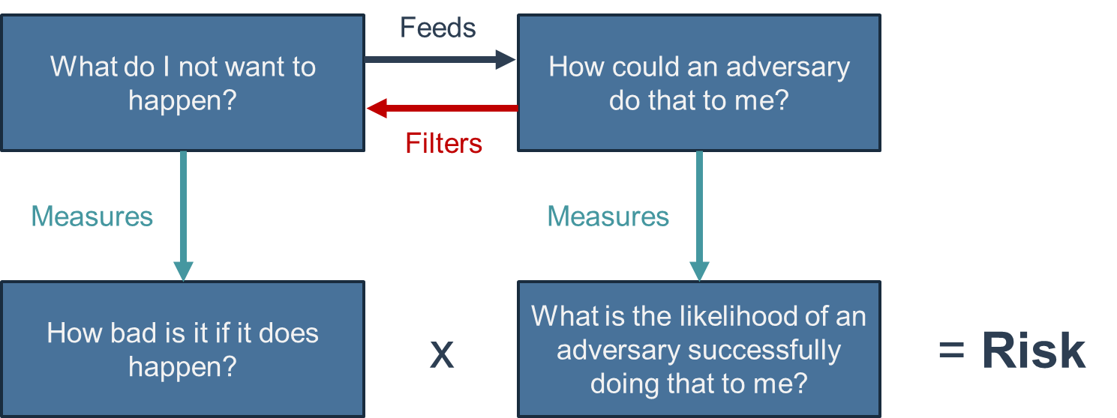
A Model of Risk
Mapping to NIST 800-30 Risk Model

Slide 37
Some Tools for “What”
In ascending order of complexity/cost
Unstructured brainstorming
Criticality analysis
Systems-Theoretic Process Analysis (STPA-Sec)
Output is typically a list of bad things we would like to avoid

Slide 38
Some Tools for “How”
In ascending order of complexity/cost
Unstructured brainstorming
Cyber kill chains
Attack path analysis
HAT TRICK
Attack trees
MITRE’s ATT&CK
Architectural approaches (COLE, TRACE, BRM, Assurant)

Slide 39
Some Tools for “How Bad”
In ascending order of complexity/cost
Direct SME estimation
Algorithmic Risk Approaches (TRACE, BRM, Assurant)
Mission level simulation (AFSIM)
Campaign level simulation

Slide 40
Some Tools for “Likelihood”
In ascending order of complexity/cost
Unstructured brainstorming
Cyber kill chains
Attack Path Analysis
Attack Trees
Algorithmic Risk Approaches (TRACE, BRM, Assurant)

Slide 41
Tools for “Risk”
In ascending order of complexity/cost
Direct SME estimation
SME inputs to risk model (URAMS)
Quantitative analysis of attack trees
Algorithmic Risk Approaches (TRACE, BRM, Assurant)
Mission level simulation (AFSIM)
Campaign level simulation

Slide 42
Tool Selection
Effort should be balanced across all components
Having extreme precision in one element, but leaving out others can result in wasted effort
Model Based Systems Engineering
If relevant models exist, look to leverage them with the tools selected

Slide 43
Selected Tools
How do we know what an adversary can attack to create an impact?
STPA-Sec
How do we know how an adversary can attack?
Attack trees
How do we know the likelihood of a particular attack?
Combination of data, human informed models, and SME estimates
How do we know the mission impact of an attack?
Direct SME assessment or simulation

Slide 44
STPA-Sec Background
System-Theoretic Accident Model and Processes (STAMP) developed by Dr. Nancy Leveson at MIT for the safety community
STPA-Sec
STPA Hazard Analysis
System Theoretic Process Analysis (STPA) Hazard analysis is based on the STAMP model
STAMP Model
System-Theoretic Process Analysis for Security (STPA-Sec) is a security extension of STPA developed by Dr. William Young
Notes:
System-Theoretic Accident Model and Processes (STAMP) was developed by Dr. Nancy Leveson at MIT for the safety community
System Theoretic Process Analysis (STPA) is based on the STAMP model
STPA is based on systems thinking and focuses on safety as an emergent property of complex systems vs. only looking at the component level
Many years of experience with very positive results when compared to traditional safety approaches
System-Theoretic Process Analysis for Security (STPA-Sec) is a security extension of STPA developed by Dr. William Young
Adds in a thinking adversary that can introduce unsecure control actions as well as the STPA unsafe control actions
Includes wargaming as an important element

Slide 45
STPA-Sec Steps
Step 1: Mission Analysis
Step 1A: Define system purpose and goal
Step 1B: Identify unacceptable losses
Step 1C: Identify system level hazards
Step 1D: Identify system level security constraints
Step 2: Control Structure
Step 2A: Create control structure
Step 2B: Assign responsibilities to controllers
Step 2C: Identify control actions
Step 2D: Identify feedback
Step 3: Hazardous Control Actions
Step 3A: Identify Hazardous Control Actions (HCAs)
Step 3B: Define controller security constraints
Step 4: Risk Scenarios
Step 4A: Develop loss scenarios from HCAs
Step 4B: Roll up loss scenarios into risk scenarios
Step 4C: Develop additional risk scenarios
URAMS Scoring Phase

Slide 46

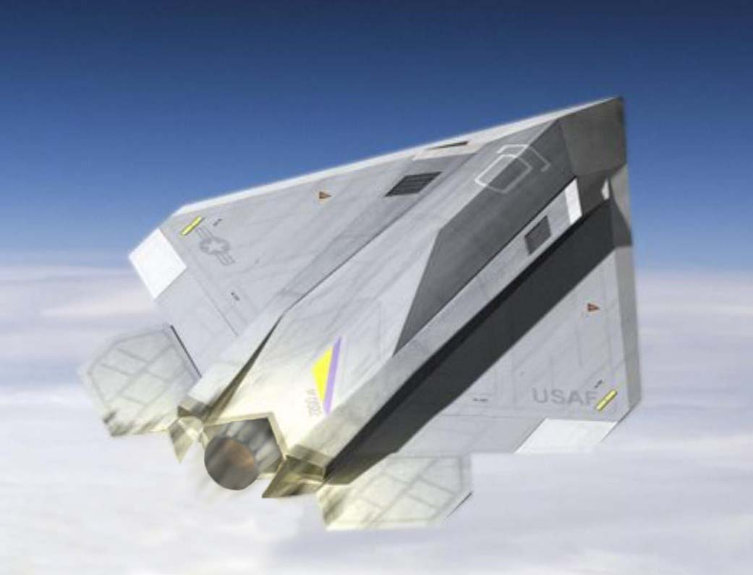
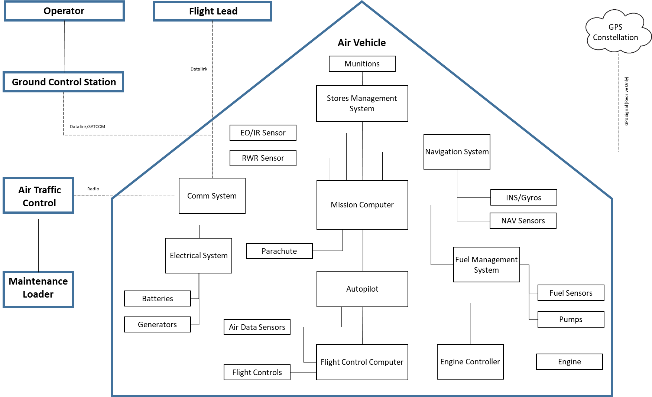
MQ-99 Berserker UAS
Notional UAS at conceptual stage of design,
any resemblance coincidental
Basic CONOPS & architecture
Air-to-Air and Air-to Ground roles
Semi-autonomous
2 x AMRAAM, or 6 x SDB
Attritable

Slide 47
Atomic Component Model v2 part 1
Adversary controlled component (privileged)
Connection
Component under attack
Attacker Goal
Write malicious data (including programs)
Execute malicious programs
Maliciously execute authorized programs
Deny authorized data
Obtain system data
Component Cyber Robustness
Fragile
Average
Robust
SSE Process Maturity
None
Compliance focus
Robust SSE
45 questions

Slide 48
Atomic Component Model v2 part 2
Component
Adversary (Man in the Middle, Man on the Side)
Component under attack
Attacker Goal
Write malicious data (including programs)
Deny authorized data
Obtain system data
Encryption
None/weak
Standard Commercial
NSA Type 1
Connection
TCP/IP
Wired non-TCP/IP
Non-TCP/IP RF
Physical Access
Component Cyber Robustness
Fragile
Average
Robust
108 questions

Slide 49
Term Definitions
Attacker Goals
From JHU/APL HAT TRICK, see for expanded discussion
Encryption
None/weak: Either there is no encryption on the communications link, or weak encryption that an adversary can break in a mission relevant timeframe (e.g. DES encryption, or “homebrew” encryption
Standard Commercial: Encryption on the link is accomplished with accepted commercial standard encryption that is unlikely to be broken in mission relevant timeframes (e.g. AES 256-bit)
NSA-Type 1: The link utilizes NSA-Type 1 encryption or equivalent and it is highly unlikely that an adversary can break it in a mission relevant timeframe

Slide 50
Term Definitions
Connection
TCP/IP: the communication link utilizes a standard TCP/IP protocol whether it travels over RF or physical medium (e.g. ethernet, Wi-Fi)
Wired non-TCP/IP: the communication link utilizes a non-TCP/IP protocol over a physical medium whether a bus or network (e.g. serial,1553 bus, AIRINC-429)
Non TCP/IP RF: the communication link utilizes a non-TCP/IP protocol over an RF link (e.g. Link-16)
Physical access: the attacker is able to establish direct physical contact with the component or its physical human machine interface

Slide 51
Term Definitions
Component Cyber Robustness (performance)
Fragile: the component has not been effectively tested, has known exploitable vulnerabilities, has performed poorly in testing or in the field, or was simply designed before significant focus was put into cyber robustness
Average: the component is expected to perform under attack similarly to the bulk of other modern systems, some testing has been done and the system has performed adequately, it was designed with cyber resilience in mind, and known exploitable vulnerabilities are quickly remediated
Robust: the component is on the security leading edge of similar modern components, has been extensively tested using adversarial approaches and performed well, and was designed from the beginning with industry-leading cyber robustness and defenses built into the baseline of the component

Slide 52
Term Definitions
SSE Process Maturity (process)
None: the component was not designed or produced in an environment that required SSE; there was no SSE process
Compliance Focus: the component has met current DoD security guidance and has gotten appropriate IATTs, ATOs, etc. and is working through associated remediation plans for known issues
Robust SSE: the component was designed and produced under a robust SSE process that considered security robustness as a key performance characteristic that received significant attention and support from stakeholders

Slide 53
Assumptions
Component is part of a developmental or currently fielded DoD weapon system that includes significant CPS elements
Top-tier nation state attacker with substantial resources ($M)
Adversary has gathered significant intelligence on the system including all unclassified and CUI data along with some classified data

Slide 54
Look for Opportunities to Improve
or
UAS flies to adversary directed location
and
Scored Leaf
0.15
Adversary sends malicious navigation command to UAS
Device on 1553 bus sends adversary spoofed navigation message
Adversary successfully spoofs nav solution
Model?
Data?
Model?
Data?
Model?
Data?
0.136
and
Test?
0.015
0.0045
Adversary gains control of ground station
Adversary gets into the middle of ground station & UAS communications link
Adversary control of device on 1553 bus via supply chain
Device on 1553 bus successfully sends adversary spoofed navigation message
MIL GPS spoofing
Other NAV sensor spoofing
0.071
0.069
0.01
0.30
0.01
0.005
Adversary gets link to shift into unencrypted mode
Adversary gets encryption key
Test?
Model?
Data?
Calculation is simple and straightforward with the leaf values
Looking at the various branches and leaves provides potential mitigation focus
0.0
0.069
Operator Insider
SIPR connected Traditional-IT cyber attack
Test?
Model?
Data?
Data?
0.002
0.07
Adversary gets insider to give them the key
Adversary breaks encryption to determine the key
Adversary steals key from SIPR connected ground station
Derived from data
Human informed model
SME assessment
Calculated
0.0005
0.02
0.05

Slide 55
Probabilistic Attack Tree Example
or
UAS flies to adversary directed location
and
Scored Leaf
0.15
Adversary sends malicious navigation command to UAS
Device on 1553 bus sends adversary spoofed navigation message
Adversary successfully spoofs nav solution
0.136
and
0.015
0.003
Adversary gains control of ground station
Adversary gets into the middle of ground station & UAS communications link
Adversary control of device on 1553 bus via supply chain
Device on 1553 bus successfully sends adversary spoofed navigation message
MIL GPS spoofing
Other NAV sensor spoofing
0.071
0.069
0.01
0.30
0.01
0.005
Adversary gets link to shift into unencrypted mode
Adversary gets encryption key
0.0
0.069
Operator Insider
SIPR connected Traditional-IT cyber attack
0.002
0.07
Adversary gets insider to give them the key
Adversary breaks encryption to determine the key
Adversary steals key from SIPR connected ground station
Derived from data
Human informed model
SME assessment
Calculated
0.0005
0.02
0.05
Notes:
$$P\left(OR\right)=1−\prod_{i=1}^{n}{\left(1−P_{i}\right)}$$

Slide 56
Model Sensitivity Analysis
Much of the result is driven by the structure of the model versus the specific inputs
For example, if the human informed model “Device on 1553 bus successfully sends adversary spoofed navigation message” was completely different
0%: Overall Likelihood = 0.149
30%: Overall Likelihood = 0.152
100%: Overall Likelihood = 0.158
Changing all SME input values
0%: Overall Likelihood = 0.152 +0%
+10%: Overall Likelihood = 0.166 +1.4%
-10%: Overall Likelihood = 0.138 -1.4%
+50%: Overall Likelihood = 0.220 +6.8%
-50%: Overall Likelihood = 0.079 -7.3%
Even with 60% of inputs direct SME generated, most of the result is driven by the attack tree structure

