Slide 1

Physics-Informed Machine Learning Towards A Real-Time Spacecraft Thermal Simulator
Manaswin Oddiraju¹, Zaki Hasnain², Saptarshi Bandopadhyay², Eric Sunada², Souma Chowdhury¹
¹ Aerospace & Mechanical Engineering, University at Buffalo
²Jet Propulsion Laboratory, California Institute of Technology
© Copyright 2024, California Institute of Technology, All Rights Reserved. Portions of this research were carried out by the Jet Propulsion Laboratory, California Institute of Technology

Slide 2
Outline
Contents
Introduction
  Motivation
  Background
  Research Objectives
Thermal Modelling of Cube Sat
  Baseline: Finite Difference Physics Model
  PIML Architecture
Results
  Modeling Performance and Cost

Slide 3
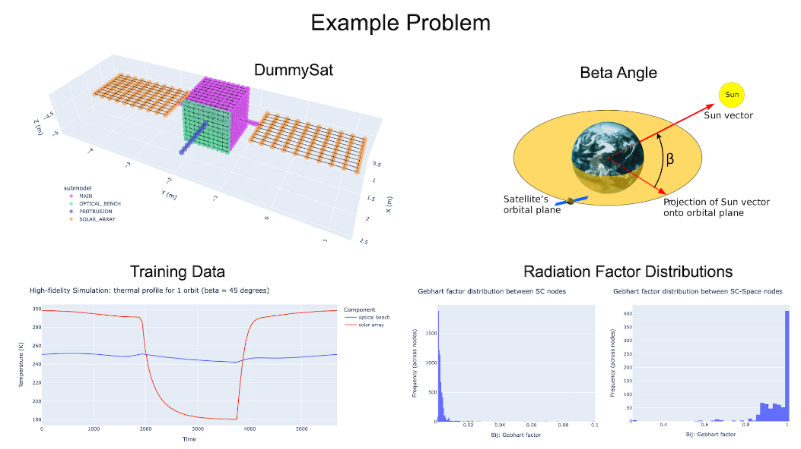
Introduction: Motivation
Spacecraft / Airless bodies operate in environments with extreme temperature gradients
Hence require equipment (heaters/radiators) to maintain operational capabilities
Current techniques for the design and control of systems result in suboptimal/ inefficient designs
Primarily limited by modelling cost of the simulation

Slide 4
Introduction: Motivation
Overall Objective: Adaptive nodalization, reliant on satellite location in-orbit.
Accuracy for a given nodalization depends on the thermal load gradients on each surface.
Hence, we propose a scheme to predict the nodalization given thermal loads on each surface.
Modelling aimed at reducing compute costs while maintaining accuracy and integrity of physics involved (no black box after nodalization).

Slide 5
Current Research Objectives
Develop an ML based adaptive nodalization scheme which reduces the computational cost of finite difference based thermal model while preserving accuracy.
Test the utility of this model by comparing with purely physics and purely data-driven baselines.

Slide 6
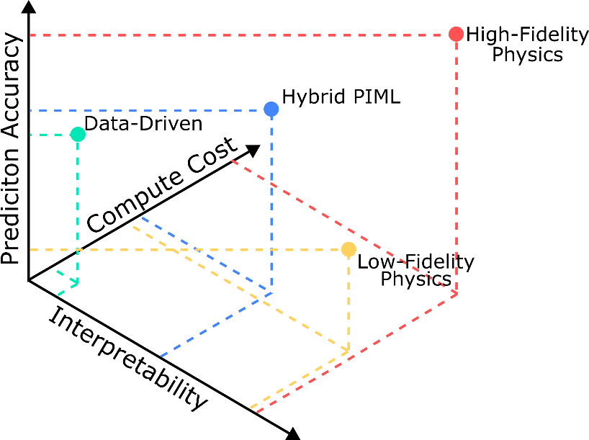
Physics Informed Machine Learning
Pure physics models are interpretable but usually trade-off accuracy for reduction of computational cost
Data-driven models - efficient and tend to generalize well, but lack interpretability and do not extrapolate well
Additionally, simplified physics models cannot fully take advantage of data from High-Fidelity models
PIML models combine advantages of both classes of models
They are more interpretable than pure data models, are faster than high-fidelity physics models and are more accurate than low-fidelity physics models

Slide 7
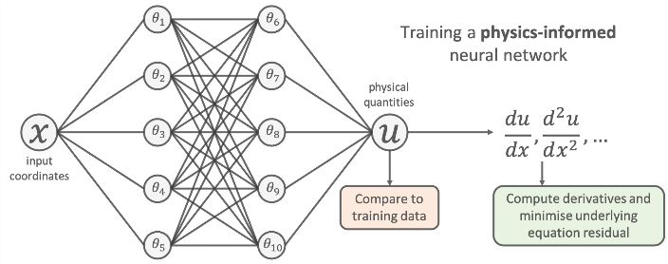
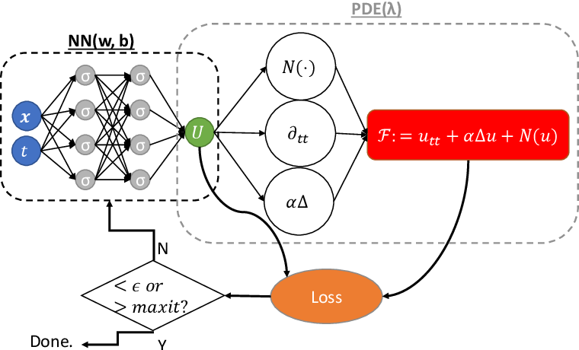
Physics Informed Machine Learning
Several types of PIML architectures have been proposed in recent years
Popular implementations include architectures:
  Use ANNs to model the dependent variables of a PDE [1]
  Architectures that use ODE/PDEs as activation functions [2]
  Hybrid Models which use a combination of physics and data-driven models for prediction [3]
  Physics constrained neural-networks [4]
  Neural Operators [5, 6]
Physics constrained generative models (GANs) have also been proposed [7]
Mao, Z., Jagtap, A.D. and Karniadakis, G.E., 2020. Physics-informed neural networks for high-speed flows
Jagtap, A.D et al.Locally adaptive activation functions with slope recovery for deep and physics-informed neural networks.
1. Mao, Z., Jagtap, A.D. and Karniadakis, G.E., 2020. Physics-informed neural networks for high-speed flows
2. Jagtap, A.D et al.Locally adaptive activation functions with slope recovery for deep and physics-informed neural networks.
3. Behjat et al. “A physics-aware learning architecture with input transfer networks for predictive modeling”
4. Liu, D. and Wang, Y., 2019. Multi-fidelity physics-constrained neural network and its application in materials modeling.
5. Kovachki, Nikola, Zongyi Li, Burigede Liu, Kamyar Azizzadenesheli, Kaushik Bhattacharya, Andrew Stuart, and Anima Anandkumar. "Neural operator: Learning maps between function spaces with applications to pdes." Journal of Machine Learning Research 24, no. 89 (2023): 1-97.
6.Lu, L., Jin, P., Pang, G., Zhang, Z. and Karniadakis, G.E., 2021. Learning nonlinear operators via DeepONet based on the universal approximation theorem of operators. Nature machine intelligence, 3(3), pp.218-229.
7. Yu, Y., Cai, C.S. and Liu, Y., 2021. Probabilistic vehicle weight estimation using physics‐constrained generative adversarial network.

Slide 8
Physics Informed Neural Networks
Models the dependent variable of a PDE using a neural network
Uses the PDE itself as an additional loss during training
Similar training costs to a purely data-driven model
Physics conformity after training is not guaranteed
Mao, Z., Jagtap, A.D. and Karniadakis, G.E., 2020. Physics-informed neural networks for high-speed flows
Mao, Z., Jagtap, A.D. and Karniadakis, G.E., 2020. Physics-informed neural networks for high-speed flows
Cai, S., Wang, Z., Wang, S., Perdikaris, P. and Karniadakis, G.E., 2021. Physics-informed neural networks for heat transfer problems. Journal of Heat Transfer, 143(6), p.060801.

Slide 9
Hybrid PIML Models
Hybrid PIML Models incorporate a lower-fidelity physics model with a data-driven model, to improve predictions of the low-fidelity model at a similar computational cost.
Encompass / can integrate all other PIML architectures
Applicable where simplified physics and high-fidelity physics models exist
Increased interpretability when compared to pure data-driven models
Can be architected to be physics conforming
They have higher training costs as compared to pure data driven models
Difficult to implement on closed-source or proprietary low-fidelity models

Slide 10
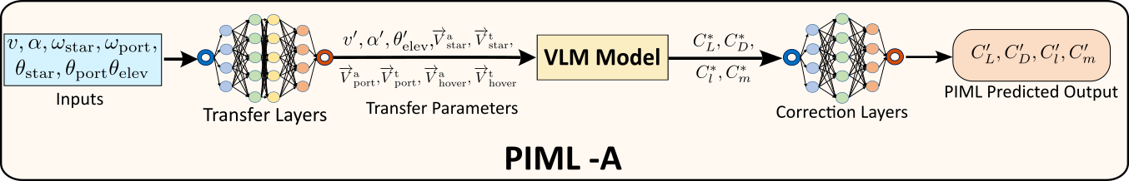
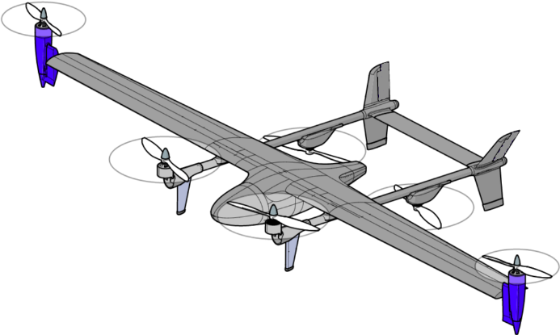
Hybrid PIML: Previous Application
Modelling requires high-fidelity data and a differentiable simplified physics model
High fidelity data is a CFD model
Vortex Lattice Method is used as the simplified physics model
Simulating aerodynamics of an eVTOL aircraft
Predicting Aerodynamic forces given control inputs
Learning to improve accuracy with similar computational cost
Oddiraju, M., Amin, D., Piedmonte, M. and Chowdhury, S., 2023. Physics Infused Machine Learning Based Prediction of VTOL Aerodynamics with Sparse Datasets. In AIAA AVIATION 2023 Forum (p. 4376).

Slide 11
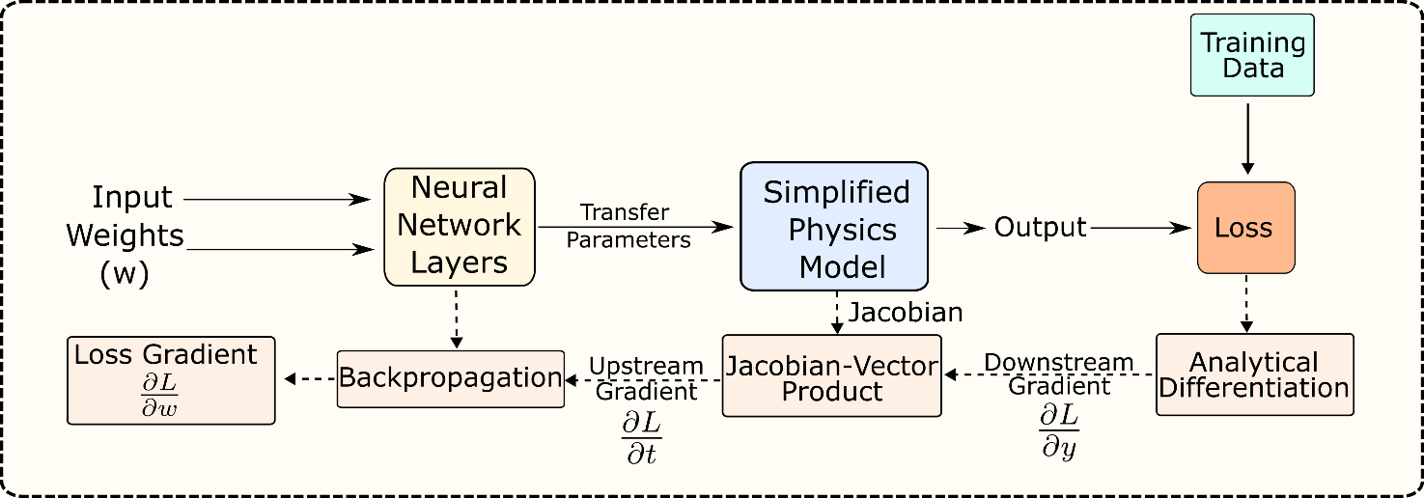
Hybrid PIML: Training
Representative Example of a Sequential Hybrid-PIML training framework
Efficient training requires differentiable low-fidelity physics models
“Differentiable” implies having a defined function that computes the Jacobian of the outputs w.r.t the transfer parameters
Easily applicable for optimization, control , uncertainty quantification owing to the end-to-end differentiability
Notes:
Stress on the distinction that only the low-fidelity models need to be differentiable, we only need samples from high-fidelity / experimental sources.

Slide 12
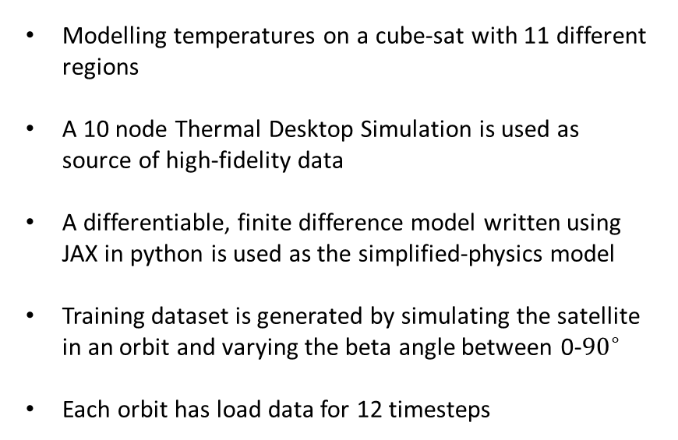
Cube-Sat Thermal Simulation
Modelling temperatures on a cube-sat with 11 different regions
A 10 node Thermal Desktop Simulation is used as source of high-fidelity data
A differentiable, finite difference model written using JAX in python is used as the simplified-physics model
Training dataset is generated by simulating the satellite in an orbit and varying the beta angle between 0-${90}^{∘}$
Each orbit has load data for 12 timesteps

Slide 13
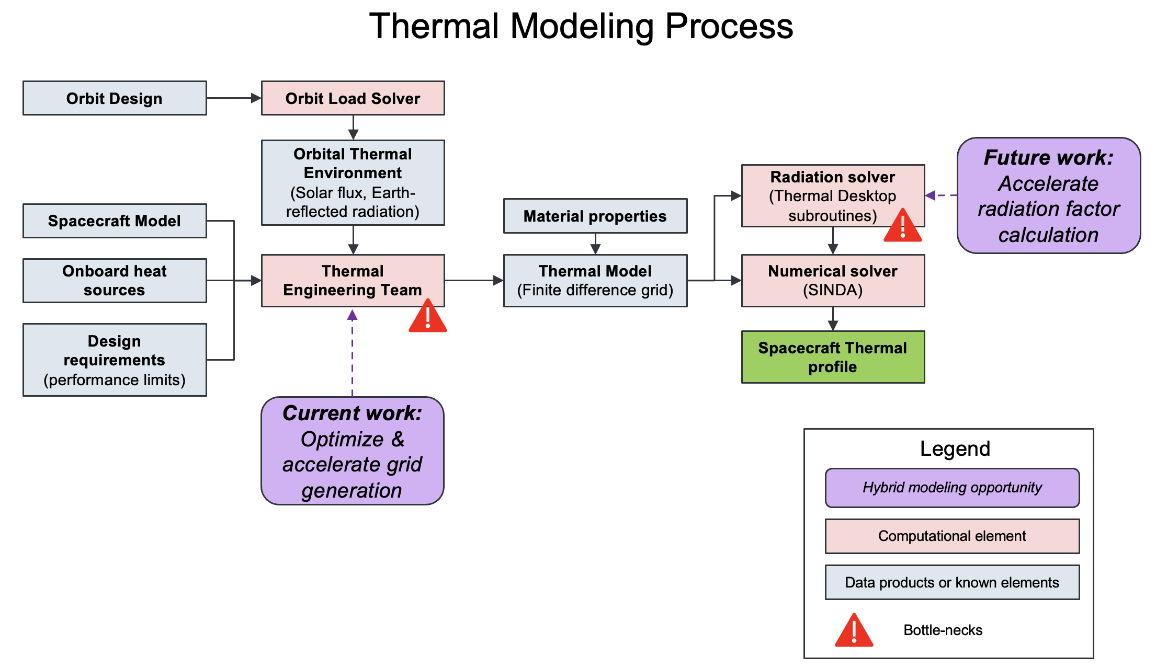
CubeSat: High-Fidelity Physics

Slide 14
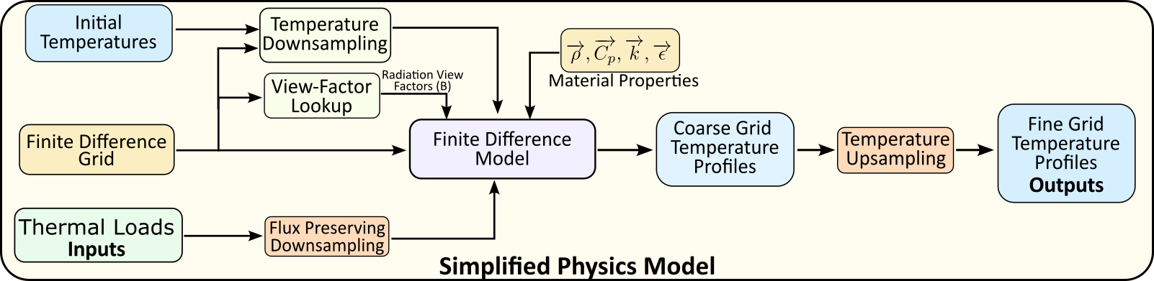
Hybrid PIML: Simplified Physics Model
Thermal loads and view-factors are determined using ray-tracing
Resolution of FD Grid determines simulation fidelity
Programmed using the JAX library in Python to enable efficient auto-differentiation
Explicit FD method requires smaller time-step with higher nodal density

Slide 15
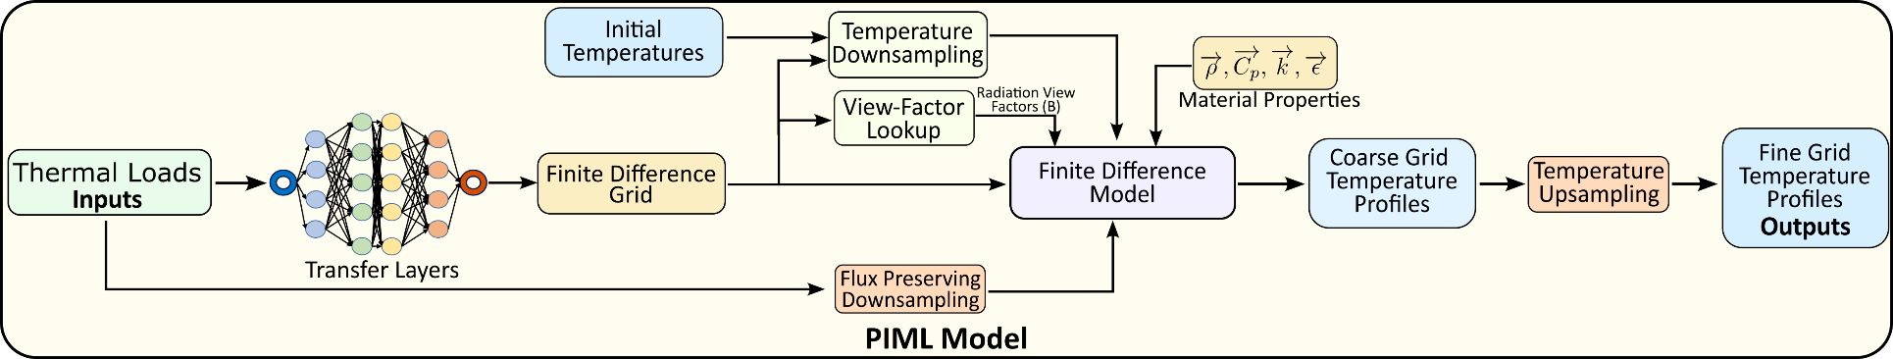
PIML Architecture
Transfer Layers adaptively predict the nodalization on each distinct surface
Input loads are then down sampled to the predicted nodalization (preserving the total amount heat input)
FD simulation is run on the down sampled model
Output temperature is then interpolated to upscale temperature output to the original dense nodalization

Slide 16
PIML Architecture: transfer network
Inputs: Thermal loads at current time step
Outputs: Mesh Nodalization for each surface (n=11) (# of nodes/surface, bounded)
Time step size: 50s
Transfer Network Type: Multi Layer Perceptron
Inputs and outputs are computed for a 10x10 mesh nodalization
Transfer Network Parameter | Value
Input Size (Loads) | 830
Output Size (Nodalization/surface) | 11
Num Hidden Layers | 5
Num nodes per layer | 1200

Slide 17
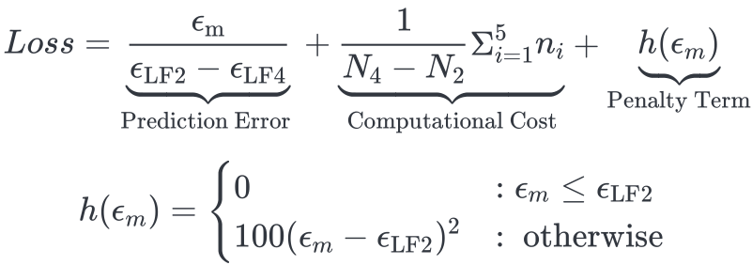
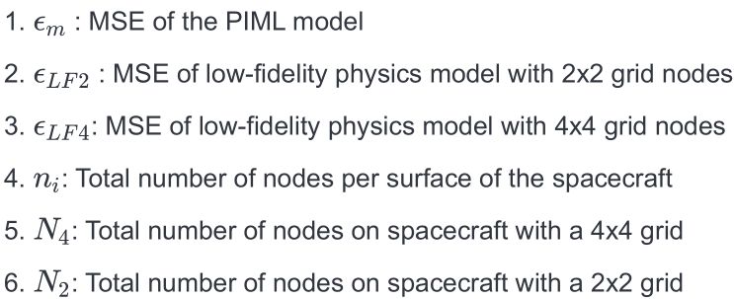
PIML Training: Loss Function
Loss function tries to minimize prediction error and computational cost
Penalty term ensures that model performs at least as well as the 2-node physics model

Slide 18
PIML Training: Vectorization & JIT Compilation
Vectorization:
Utilizes SIMD (Single Instruction, Multiple Data) instructions to perform operations on multiple data elements simultaneously.
Enhances performance by exploiting data-level parallelism inherent in modern processors.
Well-suited for operations on arrays, matrices, and vectors
Just-in-time (JIT) Compilation:
JIT compilation is a technique used by runtime environments to improve the performance of programs by compiling code at runtime, just before execution.
Unlike ahead-of-time (AOT) compilation, which compiles code before execution, JIT compilation dynamically generates machine code during program execution.
Useful for interpreted languages like Python, can result in orders of magnitude greater performance
Application in Current Framework:
The simplified physics model was written to implement both these compute cost saving techniques
The JIT compilation is especially helpful when evaluating the explicit time-stepping loop within each simulation
Vectorization is implemented in all of the meshing and update process to avoid loops and thereby save compute costs

Slide 19
Baseline: ANN
A purely data-driven ANN was directly trained on the high-fidelity training data
Architecture and size very similar to the transfer network
Inputs: Thermal loads at current time step
Outputs: Temperatures at next time step
Time step size: 50s
Transfer Network Type: Multi Layer Perceptron
Network Parameters | Value
Input Size (Loads) | 830
Output Size (Temperature) | 830
Num Hidden Layers | 5
Num nodes per layer | 1200

Slide 20
Preliminary Results: Overview
Dataset:
  For initial experimentation, we chose to train on a smaller subset of available data
  Trained on data from 5 orbits (60 samples) and tested on data from 2 orbits (12 samples)
  Test orbits are different from train orbits
Baselines:
  ANN : Data-driven Neural Network (MLP architecture)
  Phy 2-node : Simplified physics model with 2 node mesh (lower bound of PIML accuracy)
  Phy 4-node: Simplified physics model with 4 node mesh (upper bound of PIML accuracy)
  High Fidelity: 10 Node FD simulations run using Thermal Desktop
Experiments:
  Generalization: Training and validation points lie in the same domain [current]
  Extrapolation: Training and validation points lie in different domains [future work]

Slide 21
Generalization: Preliminary Results
Model | RMSE (normalized) | Run Times (s)
Phy 2 Nodes | 0.36 ± 0.163 | 0.59
Phy 4 Nodes | 0.24 ± 0.068 | 2.3
ANN | 0.16 ± 0.071 | 0.011
PIML | 0.29 ± 0.129 | 0.77
RMSE is computed against the high-fidelity thermal desktop data
Pure data-driven ANN exhibits low error while being extremely fast
PIML’s error is close to the 2 node-physics model error
Test Orbits are orbits with beta angles 6⁰ & 0⁰

Slide 22
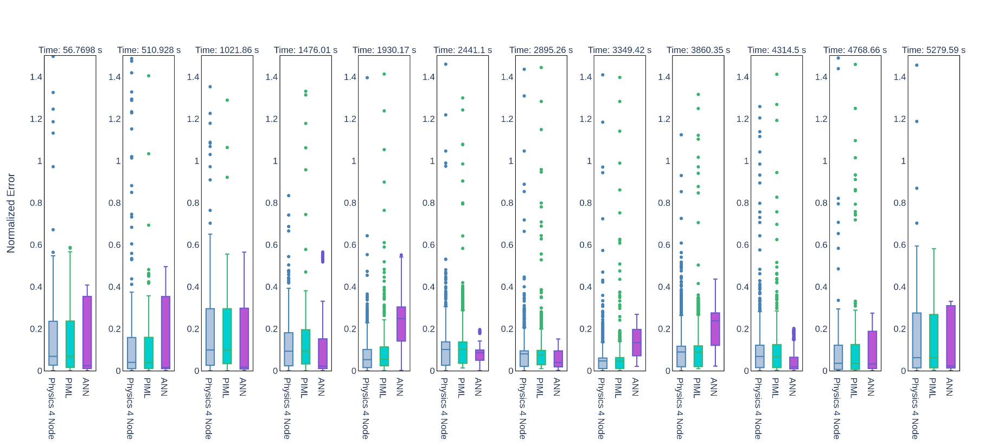
Generalization: Preliminary Results Test Orbit-1

Slide 23
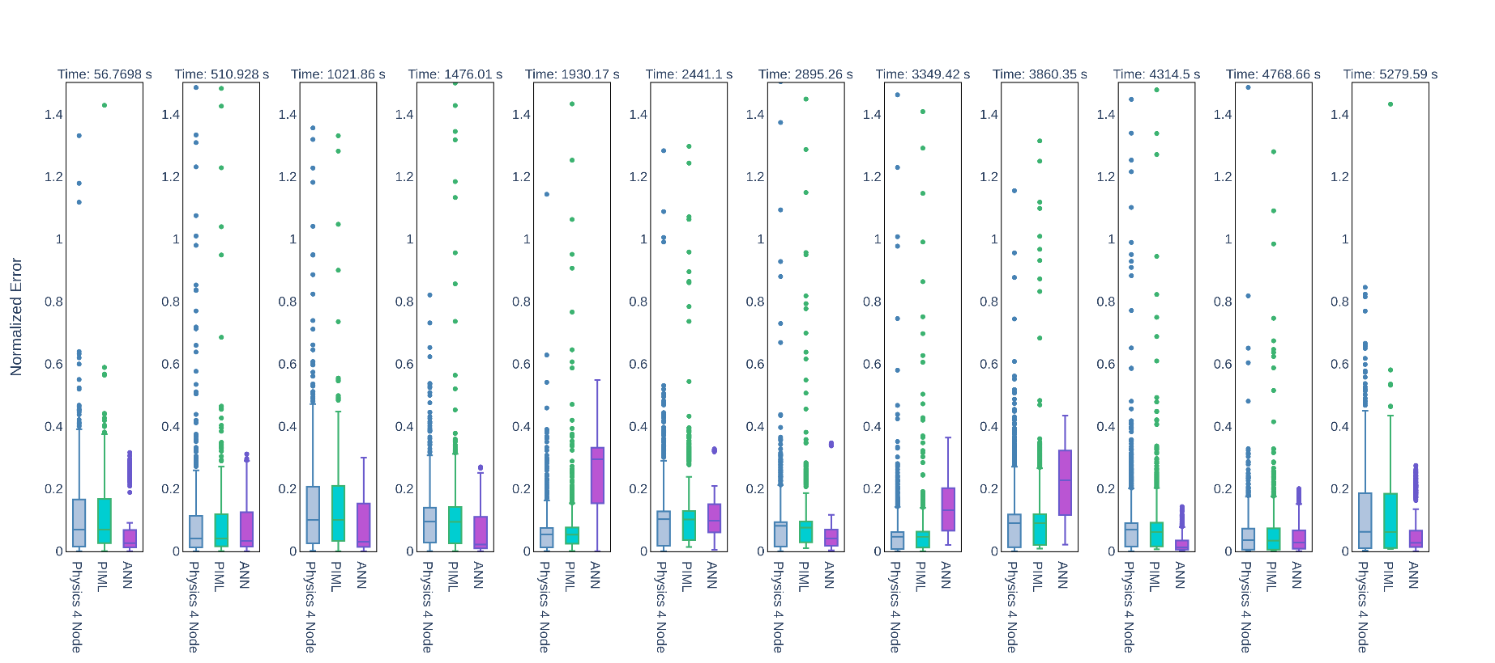
Generalization: Preliminary Results Test Orbit-2

Slide 24
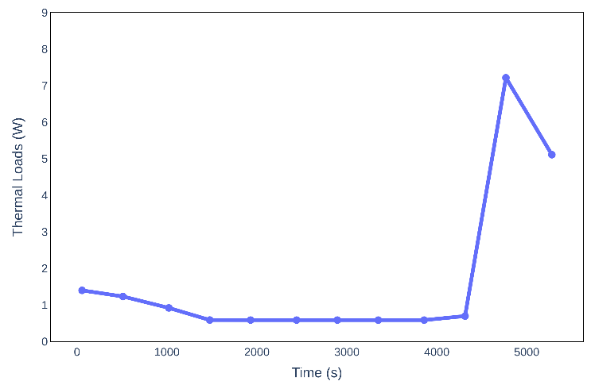
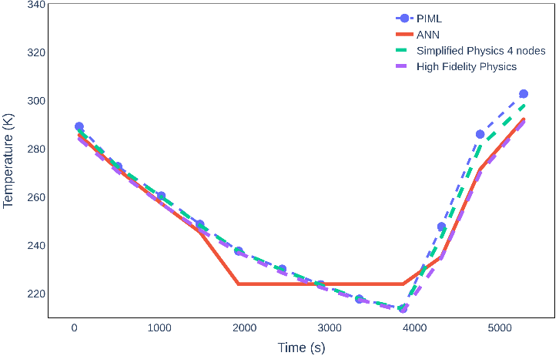
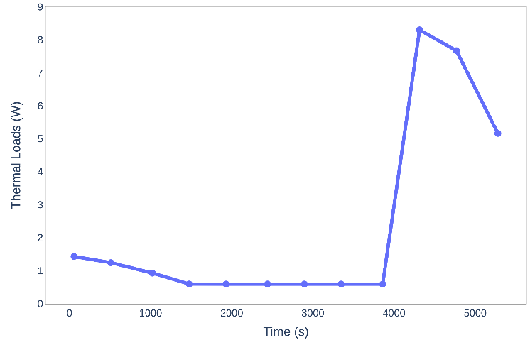
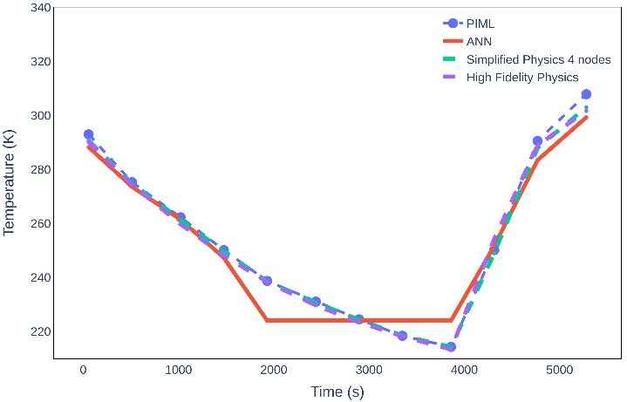
Results: Temperature Profiles
Test Orbit 1
Thermal load variation with time
Temperature variation with time
Test Orbit 2

Slide 25
Results: Temperature Profiles
Plots depict the thermal loads and temperatures on a selected node w.r.t time
ANN shows very low error in some sections but doesn’t seem to follow the general trend
The PIML and the simplified physics on the other hand follow the trend of the high-fidelity physics models
Output bi-linear upscaling of temperature could be causing outliers in the physics model

Slide 26
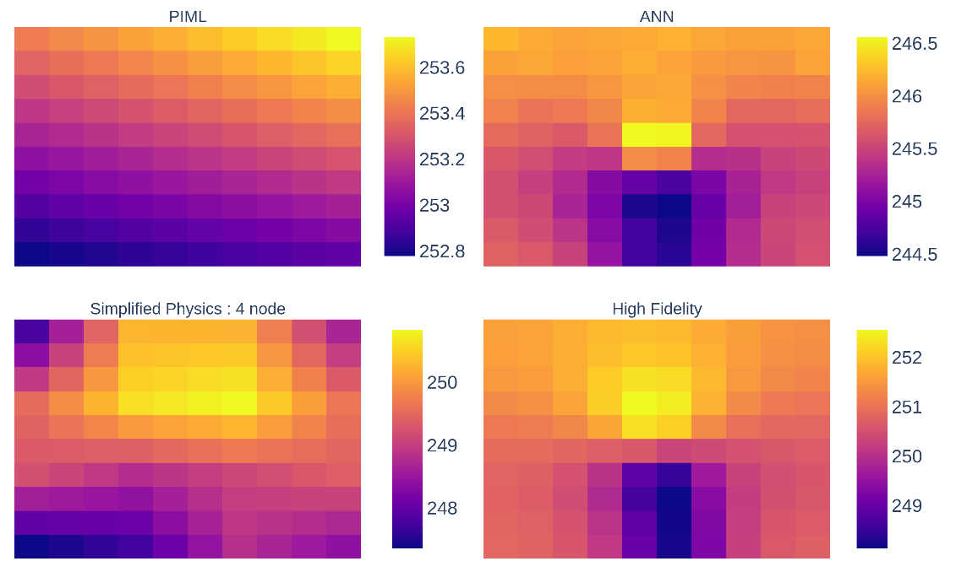
Results: Temperature Profiles Orbit-1
Figures show the spatial temperatures predicted by all models on a selected face of the CubeSat.
PIML predicts a 2 node face here, therefore not capturing thermal gradients correctly
Absolute temperature differences between all models are relatively small
Adding additional loss preserving accuracy of thermal gradients can help restrict minimum number of nodes

Slide 27
PIML Modelling: Challenges Faced
Creating Differentiable Simplified Physics Model:
Involved implementing a finite difference method with auto-differentiable operations
Creating a differentiable, flux-preserving downsampling scheme for thermal loads
Finding optimal timestep of explicit simulation to trade-off stability and training costs
PIML Training:
Modelling nodalization is an inherently discrete process
This is as the number of nodes are integer variables which therefore has discontinuous gradients
These make training the network (gradient descent) challenging
Notes:
Stress on point 2. Bring up the fact that the high-fidelity simulation has a specified time-step duration which affects how we can impose loss while training
Downsampling is hard because we have to ensure that the total heat input stays constant

Slide 28
PIML Modelling: General Challenges
PIML architecture has to be tailored for a modelling problem
  Transfer network is problem specific
Architecture also depends on / influences high-fidelity sampling
Commercial sims may not be flexible enough to be integrated into PIML
  e.g. Thermal Desktop models can't be used as a submodule of our PIMM architecture directly, and do not support differentiation anyway
Notes:
Stress on point 2. Bring up the fact that the high-fidelity simulation has a specified time-step duration which affects how we can impose loss while training
Downsampling is hard because we have to ensure that the total heat input stays constant

Slide 29
Conclusions
Developed a PIML architecture to adaptively predict number of mesh nodes based on incident thermal loads
Developed an auto-differentiable lumped-mass FD conduction, radiation model using the JAX library in python
Trained the PIML model by integrating the FD model with PyTorch based ML training pipeline
MSE might not be the best metric to compare model performance
Downsampling of IC’s and upsampling of the final temperature outputs affects the model error w.r.t the nodalization and makes it non-smooth

Slide 30
Future Work
Vectorizing / Parallelizing across simulations to enable efficient training
Using correction layers at the end to “learn” the output temperature upscaling
Integrating ray-tracing for determining thermal loads and view-factor lookup
Integrating an LSTM into the transfer network to enable predicting temperatures at multiple times

Slide 31
Thank You

