Slide 1
CIVA NDT Simulation: Improving Inspections Today for a Better Tomorrow
Presented by Starr D’Auria
Extende Inc.

Slide 2

Definition of Simulation
1 : the act or process of simulating
2 : a sham object : counterfeit
3a : the imitative representation of the functioning of one system or process by means of the functioning of another.
Ex: a computer simulation of an industrial process
b : examination of a problem often not subject to direct experimentation by means of a simulating device
Examples of simulation in a Sentence
a computer simulation of spaceflight ; a simulation of the planet's surface
Definitions from
Merriam-Wester
Notes:
Ensure we have a common understanding on what simulation is

Slide 3
Benefits of NDT Simulation
DESIGN, OPTIMIZE AND PREPARE INSPECTION:
Evaluate a wide range of testing scenarios to converge on the optimal solution
Master a technique with less iterations
Test equipment effectiveness, including for options not yet purchased
Less mock-ups, less trials : Save time and money
EXPERTISE:
Reproduce field results to understand complex situations and confirm/disprove a diagnosis
QUALIFY:
To support performance demonstrations with study of influential parameters by simulation (and reduce mock-up tests) 1) Predict the worst-case scenario 2) Compute POD curves: An element of technical justification in qualification stage
DISCUSS AND CONVINCE:
To ease technical discussions between all “players” (inspector, manufacturer, engineer, material scientist, end user, etc.) and convince
TRAIN:
Demonstrate the physics of NDT quickly and safely

Slide 4
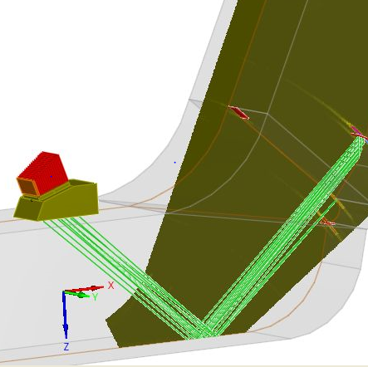
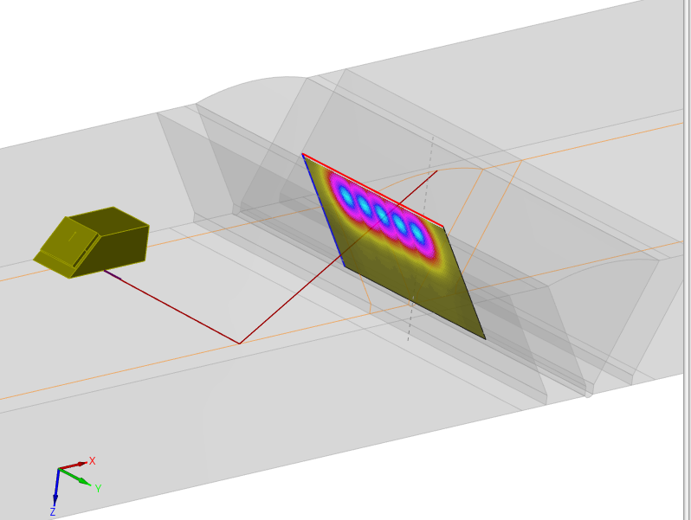
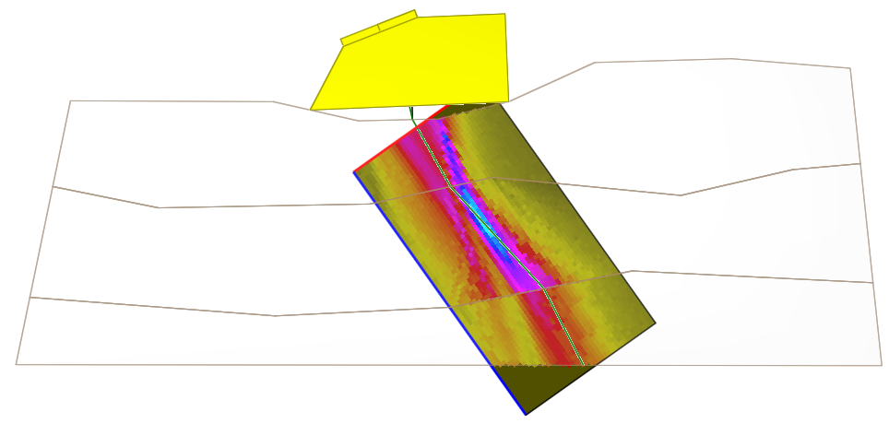
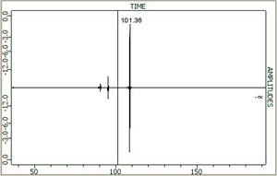
Ultrasonic Testing
Beam Profile
Inspection
Notes:
Most have seen a UT simulation in the past, even if it is just ray trace
Not all of you aware of other simulation for other methods.
Providing overview of simulation of several different inspection methds

Slide 5
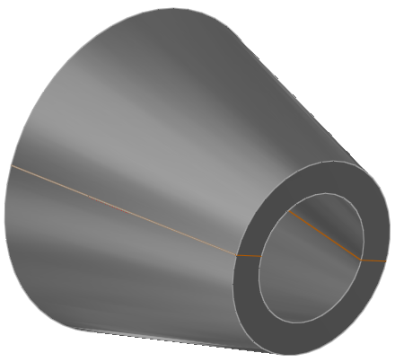
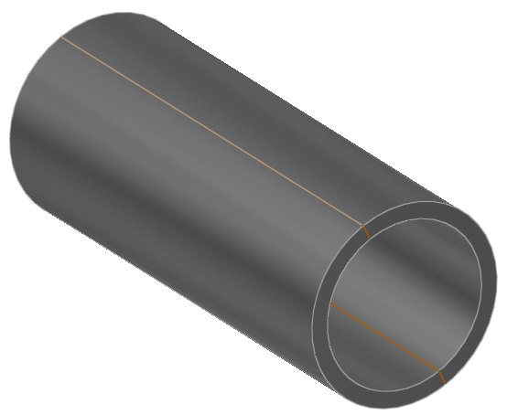
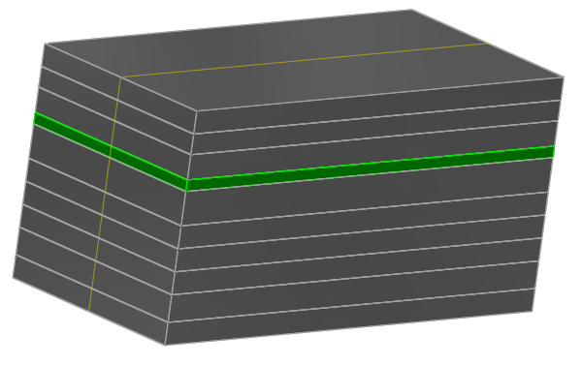
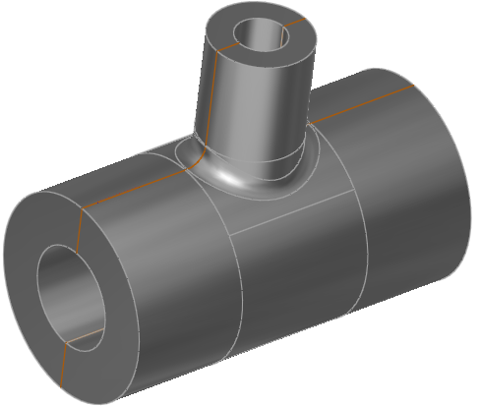
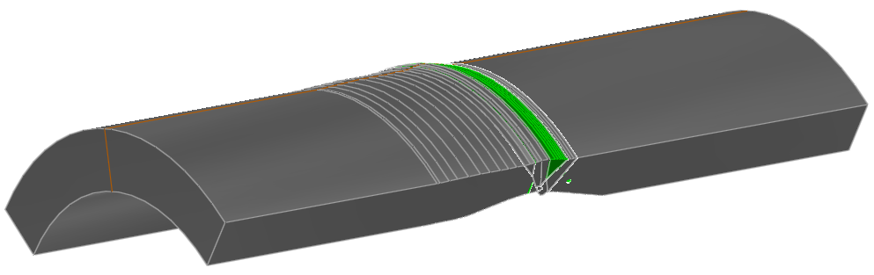
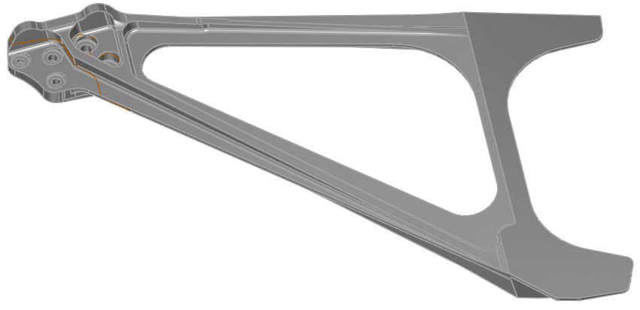
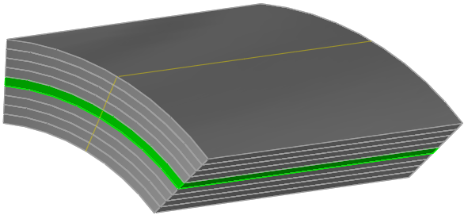
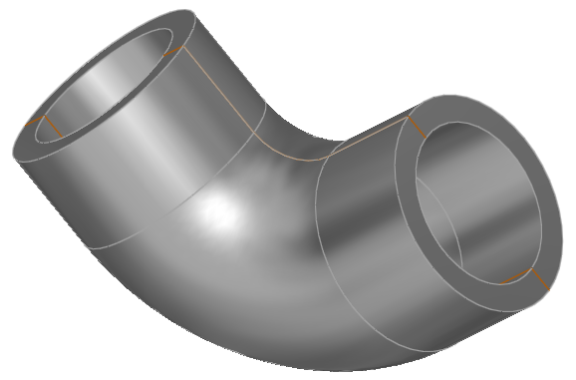
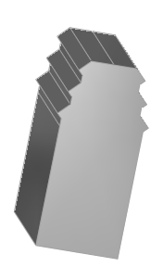
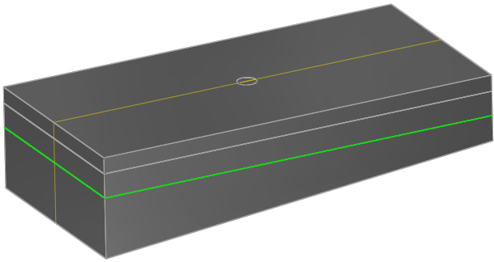
Simulation of Component to be Inspected
Evaluate:
Shape of part
Evaluate min/max conditions
Material
Isotropic, anisotropic or composite
Single or Multi-layer
Grain structure
Noise
Attenuation
Notes:
A variety of shapes that are either
In software menu and just dimensions need to be added
2D CAD extrusions
3D CAD imports
Shape
-min/ max allowed
-localized pitting or corrosion

Slide 6
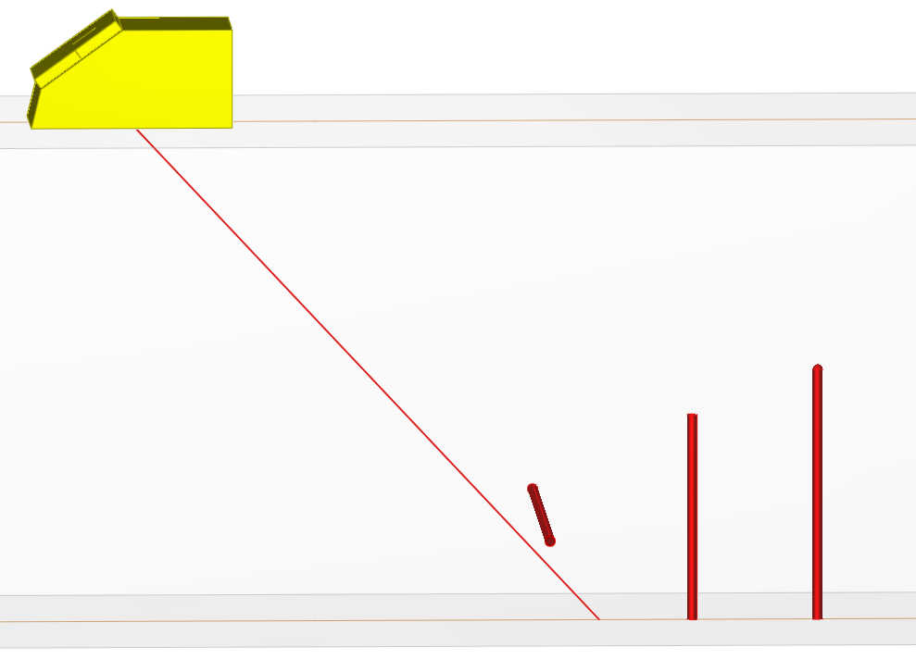

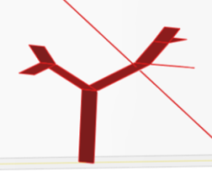

Flaw Geometry
Type of flaw geometries:
Planar or crack-like flaws
Inclusions
Calibration reflectors
Evaluate:
Flaw shape
Flaw size
Flaw position
Flaw orientation
Determine ability of the proposed equipment to detect the flaw
Notes:
The more accurately a flaw shape and orientation can be simulated, the closer the results are to experimental results

Slide 7
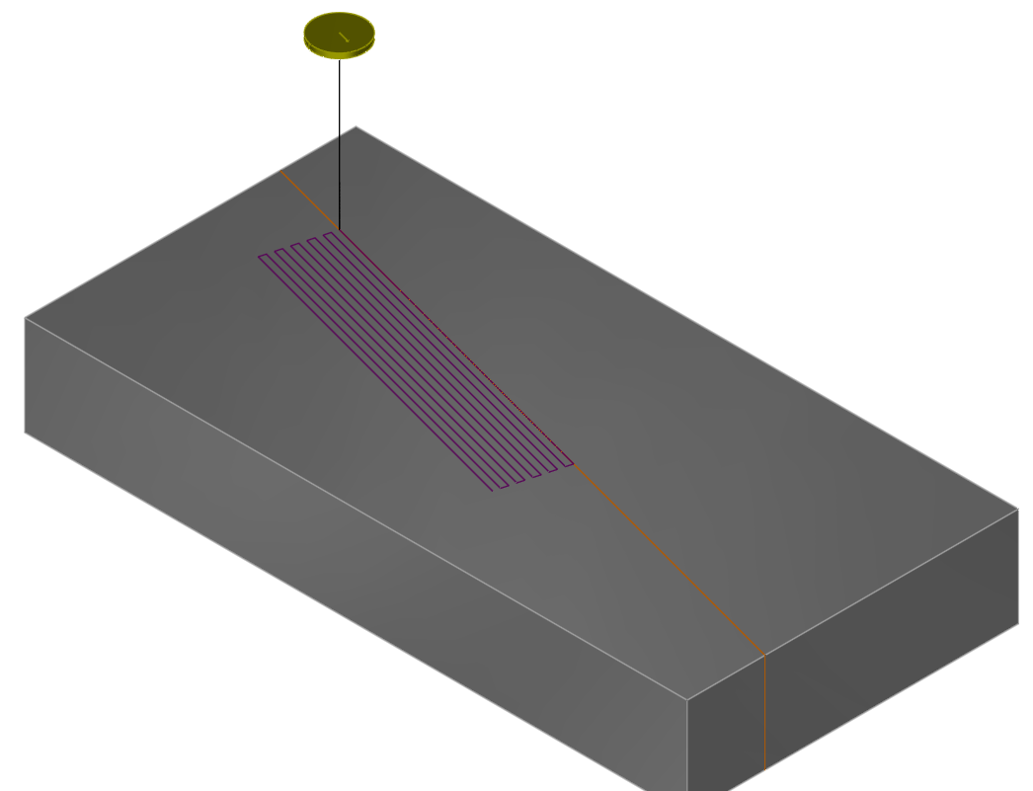
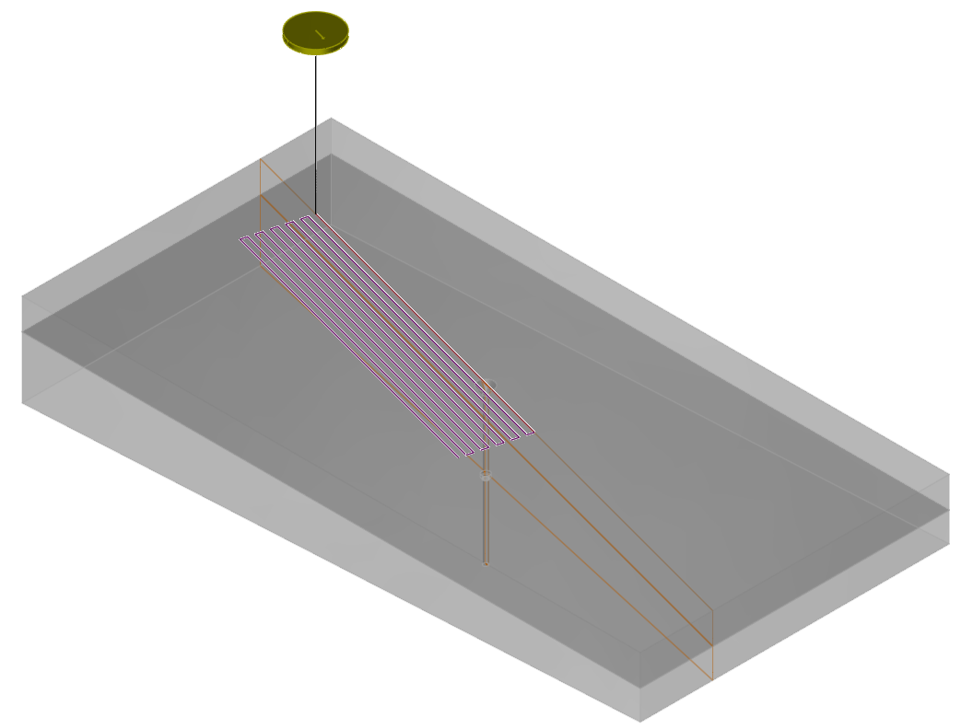
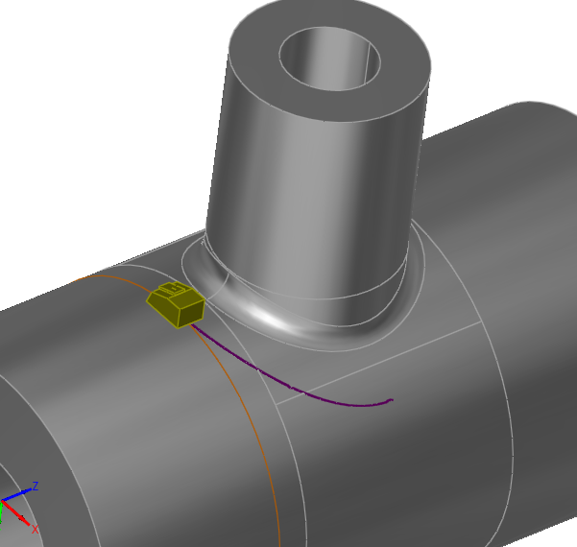
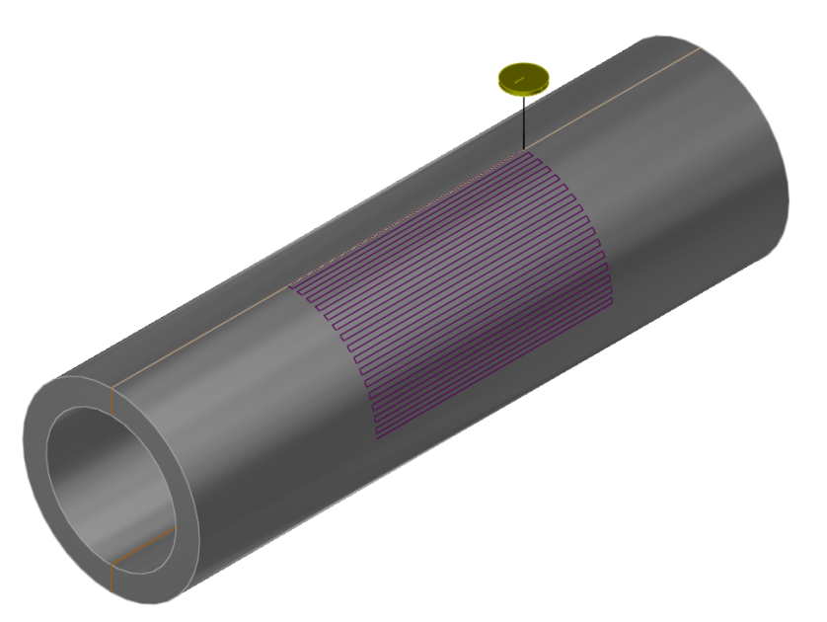
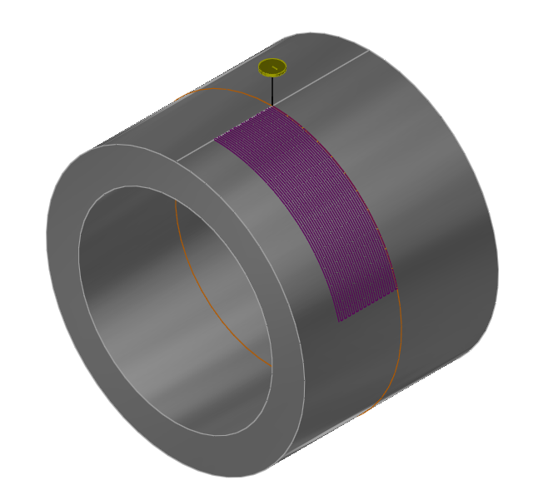
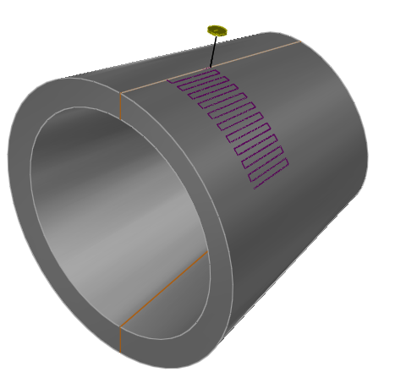
UT Inspection Simulation - Scanning patterns
Evaluate
Start/Stop location of scan
Scanning direction
Data acquisition intervals
Step size between scan passes
Notes:
Scan sim needed to accurately simulate experimental data
When planning robustness of inspection, use modeling to see if slight variations in starting postion and/or orientation have large effects on detection.
A very narrow beam may be great for sizing, but it easier to miss flaws if probe position and orientation is not dead on accurate

Slide 8
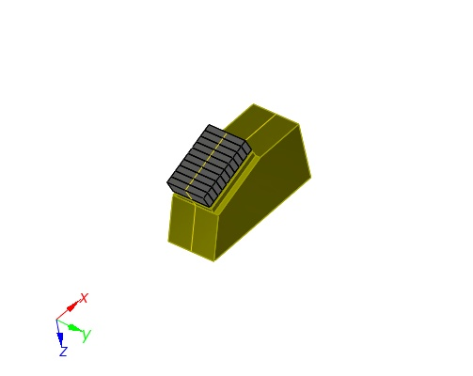
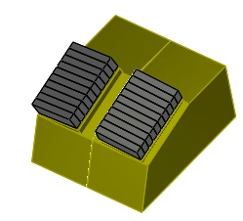
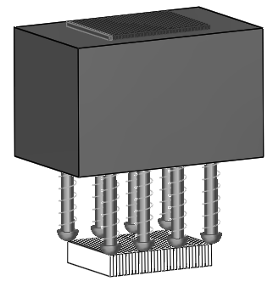
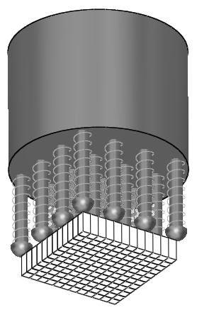
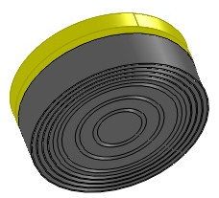
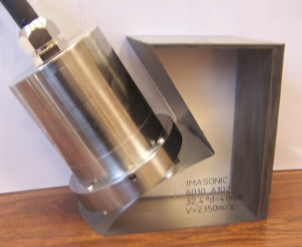
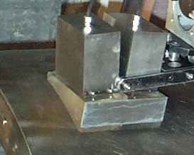
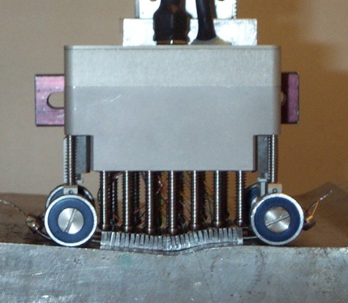
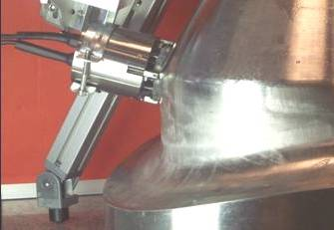

UT Simulation - Transducers
Single Element, Dual Element and Phased-Array transducers types :
Immersion
Contact
Dual Element (TRL)
Flexible array probes
Notes:
With ultrasound there are a large variety of probes that are used
Simulation needs to be able to cover the vast majority of probe types, shapes and sizes
Here you see simulated phased array transducers and corresponding real ones

Slide 9
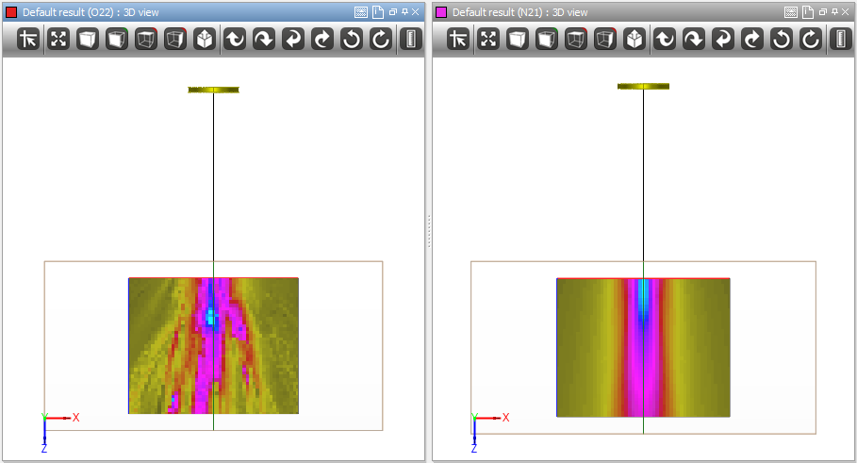
UT Beam Simulation – Coarse Grain
Coarse Grain Specimen
Isotropic Specimen
Evaluate:
Effects of grain structure on sound beam
Ability of sound to penetrate material
Changes in focusing
Notes:
Grain structure has a large effect on how sound travels in a part. With simulation you can evaluation effects of different size grains
This slide illustrates the different between a part with small even sized grains and large ones that distort and scatter the sound
Simulation can also model the effects of elongated grains

Slide 10
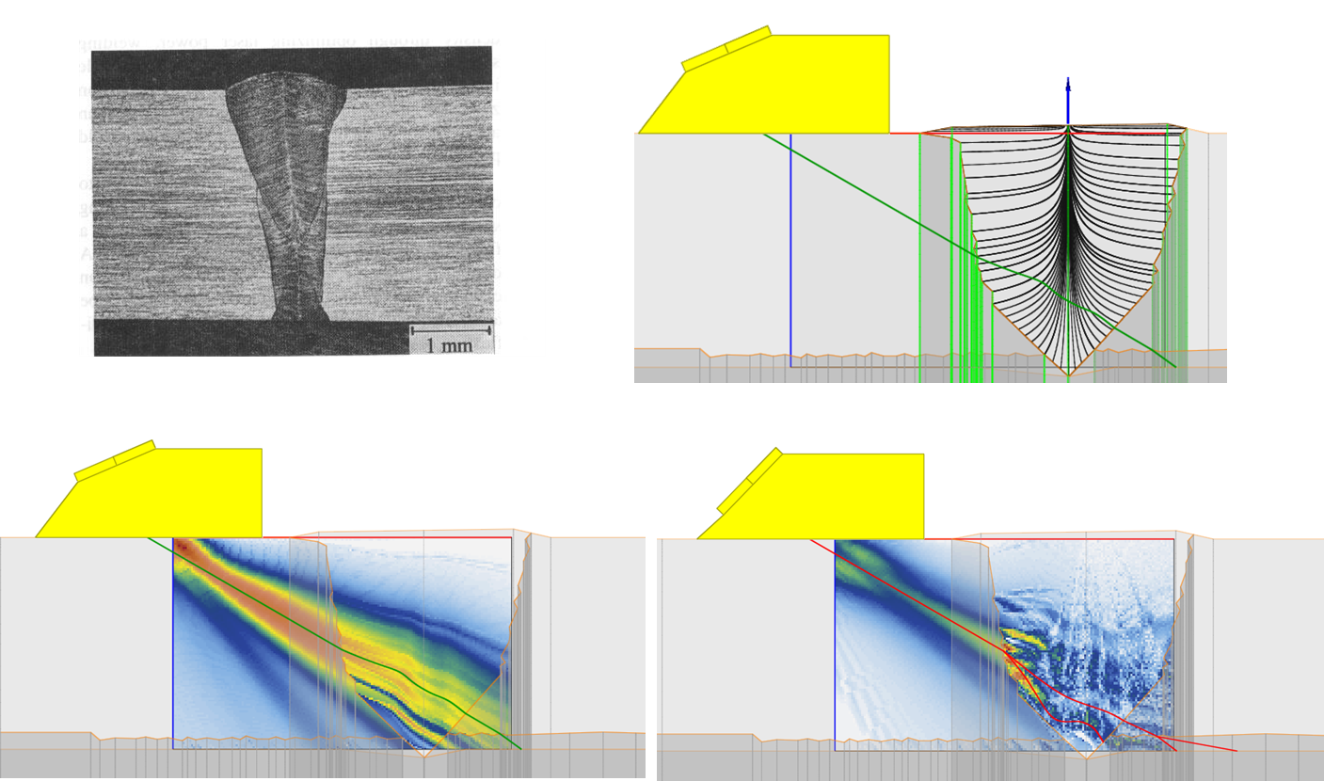
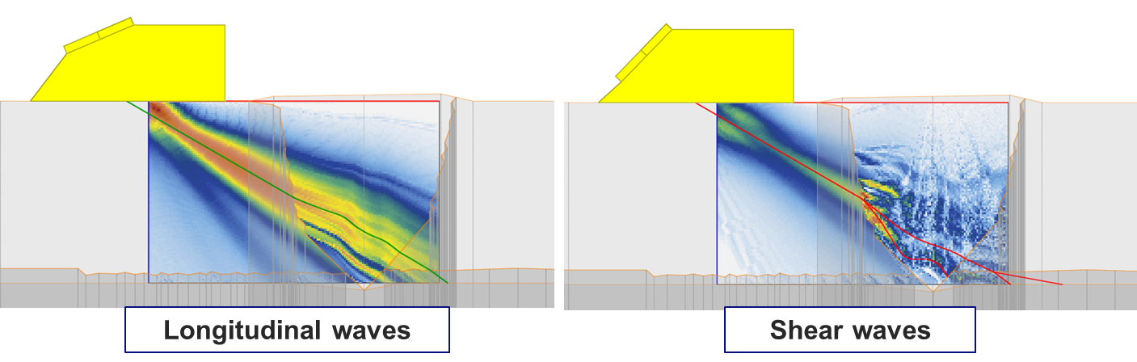
Stainless steel / Dissimilar weld material / Austenitic
UT Beam Simulation
Complex weld microstructure
Evaluate:
Ability of T45 wave to penetrate the weld
Ability of L45 wave to penetrate the weld
Conclusion:
Longitudinal waves are
significantly less affected
than shear waves
Notes:
With dissimilar metal welds it is always important to make sure you can get sound to penetrate the weld.
On right, traditonal T45. Sound largely stops at the metal/weld interface
On left, L45. Sound travels through the weld. With L45 there is also a shear component present.

Slide 11
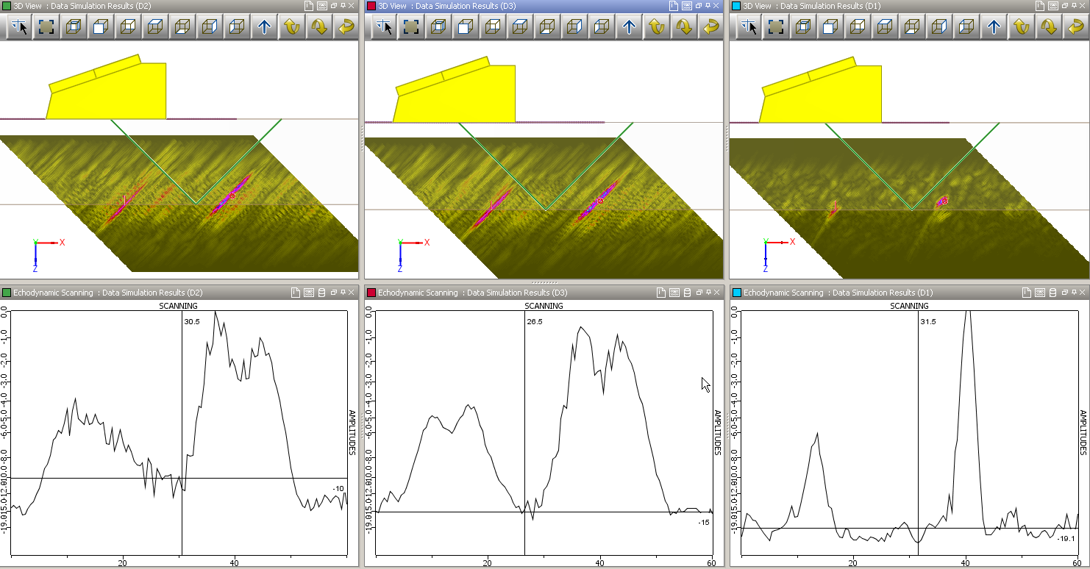
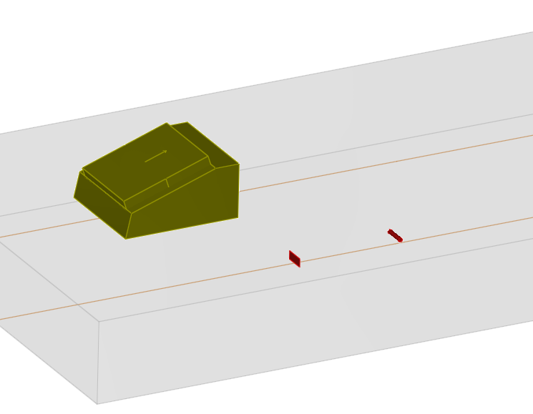
UT Inspection Simulation with Structural Noise
Contact probe L45°
Steel block of 20mm high
Two flaws: 4 mm-high notch, 2-mm diameter SDH
Evaluate:
Planar (Flat) Probe
Cylindrical focused Probe
Bifocal focused Probe
Conclusions:
The Bifocal probe had the best SNR at 19dB
With the flat probe it would be difficult to detect the notch above the noise level without risking a false positive
Planar Probe: SNR 10dB
Cylindrical focusing: SNR 15dB
Bifocal focusing: SNR 19dB
Notes:
Use simulation to see which type of focusing has best SNR

Slide 12
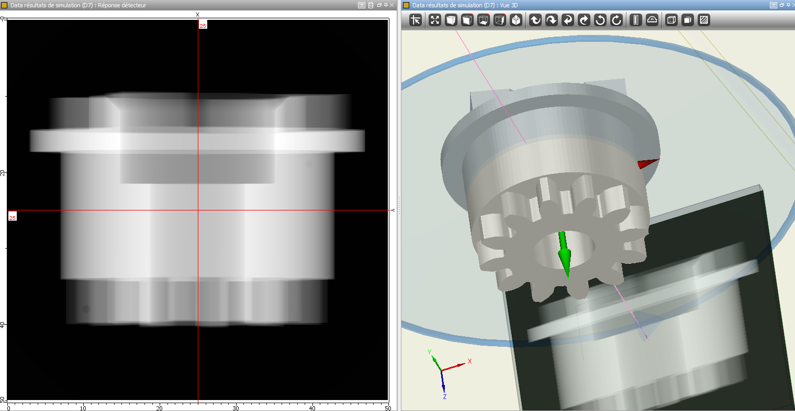
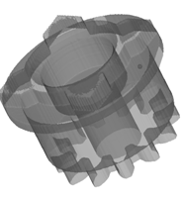
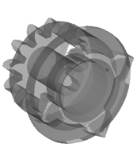
Radiography
Notes:
Most have seen a UT simulation in the past, even if it is just ray trace
Not all of you aware of other simulation for other methods.
Providing overview of simulation of several different inspection methds

Slide 13
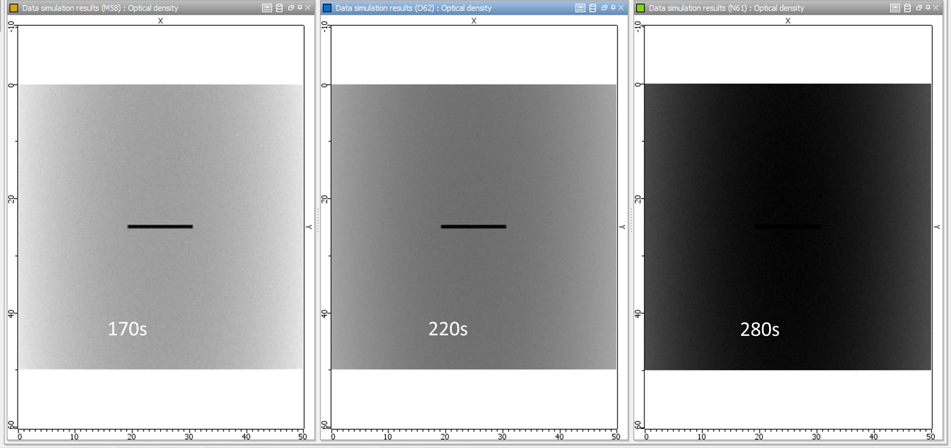
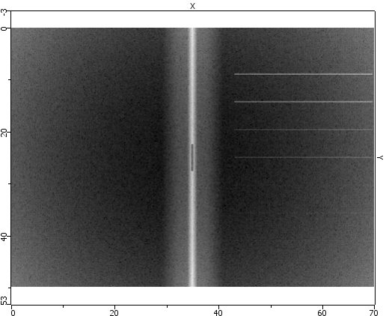
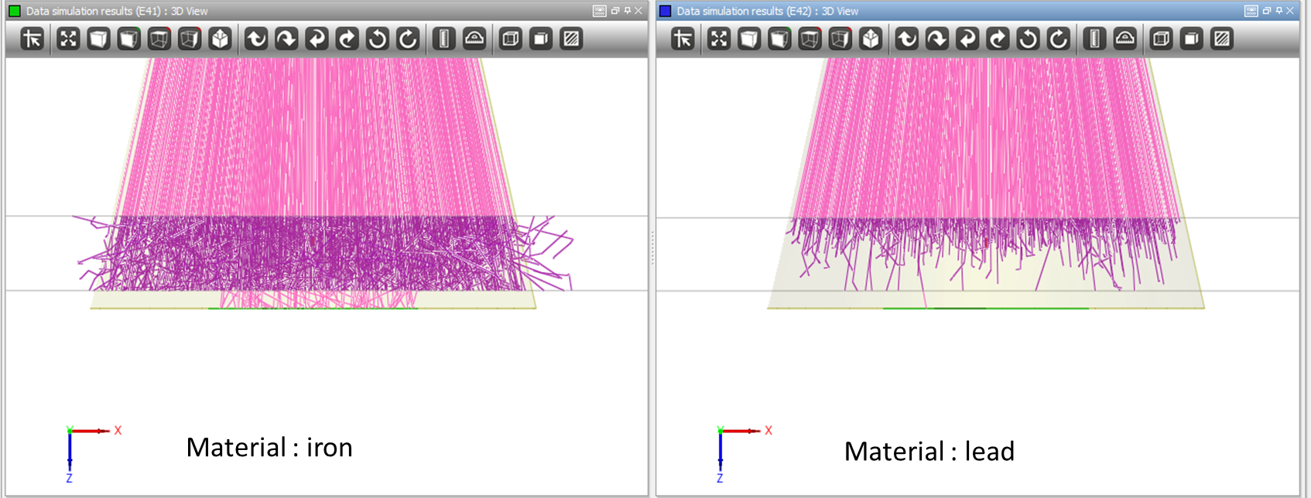
RT Simulation
Evaluate
Radiation sources
Effects of scattered radiation
Filters
Relative positioning of source, component, flaws and detector
Image quality indicators
Teach
Effects of different material
Effects of exposure time
Relationship between flaw orientation and detection
Notes:
Useful both for inspection planning and training,
For training, simulation provides a way to show effects of different equipment and setups without the hazards, constraints and regulations associated with real radiation
(either gamma or x-ray)

Slide 14
RT Simulation
RT simulation of concrete block with embedded steel hardware
Effect of photon scattering and exposure time on image quality (200keV X-ray source)
Images courtesy of Pessiki and Keller, Lehigh University

Slide 15
RT Simulation
Partial implementation of the discrete aggregate
model in CIVA RT
Effect of the discrete aggregate model on
defect visualization
Images courtesy of Pessiki and Keller, Lehigh University

Slide 16
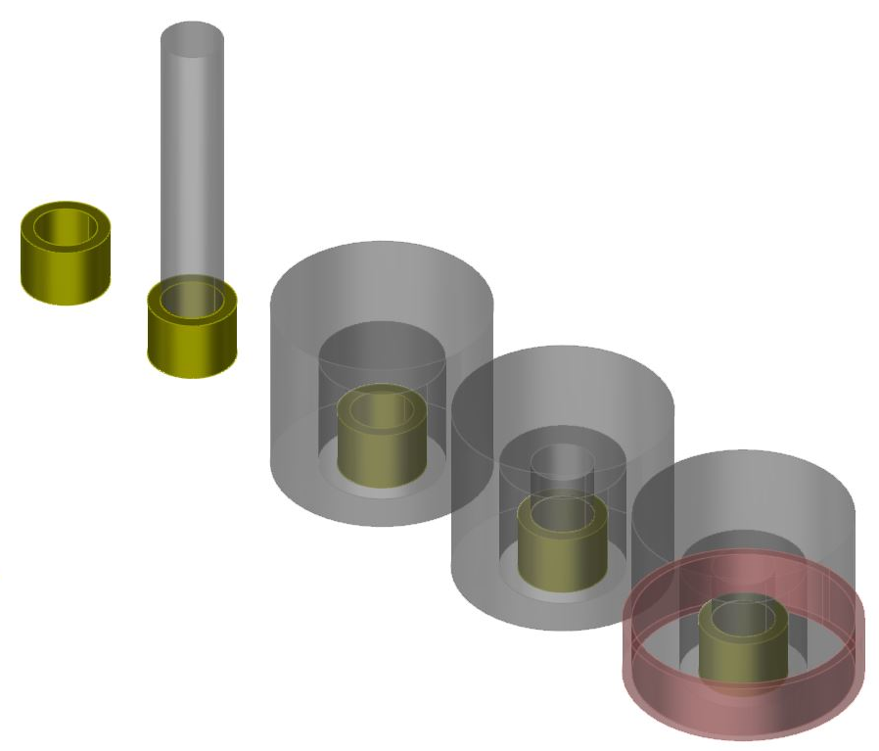
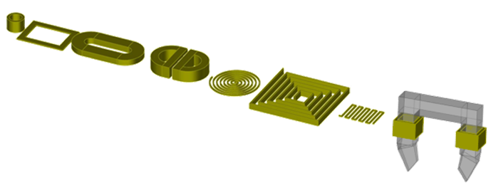
ET Probe Simulation
Evaluate
Sensor design:
Geometry optimization
addition of ferrite core
shield ring
Notes:
Like with UT, a large variety of probes can be simulated
-optimize sensor design
-determine if features such as ferrite cores of shielding rings improve results
Perform initial prototyping prior to physical probe prototyping

Slide 17
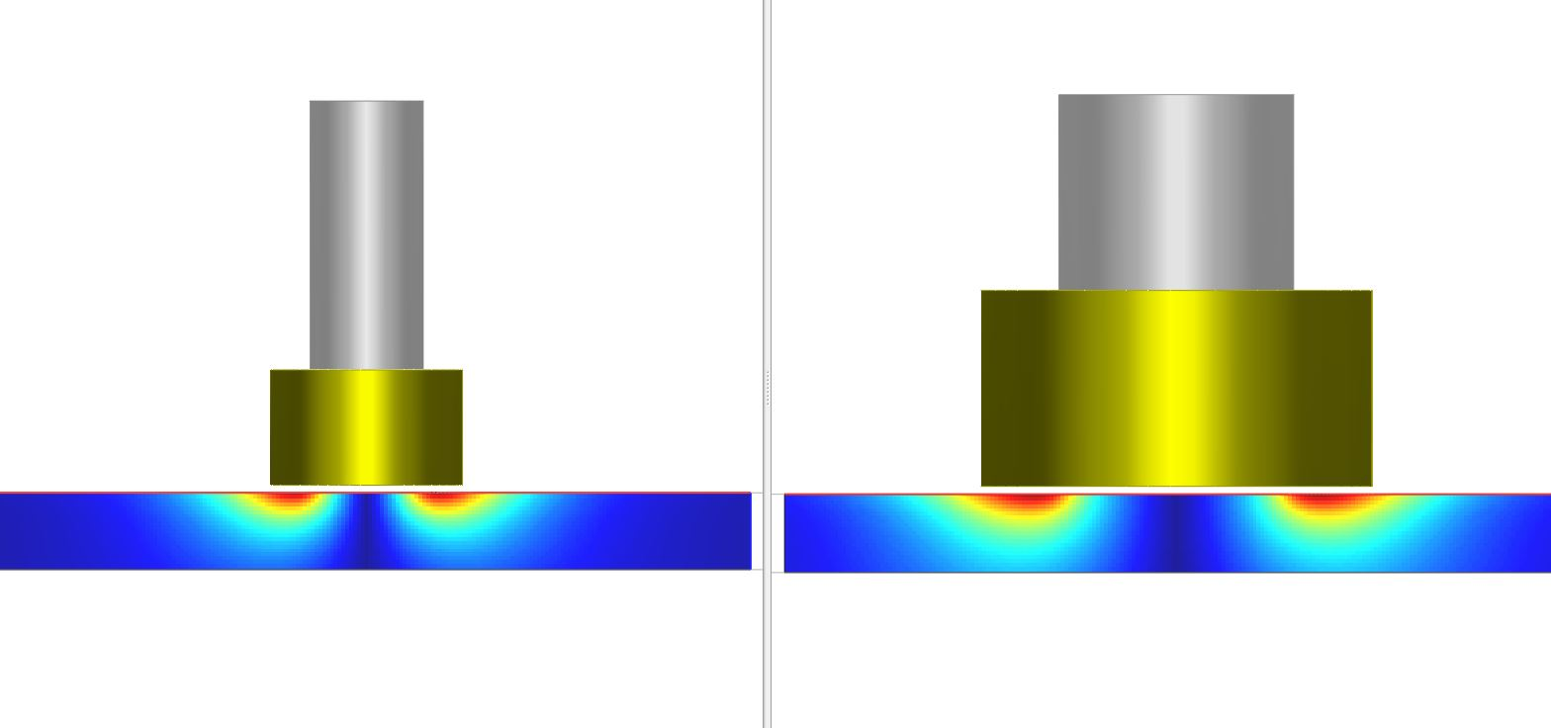
ET Field Simulation
Evaluate
Depth of Penetration
Field Size
Teach
Effects of material on depth of penetration
Effects of probe size on field
Effects of frequency on depth of penetration
Notes:
Easy to compare two probes

Slide 18
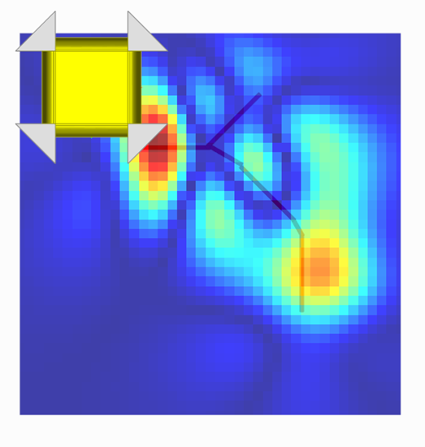
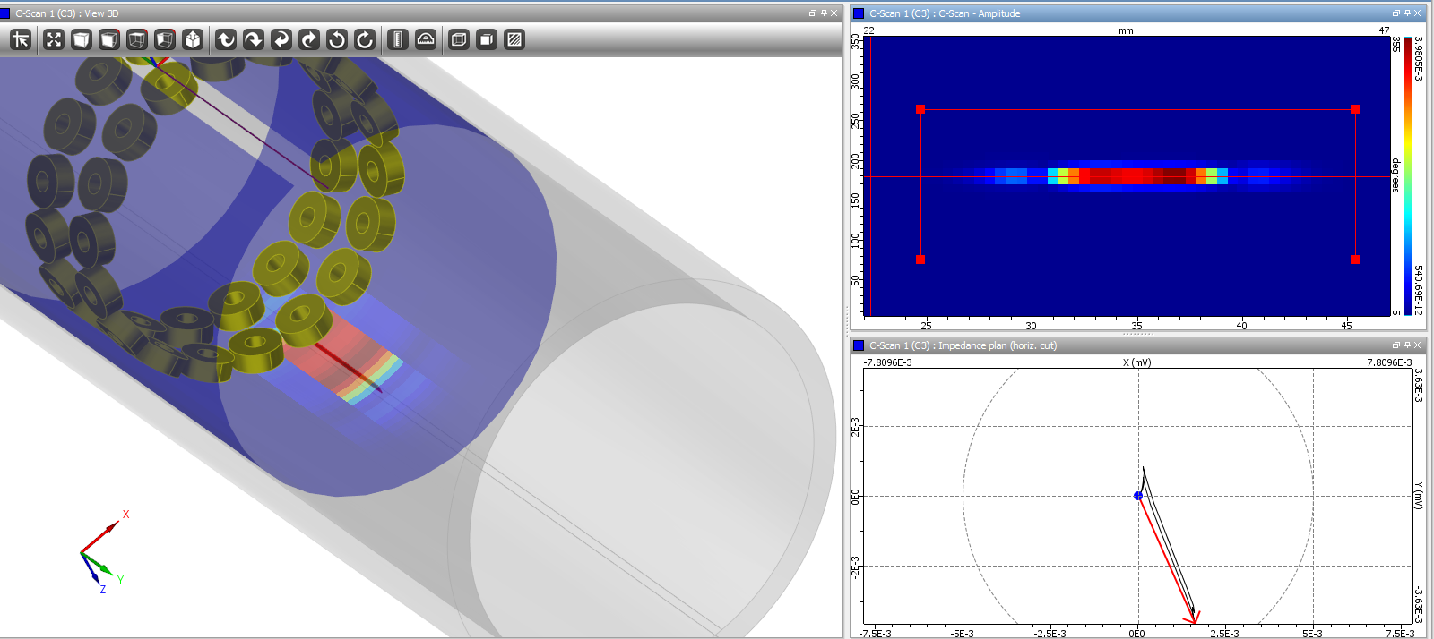
ET Inspection Simulation
Evaluate
Method design:
Compare different sensors
select the frequency
define the acquisition channels (absolute, differential,…)
set up calibration
signal processing parameters (frequency mixing, etc.)
Determine Influential and/or disturbing parameters:
Lift-off variation
Sensor disorientation
POD analysis, etc.
Notes:
Shows effectiveness or ineffectiveness of the chosen equipment and settings to detect flaws

Slide 19
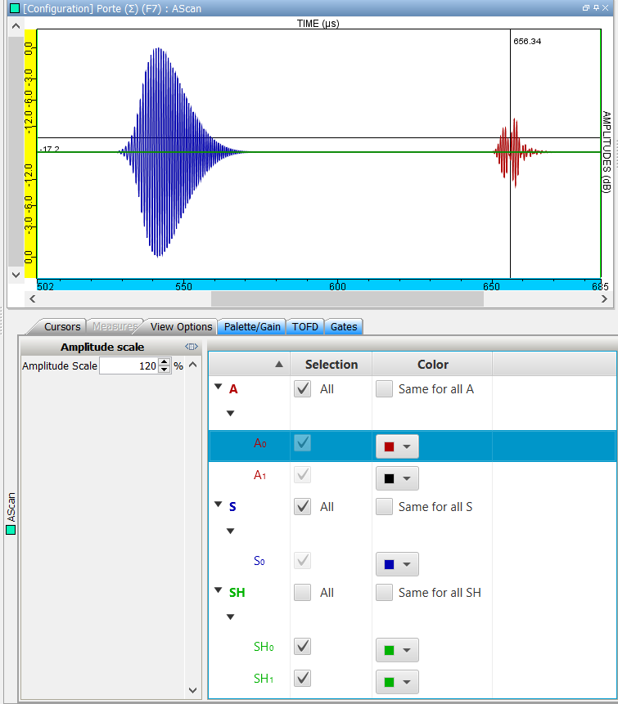
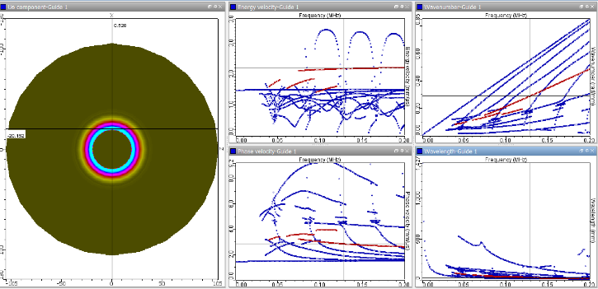
GWT Modes Simulation
Evaluate
Modal displacements and constraints for each mode of each frequency within a given frequency range
Dispersion curve graphs, including for buried pipe
Affects of specific modes
Dispersion curves…
Wavenumber
Wavelength
Phase velocity
Energy velocity
Attenuation
…in order to get
Modes available
Mode selection
Parameters of the probe
Order of the echoes
Time of flight
Length under inspection

Slide 20
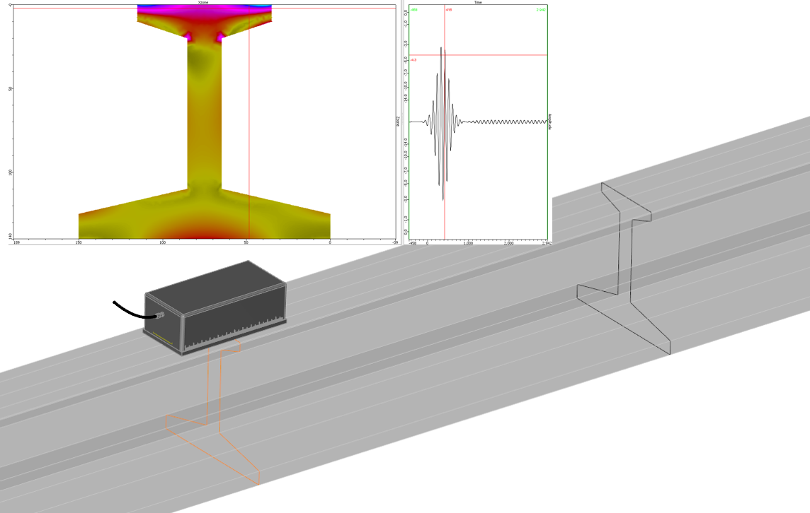


GWT Field Simulation
Evaluate
Sound penetration in area of interest
Strength of field

Slide 21

GWT Inspection Simulation
Evaluate
See how geometric discontinuities such as welds, grooves and diameter transitions effect flaw response
Predict flaw response for different size, shape, orientation and location of flaws
Evaluate the effectiveness of different transducers for specific configurations

Slide 22



Parametric Studies
Evaluate
Variances in a parameter such as
Flaw size, location and orientation
Slight variations in equipment from nominal value
Relative influence of parameters (see next slide)

Slide 23

Parametric Studies
Graph of relative influence of the different parameters
Statistical distribution of input parameters
Notes:
Simulation assesses which variables have most significant impact on results
Which variables have little effect on results
-Focus on insuring key parameters are tightly controlled to maintain accuracy of results

Slide 24

Model Assisted POD (MAPOD)
Missing values
Find most influential parameters:
Run parametric variations to determine key parameters to focus on
Optimize design of experiment:
Fill in data gaps with simulated data
Identify Key areas of uncertainty before making mock-up
?
?
Examine uncertainties that can’t be determined experimentally
Notes:
Optimize: If measurements are not in the area of interest (defect size or range of variation of influential parameters not adapted), the result obtained with mock-ups are not reliable and cost increases!
Examine uncertainties: Parameters such as exact flaw location and orientation of embedded flaws are easy with a computer, but difficult if not impossible experimentally. There is always a tolerance on flaw position and orientation in mock-ups. When evaluating POD for small flaws, the variance may equal or exceed the size of the flaw to be evaluated
-slight variatiations in material properties such as velocity and density
-slight variations in equipment such as frequency of UT probe (2.05MHz instead of 2.00Mhz…)

Slide 25
Future
Use simulation to design for inspectability before designs are finalized
Simulate additional inspection methods, gaining the same benefits as simulation of existing methods
As computing power increases, it will become practical to run even complex models on laptops, supporting offline and remote modeling of inspections to assist field work
As connectivity increases, use of cloud computing and virtual computers will increase as a way to have the benefits of powerful computing without the need for a desktop computer

Slide 26
Thanks for listening and learning!
Starr D’Auria
Starr.dauria@extende.com
www.extende.com
https://www.youtube.com/user/extendechannel

