Slide 1
DATAWorks 2024:
Silence of the Logs: A Cyber Red Team Data Collection Framework
Jason Schlup (IDA)
Jared Aguayo, Misael Valentin (APL)
April 18, 2024

Slide 2




Acknowledgements
Funded by DOT&E Cyber Assessment Program
Collaboration includes IDA, JHU APL, and MITRE
Excellent leadership supported by skilled developers, operators, and analysts
DoD Red Team collaboration, troubleshooting, and beta testing

Slide 3
Test and assessments rely on data, but
how can you instrument cyber tests for useful data?

Slide 4
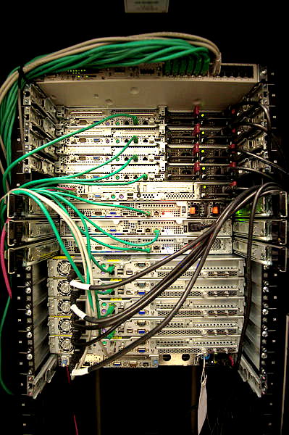



Instrumenting test events with adversarial cyber actors poses a challenge
Adversarial data collection often reduces to:
“Record all attack activities and report on their success”
Protocol? Encryption?
Destination? Time? Success?
Gather data at the source:
Likely clear-text, interpreted,
and comprehensive
Gather PCAP?
Image source: https://commons.wikimedia.org/wiki/File:Servers_in_a_Rack.jpg
PCAP – Packet Capture

Slide 5
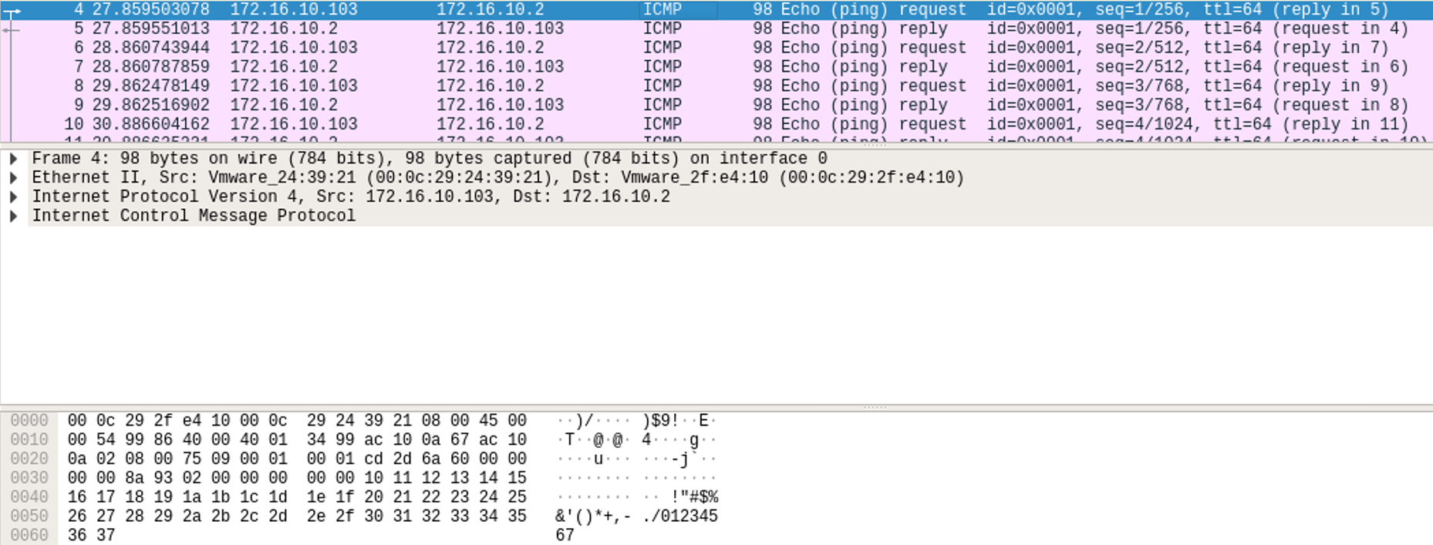
Collecting adversarial data does not mean you have to collect PCAP
Who can identify what this packet means?

Slide 6
Collecting adversarial data does not mean you have to collect PCAP
Who can identify what this packet means?
And now with some help?

Slide 7
Collecting adversarial data does not mean you have to collect PCAP
What if a computer interprets it for you?

Slide 8
Collecting adversarial data does not mean you have to collect PCAP
PS C:\> ping 172.16.10.2
What if the operator just tells you?

Slide 9

Silence of the Logs (SotL) is a logging standard and framework for capturing and processing adversarial cyber data
GOAL: Enable red teams to conduct operations as normal while automatically logging activity and generating data needed for analyses.
  Create Red Team- and technology-agnostic solution
  Reduce Red Team workload and data collection responsibilities
  Enable reproducible analysis techniques
  Capture as much Red Team activity as possible
  Capture both successful and unsuccessful Red Team activities
SILENCE OF THE LOGS
Image source: https://emojimix.app/

Slide 10



Silence of the Logs contains three core elements
Log Processor
  Converts Red Team tool logs to a defined data schema
  Red Teams must ensure their log processor output is compatible with the schema
Data schema
  Designed to be easily compatible with all Red Team tool logs
  Schema describes Entities and Actions
    Entities are the computing systems aggressed by the Red Team
    Actions are the techniques used by the Red Team against an entity
Visualizer
  Creates Action Maps to display data in a usable manner
Image sources:
https://commons.wikimedia.org/wiki/File:Cobalt_Strike_logo.png;
https://commons.wikimedia.org/wiki/File:JSON_vector_logo.svg

Slide 11
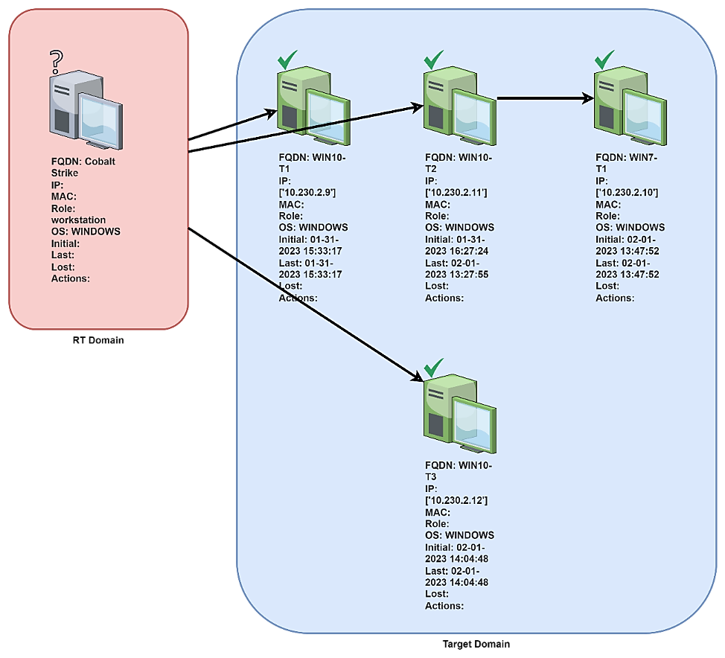
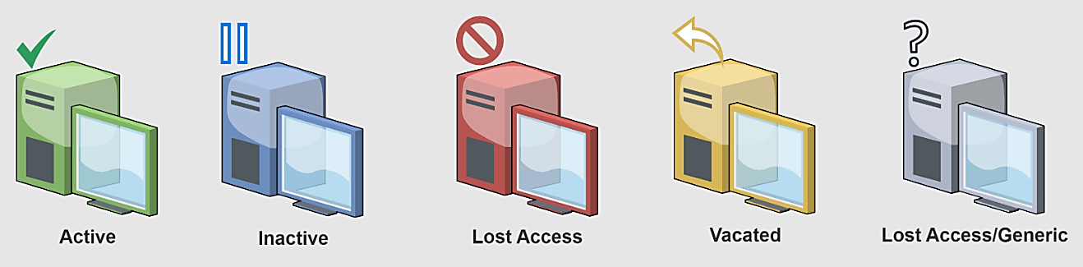
Visualizer creates Action Maps that display data in a usable manner
Action Maps provide a visual history of the assessment
The standardized symbols and colors make the visual easy to interpret
Red Teams can edit Action Maps for clarity and accuracy
Icon source: draw.io

Slide 12

Demonstration of the Silence of the Logs workflow

Slide 13




So what can we do with all of this data?
1
Scanned IP space – ports closed or filtered.
Target Mission Network
Phished user and installed malicious software. No detection from endpoint defensive software.
3
Exploited domain controller to steal credentials. Cracked 80% of passwords for expanded access.
2
4
Attempted server exploitation. Attempt detected and reported. System quarantined for remediation.
Defended path
Accessed path
Data exfiltration
5
Used stolen credentials to maneuver and find data to exfiltrate. Exfiltrated mission data about upcoming operation.
Visualization Reduction:
Assist senior leader engagements with simplified campaign from SotL output

Slide 14
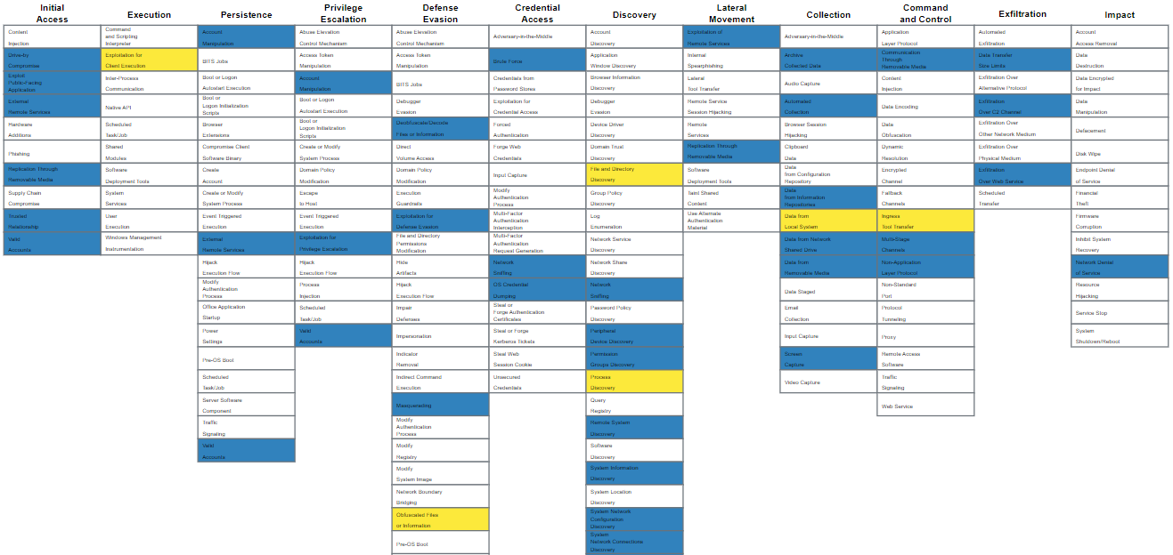
So what can we do with all of this data?
APT and Red Team
APT Only
Attack Characterization:
Identify TTPs used and mapping them to known adversaries
Image source: https://mitre-attack.github.io/attack-navigator/

Slide 15
So what can we do with all of this data?
Changes over time
Trend Analysis:
Identify historical assessment, vulnerability, cyber defense, and mission effect trends
Notional data used on this slide.

Slide 16
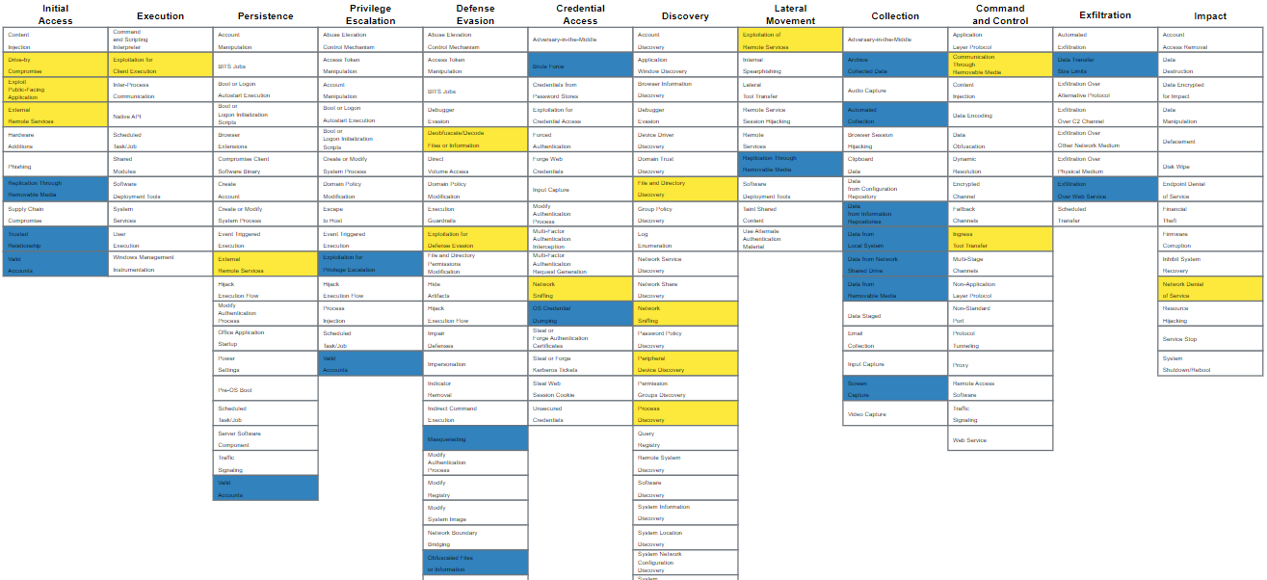
So what can we do with all of this data?
Detected
Undetected
Defensive Cyber Operations Analysis:
Investigate why defenses are successful or unsuccessful
Image source: https://mitre-attack.github.io/attack-navigator/

Slide 17
What’s next for Silence of the Logs?
Expand tool coverage
  Current focus on Cobalt Strike, very nascent Windows terminal logging
Interaction with DoD Red Teams
  Requires additional support to integrate with additional Red Team tools and logs
  Red Team coordination will be critical for continued SotL success
  Understand usability issues and benefits of SotL use
Expansion of visualization capabilities
MITRE ATT&CK® connections
Adoption into DOT&E CAP assessments and DOT&E OT events
Raise awareness within the DoD T&E community

Slide 18
The SotL team is eager for additional operational use cases!
Please reach out with questions, comments, or demonstration requests.
Government Lead
Osvaldo “Ozzie” Perez
Osvaldo.L.Perez.civ@mail.mil

Slide 19
Backup

Slide 20
SotL roadmap demonstrates continued development and gradual Red Team testing and adoption
SotL v2.0.0
SotL v1.2.0
Red Team Huddle
SotL v1.1.0
2024
DCRT Conference
Development milestones:
PoC1: Nascent logging and database
SotL v1.0.0: Red Team ready release
  Cobalt Strike focus
  Draw.io integration
SotL v1.1.0:
  Cobalt Strike robustness
  Action map upload and comparison
SotL v1.2.0:
  Cobalt Strike complete*
  Action map linkage
  Nascent Windows terminal
SotL v2.0.0:
  Action map tags
  JSON schema published
  Code refactoring
SotL v1.0.0
DOT&E Exercise #1
First Red Team Data
Proof of Concept #1
Initial White Paper
2023
September 2022

Slide 21
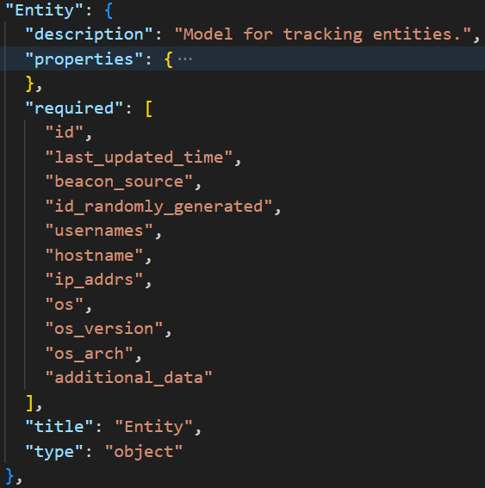
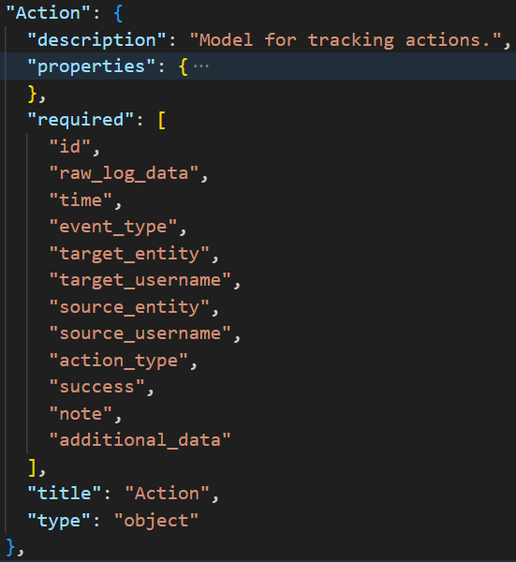
Central to Silence of the Logs is the creation of a common schema
JSON schema contains two main properties: Entities and Actions
Entities describe the computing systems
aggressed by the Red Team
  Identifying information, and connection
  to actions
  Appears as icons in visualizations
Actions describe the TTPs used
by the Red Team against an entity
  History of all Red Team TTPs
  Primarily accessed via database
Image source: https://commons.wikimedia.org/wiki/File:JSON_vector_logo.svg

Slide 22
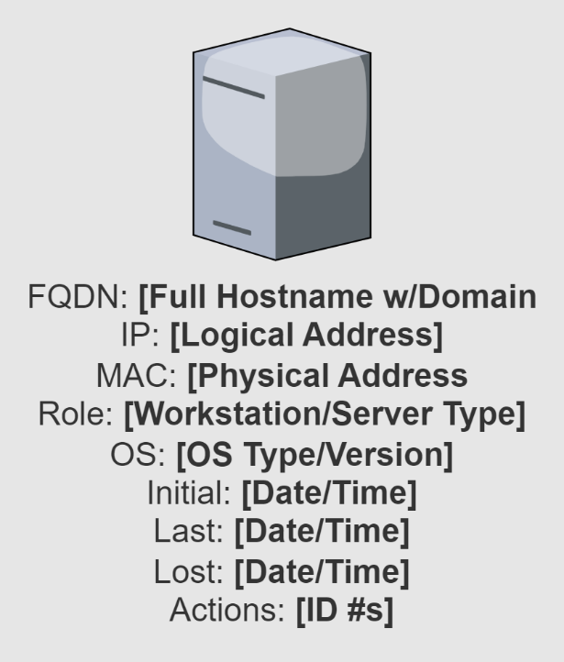
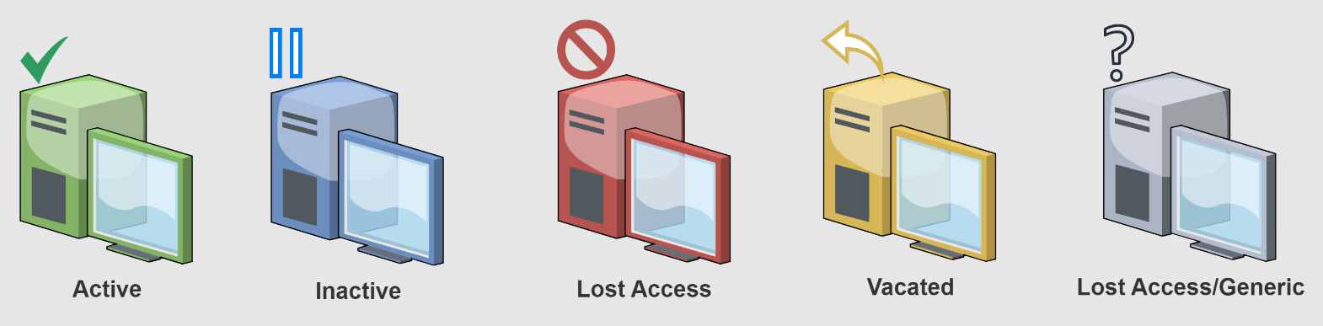
Silence of the Logs visualizer includes standard symbols for visualizations
Built using draw.io using MXML data
  Can add visible/hidden properties to the entities and links
  Allows parsing of visualization
Manual modifications may be necessary
  SotL Compare and future features
Icon source: draw.io

Slide 23

The Action Map visualization tells a story about the attack pathway
Presents a day-to-day story board for the attack campaign
System icons and information summarize key targets and objectives
Colors/symbols highlight status of current accesses
Linkages show pivots within and between enclaves and networks
Red Team can make corrections as needed
Icon source: draw.io

