Slide 1
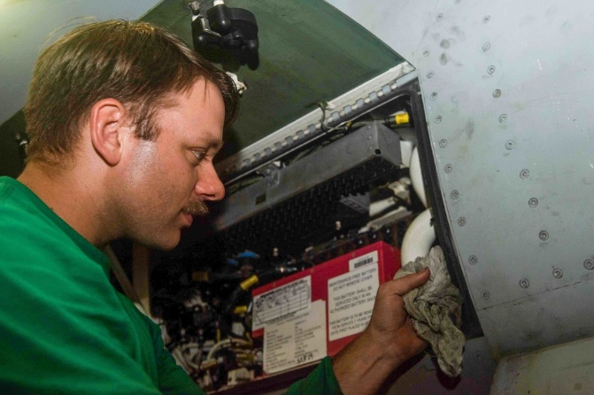
DATAWorks 2024: Operationally Representative Data and Cybersecurity for Avionics
Steve Movit, Justace Clutter, Connor Trask, Kelly Tran, Rose Clark
April 17, 2024
"The appearance of U.S. Department of Defense (DoD) visual information does not imply or constitute DoD endorsement.“
“USS Ronald Reagan (CVN 76) Hangar Bay [Image 9 of 10],”Department of Defense, last updated September 10, 2021, https://www.dvidshub.net/image/6829416/uss-ronald-reagan-cvn-76-hangar-bay

Slide 2

Overarching problem: aircraft networks were not designed for security
Aviation relies heavily on physical security
Most avionics cyber-attacks require physical access
Physical security regulations are limited
49 CFR, Subtitle B, Chapter 12, Subchapter C: Civil Aviation Security
Security requirements are vague, to enable broad application
ID badge is the only basic requirement
Latitude on how to design the badge
Airport security doesn’t account for upstream vulnerabilities
Even if the airport is secured, the manufacturer’s site might not be
“plane crash rescue,” Department of Defense, last updated May 8, 2011, https://www.dvidshub.net/image/1102416/plane-crash-rescue
"The appearance of U.S. Department of Defense (DoD) visual information does not imply or constitute DoD endorsement.“
CFR – Code of Federal Regulations
Notes:
‘Requirements of a Secured Area: Have a secured area and don’t let unauthorized people into it’

Slide 3
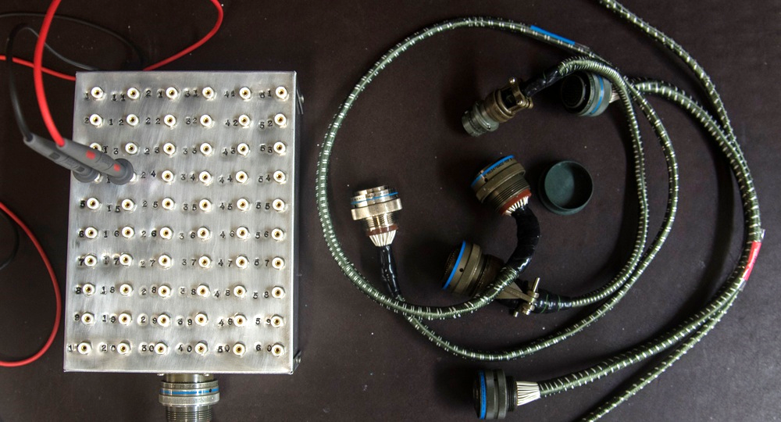
Overarching problem: aircraft networks were not designed for security
Aircraft rely on a variety of insecure communication standards
Designed for reliability and assured message delivery
MIL-STD-1553 and ARINC 429 are two of the most prevalent
The literature shows that MIL-STD-1553 has known attack vectors¹ and could be exploited by rogue devices²
Similar vectors are discussed in work describing a method for “fingerprinting” devices on an ARINC 429 bus³
More on this later in the talk
“Avionics invention [Image 1 of 3],” Department of Defense, last updated August 1, 2016 https://www.dvidshub.net/image/2775657/avionics-invention
"The appearance of U.S. Department of Defense (DoD) visual information does not imply or constitute DoD endorsement.“
See References slide for sources.
ARINC – Aeronautical Radio, Incorporated; MIL-STD - United States Military Standard
Notes:
‘Requirements of a Secured Area: Have a secured area and don’t let unauthorized people into it’

Slide 4
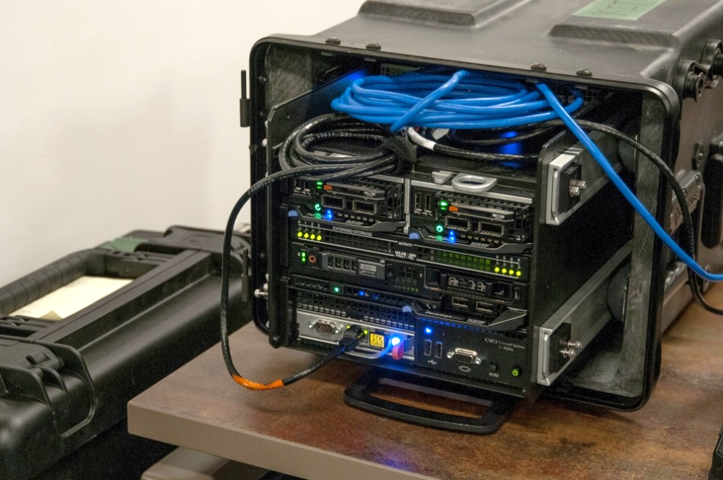
Capabilities of our hardware-in-the-loop simulator for avionics systems
We created a hardware-in-the-loop simulator for avionics systems which can:
Demonstrate a cyber attack with mission effects
Collect operationally relevant and realistic bus data
Act as a test bed for intrusion detection algorithms
Army Intrusion Detection System (Ethernet)
“CYBERSECURITY TO GO [Image 4 of 4]],” Department of Defense, last updated May 16, 2019 https://www.dvidshub.net/image/5616775/cybersecurity-go
"The appearance of U.S. Department of Defense (DoD) visual information does not imply or constitute DoD endorsement.“

Slide 5
Detail on the ARINC 429 protocol – vector for our simulator
Thousands of planes currently flying with ARINC 429
Standard first published in 1978 and last updated in 2018 (ARINC 429-19)
Inherently unsecure due to a lack of encryption and authentication
Unidirectional, one “transmit” node and up to twenty “receive” nodes
If a receiver wants to transmit back, it must do so on a different ARINC 429 connection
Each message is sent in a fixed format
ARINC 429 Link
Transmitter
Receiver
. . .
Receiver
Receiver
Receiver
ARINC – Aeronautical Radio, Incorporated
Notes:
Plane figure based off flight tracker data (Flight Aware) using a cautious estimate of which planes have ARINC 429 systems

Slide 6
Hardware-in-the-loop (HITL) design
Mimics a general aviation aircraft with avionics dependent on ARINC 429 bus
Primary focus is on the ARINC 429 connections between the EGPWS ground proximity warning device and the display (MFD)
Has the capacity to expand to include other avionics systems
Xplane software running on a PC provides a virtual environment for a human in the loop and drives the avionics systems
Python code links the individual components via existing RS-232 control ports on the avionics
ARINC – Aeronautical Radio, Incorporated; EGPWS – Enhanced Ground Proximity Warning System; MFD – Multi-Function Display

Slide 7
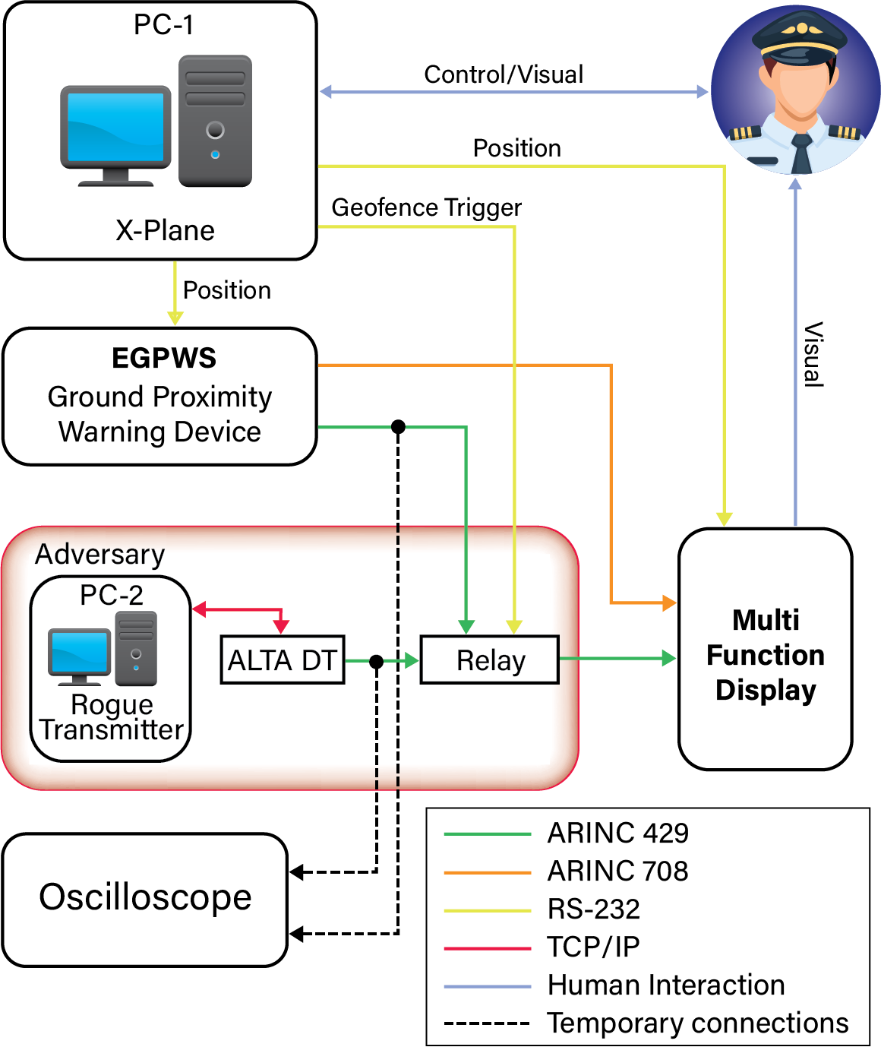
Simulator Diagram
ARINC – Aeronautical Radio, Incorporated; EGPWS – Enhanced Ground Proximity Warning System; MFD – Multi-Function Display; TCP/IP – Transfer Control Protocol/Internet Protocol

Slide 8
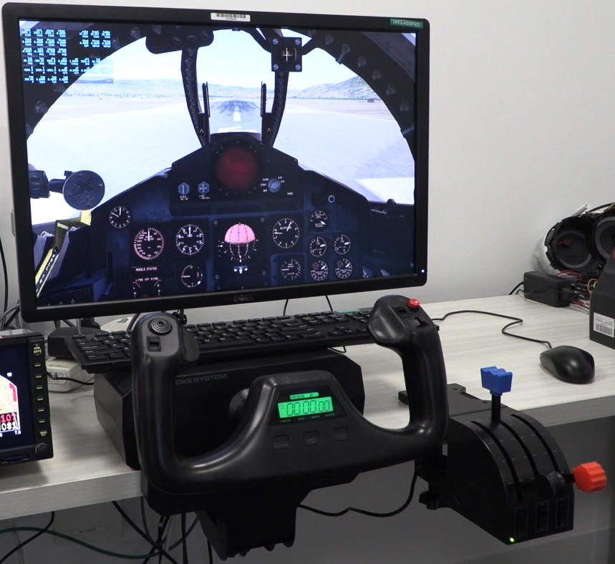
Simulator Diagram
PC-1: X-Plane
ARINC – Aeronautical Radio, Incorporated; EGPWS – Enhanced Ground Proximity Warning System; MFD – Multi-Function Display; TCP/IP – Transfer Control Protocol/Internet Protocol

Slide 9
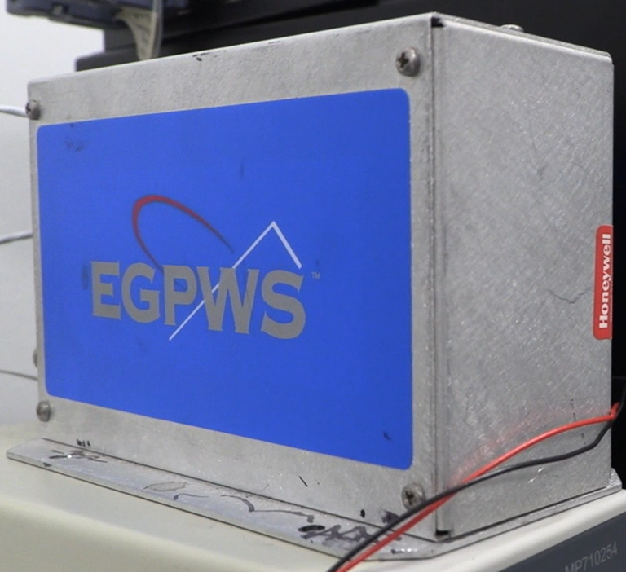
Simulator Diagram
Enhanced Ground Proximity Warning System
Bendix/King KGP-560
ARINC – Aeronautical Radio, Incorporated; EGPWS – Enhanced Ground Proximity Warning System; MFD – Multi-Function Display; TCP/IP – Transfer Control Protocol/Internet Protocol

Slide 10
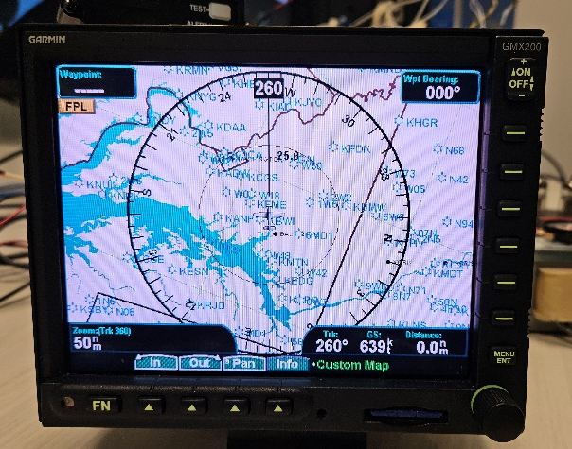
Simulator Diagram
Multi-Function Display (MFD)
Garmin GMX-200
ARINC – Aeronautical Radio, Incorporated; EGPWS – Enhanced Ground Proximity Warning System; MFD – Multi-Function Display; TCP/IP – Transfer Control Protocol/Internet Protocol

Slide 11
Simulator Diagram
ARINC – Aeronautical Radio, Incorporated; EGPWS – Enhanced Ground Proximity Warning System; MFD – Multi-Function Display; TCP/IP – Transfer Control Protocol/Internet Protocol

Slide 12
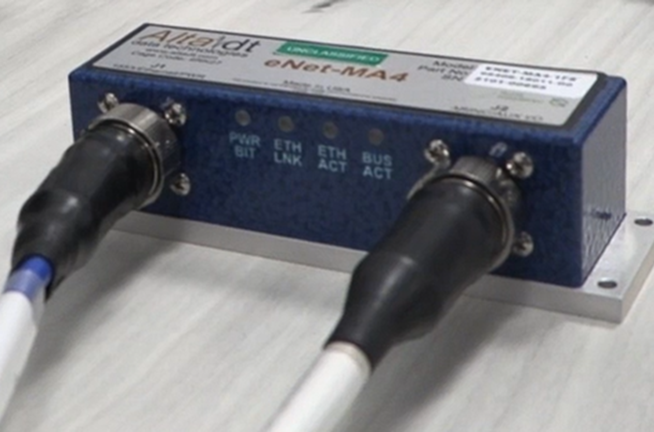
Simulator Diagram
AltaDT eNet-MA4
MIL-STD-1553 / ARINC-429 Interface
ARINC – Aeronautical Radio, Incorporated; EGPWS – Enhanced Ground Proximity Warning System; MFD – Multi-Function Display; TCP/IP – Transfer Control Protocol/Internet Protocol

Slide 13
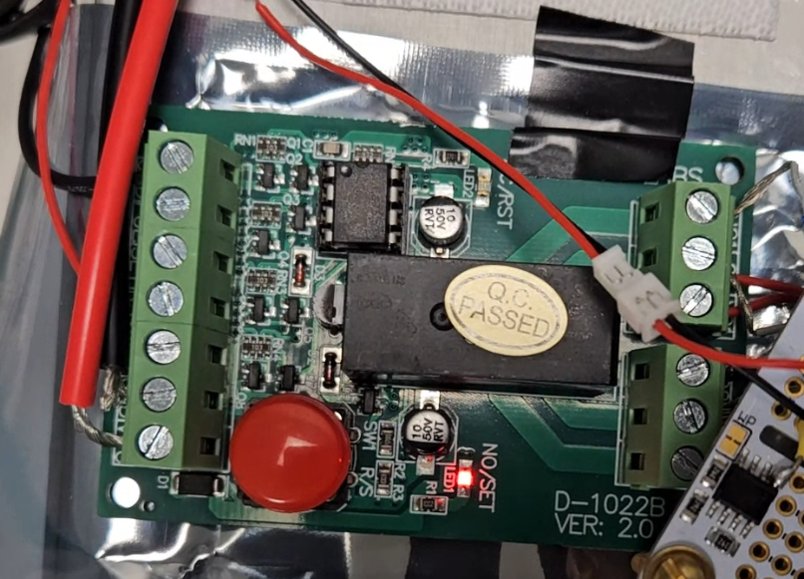
Simulator Diagram
Relay
Used to select the ARINC-429 input device for the MFD
ARINC – Aeronautical Radio, Incorporated; EGPWS – Enhanced Ground Proximity Warning System; MFD – Multi-Function Display; TCP/IP – Transfer Control Protocol/Internet Protocol

Slide 14
Anatomy of an attack
Execute a DoS attack on the pilot’s avionics displays
Attack will replay previously recorded alarm messages in place of the regular non-alarm output from the EGPWS
Attack will impact the pilot’s ability to maintain situational awareness
Could result in the loss of a mission goal (landing the aircraft, in our case)
Real-life version of the attack could be facilitated by a leave-behind device, or planned further upstream in the avionics supply chain
DoS – Denial of Service; EGPWS – Enhanced Ground Proximity Warning System

Slide 15
Anatomy of an attack
Record legitimate alarm messages from an EGPWS unit
Manufacture a leave-behind device which can take over an ARINC 429 bus and replay the pre-recorded alarm messages
Plant the leave-behind device in the target system
Could also be executed as an upstream supply chain attack
Execute a DoS attack on the pilots avionics displays by taking over the ARINC 429 bus and transmitting the messages
Can be configured to happen automatically based on a trigger
Attack impacts the pilot’s ability to maintain situational awareness
Could result in the loss of a mission goal (landing the aircraft, in our case)
DoS – Denial of Service ; EGPWS – Enhanced Ground Proximity Warning System

Slide 16
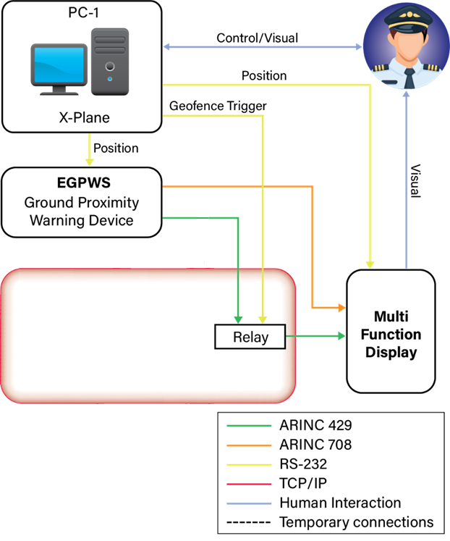
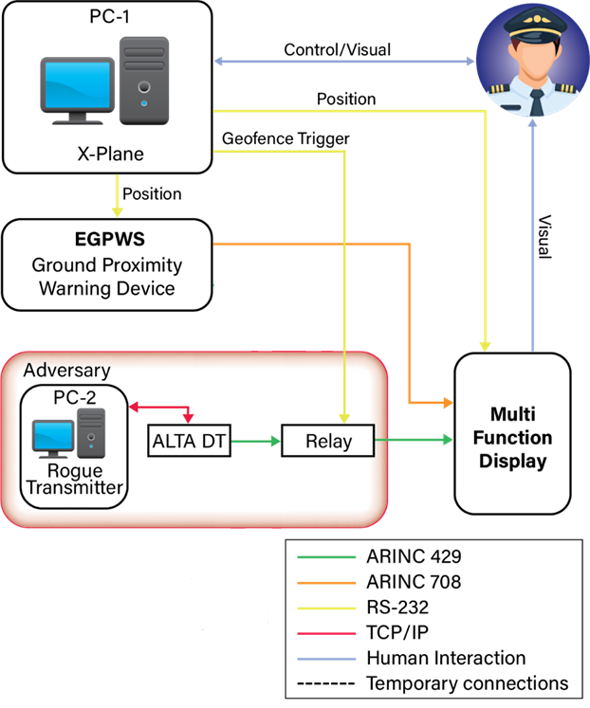
Anatomy of an Attack
Before Cyber Attack
During Cyber Attack
ARINC – Aeronautical Radio, Incorporated; EGPWS – Enhanced Ground Proximity Warning System; MFD – Multi-Function Display; TCP/IP – Transfer Control Protocol/Internet Protocol

Slide 17
Video Demonstration of a Cyber-attack

Slide 18
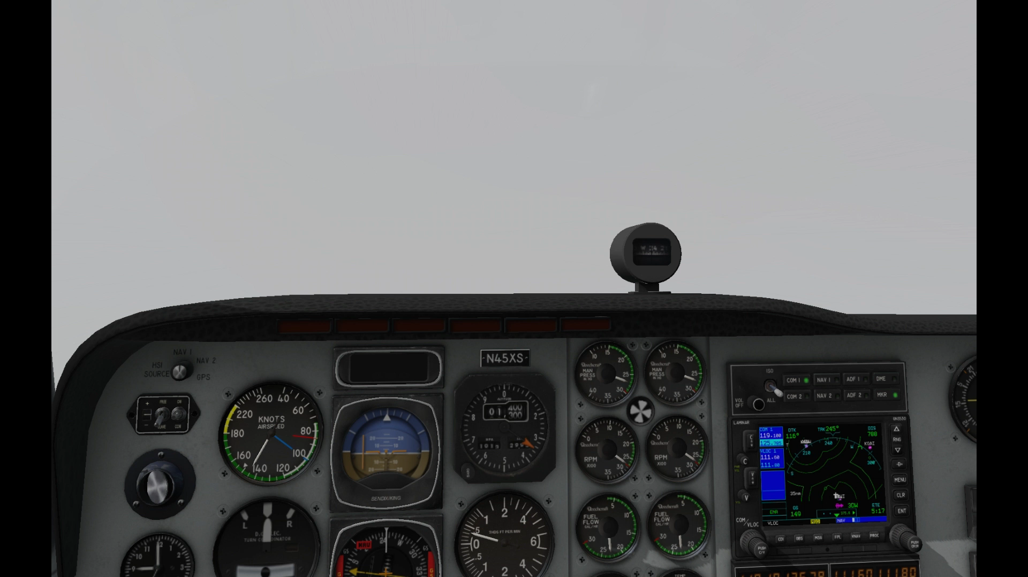
Video demonstration of a cyber-attack

Slide 19
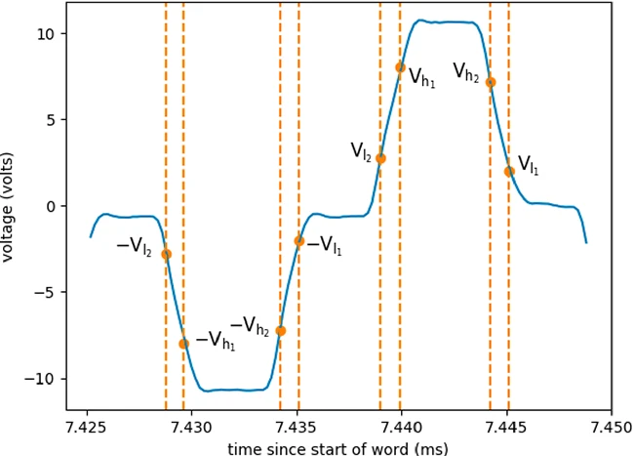
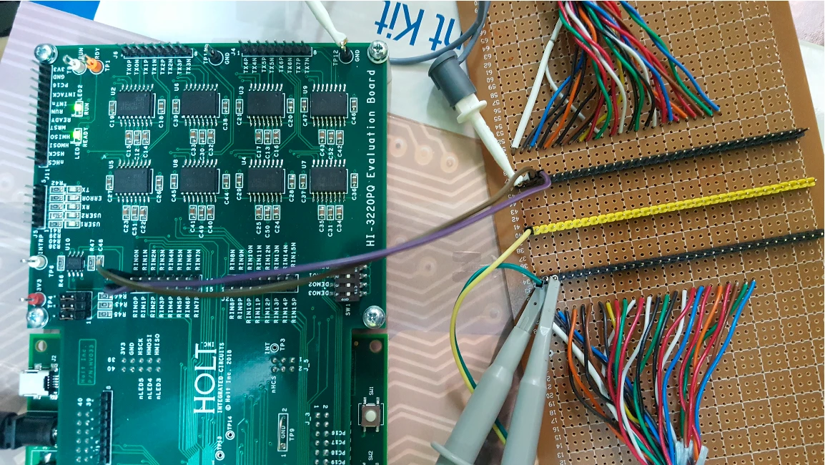
Existing work on intrusion detection for ARINC 429 buses
“Hardware Fingerprinting for the ARINC 429 Avionic Bus”³
Appears to be only publication detailing a method for intrusion detection on ARINC 429
Builds on previous work implementing intrusion detection on similar unsecured buses, such as CAN buses
Message-agnostic strategy
Relies on differences in the electrical signal, not message content
Tested detection of both rogue transmitters and rogue receivers
See References slide for sources.
ARINC – Aeronautical Radio, Incorporated; CAN – Controller Area Network; IDS – Intrusion Detection System;

Slide 20
Achievements and limitations of existing hardware fingerprinting work
Achievements
Limitations
Demonstrated that rogue transmitters can be identified by their voltage characteristics
Able to distinguish between devices made by the same manufacturer
Rogue receivers can also be identified
Transmitter attacks are detected within 50ms; receiver attacks within 3 seconds
Messages are created by integrated circuit boards, not avionics hardware
Message content is not operationally representative
Parity of messages is odd, while ARINC 429 messages must be even parity
Does not evaluate sensitivity of voltage characteristics to external factors such as temperature
Objective: Replicate these results in avionics hardware with operationally representative messages

Slide 21
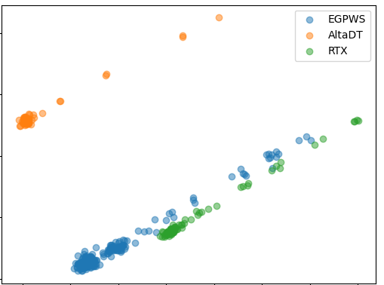
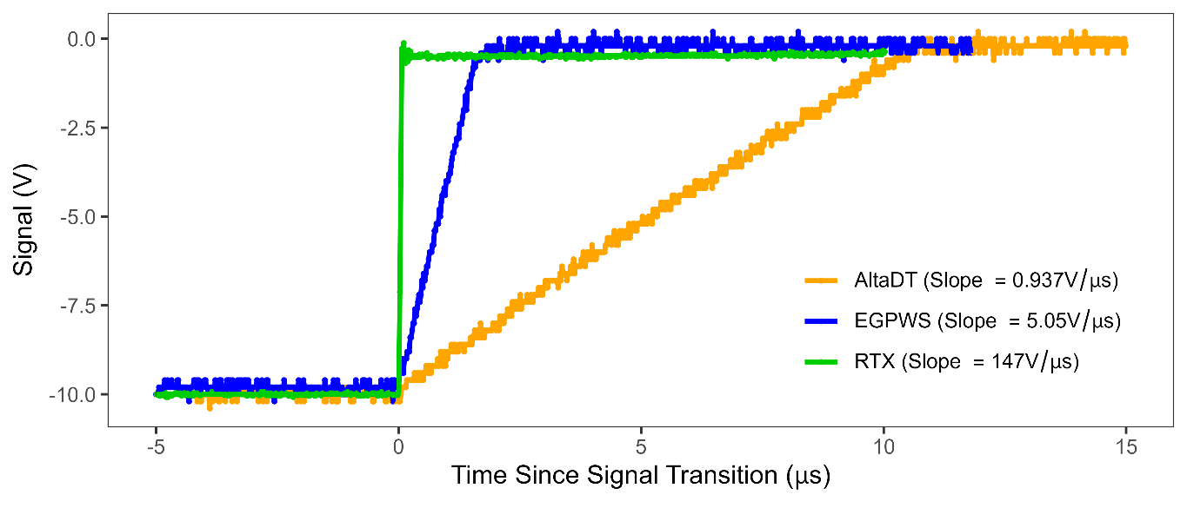
Initial Results
Collected and segmented operational data from three transmitters
One “valid” (EGPWS), two “malicious” (AltaDT, RTX ARINC-to-Serial Port interface)
Simple descriptive statistics for each transmitter appear the same
Principal Component Analysis (PCA) can visualize segment-level differences between the transmitters
Local Outlier Factor (LOF)⁴ implemented as anomaly detection algorithm
Currently achieving promising classification results using only a small section of the HI and LO segments
See References slide for sources.
EGPWS - Enhanced Ground Proximity Warning System
Notes:
LOF good for Intrusion Detection: Lazarevic, A., Ertoz, L., Kumar, V., Ozgur, A., Srivastava, J.: A comparative study of anomaly detection schemes in network intrusion detection. In: Proceedings of the 2003 SIAM International Conference on Data Mining, pp. 25–36. SIAM (2003)

Slide 22
Future Work
Expand the number of avionics systems included in our HITL system
Explore other unsecured avionics buses, such as MIL-STD-1553
Investigate system-level cyberattacks:
Effects of cyber compromise on other systems
Effects of compromising multiple systems simultaneously
Potential for lateral movement through ARINC 429 connections
Collect additional samples for our operationally representative dataset
Expand dataset scope to include MIL-STD-1553 data
Develop and test the IDS in real-time (“operationalize”)
“Avionics invention [Image 1 of 3],” Department of Defense, last updated August 1, 2016 https://www.dvidshub.net/image/2775657/avionics-invention
"The appearance of U.S. Department of Defense (DoD) visual information does not imply or constitute DoD endorsement.“
ARINC – Aeronautical Radio, Incorporated; HITL – hardware-in-the-loop; IDS – Intrusion Detection System; MIL-STD – United States Military Standard

Slide 23
Conclusions
Critical avionics buses are vulnerable to cyber-attack
Attacks are possible with commercially available tools, using publicly available information
Cybersecurity testing of avionics buses is feasible
We have demonstrated an operationally relevant mission effect
We can create a dataset of operationally realistic bus traffic without an aircraft
While our solution is better than simulated data, testing on aircraft is ideal
Rogue devices on an ARINC 429 bus can be distinguished from legitimate hardware using relatively simple techniques
ARINC – Aeronautical Radio, Incorporated;

Slide 24
Questions?

Slide 25
References
Lounis, Karim, Ziad Mansour, Michael Wrana, Marwa A. Elsayed, Steven H. H. Ding, Mohammad Zulkernine. "A Review and Analysis of Attack Vectors on MIL-STD-1553 Communication Bus." IEEE Transactions on Aerospace and Electronic Systems, vol. 58, issue 6, pp. 5586-5606. (IEEE December 2022). DOI: 10.1109/TAES.2022.3177583
De Santo, Damiano, Claudio S. Malavenda, Simon P. Romano, Cristian Vecchio. “Exploiting the MIL-STD-1553 avionic data bus with an active cyber device.” Computers & Security, Volume 100, Article 102097. (New York, NY: Elsevier Ltd. January 2021). DOI: 10.1016/j.cose.2020.102097
Gilboa-Markevich, Nimrod, Avishai Wool. “Hardware Fingerprinting for the ARINC 429 Avionic Bus.” Paper presented at the 25th European Symposium on Research in Computer Security, ESORICS 2020, Guildford, UK, September 14–18, 2020. DOI: 10.1007/978-3-030-59013-0_3
Breunig, Markus M., Hans Peter Kriegel, Raymond Ng, Jörg Sander. “LOF: identifying density-based local outliers.” ACM SIGMOD Record, Volume 29, Issue 2, pp. 93–104. (New York, NY: ACM 2000). DOI: 10.1145/335191.335388

Slide 26
Appendix A: Nature of a Physical Attack
Current avionics security relies heavily on physical security
Avionics cyber-attacks require physical access; therefore, we only have to prevent physical access
Unfortunately, the physical security of aircraft is questionable at best
49 CFR, Subtitle B, Chapter 12, Subchapter C: Civil Aviation Security
Security requirements are vague, to enable broad applicability
Personnel ID requirements are just a badge
Airport security doesn’t account for upstream vulnerabilities
Even if the airport is secured, the manufacturer’s site might not be
Insider/Near-sider attacks are still attacks
Notes:
‘Requirements of a Secured Area: Have a secured area and don’t let unauthorized people into it’

Slide 27
Appendix B: Scope of this Attack
Denial-of-Service Playback Attack
Effectively a black-box test
ARINC 429 fundamentals are freely available
Attack targeted relatively minor connection
Attacks against GPS ARINC 429 buses can be far more refined
Spoofing takes more effort, but still very feasible
ARINC 429 labels are standardized, again eliminating need for internal knowledge
Remote access is now possible, due to airplane Wi-Fi services
ARINC – Aeronautical Radio, Incorporated;

