Slide 1
DATAWorks 2024: Operational T&E of AI-supported Data Integration, Fusion, and Analysis Systems
Adam M Miller, John T Haman, Logan K Ausman,
Keyla Pagán-Rivera, Sarah A Shaffer, Brian Vickers
April 2024

Slide 2
Outline
Introduction to AI-supported data integration
Operational T&E challenges posed by AI-supported data integration
Strategies for operational T&E of AI-supported data integration systems
  Test data
  Methods
  Evaluation
  Test design
Summary
  AI – Artificial Intelligence; T&E – Test & Evaluation

Slide 3
AI Capabilities for Data Integration
  AI – Artificial Intelligence

Slide 4
















Data Integration is the gathering, formatting, fusing, and refining of data from multiple sources to facilitate analysis

Slide 5




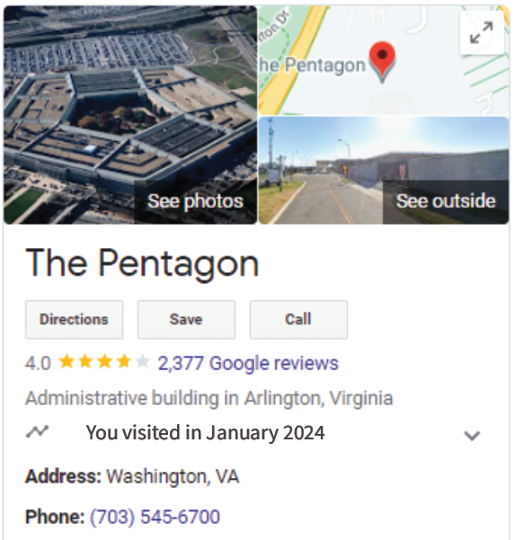
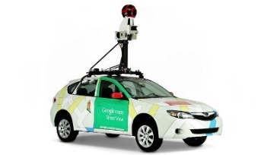



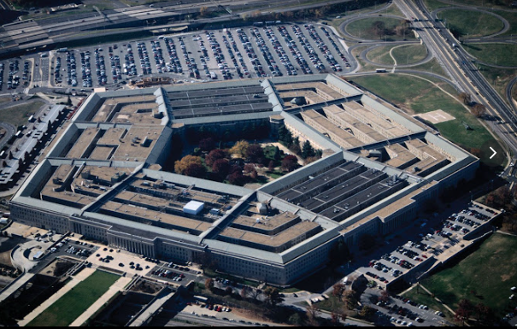
Google Maps as an example data integration system (1 of 2)
Extract data elements
Fuse elements
into entities
Raw data
sources
Formatted data elements
Unique entities

Slide 6


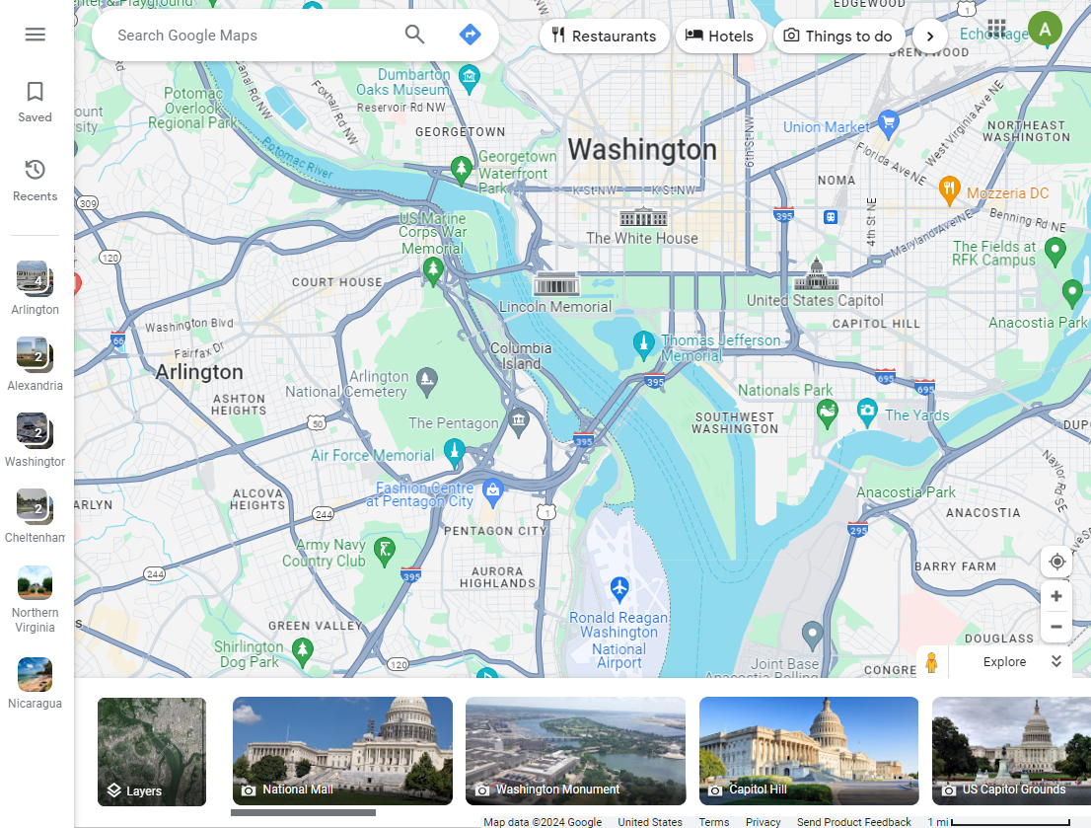
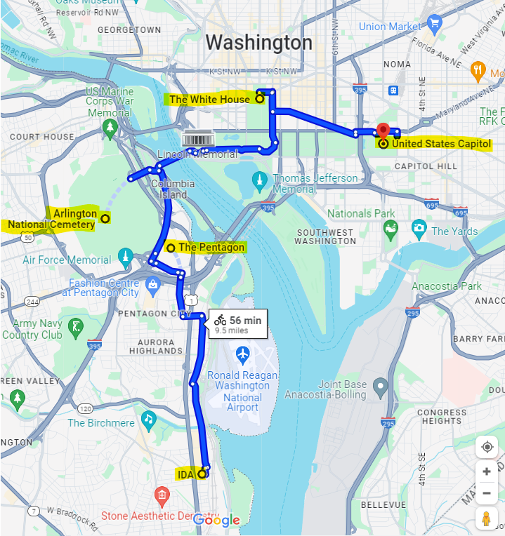
Google Maps as an example data integration system (2 of 2)
User & AI
collaboration
Database
Output
  AI – Artificial Intelligence

Slide 7


Notional AI-supported data integration pipeline
Data Engineer & AI
Selects & formats data
Data Manager & AI
Fuses data into entities
Analyst & AI
Writes analysis
Consumer
Acts on analysis
DE
DM
A
Raw data
Multiple sources, formats
Extracted data
Formatted for database
Fused data
Unique entities
Analysis
Output for human reader
  AI – Artificial Intelligence; DM – Data Manager; DE – Data Engineer; A – Analyst

Slide 8
Operational T&E Challenges Posed by AI-supported data integration
  AI – Artificial Intelligence; T&E – Test & Evaluation

Slide 9
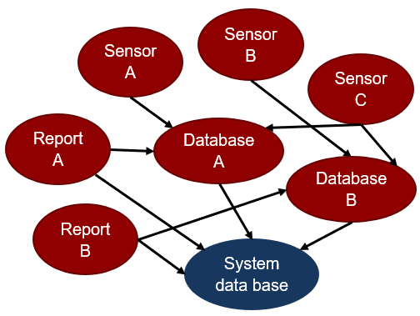
Test challenges for operational T&E of AI
Operationally representative
test data
Grading the accuracy of responses
What was the
AI contribution?
  AI – Artificial Intelligence; T&E – Test & Evaluation

Slide 10
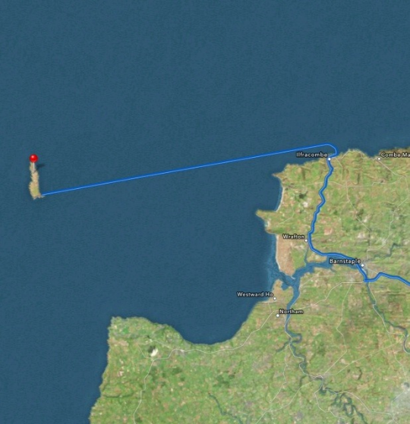
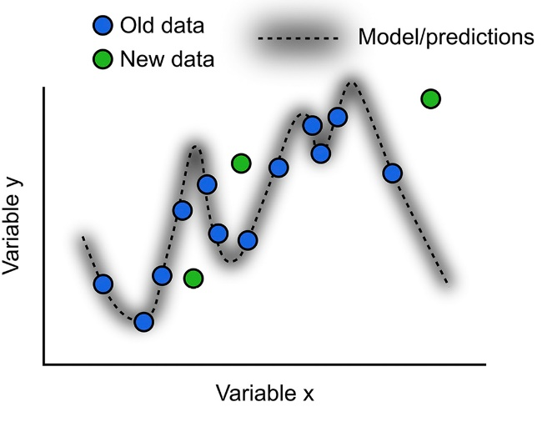

Characterizing performance over the operational envelope
Predicting performance with rare inputs
Generalizability of the model solution
Model may change during testing
Theamazingios6maps.tublr.com
Richards & Frankland (2017) The Persistence and Transience of Memory

Slide 11
Strategies for T&E of AI-supported data integration system: Test data
Test
data
Methods
Evaluation
Test design
  AI – Artificial Intelligence; T&E – Test & Evaluation

Slide 12
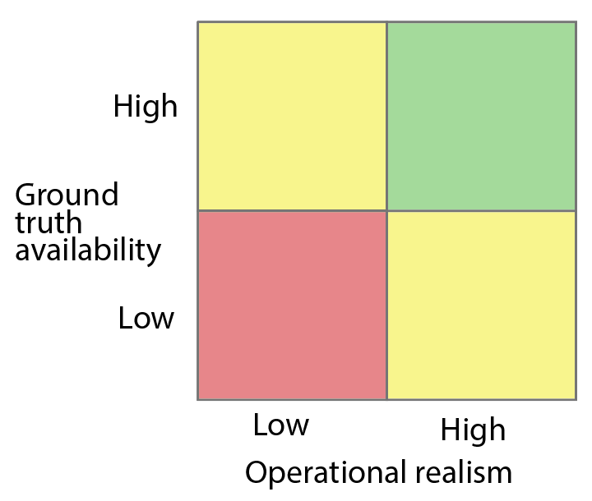
Operationally representative test data
Properties of test data
Synthetic
data
How to improve?
Enhance operational realism of synthetic data
Approximate truth for operational data
Combine synthetic and operational data
Operational
data

Slide 13



















Approximating ground truth for operational data
Real historical data with SME retrospective analyses
Data Timeline
Past
Present
Historical
raw data
Historical
raw data
Historical
raw data
Important:
SMEs may
be wrong
SME analysis
SME analysis
SME analysis
  SME – Subject Matter Expert

Slide 14
Strategies for T&E of AI-supported data integration system: Methods
Test
data
Methods
Evaluation
Test design
  AI – Artificial Intelligence; T&E – Test & Evaluation

Slide 15

Evaluating the accuracy of AI responses
For when you have ground truth
Confusion matrix
Regression error
 |  | Truth
 |  | Rating A | Rating B
AI Model | Rating A | Agree A | Disagree
 | Rating B | Disagree | Agree B
AI Model
prediction
Error
Distance
Truth variable y
Truth variable x
  AI – Artificial Intelligence

Slide 16


Compare AI responses to SME responses
For characterizing the similarity of AI and SME responses
Interrater agreement
AI-SME Disagreement
AI
mean
response
SME mean response distribution
Agreement axis
  AI – Artificial Intelligence; SME – Subject Matter Expert

Slide 17
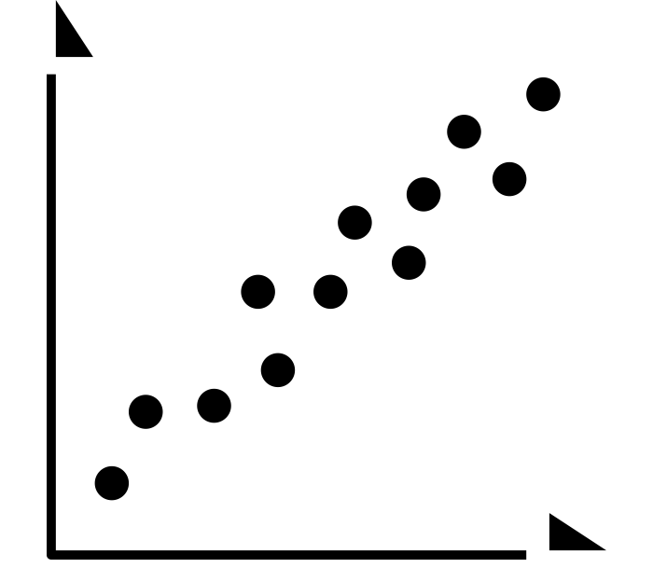
Characterize user trust and utilization
In addition to standard HSI measures
Calibrated trust
User utilization confusion matrix
 |  | Human Behavior
 |  | Intervention | No Intervention
AI Accuracy | Unsatisfactory | Hit | Miss
 | Satisfactory | False Alarm | Correct Rejection
Human
trust
AI accuracy
  AI – Artificial Intelligence

Slide 18
Strategies for T&E of AI-supported data integration system: Evaluation
Test
data
Methods
Evaluation
Test design
  AI – Artificial Intelligence; T&E – Test & Evaluation

Slide 19
Evaluate ability of users to generate data analyses
Engineer
& AI
Manager
& AI
Analyst
& AI
Consumer
Curated
historical
scenario
(raw data)
DE
DM
A
Extracted data
Correlated data
Analysis
  AI – Artificial Intelligence; DE – Data Engineer; DM – Data Manager; A – Analyst

Slide 20
Evaluate ability of users to generate data analyses
HSI Methods
Survey
Interview
Behavior
HSI variables (all users)
Usability
Workload
Calibrated trust
HSI variable
(consumer)
Approval
Utilization
Timeliness
Engineer
& AI
Manager
& AI
Analyst
& AI
Consumer
Curated
historical
scenario
(raw data)
DE
DM
A
Extracted data
Correlated data
Analysis
  HSI – Human System Interaction; AI – Artificial Intelligence; DE – Data Engineer; DM – Data Manager; A – Analyst

Slide 21
Evaluate ability of users to generate data analyses
HSI Methods
Survey
Interview
Behavior
HSI variables (all users)
Usability
Workload
Calibrated trust
HSI variable
(consumer)
Approval
Utilization
Timeliness
Engineer
& AI
Manager
& AI
Analyst
& AI
Consumer
Curated
historical
scenario
(raw data)
DE
DM
A
Extracted data
Correlated data
Analysis
Performance Methods
Confusion matrices
Error distances
Performance variables (products)
Accuracy
Similarity to SME-generated products
Performance variable (consumer)
Mission success
  HSI – Human System Interaction; AI – Artificial Intelligence; DE – Data Engineer; DM – Data Manager; A – Analyst;
  SME – Subject Matter Expert

Slide 22
Evaluate ability of users to generate data analyses
Engineer
& AI
Manager
& AI
Analyst
& AI
System under test
Consumer
DE
DM
A
Extracted data
Correlated data
Analysis
Curated
historical
scenario
(raw data)
Compare
Engineer
Manager
Analyst
Consumer
DE
DM
A
Comparison
system
Extracted data
Correlated data
Analysis
  AI – Artificial Intelligence; DE – Data Engineer; DM – Data Manager; A – Analyst

Slide 23
Strategies for T&E of AI:
Test Design
Test
data
Methods
Evaluation
Test design
  AI – Artificial Intelligence; T&E – Test & Evaluation

Slide 24








Candidate operational factors
Focus should be on operational factors that affect the input to the data integration system
Data Sources
Geographical regions
Entity Types
Network Domain
…
Duplicate records

Slide 25
Sizing adequate tests
Factors that increase the number of runs needed:
Novelty of system/ mission/ capability/ AI task
Magnitude of AI contribution to mission
Task Complexity (input and decision spaces)
Factors that decrease the number of runs needed:
Quality of training data (relevance & quantity)
Ground truth data availability
Prior testing (relevance & recency)
  AI – Artificial Intelligence

Slide 26
Summary
AI data integration evaluations may become common
Data classification and interrater agreement metrics are useful for assessing AI performance
Standard HSI measures should be augmented with behavioral measures of calibrated trust and AI utilization
Use between-systems comparisons to characterize AI contributions to system performance
Characterizing the operational space requires identifying operational factors governing system input
  AI – Artificial Intelligence; HSI – Human Systems Interaction

