Slide 1
Improving the Long-Term Reusability of Nondestructive Evaluation Data Sets
DATAWorks 2025
  Tyler Lesthaeghe
    2025-04-23

Slide 2
Acknowledgements
University of Dayton Research Institute
  Tom Boehnlein
  David Zainey
  Norm Schehl
  Vicki Kramb
Air Force Research Laboratory
  John Wertz
  Matt Cherry
  Mike Uchic
  Lauren Ferguson
BlueHalo
  Jason Thiese
Iowa State University Center for NDE
  Steve Holland
  Nate Scheirer
Texas Research Institute – Austin
  Dave Forsyth
  Jared Taylor
Electric Power Research Institute
  Terrill Massey
  Mark Dennis
Evident Scientific
  Baptiste Gauthier
Électricité de France
  Andreas Schumm
And many others…
Portions of this work are funded by the US Air Force through Contracts FA8650-10-D-5210 and FA8650-19-D-5230.

Slide 3
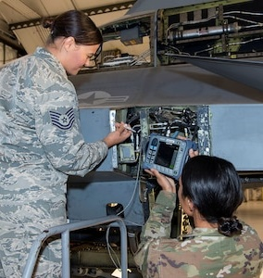
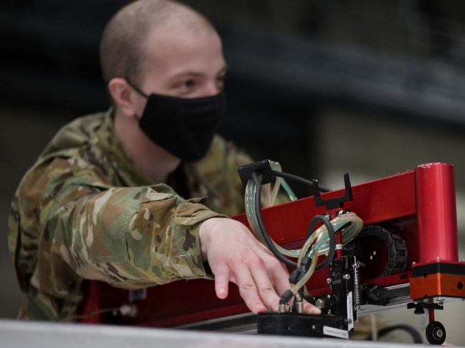
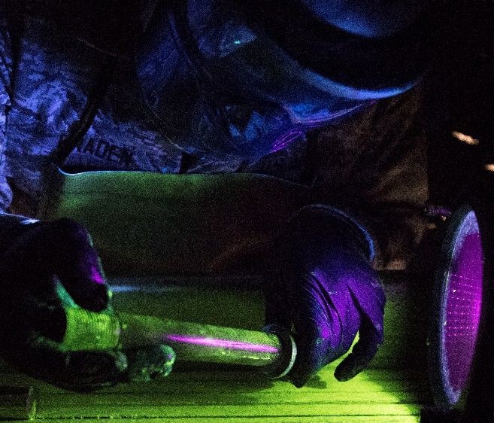
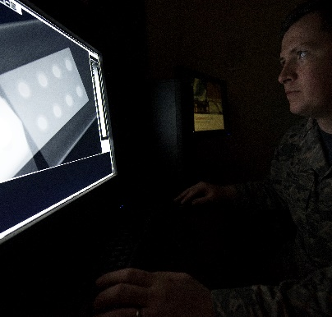
What is Nondestructive Evaluation (NDE)?
Multidisciplinary Field Focused on Material Characterization and Damage/Defect Detection in Critical Components without Impacting Usability of Component
Some Techniques: Ultrasound, X-Ray, Eddy Current, Thermography, etc.
Areas Utilized: Aerospace, Civil Structures, Energy, Rail, etc.
Colorado ANG, Photo by SMSgt. John Rohrer
US Air Force, Photo by A1C Ashley Richards
US Air Force, Photo by A1C Rhett Isbell
US Air Force, Photo by A1C Rhett Isbell

Slide 4
Digital Transformation in NDE
ADDITIVE MANUFATURING
X-RAY CT
BLOCKCHAIN
SAFETY
MACHINE LEARNING
MODELING
NDE 4.0
ROBOTICS
CLOUD COMPUTING
EDDY CURRENT
DIGITAL TRANSFORMATION
COMPUTER VISION
BIG DATA
EMBEDDED SENSING
SPEED
ULTRASOUND
INTERNET OF THINGS
ARTIFICIAL INTELLIGENCE
AUGMENTED REALITY
COST
AUTOMATION
DIGITAL TWIN
DIGITAL THREAD
REAL-TIME MONITORING
INDUSTRY 4.0
ACCURACY
THERMOGRAPHY
SIMULATION
DEEP LEARNING
PREDICTIVE MAINTENANCE
REMOTE INSPECTION
RELIABILITY
RADIOGRAPHY

Slide 5
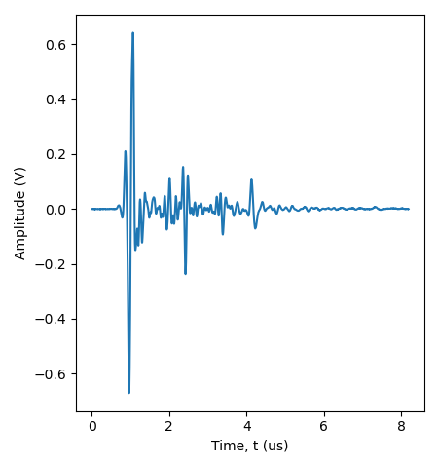
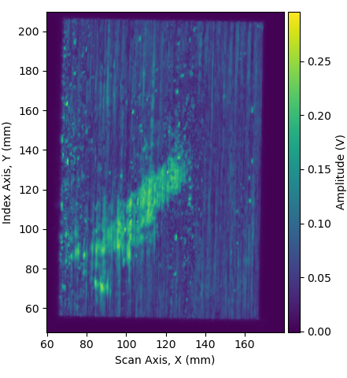
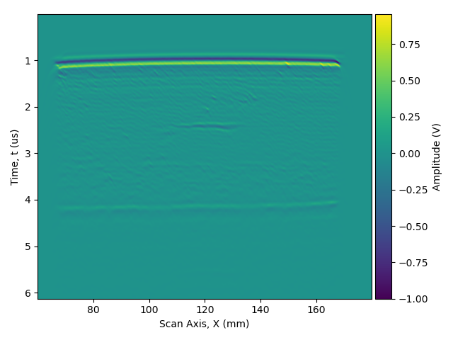
Data in NDE
A-Scan
C-Scan
B-Scan
Point Measurement
Area Measurement
Cross-Section
Data Recorded Might Include…
All Raw Data
Reduced Dimensionality Representation
Reconstruction Results
Screenshot
Nothing…
Metadata
Specimen Information
Operator Information
Equipment Configuration
Etc.
NDE Data Is Wide-Ranging and Complex

Slide 6
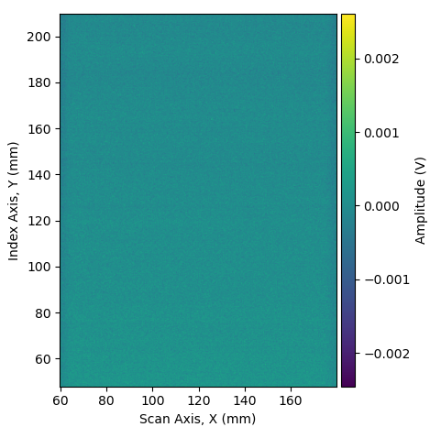
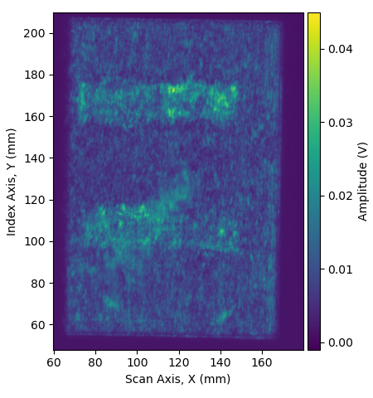
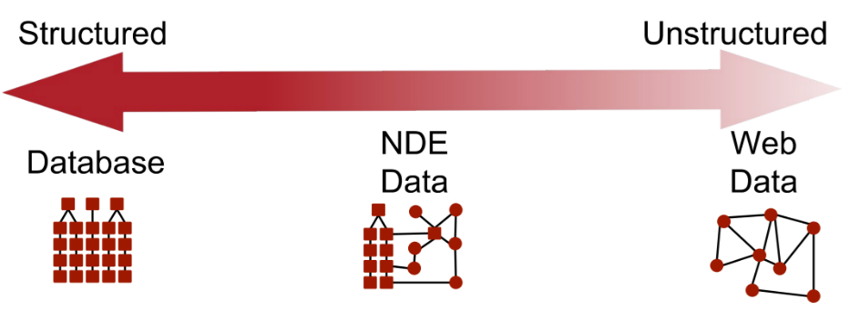
Several Major Problems…
Data is Semi-Structured
Useful Data is Limited and Noisy

Slide 7

Several Major Problems…
Missing Critical Metadata
Proprietary Data Formats
When?
Where?
What?
Who?
Why?
User Interpretation/Labeling?
Machine Readable?

Slide 8
Tackling Metadata and Long-Term Reusability
Rigorous Processes
Imposed on User
Minimal Processes
Imposed on User
Two Possible Strategies

Slide 9
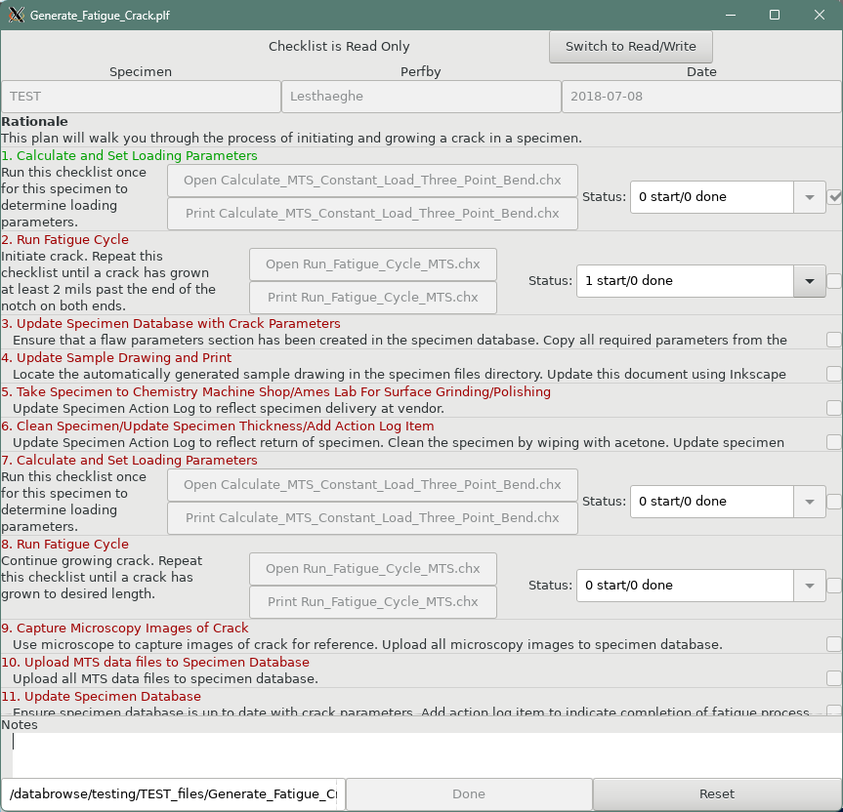
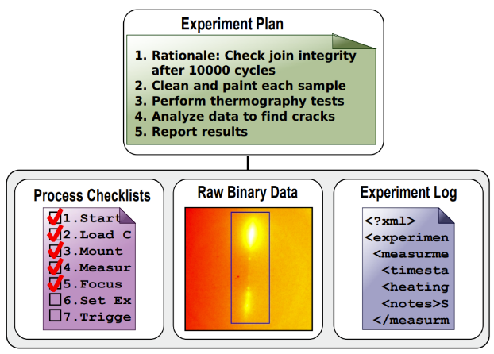
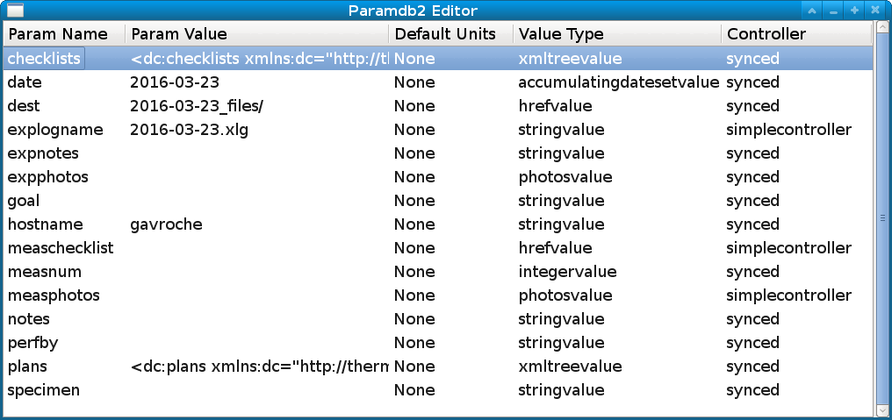
LIMATIX: datacollect2
Checklist-based data logging and automation
Built around well-defined plans and processes
Parameter database with ability to link to data acquisition software
Can assist in acquiring photographs of experiments
Paper checklist capability

Slide 10
LIMATIX: ProcessTrak
Command-line Based Tool for Data Analysis
Built Around XML and Python
Tracks Provenance
Integrates with Version Control Tool Git
<processinginstructions
xmlns= "http://limatix.org/processtrak/processinginstructions"
xmlns:xlink="http://www.w3.org/1999/xlink">
<inputfiles>
<inputfile xlink:href="example_input.xlg"/>
</inputfiles>
<!-- elementmatch says what elements in the experiment log to
Iterate over by default -->
<elementmatch>xpath_condition</elementmatch>
<step name="pullparams" descr="Pull in parameters from other files">
<script xlink:href="pullparams.py">
<!-- Parameters can be generated from other elements of the
Experiment log, or explicitly in the .prx file: -->
<parameter name="foo">
<numvalue>34.5</numvalue>
</parameter>
<parameter name="bar">
<strvalue>BAR</strvalue>
</parameter>
</script>
</step>
</processinginstructions>
import sys
import numpy as np
from limatix.dc_value import numericunitsvalue
def run(_xmldoc,_element,dc_magnitudesquared_numericunits):
magsq=dc_magnitudesquared_numericunits.value('Volts^2’)
mag=np.sqrt(magsq)
return { “dc:magnitude”: numericunitsvalue(mag,'Volts') }

Slide 11
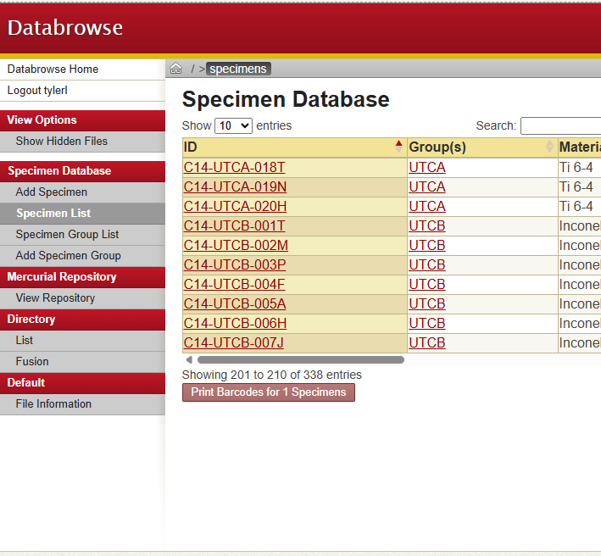
LIMATIX: Databrowse
Browser-Based Tool for Data Visualization
Generates XML Representation of Anything and XSLT to Transform Into a Web Page
Points at Location in File System
Can Generate Images or Other Representations of Binary Data on Demand

Slide 12



NORMS: No Omission Research Management System
Reactive Documentation System
  Monitors Acquisition System in Background
  Injects itself into Measurement Process at Appropriate Times to Provide User an Opportunity to Document Results
Designed to Work with Both Open and Closed Data Acquisition Systems
  External to Measurement Process
Can Perform Post-Processing/Analysis Automatically
Managed Data Backups

Slide 13
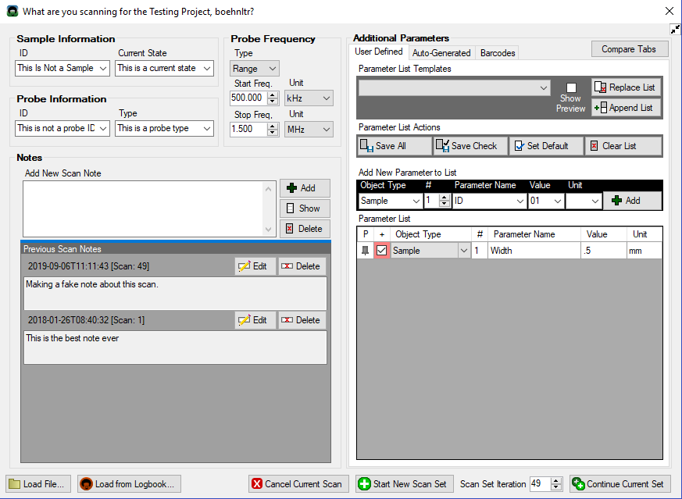
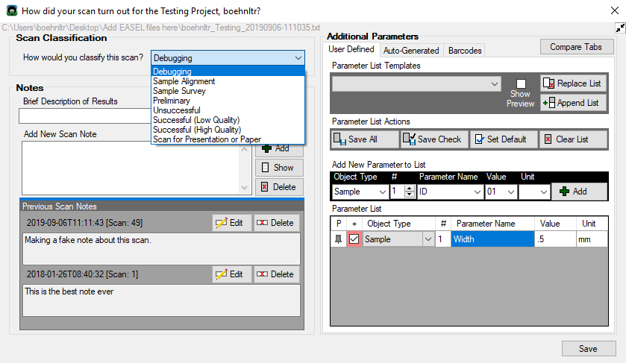
NORMS: EASEL
Experimental And Simulation Electronic Logbook
Prompts User to Provide Documentation
Allows User to Document Parameters
Tracks Modified Files
Extracts Metadata after Measurement
Imports QR Codes to Provide Documentation

Slide 14
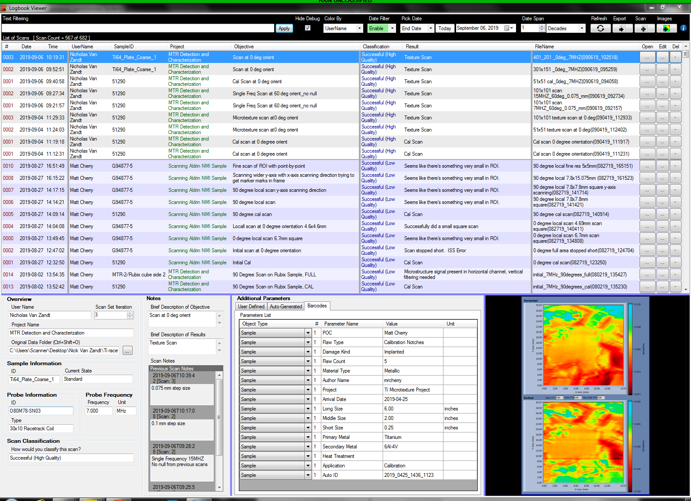
NORMS: Logbook Viewer
Searchable Log of All Measurements
Displays Metadata and Previews of Images included with Measurement
Facilitates and Tracks Data Export

Slide 15
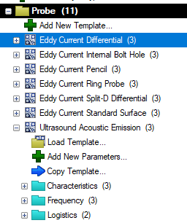
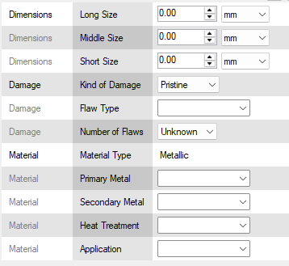
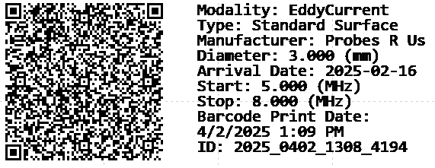
NORMS: BASE
Barcode Assistant Software for EASEL
Originally Intended for Offline Transfer of Static Metadata Information
Develop Templates for Any Kind of Item
(i.e. Specimen, Equipment)
Works with Barcode Scanners Configured as Keyboard (No Drivers)
Currently Supports ZPL-based Label Printers
Probe Barcodes Types
Metallic Specimen Input
Probe Barcode Live Preview

Slide 16
File Formats
Regulations Increasingly Mandating Open and Accessible Data
Currently, in the NDE Field:
  ASTM Standard
  Numerous Vendor Specific Formats
  Random Mix of Ad Hoc Formats
Several Recent International Efforts to Develop New NDE File Formats

Slide 17
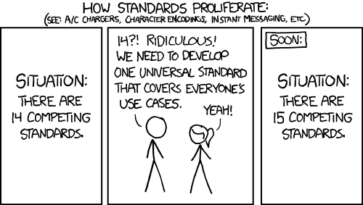
Ongoing File Format Development – Some Observations
The Main Question: How Do you Organize Data/Metadata?
Some Potential Sticking Points:
  Ease of Implementation on Embedded Devices
  Competing Interests
Some Useful Thoughts:
  Start with Examples instead of Specifications
  Consider Data Model Compatibility
  Make Documentation Useful
From http://xkcd.com/927/ (Licensed under CC BY-NC 2.5)

Slide 18
Final Thoughts
Proper Recording of Metadata is Absolutely Vital to Enabling Data Sustainability and Digital Transformation
Accessibility of Raw Data is also Critical Where Possible and Open Format Initiatives are Encouraging albeit Fraught
More Work is Still Needed to Enable Proper Segmentation/Labeling on a Routine Basis
Contact Tyler.Lesthaeghe@udri.udayton.edu if Interested in NORMS
LIMATIX is available from https://www.github.com/limatix

