Slide 1
Threat Integration for Full Spectrum Survivability Assessments
Russell Kupferer
DOT&E Naval Warfare
17 April 2024

Slide 2
Analysis of Full Spectrum Survivability will be required for future DoD systems
The 2022 National Defense Authorization Act (NDAA) Sect. 223 directed DOT&E to identify changes to existing law necessary to:
  “Implement realistic survivability and lethality testing of covered systems, required under Section 4172 of Title 10, United States Code, to include testing against non-kinetic threats”
DOT&E responded to the tasker by conducting a survey of current DoD capabilities to evaluate the “Full Spectrum” of lethality and survivability assessments
  Concluded that analysis of Full Spectrum survivability/lethality would require investment in new testing and M&S development to support integrated assessment of kinetic and non-kinetic attacks/threats
DOT&E provided recommended changes to the existing LFT&E law (Title X Sect. 4172) to implement full spectrum survivability/lethality evaluation
DoD: Department of Defense DOT&E: Director, Operational Test and Evaluation LFT&E: Live Fire Test and Evaulation

Slide 3
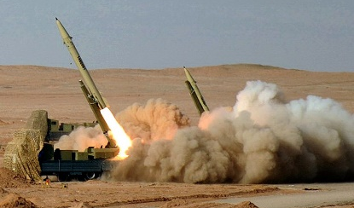
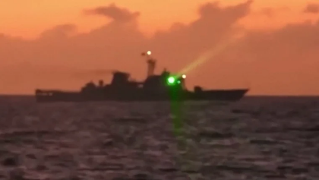

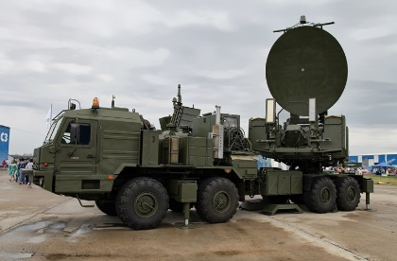
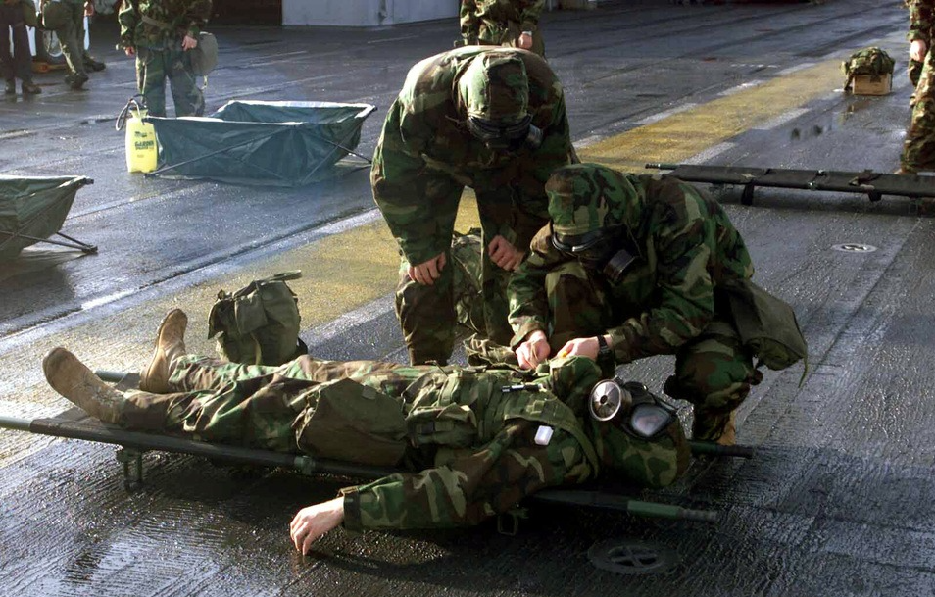
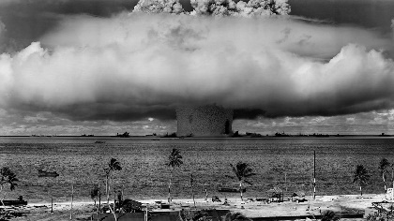
The full spectrum of potential threats to DoD Systems takes us far beyond kinetic threats
The full spectrum of threats include any adversary capability that could cause meaningful damage or degradation of system capability
  Kinetic Threats: Missiles, bombs, mines, torpedoes, projectiles, sharp sticks
  Directed Energy Weapons: Lasers, high power microwaves
  Cyber Threats: Attacks on system availability, integrity, and confidentiality
  Electromagnetic Spectrum Operations: Electronic attack, jamming, spectrum denial
  Chemical, Biological, and Radiological Threats: Chemical weapons, weaponized pathogens, “dirty” bombs
  Nuclear: Blast, electromagnetic pulse, radiation
Full spectrum analysis should also consider the combinative lethality of these threats operating in concert
  e.g. A anti-ship missile attack following a cyber attack designed to disable a combatant’s defensive systems.
DoD: Department of Defense

Slide 4
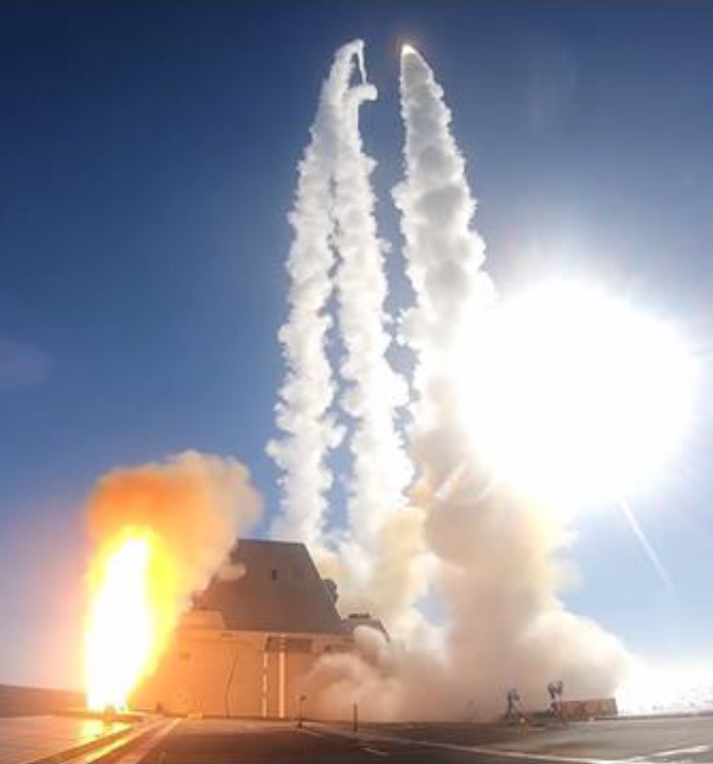
Testing of the full range of threat permutations is not practical (or possible!)
Traditional test design selects one variable at a
time to test
  Simplifies test design and allows evaluation of variable
  sensitivity
  Even when testing one variable at a time, test design for
  survivability assessments will often be limited by budget
  and practicality
In the context of full spectrum survivability
evaluations, real world testing should focus on
building validation datasets
  Identify gaps and uncertainties in supporting survivability M&S and test the edge cases one at a time
  In most cases, testing of synergistic effects is not supported by range infrastructure
  Combinative testing should only be conducted to investigate specific uncertainties associated with synergistic effects
Intent is to build toward an integrated survivability model in which the full spectrum threats can be evaluated
  Use continued testing to validate predictions and demonstrate capability
M&S: Modeling and Simulation

Slide 5
Full spectrum survivability assessments will require drafting of “survivability vignettes” for evaluation
Full Spectrum survivability assessments must consider the context of each attack within a specific kill chain
  A cyber attack that results in a temporary darkship condition on a ship might be a nuisance for the ship under normal steaming conditions
  The same cyber attack during a cruise missile attack could result in ship loss
But both the threat and the operator should get a vote in how a scenario plays out!
  Combinative full-spectrum survivability evaluations should not be scripted without considering realistic threat/operator responses to attack
  e.g. A ship experiencing periodic, unexplained darkship events is unlikely to stay on the firing line
Survivability assessments will no longer be an evaluation of specific threat-system pairings

Slide 6
Example Survivability Vignette
Consider a notional vignette for a warship supporting maritime security operations in a congested strait
An unflagged craft utilizes ESM to locate and track the warship among other commercial traffic
A latent cyberattack is attempted to force frequent resets of the ship’s combat system
A fishing boat equipped with a RF jamming pod moves into range to jam the warship’s radar system
Explosive-laden drones are launched to attack while the jamming is active
The drones utilize shaped charge warheads to attempt to target the ship’s magazines
In this example, each element of the scenario would be tested in isolation and then combined using M&S to determine what vulnerabilities contributed most significantly to the outcome of the attack
Potential survivability improvements would be evaluated through the same M&S
1
4
5
2
3
ESM: Electronic Support Measures M&S: Modeling and Simulation RF: Radio Frequency

Slide 7
Defining survivability vignettes forms the foundation of full spectrum assessments
In a full-spectrum survivability rubric, threat vignettes need to be established and agreed to before assessment
  In some cases, vignettes will evaluate a specific threat in a specific condition (e.g. ship response to a chemical weapon attack while in a foreign port)
  Other cases should consider generic combinative effects (e.g. ASCM raid defense while operating in a comms-denied environment)
  The most complicated threat vignettes would consider the response to specific sequenced attacks (e.g. A cyber attack to disable the ship’s radars, followed by an electronic warfare attack to deny comms, followed by a cruise missile salvo)
Such vignettes would not need to cover every possible attack, but should be designed to be representative of a wide range of possible threat scenarios
  To properly define specific intended uses, DOT&E would formally approve the agreed to threat scenarios prior to VV&A of survivability M&S
In this approach, we move away from P_{d}s and P_{k}s to focus on driving vulnerabilities of the systems
  Quantitative measures will be included in survivability assessments, but the “roll up” numbers will have little objective value
ASCM: Anti-Ship Cruise Missile DOT&E: Director, Operational Test and Evaluation M&S: Modeling and Simulation P_{d}: Probability of Damage P_{k}: Probability of Kill VV&A: Verification, Validation, and Accreditation

Slide 8
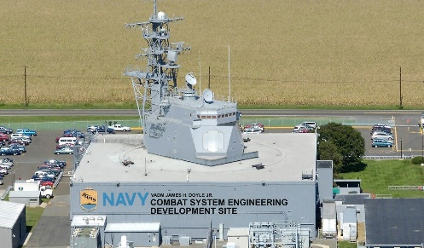
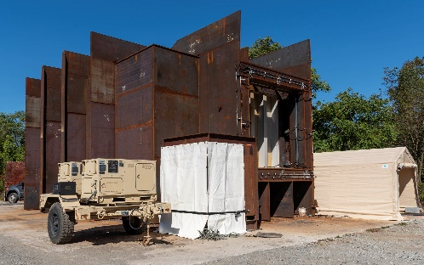
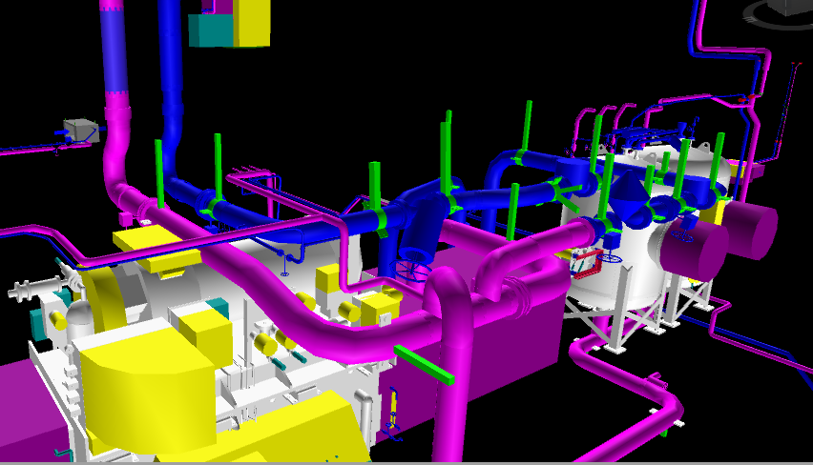
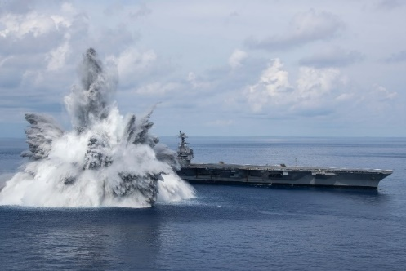
DOT&E will need to work with the services to the build adequacy of full spectrum assessments
DOT&E is not yet ready to go all-in for integrated full spectrum survivability assessments
  Need a process by which survivability vignettes are defined and codified
  M&S is not currently adequate to analyze many of the threats that should be included under the full spectrum umbrella
  Test capabilities and ranges don’t currently support validation of M&S for survivability assessment in many areas of interest
Full spectrum survivability assessments will depend on a number of enabling factors
  Design sites – have the potential to support testing of Cyber threats in a controlled environment
    Leverage the Mission based Risk Assessment for Cyber(MRAP-C) process
  Component/surrogate testing – Destructive testing of smaller test articles under controlled conditions will provide valuable validation data
  System engineering models and digital twins – Have the potential to dramatically reduce the time required to generate survivability models
  Expanded system testing – If it can be done safely and securely, there is no substitute for testing at the system itself
DOT&E: Director, Operational Test and Evaluation M&S: Modeling and Simulation

Slide 9
Conquering the Full Spectrum of threats must be taken one battle at a time
The analysis of the full-spectrum of threats, including synergistic effects between different threats, is key to adequately evaluating the survivability of our systems
  The early definition of representative survivability vignettes will be key to driving M&S and test requirements
  Leverage of enabling factors such as system-based models and surrogate testing is needed to support full spectrum M&S development and validation
  Test design must be shaped by realistic constraints on both models and tests
  Full spectrum survivability assessments will need to move away from simplified probability-based metrics to focus on identifying driving vulnerabilities
    Probabilistic metrics will still be useful for quantifying relative impact and importance of identified vulnerabilities
The first systems to conduct full spectrum survivability assessments should expect a rough ride across terra incognita
  Yee-haw!
M&S: Modeling and Simulation

Slide 10
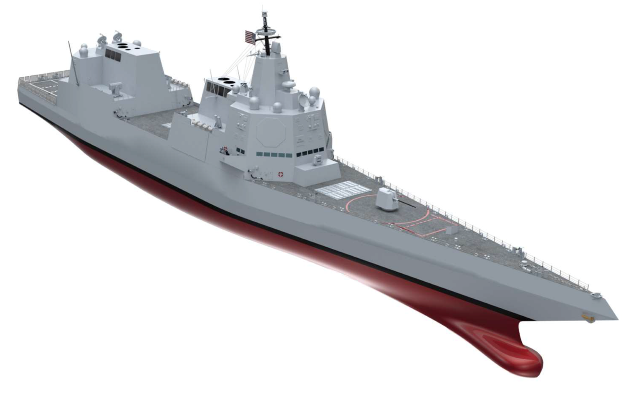
Questions?
DDG(X) concept rendering

