Slide 1
A Framework for OT&E of Rapidly Changing Software Systems: C3I and Business Systems
Logan K. Ausman
Allison Goodman

Slide 2
Software is widespread in DoD acquisitions
82 of 87 systems entries in the DOT&E CY 2023 Annual Report contain the words software, cyber, or both.
Image source: Director, Operational Test and Evaluation, “FY2023 Annual Report” (Washington, DC: DOT&E, January 2024)
Notes:
Cyber indicative of software
In planes, ships, etc.

Slide 3

Focus of this presentation is C3I and Business Systems (i.e., Information Systems)
Image source: Director, Operational Test and Evaluation, “FY2023 Annual Report” (Washington, DC: DOT&E, January 2024)
Notes:
These types of acquisitions are either entirely, or almost entirely software—rather than software embedded in a conventional platform

Slide 4


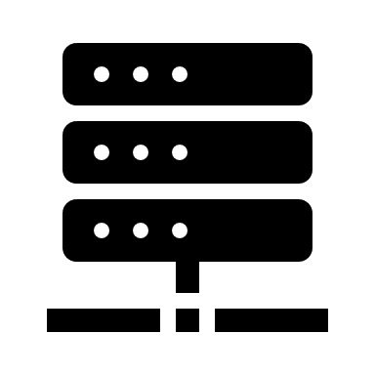
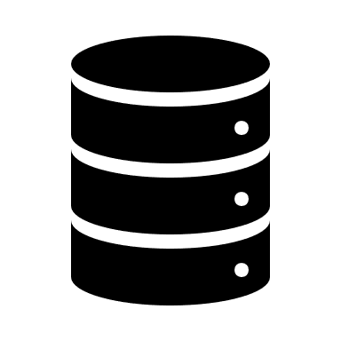





Information Systems include complex interactions between the software, end users, maintainers, help desk, and interfaces to support decision-making
Software and
Hardware Platform/Infrastructure
System Users and Support
Decision-Maker
Figure Copyright 2023, International Test and Evaluation Association, All Rights Reserved.
External Systems
Notes:
(click) Easy to think of information system performance consisting of the software and hardware it runs on.
But it also consists of interactions with:
External systems
System users and support
Decision makers and those who consume the information

Slide 5
Operational evaluations must look at the holistic system
Software and
Hardware Platform / Infrastructure
System Users and Support
Decision-Maker
Figure Copyright 2023, International Test and Evaluation Association, All Rights Reserved.
External Systems
Notes:
OT&E needs to include all of these to the extent possible so that performance of system during test is a good match for that during actual use
This because OT&E informs decision to use
With this in mind, what needs to be done to achieve this goal?

Slide 6
Lifecycles of DoD acquisition programs
Notes:
Must consider what, when, where, and how to test
Align activities to program lifecycle

Slide 7
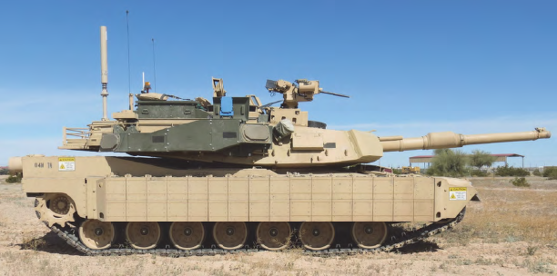


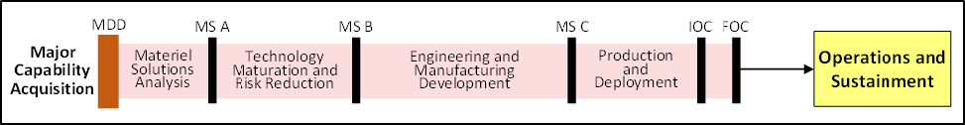
Historically, DoD acquisitions take years, with OT&E occurring during a large event right before deployment*
Image source: Director, Operational Test and Evaluation, “FY2023 Annual Report” (Washington, DC: DOT&E, January 2024)
Testing Complete
IOT&E
Image source: Department of Defense, “Operation of the Adaptive Acquisition Framework” DoDI 5000.02.
(Washington, DC: USD (A&S), 2020),
FOT&E
(maybe)
*Technically full-rate production
Acronyms: FOC – Full Operational Capability; FOT&E – Follow-on Operational Test and Evaluation; IOC – Initial Operational Capability; MDD – Materiel Development Decision; MS A – Milestone A; MS B – Milestone B; MS C – Milestone C; OT&E – Operational Test and Evaluation
Notes:
Traditional (conventional) acquisitions--this is something most doing OT&E are familiar with.
Program phases are in series, with well-defined gates between them.
OT&E involvement ends with program moving into O&S

Slide 8
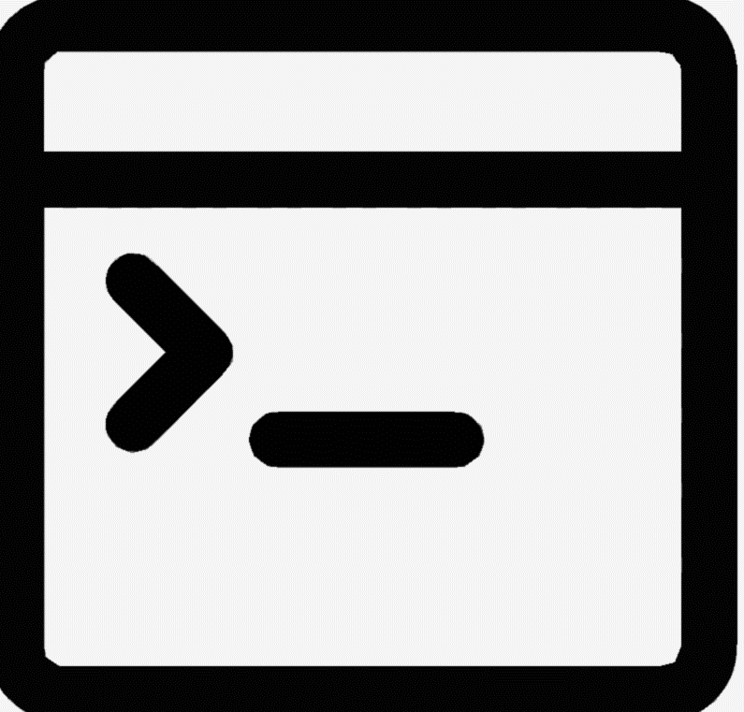

Iterative software development moves code through a series of environments, often termed the “Software Pipeline”
Notional Software Development Pipeline
Development
Integration
Test
Pre-Production
Production
Adapted from: “AWS CodePipeline,” Amazon Web Services, last accessed March 22, 2024, https://aws.amazon.com/codepipeline/
Notes:
Software development does not match the traditional lifecycle
Code moves through a pipeline via steps that are iterative and done in parallel
Requirements may change or initially be unclear
Timelines are shorter

Slide 9
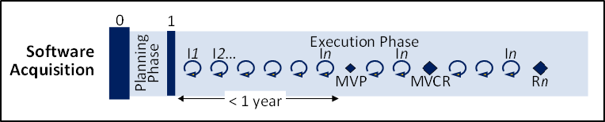
DoD expects software acquisitions to occur in a year or less, and OT&E is expected throughout
Testing
is never complete
OT&E
Image source: Department of Defense, “Operation of the Adaptive Acquisition Framework” DoDI 5000.02.
(Washington, DC: USD (A&S), 2020),
Acronyms: OT&E – Operational Test and Evaluation; MVCR – Minimum Viable Capability Release; MVP – Minimum Viable Product
Notes:
This is how DoD envisions software acquisition looking
OT&E—like the path the software takes—is iterative and conducted throughout
Also, it is never done.
Where to start? Get insights by looking at program maturity over time

Slide 10
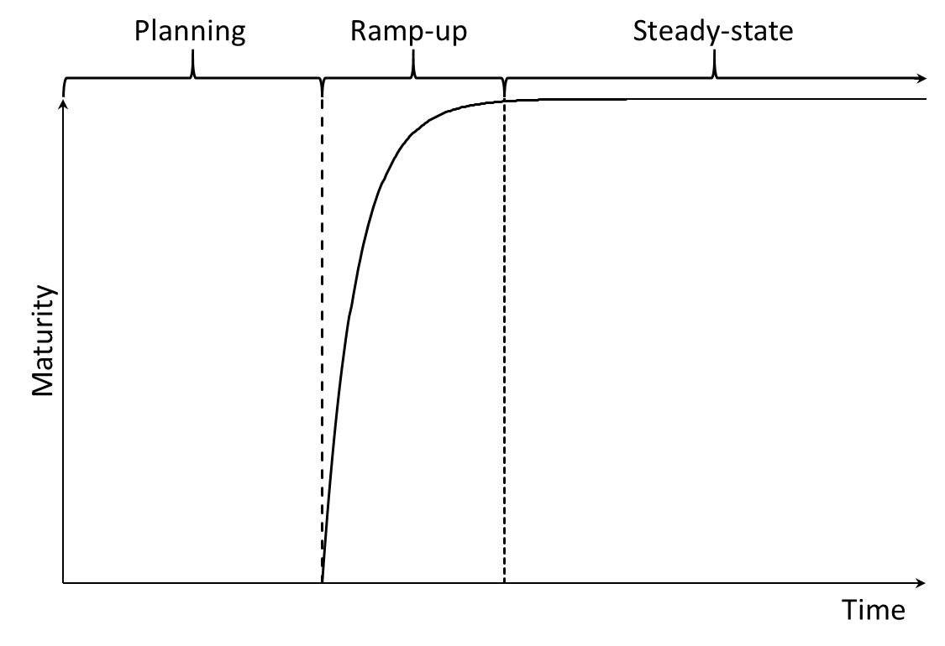
Simplistic view of the life of a software-intensive program/system
Notes:
Software programs are (almost) never ready immediately—they first undergo planning and ramp-up before getting to a stable level of maturity (where continuous integration/continuous deployment takes place)
Recall that just as software performance consists of more than the software—the maturity does, too

Slide 11

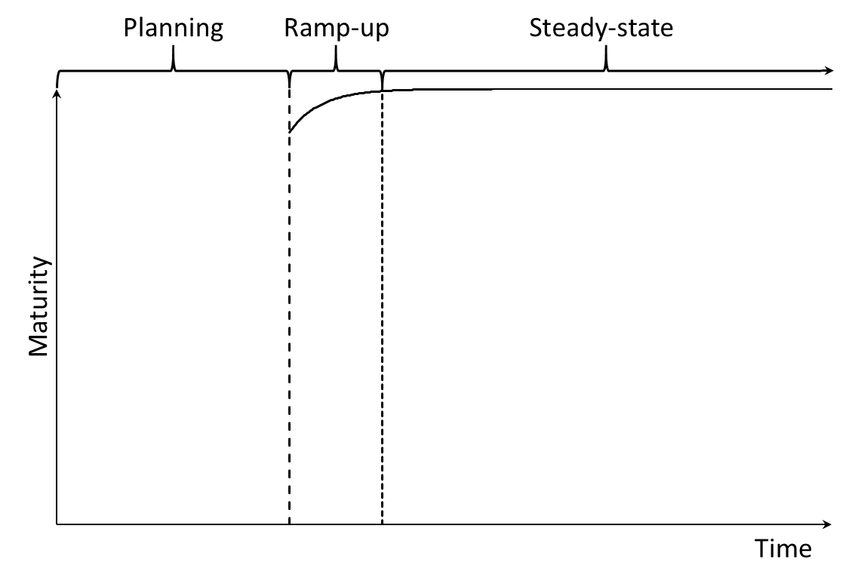
Variations on software-intensive program/system origins
A program that starts as a brand new development or that starts by adopting developed capabilities whose performance data do not exist.
A program that starts by adopting mature capabilities that have performance data.
Notes:
Without additional info, a new program starts with negligible maturity (immature) with brand new development (of software, concepts of employment, concepts of operations, etc.)---for purposes of OT&E this is also the case when a program choses to use already built software, but where data about performance and employment do not exist (never tested, TTPs not documented, etc.)

Slide 12
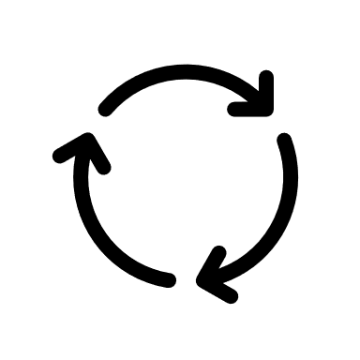
OT&E needs to balance evaluations between the updating of the system and the rate of deployment of the system
Developmental Testing
Operational Testing
System Fielding
Figure Copyright 2023, International Test and Evaluation Association, All Rights Reserved.
Acronym: OT&E – Operational Test and Evaluation
Notes:
As system matures to a point where it is ready for individual users—to ready for collective use by units/organizations, OT&E needs to progress in order to remain relevant.

Slide 13


Maturity of OT&E readiness precedes that of the system
System new or maturity unknown
OT&E Readiness
System maturity known
During planning: Need to have strategy for getting operational T&E in-place before ramp-up.
During ramp-up: Establish workforce and testing infrastructure and tools identified in T&E strategy.
During steady-state: Maintain workforce and maintain and upgrade test infrastructure and tools.
Acronyms: OT&E – Operational Test and Evaluation; T&E – Test and Evaluation
Notes:
The maturity of OT&E readiness (ability to conduct OT&E) (click) needs to precede that of the system
Otherwise OT&E gets out of sync with system timeline—delays fielding or results in untested/unproven systems being used (bad if they have lurking problems)
What to do during the phases?
Why are these important?

Slide 14
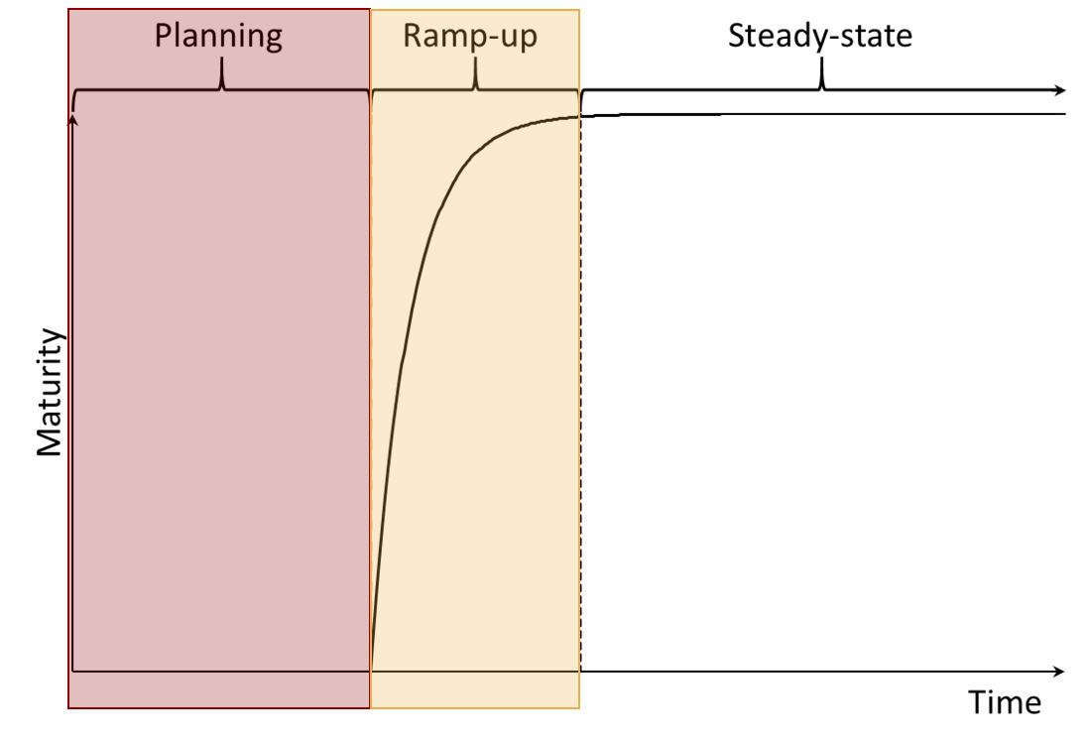
The ability of OT&E to remain responsive to the anticipated software development cadence starts with establishing operationally representative testing environments
Notional Software Development Pipeline
Development
Integration
Test
Pre-Production
Production
Testing Environments
Adapted from: “AWS CodePipeline,” Amazon Web Services, last accessed March 22, 2024, https://aws.amazon.com/codepipeline/
Acronyms: OT&E – Operational Test and Evaluation
Notes:
Need to have workforce, tools, and infrastructure to establish operationally representative testing environments
Why is this important?

Slide 15
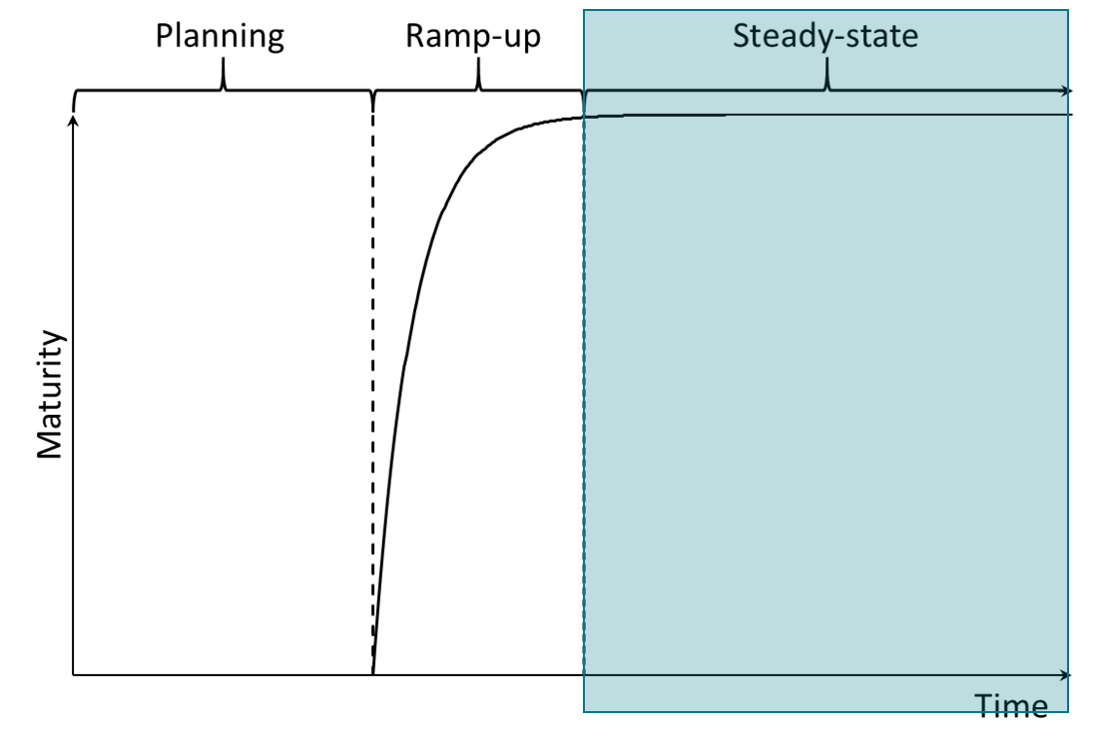
Operationally representative use of the system throughout the development scopes what operational test data can be gathered
Testing Functionality
  Individual mission performance
  Reliability, availability, maintainability
  Interoperability
  Human-systems interaction
Testing with Operationally Representative Use
  Collective mission performance
  Doctrine and TTP maturity
  Training (individual and collective)
  Supportability
Example data collection areas
Acronym: TTP – Tactics, Techniques, and Procedures
Notes:
Having the environments in-place means data can be gathered as soon as capability is ready

Slide 16
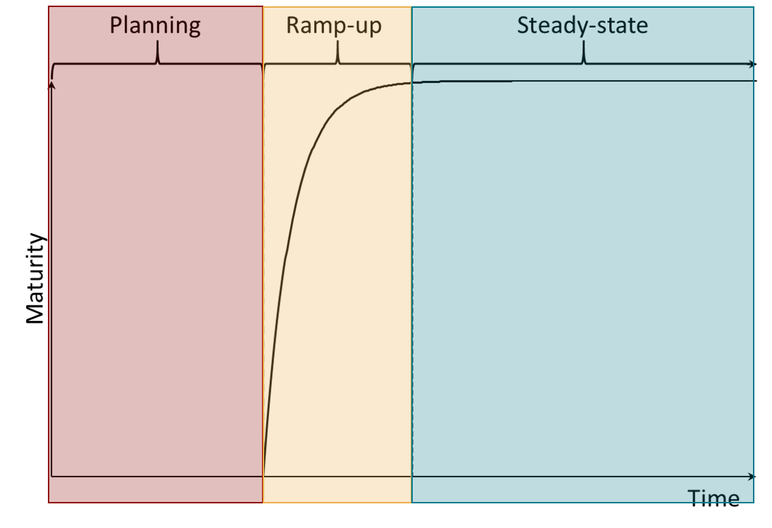

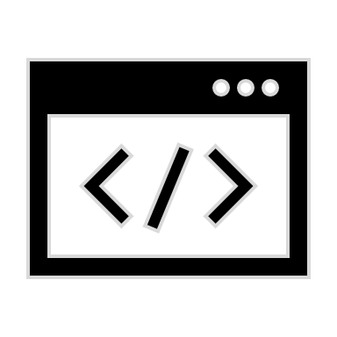

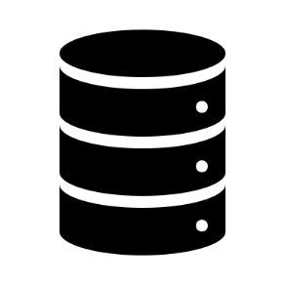

Two challenges that are essential to address during Planning and Ramp-up
Acquire, Develop, and Accredit Test Infrastructure and Tools for OT&E
Embed OT&E Workforce in Program Activities
Notes:
Image source: (U) Heather M. Wojton et Al., Concept for OT&E in the Software Acquisition Pathway, IDA Document D-21523
(Alexandria, VA: Institute for Defense Analyses, May 2021) UNCLASSIFIED
How to accomplish? Test infrastructure and workforce

Slide 17
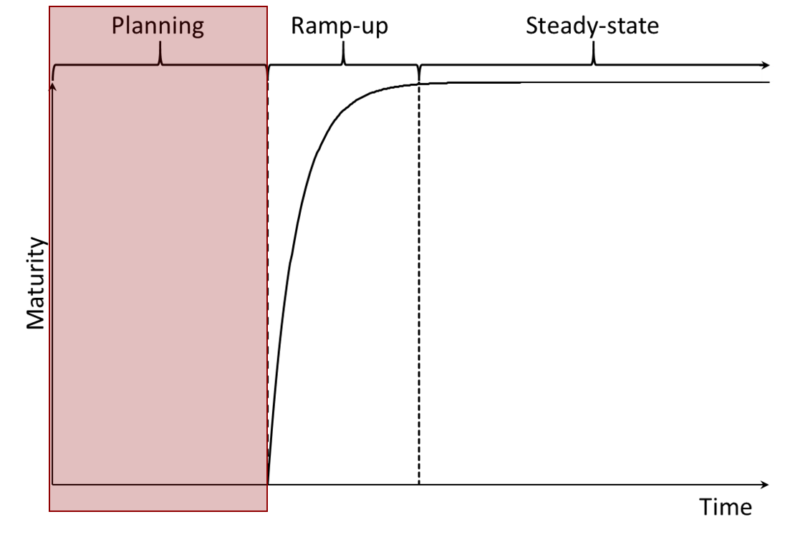
Acquire, develop, and accredit test infrastructure and tools for OT&E
Identify data needs and collection methods
Evaluate available test environments and tools
Develop/acquire test tools and environments
Verify, validate, and accredit test environments
and tools
Acronyms: OT&E – Operational Test and Evaluation; VV&A – Verification, Validation, and Accreditation
Notes:
Image source: (U) Heather M. Wojton et Al., Concept for OT&E in the Software Acquisition Pathway, IDA Document D-21523
(Alexandria, VA: Institute for Defense Analyses, May 2021) UNCLASSIFIED
What does acquiring, developing, and accrediting test infrastructure entail?

Slide 18
Embed operational testers into Planning Phase activities
Participate in requirements discussions to understand needs from user-level through DoD-level.
Participate in meetings to understand technology and the acquisition strategy.
Develop measures and test and evaluation strategy to determine effectiveness, suitability, and survivability.
Identify and accredit testing environments and tools to obtain evaluation data.
Acronym: VV&A – Verification, Validation, and Accreditation
Notes:
Image source: (U) Heather M. Wojton et Al., Concept for OT&E in the Software Acquisition Pathway, IDA Document D-21523
(Alexandria, VA: Institute for Defense Analyses, May 2021) UNCLASSIFIED
What does it mean to embed OT into program activities? First embed into planning activities.

Slide 19
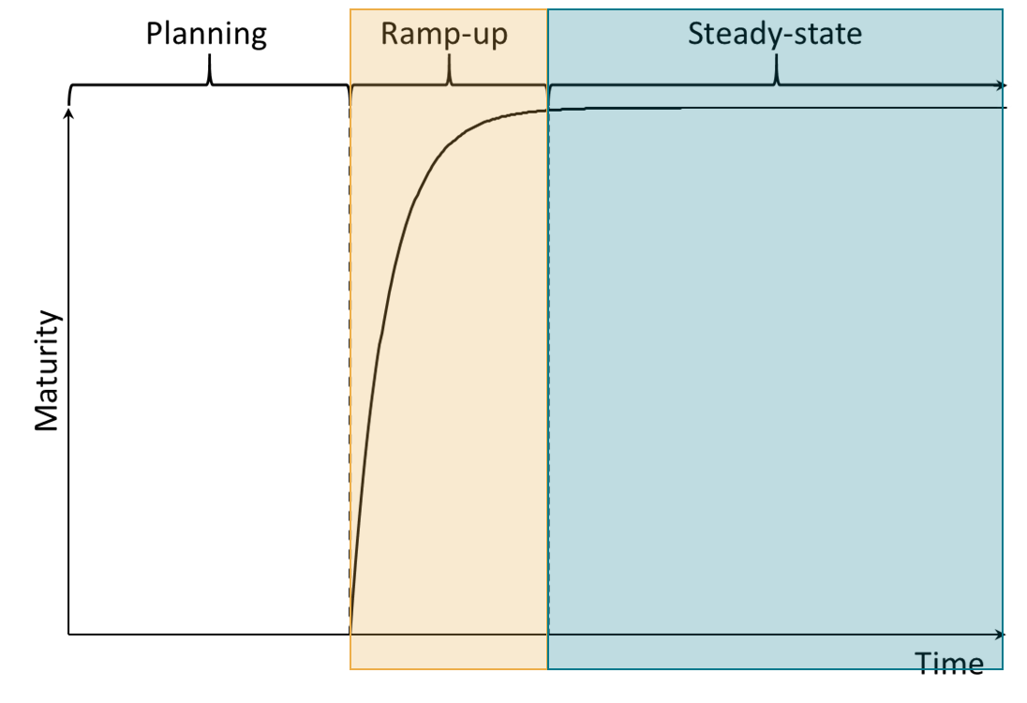
Embedding into the process
Monitor planning of each Release to scope operational testing.
Track Features to understand user needs and requirements.
User Stories highlight opportunities to collect operational data.
Release
Feature
Feature
User Story
User Story
User Story
User Story
Notes:
Image source: (U) Heather M. Wojton et Al., Concept for OT&E in the Software Acquisition Pathway, IDA Document D-21523
(Alexandria, VA: Institute for Defense Analyses, May 2021) UNCLASSIFIED
Then during ramp-up and steady-state, embed into process. The process itself consists of the components plan, develop, test, and deploy
That means for planning components:
Monitoring release planning to scope OT&E
Do this by tracking features to understand user needs and requirements
Performance of which connect to underlying data via user stories

Slide 20
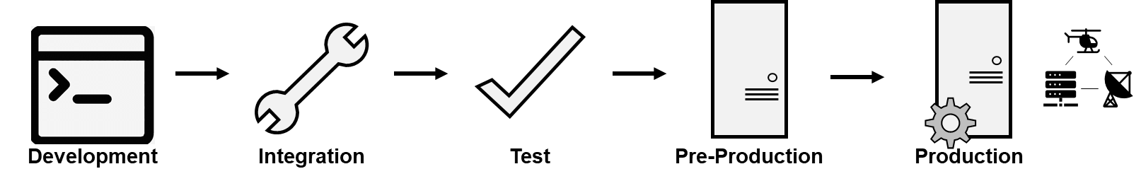
Embedding into the process
Monitor test results from the software development
Monitor automated testing.
Monitor manual testing.
Monitor deployment of new software to production.
Adapted from: “AWS CodePipeline,” Amazon Web Services, last accessed March 22, 2024, https://aws.amazon.com/codepipeline/
Notes:
For develop and testing components

Slide 21
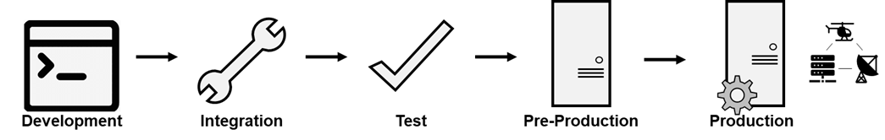
Embedding into the process
Observe whether and how the Software Pipeline affects releases
Cybersecurity Checks and Testing
Adapted from: “AWS CodePipeline,” Amazon Web Services, last accessed March 22, 2024, https://aws.amazon.com/codepipeline/
Development pipelines and pre-production environments should be established with cybersecurity checks throughout.
Notes:
And for deployment
Learn from deployment to check OT&E readiness (are there things OT&E needs to consider in future tests)

Slide 22
OT&E strategy differs during Ramp-up and Steady-state
Ramp-up
  Begin gathering data when the first product is ready for exposure to operations.
  Conduct OT&E to inform the decision to deploy the first product and establish that the maturity baseline is operationally useful.
Steady-state
  Conduct risk-informed OT&E for remaining development.
  Determine whether individual release or cumulative releases drive risk.
Programs might move directly to Steady-state by adopting fielded capability
This depends on the extent program requirements are covered by the adopted capability as configured.
Requires extent OT&E data on currently fielded capability.
Programs could move back to Ramp-up
Change in requirements or capability needs will dictate this.
OT&E
Risk-Informed OT&E
Early and Continuous Involvement – Build a Shared Body of Evidence
Acronym: OT&E – Operational Test and Evaluation
Notes:
What does this look like when put together? How does ramp-up differ from steady-state?

Slide 23
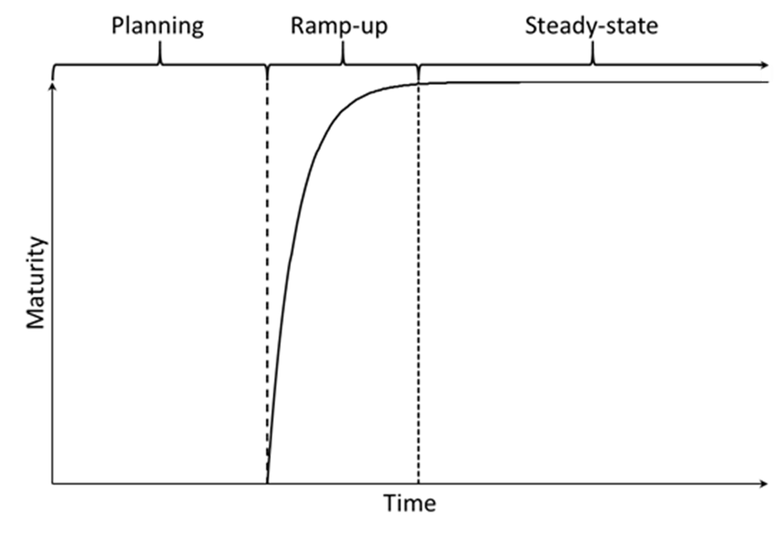
Scope tests to capabilities delivered
Develop testing cadence based on how risk is incurred
Risk primarily from…
OA
Individual releases
Determine
Scope
OT&E
OT&E
Cumulative releases
Determine Scope
Test Infrastructure Development
Determine Scope
Program Increment Planning
DT&E
OT&E
Analysis and Reporting
Acronyms: DT&E – Developmental Test and Evaluation; OT&E – Operational Test and Evaluation
Notes:
Image source: (U) Heather M. Wojton et Al., Concept for OT&E in the Software Acquisition Pathway, IDA Document D-21523
(Alexandria, VA: Institute for Defense Analyses, May 2021) UNCLASSIFIED
What does this look like in steady-state? A couple of ideas.

Slide 24
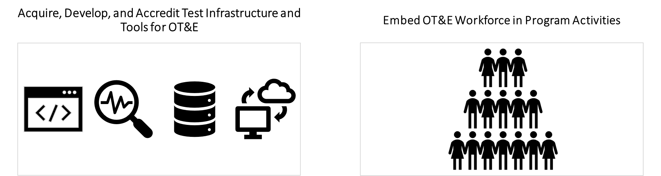
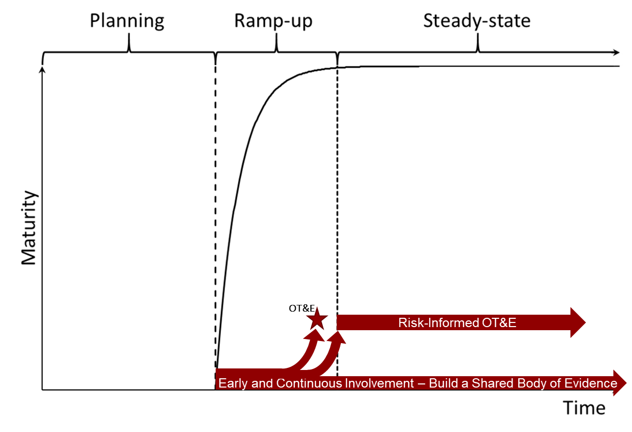
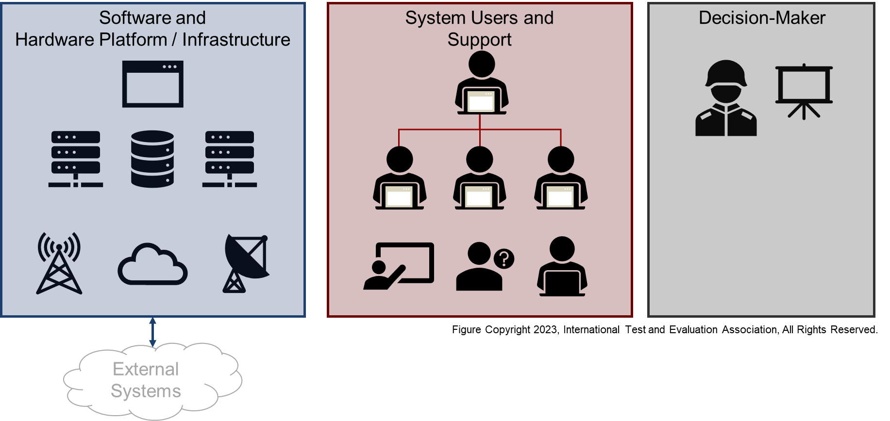
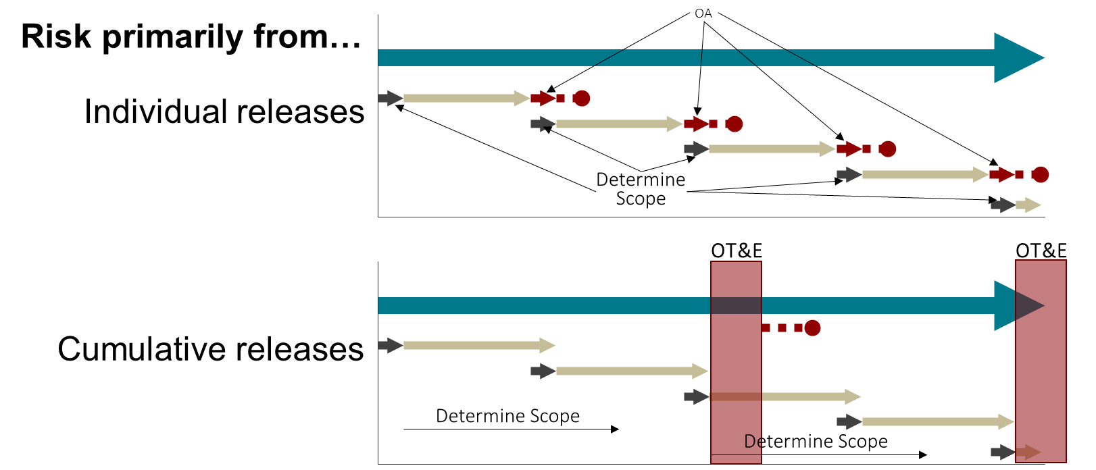
OT&E should evaluate both the software and its integration into the operational environment, providing an end-to-end system evaluation
End-to-End System Evaluation
Acronym: OT&E – Operational Test and Evaluation
Notes:
Left image source: (U) Heather M. Wojton et Al., Concept for OT&E in the Software Acquisition Pathway, IDA Document D-21523
(Alexandria, VA: Institute for Defense Analyses, May 2021) UNCLASSIFIED

