Slide 1
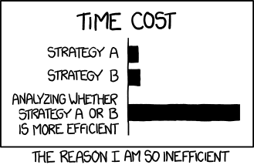
Test, Evaluation, and Assurance of Agentic AI for Operational Use
Source: https://xkcd.com/1445/
Dr. Jane Pinelis
Chief Scientist for Special Operations
Program Manager, Joint Enabling Initiatives
Email: Jane.Pinelis@jhuapl.edu
Dr. Julie Obenauer-Motley
Sr. Technical Advisor – R-TEC
Sr. AI Analyst – JHU/APL
Email: Julie.Obenauer@jhuapl.edu

Slide 2
Purpose
Agentic AI must be evaluated in the context of the mission and workflow
T&E should focus on claims, operational conditions, and decision consequences
Design and evidence should support fielding decisions
Notes:
Generative AI (GenAI) tools are rapidly moving from experimentation to everyday use across operational and enterprise environments. Yet adoption does not happen simply because a tool is powerful. Empowering people to use GenAI effectively requires justified confidence that the system will perform reliably under real-world conditions. This talk explores practical lessons learned from deploying GenAI across DoW applications, with a focus on building and communicating assurance for non-technical stakeholders.
At the heart of successful GenAI adoption is a clear understanding of operational realities. In real-world environments, users face time pressure, incomplete information, competing priorities, and evolving mission needs. AI systems be resilient to these realities and perform as intended. We begin by examining how we identify the conditions that are most likely to impact operational outcomes: What tasks are users trying to accomplish? What types of errors would have meaningful consequences? How does the GenAI empower and enable the user?
The second focus of the talk is translating operational realities into meaningful test and evaluation approaches. GenAI generates open-ended and varied outputs and may behave differently across contexts. We give examples of evaluations to test performance from real-world GenAI implementation. This included assessing where GenAI may provide benefit in a workflow, designing experiments and identify metrics to assess those benefits, and evaluating performance as a function of the mission needs. Importantly, we also discuss how to evaluate and structure assurance for user interactions with the GenAI workflows. Our experience highlights the importance of iterative testing, structured experimentation, and scenario-based evaluation that reflects operational pressures.
Finally, we address how to communicate assurance in ways that enable informed decision making. Technical reports and performance statistics alone rarely build user confidence. Instead, assurance evidence must be translated into clear, decision-relevant insights. We share approaches for presenting findings in accessible formats that help leaders and users understand where the system performs well, where caution is warranted, and how to apply appropriate safeguards.
This talk offers practical insights and examples for those seeking to leverage GenAI across their workflows. Attendees will leave with a clearer understanding of how to align AI assurance with real-world needs, design meaningful evaluation strategies, and communicate evidence in ways that empower decision makers.

Slide 3
Agenda
Why AI assurance?
What decision is this system supporting?
How do I identify operational realities?
How do I translate my findings into meaningful T&E?
What evidence is enough for fielding or limited use?
How do I communicate results to decision-makers?

Slide 4
Assurance Case
How we make AI systems that do things we want them to do and don’t do things we don’t want them to do
Structured approach to:
  Identifying key assurance stakeholders and claims for an AI system
    Who needs to be assured of what?
  Designing a test and evaluation (T&E) schema for those claims
    What evidence do we need to demonstrate those claims?
  Documenting and presenting evidence for assurance claims
    How do we show evidence for the claims in ways that address stakeholder needs?
Claim
Subclaim
Evidence
Documentation

Slide 5

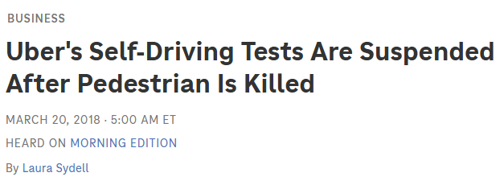

Stakeholders
The National Transportation Safety Board is an independent federal agency charged by Congress with investigating every civil aviation accident in the United States and significant events in the other modes of transportation—railroad, transit, highway, marine, pipeline, and commercial space. We determine the probable causes of the accidents and events we investigate and issue safety recommendations aimed at preventing future occurrences.
In addition, we conduct transportation safety research studies and offer information and other assistance to family members and survivors for each accident or event we investigate.
We also serve as the appellate authority​ for enforcement actions involving aviation and mariner certificates issued by the Federal Aviation Administration (FAA) and US Coast Guard, and we adjudicate appeals of civil penalty actions taken by the FAA.​​​​​
Who is the audience for the assurance claim?
  What are their responsibilities and authorities?
  What is their role in the development, deployment, or use of the system?
What information do they need for assurance?
  Are there existing laws, regulations, policies, and/or standards the assurance case needs to meet?
  Is there a specified format?
Source: https://www.ntsb.gov/Pages/home.aspx
Notes:
Self driving tests suspended by NTSB based on their mandate

Slide 6
Assurance =/= Trust
Trust is a complex concept that varies based on unpredictable factors, such as:
  User feelings at any given time
  Environment/Context
  Technology
There is significant debate about whether a human can actually trust a technology
Assurance support justified and calibrated confidence in system performance
  Justified: can point to specific evidence and or reasonable basis
  Calibrated: is appropriate to context, system, capabilities, operational environment
  Confidence: the belief that the system will perform as intended in relevant contexts

Slide 7
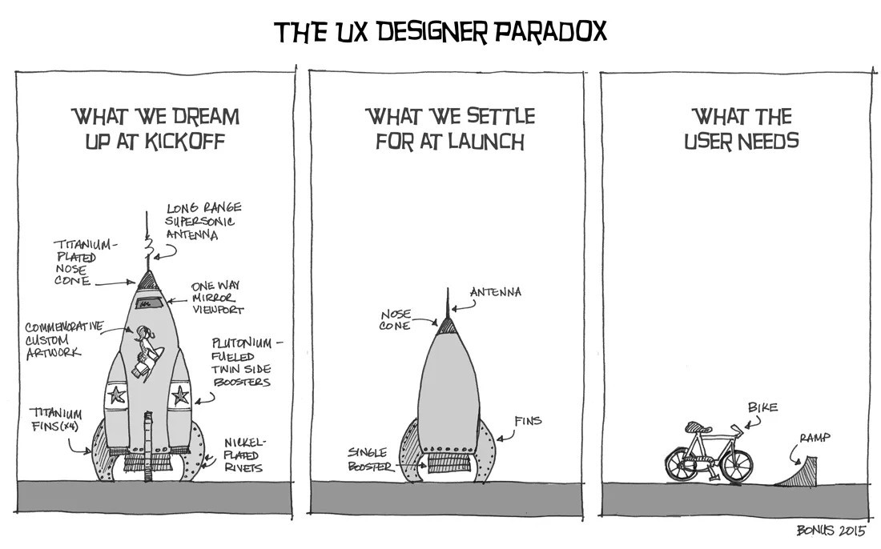

What mission outcome is at risk?
Operationally grounded AI assurance starts with understanding the mission needs
What needs to happen?
What cannot happen?
What would generative AI do here?
Source: https://medium.com/@Ana.Manrique/the-ux-paradox-6f2e4b5979df
Notes:
Critical task
Human role
Ai role
Failure modes
Unacceptable outcomes
Measurable benefits
System stressors
UX Designer paradox – key factor in operational grounding is understanding what is operationally relevant. Without context, it’s impossible to do meaningful T&E -> talk about willingness to accept less performant systems depending on mission needs

Slide 8





Operationally Grounded Workflow Analysis
Initiate Task
Step 1
Step 2
Step 3
Outcome: Why do users do this workflow?
  Intended deliverable and purpose
  Decisions or effects it supports
Input: What triggers the workflow?
  Requests for information, specific time, operational event
Process: What are the steps in the workflow?
  Information inputs and outputs
  Person performing the step
  Handoffs, data needs, other inputs, etc.
  Friction and pain points
Stakeholders: Who cares?

Slide 9
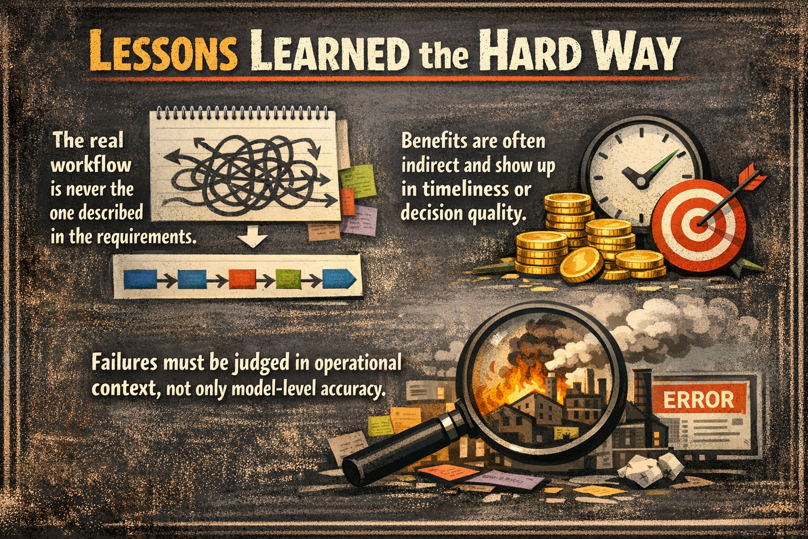
What does good look like?
If the GenAI application was wildly successful, what would be different about the workflow with AI?
  Walk through the workflow step-by-step as imagined
What defines success/goodness for the workflow? How would integrating AI change/enable that?
  If possible, align to both individual steps and to the overall workflow
Notes:
Get at real workflows without judgement/fear of reprisal; many “genAI” challenges are actually data challenges i.e. classification; how do you measure “good” if the outcome is subtle, i.e. influence campaigns; failures matter in context of workflow – i.e. a successful prompt injection attack may only matter if the user can edit those files in the first place

Slide 10
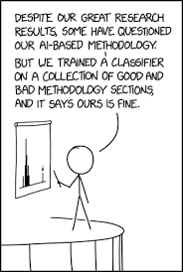
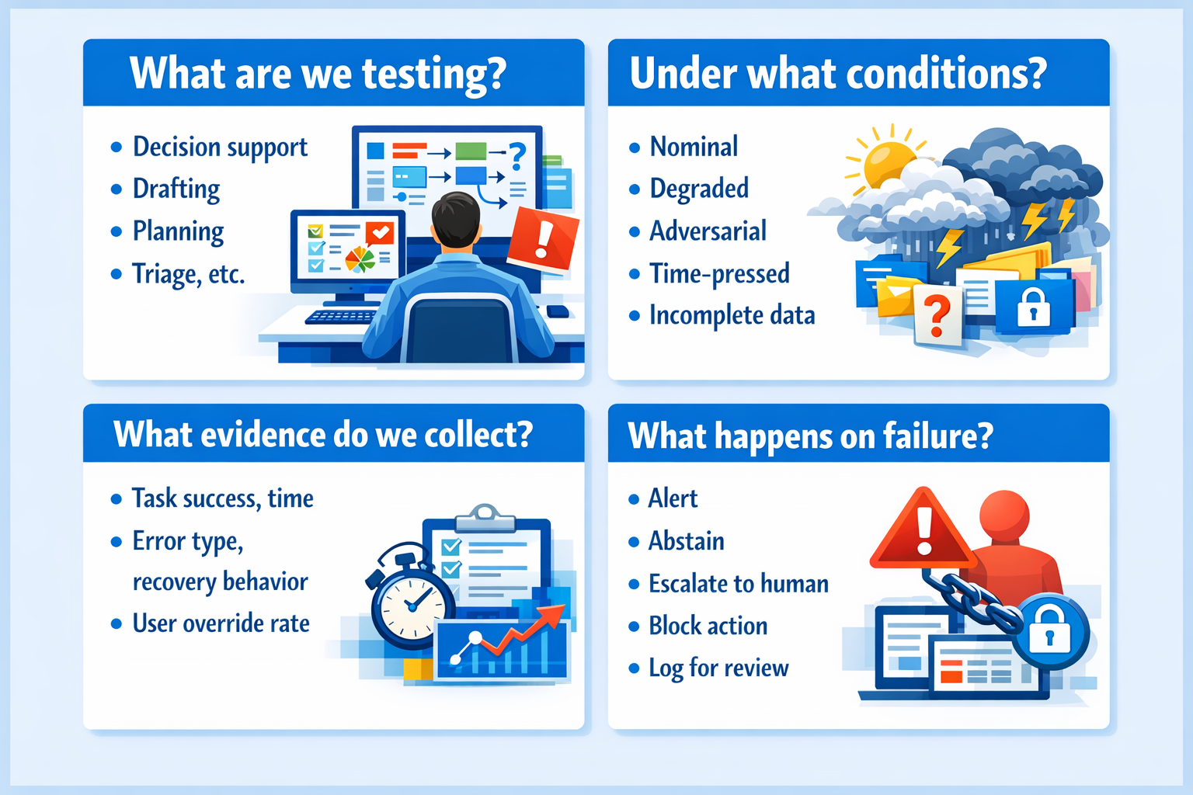
How do I test it?
Source: https://xkcd.com/2451/
Notes:
What decision or outcome is this supporting?
What contributes to success at each step?
Simulation-based
Virtual environments
Stress-testing
Resilience
Robustness
Graceful degradation
Real-world
Limited early introduction to observe behaviors / interactions
I.e. user testing and pilot programs
Operational: gradual scaling, monitoring, assessing adaptability
Behavioral
Value alignment
Bias identification: systematic errors

Slide 11
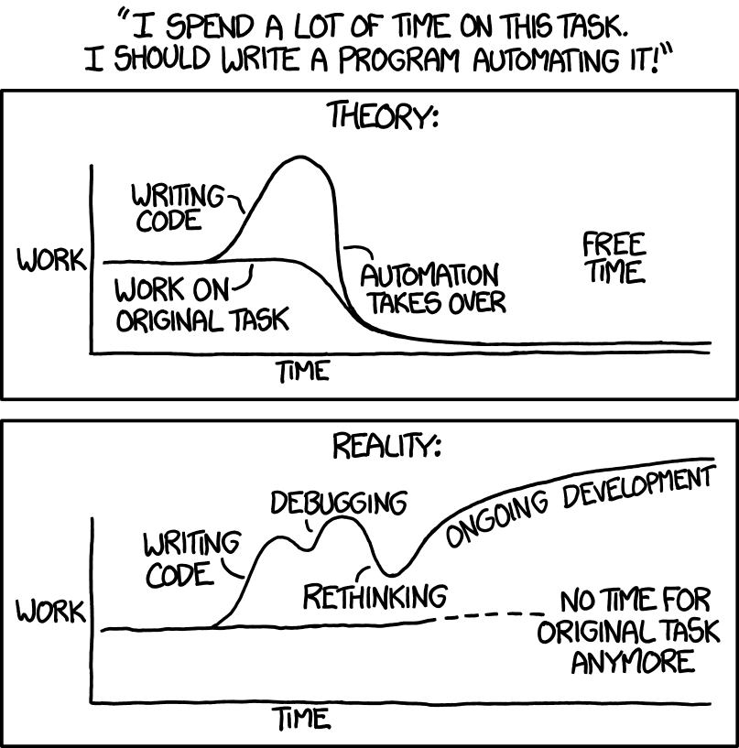
What metrics can I use?
Task Performance
  Accuracy, effectiveness
Process and behavior
  Efficiency, timeliness, correctness
Robustness
  Stability across perturbations
  Consistency across scenarios
Safety
  Frequency and severity of issues
  Unintended behaviors
  High-risk catastrophic error, fail safe / abort engagement testing
Explainability
  Transparency, traceability
  Comprehensibility / user engagement
Oracle / adjudication method
  Who decides whether an output is acceptable?
Thresholds
  What is good enough for intended use?
Source: https://xkcd.com/1319/

Slide 12
Complementary Testing Modes
Structured Experimentation
Controlled variables
Iterative testing
Rapid defect discovery
Human factors feedback
Scenario-based evaluation
Mission realism
Repeatability
Threshold estimation
Prompt / tool / workflow improvement
Edge cases
Decision relevance

Slide 13


Structured Experimentation
Exercises are great for observing potential workflows
But they aren’t the real world
And they rarely allow for enough experimental control to evaluate workflows
Notes:
Structured experimentation is crucial for assessing whether the tool meet mission objectives in operational environments. We often test at exercises because they are already a place for experimentation and may look like more like the operating environment than a normal day. However, exercises rely on simulated or toy data sets and scenarios, are already heavily constrained by the purpose of the exercise, and have a lot of other folks competing for the same experimental control from the same people. Go to the exercise if you can, but understand it doesn’t replaced setting up structured experimentation with users on key workflows, especially for things like A/B testing.

Slide 14

Iterative Testing
“We don’t even know how to turn it on.”
T&E has to be a collaborative process between stakeholders
“T&E happens too late to fix the problems.”
“T&E is a blocker to fielding.”
Notes:
Without T&E integration in the dev teams, we see systems that don’t get used because the users don’t even know how to turn them on, bolt-on solutions or unremediated risks, and an overall view that T&E is a lengthy process that only prevents fielding. Our current approach with rapid iteration has allowed our T&E teams to surface issues as soon as they can be detected and provide actionable feedback for improvement. In recent cases, we’ve been able to get important fixes made to mission-critical systems in real time without impacting operational use. We do this by ensuring our testers understand the system and can test as changes are pushed and new features are added. We are even able to help users effectively leverage features they may not have identified otherwise.

Slide 15
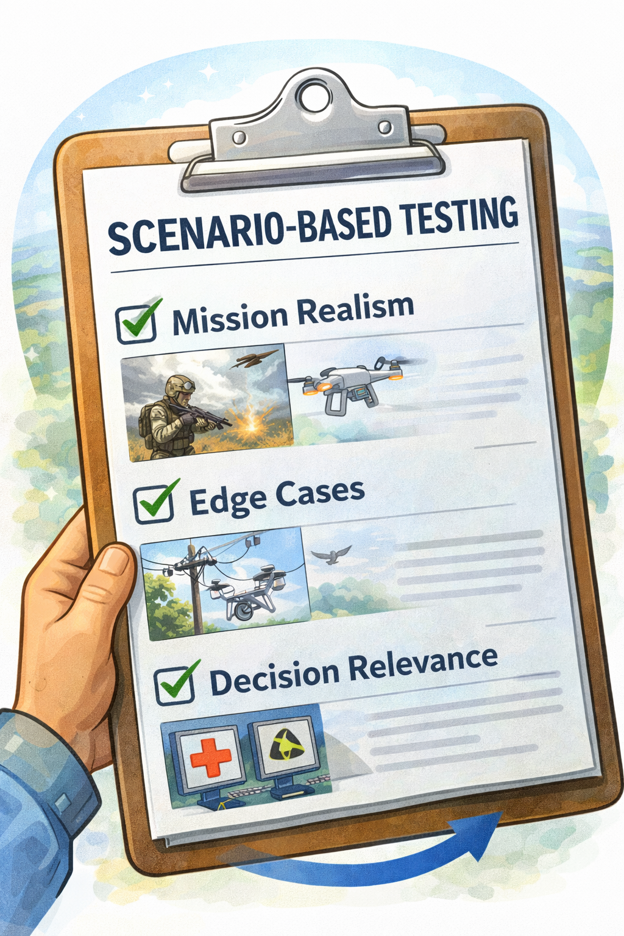
Scenario-Based Testing
Testing without concrete scenarios is often too abstract to be successful
Good scenarios for testing:
  Are realistic for the mission and based on stakeholder input
  Include edge cases and potential failure modes
  Focus on metrics and features that are important and relevant to the mission outcomes
Notes:
Abstract – talk about seeing stakeholder tests fail because the scenarios were too abstract to get everyone on the same page and measure effectively. Have found that we have to provide enough detail on the scenario itself that everyone can share a mental model and then design test and metrics appropriately. Or, if working the other way, ensure that there is a clear linkage to the test scenario and the things that need to be measured. Use project on abstract, scenario-based eval of AWS as a state-space explosion for testing. Mention project did not have enough realism because the operator experience and input was limited. Due to lack of scoping, project could not identify edge cases because they couldn’t agree on what a good scenario or outcome was in the first place, and also of this built to a lack of understanding on what really was relevant for decision making. Led to a meeting in which devs showed operators a demo followed by a frustrated operator responding “don’t show me any of your nerd math.”

Slide 16

Establishing Metrics
DOD use case: Deter war and ensure national security by preventing adversary from amassing force.
What does good look like?
The target will be unable to launch munitions.
How will I know I have succeeded?
What do I need to avoid?
Avoid striking civilian infrastructure in the vicinity.
How will I detect undesired outcomes?
Observables and Measurables
System will detect target.
System will achieve sufficient positive ID and confidence to strike.
Weapon will strike target.
After strike, satellite imagery will show damage to the target and intact civilian infrastructure.
What can I observe in the system, outputs, and outcomes?
What outputs and/or artifacts are created?
When and how?
Metrics
Confidence score for the detection and positive ID.
Visual confirmation the weapon fired.
Satellite imagery showing outcome.
What information do I need to evaluate my observables and measurables?
Notes:
Takeaway here is that metrics have to be established and evaluated as part of detailed scenarios rather than in the abstract. I.e. which civilian infrastructure you do or do not strike, and how you develop metrics to evaluate that, may be the different between a legitimate strike and a war crime. Using generalized testing scenarios usually won’t tell you whether the system can be assured for the level of nuance you need in your operational environment. This will also vary by use case. The metrics I build out for an automated email response tool will look wildly different, and may be less specific, than those I need for a high-consequence use case.

Slide 17
Challenges
Challenge
Implication for T&E
Complexity / state-space explosion
→ Use risk-based coverage models, interaction taxonomies, and combinatorial sampling rather than only scripted test cases.
Difficult to predict all possible paths; interactions explode in number and quality.
Human-machine teaming
→ Include human-in-the-loop exercises and measure operator trust, workload, intervention timing, and recoverability.
Unpredictable human-agent interactions, handoffs, and coordination failures.
Emergent behavior / Black Swan events
→ Run long-horizon scenario tests, sandbox pilots, and tripwires for anomaly detection, stop conditions, and escalation.
Novel behaviors may appear only through composition, scale, or long-horizon execution.
Unpredictability / non-determinism
→ Run repeated trials, vary seeds and context, and characterize distributions, not just single-run success rates.
The same setup can yield different outputs or trajectories across runs.
Multi-step decision loops
→ Score process as well as outcome: log trajectories, inspect intermediate actions, and test policy and guardrail compliance.
A goal may be achieved, but by a pathway that is unsafe, brittle, or unintended.
Dynamic environments
→ Vary scenario conditions and context windows; test response to drift, interruptions, late updates, and missing information.
Rapidly changing context can change system consistency and degrade plans in flight.
Open, complex environments
→ Continuously refresh the test corpus with discovered failures and use scenario families instead of a fixed checklist.
Countless edge cases exist beyond any finite scripted dataset.
Adversarial conditions / lack of ground truth
→ Red-team prompts, tools, and data sources; use expert adjudication, rubrics, and proxy measures when ground truth is unclear.
Systems face malicious inputs, deceptive users, and tasks with ambiguous evaluation criteria.
Notes:
Complexity
Difficulty in predicting all possible paths
State-space explosion in number and quality of interactions
Unpredictable interactions / human-machine teaming challenges
Emergent behavior
Black Swan events
Unpredictability and non-determinism
Multi-step decision loops
What if the goal is achieved by the way is unintended?
Dynamic environments
Rapidly changing context that changes system consistency
Open, complex environments
Countless edge cases
Adversarial conditions
Lack of ground truth / evaluation criteria

Slide 18
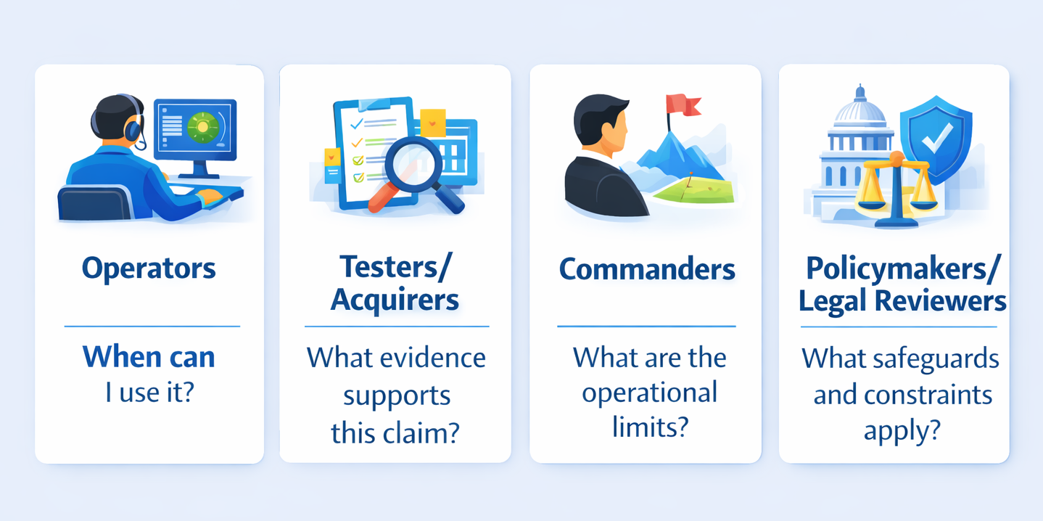
Same evidence, different consumers

Slide 19
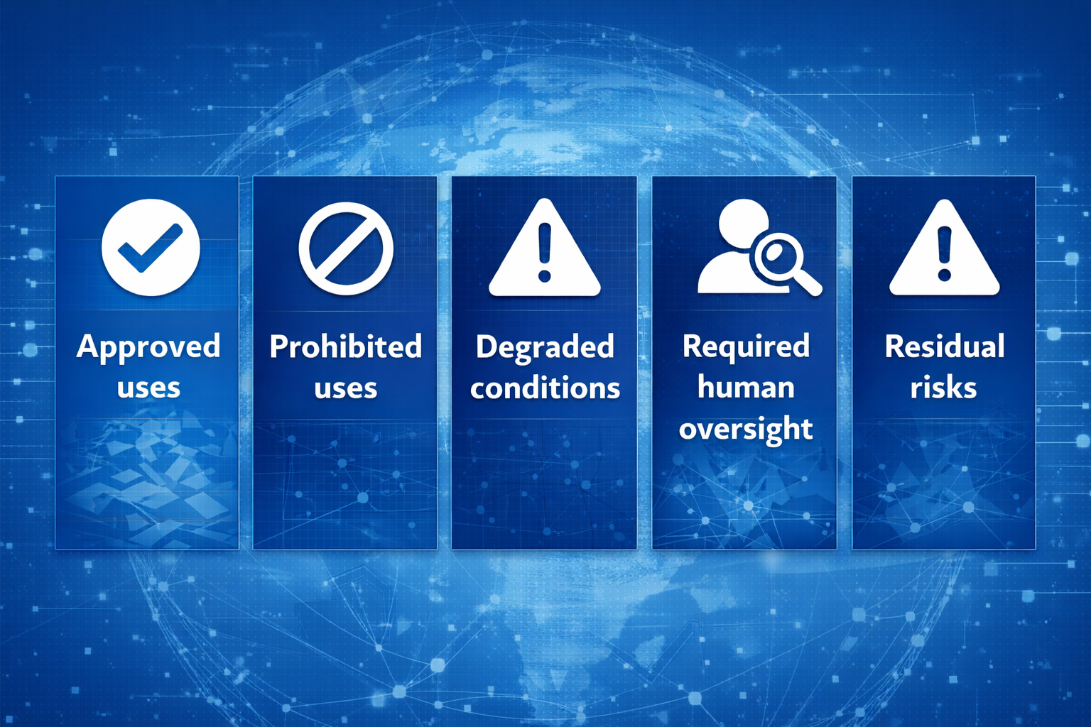
Translate results into decision language

Slide 20
Questions?

