Slide 1

Transforming UAV Imagery into Queryable 3D Scene Representations
CDT Jake Curran
Advisor:
COL Mike Powell

Slide 2
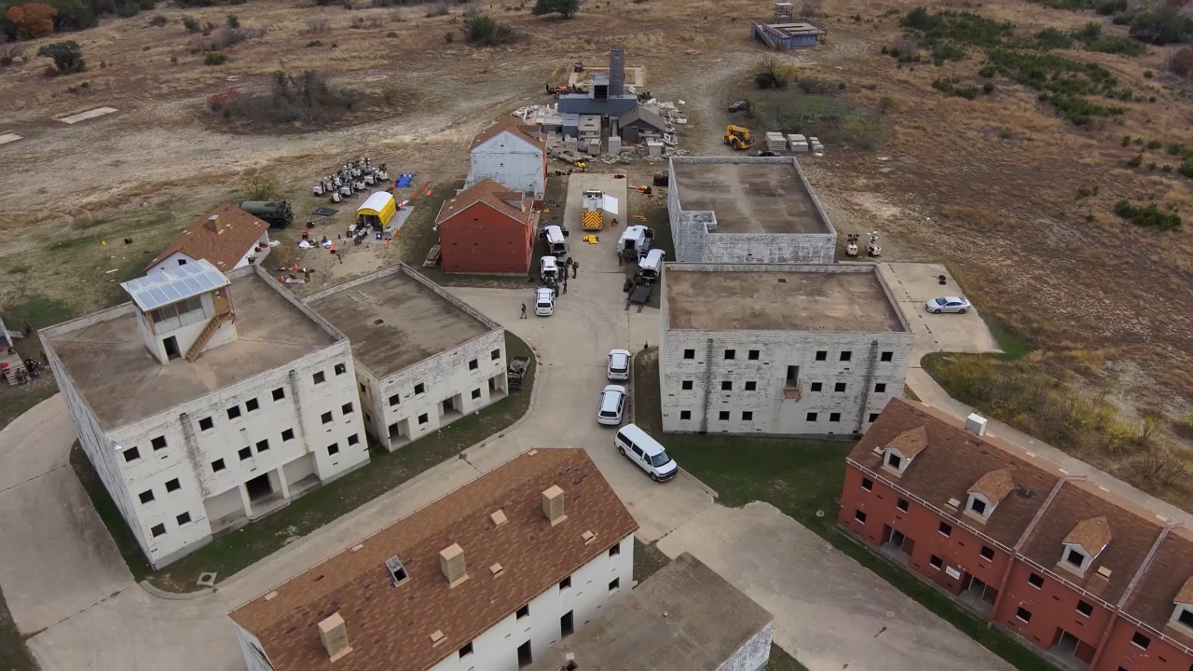
ChatGPT Test

Slide 3
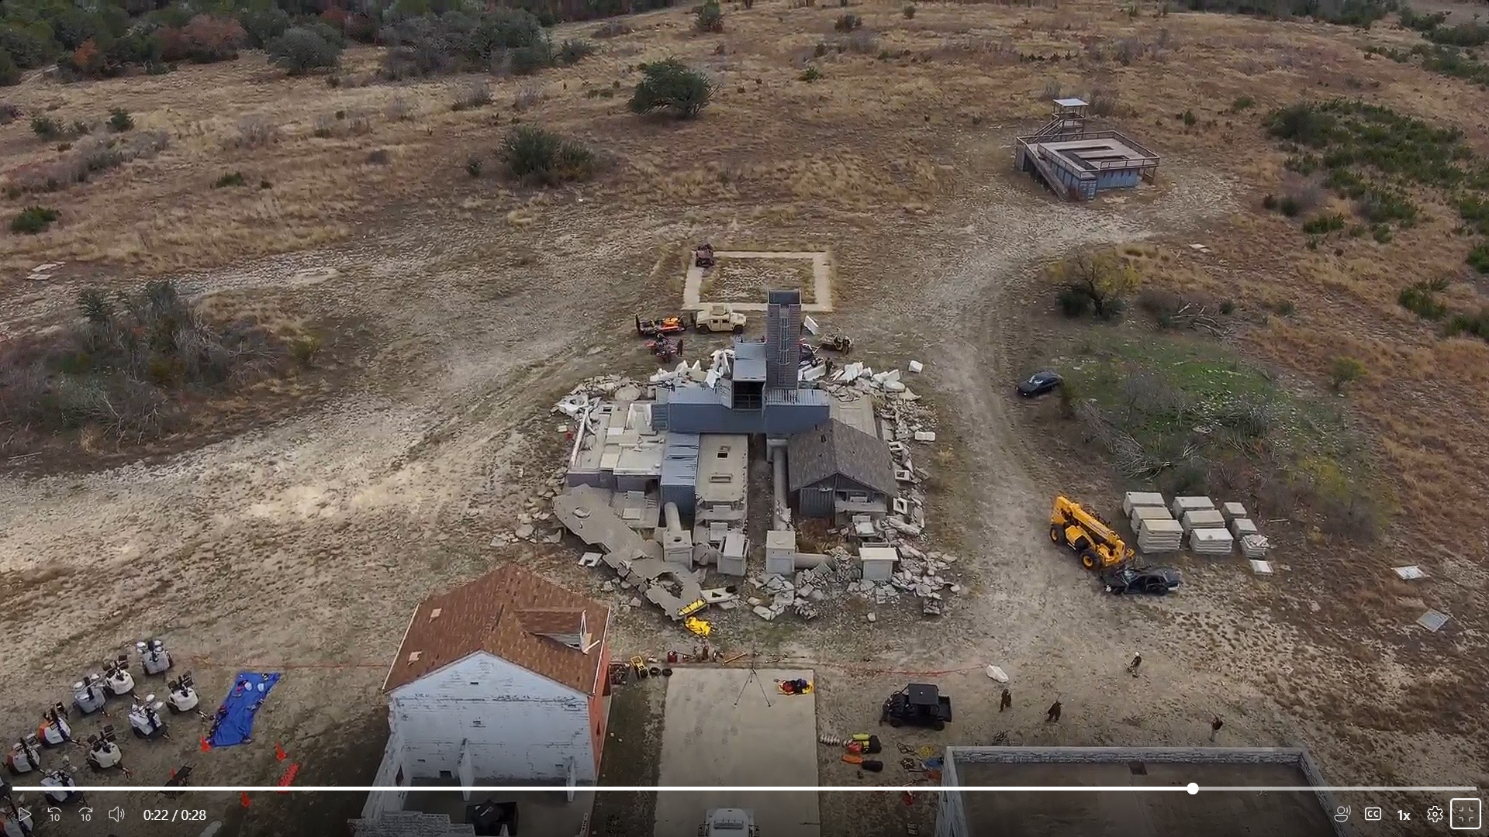
ChatGPT Test
What objects are near the yellow crane?

Slide 4
ChatGPT Test
Where is the yellow crane?

Slide 5
Research Objective
Technical Task:
  UAV videos → Structured, queryable 3D scene graphs
End State:
  A scalable system that turns overwhelming UAV video into actionable insight for decision-makers.

Slide 6
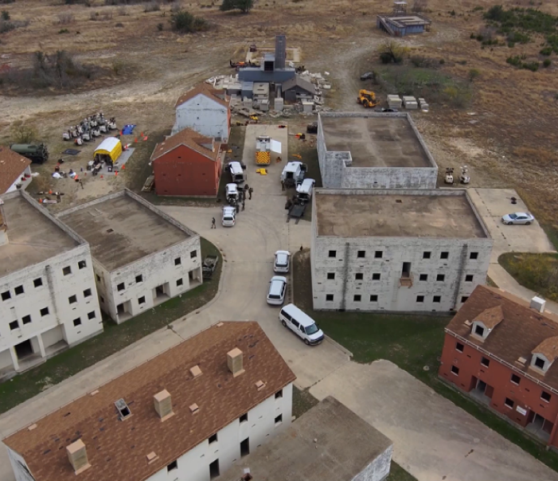
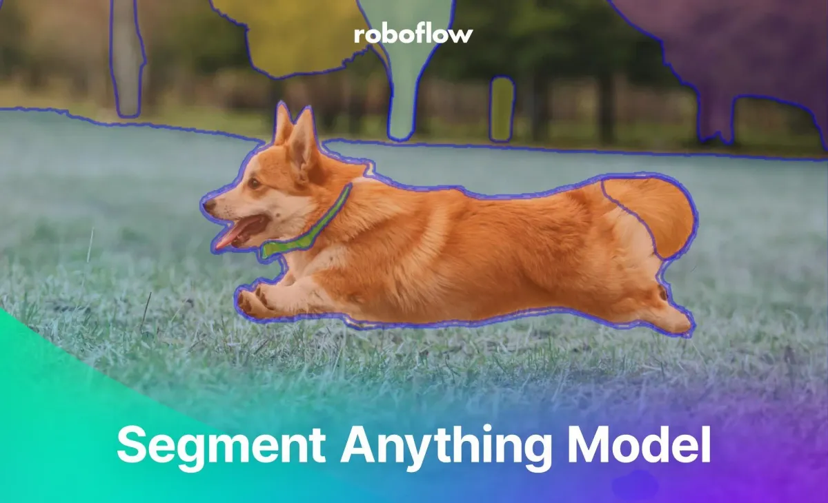


Methodology
Input: RGB-D Video
SAM
3D Propagation
Scene Graph
RAG/LLM
Semantic Labeling

Slide 7
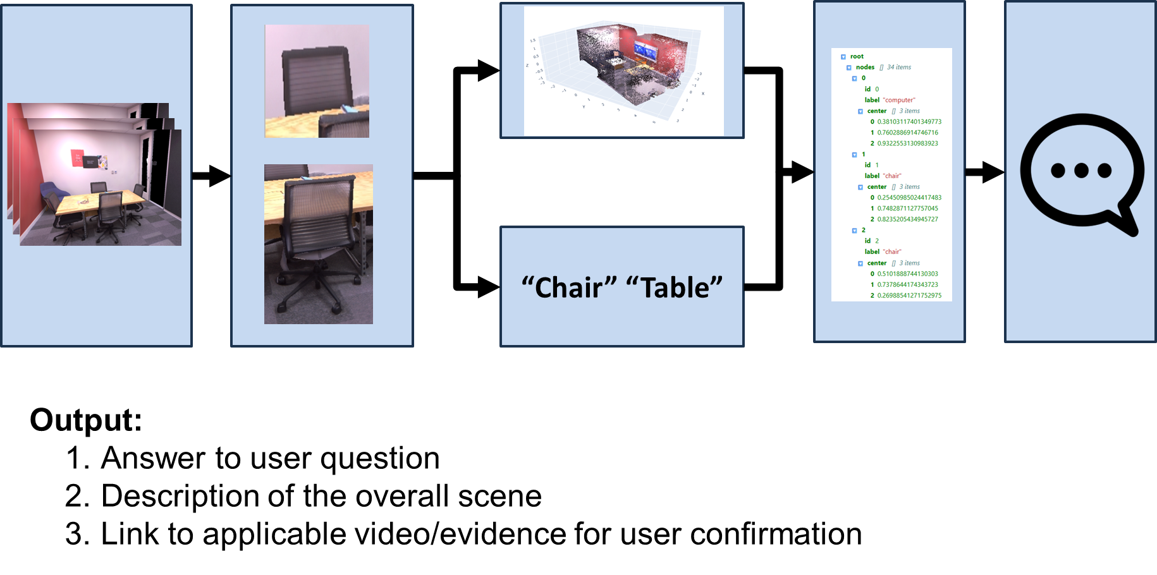
Pipeline in Action

Slide 8
Evaluation Criteria
1. Caption Quality
  Compare pipeline’s generated captions with competitors (ChatGPT)
2. Spatial Reasoning Ability
  Assessed relationship-based queries (e.g., “What objects are near X?”).
  Compare responses for correctness and usefulness
3. Object Identification
  Measured detection and counting accuracy (e.g., “How many vehicles are in the scene?”).

Slide 9
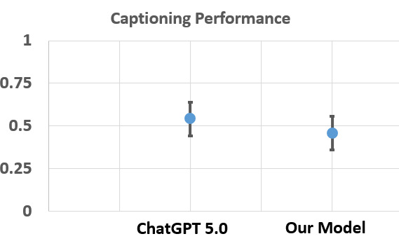
Captioning Performance
Takeaway: Human evaluators slightly preferred ChatGPT captions, though the margin reflects only a few responses.

Slide 10
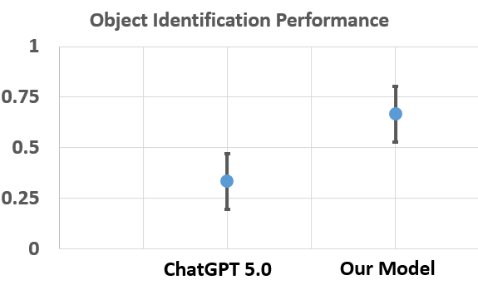
Object Identification Performance
Takeaway: Our model outperforms ChatGPT in object identification by a wide margin in this study.

Slide 11
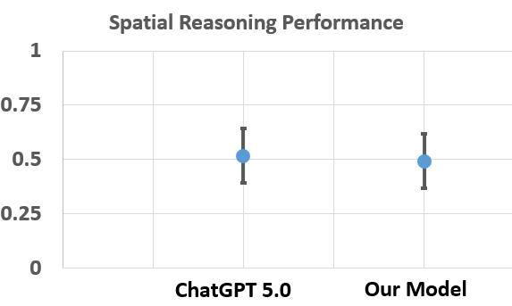
Spatial Reasoning Performance
Takeaway: Spatial reasoning results are comparable, indicating no meaningful performance gap.

Slide 12
Final Takeaways
Performance: ChatGPT leads in captioning; our model excels in object identification and is competitive in spatial reasoning.
Strength: 3D, multimodal approach enables grounded, spatially-aware outputs.
Limitation: Less robust than ChatGPT on complex or open-ended queries.
Takeaway: Not a replacement for LLMs but shows clear promise for targeted UAV video analysis.

Slide 13


