Slide 1
Combinatorial and Adaptive Stress Testing for Spacecraft Runtime Assured Neural Network Control Systems
Gabriel Behrendt
Alexandra Mangel
Kerianne Hobbs
Todd Moeller
DATAWorks April 21-23, 2026
Approved for public release. OTR 2026-00517.

Slide 2
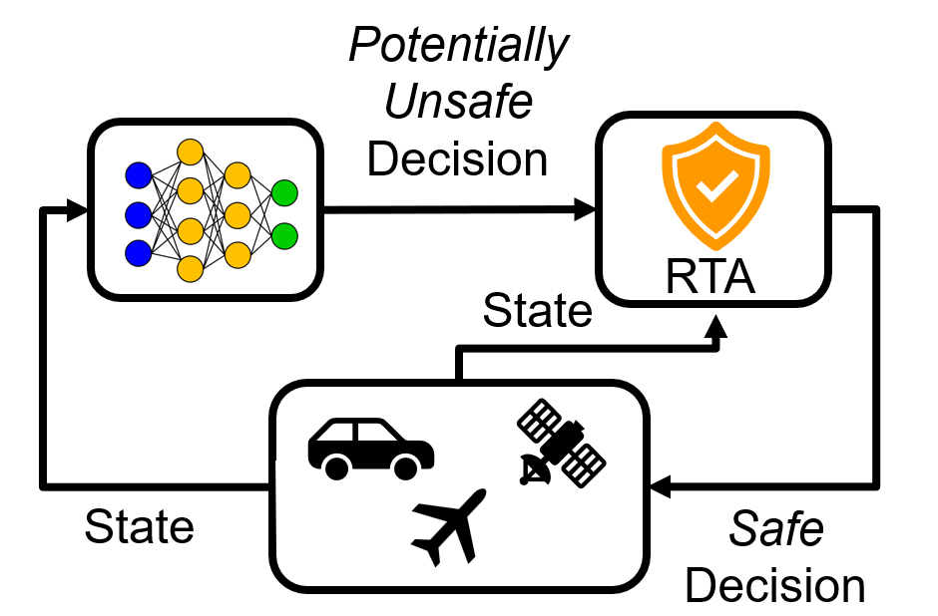
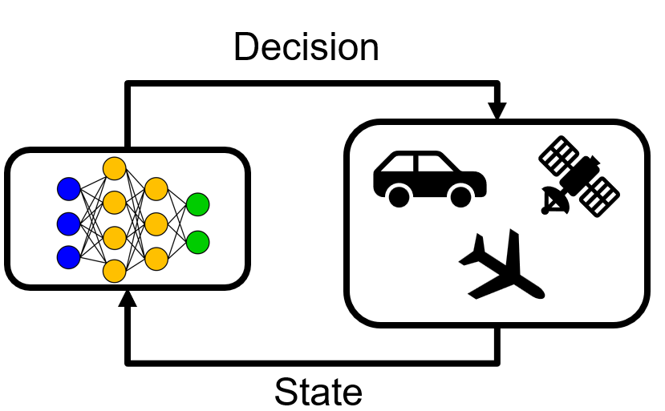
Trustworthy Autonomous Systems Require Rigorous Testing
Neural Network Control Systems (NNCS)
Powerful approach for complex autonomous systems
Learn optimal policies from data and handle high dimensional state spaces
Challenge: Learned complexity creates unpredictability where small variations cause dramatically different behavior
Safety Approaches & Limitations
Theoretical guarantees (reachability analysis, differential dynamic logic, certificate functions)
  Limited to small state spaces and short time horizons
Runtime Assurance (RTA): Monitors system state and controller output, intervenes when necessary
Challenge: Real-world implementations face discretization effects and numerical precision limitations
The Testing Challenge
Establishing trustworthiness requires knowledge of operational boundaries, edge cases, and failure modes
Existing approaches may be inadequate for complex systems
Our Goal: A Rigorous Testing Framework
Thorough initial state space coverage
Targeted exploration of operational boundaries and edge cases

Slide 3
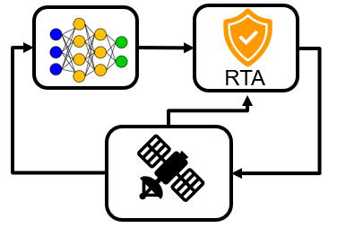
Our Proposed Testing Approach for Complex Systems
Comprehensive testing of complex systems presents two distinct challenges to uncover failure modes:
Thorough coverage of the initial state space
Systematic exploration of system behavior under stressing conditions
Problems with Current Approaches
Traditional Monte Carlo testing approaches rely on random sampling to address the challenges above, but:
High-dimensional state spaces challenge random sampling approaches because volume grows exponentially with dimension
The systematic targeting of critical regions near safety boundaries where failures are likely to occur does not occur with random sampling
Our Proposed Approach
Combinatorics generated t-way initial conditions reduces dimensionality of sampling
Adaptive stress testing (AST) will target critical regions by intelligently selecting disturbances
System under test - satellite attitude control system

Slide 4
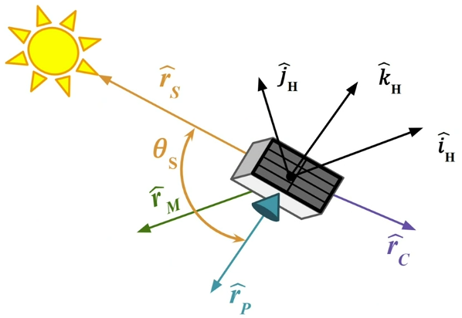
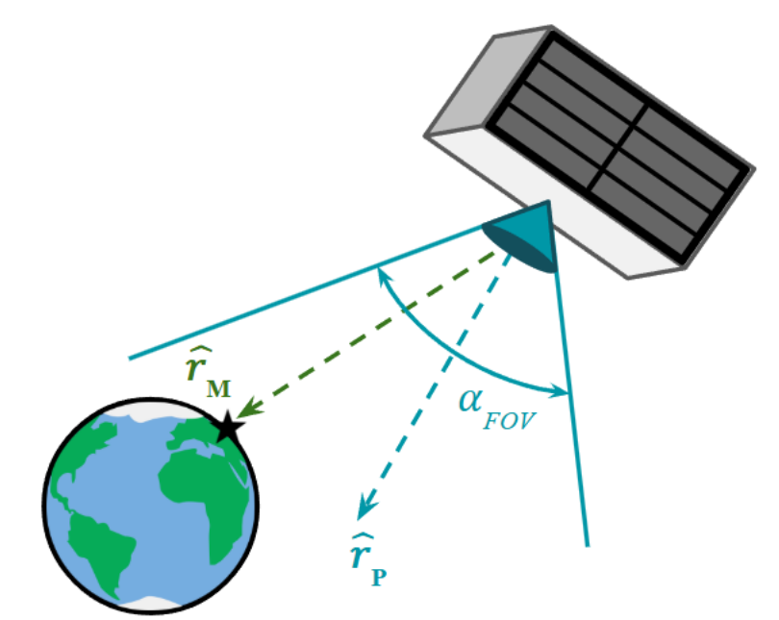
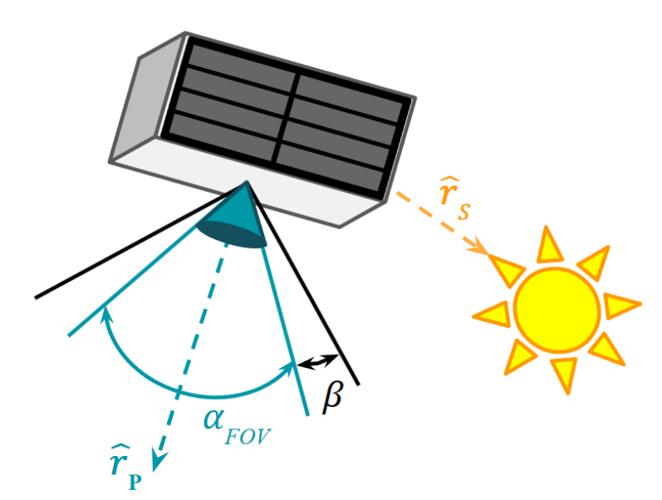


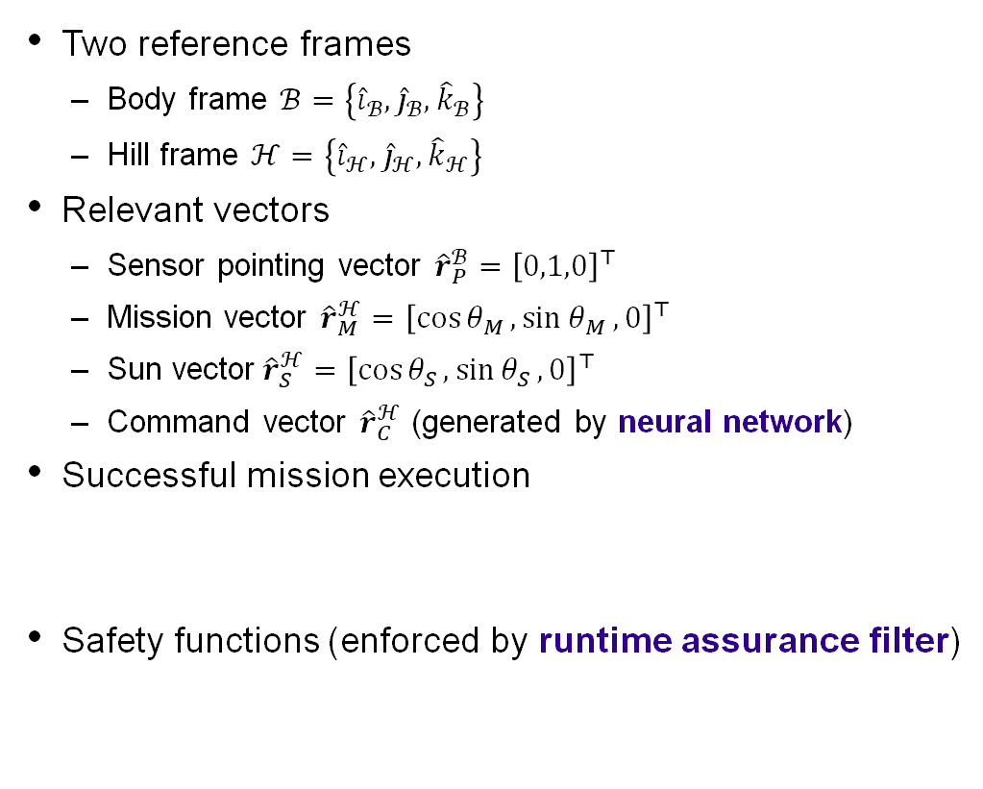



System Under Test - Autonomous Satellite Attitude Control System
Mission: align the sensor pointing with the mission vector while avoiding the sun vector to avoid mission critical sensor damage
Two reference frames
  Body frame $ℬ=\left\{{\hat{i}}_{ℬ},{\hat{j}}_{ℬ},{\hat{k}}_{ℬ}\right\}$
  Hill frame $ℋ=\left\{{\hat{i}}_{ℋ},{\hat{j}}_{ℋ},{\hat{k}}_{ℋ}\right\}$
Relevant vectors
  Sensor pointing vector ${\hat{r}}_{P}^{ℬ}={\left[0,1,0\right]}^{⊤}$
  Mission vector ${\hat{r}}_{M}^{ℋ}={\left[\cos{θ_{M}},\sin{θ_{M}},0\right]}^{⊤}$
  Sun vector${\hat{r}}_{S}^{ℋ}={\left[\cos{θ_{S}},\sin{θ_{S}},0\right]}^{⊤}$
  Command vector ${\hat{r}}_{C}^{ℋ}$ (generated by neural network)
Successful mission execution
Safety functions (enforced by runtime assurance filter)
Inclusion Zone
Exclusion Zone
$$θ_{IZ}≔\cos^{−1}{({\hat{r}}_{M}^{ℋ}⋅{\hat{r}}_{P}^{ℋ})<γ_{FOV}/2}$$
$$θ_{EZ}≔\cos^{−1}\left({\hat{r}}_{S}^{ℋ}⋅{\hat{r}}_{P}^{ℋ}\right)>α_{FOV}/2+β$$
$$h_{IZ}≔\left(γ_{FOV}/2\right)−θ_{IZ}$$
$$h_{EZ}≔θ_{EZ}−\left(α_{FOV}/2+β\right)$$

Slide 5






Runtime Assured Neural Network Control System Architecture
RL Agent (0.05 Hz)
Feedback Control Loop (1 Hz)
$$τ$$
nom
Neural Network*
$${\hat{r}}_{c}^{ℋ}$$
PD Controller
RTA
$${\hat{r}}_{c}^{ℋ}$$
$$o$$
$$ω_{ℋℬ}^{ℋ}$$
$$x=\left[\begin{matrix}ω_{ℋℬ}^{ℋ} \\ q_{ℋℬ}\end{matrix}\right]$$
$$τ$$
RTA
Observer
Spacecraft Dynamics
The RL agent generates pointing commands based on the spacecraft state
The commands are translated to nominal torque inputs by a Proportional-Derivative Controller
To monitor safety, a Control Barrier Function (CBF) based RTA filter monitors and modifies the nominal torques when necessary to fulfill safety constraints
To increase the trustworthiness of this runtime assured NNCS we must propose a testing framework which tests its operational boundaries and finds edge cases through
(1) initial state space coverage and (2) targeted disturbances
* Santos, Raul, et al. "Deep Reinforcement Learning Waypoint Generation for Attitude Station-Keeping With Sun Avoidance." AIAA SCITECH 2026 Forum. 2026.

Slide 6
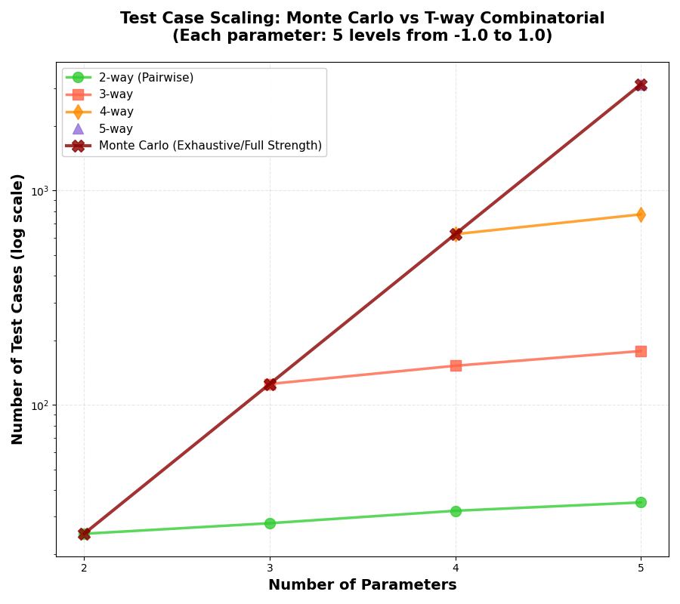
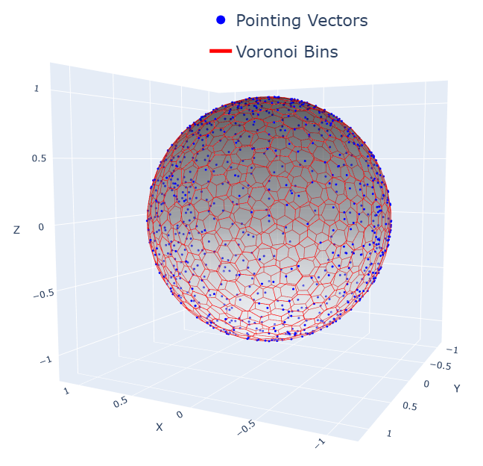
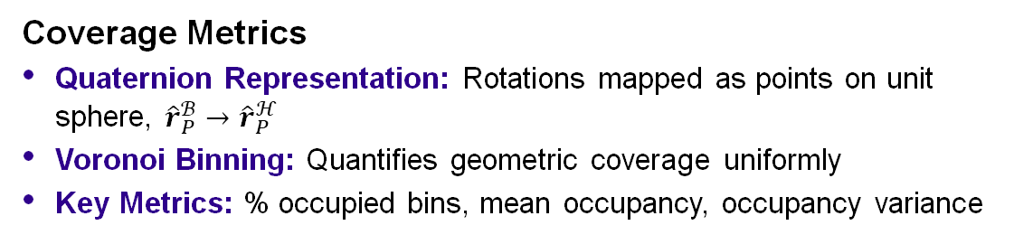
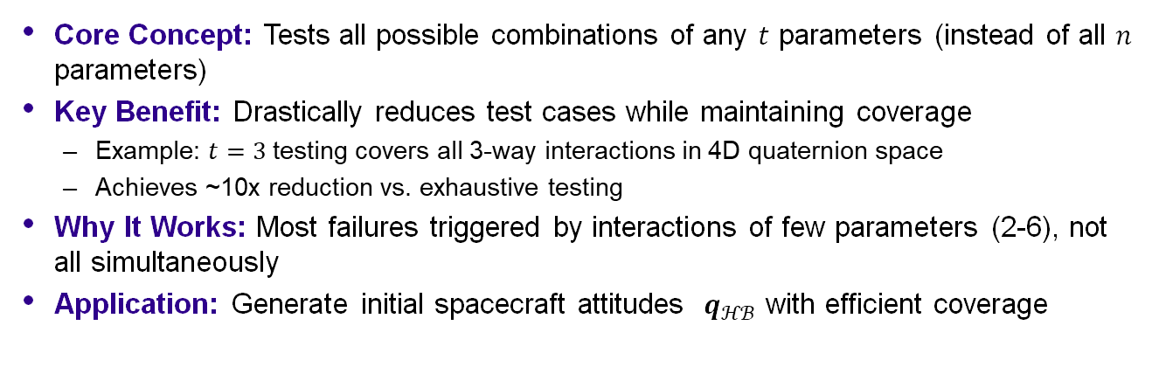

Initial Condition Generation with $t$-way Testing
What is $t$-way Testing?*
Core Concept: Tests all possible combinations of any $t$ parameters (instead of all $n$ parameters)
Key Benefit: Drastically reduces test cases while maintaining coverage
  Example: $t=3$ testing covers all 3-way interactions in 4D quaternion space
  Achieves ~10x reduction vs. exhaustive testing
Why It Works: Most failures triggered by interactions of few parameters (2-6), not all simultaneously
Application: Generate initial spacecraft attitudes $q_{ℋℬ}$ with efficient coverage
Coverage Metrics
Quaternion Representation: Rotations mapped as points on unit sphere, ${\hat{r}}_{P}^{ℬ}→{\hat{r}}_{P}^{ℋ}$
Voronoi Binning: Quantifies geometric coverage uniformly
Key Metrics: % occupied bins, mean occupancy, occupancy variance
*Kuhn, D. Richard, et al. "Combinatorial testing: Theory and practice." Advances in computers 99 (2015): 1-66

Slide 7
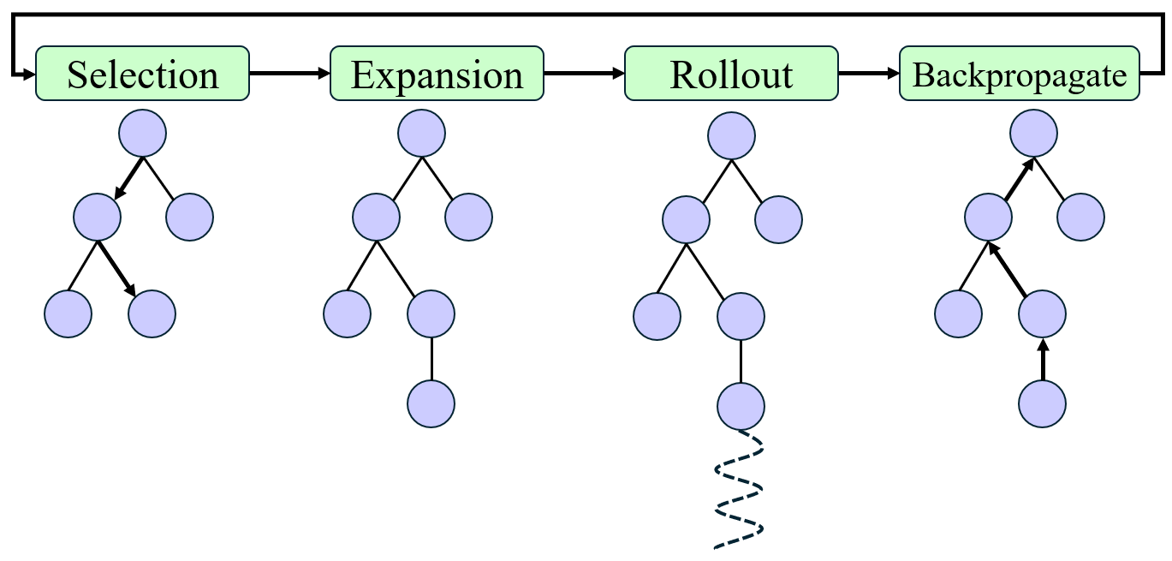


Adaptive Stress Testing (AST)
AST Framework: Casts failure search as Markov decision process using reinforcement learning*
Objective: Find most likely failure path by solving
RL Algorithms: MCTS, Q-Learning, deep RL to optimize disturbance sequences
Our Implementation: Monte Carlo Tree Search with Progressive Widening (MCTS-PW)
  Handles continuous action spaces
  Balances exploration of new disturbances with exploitation of promising failures
Two Test Configurations:
  Runtime Assurance Filter Testing
  Runtime Assured NNCS Testing
AST Agent
Reinforcement Learner
Reward Function
$$\underset{x_{0},…,x_{t_{f}}}{\text{max}\text{imize}} \prod_{t=0}^{t_{f}}{p(x_{t}|s_{t})}$$
Next State
Disturbance
$$\text{subject} \text{to} s_{t_{f}}∈ℰ$$
Simulator
System Under Test
Environment
Monte Carlo Tree Search
*Lee, Ritchie, et al. "Adaptive stress testing of airborne collision avoidance systems." 2015 IEEE/AIAA 34th Digital Avionics Systems Conference (DASC). IEEE, 2015.

Slide 8
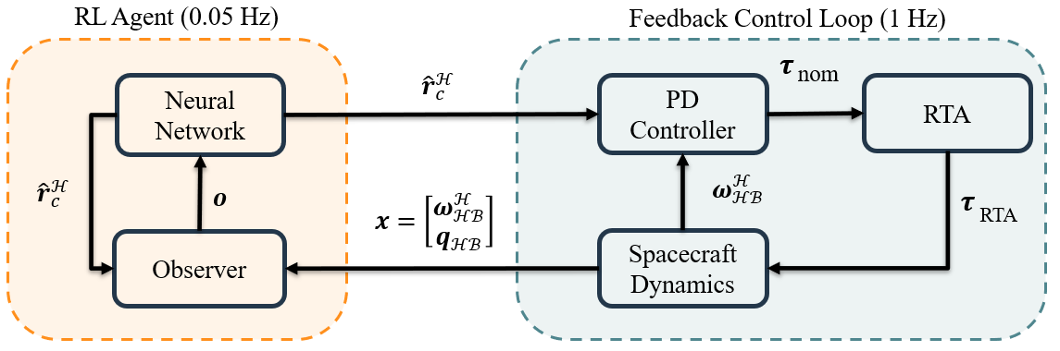
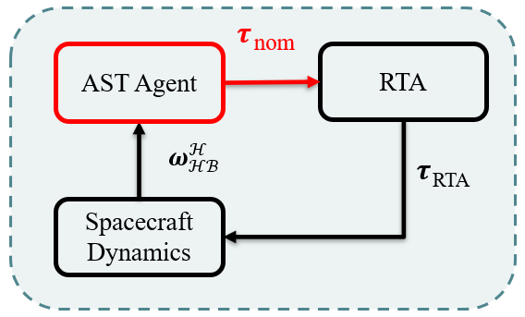
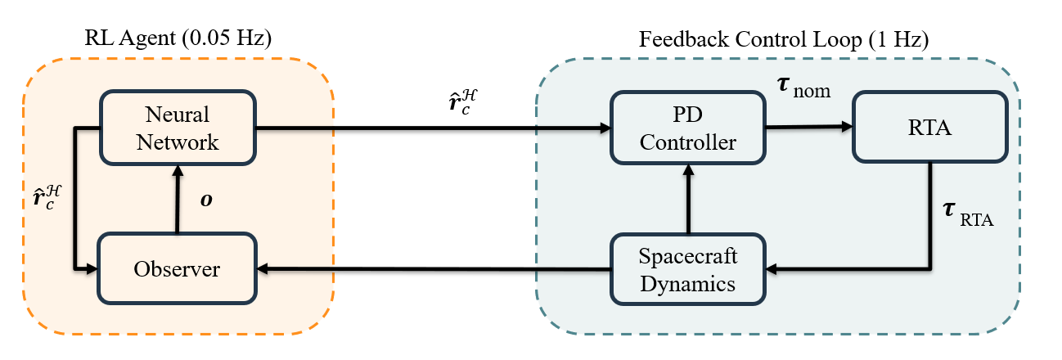
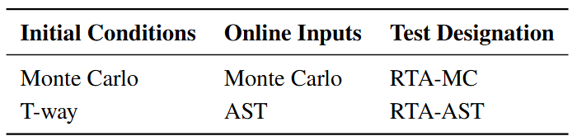
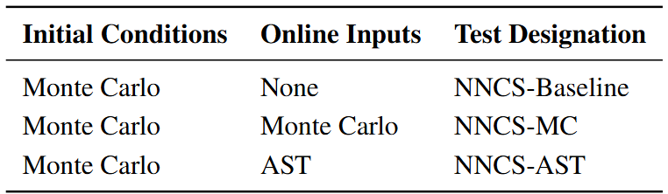



Summary of Tests
We conduct two test configurations to assess our proposed approach vs. Monte Carlo approach
Configuration 1: Runtime Assurance Filter
Configuration 2: Runtime Assured NNCS
$$\left[\begin{matrix}ω_{ℋℬ}^{ℋ} \\ q_{ℋℬ}\end{matrix}\right]$$
$$+\tilde{ω}$$
$$ω_{ℋℬ}^{ℋ}+\tilde{ω}$$

Slide 9
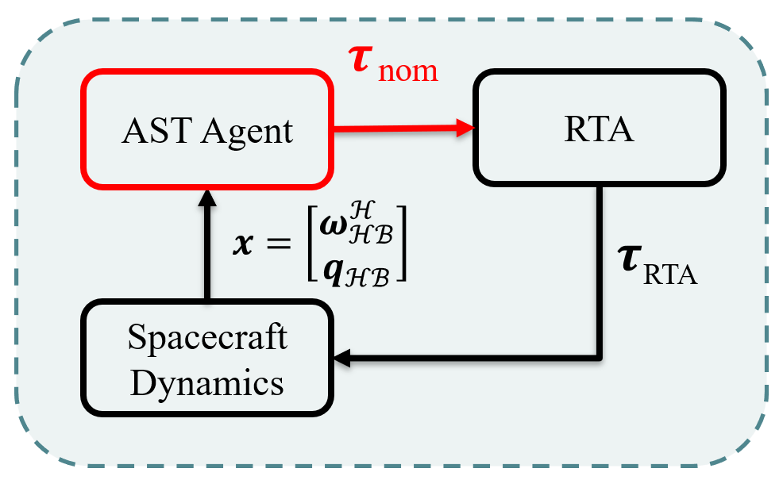

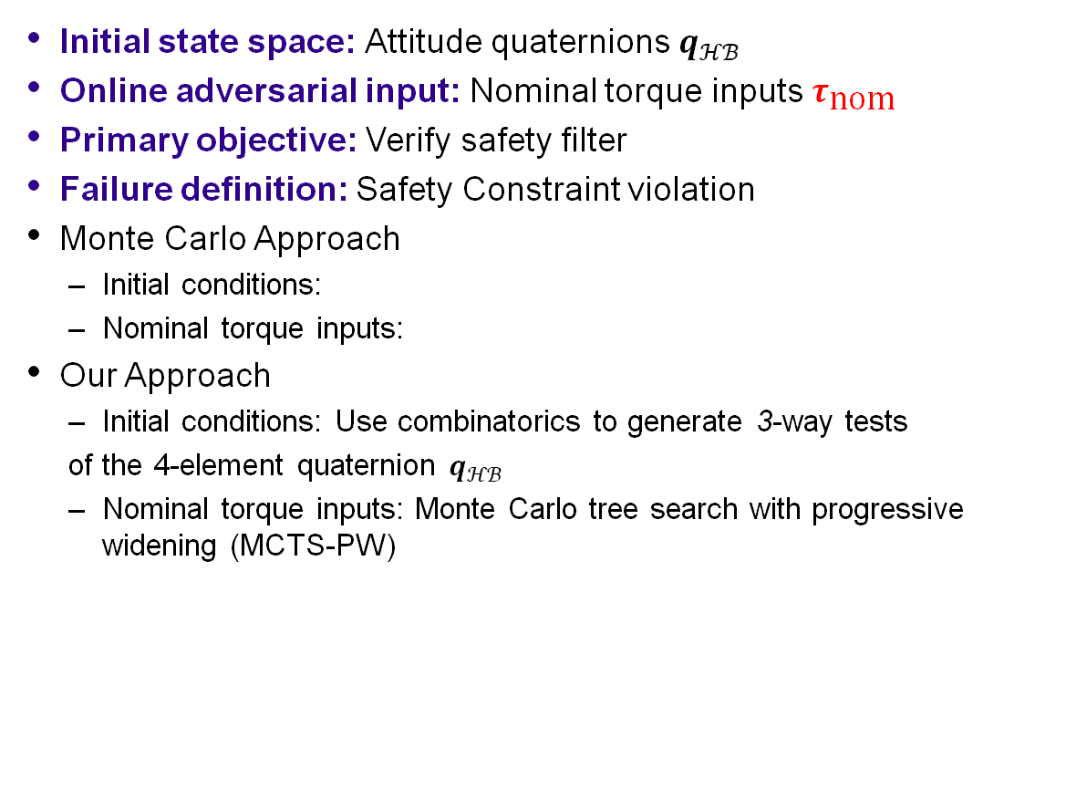

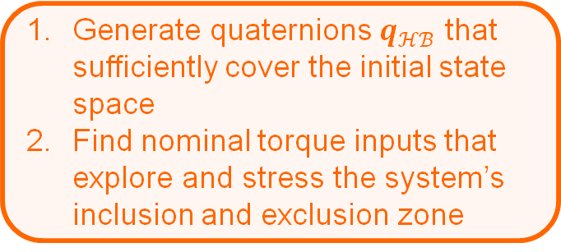



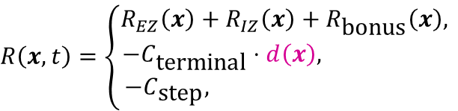

Runtime Assurance Filter Testing
Initial state space: Attitude quaternions $q_{ℋℬ}$
Online adversarial input: Nominal torque inputs $τ_{\text{nom}}$
Primary objective: Verify safety filter
Failure definition: Safety Constraint violation
Monte Carlo Approach
  Initial conditions:
  Nominal torque inputs:
Our Approach
  Initial conditions: Use combinatorics to generate 3-way tests
  of the 4-element quaternion $q_{ℋℬ}$
  Nominal torque inputs: Monte Carlo tree search with progressive widening (MCTS-PW)
$$q_{ℋℬ}\sim {𝒩(0,1)}^{4}→q_{ℋℬ}/\left\|q_{ℋℬ}\right\|$$
$$τ_{\text{nom}}\sim {𝒰(−τ_{\text{max}},τ_{\text{max}})}^{3}$$
Testing Goals
$$R\left(x,t\right)=\left\{\begin{aligned}R_{EZ}\left(x\right)+R_{IZ}\left(x\right)+R_{\text{bonus}}\left(x\right), \\ −C_{\text{terminal}}⋅d\left(x\right), \\ −C_{\text{step}}, \end{aligned}\right.$$
$$\text{if} \text{safety} \text{violated}$$
Generate quaternions $q_{ℋℬ}$ that sufficiently cover the initial state space
Find nominal torque inputs that explore and stress the system’s inclusion and exclusion zone
$$\text{if} \text{no} \text{safety} \text{violation} \text{and} \text{end} \text{of} \text{rollout}$$
$$\text{if} \text{no} \text{safety} \text{violation} \text{and} \text{intermediate}$$
$$d\left(x\right)=0.5\left(h_{EZ}\left(x\right)+h_{IZ}\left(x\right)\right)$$
Incentivizes safety constraint violation

Slide 10
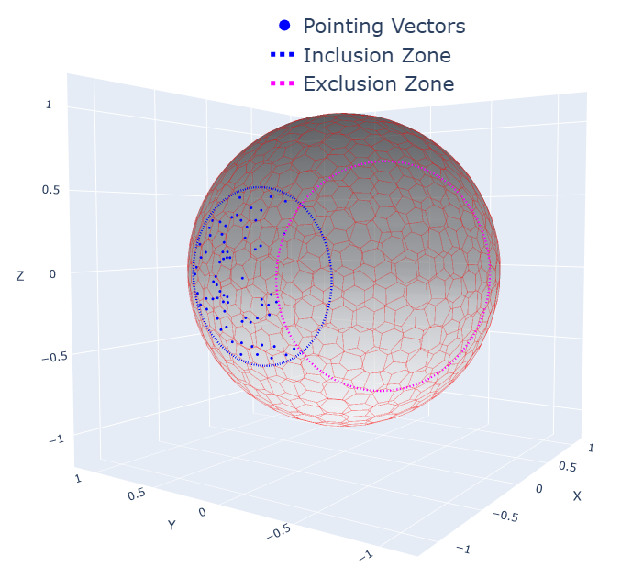
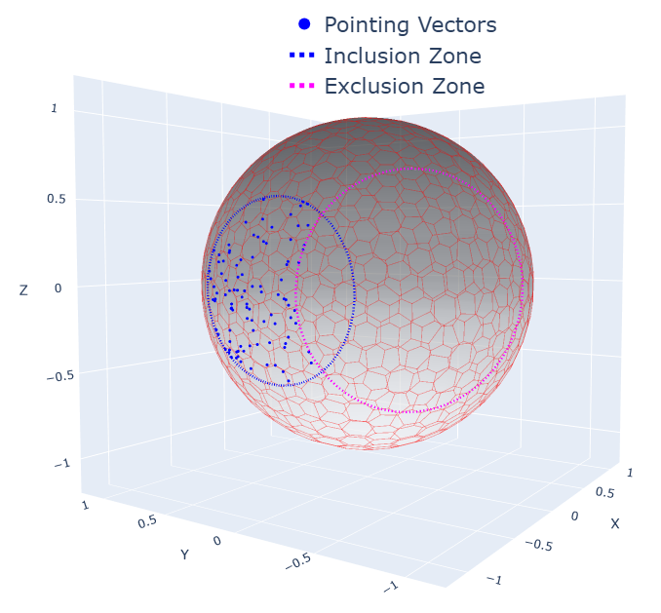
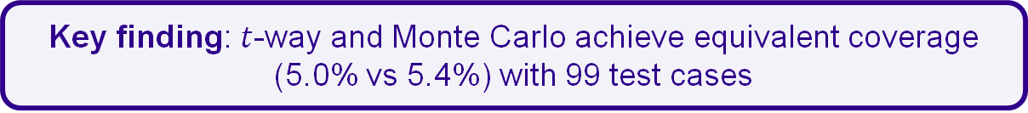
Runtime Assurance Filter Testing - Test Case Generation Results
Generated 99 valid test cases using $t$-way and Monte Carlo methods
$t$-way guarantees all 3-way parameter combinations; Monte Carlo relies on random chance
T-way
Monte Carlo
Metric | T-way | Monte Carlo
Occupancy [%] | 5.0 | 5.4
Mean | 0.2 | 0.2
Variance | 1.03 | 0.85
~5% occupancy due to geometric constraint, not sampling limitation
Key finding: $t$-way and Monte Carlo achieve equivalent coverage (5.0% vs 5.4%) with 99 test cases
Can AST find failures Monte Carlo misses?
Implication: Both methods provide adequate initial state coverage
Notes:
We should tell the audience how to interpret these results and give reason for them.

Slide 11
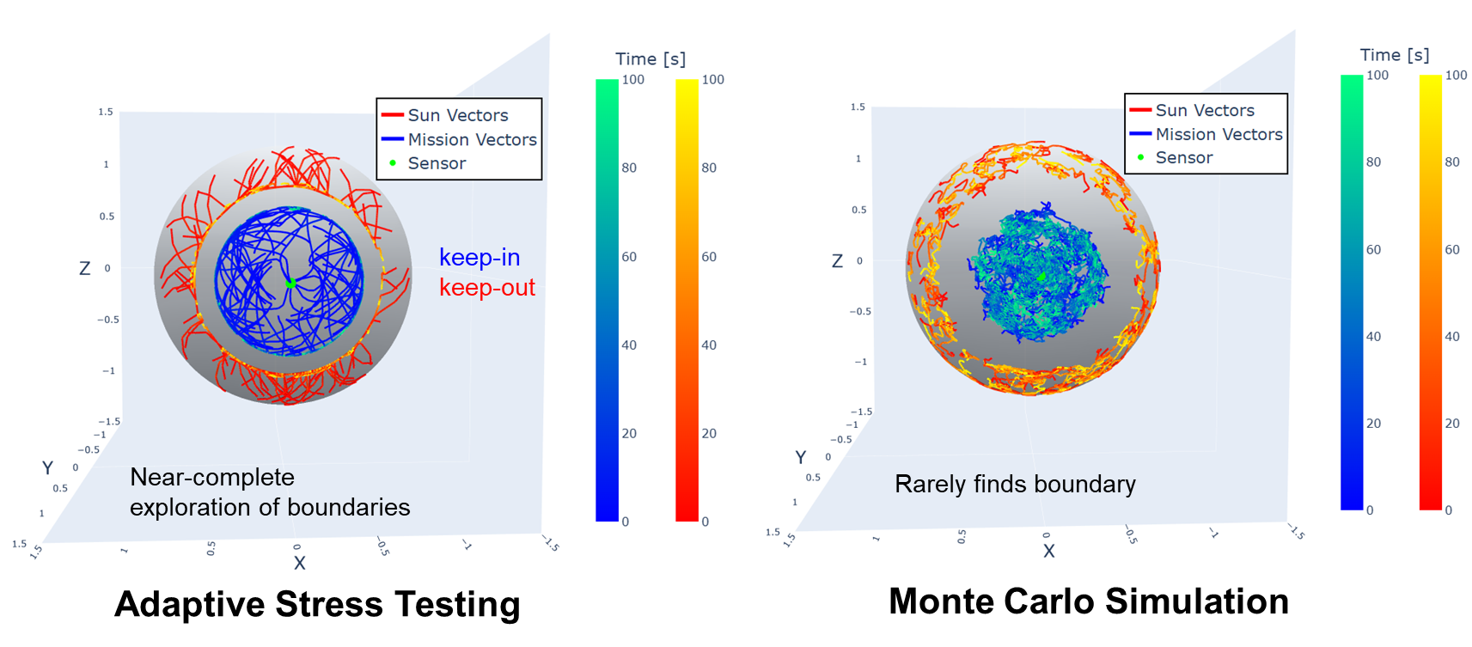
Runtime Assurance Filter Testing
AST-Driven vs. MC-Random Torque Inputs
Adaptive Stress Testing
Monte Carlo
Key Finding: Adaptive stress testing finds and explores the boundary, while Monte Carlo rarely finds the boundary

Slide 12
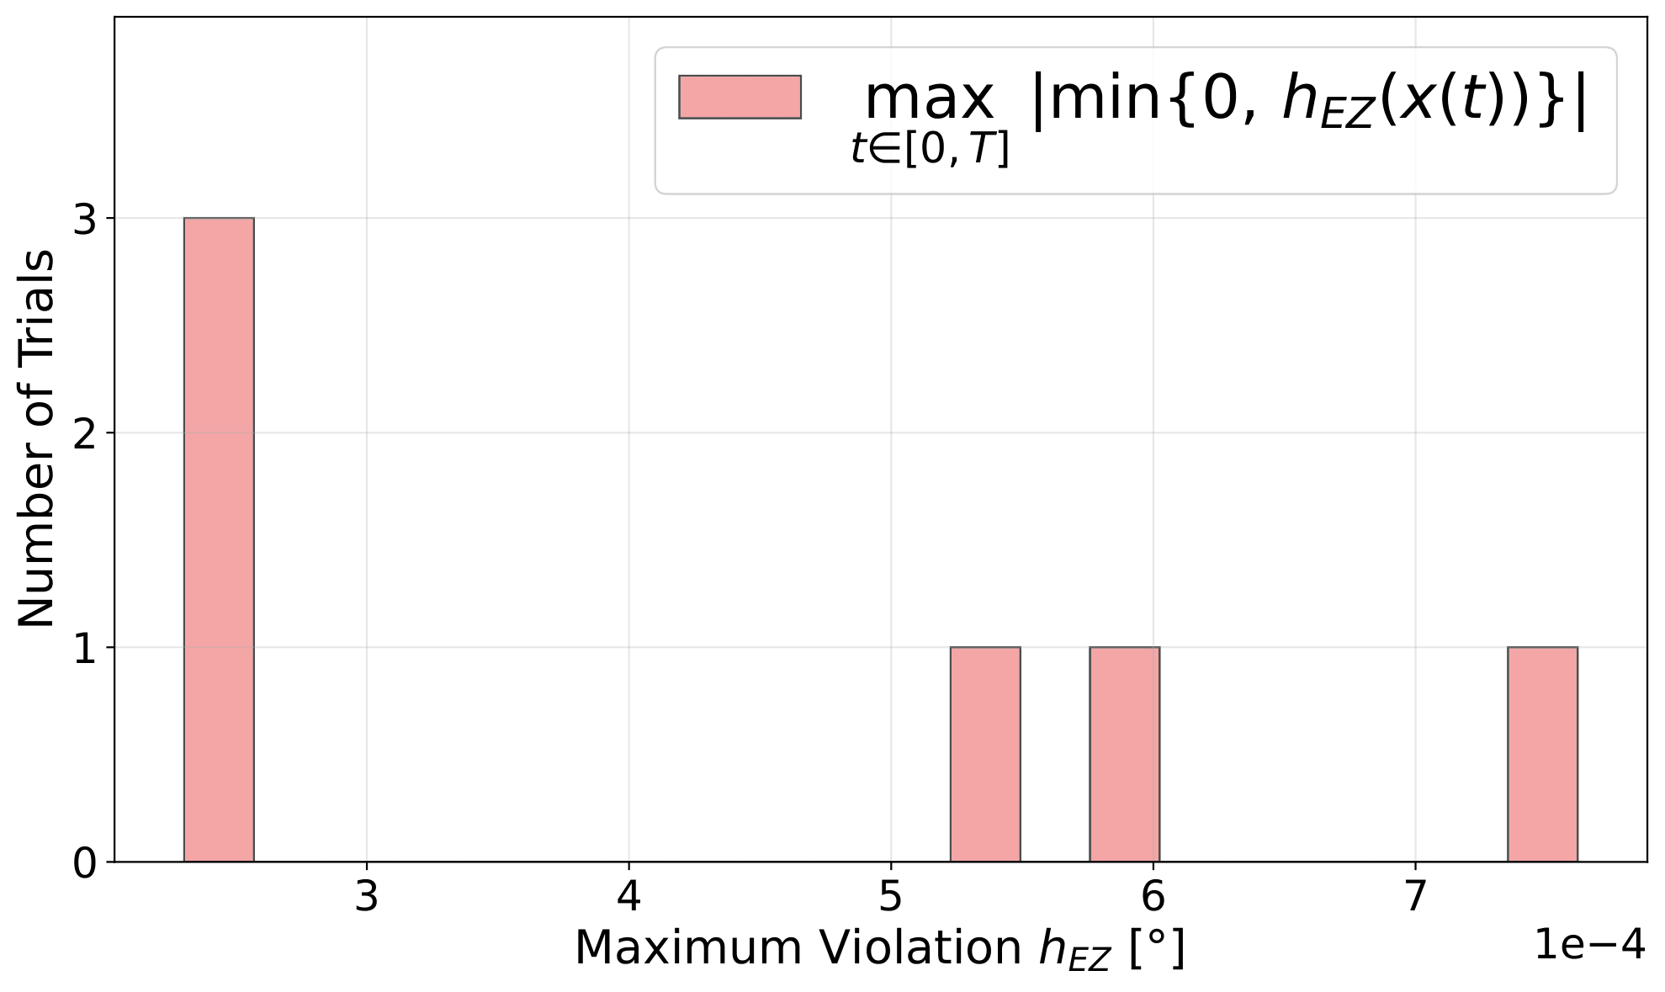
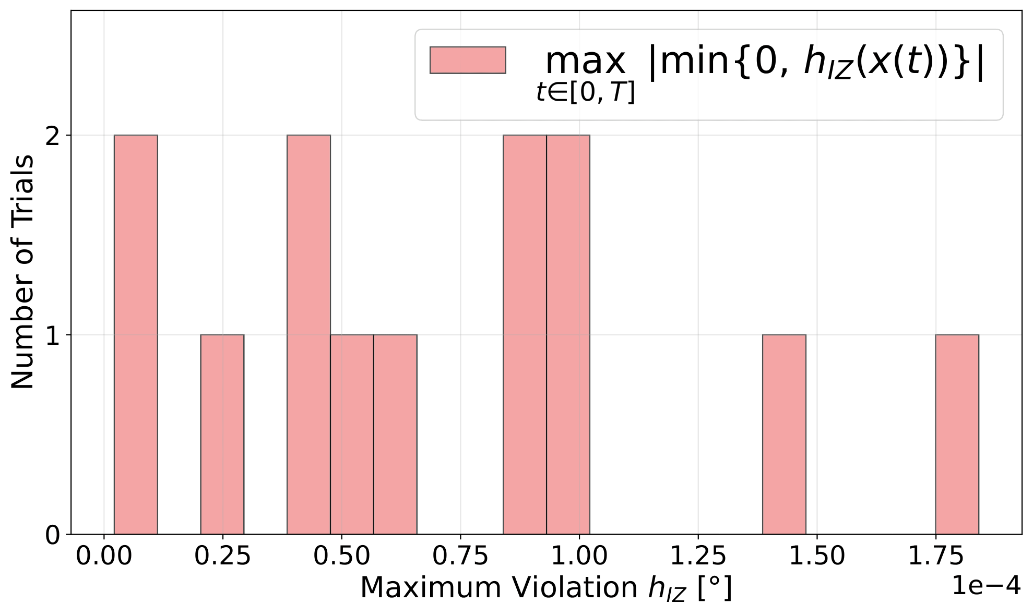
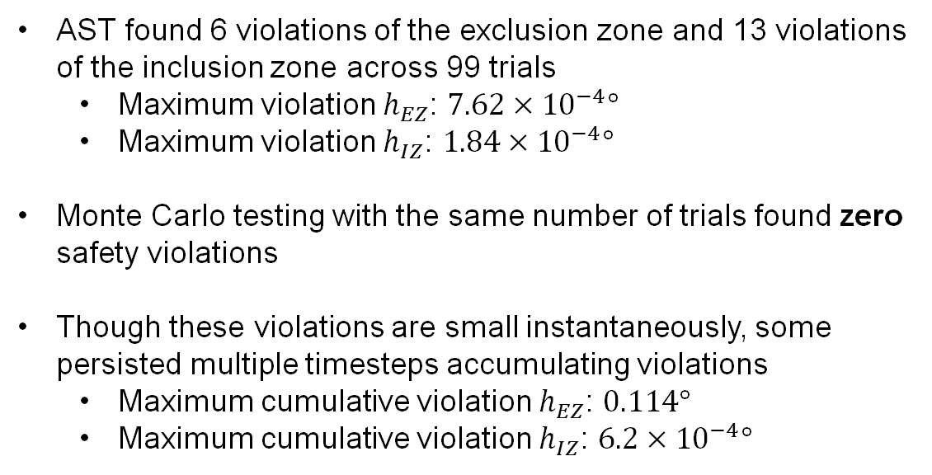
Runtime Assurance Filter Testing
Adaptive Stress Testing Found Failures Better Than Monte Carlo
AST found 6 violations of the exclusion zone and 13 violations of the inclusion zone across 99 trials
  Maximum violation $h_{EZ}$: $7.62×{10}^{−4}°$
  Maximum violation $h_{IZ}$: $1.84×{10}^{−4}°$
Monte Carlo testing with the same number of trials found zero safety violations
Though these violations are small instantaneously, some persisted multiple timesteps accumulating violations
  Maximum cumulative violation $h_{EZ}$: $0.114°$
  Maximum cumulative violation $h_{IZ}$: $6.2×{10}^{−4}°$
6 Violations
Key Finding: Even with mathematical guarantees runtime assurance filters can be violated under adversarial conditions generated by AST that are missed by random testing
13 Violations
Can AST stress the complete integrated system - the neural network, the RTA filter, and the spacecraft dynamics all working together at different rates?

Slide 13
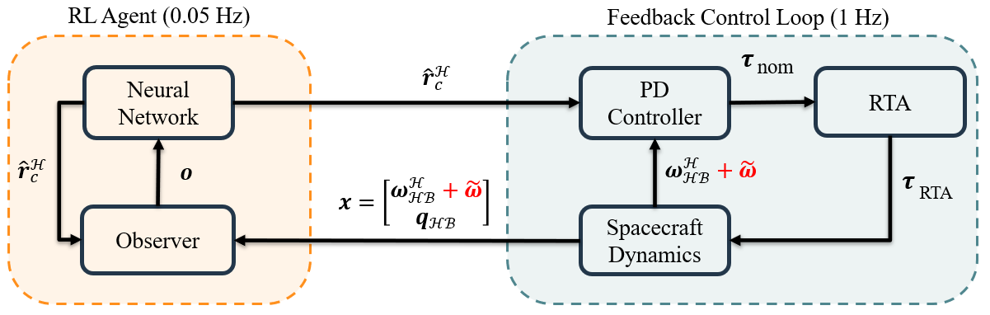

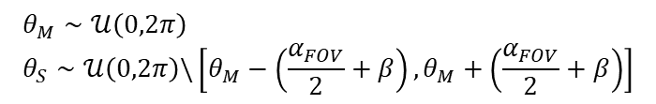
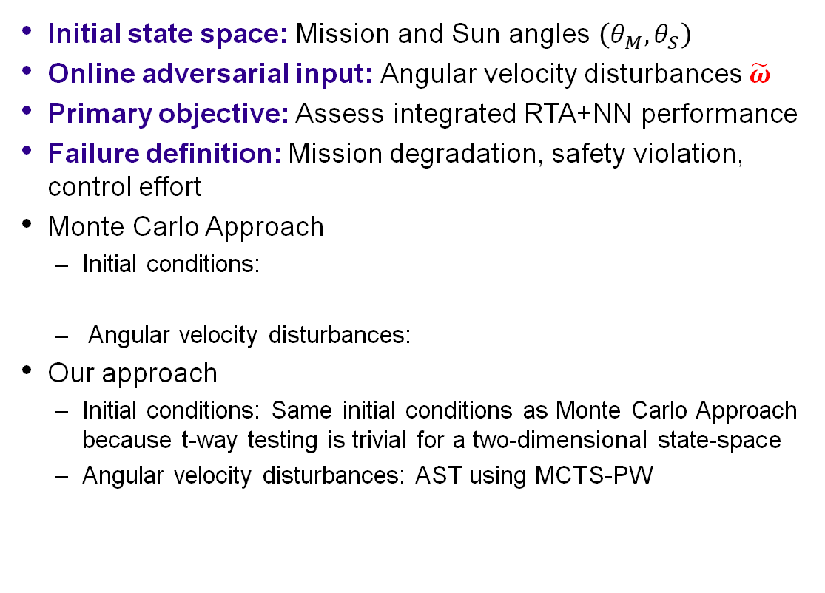
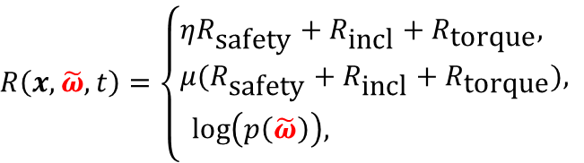

Runtime Assured NNCS Testing
Initial state space: Mission and Sun angles $\left(θ_{M},θ_{S}\right)$
Online adversarial input: Angular velocity disturbances $\tilde{ω}$
Primary objective: Assess integrated RTA+NN performance
Failure definition: Mission degradation, safety violation, control effort
Monte Carlo Approach
  Initial conditions:
  Angular velocity disturbances:
Our approach
  Initial conditions: Same initial conditions as Monte Carlo Approach because t-way testing is trivial for a two-dimensional state-space
  Angular velocity disturbances: AST using MCTS-PW
$$θ_{M}∼𝒰\left(0,2π\right) \\ θ_{S}∼𝒰\left(0,2π\right)\backslash \left[θ_{M}−\left(\frac{α_{FOV}}{2}+β\right),θ_{M}+\left(\frac{α_{FOV}}{2}+β\right)\right]$$
$$\tilde{ω}∼{𝒰\left(−1,1\right)}^{3} °/s$$
The log likelihood of the probability incentivizes the MCTS-PW to select likely disturbances
$$R\left(x,\tilde{ω},t\right)=\left\{\begin{aligned}ηR_{\text{safety}}+R_{\text{incl}}+R_{\text{torque}}, \\ μ(R_{\text{safety}}+R_{\text{incl}}+R_{\text{torque}}), \\ \text{log}\left(p\left(\tilde{ω}\right)\right), \end{aligned}\right.$$
$$\text{if} \text{safety} \text{violated}$$
$$\text{if} \text{no} \text{safety} \text{violation} \text{and} \text{end} \text{of} \text{rollout}$$
$$\text{if} \text{no} \text{safety} \text{violation} \text{and} \text{intermediate}$$
Testing Goal: Find angular velocity disturbances that (1) degrade mission, (2) decrease safety margin, and (3) increase control effort

Slide 14
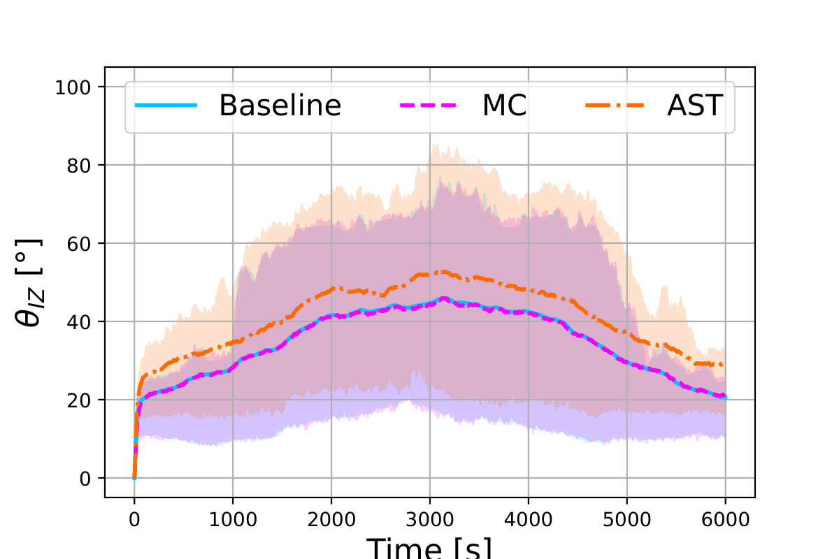
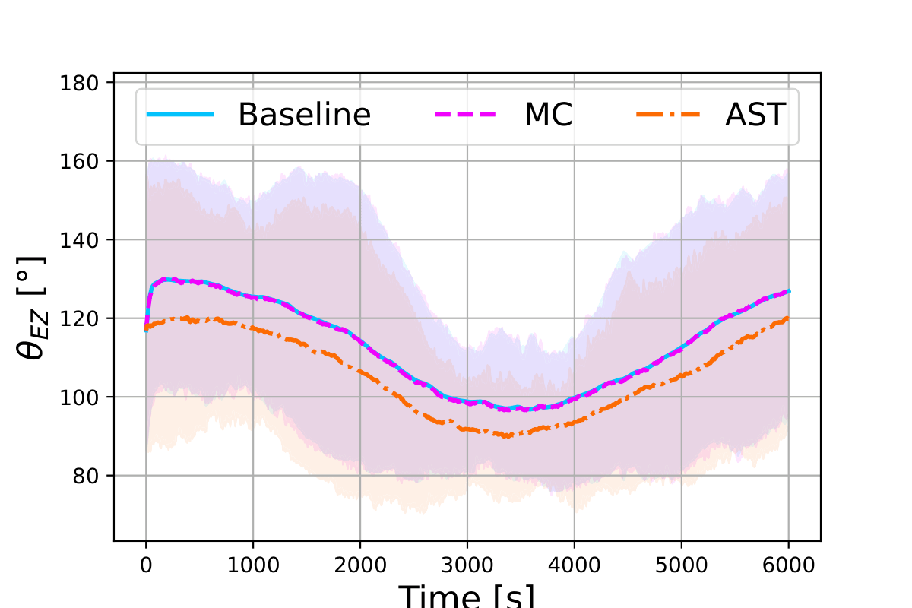
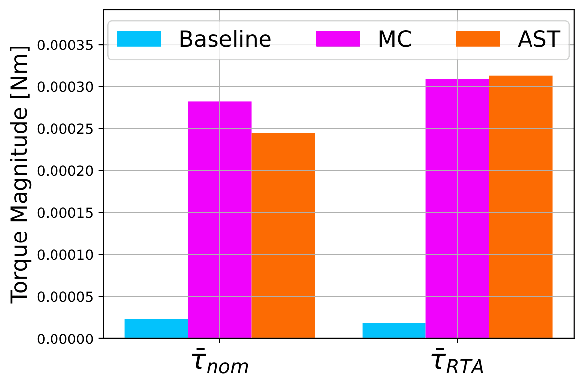
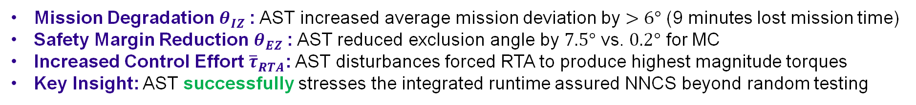
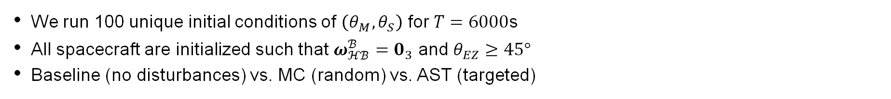
Runtime Assured NNCS Testing Results
We run 100 unique initial conditions of $\left(θ_{M},θ_{S}\right)$ for $T=6000$s
All spacecraft are initialized such that $ω_{ℋℬ}^{ℬ}=0_{3}$ and $θ_{EZ}≥45°$
Baseline (no disturbances) vs. MC (random) vs. AST (targeted)
Mission Performance
Safety Margin
Control Effort
Mission Degradation $θ_{IZ}$: AST increased average mission deviation by $>6°$ (9 minutes lost mission time)
Safety Margin Reduction $θ_{EZ}$: AST reduced exclusion angle by $7.5°$ vs. $0.2°$ for MC
Increased Control Effort ${\overline{τ}}_{RTA}$: AST disturbances forced RTA to produce highest magnitude torques
Key Insight: AST successfully stresses the integrated runtime assured NNCS beyond random testing

Slide 15
Thank you

Slide 16
References
Kuhn, D. Richard, et al. "Combinatorial testing: Theory and practice." Advances in computers 99 (2015): 1-66
Lee, Ritchie, et al. "Adaptive stress testing of airborne collision avoidance systems." 2015 IEEE/AIAA 34th Digital Avionics Systems Conference (DASC). Ieee, 2015.
Santos, Raul, et al. "Deep Reinforcement Learning Waypoint Generation for Attitude Station-Keeping With Sun Avoidance." AIAA SCITECH 2026 Forum. 2026.

Slide 18
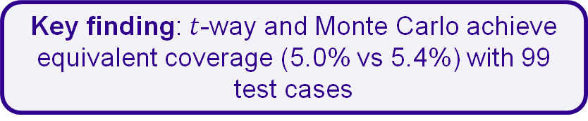
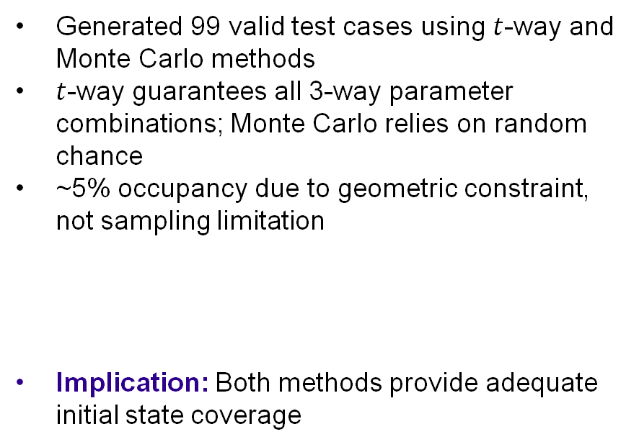
Runtime Assurance Filter Testing - Test Case Generation Results
T-way
Monte Carlo
Generated 99 valid test cases using $t$-way and Monte Carlo methods
$t$-way guarantees all 3-way parameter combinations; Monte Carlo relies on random chance
~5% occupancy due to geometric constraint, not sampling limitation
Implication: Both methods provide adequate initial state coverage
Key finding: $t$-way and Monte Carlo achieve equivalent coverage (5.0% vs 5.4%) with 99 test cases
Metric | T-way | Monte Carlo
Occupancy [%] | 5.0 | 5.4
Mean | 0.2 | 0.2
Variance | 1.03 | 0.85
Can AST find failures Monte Carlo misses?
Notes:
We should tell the audience how to interpret these results and give reason for them.

