Slide 1
Change Often Takes Time
Determining a “Soft Changepoint” in Lifetime Mixture Distributions
Di Michelson, Don McCormack, and Caleb King

Slide 2
Abstract
  It is quite common for data to come from populations that actually consist of two or more subpopulations. For example, the lifetime distribution of a product may actually consist of multiple distributions depending on specific failure modes. The typical approach in these instances is to use a mixture distribution, where the likelihood of each observation is a weighted combination of several distribution models. These weights may be constant or a function of covariates. Another approach is to consider a changepoint where the distribution model makes a sudden change from one model to another. In this talk, we propose an approach that falls between these two extremes. Instead of a hard changepoint, we instead use a probit or logistic model that allows the mixture proportion to vary over the range of the variable, with the point at which the mixture is evenly split serving as a “soft changepoint”. We illustrate this new approach using data from an industrial application.

Slide 3
Outline
Introduction
Estimation
Simulations
Conclusion/Future Research

Slide 4
Background
A common assumption in reliability analysis is that the data come from a homogeneous population.
More likely is that the data come from some mixture of groups within the population.
  Motivation: Data collected over several weeks in various locations on a factory floor. Needed to assess:
    Possible changes over time
    Impact of process changes/improvements
    Low-ppm projections for high reliability applications

Slide 5
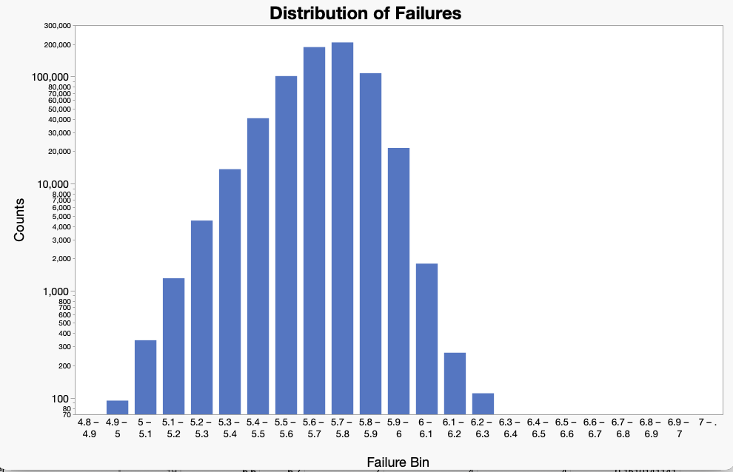
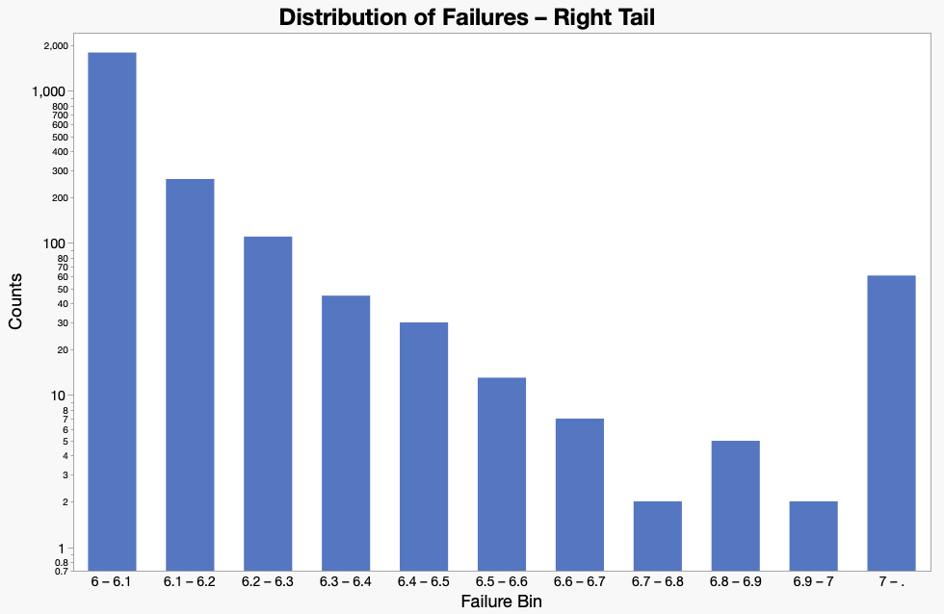
Motivation

Slide 6
Distinguishing Groups
Several techniques have been developed over the years to account for the presence of two or more groups in the data.
Most of these techniques can be broadly categorized into two families
  Mixture distributions
  Changepoint detection
Notes:
We see an observation at X. What’s the probability it comes from distribution A? distribution B?

Slide 7
Mixture Distributions
In a mixture distribution, the overall observed distribution is assumed to be a blend of different underlying distributions.
0.4 x
x =
+
0.6 x

Slide 8
Changepoint Detection
With a changepoint, an observation switches from one distribution to another after some fixed point.
This after changepoint
x comes from:
This before changepoint

Slide 9
Pros and Constraints (not necessarily Cons)
Mixture Distributions
Pros
  Useful for when populations are more of a blend of several groups rather than distinct groups
Constraint
  The mixture weights are the same across the range of the random variable.
Changepoint Detection
Pros
  Useful for when groups change over the range of a random variable.
Constraint
  Assumes a hard change from one distribution/population to the other.
Notes:
Might want to point out either here or as you go through the next slides that these categories hold for clustering techniques as well.

Slide 10
Why Not Both?
Here, we propose a technique that blends these two categories: “Input-varying weights” or “Soft changepoint”
x =
weighted by
+
weighted by complement of

Slide 11
But Why Consider Both?
Unlike a mixture distribution, the weights in this method are not constant across the range of the random variable but change according to some function (i.e. probit or logistic).
  Might better model situations where we expect a transition across the range of the random variable (e.g. change in failure mechanism over the lifetime of a system).
Unlike a changepoint, the switch from one distribution to another is gradual instead of hard.
  Acknowledges that there might be some overlap in the underlying distributions, especially in the respective tails.

Slide 12
But Why Consider Both?
There are practical reasons to consider a “soft changepoint” approach.
Consider a maintenance schedule for a system or part. Different failure modes might require different tools and techniques for repair.
Under an assumed hard changepoint, the repair procedures might only change at the changepoint. What if failures for a different mechanism become more frequent than expected before then?
Under a “soft changepoint”, there exists a transition period where both failure modes can occur, which can be accounted for in the maintenance schedule.
A soft changepoint also allows you to determine the probability of experiencing one failure mode versus another at a certain time
  For a standard mixture distribution, this value is fixed for all time.
  It’s more realistic that failure modes change over time.

Slide 13
Hasn’t Someone Already Thought of This?
There do exist time-varying mixture models, particularly in financial and marketing analysis
Typically, these models assume a mixture model over a different variable, with time being an additional covariate.
  As such, both the mixture weight and distribution parameters can vary over time.
In our case, time is both a covariate and the random variable!
  As such, we assumed fixed distribution parameters.

Slide 14
Estimation Procedure
Maximum Likelihood

Slide 15
Soft Mixture of Two Weibulls, no censoring
There are six parameters to be estimated:
  Weibull 1 β and α
  Weibull 2 β and α
  probit weighting function μ and σ
The goal is then to minimize the negative log likelihood:
Note: easily extended to
  distributions other than Weibull
  probit, logistic, or other soft mixture functions
  include censoring
$$−\sum_{i=1}^{n}{\log\left[Φ(x_{i};μ,σ)⋅Weibull(x_{i};β_{1},α_{1})+(1−Φ(x_{i};μ,σ))⋅Weibull(x_{i};β_{2},α_{2})\right]}$$

Slide 16
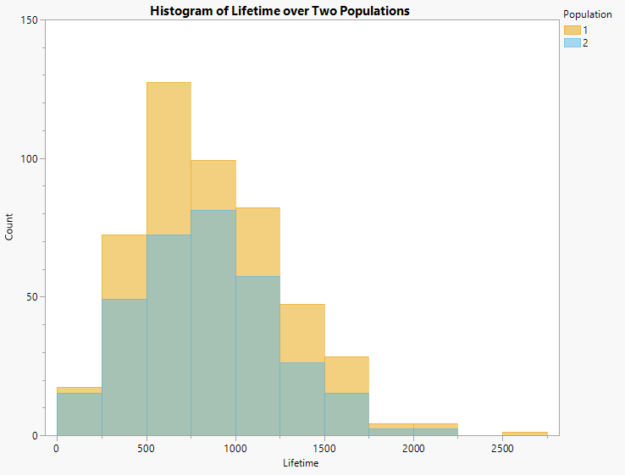
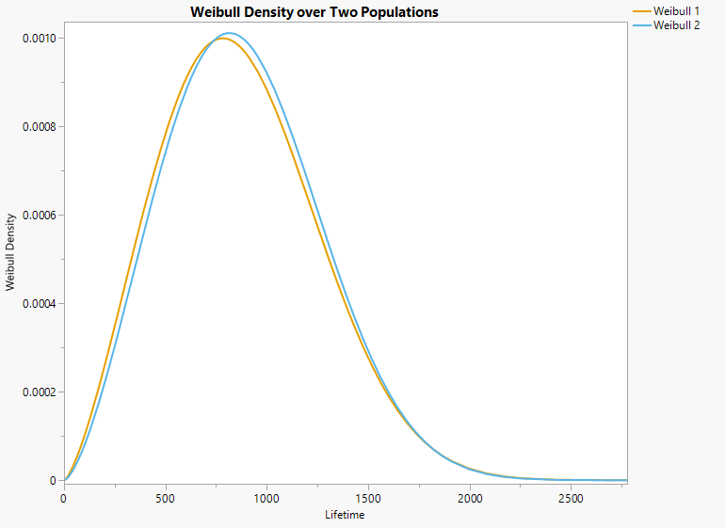
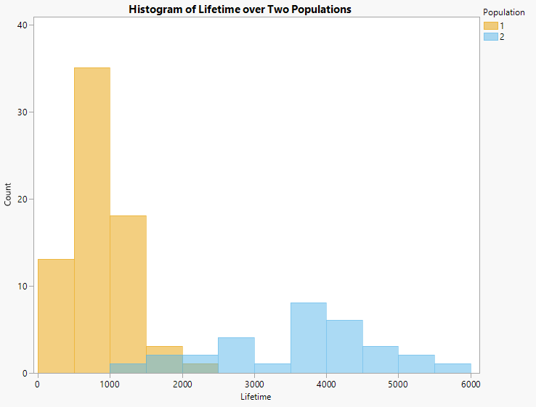
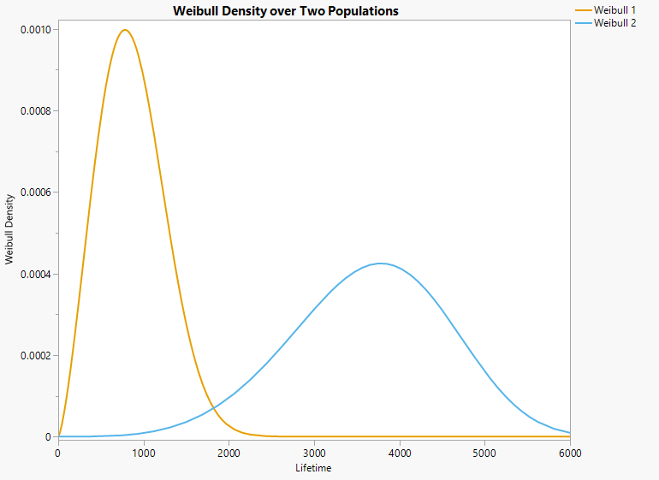
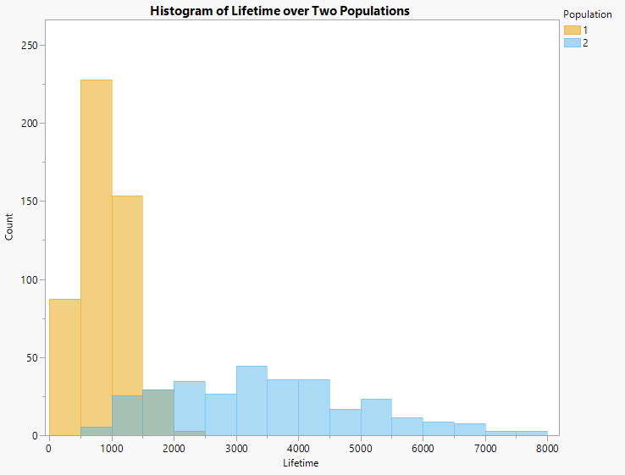
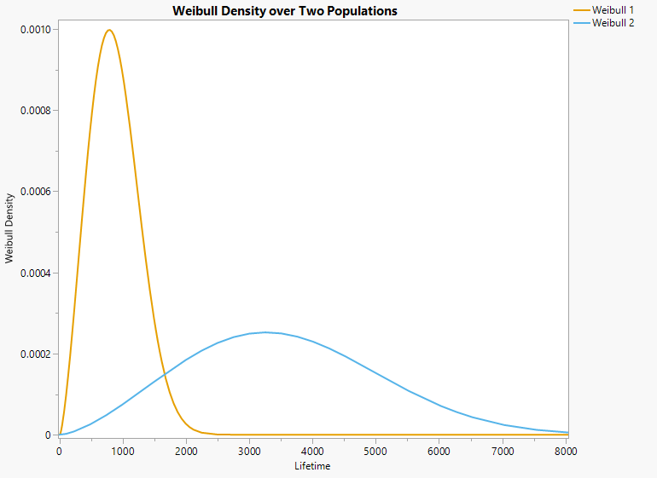
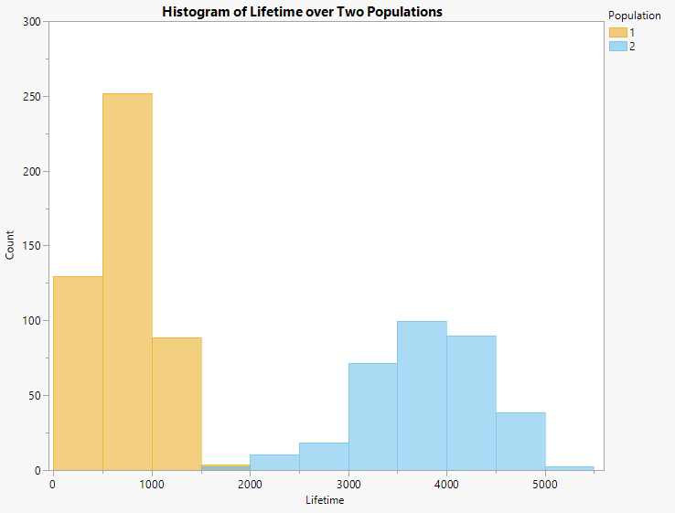
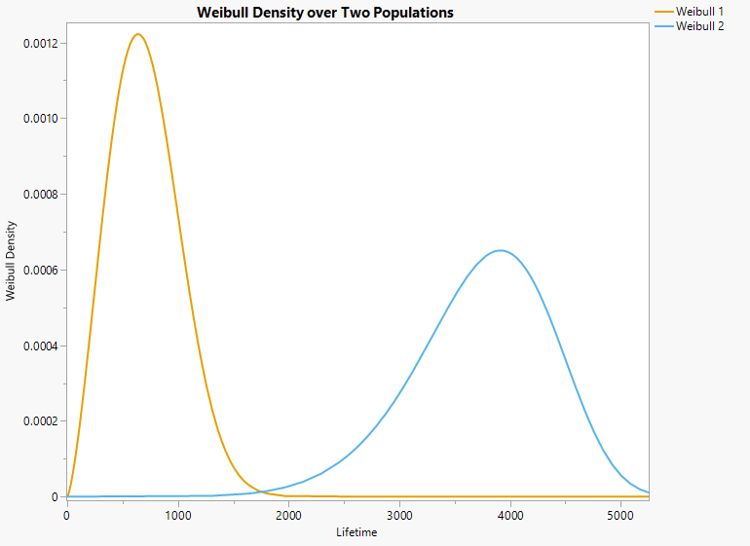
Four examples of overlapped Weibulls, no censoring
Almost Complete Overlap
β₁ | 2.4 | β₂ | 2.5 | p | 0.6
α₁ | 980 | α₂ | 1000
Limited Overlap
β₁ | 2.4 | β₂ | 4.5 | p | 0.6
α₁ | 980 | α₂ | 4000
Partial Overlap
β₁ | 2.4 | β₂ | 2.5 | p | 0.6
α₁ | 980 | α₂ | 4000
Minimal Overlap
β₁ | 2.4 | β₂ | 7 | p | 0.6
α₁ | 800 | α₂ | 4000

Slide 17
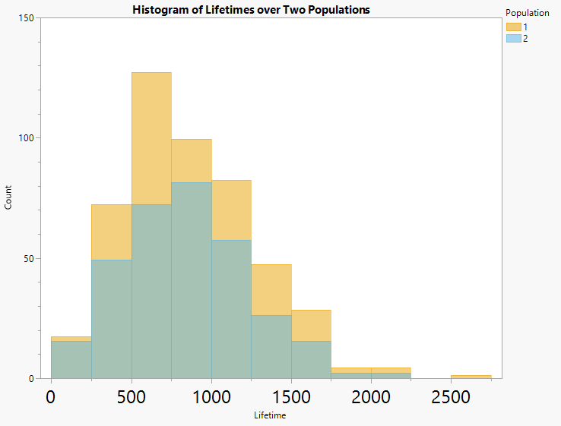
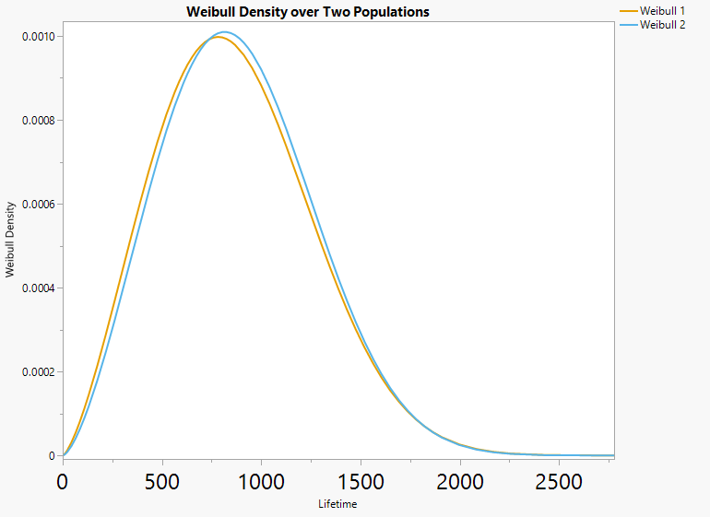
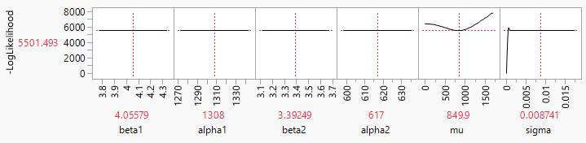
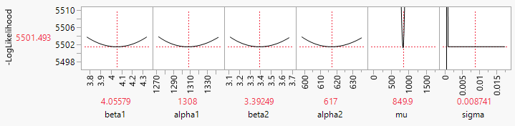
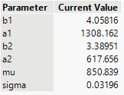
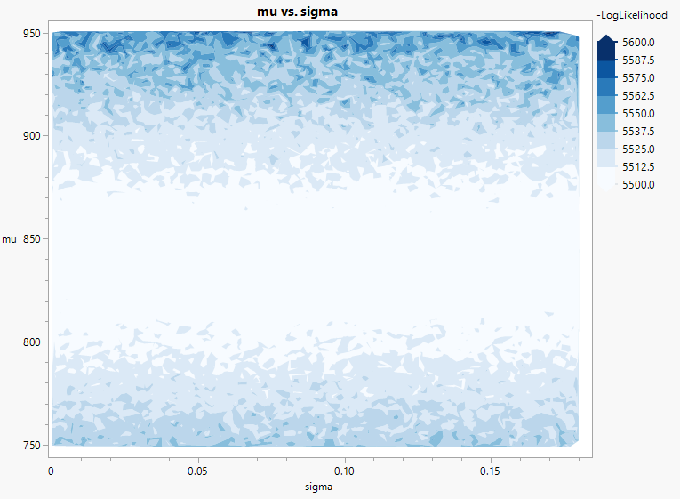
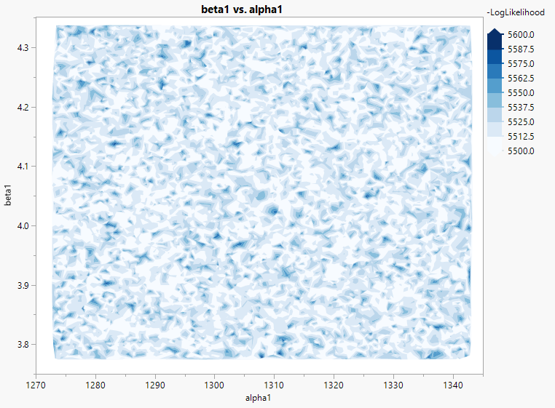
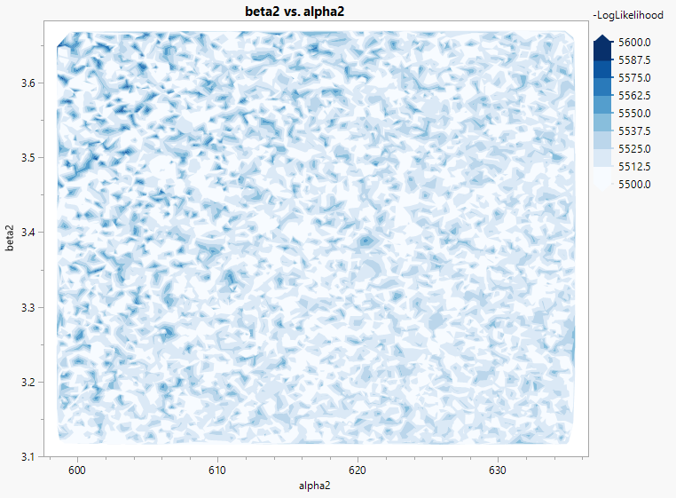
Almost Completely Overlapped Weibulls
Almost Completely Overlapped Weibulls
β₁ | 2.4 | β₂ | 2.5 | p | 0.6
α₁ | 980 | α₂ | 1000

Slide 18
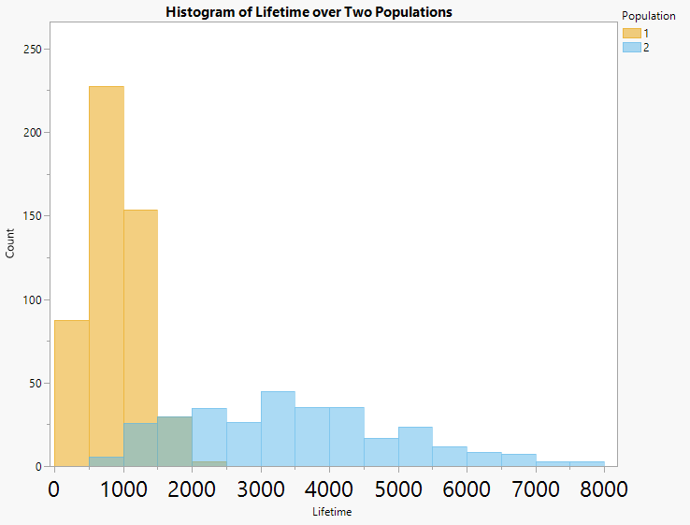
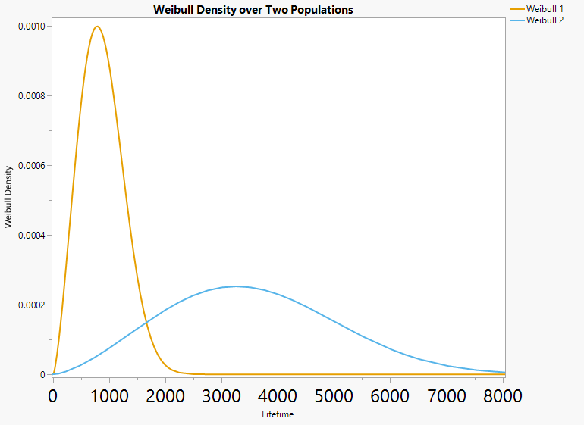
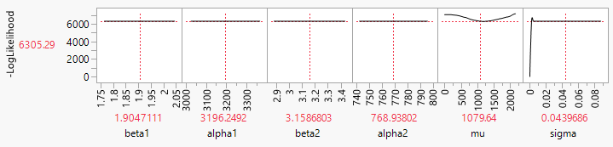
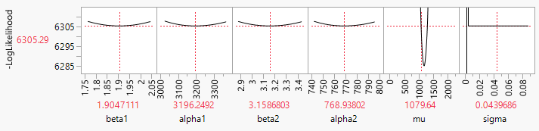
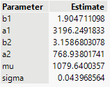
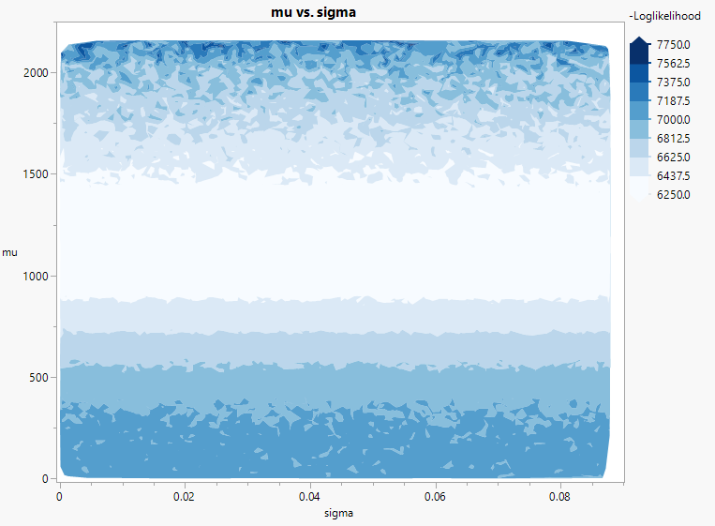
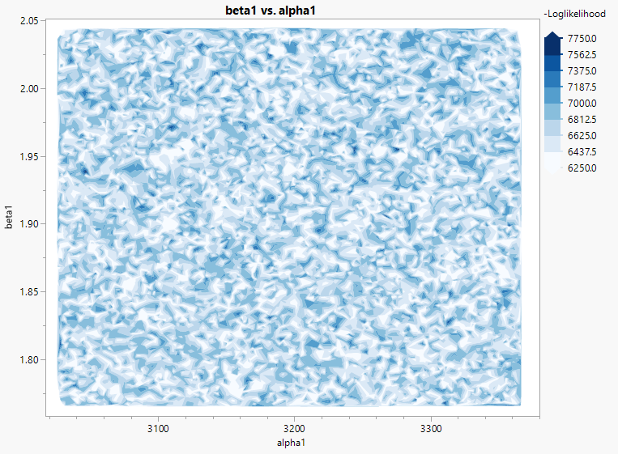
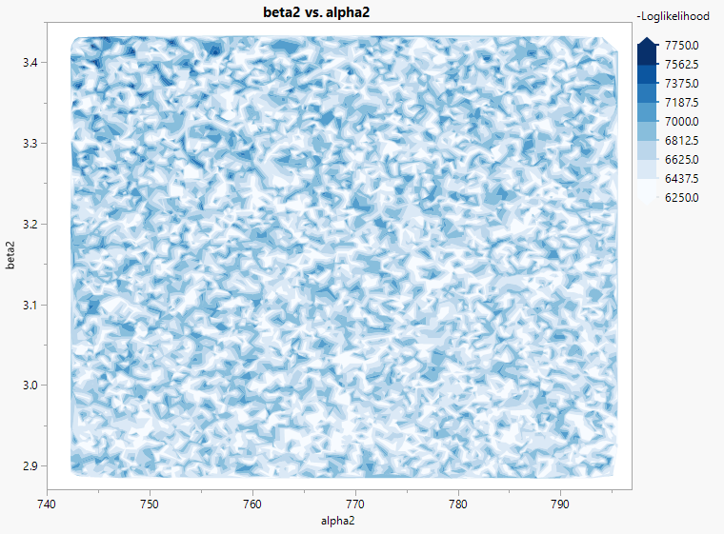
Partially Overlapped Weibulls
Partially Overlapped Weibulls
β₁ | 2.4 | β₂ | 2.5 | p | 0.6
α₁ | 980 | α₂ | 4000

Slide 19
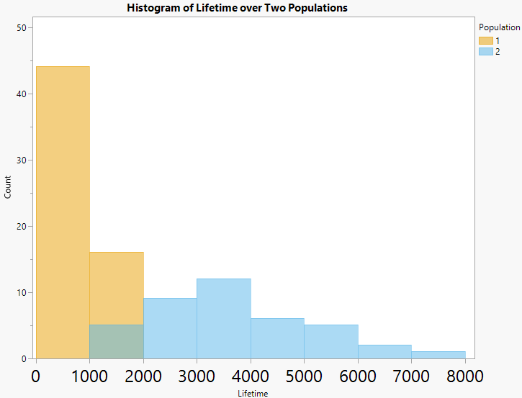
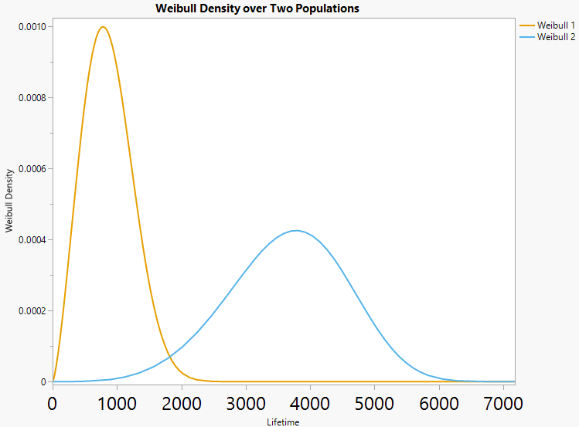
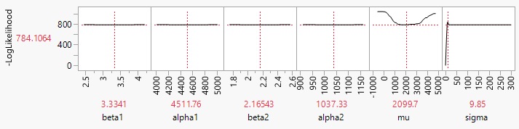
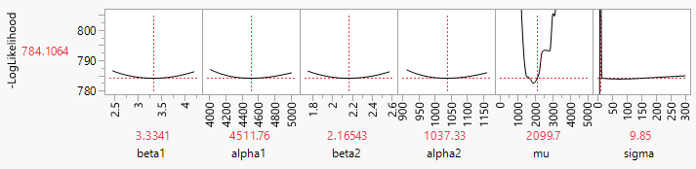
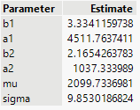
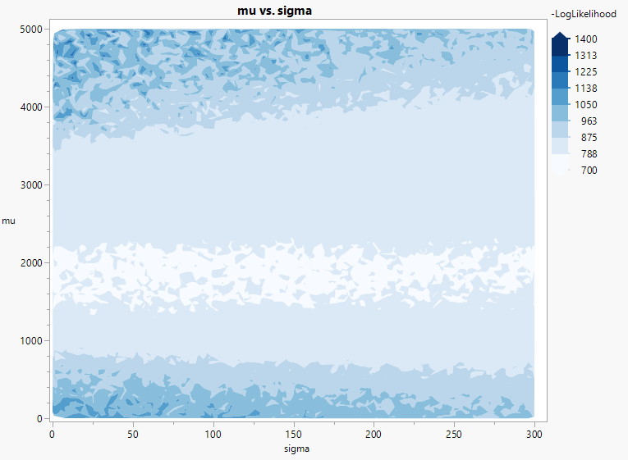
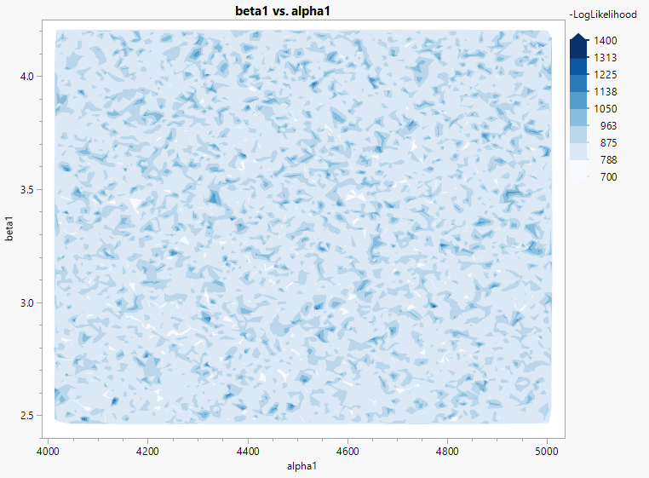
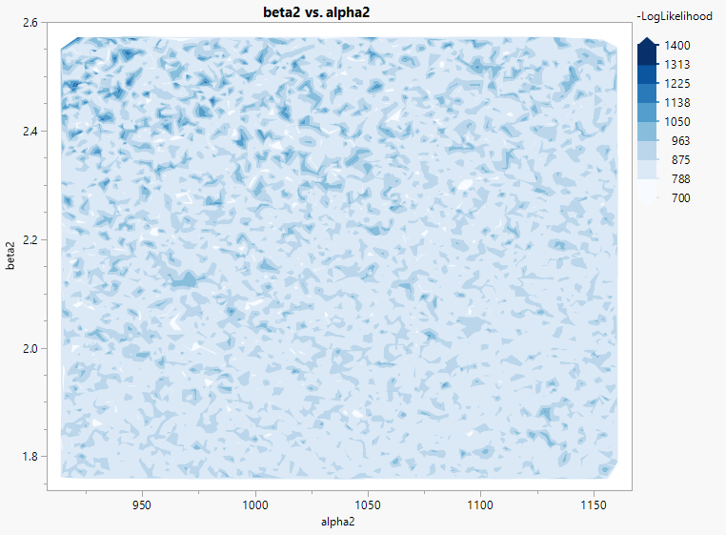
Limited Overlapped Weibulls
Limited Overlapped Weibulls
β₁ | 2.4 | β₂ | 4.5 | p | 0.6
α₁ | 980 | α₂ | 4000

Slide 20
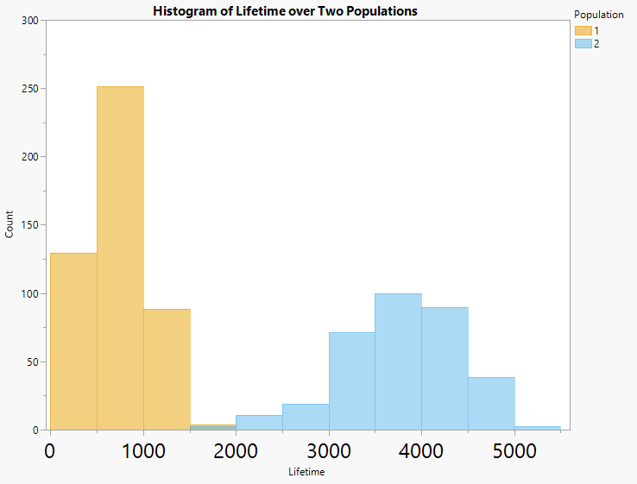
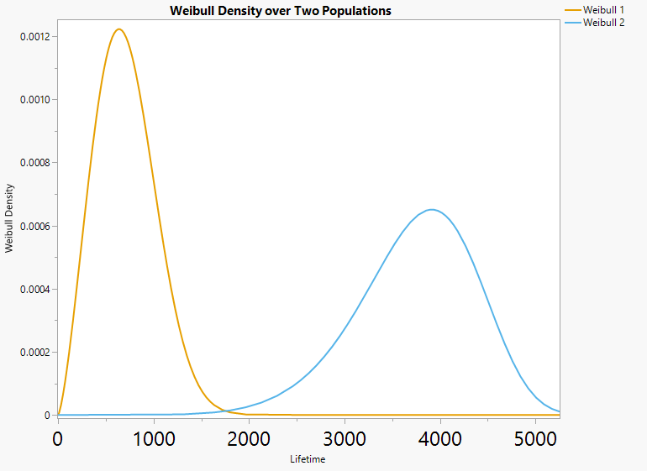
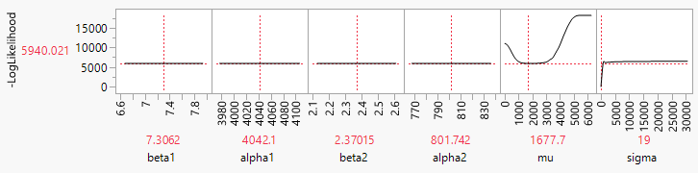
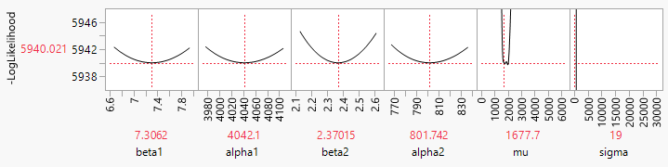
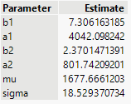
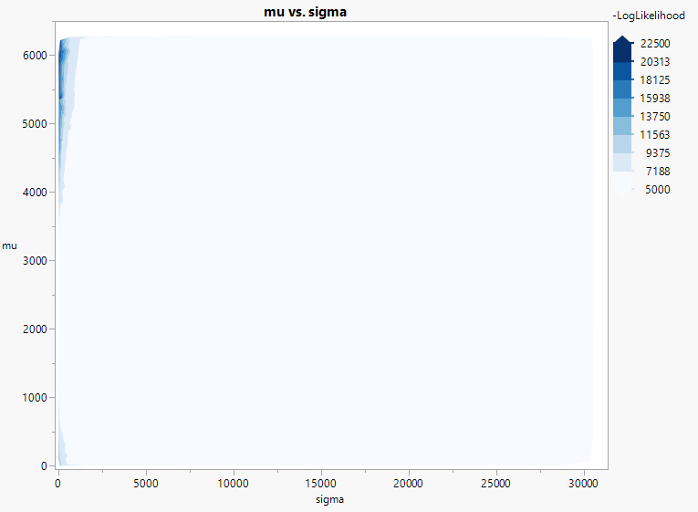
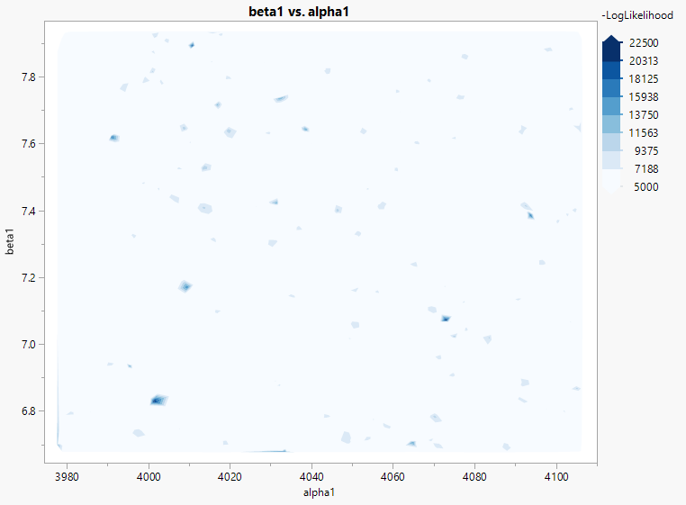
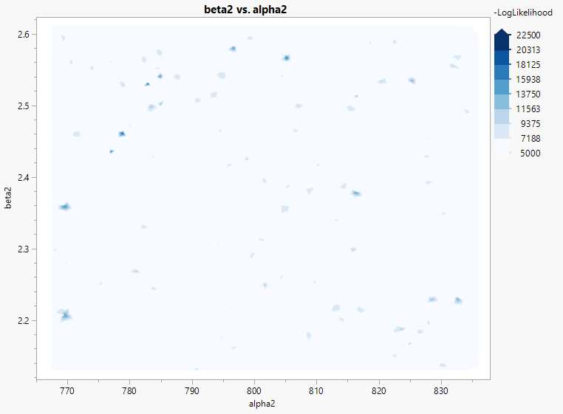
Minimally Overlapped Weibulls
Minimally Overlapped Weibulls
β₁ | 2.4 | β₂ | 7 | p | 0.6
α₁ | 800 | α₂ | 4000

Slide 21
Solution’s Dependence on Model Parameters
Easy identification of μ
  Seems reasonable, given that this parameter determines the where membership in either distribution is equally likely.
Need to be aware of group “swapping”
  The parameter values that optimize the likelihood are a better match to the other group.
The likelihood functions for the distribution parameters are very shallow.
  Greater chance of falling into a local minimum.
The likelihood for σ is practically flat, except for close to zero.
  A value close to zero indicates a sharp transition.
  May indicate stability issues with this particular parameter.
Flat likelihood in minimally overlapped scenario
  As the distributions spread out, there are likely multiple combinations of the probit parameters that will maximize the likelihood.

Slide 22
A Fitting Note
Finding starting values that allowed convergence to reasonable estimates was difficult
  fit a mixture model, use Weibull parameter estimates as starting values for both β and α
  use average of data as starting value for μ
  use 10% of average as starting value for σ
From there, use Newton to find second stage starting values, then use BFGS to optimize
Nonidentifiability was sometimes a problem
  multiple values of μ and σ minimized –logL
  use Newton to find different starting values

Slide 23
Simulation Study
Reproducibility of parameter estimates

Slide 24
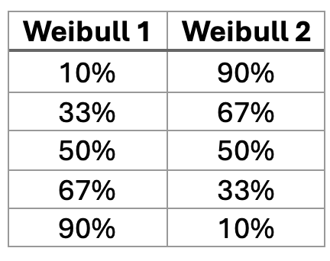
Conditions
Simulate distributions under standard mixture or soft changepoint model.
  For standard mixture, five different mixture proportions ->
  For soft changepoint, μ was fixed at 2000 and sigma was varied as follows: 0.5, 1, 2, 5.
Sample size set at 100; exact failures
500 simulated sets for each condition
Fit using maximum likelihood via SciPy’s Minimize routine (L-BFGS-B). Five random restarts per fitting.
Mixes
Partial Overlap
β₁ | 2.4 | β₂ | 2.5
α₁ | 980 | α₂ | 4000
Limited Overlap
β₁ | 2.4 | β₂ | 4.5
α₁ | 980 | α₂ | 4000

Slide 25
Sample Python Code (generated by Claude and Don)
Probit function
def mixing_weight(x, mu, sigma, log_x=False):
"""
pi(x) = Phi((x* - mu) / sigma)
where x* = log(x) if log_x=True, else x* = x.
log_x should be True when both component distributions
have strictly positive support (Weibull, Frechet, Lognormal),
so the probit acts on the natural-log scale rather than the raw scale.
"""
x = np.asarray(x, float)
z = np.log(np.clip(x, 1e-300, None)) if log_x else x
return norm.cdf((z - mu) / sigma)
Soft changepoint log-likelihood
Standard mix log-likelihood
def log_likelihood(lo, hi, dist1, p1, dist2, p2, mu,
sigma, log_x=False):
mid = _midpoint(lo, hi)
pi = mixing_weight(mid, mu, sigma, log_x=log_x)
pr1 = dist1.prob(lo, hi, p1)
pr2 = dist2.prob(lo, hi, p2)
mix = pi * pr1 + (1 - pi) * pr2
return np.sum(np.log(np.clip(mix, 1e-300, None)))
def neg_ll(theta):
p1_ = _unpack_params(theta[:n1], dist1)
p2_ = _unpack_params(theta[n1:n1+n2], dist2)
pi_ = 1.0 / (1.0 + np.exp(-theta[n1+n2])) # sigmoid
pr1 = dist1.prob(lo, hi, p1_)
pr2 = dist2.prob(lo, hi, p2_)
mix = pi_ * pr1 + (1.0 - pi_) * pr2
return -np.sum(np.log(np.clip(mix, 1e-300, None)))

Slide 26
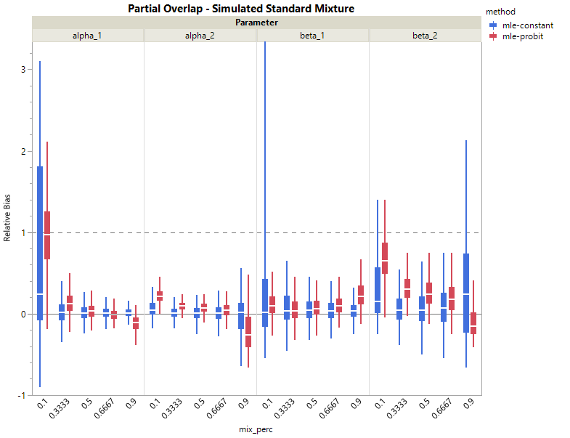
Partial Overlap – Standard Mixture

Slide 27
Partial Overlap – Soft Changepoint
True μ = 2000

Slide 28
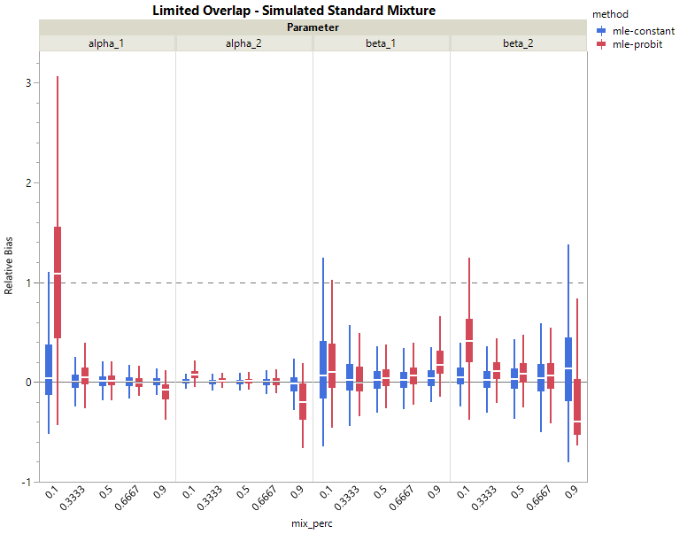
Limited Overlap – Standard Mixture

Slide 29
Limited Overlap – Soft Changepoint
True μ = 2000

Slide 30
Conclusions and Future Research

Slide 31
A Potential Criticism…
In some cases, our method would give results that are not visibly different from that obtained from a standard mixture distribution with overlapping groups.
So, what’s the advantage of our method?
  A mixture distribution approach does not explicitly consider transition boundaries. It assumes a mixed population but lets the underlying distributions specify how “evenly spread” that mixture is.
  With our approach (for two groups at least), we can provide an estimate of a transition point and the level of overlap.
  A likelihood ratio interval or bootstrap interval approach can provide measures of uncertainty on these estimates.

Slide 32
Future Research
How do we handle more than two groups?
  Two probit functions?
  A multivariate probit?
  Something else?
What if we use something other than the probit?
  Logistic?
  Will it make much of a difference?
  What about log-transformations?
What about fitting?
  Algorithms
    EM algorithm performed no better than ML algorithm.
  Starting values
  Bounds
Censored data

Slide 33
Summary
We proposed a method that acts as a hybrid between mixture distribution and changepoint methodologies.
We investigated the nature of the likelihood function to understand potential issues in estimation.
The soft change methodology reproduced the parameter estimates well enough to warrant further investigation.
Our method allows for estimating both location and intensity of change between two groups.

Slide 34
References

Slide 35
Thank you!
Di Michelson
di.michelson@jmp.com
Don McCormack
don.mccormack@jmp.com
Caleb King
caleb.king@jmp.com

Slide 36
Almost Completely Overlapped Weibulls
Almost Completely Overlapped Weibulls
β₁ | 2.4 | β₂ | 2.5 | p | 0.6
α₁ | 980 | α₂ | 1000

Slide 37
Partially Overlapped Weibulls
Partially Overlapped Weibulls
β₁ | 2.4 | β₂ | 2.5 | p | 0.6
α₁ | 980 | α₂ | 4000

Slide 38
Limited Overlapped Weibulls
Limited Overlapped Weibulls
β₁ | 2.4 | β₂ | 4.5 | p | 0.6
α₁ | 980 | α₂ | 4000

Slide 39
Minimally Overlapped Weibulls
Minimally Overlapped Weibulls
β₁ | 2.4 | β₂ | 7 | p | 0.6
α₁ | 800 | α₂ | 4000

Slide 41
Welcome to the Grid
Describe the grid-based search here…
Explain why not EM procedure?

Slide 42
Four examples of overlapped Weibulls, no censoring
Almost Complete Overlap
β₁ | 2.4 | β₂ | 2.5 | p | 0.6
α₁ | 980 | α₂ | 1000
Limited Overlap
β₁ | 2.4 | β₂ | 4.5 | p | 0.6
α₁ | 980 | α₂ | 4000
Partial Overlap
β₁ | 2.4 | β₂ | 2.5 | p | 0.6
α₁ | 980 | α₂ | 4000
Minimal Overlap
β₁ | 2.4 | β₂ | 7 | p | 0.6
α₁ | 800 | α₂ | 4000

Slide 43
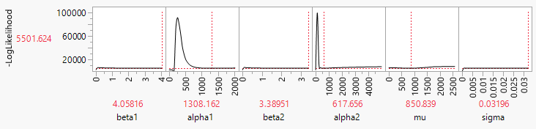
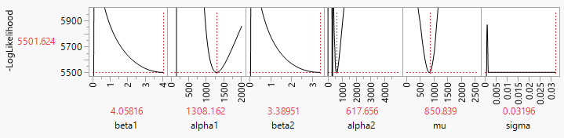
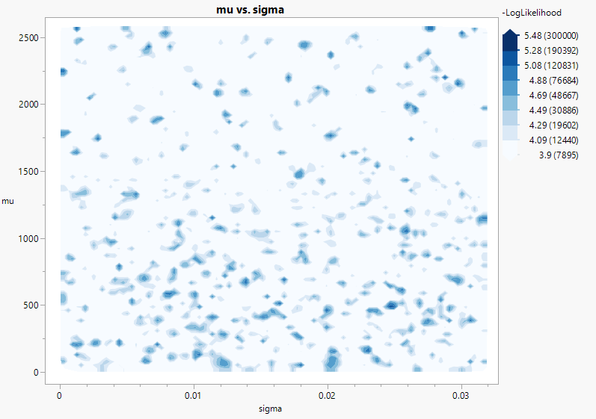
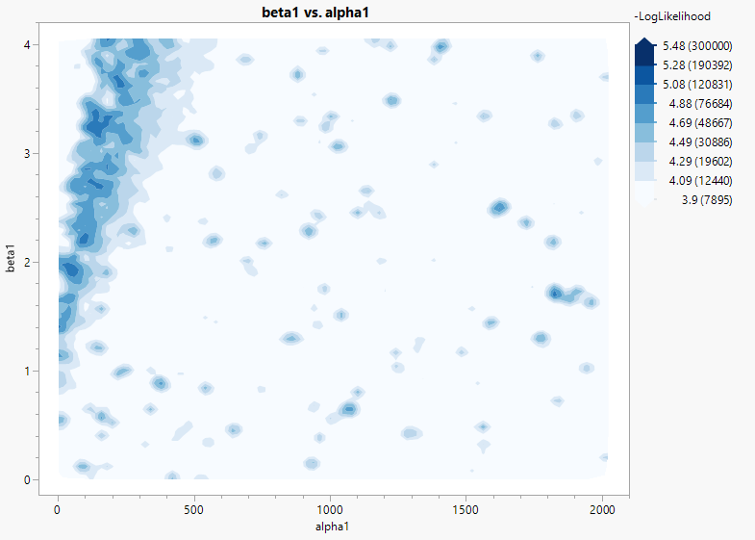
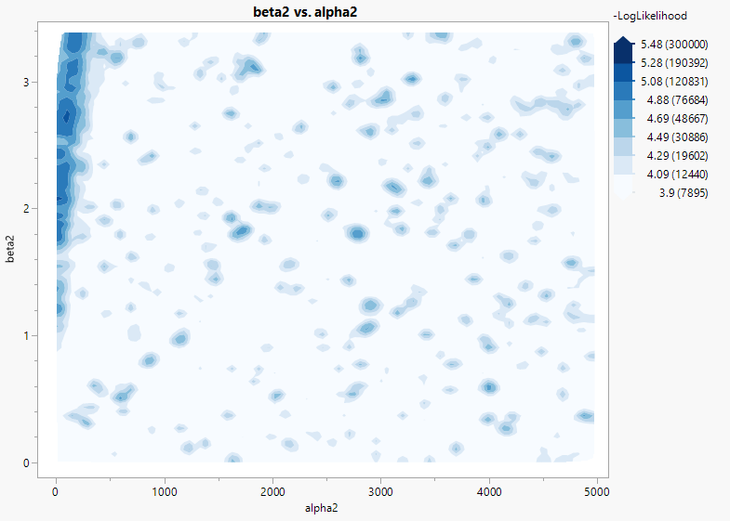
Almost Completely Overlapped Weibulls
Almost Completely Overlapped Weibulls
β₁ | 2.4 | β₂ | 2.5 | p | 0.6
α₁ | 980 | α₂ | 1000

Slide 44





Partially Overlapped Weibulls
Partially Overlapped Weibulls
β₁ | 2.4 | β₂ | 2.5 | p | 0.6
α₁ | 980 | α₂ | 4000

Slide 45



Limited Overlapped Weibulls
Limited Overlapped Weibulls
β₁ | 2.4 | β₂ | 4.5 | p | 0.6
α₁ | 980 | α₂ | 4000

Slide 46






Minimally Overlapped Weibulls
Minimally Overlapped Weibulls
β₁ | 2.4 | β₂ | 7 | p | 0.6
α₁ | 800 | α₂ | 4000

Slide 47

Some Overlap
Summary – Betas

Slide 48

Some Overlap
Summary – Alpha 1

Slide 49

Some Overlap
Summary – Alpha 2

Slide 50

Some Overlap
Betas

Slide 51

Some Overlap
Alpha 1

Slide 52

Some Overlap
Alpha 2

Slide 53
Four examples of overlapped Weibulls, no censoring
Almost Complete Overlap
β₁ | 2.4 | β₂ | 2.5 | p | 0.6
α₁ | 980 | α₂ | 1000
Limited Overlap
β₁ | 2.4 | β₂ | 4.5 | p | 0.6
α₁ | 980 | α₂ | 4000
Partial Overlap
β₁ | 2.4 | β₂ | 2.5 | p | 0.6
α₁ | 980 | α₂ | 4000
Minimal Overlap
β₁ | 2.4 | β₂ | 7 | p | 0.6
α₁ | 800 | α₂ | 4000

Slide 54
Illustration

Slide 55
Application Example
Describe Mahul’s data here…
Should we compare to standard mixture and changepoint methods?

Slide 56
Conditions
Parameters shown below
Five different percent mixes for the two distributions.
Three sample sizes: 50, 100 and 250
Exact failures, 5000 sets for each combination
Fit using maximum likelihood via SciPy’s Minimize routine (L-BFGS-B). Bounds on beta (0, 100) and
alpha (0, 10000)
Mixes
Partial Overlap
β₁ | 2.4 | β₂ | 2.5
α₁ | 980 | α₂ | 4000
Limited Overlap
β₁ | 2.4 | β₂ | 4.5
α₁ | 980 | α₂ | 4000

Slide 57
Code
def loglik_mix(params,t):
b1, b2, a1, a2, p = params
ll = p*weibull_pdf(t,b1,a1) + \
(1-p)*weibull_pdf(t,b2,a2)
ll = np.clip(ll, 1e-300, 1.0)
neg2ll = -2*np.log(ll)
return np.sum(neg2ll)
def loglik_change(params,t):
b1, b2, a1, a2, m, s = params
ll = (1-sp.norm.cdf(t,m,s))*weibull_pdf(t,b1,a1) + \
sp.norm.cdf(t,m,s)*weibull_pdf(t,b2,a2)
ll = np.clip(ll, 1e-300, 1.0)
neg2ll = -2*np.log(ll)
return np.sum(neg2ll)
def weibull_pdf(t, beta, alpha):
#Weibull parameterization
out = np.empty_like(t, dtype=float)
z = (beta/alpha)*(t/alpha)**(beta-1)*np.exp(-(t/alpha)**beta)
z = np.clip(z, 0.0, 1e300)
return z

Slide 58
Partial Overlap
β₁ = 2.4, β₂ = 2.5
MAD – Betas

Slide 59
Partial Overlap
α₁ = 980
MAD – Alpha 1

Slide 60
Partial Overlap
α₂ = 4000
MAD – Alpha 2

Slide 61
Minimal Overlap
β₁ = 2.4, β₂ = 7.0
MAD – Betas

Slide 62
Minimal Overlap
α₁ = 800
MAD – Alpha 1

Slide 63
Minimal Overlap
α₂ = 4000
MAD – Alpha 2

