Slide 1


Optimizing Spending for Operational Readiness:
A Decision Support Dashboard
CDT Grayson Peyovich
Advisor: LTC Jonathan Paynter
Sponsor: AI2C
Distribution Statement A. Approved for public release: distribution is unlimited.

Slide 2
The Problem: What to buy?
Situation: Finance Officer in Brigade S8 Shop, Boss needs you to approve Orders for the Week

Slide 3
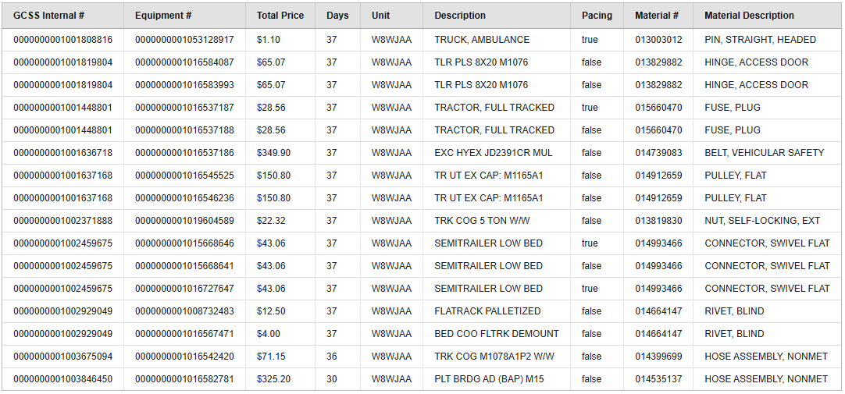
The Problem: What to buy?
Situation: Finance Officer in Brigade S8 Shop, Boss needs you to approve Orders for the Week

Slide 4
The Problem: What to buy?
Situation: Finance Officer in Brigade S8 Shop, Boss needs you to approve Orders for the Week
+29 more columns
100+ more rows to choose from

Slide 5


What information would you want?
Readiness by Equipment by Unit

Slide 6
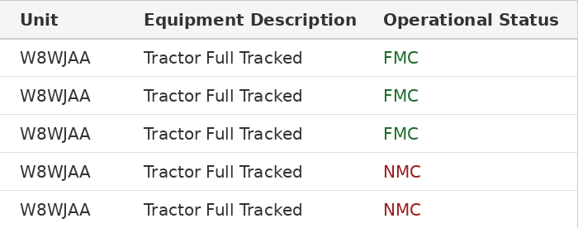
What information would you want?
Readiness by Equipment by Unit
Define Operational Readiness (# FMC/# total) on the Equipment Level
Allows a unit to see which equipment types are lacking relative to others
Current OR Rate: 60%

Slide 7
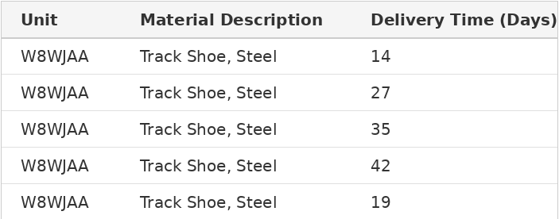
What information would you want?
Historical Lead Time by Part by Unit

Slide 8
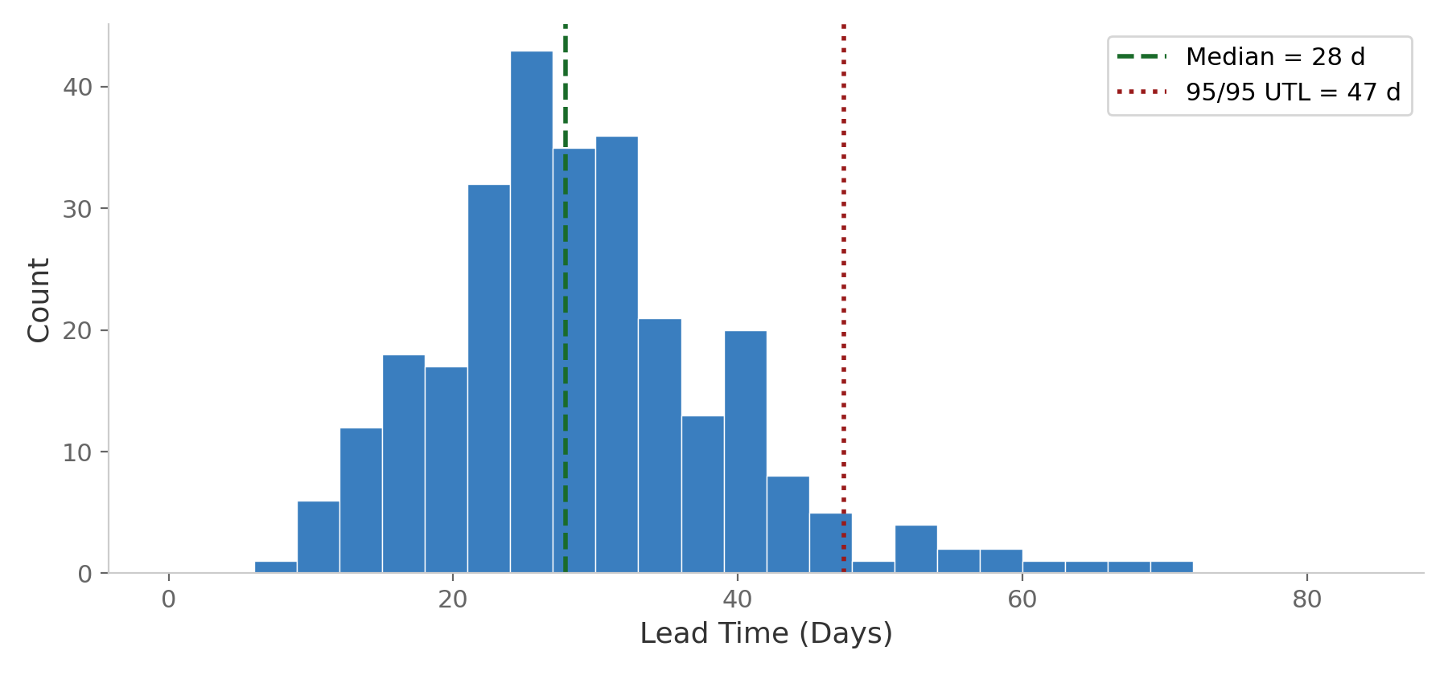
What information would you want?
Historical Lead Time by Part by Unit
Historically, how long has it taken your unit to receive that part?
Backed by dataset containing every order ever placed by the Army, ~18M orders
Allows us to extract distribution metrics: expected lead time (median), and upper limit (95% confidence)
Median Lead Time: 27.4

Slide 9
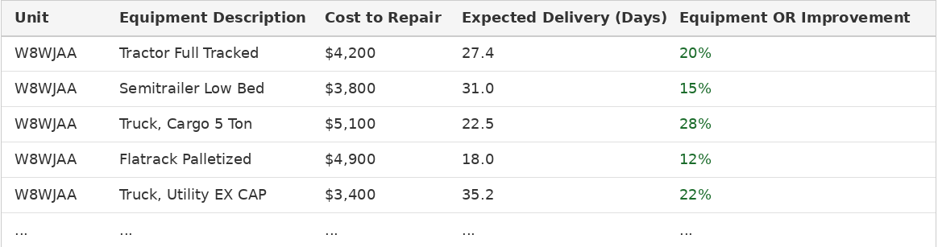
Order Information + Context
Repeating across every unfunded equipment and in a Unit, we can create the above table, where:
  Cost To Repair = sum(Price per Part)
  Expected Delivery = max(Part Expected Lead Time)
Allows a user to prioritize spending by OR, under constraints
How do we present this to the user?

Slide 10
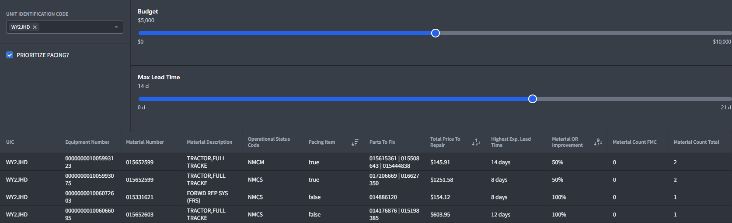
The Solution: Readiness Dashboard
Take in User Constraints (Unit, Budget, and Lead Time)
Extract Historical Lead Times (specific to Unit and Material)
Filter Unit’s Current Unfunded Orders to meet Constraints
Extract Current Operational Readiness (by Unit, by Material)
Provide Individualized Ranking by Equipment: OR Improvement > Cost > Lead Time

Slide 11
The Solution: Readiness Dashboard
Take in User Constraints (Unit, Budget, and Lead Time)
Extract Historical Lead Times (specific to Unit and Material)
Filter Unit’s Current Unfunded Orders to meet Constraints
Extract Current Operational Readiness (by Unit, by Material)
Provide Individualized Ranking by Equipment: OR Improvement > Cost > Lead Time

Slide 12
The Solution: Readiness Dashboard
Take in User Constraints (Unit, Budget, and Lead Time)
Extract Historical Lead Times (specific to Unit and Material)
Filter Unit’s Current Unfunded Orders to meet Constraints
Extract Current Operational Readiness (by Unit, by Material)
Provide Individualized Ranking by Equipment: OR Improvement > Cost > Lead Time

Slide 13
The Solution: Readiness Dashboard
Take in User Constraints (Unit, Budget, and Lead Time)
Extract Historical Lead Times (specific to Unit and Material)
Filter Unit’s Current Unfunded Orders to meet Constraints
Extract Current Operational Readiness (by Unit, by Material)
Provide Individualized Ranking by Equipment: OR Improvement > Cost > Lead Time

Slide 14
The Solution: Readiness Dashboard
Take in User Constraints (Unit, Budget, and Lead Time)
Extract Historical Lead Times (specific to Unit and Material)
Filter Unit’s Current Unfunded Orders to meet Constraints
Extract Current Operational Readiness (by Unit, by Material)
Provide Individualized Ranking by Equipment: OR Improvement > Cost > Lead Time

Slide 15
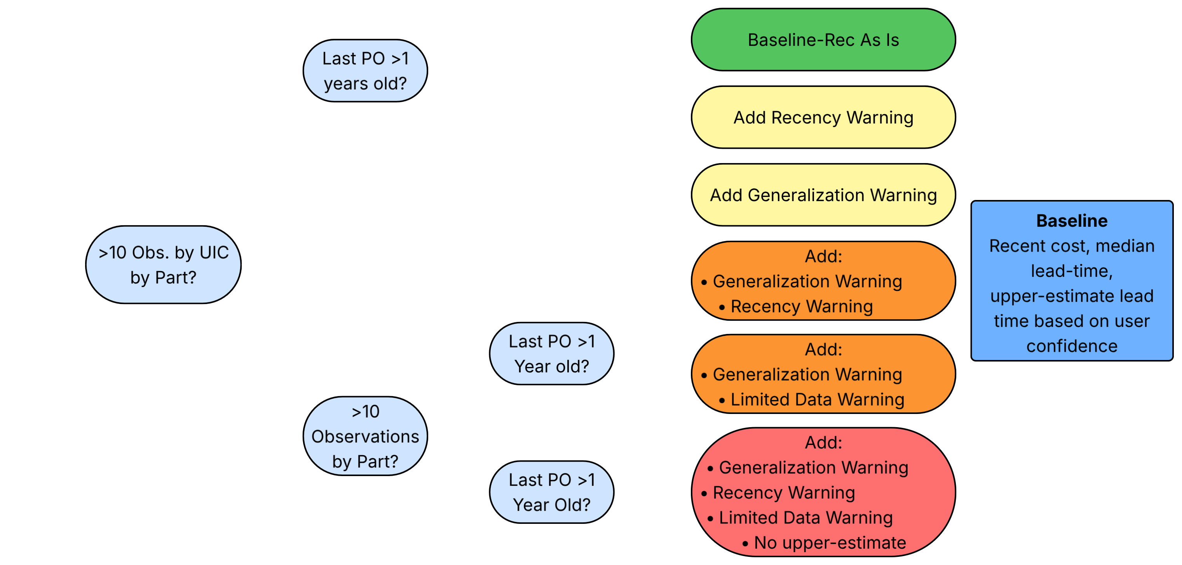
Handling Limited Data
Despite 18M rows, not every unit has robust data for every part
Do the best we can, but some units lack:
  Recent data,
  Unit-specific data,
  Robust data
Still provide estimates, but warnings when necessary:

Slide 16




Handling Limited Data
Despite 18M rows, not every unit has robust data for every part
Do the best we can, but some units lack:
  Recent data,
  Unit-specific data,
  Robust data
Still provide estimates, but warnings when necessary:

Slide 17
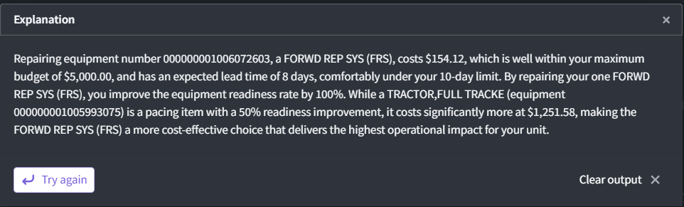
AI-Powered Interpretability
Drill through option provides AI-backed explanation, weighing costs and benefits of user’s selected option against others

Slide 18
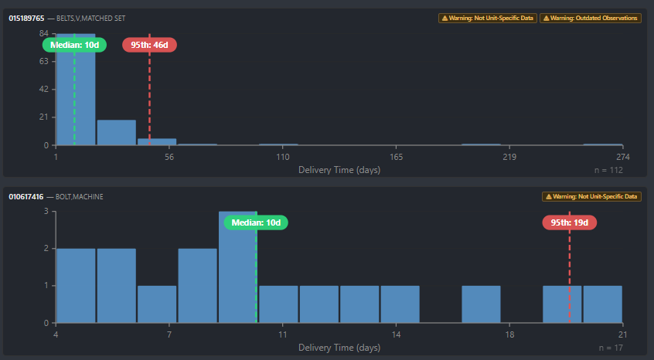
Part-by-Part Drill Through
View delivery distributions by part within equipment
Provides an expected (median) delivery time, and a 95% confidence upper limit
Complete with warnings specific to part/unit

Slide 19
Future Work
Portfolio Mode – Which Bundle of Equipment Improves my Unit’s OR the most? (Knapsack Problem)
Integrate Operator Availability – if this Part Arrives at this Time, will I have someone ready to install it?
Provide finished product to AI2C for real-time deployment and testing

Slide 20
Thank you!

