Slide 1
Probability of Detection:
Evaluating the Reliability of
Nondestructive Inspection Systems
Christine Knott, PhD, Research Mathematician
AFRL/RXNW, Material state awareness branch

Slide 2
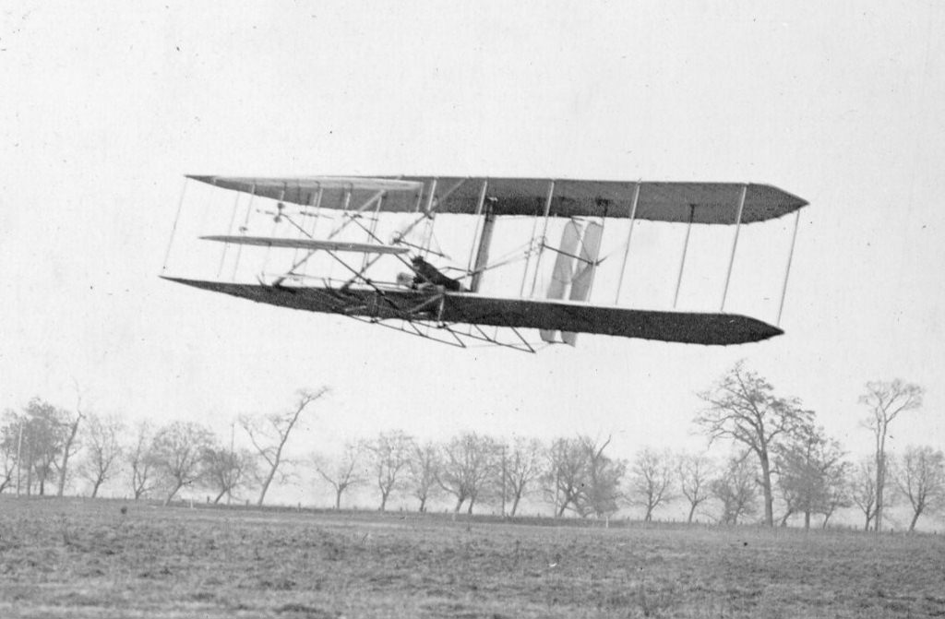
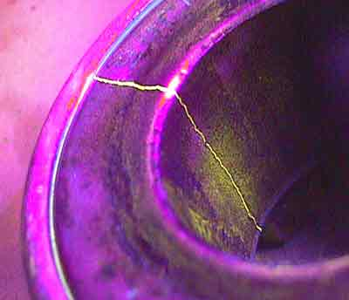
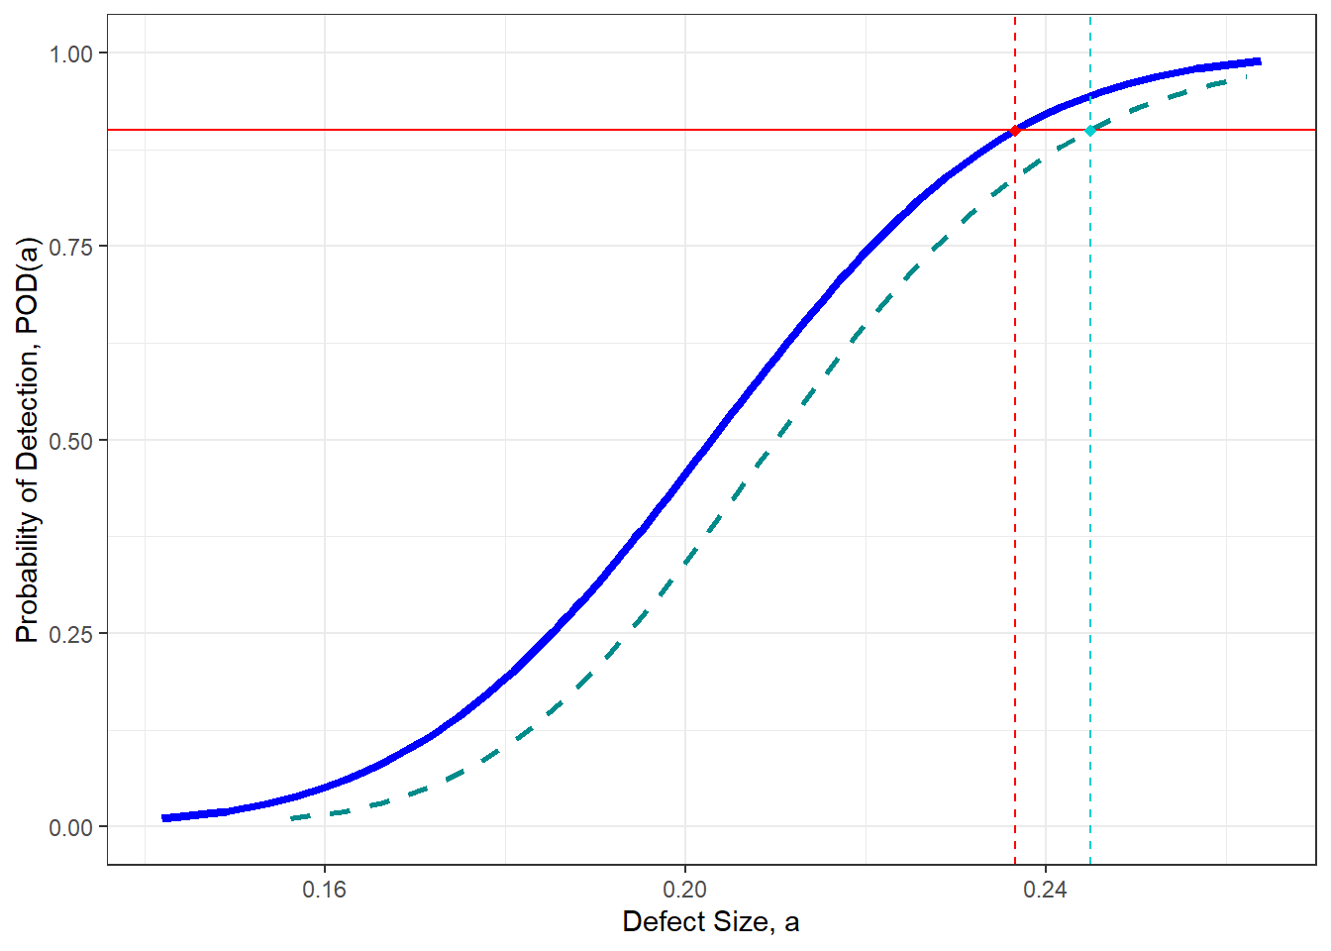
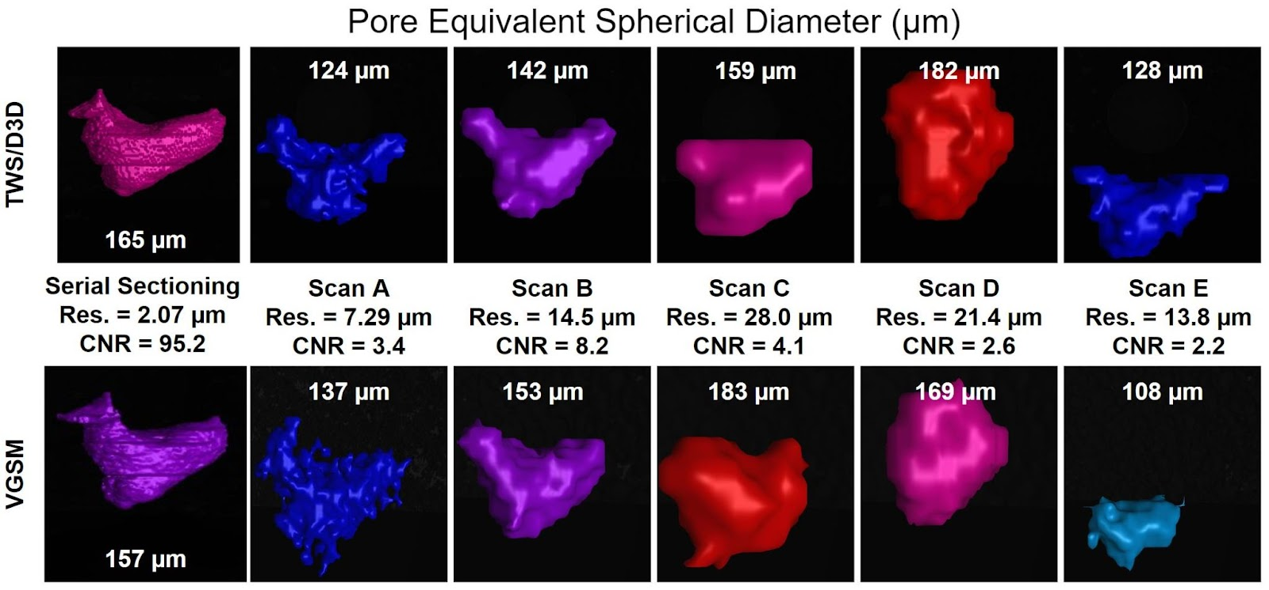
Agenda
Background
Designing the Experiment
Statistical Analysis
Example: XCT for AM

Slide 3



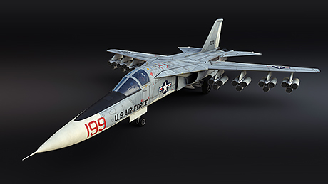
Evolution of Aircraft Structural Integrity
1903: Wright Brothers’ Static Loads Tests
During WWII, fatigue rarely seen
1956: Air Force structural integrity through Safe-Life
  Service Life Capability: “the total number of operating hours of the specific mission spectrum through which an aircraft structure has been determined by test and analysis to be capable of operating safely and economically,”
Cold War Era Losses
  1958: B-47 medium-range strategic bomber for nuclear deterrence
    Designed for high-altitude, used for low-altitude: fast pull-up,
    more weight, frequent take-off/landings
    Lost five B-47s in March and April of 1958 in midair - 4 had structural fatigue failure
  1969: F-111A fighter bomber and F-5 fighter - fatigue-related accidents
  well before end of safe-life
Damage Tolerant Design
  Assume aircraft have pre-existing manufacturing defects
  Safety through design, nondestructive inspection and maintenance

Slide 4
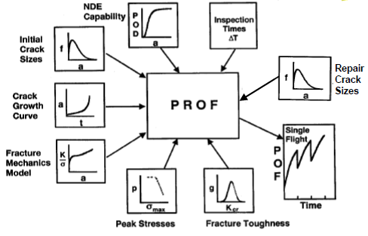
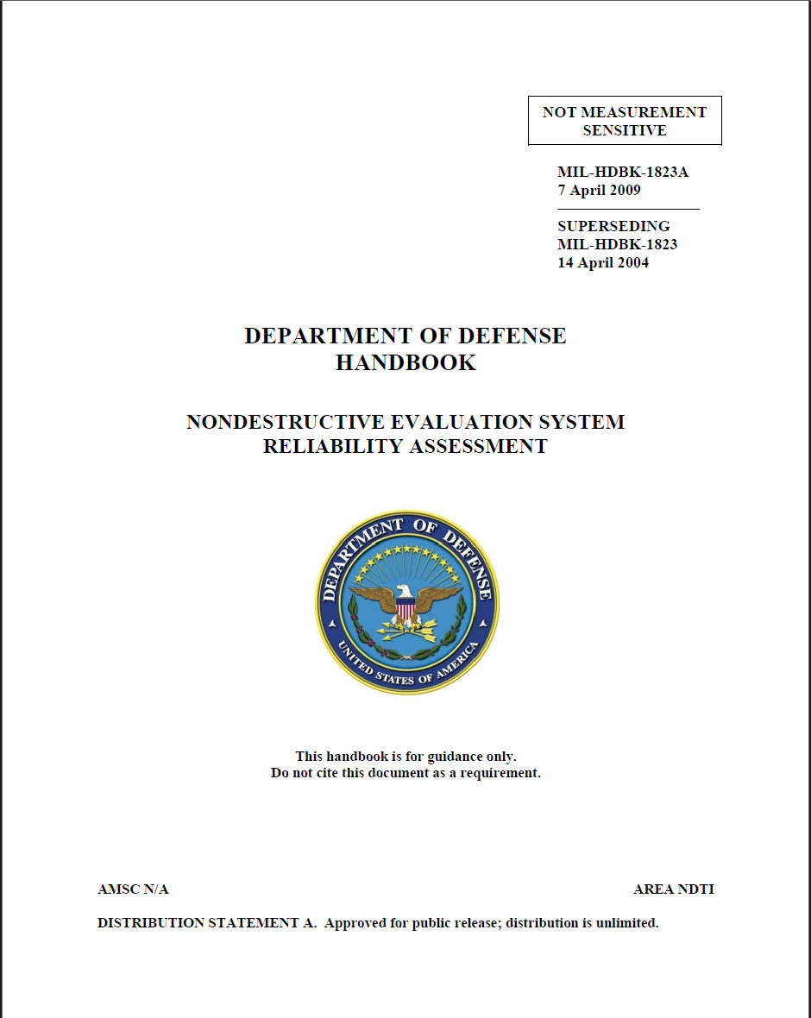




Damage Tolerant Design Goal: multiple nondestructive inspection opportunities on critical structures before failure
Initial Inspection
In-service Inspections
$a_{crit}$=Critical Flaw Size
(Part Failure)
Flaw Growth Curve
RISK OF FAILURE
$aNDI$=NDI Capability Limit
$a0$=Initial Flaw Size
0 600 1200
FLIGHT HOURS
Inspection Frequency
Safety Risk
Too Infrequent
Optimal
Too Frequent
Expensive (Time/Money)
Unavailable for Mission

Slide 5
Probability of Detection: What is the largest defect size a nondestructive inspection system may miss?
Probability of Detection
DOE Goal: Understand capabilities of a specific NDE/NDI system for a
specific application
Design an experiment which varies over all the known variables
Create specimens which represent the specific application
  Embed the appropriate kinds of defect/flaw/crack in some of the specimens
  Measure the size of the created defects
Perform round-robin study
  Specimens taken to several inspection locations
  Inspectors use the inspection system to gather data without knowing which specimens contain flaws.
Collected experiment data is analyzed using Statistical Models
  1. False Positive Rate checked
  2. Crack data (True Positives + False Negatives) analyzed using POD Methods
Results provide inputs to damage tolerant design calculations of inspection intervals
 | Flaw Detected | No Flaw Detected
Flaw Exists | True Positive | False Negative
No Flaw Exists | False Positive | True Negative
POD studies provide helpful inputs to decision-makers, but engineering judgement is still necessary.

Slide 6
Agenda
Background
Designing the Experiment
Statistical Analysis
Example: XCT for AM

Slide 7
Picking the inspection interval depends on the analysis of a designed experiment over all the important variables
Input Variables
  Defect Size
  People
  Part
  Probe
Notes:
S.K. Bhaumik, M. Sujata, M.A. Venkataswamy, Fatigue failure of aircraft components, Engineering Failure Analysis, Volume 15, Issue 6, 2008, Pages 675-694, ISSN 1350-6307, https://doi.org/10.1016/j.engfailanal.2007.10.001. (https://www.sciencedirect.com/science/article/pii/S1350630707001409)
NIST Advanced Manufacturing Series 100-16 Literature Review of Metal Additive Manufacturing Defects Felix H. Kim Shawn P. Moylan Engineering Laboratory May 2018

Slide 8
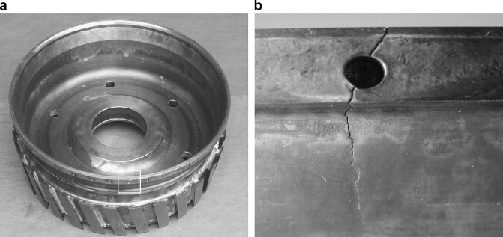
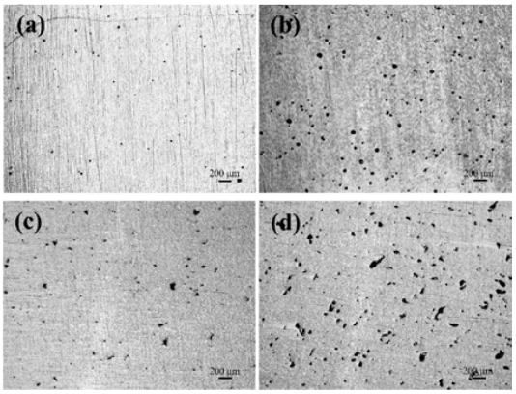
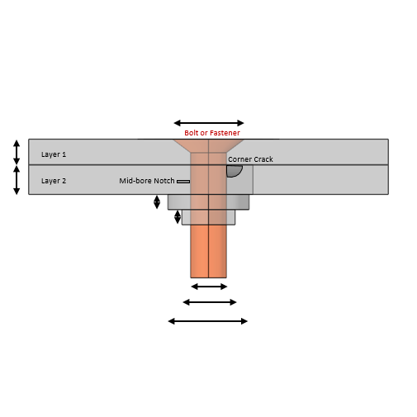
Picking the inspection interval depends on the analysis of a designed experiment over all the important variables
Input Variables
  Defect Size
  People
  Part
  Probe
Surface cracks
Internal Cracks
Corner Cracks
Notches
Corrosion
Pores
Delamination
Notes:
S.K. Bhaumik, M. Sujata, M.A. Venkataswamy, Fatigue failure of aircraft components, Engineering Failure Analysis, Volume 15, Issue 6, 2008, Pages 675-694, ISSN 1350-6307, https://doi.org/10.1016/j.engfailanal.2007.10.001. (https://www.sciencedirect.com/science/article/pii/S1350630707001409)
NIST Advanced Manufacturing Series 100-16 Literature Review of Metal Additive Manufacturing Defects Felix H. Kim Shawn P. Moylan Engineering Laboratory May 2018
CNDE https://www.nde-ed.org/NDETechniques/MagParticle/Indications/WetExamples.xhtml

Slide 9
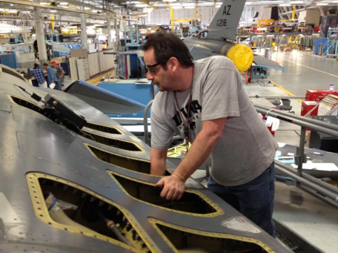
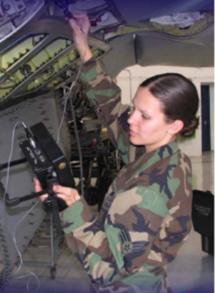
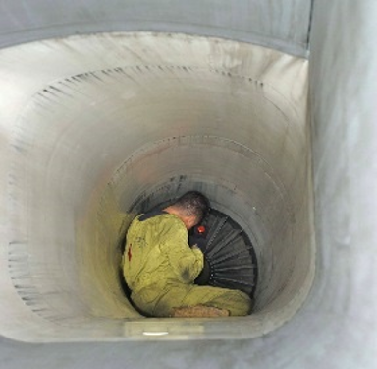
Picking the inspection interval depends on the analysis of a designed experiment over all the important variables
Input Variables
  Defect Size
  People
  Part
  Probe
Different levels of experience
Different areas of experience

Slide 10
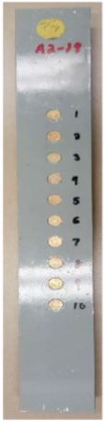
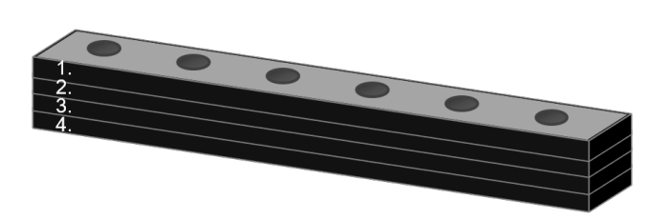
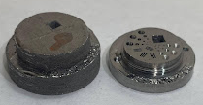
Picking the inspection interval depends on the analysis of a designed experiment over all the important variables
Input Variables
  Defect Size
  People
  Part
  Probe
    Material(s)
    metal
    composite
    Geometry
    flat plate
    bolt hole
    Fastener head
    Joint
    fins
Notes:
S.K. Bhaumik, M. Sujata, M.A. Venkataswamy, Fatigue failure of aircraft components, Engineering Failure Analysis, Volume 15, Issue 6, 2008, Pages 675-694, ISSN 1350-6307, https://doi.org/10.1016/j.engfailanal.2007.10.001. (https://www.sciencedirect.com/science/article/pii/S1350630707001409)

Slide 11
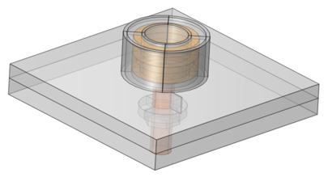
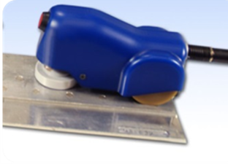
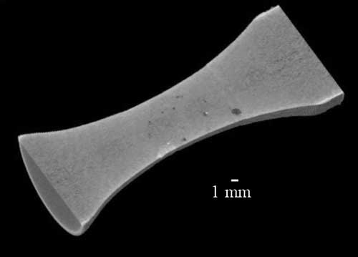
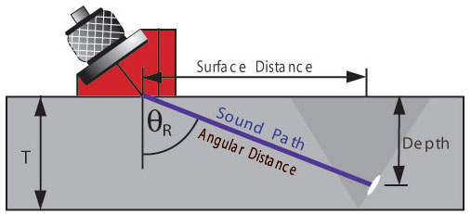
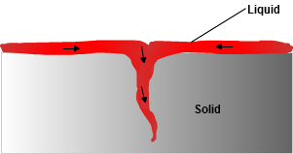
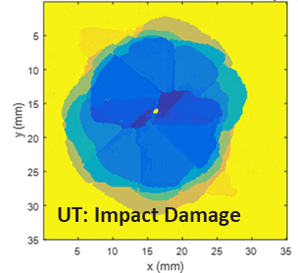
Picking the inspection interval depends on the analysis of a designed experiment over all the important variables
Input Variables
  Defect Size
  People
  Part
  Probe
Eddy Current
  Probe characteristics
  frequency
  field of view
  fixtures
  Calibration procedure
  how often?
  Noise
  electrical noise
  signal-to-noise
Magnetic Particle
Radiography
Florescent Penetrant
Ultrasound
Notes:
CNDE (https://www.nde-ed.org/NDETechniques/Ultrasonics/MeasurementTech/beaminspection.xhtml) and CNDE https://www.nde-ed.org/NDETechniques/MagParticle/Indications/WetExamples.xhtml

Slide 12
Agenda
Background
Designing the Experiment
Statistical Analysis
Example: XCT for AM

Slide 13
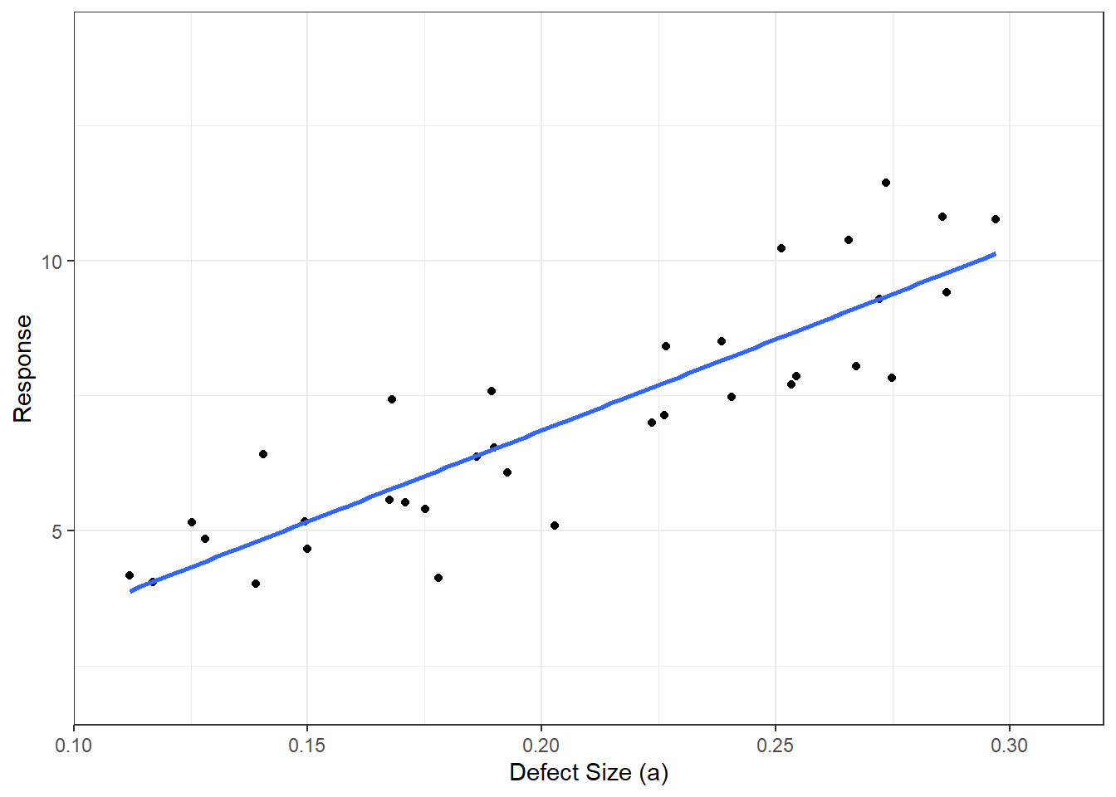
Probability of Detection Steps
Build a model relating NDI sensor response to defect size.
Transform model to a probability (of detection) curve.
Estimate a 95% confidence interval on the probability curve.
Probability of Detection Curve
95% Confidence Interval Curve
90% Probability of Detection
a₉₀
a_{90/95}

Slide 14
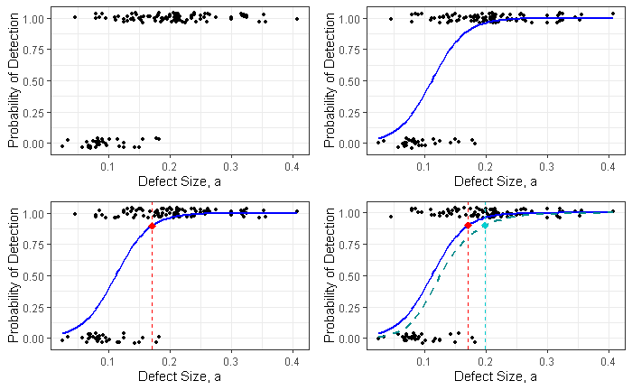
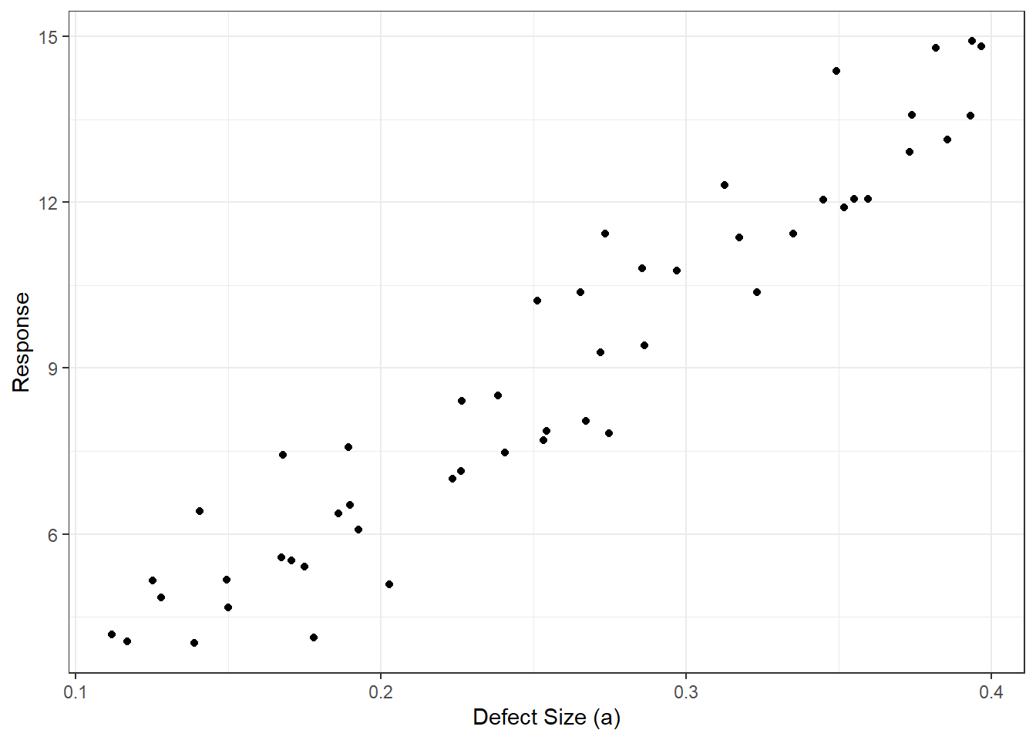
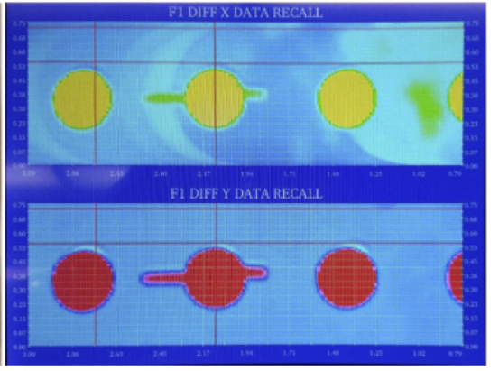
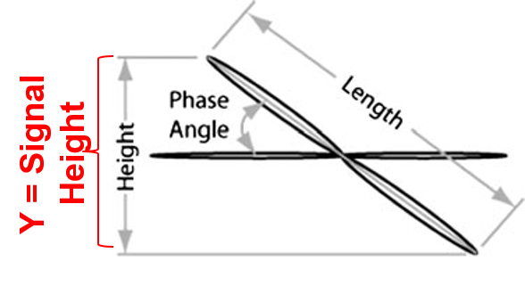

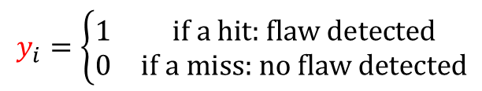
The nondestructive evaluation system can provide categorical or continuous responses
Response Variable
Hit/Miss
Signal-Response
Detection = Hit
Inspector Call
Y = Response
No Detection = Miss
X = Defect Size (a)
X = Defect Size (a)
$$y_{i}=\left\{\begin{matrix}1 & \text{if} \text{a} \text{hit}\text{: }\text{flaw} \text{detected} \\ 0 & \text{if} \text{a} \text{miss}\text{: }\text{no} \text{flaw} \text{detected}\end{matrix}\right.$$
$$y_{i}∈ℝ_{≥0}, y_{dec}=\text{noise} \text{threshold}$$
Notes:
S.K. Bhaumik, M. Sujata, M.A. Venkataswamy, Fatigue failure of aircraft components, Engineering Failure Analysis, Volume 15, Issue 6, 2008, Pages 675-694, ISSN 1350-6307, https://doi.org/10.1016/j.engfailanal.2007.10.001. (https://www.sciencedirect.com/science/article/pii/S1350630707001409)
NIST Advanced Manufacturing Series 100-16 Literature Review of Metal Additive Manufacturing Defects Felix H. Kim Shawn P. Moylan Engineering Laboratory May 2018

Slide 15
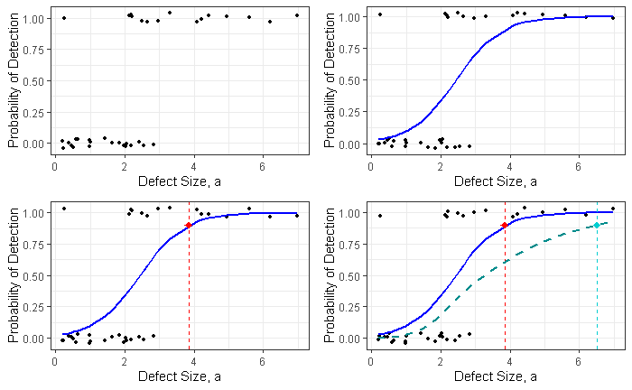


The statistical analysis involves (1) building a model
  Hit/Miss
  Signal-Response
Linear Regression
Logistic Regression
Y = Response
X = Defect Size (a)
$$logit\left(POD\left(a\right)\right)= {\hat{β}}_{0}+{\hat{β}}_{1}a$$
$$\hat{y′}= {\hat{β}}_{0}+{\hat{β}}_{1}a$$

Slide 16

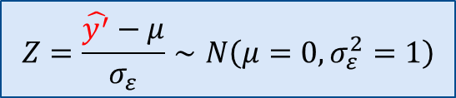

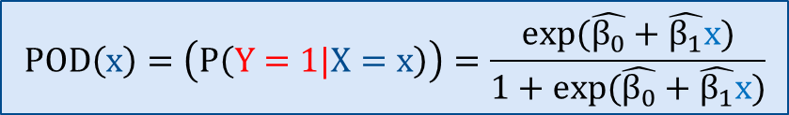
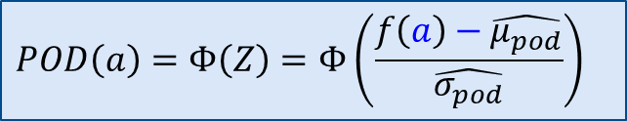
The statistical analysis involves (2) converting it to probability of detection (POD)
  Hit/Miss
Probability of Detection Curve
  Signal-Response
Probability of Detection Curve
Probability of Detection
X = Defect Size (a)
$\hat{y′}= {\hat{β}}_{0}+{\hat{β}}_{1}a$ $=σ_{ε}Z+μ∼N\left(μ,σ_{ε}^{2}\right)$
$$logit\left(POD\left(x\right)\right)= {\hat{β}}_{0}+{\hat{β}}_{1}x$$
$$Z=\frac{\hat{y^{′}}−μ}{σ_{ε}}∼N\left(μ=0,σ_{ε }^{2}=1\right)$$
$$POD\left(x\right)=\left(P\left(Y=1|X=x\right)\right)=\frac{exp(\hat{β_{0}}+\hat{β_{1}}x)}{1+exp(\hat{β_{0}}+\hat{β_{1}}x)}$$
$$POD\left(a\right)=Φ\left(Z\right)=Φ\left(\frac{f\left(a\right)−\hat{μ_{pod}}}{\hat{σ_{pod}}}\right)$$

Slide 17
(3) Estimate a 95% confidence interval on the probability curve.
  Hit/Miss
  Signal-Response
Probability of Detection Curve
95% Confidence Interval Curve
Probability of Detection Curve
90% Probability of Detection
95% Confidence Interval Curve
a₉₀
a_{90/95}
a₉₀
a_{90/95}

Slide 18

Probability of Detection Studies inform Risk Calculations
Probability of Detection Curve
95% Confidence Interval Curve
90% Probability of Detection
Initial Inspection
In-service Inspections
$a_{crit}$=Critical Flaw Size
(Part Failure)
a₉₀
a_{90/95}
Flaw Growth Curve
RISK OF FAILURE
$aNDI$=NDI Capability Limit
$a0$=Initial Flaw Size
0 600 1200
FLIGHT HOURS

Slide 19
Agenda
Background
Designing the Experiment
Statistical Analysis
Example: XCT for AM

Slide 20
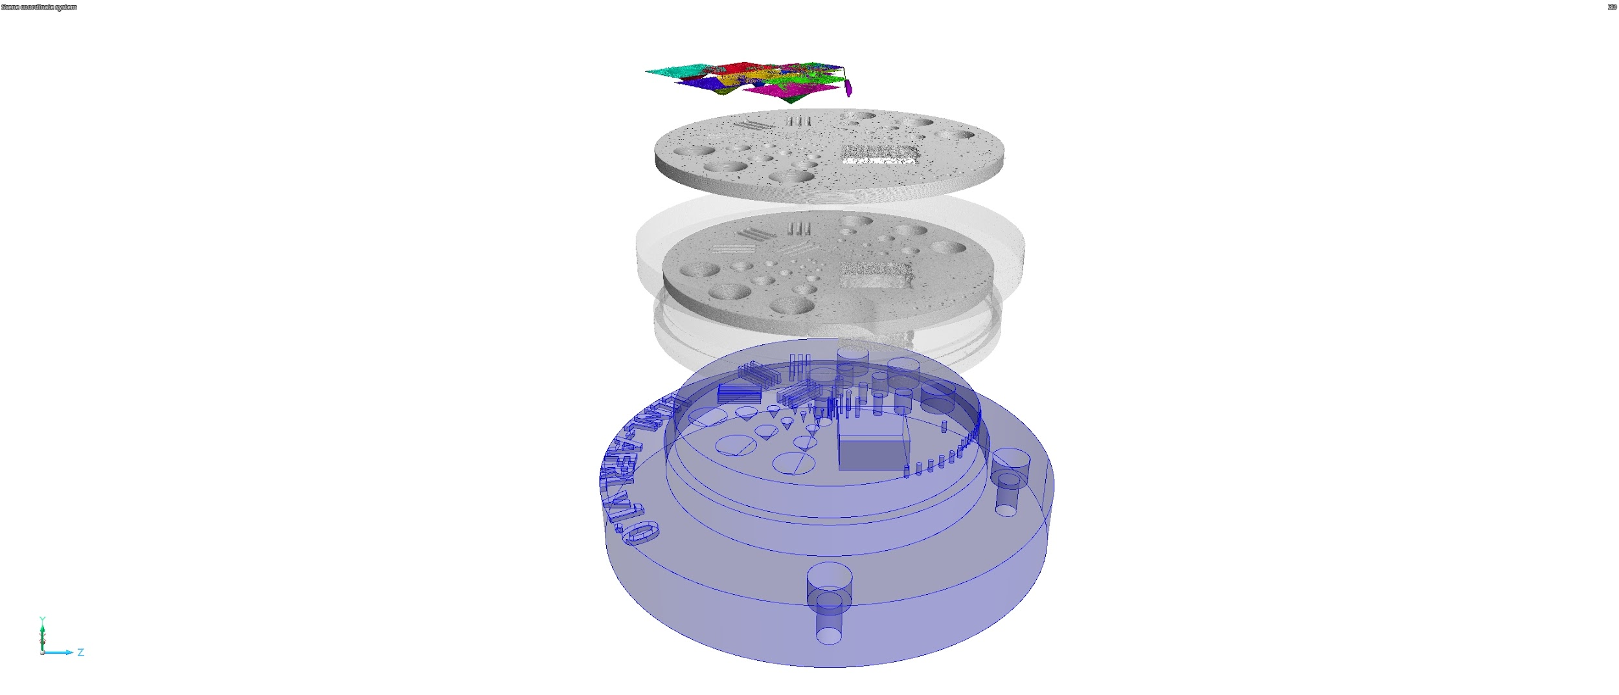


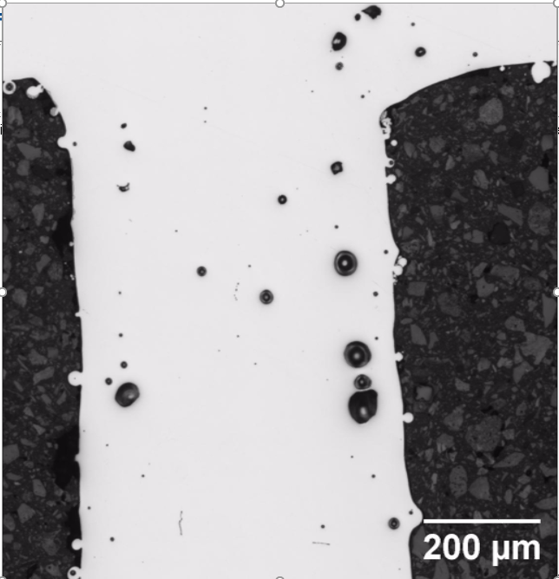
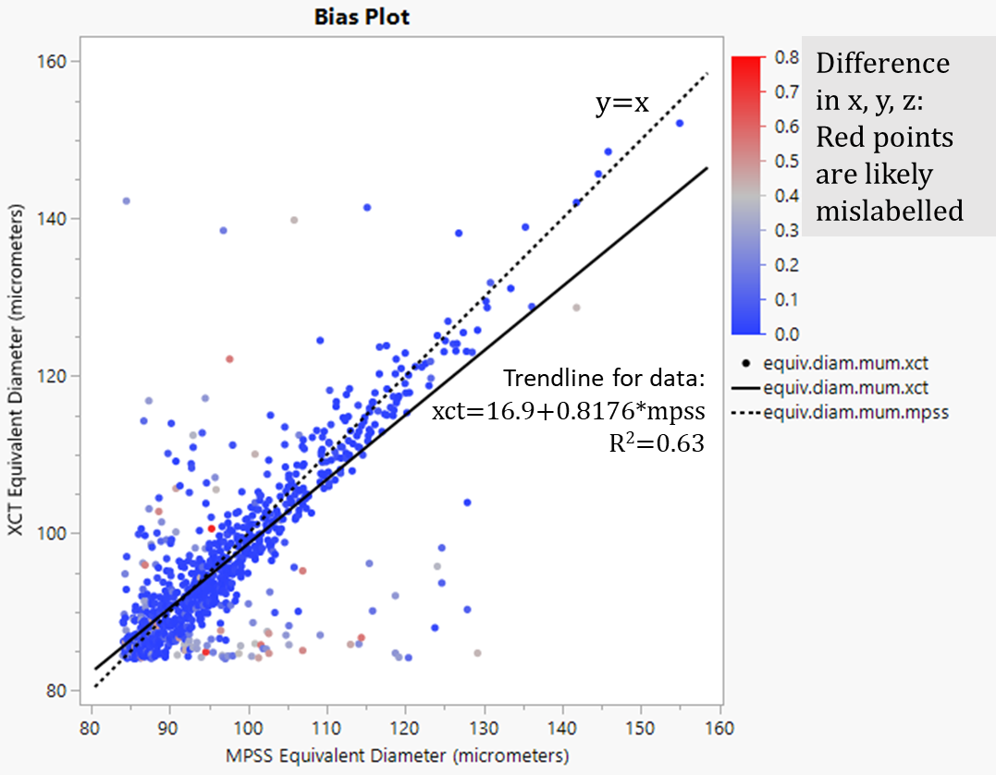


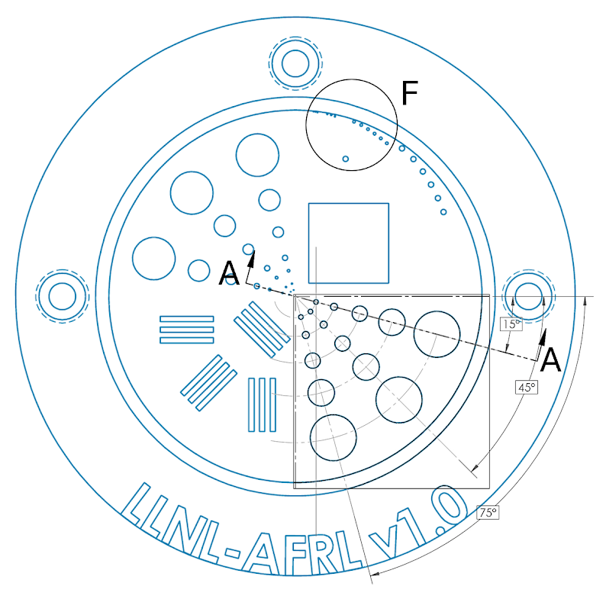
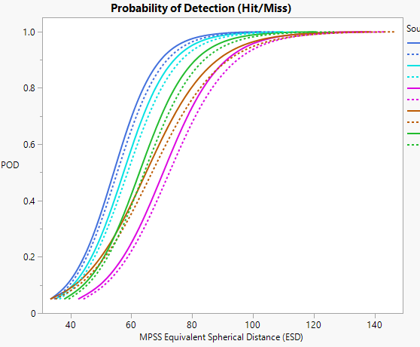
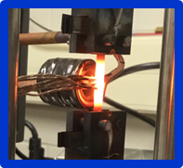
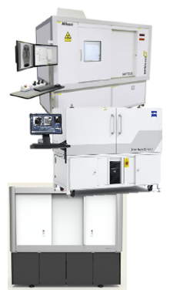
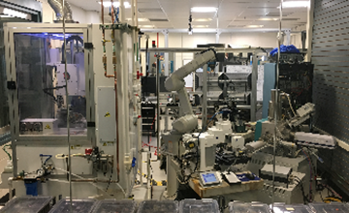
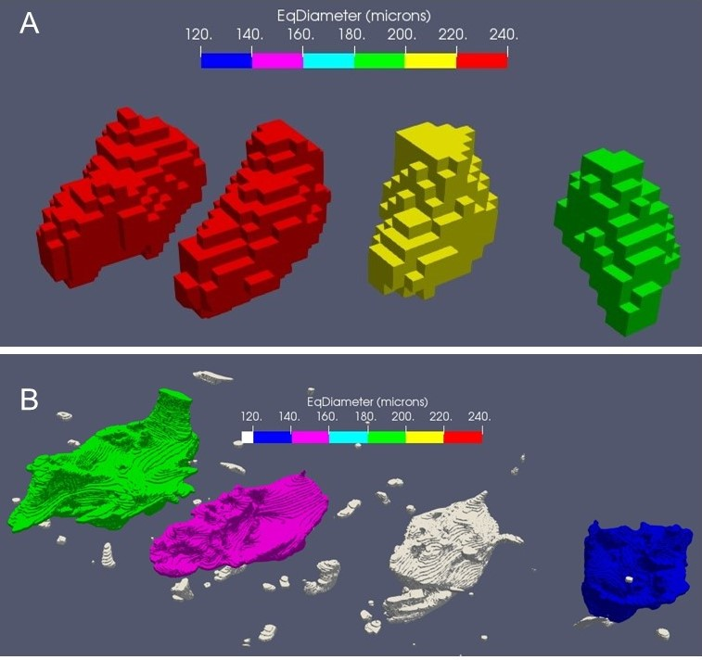
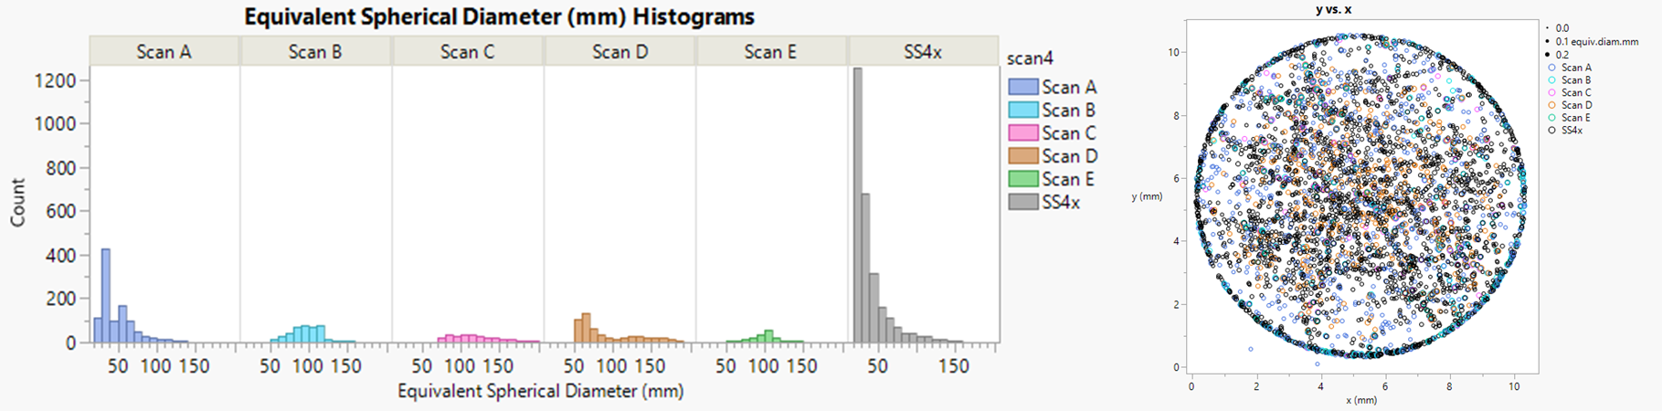
Example: Additive Manufacturing: Opportunities and Challenges
Modeling & Simulation
MPSS – Mechanical Polishing Serial Sectioning
XCT – X-ray Computed Tomography
CLSM – Confocal Laser Scanning Microscopy
Physics Modeling
Statistical Simulation
Experimentation
Specimen Creation
Data Acquisition
Data Processing
Reliability Assessment
CLSM
Detection & Sizing Statistics
MPSS
XCT
Segmentation (within dataset)
Registration (between datasets)
CAD
Feature Matching (between datasets)
In-situ monitoring during printing
Xray Computed Tomography Systems
XCT Data
 | Flaw Detected | No Flaw Detected
Flaw Exists | True Positive | False Negative
No Flaw Exists | False Positive | True Negative
Automated Mechanical Polishing
Serial Sectioning (Ground Truth)
MPSS Data

Slide 21

Example: Additive Manufacturing: Opportunities and Challenges
Modeling & Simulation
MPSS – Mechanical Polishing Serial Sectioning
XCT – X-ray Computed Tomography
CLSM – Confocal Laser Scanning Microscopy
Physics Modeling
Statistical Simulation
Experimentation
Specimen Creation
CAD Modeled Part with designs for printed and machined features
In-situ monitoring during printing
(Right) Printed part after machining.
(Left) Printed cap used to make features appear internal

Slide 22
Example: Additive Manufacturing: Opportunities and Challenges
Modeling & Simulation
MPSS – Mechanical Polishing Serial Sectioning
XCT – X-ray Computed Tomography
CLSM – Confocal Laser Scanning Microscopy
Physics Modeling
Statistical Simulation
Experimentation
Specimen Creation
In-situ monitoring during printing

Slide 23
Example: Additive Manufacturing: Opportunities and Challenges
Modeling & Simulation
MPSS – Mechanical Polishing Serial Sectioning
XCT – X-ray Computed Tomography
CLSM – Confocal Laser Scanning Microscopy
Physics Modeling
Statistical Simulation
Experimentation
Specimen Creation
CLSM
MPSS
XCT
Automated Mechanical Polishing
Serial Sectioning (Ground Truth)
In-situ monitoring during printing
CAD
Xray Computed Tomography Systems
Data Acquisition

Slide 24
Example: Additive Manufacturing: Opportunities and Challenges
Modeling & Simulation
MPSS – Mechanical Polishing Serial Sectioning
XCT – X-ray Computed Tomography
CLSM – Confocal Laser Scanning Microscopy
Physics Modeling
Statistical Simulation
Experimentation
Specimen Creation
Data Acquisition
CLSM
MPSS
XCT
CAD
In-situ monitoring during printing
Xray Computed Tomography Systems
Automated Mechanical Polishing
Serial Sectioning (Ground Truth)

Slide 25
Example: Additive Manufacturing: Opportunities and Challenges
Modeling & Simulation
MPSS – Mechanical Polishing Serial Sectioning
XCT – X-ray Computed Tomography
CLSM – Confocal Laser Scanning Microscopy
Physics Modeling
Statistical Simulation
Experimentation
Data Processing
XCT Data
Segmentation (within dataset)
Registration (between datasets)
Feature Matching (between datasets)
MPSS Data

Slide 26
Example: Additive Manufacturing: Opportunities and Challenges
Modeling & Simulation
MPSS – Mechanical Polishing Serial Sectioning
XCT – X-ray Computed Tomography
CLSM – Confocal Laser Scanning Microscopy
Physics Modeling
Statistical Simulation
Experimentation
Specimen Creation
Data Acquisition
Data Processing
Reliability Assessment
CLSM
Detection & Sizing Statistics
MPSS
XCT
Segmentation (within dataset)
Registration (between datasets)
CAD
Feature Matching (between datasets)
In-situ monitoring during printing
Xray Computed Tomography Systems
XCT Data
Automated Mechanical Polishing
Serial Sectioning (Ground Truth)
MPSS Data

Slide 27
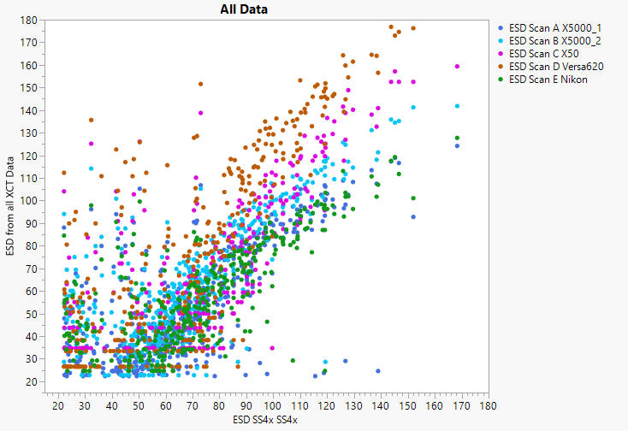
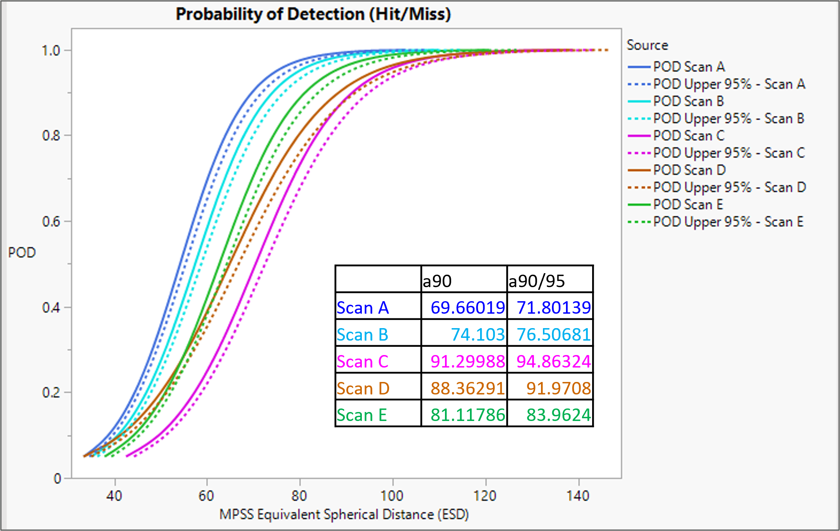
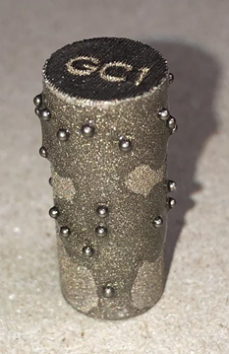
Example: Additive Manufacturing: Opportunities and Challenges
Modeling & Simulation
MPSS – Mechanical Polishing Serial Sectioning
XCT – X-ray Computed Tomography
CLSM – Confocal Laser Scanning Microscopy
Physics Modeling
Statistical Simulation
Experimentation
Reliability Assessment
Detection & Sizing Statistics
XCT Equivalent Spherical Diameter
MPSS Equivalent Spherical Diameter (“Truth”)

Slide 28
Agenda
Background
Designing the Experiment
Statistical Analysis
Example: XCT for AM

Slide 29
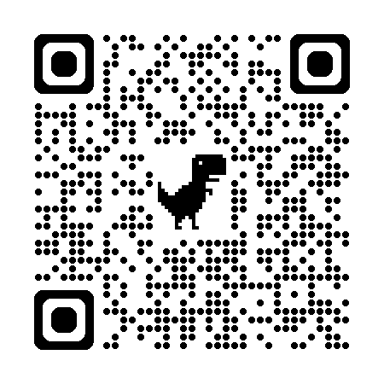
Questions?
Christine.Knott.1@us.af.mil
Background
Designing the Experiment
Statistical Analysis
Example: XCT for AM
Opportunities for faculty and students to partner with us:
https://afresearchlab.com/careers-and-opportunities/students-and-faculty/#intern-box

Slide 30
References
Military Handbooks:
[67] U.S., Department of Defense. “MIL-STD-1530D”. Aircraft Structural Integrity Program, Airplane Requirements.
[69] U.S., Department of Defense. “MIL-HDBK-1823A”. Nondestructive Evaluation System Reliability Assessment, Department of Defense Handbook, August 2010
Educational Texts
[1] Agresti, A. Categorical Data Analysis. Wiley, Hoboken, New Jersey, 2nd edition, 2002.
[19] Casella, G. and R. Berger. Statistical Inference. Cengage Learning, Boston, Massachusetts, 2nd edition, 2001
[29] Hahn, G. and W. Meeker. Statistical Intervals. John Wiley and Sons, New York, New York, 1991.
[35] James, Gareth, Daniela Witten, Trevor Hastie, and Robert Tibshirani. An Introduction to Statistical Learning with Applications in R. Springer, New York, 2013.
[45] Kutner, M.H., C.I. Nachtsheim, J. Neter, and W. Li. Applied Linear Statistical Models. McGraw-Hill/Irwin, New York, New York, 5th edition, 2004.
[50] Meeker, W.Q. and L.A. Escobar. Statistical Methods for Reliability Data. Wiley, Hoboken, New Jersey, 1998.
[51] Montgomery, Douglas C. Design and Analysis of Experiments. John Wiley, New York, 9th edition, 2017.

Slide 31
References: Selected Papers
[5] Annis, Charles, John C. Aldrin, and Harold A. Sabbagh. “NDT Capability”. Materials Evaluation, 44–54, January 2015.
[9] Berens, A.P. “NDE Reliability Data Analysis”. ASM Handbook, Vol. 17, Ed. 9, 689–701, 1989. [
[10] Berens, A.P. Probability of Detection (POD) Analysis for the Advanced Retirement for Cause (RFC)/Engine Structural Integrity Program (ENSIP) Nondestructive Evaluation (NDE) System Development, Technical Report AFRL-ML-WP-TR-2001-4010,. Technical report, Air Force Research Laboratory, 2000.
[11] Berens, A.P. and P.W. Hovey. “Statistical Methods for Estimating Crack Detection Probabilities”. ASTM STP 798: Probabilistic Fracture Mechanics and Fatigue Methods, 79–94, 1983.
[12] Berens, A.P. and P.W. Hovey. Flaw Detection Reliability Criteria. Technical Report AFWALTR-84-4022, Air Force Wright Aeronautical Laboratories, 1984.
[13] Berens, A.P. and P.W. Hovey. Flaw Detection Reliability Criteria Vol. I: Methods and Results. Technical Report AFWAL-TR-83-4089, Vol. 1, Air Force Wright Aeronautical Laboratories, 1984.
[14] Berens, A.P. and P.W. Hovey. “Quantifying NDI Capability for Damage Tolerance Analyses”. Review of Progress in Quantitative Nondestructive Evaluation, 1984.
[15] Berens, A.P. and P.W. Hovey. “The Sample Size and Flaw Size Effects in NDI Reliability Experiments”. Review of Progress in Quantitative Nondestructive Evaluation, 4:1327–1334, 1985.
[16] Berens, A.P. and P.W. Hovey. “NDE Reliability Data Analysis, Metals Handbook, Vol. 17, 9e, NDE and QC”. ASM International, 689–701, 1988.
[17] Berens, A.P. and P.W. Hovey. The Effect of Inspection Uncertainty on Crack Growth Based Maintenance Scheduling, Summary Paper. Technical Report Contract F33615-80C-5140, Air Force Materials Laboratory, February 1982.
[23] Gandossi, L. and C. Annis. “ENIQ report No. 41: Probability of Detection Curves: Statistical Best-Practices”. EUR – Scientific and Technical Research Series – ISSN1018-5593, ISBN 978-92-79-16105-6, 2010.
[24] Gandossi, L. and C. Annis. “ENIQ report No. 47: Influence of Sample Size and Other Factors on Hit/Miss Probability of Detection Curves”. EUR – Scientific and Technical Research Series – ISSN 1831-9424, ISBN 978-92-79-23018-9, 2010.
[30] Harding, C.A. and G.R. Hugo. “Experimental Determination of the Probability of Detection Hit/Miss Data for Small Data Sets”. Review of Progress in Quantitative Nondestructive Evaluation, 22:1823–1844, 2003
[34] Information, Aerospace Structures and Analysis Center. “The History of the Aircraft Structural Integrity Program”. Report No. 680.1B, June 1980.
[40] Knopp, J.S. and L. Zeng. “Statistical Analysis of Hit/Miss Data”. Materials Evaluation, Vol. 71, No. 3, 323–329, 2013
[54] Olin, B.D. and W.Q. Meeker. “Applications of Statistical Methods to Nondestructive Evaluation”. Technometrics, 38:95–112, 1996.
[55] P. Berens, Alan and Peter Hovey. “Evaluation of NDE Reliability Characterization. Volume I”. Air Force Wright Aeronautical Laboratories, 98, 12 1981.
[61] Singh, R. Three Decades of NDI Reliability Assessment. Technical Report Karta-3510-99-01, AF NDI Office, 2000.

Slide 32
Backup Slides

Slide 33


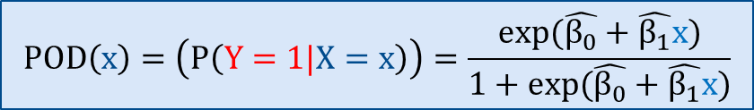



Hit/Miss Data has a Categorical Response: Logistic Regression
$$y∼\text{B}\text{inomial}\left(n,p\right)$$
Hit/Miss
$$y_{i}=\left\{\begin{matrix}1 & \text{if} \text{a} \text{hit}\text{: }\text{flaw} \text{detected} \\ 0 & \text{if} \text{a} \text{miss}\text{: }\text{no} \text{flaw} \text{detected}\end{matrix}\right.$$
Detection = Hit
$$x=flaw size$$
Inspector Call
No Detection = Miss
$$logit\left(POD\left(x\right)\right)= {\hat{β}}_{0}+{\hat{β}}_{1}x$$
X = Defect Size (a)
$$POD\left(x\right)=\left(P\left(Y=1|X=x\right)\right)=\frac{exp(\hat{β_{0}}+\hat{β_{1}}x)}{1+exp(\hat{β_{0}}+\hat{β_{1}}x)}$$
Probability of Detection Curve
Modern methods encourage the use of:
- Firth’s Bias Adjusted Model (for separated classes) - Nonparametric Ranked Set Resampling Method (for very small sample sizes)
Notes:
S.K. Bhaumik, M. Sujata, M.A. Venkataswamy, Fatigue failure of aircraft components, Engineering Failure Analysis, Volume 15, Issue 6, 2008, Pages 675-694, ISSN 1350-6307, https://doi.org/10.1016/j.engfailanal.2007.10.001. (https://www.sciencedirect.com/science/article/pii/S1350630707001409)
NIST Advanced Manufacturing Series 100-16 Literature Review of Metal Additive Manufacturing Defects Felix H. Kim Shawn P. Moylan Engineering Laboratory May 2018

Slide 34

Hit/Miss Data has a Categorical Response: Logistic Regression
$$y∼\text{B}\text{inomial}\left(n,p\right)$$
Hit/Miss
$$y_{i}=\left\{\begin{matrix}1 & \text{if} \text{a} \text{hit}\text{: }\text{flaw} \text{detected} \\ 0 & \text{if} \text{a} \text{miss}\text{: }\text{no} \text{flaw} \text{detected}\end{matrix}\right.$$
Detection = Hit
$$x=flaw size$$
Inspector Call
No Detection = Miss
$$logit\left(POD\left(x\right)\right)= {\hat{β}}_{0}+{\hat{β}}_{1}x$$
a₉₀
X = Defect Size (a)
$$POD\left(x\right)=\left(P\left(Y=1|X=x\right)\right)=\frac{exp(\hat{β_{0}}+\hat{β_{1}}x)}{1+exp(\hat{β_{0}}+\hat{β_{1}}x)}$$
Probability of Detection Curve
95% Confidence Interval Curve
Legacy methods used Wald Confidence Intervals
${ a}_{p/q}=a_{p}+z_{q}\hat{σ_{pod}}$
$=\left(\hat{μ_{pod }}+z_{p}\hat{σ_{pod}}\right)+z_{q}σ_{a_{p}}$
a₉₀
a_{90/95}
Modern methods used Profile Likelihood Ratio Confidence Intervals
Notes:
S.K. Bhaumik, M. Sujata, M.A. Venkataswamy, Fatigue failure of aircraft components, Engineering Failure Analysis, Volume 15, Issue 6, 2008, Pages 675-694, ISSN 1350-6307, https://doi.org/10.1016/j.engfailanal.2007.10.001. (https://www.sciencedirect.com/science/article/pii/S1350630707001409)
NIST Advanced Manufacturing Series 100-16 Literature Review of Metal Additive Manufacturing Defects Felix H. Kim Shawn P. Moylan Engineering Laboratory May 2018

Slide 35


POD for Continuous-Response Data
  Signal-Response
Signal-Response
Y = Response
Y = Response
X = Defect Size (a)
$$\hat{y′}= {\hat{β}}_{0}+{\hat{β}}_{1}f(a)$$
X = Defect Size (a)
$$y_{i}∈ℝ_{≥0}, y_{dec}=\text{noise} \text{threshold}$$
Notes:
S.K. Bhaumik, M. Sujata, M.A. Venkataswamy, Fatigue failure of aircraft components, Engineering Failure Analysis, Volume 15, Issue 6, 2008, Pages 675-694, ISSN 1350-6307, https://doi.org/10.1016/j.engfailanal.2007.10.001. (https://www.sciencedirect.com/science/article/pii/S1350630707001409)
NIST Advanced Manufacturing Series 100-16 Literature Review of Metal Additive Manufacturing Defects Felix H. Kim Shawn P. Moylan Engineering Laboratory May 2018

Slide 36
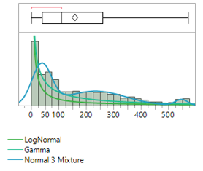
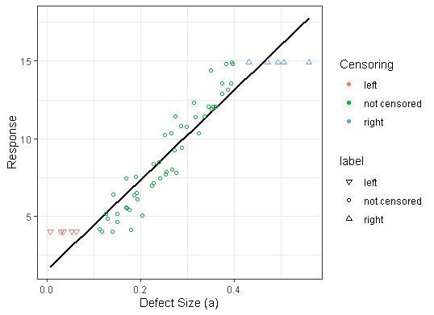
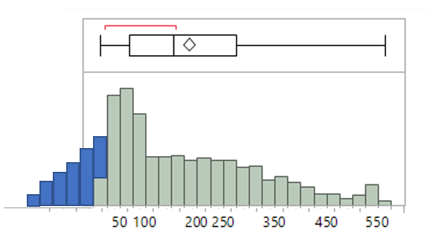





What are the assumptions of a linear model?
$$y=β_{0}+β_{1}x+ε$$
$$y′=β_{0}+β_{1}f(x)+ε$$
    Box Cox Transformation of Y:
      $y^{′}=\left\{\begin{aligned}{(y}^{λ}−1)/λ \text{if} λ≠0 \\ \log\left(y\right) \text{if} λ=0\end{aligned}\right.$ where $y$ is positive
    Transformation of $x$: ($log\left(x\right),\frac{1}{x}, e^{x}$)
Truncation
Censoring
Why are we using a simple Linear Regression?
Build a model relating NDI sensor
response to crack size.
Transform model to a probability
(of detection) curve.
Estimate a 95% confidence interval
on the probability curve.

Slide 37



2. Transform model to a probability (of detection) curve.
  Signal-Response
  Signal-Response
Probability of Detection Curve
Y = Response
Probability of Detection
$$\hat{y′}= {\hat{β}}_{0}+{\hat{β}}_{1}f(a)$$
X = Defect Size (a)
X = Defect Size (a)
If $\hat{y′} is distributed as Normal\left(\hat{μ},{{\hat{σ}}_{ε}}^{2}\right), then Z=(\hat{y^{′}}−μ)/σ_{ε}$ is distributed as a Standard Normal.
The cumulative distribution function of $Z$ is the Probability of Detection Curve.
$$\hat{μ_{pod}}=−\frac{\hat{β_{0}}−y_{dec}}{\hat{β_{1}}}$$
$\hat{σ_{pod}}=\frac{\hat{σ_{ε}^{2}}}{\hat{β_{1}^{2}}}$
$$POD\left(a\right)=Φ\left(Z\right)=Φ\left(\frac{f\left(a\right)−\hat{μ_{pod}}}{\hat{σ_{pod}}}\right)$$
To get the values on the curve, just solve for a.
$$a_{p}=Φ^{−1}\left(POD\left(a\right)\right)\hat{σ_{pod}}+\hat{μ_{pod}}= z_{p}\hat{σ_{pod}}+\hat{μ_{pod}} where p is the probability$$

Slide 38


3. Estimate a 95% confidence interval on the probability curve.
  Signal-Response
Probability of Detection Curve
95% Confidence Interval Curve
90% Probability of Detection
Probability of Detection
X = Defect Size (a)
a₉₀
a_{90/95}
We have the variance-covariance matrix
of the linear model
We need the variance-covariance matrix
of the POD Curve
$$V\left(\hat{β}\right)= \left[\begin{matrix}Var\left[β_{0}\right] & Cov\left[β_{0},β_{1} \right] & Cov\left[β_{0},σ_{ε}^{2}\right] \\ Cov\left[β_{0},β_{1} \right] & Var\left[β_{1}\right] & Cov\left[β_{1},σ_{ε}^{2}\right] \\ Cov\left[β_{0},σ_{ε}^{2}\right] & Cov\left[β_{1},σ_{ε}^{2}\right] & Var\left[σ_{ε}^{2}\right]\end{matrix}\right]$$
  $$V_{pod}=\left[\begin{matrix}Var[μ_{pod}] & Cov[μ_{pod},σ_{pod}] \\ Cov[μ_{pod},σ_{pod}] & Var[σ_{pod}]\end{matrix}\right]$$
?

Slide 39




3. Estimate a 95% confidence interval on the probability curve.
Delta Method
Given a differentiable function, $g$, and a random variable $y$ such that $E\left[y\right]=μ$,
$$Var\left[g\left(y\right)\right]≈Σ_{i=1}^{k}{\left[g_{i}′(μ)\right]}^{2}Var\left[y_{i}\right]+2Σ_{i>j}g_{i}^{′}\left(μ\right)g_{j}^{′}\left(μ\right)Cov\left[y_{i},y_{j}\right]$$
We have the variance-covariance matrix
of the linear model
$$V\left(\hat{β}\right)= \left[\begin{matrix}Var\left[β_{0}\right] & Cov\left[β_{0},β_{1} \right] & Cov\left[β_{0},σ_{ε}^{2}\right] \\ Cov\left[β_{0},β_{1} \right] & Var\left[β_{1}\right] & Cov\left[β_{1},σ_{ε}^{2}\right] \\ Cov\left[β_{0},σ_{ε}^{2}\right] & Cov\left[β_{1},σ_{ε}^{2}\right] & Var\left[σ_{ε}^{2}\right]\end{matrix}\right]$$
Derivatives describe how $μ_{pod},σ_{pod}$change
We need the variance-covariance matrix
of the POD Curve
$$U\left(\hat{β}\right)=\left[\begin{matrix}\left(\frac{∂\hat{μ_{pod}}}{∂β_{0}}\right) & \left(\frac{∂\hat{σ_{pod}}}{∂β_{0}}\right) \\ \begin{aligned}\left(\frac{∂\hat{μ_{pod}}}{∂β_{1}}\right) \\ \left(\frac{∂\hat{μ_{pod}}}{∂σ_{ε}^{2}}\right)\end{aligned} & \begin{aligned}\left(\frac{∂\hat{σ_{pod}}}{∂β_{1}}\right) \\ \left(\frac{∂\hat{σ_{pod}}}{∂σ_{ε}^{2}}\right)\end{aligned}\end{matrix}\right]$$
  $$U^{T}VU=V_{pod}=\left[\begin{matrix}Var[μ_{pod}] & Cov[μ_{pod},σ_{pod}] \\ Cov[μ_{pod},σ_{pod}] & Var[σ_{pod}]\end{matrix}\right]$$

Slide 40



3. Estimate a 95% confidence interval on the probability curve.
  $$V_{pod}=U^{T}VU=\left[\begin{matrix}Var[μ_{pod}] & Cov[μ_{pod},σ_{pod}] \\ Cov[μ_{pod},σ_{pod}] & Var[σ_{pod}]\end{matrix}\right]$$
$$σ_{a_{p}}^{2}=\left[\begin{matrix}1 \\ z_{p}\end{matrix}\right]\left[\begin{matrix}Var[μ_{pod}] & Cov[μ_{pod},σ_{pod}] \\ Cov[μ_{pod},σ_{pod}] & Var[σ_{pod}]\end{matrix}\right]\left[\begin{matrix}1 & z_{p}\end{matrix}\right]$$
$$=Var\left[μ_{pod}\right]+2z_{p}Cov\left[μ_{pod},σ_{pod}\right]+z_{p}^{2}Var\left[σ_{pod}\right]$$
Probability of Detection Curve
${ a}_{p/q}=a_{p}+z_{q}\hat{σ_{pod}}$
$=\left(\hat{μ_{pod }}+z_{p}\hat{σ_{pod}}\right)+z_{q}σ_{a_{p}}$
95% Confidence Interval Curve
90% Probability of Detection
Probability of Detection
Wald Confidence Intervals are okay since we assumed Normality
X = Defect Size (a)
a₉₀
a_{90/95}

Slide 41





Research Questions for Reliability of NDI
NDI research is largely engineers doing their best to use statistics, without formal training
  Estimates may be biased
  Sample size may be too small
  Estimates may not exist
Over-conservative
a_{90/95}???
Confidence Interval Width/2
a₉₀
Models may be too simple
Under-conservative
Sample Size
Observations may be dependent
  Current models have strong assumptions
Methods only consider one NDE source
Low Freq EC

Slide 42


Simulation of 252,000 hit/miss data sets which vary over important factors
⇝ Sample Size
N=35
N=120
⇝Distribution
$$\text{⇝}\text{Overlap}\text{=}\frac{\text{(}\text{Number} \text{of} \text{points} \text{between} \text{smallest} \text{hit} \text{and} \text{largest} \text{miss}\text{)}}{\text{Total} \text{Number} \text{of} \text{Points}}$$
$$\text{⇝}\text{Evenness}\text{ =}\frac{\text{Number} \text{of} \text{misses}}{\text{Total} \text{Number} \text{of} \text{Points}}=P(miss)$$
$\text{⇝}\text{Variance}\text{ =}$ $P\left(miss\right)∗P\left(hit\right)=P\left(miss\right)∗(1−P(miss))$
NEW! Models
Logistic Regression
Firth’s Bias Adjusted Model
The Lasso
Nonparametric Ranked Set Sampling
NEW! Confidence Intervals
Standard Wald
Modified Wald
Profile Likelihood Ratio
Modified Profile Likelihood Ratio

Slide 43

Confidence interval width is related to sample size and can cause over-conservatism
N=35
N=120
a₉₀
a_{90/95}
a₉₀
a_{90/95}

Slide 44

Confidence interval width is related to sample size and can cause over-conservatism
Small sample → over-conservative
Larger sample → zero bias

Slide 45





What are some examples of a too-simple model?
Flaw size is not 1D
$$\hat{y′}= {\hat{β}}_{0}+{\hat{β}}_{1}x$$
$$l$$
$$d$$
$$r$$
$$a$$
NDE Response
Flaw Size
$$b$$
$$w$$
$$y=β_{0}+β_{1}x+β_{2}x^{2}$$
$$l$$
$$d$$
$$y=β_{0}+β_{1}x+β_{2}x^{2}+β_{3}xm+β_{4}x^{2}m$$

Slide 46











Missing variables can decrease the quality of the fit.
Important variables are not included
$$\hat{y′}=\hat{β_{0}}+\hat{β_{1}}x+\hat{β_{2}}m+\hat{β_{3}}xm$$
$$m=\left\{\begin{matrix}0 & \text{if} \text{material} \text{A} \\ 1 & \text{if} \text{material} B\end{matrix}\right.$$
$$\hat{y′}=\hat{β_{0}}+\hat{β_{1}}x$$
$$\hat{y′}=\hat{β_{0}}+\hat{β_{1}}x+\hat{β_{2}}m+\hat{β_{3}}xm$$
$$\hat{y′}= {\hat{β}}_{0}+{\hat{β}}_{1}x$$
Which model is better?
$$y=β_{0}+β_{1}x$$
$$versus$$
$$y=β_{0}+β_{1}x+β_{2}m+β_{3}xm$$
NDE Response
Flaw Size
Materials
$$Maximize {Adjusted R}^{2}$$
Hole Numbers
$Minimize$AICc and BIC
Layers
Notches vs Cracks
Likelihood Ratio Tests
NDE Scanner Number
Gain/Calibration

Slide 47

Many variables may be necessary, leading to complicated models
Explanatory Variables
  3 Materials (A, B, C)
  4 Layers, scanned 1 at a time
    Material above scanned layer
    Material below scanned layer – Material A below is significant
  6 Bolt Holes
  Crack locations – corners
  2 Crack types
    Fatigue cracks
    EDM notches
  Crack Lengths (continuous values)
Signal Response
  Percent screen height (0% to 100%)
$$Response=β_{0}+β_{1}length$$
Interaction between crack size, material C and EDM notches

Slide 48






Missing variables can decrease the quality of the fit and change the estimates of a₉₀ and a_{90/95}
$$y=β_{0}+β_{1}x$$
$$y=β_{0}+β_{1}x+β_{2}m+β_{3}xm$$
$$m=\left\{\begin{matrix}0 & \text{if} \text{material} \text{A} \\ 1 & \text{if} \text{material} B\end{matrix}\right.$$
$$y=β_{0}+β_{1}x+β_{2}x^{2}$$
$$y=β_{0}+β_{1}x+β_{2}x^{2}+β_{3}xm+β_{4}x^{2}m$$

Slide 49


How do you handle dependent observations for POD?
Sensor-Crack Pair 1
Sensor-Crack Pair 2
…
Sensor-Crack Pair 60
Crack Signal
y_{dec} = Detection Threshold
Noise Signal
Time
Time
scalar
Independent POD uses a linear model $y=Xβ+ε$ with $Var\left[y\right]=σ_{ε}^{2}$
Dependent POD uses a linear mixed model $y=Xβ+ε$ with $Var\left[y\right]=Σ^{2}$
matrix

Slide 50





What structure should the variance matrix have?
$$Σ_{i}^{2}=Var\left[y_{i}\right]={\hat{σ}}_{ε}^{2}I+{\hat{ω}}^{2}1=\left[\begin{matrix}{\hat{σ}}_{ε}^{2}+{\hat{ω}}^{2} & {\hat{ω}}^{2} & ⋯ & {\hat{ω}}^{2} \\ \begin{aligned}{\hat{ω}}^{2} \\ ⋮\end{aligned} & \begin{aligned}{\hat{σ}}_{ε}^{2}+{\hat{ω}}^{2} \\ ⋮\end{aligned} & \begin{aligned} \\ ⋱\end{aligned} & \begin{aligned}{\hat{ω}}^{2} \\ ⋮\end{aligned} \\ {\hat{ω}}^{2} & {\hat{ω}}^{2} & ⋯ & {\hat{σ}}_{ε}^{2}+{\hat{ω}}^{2}\end{matrix}\right]$$
$$Var\left[y\right]=Σ^{2}=\left[\begin{matrix}Σ_{i}^{2} & 0 & ⋯ & 0 \\ \begin{aligned}0 \\ ⋮\end{aligned} & \begin{aligned}Σ_{i}^{2} \\ ⋮\end{aligned} & \begin{aligned} \\ ⋱\end{aligned} & \begin{aligned}0 \\ ⋮\end{aligned} \\ 0 & 0 & ⋯ & Σ_{i}^{2}\end{matrix}\right]$$
between groups
within
groups
$$Σ^{2}=Var\left[y\right]={\hat{σ}}_{ε}^{2}R={\hat{σ}}_{ε}^{2}\left[\begin{matrix}R_{1}^{2} & 0 & ⋯ & 0 \\ \begin{aligned}0 \\ ⋮\end{aligned} & \begin{aligned}R_{2}^{2} \\ ⋮\end{aligned} & \begin{aligned} \\ ⋱\end{aligned} & \begin{aligned}0 \\ ⋮\end{aligned} \\ 0 & 0 & ⋯ & R_{3}^{2}\end{matrix}\right]$$
Open question: How would you model the data when you also have spatial correlation?
$$ρ is correlation$$
$t$ $is time$
Sensors
Crack
Specimen
AR(1): Equally-spaced
SPOW: Un-equally-spaced

Slide 51





Different models yield different estimates; assuming independence is under-conservative
Between + Within
Assume independence
21
17
5
25
13
9
Naïve (Independent) Models
CS Mixed Model (Improved)
AR(1) Mixed Model
1
$$a_{90/95}$$
$$a_{90}$$
$$a_{50}$$
Reliably Detectable Flaw Size

Slide 52


What could go wrong with a POD study? Estimates do not exist
a_{90/95}???
a₉₀

Slide 53


Existence can be compared between new modeling types and new confidence intervals
MODELS
High Risk
CONFIDENCE INTERVALS
Low Risk

Slide 54


For small samples, Wald confidence intervals have more over-conservative bias than profile likelihood methods
Over-conservative (Bias > 0):
  Inspect more often than necessary
Unbiased (Bias = 0)
  Inspect when needed
Under-conservative (Bias < 0):
  Not enough inspections

Slide 55

Smaller sample sizes have more bias, across modeling types
Over-conservative (Bias > 0):
  Inspect more often than necessary
Unbiased (Bias = 0)
  Inspect when needed
Under-conservative (Bias < 0):
  Not enough inspections

Slide 56
Smaller sample sizes have more bias, across modeling types
Over-conservative (Bias > 0):
  Inspect more often than necessary
Unbiased (Bias = 0)
  Inspect when needed
Under-conservative (Bias < 0):
  Not enough inspections

Slide 57








What are the assumptions of a linear regression model?
Linear in the parameters
$$y=β_{0}+β_{1}a+ε$$
$$\hat{y}= {\hat{β}}_{0}+{\hat{β}}_{1}a$$
Pearson Standardized Residuals
Random errors ($ε)$ are identically and independently distributed Gaussians
$$y ∼N\left(μ,σ_{ε}^{2}\right)$$
Residuals = $y− \hat{y}$
$${μ=\hat{β}}_{0}+{\hat{β}}_{1}a$$
$$ε∼N(0,σ_{ε}^{2})$$
Constant Variance Test
Normality Test of Residuals
Durbin-Watson Test for Autocorrelation

Slide 58
What are the assumptions of a linear regression model?
Linear in the parameters
$$y=β_{0}+β_{1}a+ε$$
$$\hat{y}= {\hat{β}}_{0}+{\hat{β}}_{1}a$$
Pearson Standardized Residuals
Random errors ($ε)$ are identically and independently distributed Gaussians
$$y ∼N\left(μ,σ_{ε}^{2}\right)$$
Residuals = $y− \hat{y}$
$${μ=\hat{β}}_{0}+{\hat{β}}_{1}a$$
$$ε∼N(0,σ_{ε}^{2})$$
Constant Variance Test
Normality Test of Residuals
Durbin-Watson Test for Autocorrelation

Slide 59
What are the assumptions of a linear regression model?
Linear in the parameters
$$y=β_{0}+β_{1}a+ε$$
$$\hat{y}= {\hat{β}}_{0}+{\hat{β}}_{1}a$$
Pearson Standardized Residuals
Random errors ($ε)$ are identically and independently distributed Gaussians
$$y ∼N\left(μ,σ_{ε}^{2}\right)$$
Residuals = $y− \hat{y}$
$${μ=\hat{β}}_{0}+{\hat{β}}_{1}a$$
$$ε∼N(0,σ_{ε}^{2})$$
Constant Variance Test
Normality Test of Residuals
Durbin-Watson Test for Autocorrelation

Slide 60


Censored and Truncated Data

