Slide 1
Test Incident Report Analytics (TIRANICS) & RAG Assisted fdsc scoring
23 APRIL 2026
Analytics & Artificial Intelligence Division (AAI), Chinomso Oji

Slide 2
AGENDA
Test Incident Reports and the scoring process
What is TIRANICS?
NLP Based Features
RAG Assisted TIR Scoring
Deconstructing the RAG Workflow
Future Work

Slide 3
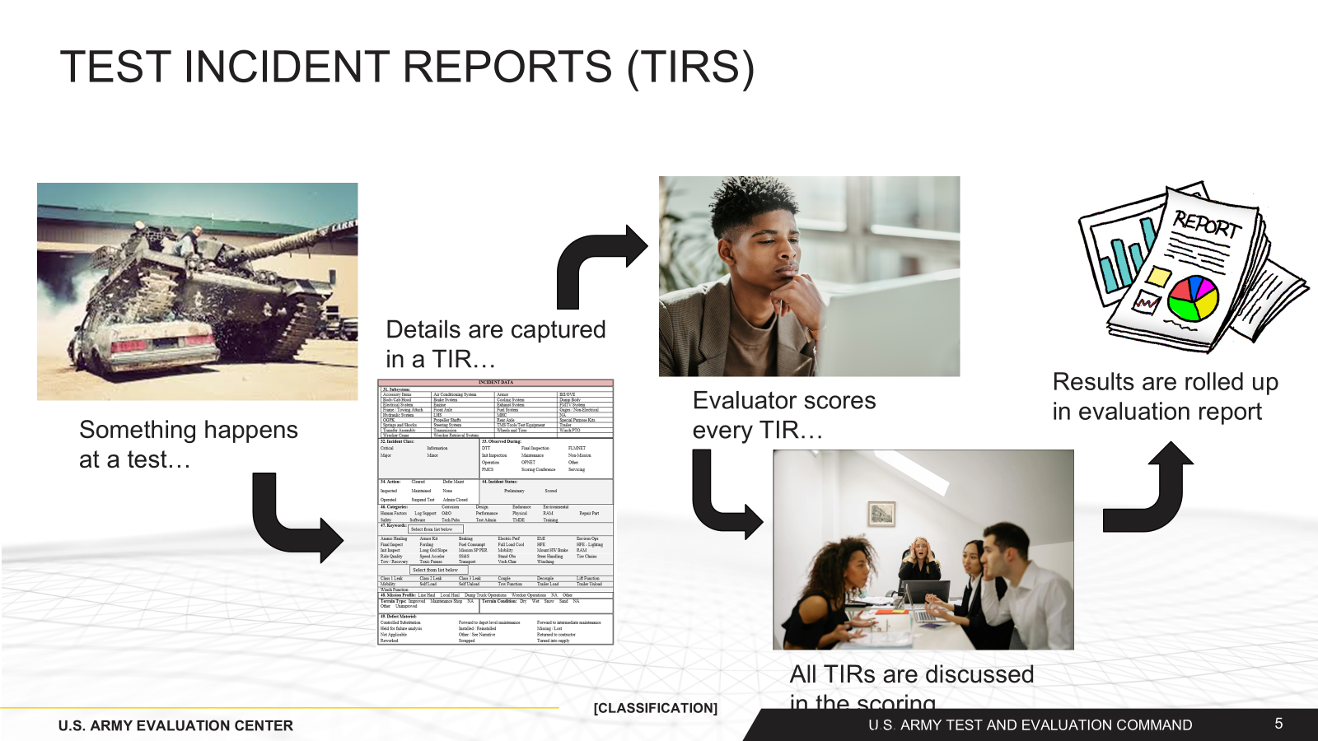
TEST INCIDENT REPORTS

Slide 4
TEST INCIDENT REPORTS
Cover everything from routine maintenance to catastrophic failure
Contain structured and unstructured data
  System ID, time, date, subsystem, keywords, etc.
  Free text description of incident and actions taken
Scored in three ways:
  Class – Information, Minor, Major, Critical
  Severity – Essential Function Failure, System Abort, Rapidly Recoverable Event, etc.
  Chargeability – Hardware, software, operator, etc.
Potentially hundreds to more than one thousand per test event

Slide 5
Failure Definition and scoring Criteria (FD/SC)
Example FDSC Scoring Process Chart
What is the FDSC?
Main Reference Document for scoring TIRs
Provides definitions of failure types and severity
Typically lays out a system’s essential functions and what it means for them to be lost or degraded

Slide 6

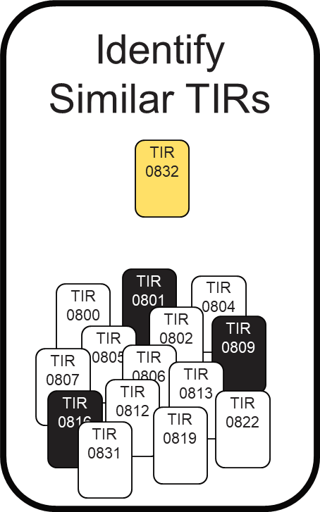

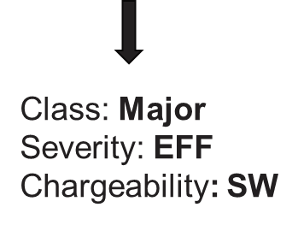

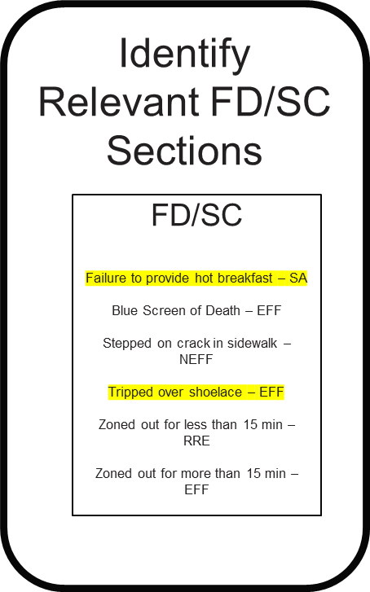



WHAT IS TIRANICS?
System Features
Our TIR AI Scoring Strategy
TIRANICS is already a valuable tool with two production-ready features.
Historical Insight: The system can identify similar past TIRs and recommend scores using our established NLP/ML pipeline.
The Value: This gives analysts powerful insight into historical patterns and trends, answering the question: "What does this new TIR look like based on everything we've seen before?"
The Challenge: While our current NLP models are effective, their knowledge is based solely on past data. They don't inherently know the "why" behind a score according to official guidance.
The Solution: The next phase of TIRANICS, currently in development, integrates Retrieval-Augmented Generation (RAG). This is a strategic enhancement, not a replacement.
The Goal: RAG connects our analysis directly to the source—the FD/SC documents. It enables the system to score a TIR based on written, verifiable doctrine.
Recommend Scores (NLP/ML)
Recommend Scores (RAG Assisted FD/SC Scoring)
Document Chatbot (FD/SC Document)

Slide 7
The DUAL Score Recommendation system
TIRANICS will provide analysts with two distinct and complementary AI-recommended scores.
Score #1: The NLP/ML Score (Pattern-Based)
  This is the score from our existing, proven pipeline.
  It reflects historical precedent and common practice.
Score #2: The RAG Score (Evidence-Based)
  This new score is generated by a RAG workflow.
  It reflects official documentation by citing the specific FD/SC sections that justify its conclusions.

Slide 8
The DUAL Score Recommendation system
The Strategic Value of a Dual-Score Approach
High-Confidence Validation: When both AI models agree on a score, it provides an extremely high degree of confidence for the human reviewer.
Flagging Key Discrepancies: The most valuable insights come when the scores disagree. A discrepancy between the historical pattern (NLP/ML) and official doctrine (RAG) is a critical flag for human experts. It immediately highlights:
  Novel or unusual situations.
  Potential gaps in the official documentation.
  Instances where common field practice may have diverged from doctrine.
A More Complete Picture: This two-pronged approach gives analysts the full context: what has been done in the past, and what the official guidance mandates.

Slide 9
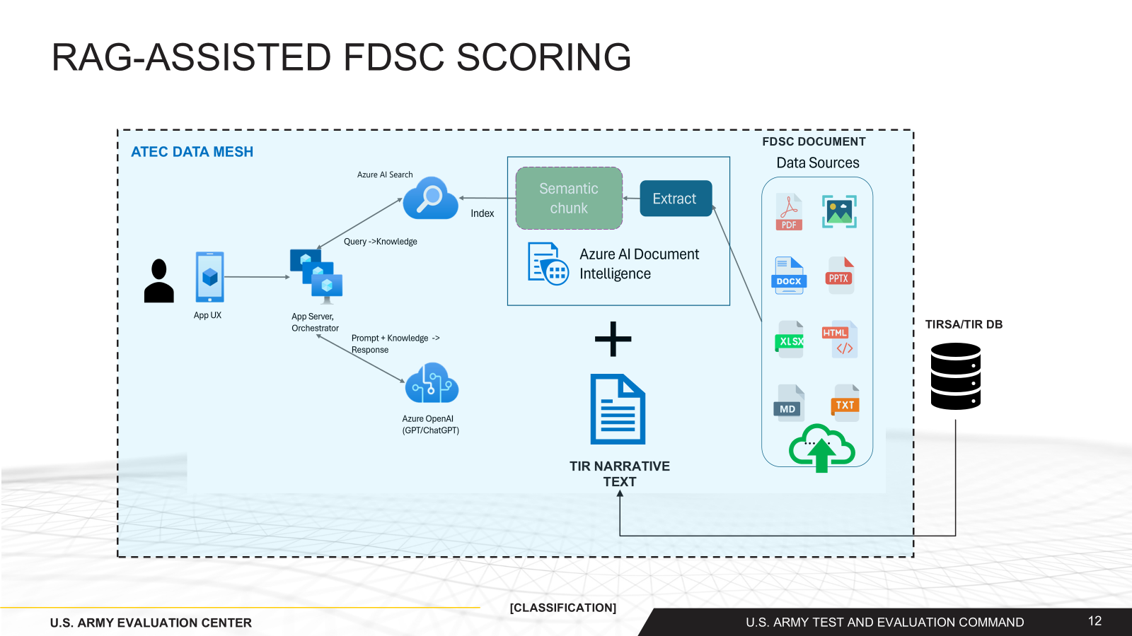
RAG-ASSISTED FDSC SCORING
Notes:
Retrieval-Augmented Generation (RAG) is a design pattern that combines a pretrained Large Language Model (LLM) like ChatGPT with an external data retrieval system to generate an enhanced response incorporating new data outside of the original training data
The goal of semantic chunking is to find semantically coherent fragments of a sentence representation. These fragments can then be processed independently and recombined as semantic representations without loss of information, interpretation, or semantic relevance. The inherent meaning of the text is used as a guide for the chunking process
The orchestrator creates a detailed prompt for Azure OpenAI (ChatGPT).
This prompt is "augmented" – it combines the original TIR text with the relevant knowledge retrieved from the documents.
Azure OpenAI then uses this rich context to generate the FDSC score and/or a detailed explanation, ensuring the output is based on the provided documents.
Accuracy and Grounding: The AI's responses are not just based on its general training data. They are grounded in the specific "FDSC Documents," which drastically improves accuracy and relevance to the U.S. Army's standards.
Transparency and Auditability: Because the system retrieves specific information, it can potentially cite the exact sources used for scoring, making the results transparent and auditable.
Efficiency: This system can perform in seconds what might take a human expert hours of research and cross-referencing.
Scalability: It can handle an enormous volume of documents and scoring requests without a linear increase in human effort.

Slide 10
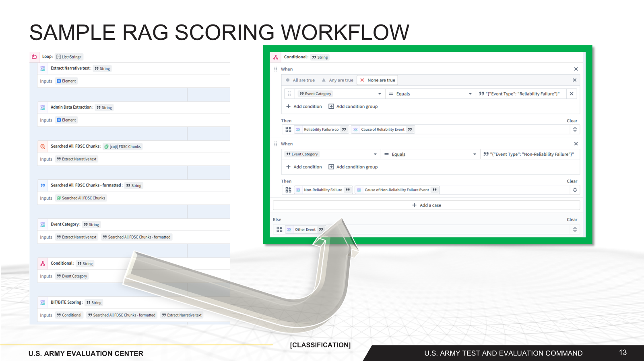
SAMPLE RAG SCORING workflow
Notes:
Step 1: Ingestion & Retrieval.
"First, the workflow ingests a narrative report. It Extracts the Narrative Text and any associated Admin Data."
"Immediately, it performs the 'Retrieval' part of RAG. It takes the narrative text and Searches all FDSC document chunks to find the most relevant reference material. This is crucial—we're not just analyzing the report in isolation; we're instantly pulling up the rulebook."
Step 2: AI-Powered Classification.
"This next step is where the intelligence happens. The system creates an Event Category. To do this, it looks at both the original narrative text and the relevant FDSC documents it just retrieved."
"This isn't just keyword matching. The AI reads the context to make a high-level judgment, like, 'Based on the report and the official documents, this event looks like a Reliability Failure.’”
Explain the "When/Then" Logic.
"It operates on simple but powerful 'WHEN-THEN' rules. For example, WHEN the Event Category is determined to be an "Event Type: Reliability Failure"..."
"...THEN the workflow automatically triggers a deeper analysis focused specifically on that. It moves on to tasks like determining the Cause of the Reliability Event."
Show its Flexibility.
"Likewise, WHEN the category is a "Non-Reliability Failure," it triggers a different, more appropriate set of analytical tasks."
"And if it's neither, the Else condition catches it as an "Other Event," ensuring nothing falls through the cracks and can be flagged for human review."
Key Takeaway: "The key here is that we are combining AI-based classification with structured business rules. The AI handles the fuzzy, context-heavy task of categorization, which then triggers a precise, repeatable analytical process."

Slide 11
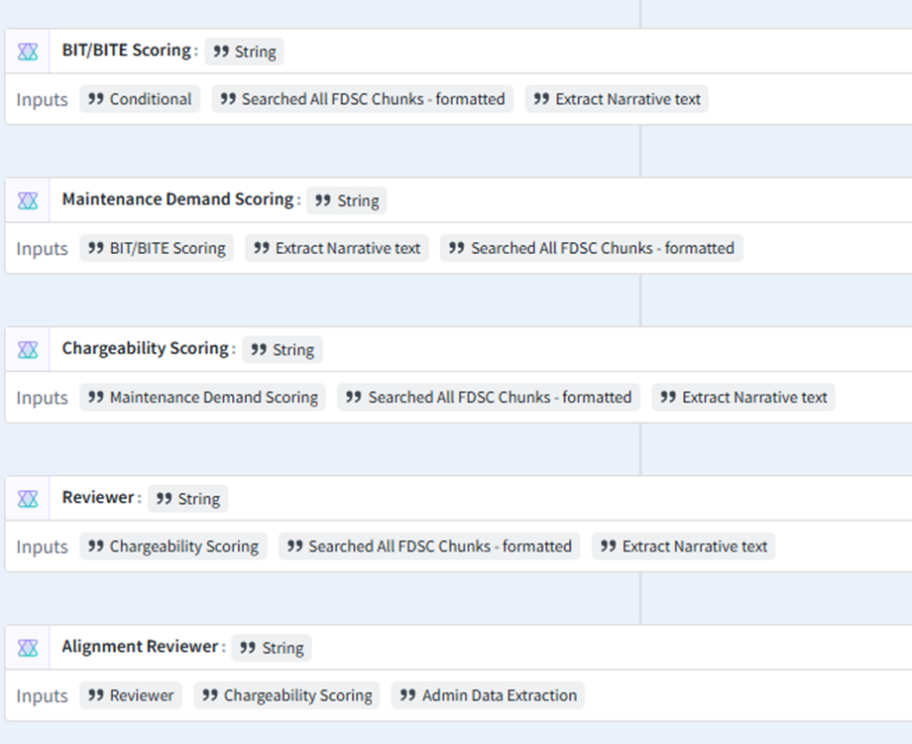
SAMPLE RAG SCORING WORKFLOW (2)
Scoring Cascade
Once the event is triaged, the workflow begins a 'scoring cascade.' This is a series of dependent analyses where each step builds upon the last, adding a new layer of insight.
It starts with BIT/BITE Scoring. This is the initial technical analysis, directly informed by the conditional path we just chose.
The output of that step then becomes the input for the next: Maintenance Demand Scoring. The system now asks, 'Given the technical specifics of this failure, what is the impact on maintenance resources?' It re-analyzes the narrative and documents through this new lens.
Following that, we determine Chargeability Scoring. This is a critical operational logistics question. The workflow uses the Maintenance Demand Scoring as a primary input, ensuring our chargeability decisions are directly linked to the analyzed maintenance impact.

Slide 12
Deconstructing the rag workflow
Core Technology: Retrieval-Augmented Generation (RAG) bridges the gap between massive knowledge bases and the reasoning capabilities of Large Language Models (LLMs).
The Two Main Phases:
  Phase 1: Offline Knowledge Base Construction. This is the foundational step where we process and index all our official documentation (e.g., FD/SC documents) so it can be searched at high speed.
  Phase 2: Real-time Scoring Workflow. This is the active process that is triggered when a new TIR narrative is submitted for analysis. It involves searching the knowledge base and using that information to generate a score.

Slide 13
Deconstructing the rag workflow
Building the Knowledge Base - Ingestion and Chunking: To extract clean text from raw source documents and break it down into meaningful, contextually complete pieces.
Text Extraction:
  The system ingests a wide variety of formats: PDFs, Word documents, PowerPoints, Excel files, and more.
  It uses advanced tools like Azure AI Document Intelligence (or similar OCR and parsing technologies) to not just pull text, but also understand layouts, tables, and headers.
  The output is clean, machine-readable text, stripped of its original complex formatting.
Semantic Chunking:
  Simply splitting documents by paragraph is not enough. A single idea might span multiple paragraphs, or one paragraph might contain several ideas.
  Semantic Chunking is an intelligent process that breaks down the text based on its meaning. It aims to create self-contained "chunks" of information.
  This ensures that when we retrieve information later, we get the full context of an idea, which is essential for the AI to make an accurate judgment.

Slide 14
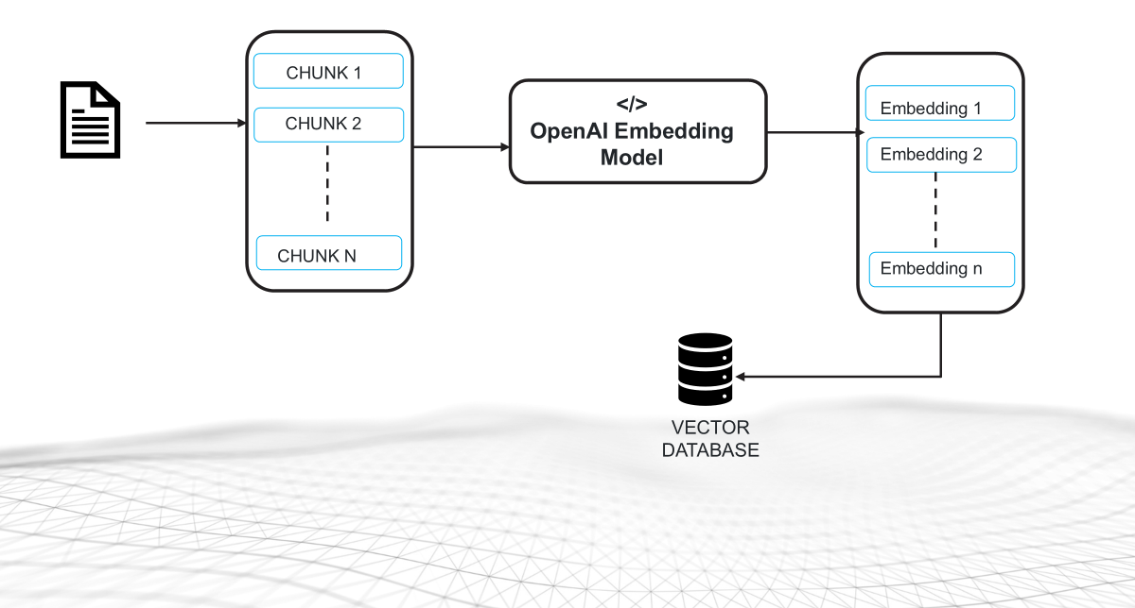
Deconstructing the rag workflow

Slide 15
Deconstructing the rag workflow
Embedding and Vector Indexing: convert the semantic text chunks into a numerical format that a machine can search based on meaning.
Document Embedding:
  Each text chunk is fed into a deep learning model known as an Embedding Model (e.g., OpenAI's text-embedding-ada-002).
  This model converts the text chunk into a vector—a long list of numbers (e.g., 1,536 dimensions).
  The Magic: Semantically similar text chunks will produce vectors that are mathematically "close" to each other in this high-dimensional space. E.g. The vector for "component malfunction" will be closer to "hardware failure" than to "operator training.“
Indexing in a Vector Database:
  These vectors are stored in a specialized Vector Database, such as Azure AI Search.
  This database is optimized for one core task: finding the vectors in its index that are closest to a new query vector, even among billions of entries.
  Each stored vector is linked back to its original text chunk.

Slide 16
Deconstructing the rag workflow
Finding the Evidence - Semantic Search & Retrieval: When a new TIR Narrative arrives, find the most relevant pieces of information from our entire knowledge base.
Querying:
  The incoming TIR narrative text is passed through the exact same Embedding Model used in Phase 1. This creates a "query vector" that represents the meaning of the report.
Semantic Search:
  This query vector is sent to the Vector Database. The database then performs a similarity search to find the indexed document vectors that are most similar to the query vector.
  This is typically done using a metric called Cosine Similarity, which measures the angle between two vectors. A smaller angle equals higher similarity.
Reranking and Top-K Selection:
  The database returns the "Top-K" most similar document chunks (e.g., the top 5 or 10 results). Optionally, a reranking model can be used to re-order these Top-K results.

Slide 17


Deconstructing the rag workflow
Embedding 1
</>
Embedding
Model
</>
Embedded
Query
TIR
Embedding 2
LLM Response to the Query
Embedding n
VECTOR DATABASE
User Query
+
Retrieved relevant Documents
Notes:
https://pub.towardsai.net/unlocking-the-advantages-of-semantic-chunking-to-supercharge-your-rag-models-d0daa61bab2c

Slide 18
Deconstructing the rag workflow
Prompt Augmentation and Generation: Uses the retrieved evidence to guide a Large Language Model (LLM) in generating an accurate, grounded, and justifiable score.
Prompt Augmentation:
  This is the "Augmented" part of RAG. The system constructs a detailed, comprehensive prompt for an LLM like Azure OpenAI (ChatGPT).
  This prompt is a careful combination of:
    A System Instruction: "You are an expert at scoring TIRs based only on the provided context."
    The Retrieved Context: The Top-K document chunks retrieved in the previous step are inserted directly into the prompt.
    The User Query: The original TIR narrative that needs to be scored.
Generation:
  The LLM receives this rich, "augmented" prompt. Imperatively, the LLM is instructed to base its analysis and generate its response using the provided context. This prevents the model from "hallucinating“ (probabilistic errors still possible) or using irrelevant general knowledge.

Slide 19
Deconstructing the rag workflow
The Agentic Process:
  The output from the LLM (e.g., the text "Event Type: Reliability Failure") is not the final answer. It is data that is used to make a decision. Each agent in the chain is provided with a more specialized system prompt depending on its role.
  The orchestrator treats this output as a routing instruction for a team of specialized "agents" (which are other LLM calls).
Example Conditional Logic:
  IF the LLM output is "Reliability Failure," THEN the orchestrator triggers the (Built-In Test/Built-In Test Equipment) BIT/BITE Scoring agent.
  The result of that agent then becomes the input for the Maintenance Demand Scoring agent.
  This continues down the chain for Chargeability and Reviewer assignment.
Notes:
BIT/BITE (Built-In Test/Built-In Test Equipment) reliability analysis assesses the capability of embedded diagnostics to accurately detect, isolate, and report system failures without generating false alarms.

Slide 20
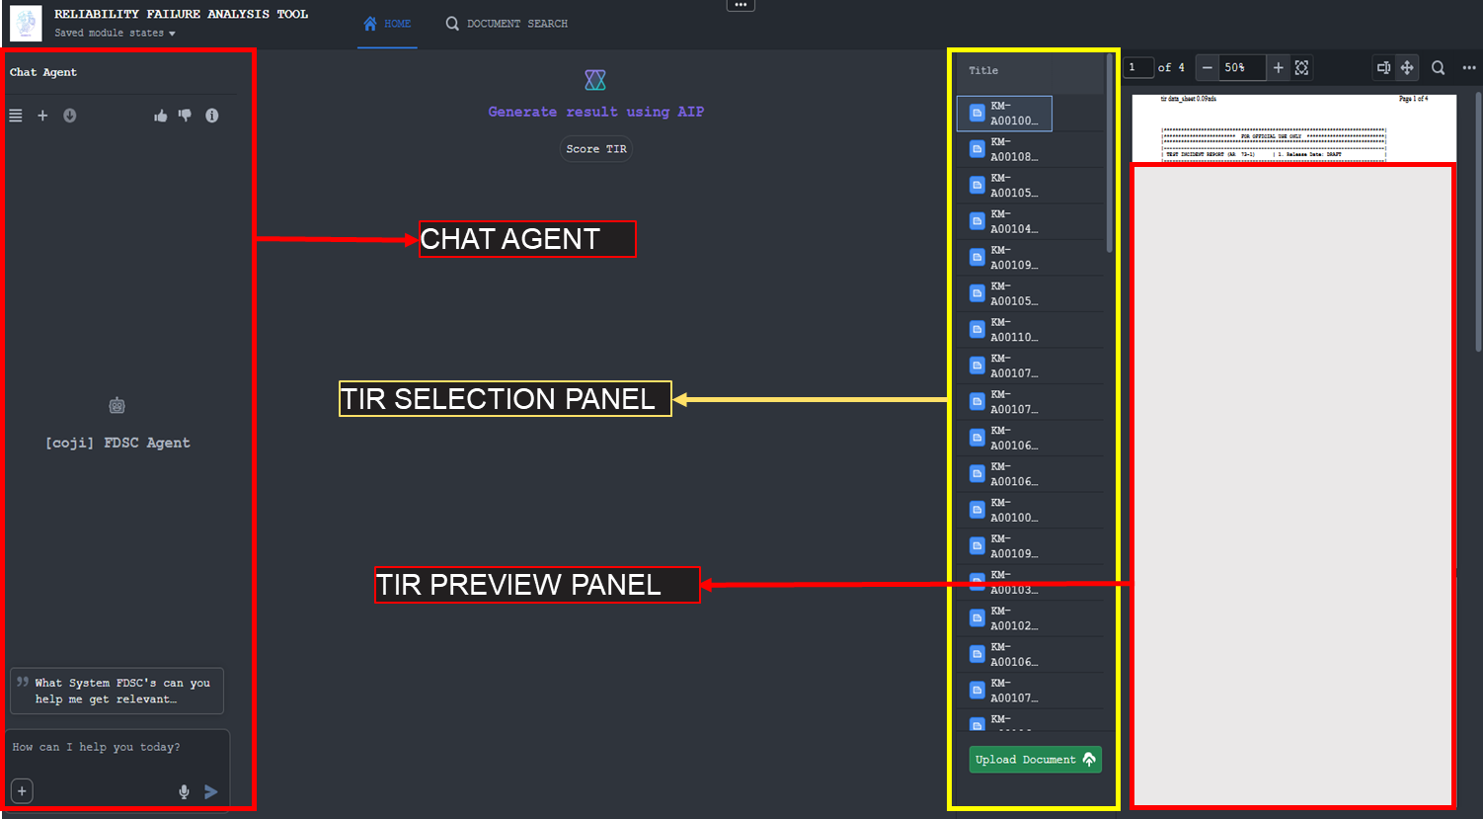
Proof Of Concept
TIR PREVIEW PANEL

Slide 21
FUTURE WORK
ATEC Data Mesh – ATEC’s Azure Cloud Environment
Integrated with TIRSA – ATEC’s Online TIR Scoring tool
CAC Authentication
Access managed at the project level (following TIRSA)

