Slide 1
Integrating Mission Engineering with Systems Engineering to Enable Naval Ship Design
Dr. Jim Moreland, Jr, Dr. Alan Brown, Geoffrey Kerr
MEI Innovative Solutions Inc & Virginia Tech
April 2026

Slide 2













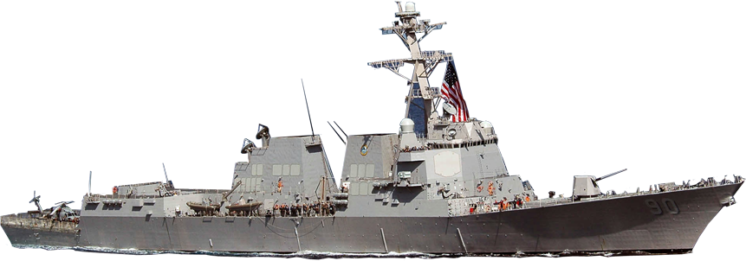
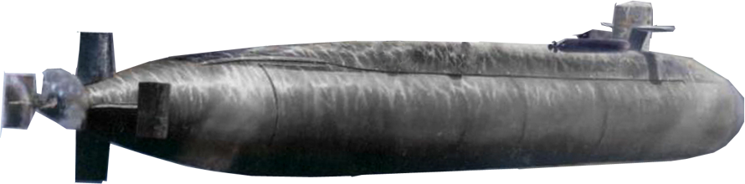
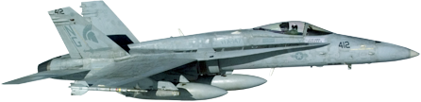
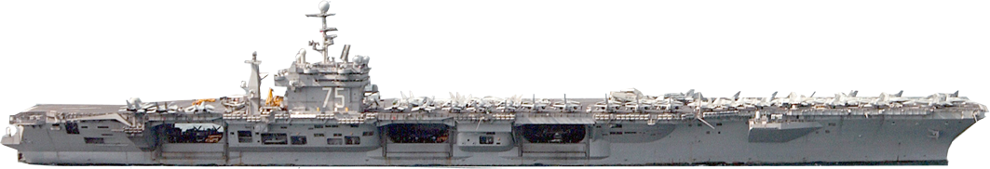
Engineering of System-of-Systems
(Systems Engineering Hierarchy)
Mission
Objective
Measure of Success
Mission Essential Tasks
Measures of Effectiveness
Mission Engineering Thread
Measures of Performance
Key Performance Parameters
Key System Attributes
Translates
Operational Concepts to Mission Essential Tasks and Mission Capabilities
Anti-Submarine
Warfare
Strike
Mission
Enterprise
Anti-Air Warfare
Electronic Warfare
Force Focus
Ballistic
Missile Defense
Mine Warfare
Translates
Mission Capabilities and Functions to System Requirements
SoS
Capability Focus
Mission Engineering Focus
System
Translates
System Requirements to Component Functions
Functional Focus
Component
Translates
Component Functions to End Items
End Item Focus
2
Systems Integration required at each level of hierarchy and requirements are passed between levels

Slide 3
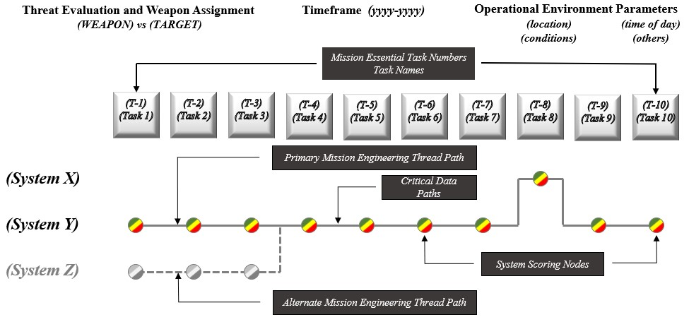
Notional Mission Engineering Thread
Using Common Effects/Kill Web Framework
3

Slide 4
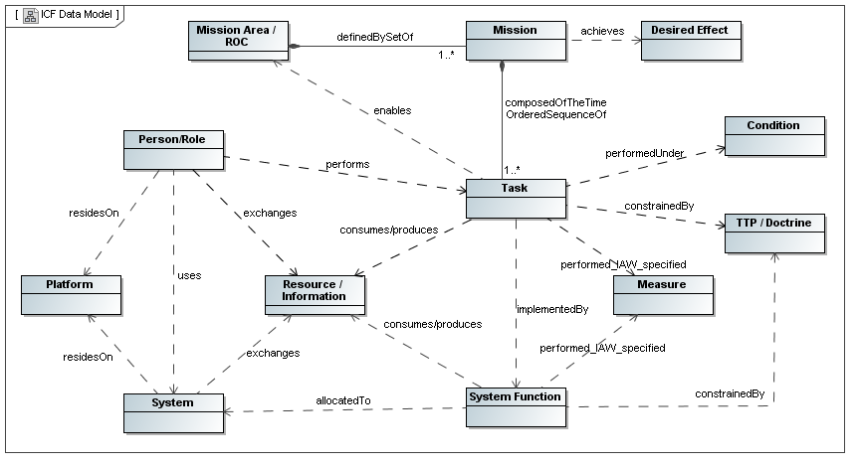
The ME input I was hoping for was a set of time-ordered sequence of tasks, MTs, requiring system functions allocated to systems, METs, with measures, MOPs and MOEs, perhaps with goal and threshold values vs. specific threats. This would allow the ship (platform) designers to allocate systems to platform, define a design space; assess cost, effectiveness, risk and feasibility; and identify and assess alternatives for acquisition decision. Am I close? Al
Integrated Capability Framework
Data Structure
4

Slide 5
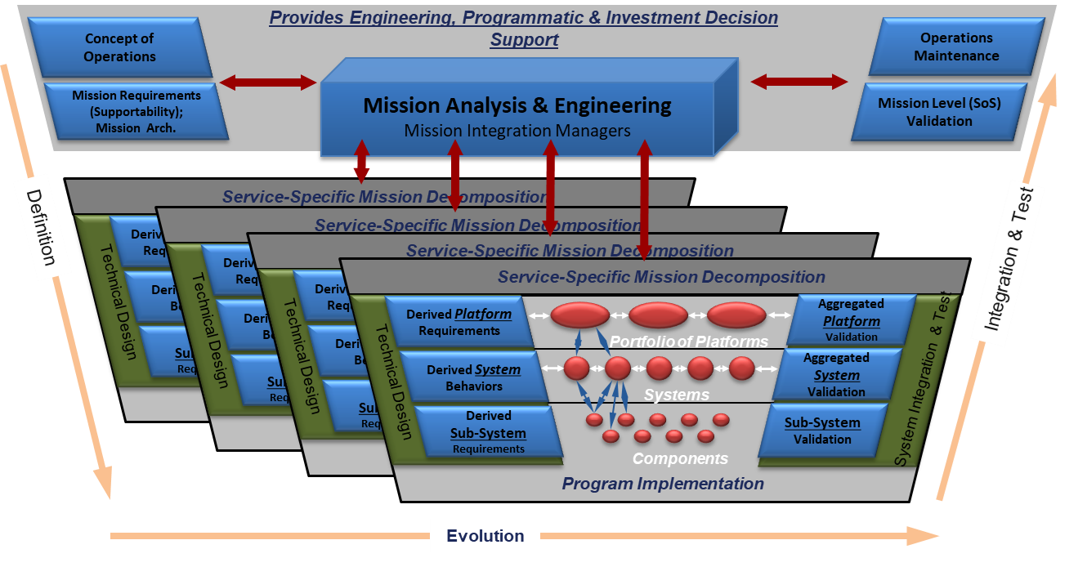
Applying SoS Engineering for Mission Success
_{JCS}
_{OSD}
_{Military Service PAEs}
_{SAE}
_{PEOs}
_{PMs}
Provides Decision Support for Acquisition Programs Providing Engineering Details Across Mission Engineering Threads
5

Slide 6
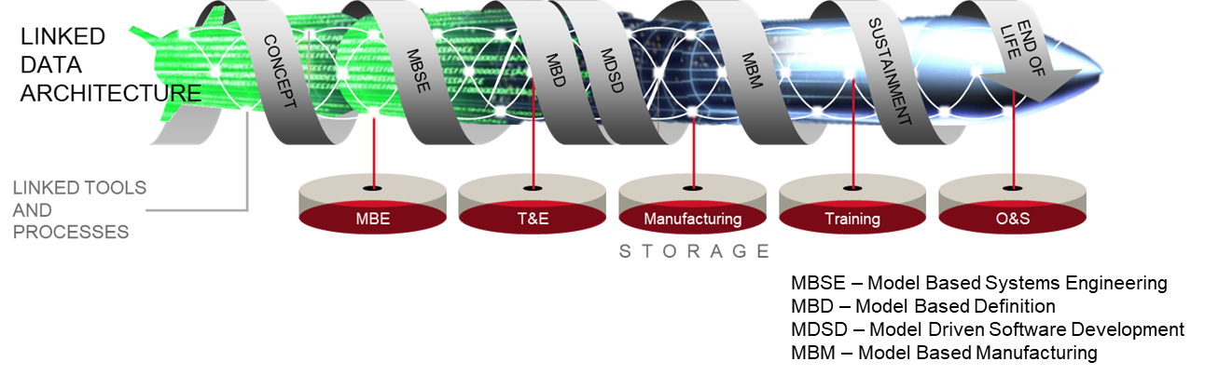
Digital Flow of Authoritative Data
6

Slide 7
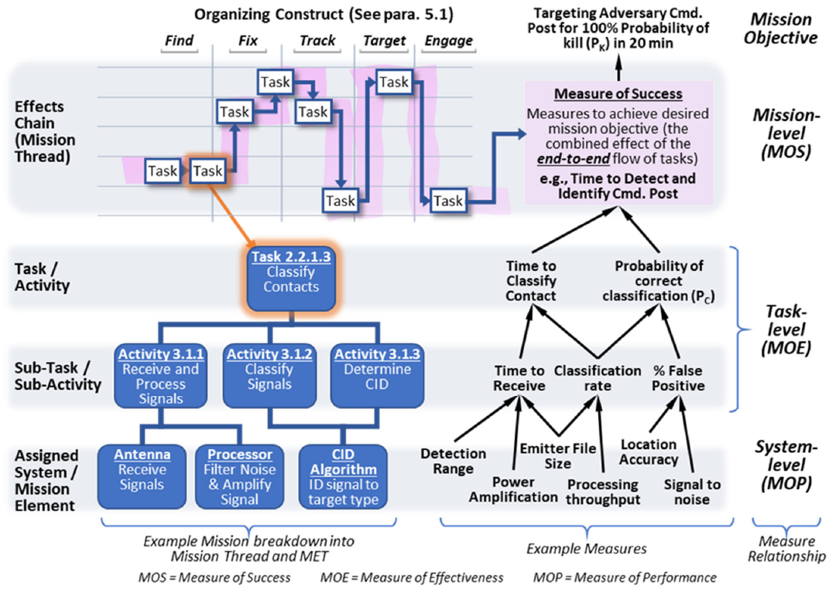
  Platform METs from MT Task Allocation and Decomposition w/Task-level MOEs and System-level MOPs (Goals & Thresholds)
MTs:
Tasks assigned to different platforms. For ships needing to operate independently, they may have to perform all tasks. This figure considers 5 platforms.
Operational
Detect
Identify
Platform
Operational
MOEs Vs. Specific Threats under specific Conditions
METs:
Platform
VCs from platform design space
MOPs for Platform System Elements (VCs)
DoD_MissionEngineeringGuide_Oct2023

Slide 8
VT Naval Ship Concept Design Process
Concept Exploration, pre-AoA
Concept Development, AoA
Important ME Input

Slide 9
AAW Example - MTs, METs w/MOPs, goals, thresholds

Slide 10
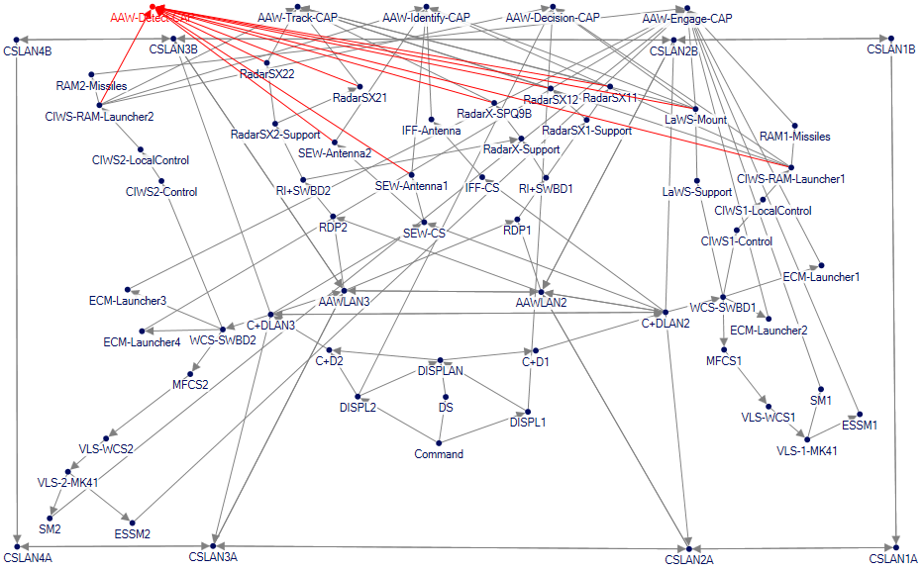
AAW Logical Architecture

Slide 11
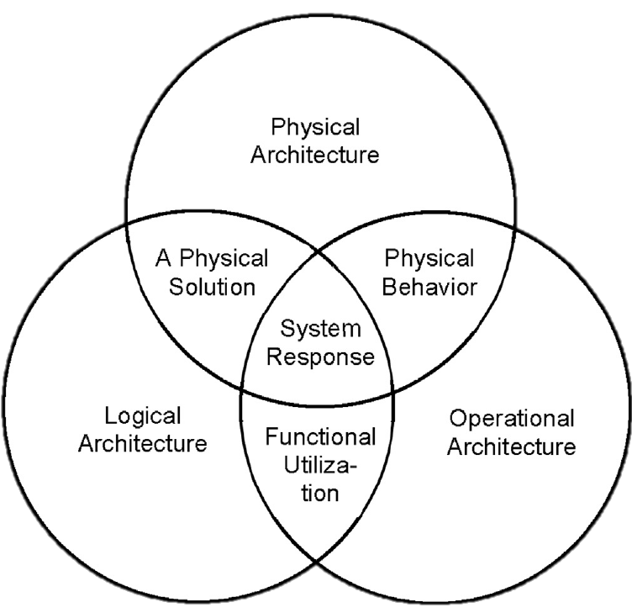
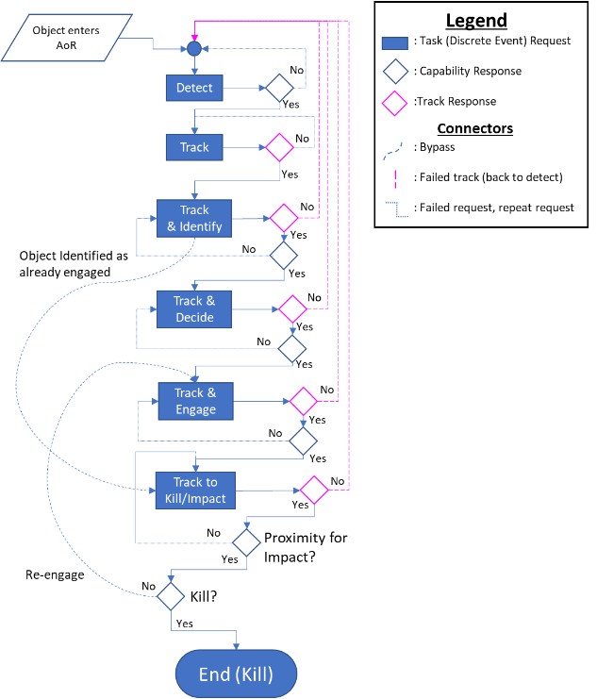




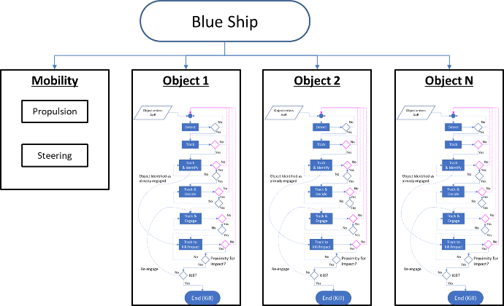


Ship Operational Architectures (from MT)
Shane, A., Parsons, M. A., Berrow, D. J., Kara, M. Y., & Brown, A. J. (2023). Operational Architecture and Framework for Assessing Mission Effectiveness in Surface Ship Concept and Requirements Exploration. Naval Engineers Journal, 135(2), pp. 101–117.

Slide 12
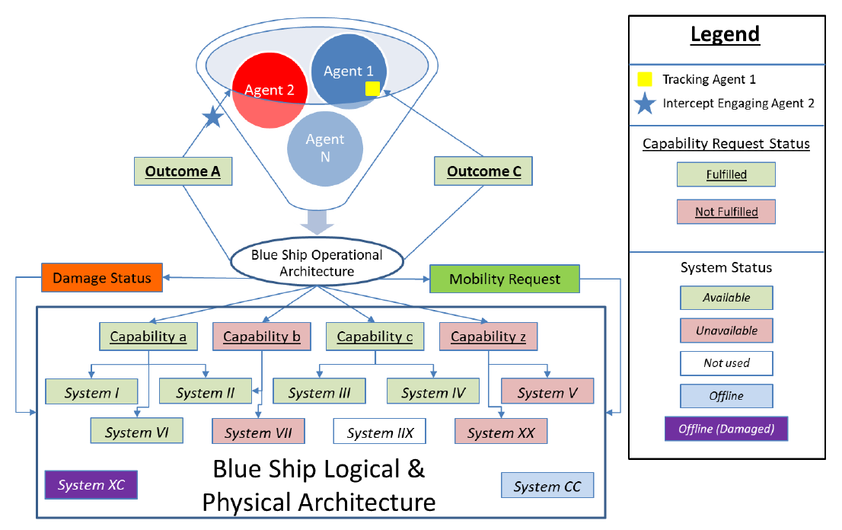
Series of Probabilistic Threat Agents and Conditions

Slide 13
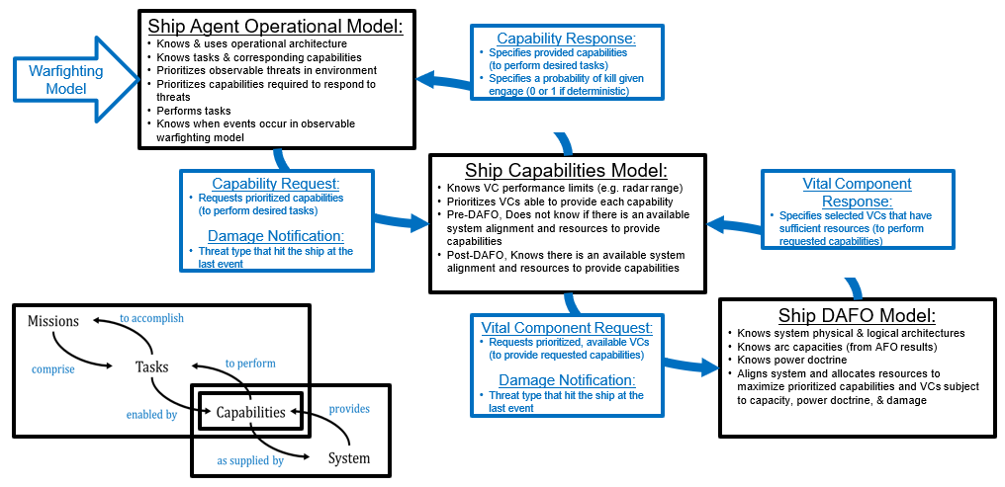
Ship Behavior and Interaction Model

Slide 14
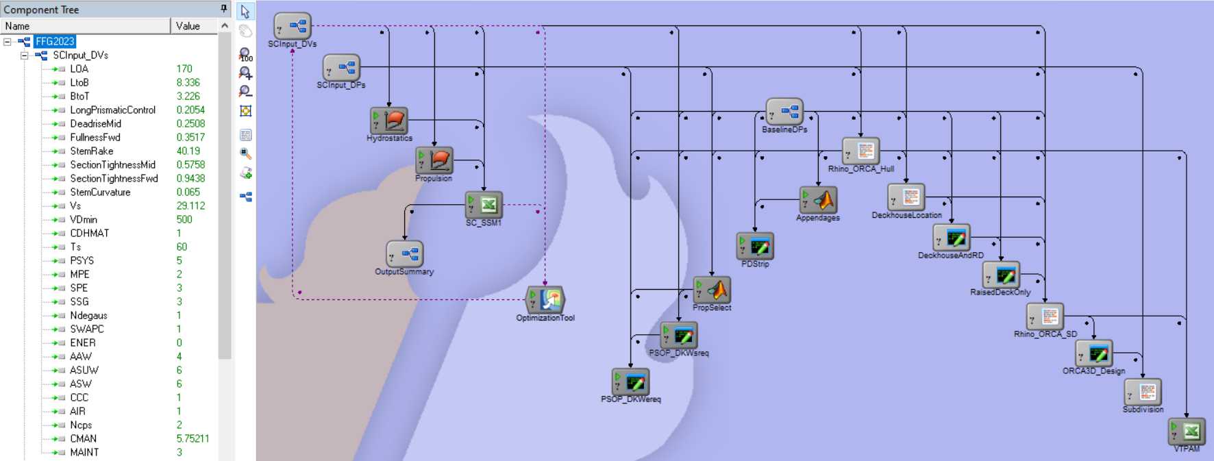
Concept Design Model in Model Center – AOE Tool
VT Concept Design Model in Model Center
Concept Exploration
Synthesis
Hullform
Exploration
Concept Development

