Slide 1
Rethinking Defense Planning: Are We Investing in Capabilities? Or Security?
DATAWorks 2024
Institute for Defense Analyses
Washington, DC
Leo Blanken
Associate Professor
Defense Analysis Department
Naval Postgraduate School
Monterey, California
Jason Lepore
Professor
Economics Department
California Polytechnic State University
San Luis Obispo, California

Slide 2
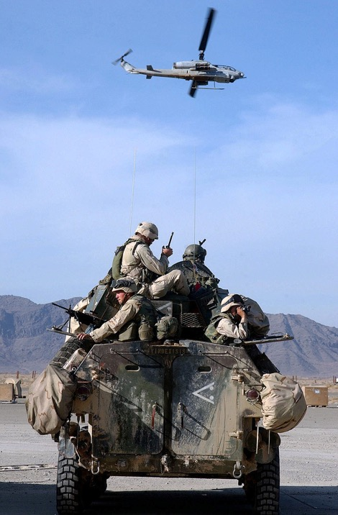
The Trillion Dollar Noisemaker
Bala Murghab, Afghanistan, 2009
Notes:
The Trillion Dollar Noisemaker: The “Battle” of Bala Murghab, 2009
Consider the following vignette. In the Fall of 2009, a Marine Special Operations Team (MARSOT), elements of the 82nd Airborne Division, Italian International Security Assistance Force (ISAF) coalition troops, and partner Afghan National Security Forces (ANSF) engaged Taliban irregulars who were holed up in an isolated cluster of buildings in the remote Bala Murghab valley of northwestern Afghanistan. During the engagement, eight Afghan National Army soldiers, three Afghan policemen and an interpreter were killed, while 17 Afghan troops and five American soldiers were wounded. (Faiez, 2009) The nature of this engagement is very familiar but, at the same time, quite puzzling. On the one hand, it will seem recognizable to any casual viewer of television newsfeeds (or social media, or Hollywood movies) over the last two decades – normalized to the point that one no longer questions it. On the other hand, when one breaks it down through fresh eyes, the bizarre nature of the engagement should give us all reason to pause.

Slide 3
Puzzle and Motivation
The Puzzle: The United States makes enormous investment in seemingly impressive military forces that often fail to defeat or coerce much weaker adversaries.
Our Way Forward: Reframe capabilities planning within its real context – the search to secure national welfare. Focus on the incentive structures for actors throughout the enterprise.

Slide 4
Outline
Section I: Introduce the Feasible Production Framework
Budgeting > Planning > Coercion > Warfighting
Section II: Focus on Constrained Performance in Warfighting Stage
Budgeting > Planning > Coercion > Warfighting
Section II: Focus on a New Source of Uncertainty for Planning Stage
Budgeting > Planning > Coercion > Warfighting

Slide 5
Section One:
The Feasible Production Framework

Slide 6
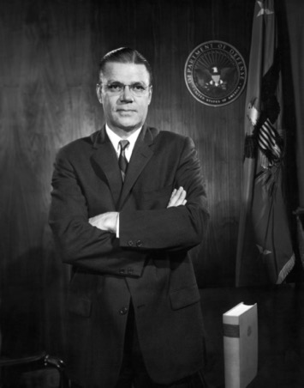
Cold War Background: Capabilities per Dollar
The use of managerial economics tools to enable OSD to rationalize planning for the uniformed services
Impose coherence and efficiency onto national security
“[M]y team and I were determined to guide the department in such a way as to achieve the objective the president had set: security for the nation at the lowest possible cost” – SECDEF Robert McNamara

Slide 7
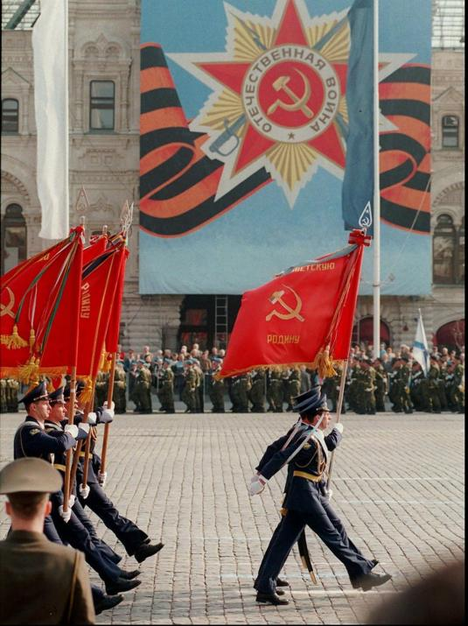
Cold War Approach
Aided by transparent and grave security challenge:
  “Soviet forces provided a well-understood, slowly advancing focal point for long-range planning” (McNaugher 1996)
All else was lesser included:
  “The idea was that if the U.S. military was prepared to fend off a large threat – …the Soviet military—then it was certainly equipped to defeat smaller-scale threats” (Stout 2014)
RAND Pioneers: (Hitch, McKean, Quade, etc)
  Used Neoclassical Economics’ assumption that “black boxed” production
  Treated capabilities per dollar as measured output

Slide 8
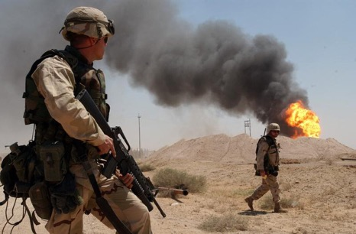
The Post Cold War Legacy
The clear and grave target of the Soviet Union disappeared
Rise of the “Scenario” versus “Capabilities” Planning debate
This can be represented as uncertainty over “correct” capabilities for a future mission
  Tanks versus ships
Didn’t consider problems in performance
  Gulf War Euphoria /RMA
  Full-Spectrum Dominance

Slide 9
Why this was OK then, but not now…
These models were built in the wake of World War II and intended to design for catastrophic war with a peer superpower (USSR)…
  …but how does the changing size and nature of threats confound this approach?
We still field seemingly superlative capabilities…
  …so how have we ended up with the Trillion Dollar Noisemaker problem?
  How might we use new analytic tools to address this problem?
We now have far better analytic tools for modeling:
  Can “unpack” the black box of production

Slide 10
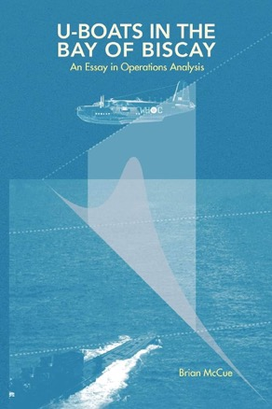
Step One: Focus on the real goal – “Security”
The Cold War Capabilities Lens:
  “[it is an] ill-informed [approach, in which] designers… start at the top and work up, asking what the weapon’s mission is, what the the mission’s purpose is, and so on until they get to a lofty goal such as undisturbed continuation of the American way of life… This top-up… process does not work” (McCue 2008)
… but what if we actually tackle this problem? Moving from neoclassical concepts of efficient battlefield capabilities to the production of national security?

Slide 11
Step Two: Widen the aperture
Security as multi-stage production process to support the national welfare
Consider efficiency through the lens of national welfare, rather than capabilities (which is an intermediate stage)
Ascertain the conditions under which efficient choices are in equilibrium at all stages
Asking the question: What is “feasible” security that can be produced, given investments and actors’ expected behavior?
This allows us to address both the “correct” capabilities challenge and the “constrained performance” challenge

Slide 12
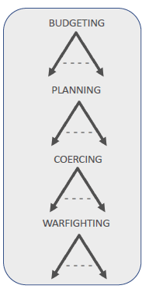
Feasible Production Framework
Four stages of production
Consider actors at all stages
Each actor has a vector of incentives, of which “pursuit of mission” is only one (career, bureaucratic rivalry, jobs in districts, profit are others)
Search for the conditions under which actors prioritize (or not) the pursuit of mission?
Most efficient, feasible outcome is obtained when actors’ incentives are all aligned to the pursuit of mission
Threat environment is key driver to incentive alignment

Slide 13
The Neoclassical Production Problem
Inputs f Outputs
$$R∈ℝ^{L}$$
$$Q∈ℝ^{J}$$
Objective: Maximize Profit (expected future discounted profit)
Choices: Inputs and Outputs
More inputs directly decrease profit through cost
More output directly increases profit through revenue
Outputs constrained by inputs: reduction to input choice problem
Profit maximization implies cost minimization: for a fixed Q minimizing cost of R

Slide 14
Production of National Security
Inputs f Outputs
$$R∈ℝ^{L}$$
$$NS∈ℝ^{J}$$
Objective: Maximize National Welfare (expected future discounted NW)
Choices: Inputs and NS
More inputs directly NW by taking productive resources out of the economy.
More NS directly increases NW by increasing the probability that the full welfare is secured in range of possible future worlds
NS constrained by inputs: reduction to input choice problem

Slide 15
What is National Welfare?
Abstract idea that is difficult to pin down
Multidimensional Totality of Value? GDP?
Can we get around linking production to a concept of NW?
-Only in special cases
To understand this question, we need a framework to unpack the production problem

Slide 16
Four Stages of Production Choices
Stage 1: Budgeting: choose $B$
Congress decides budget
Stage 2: Coercion: choose $C$
Political Leadership decides on Use and Threat of force
Stage 3: Planning: choose $R$
Professional Planner decide how to use budget
Stage 4: Warfighting: choose $A$
Military actors make war decisions

Slide 17
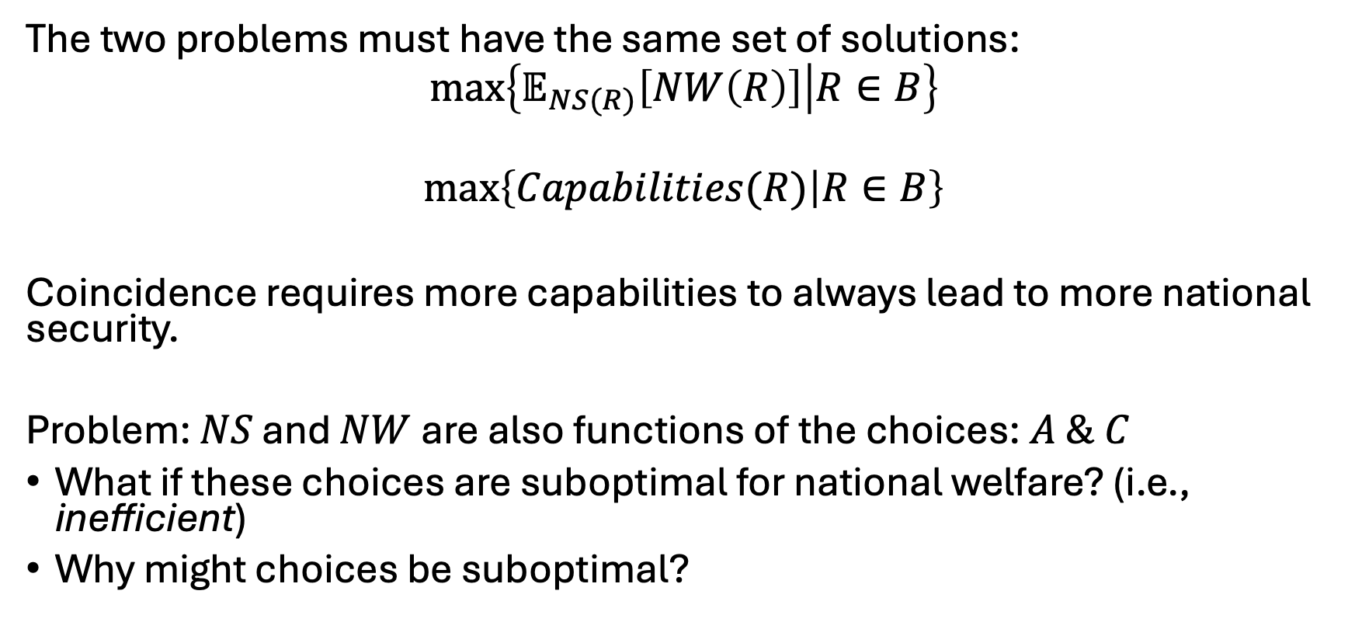
When is capabilities maximization optimal?
The two problems must have the same set of solutions:
$$\max\left\{𝔼_{NS(R)}\left[NW\left(R\right)\right] | R∈B\right\}$$
$$\max\left\{Capabilities(R) | R∈B\right\}$$
Coincidence requires more capabilities to always lead to more national security.
Problem: $NS$ and $NW$ are also functions of the choices: $A \& C$
What if these choices are suboptimal for national welfare? (i.e., inefficient)
Why might choices be suboptimal?

Slide 18
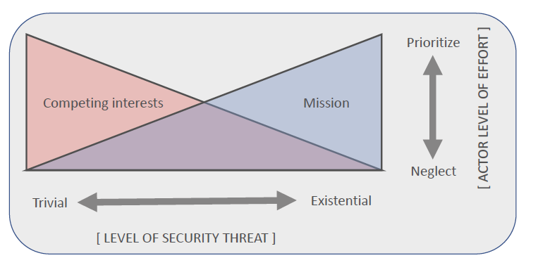
Threat environment as driver of incentives

Slide 19
Conclusions Regarding the Feasible Production Framework
Towards the “Existential” end of the spectrum
  Alignment of incentives around the mission is achieved
  Constrained performance problems disappear
  Uncertainty over correct capabilities is low
    Wartime: feedback on “correct capabilities” in real time
    Peacetime: target is clear and grave (Fulda Gap)
Towards the “Trivial” end of the spectrum
  Alignment of incentives around the mission is not achieved
  Constraints on performance loom large
  Uncertainty over correct capabilities is high
    Wartime: constraints on actor behavior inhibits adaptation
    Peacetime: uncertainty over both “correct capabilities” and “expected performance” loom large

Slide 20
Section Two:
Constraints on Warfighter Performance
Budgeting > Planning > Coercion > Warfighting

Slide 21
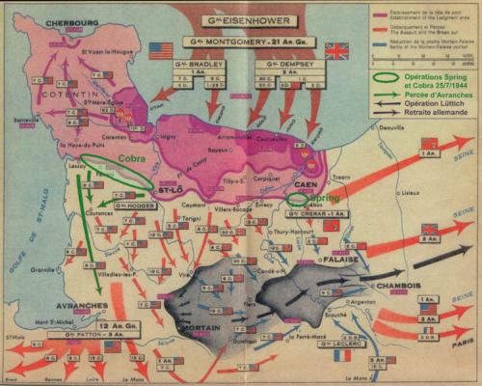
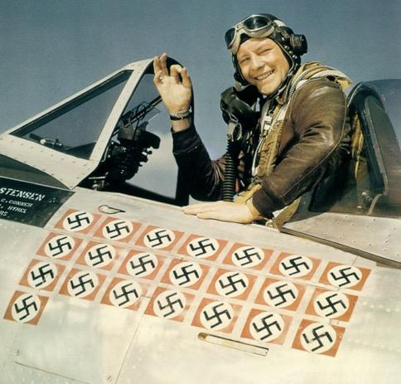
World War II
Notes:
Goal – unconditional surrender
Strategy – total war
Metrics - territory

Slide 22
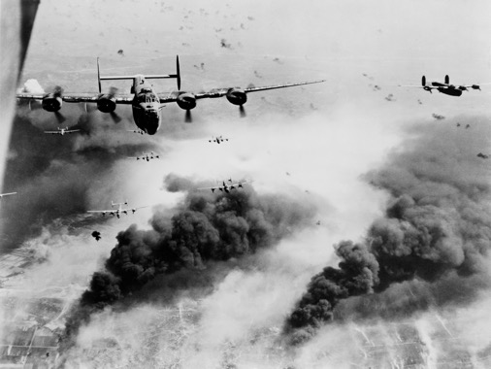
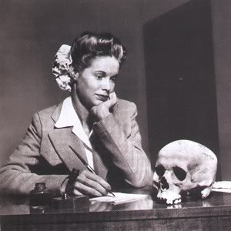
World War II
Notes:
“When he said goodbye two years ago to Natalie Nickerson, 20, a war worker of Phoenix, Ariz., a big, handsome Navy lieutenant promised her a Jap. Last week Natalie received a human skull, autographed by her lieutenant and 13 friends, and inscribed: “This is a good Jap—a dead one picked up on the New Guinea beach.” Natalie, surprised at the gift, named it Tojo. The armed forces…disapprove strongly of this sort of thing.” (LIFE Magazine, May 22, 1944)
An authenticated kill came off the Tokara Islands on 22 August 1944, when she attacked a convoy, hit several ships, and claimed several kills including two destroyers, but apparently only sank the 6,754-ton transport Tsushima Maru. According to Tsushima-muru Commemoration Association data, the ship was carrying 1,661 civilian evacuees, including 834 schoolchildren (of whom 775 were killed)
GEN Curtis Lemay
- Firebombed 63 Japanese cities
Killing 500,000 civilians
De-housing another 8 million
“There are no innocent civilians. It is their government and you are fighting a people, you are not trying to fight an armed force anymore. So it doesn't bother me so much to be killing the so-called innocent bystanders.”…” I'll tell you what war is about, you've got to kill people, and when you've killed enough they stop fighting.”
POINT: The metric worked – in terms of producing useful behavior – the more of the metric you produced aligned with progress in the war’s strategy – and brought you closer to your goals
YOU WERE NEVER TOLD YOU KILLED TOO MANY OF THE ENEMY TODAY

Slide 23
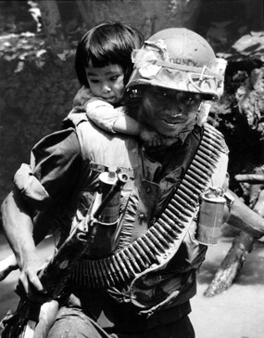
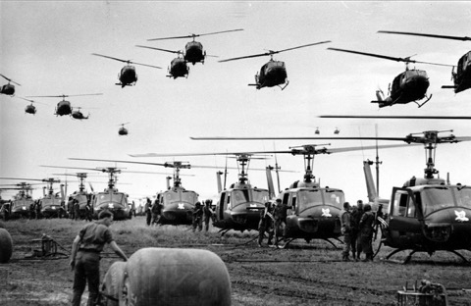

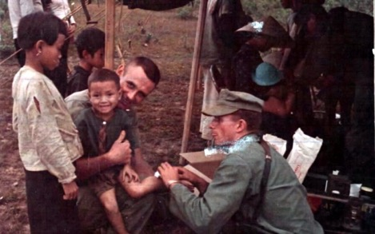
Vietnam
Notes:
Goal: Viable, legitimate South Vietnamese regime
Strategy: win the hearts and minds of the South Vietnamese people
Metric: body counts

Slide 24
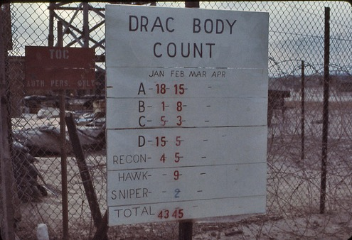
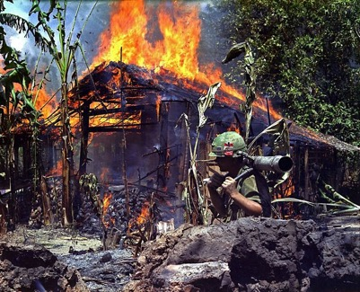
Vietnam
Notes:
MY LAI massacre of March 1968:
One soldier would testify later, "I cut their throats, cut off their hands, cut out their tongues, scalped them. I did it. A lot of people were doing it and I just followed. I lost all sense of direction." [~400 killed, company of the 23rd ID, march 68 – scandal was in late 69]
MCNAMARA: ”Westy’s attrition strategy relied heavily on firepower…It often proved difficult to distinguish combatants from noncombatants Fighting produced more and more civilian casualties [and this] undermined, in an unintended but profound way, the pacification program designed to win the ‘hearts and minds’ of the South Vietnamese people”
POINT: The metric DID NOT WORK. It induced pathological behavior in the military – in the sense that you were rewarded for doing it, but doing more and more of it worked against the overall strategy.
Unlike the fighter pilot, bomber pilot, or subamrine commander in WWII – you COULD kill too many of the enemy

Slide 25
Implications of Existential Conflict for the Warfighting Stage
Gravity of conflict outweighs other considerations:
  Easy to nest activities from tactical/operational/strategic
  Easy to choose clean metrics that capture intent (measurement validity)
  Easy to capture values for those metrics (measure reliability)
  Easy to establish a positive, monotonic impact on intended effect
  Easy to reward “useful” behavior in agents: fighter pilot example
Type I versus Type II errors:
  Errors of omission punished
  Can easily manipulate risk attitude of actors towards the mission

Slide 26
Implications of Trivial Conflict for the Warfighting Stage
Triviality of conflict causes it to be outweighed by other considerations:
  Complexity of exogenous factors leads to problems of non-monotonicity of actor behavior on strategic goals
  Difficult to assess actors with simple metrics and guide behavior via rewards mechanism
  When you don’t take this into consideration: Vietnam body count example
Type I versus Type II errors:
  Errors of commission punished (“stepping over the line”)
  Induced risk aversion around pursuing the mission
  When you take this into consideration poorly: Bala Murghab example
  “The Strategic Corporal” problem

Slide 27
Section Three:
Reframing the Planning Stage
Budgeting > Planning > Coercion > Warfighting

Slide 28
Planning in a non-existential world
All other levels of choices are suboptimal (2nd Best Problem)
Simple case
Assume force is only used and threatened optimally (i.e., in the interest of NW)
Capabilities needs to be redefined to Applicable Capabilities
Probability of future conflict types includes not only correct capabilities for mission, but also potential constraints on performance
Hard case
Forces can be used sub-optimally
Must also consider impact on coercion choices of force to plan optimally
  Self-interested leadership choice
  Pathologies in civ-mil estimations

Slide 29
Educate Upward?
We are exploring prescriptions for actors at each stage to sensitize superiors to performance problems?
Realistic estimations of capability
Bank loans?
Reframing requirements analysis?

Slide 30
Questions?

Slide 31
Very Simple Example
Basketball team
-always most points wins game
Fixed budget
Problem: Find optimal players within budget
Maximize basketball capabilities
Should lead to most wins if you account for complementarities
But what if rules are not fixed: every game has different rules/asymmetric
Ex: Two versions: (i) Stadard Rules, (ii) Other team has no rules

