Slide 2
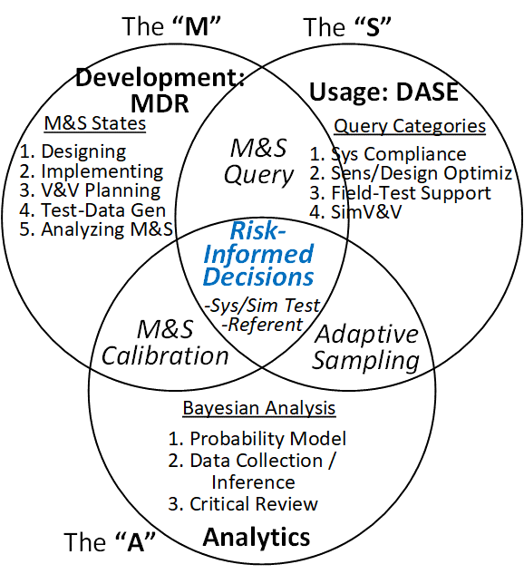
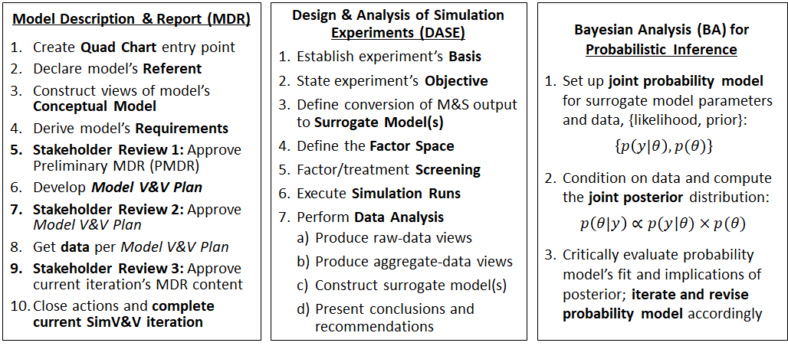
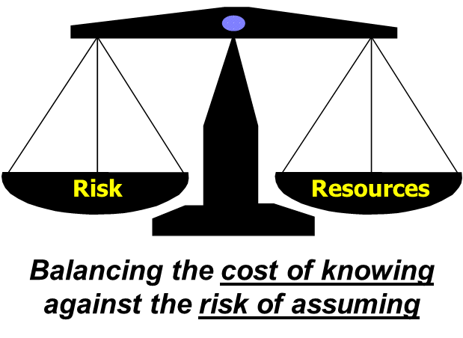
The Modeling, Simulation, & Analysis (MSA) Protocols
The MSA protocols are scalable standard operating procedures because they’re embodied as high-level checklists*
2018
2007-2023
2022
2024
*Hurst et al, “How Credible Model-Based Engineering Can Enable Risk-Informed Decision-Making,” AIAA SciTech2023.
Bayesian Analysis is key for moving from frequentist DASE to credible MSA, fully transforming MSA into a digital test & evaluation venue

Slide 3
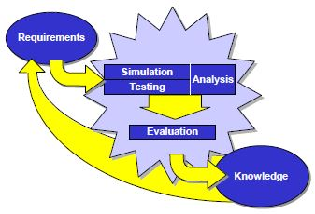
Simulation-Based Acquisition (SBA): Hope vs. Reality
Hope
Save cost/time by using “cheap” Modeling & Simulation (“Sim”) to reduce the number of “expensive” field test events
Reality and Consequences
Decades of replacing field tests with “cheaper” M&S on high-performance computing (HPC) has led to
a reduced amount of simuland data available for calibrating or validating M&S
more difficulty in assuring that a Sim is credible for its intended use
high risk of Sim/HPC mis-use
The MSA protocols, including Bayesian Analysis, are key for moving from DASE to credible MSA, fully transforming MSA into a digital test & evaluation (T&E) venue
Source: Simulation, Test, and Evaluation Process (STEP) Guidelines, Director, Operational Test and Evaluation, and Director, Test, Systems Engineering and Evaluation, 4 Dec 1997.
No matter how much HPC is available for Sim runs, given limited data from field tests, the Sim credibility issue persists

Slide 4
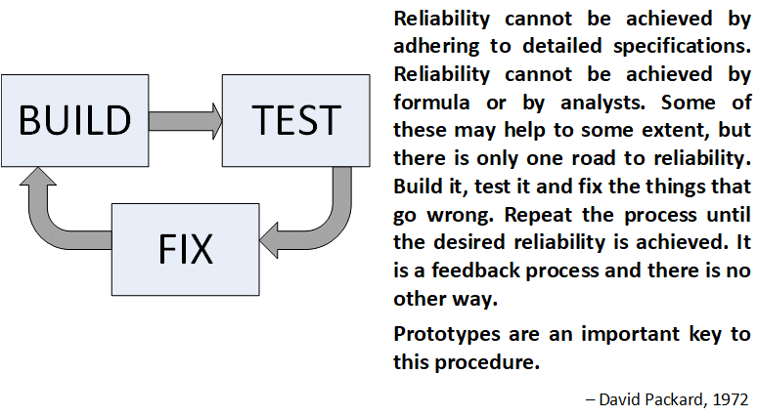
Treating MSA as a T&E venue enables closing the loop
See also SecAF Frank Kendall’s 2013 comments on Dave Packard’s Acquisition Rules (1971), and on over-hyped digital engineering (2023)
Credible MSA is key to calibrating expectations on the payoff of digital engineering

Slide 5
A simple example of closing
the loop: Calibrating a Sim

Slide 6
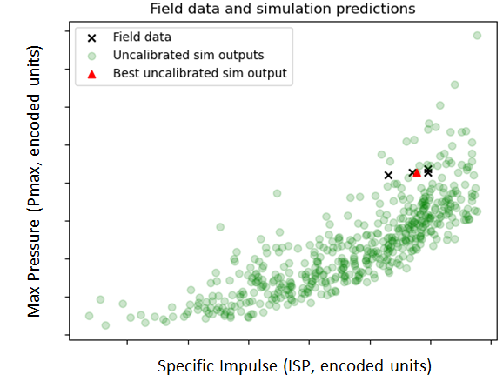
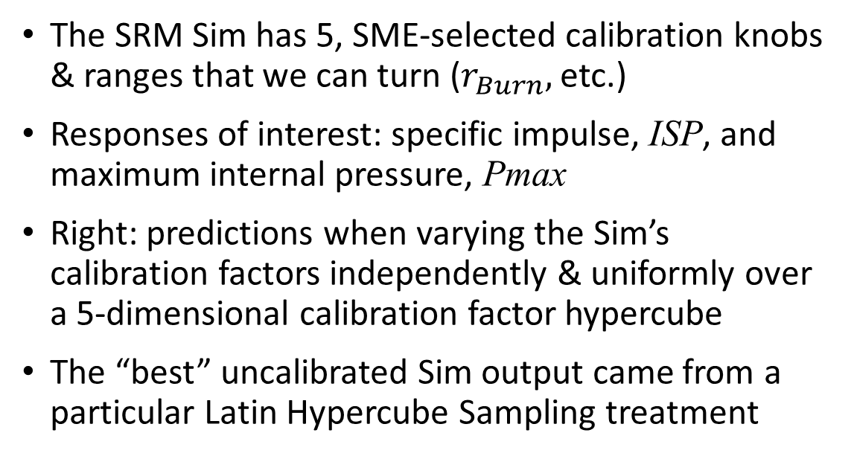
The Model: Solid Rocket Motor (SRM)
The SRM Sim has 5, SME-selected calibration knobs & ranges that we can turn ($r_{Burn},$etc.)
Responses of interest: specific impulse, ISP, and maximum internal pressure, Pmax
Right: predictions when varying the Sim’s calibration factors independently & uniformly over a 5-dimensional calibration factor hypercube
The “best” uncalibrated Sim output came from a particular Latin Hypercube Sampling treatment

Slide 7
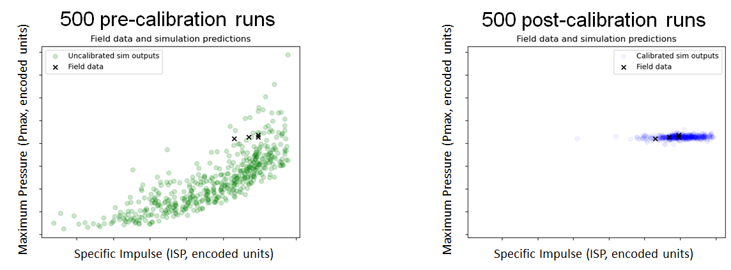
SRM model calibration
Bayesian Calibration
We used field data and SME judgement to successfully calibrate the SRM model

Slide 8
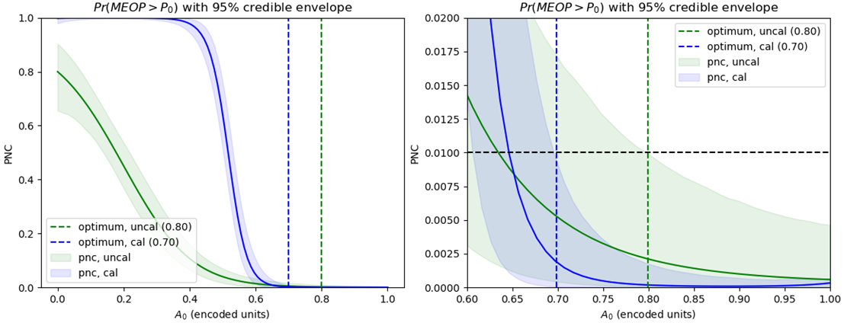
Using the calibrated model (same number of runs as un-calibrated)
Objective: Choose SRM nozzle area A₀ to maximize specific impulse but with low probability of exceeding Maximum Expected Operating Pressure P₀, i.e. $PNC\overset{def}{=}\operatorname{Pr}\left(MEOP>P_{0}\right)≤0.01$
zoomed-in
The high→low transition in PNC is sharper when using a calibrated SRM model

Slide 9
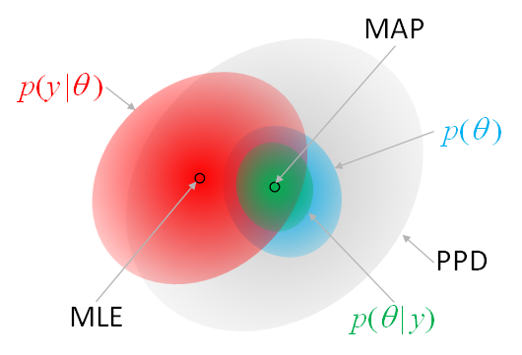
Summary: Achieving credible MSA
The DASE Axioms in our 2016 CASD paper focused on choosing a sample size a priori, in accordance with accepted levels of power & confidence for maximum-likelihood estimates (MLE)
Bayesian Analysis enabled a transition from a priori sampling to more effective, information-theoretic adaptive sampling, to fully quantify uncertainty (see our DATAWorks2022 paper)
The simple calibration example described above shows how, using limited field test data and Sim output, Bayesian Analysis enables Sim calibration and risk-informed decision-making when using MSA
The transition from DASE to integrated, credible MSA is analogous to transitioning from practicing “DOE” in isolation, to practicing STAT as an integrated whole
Being able to fully quantify uncertainty leads to viewing MSA as a credible T&E venue, conditioned on the availability of field data for Sim calibration

