Slide 1
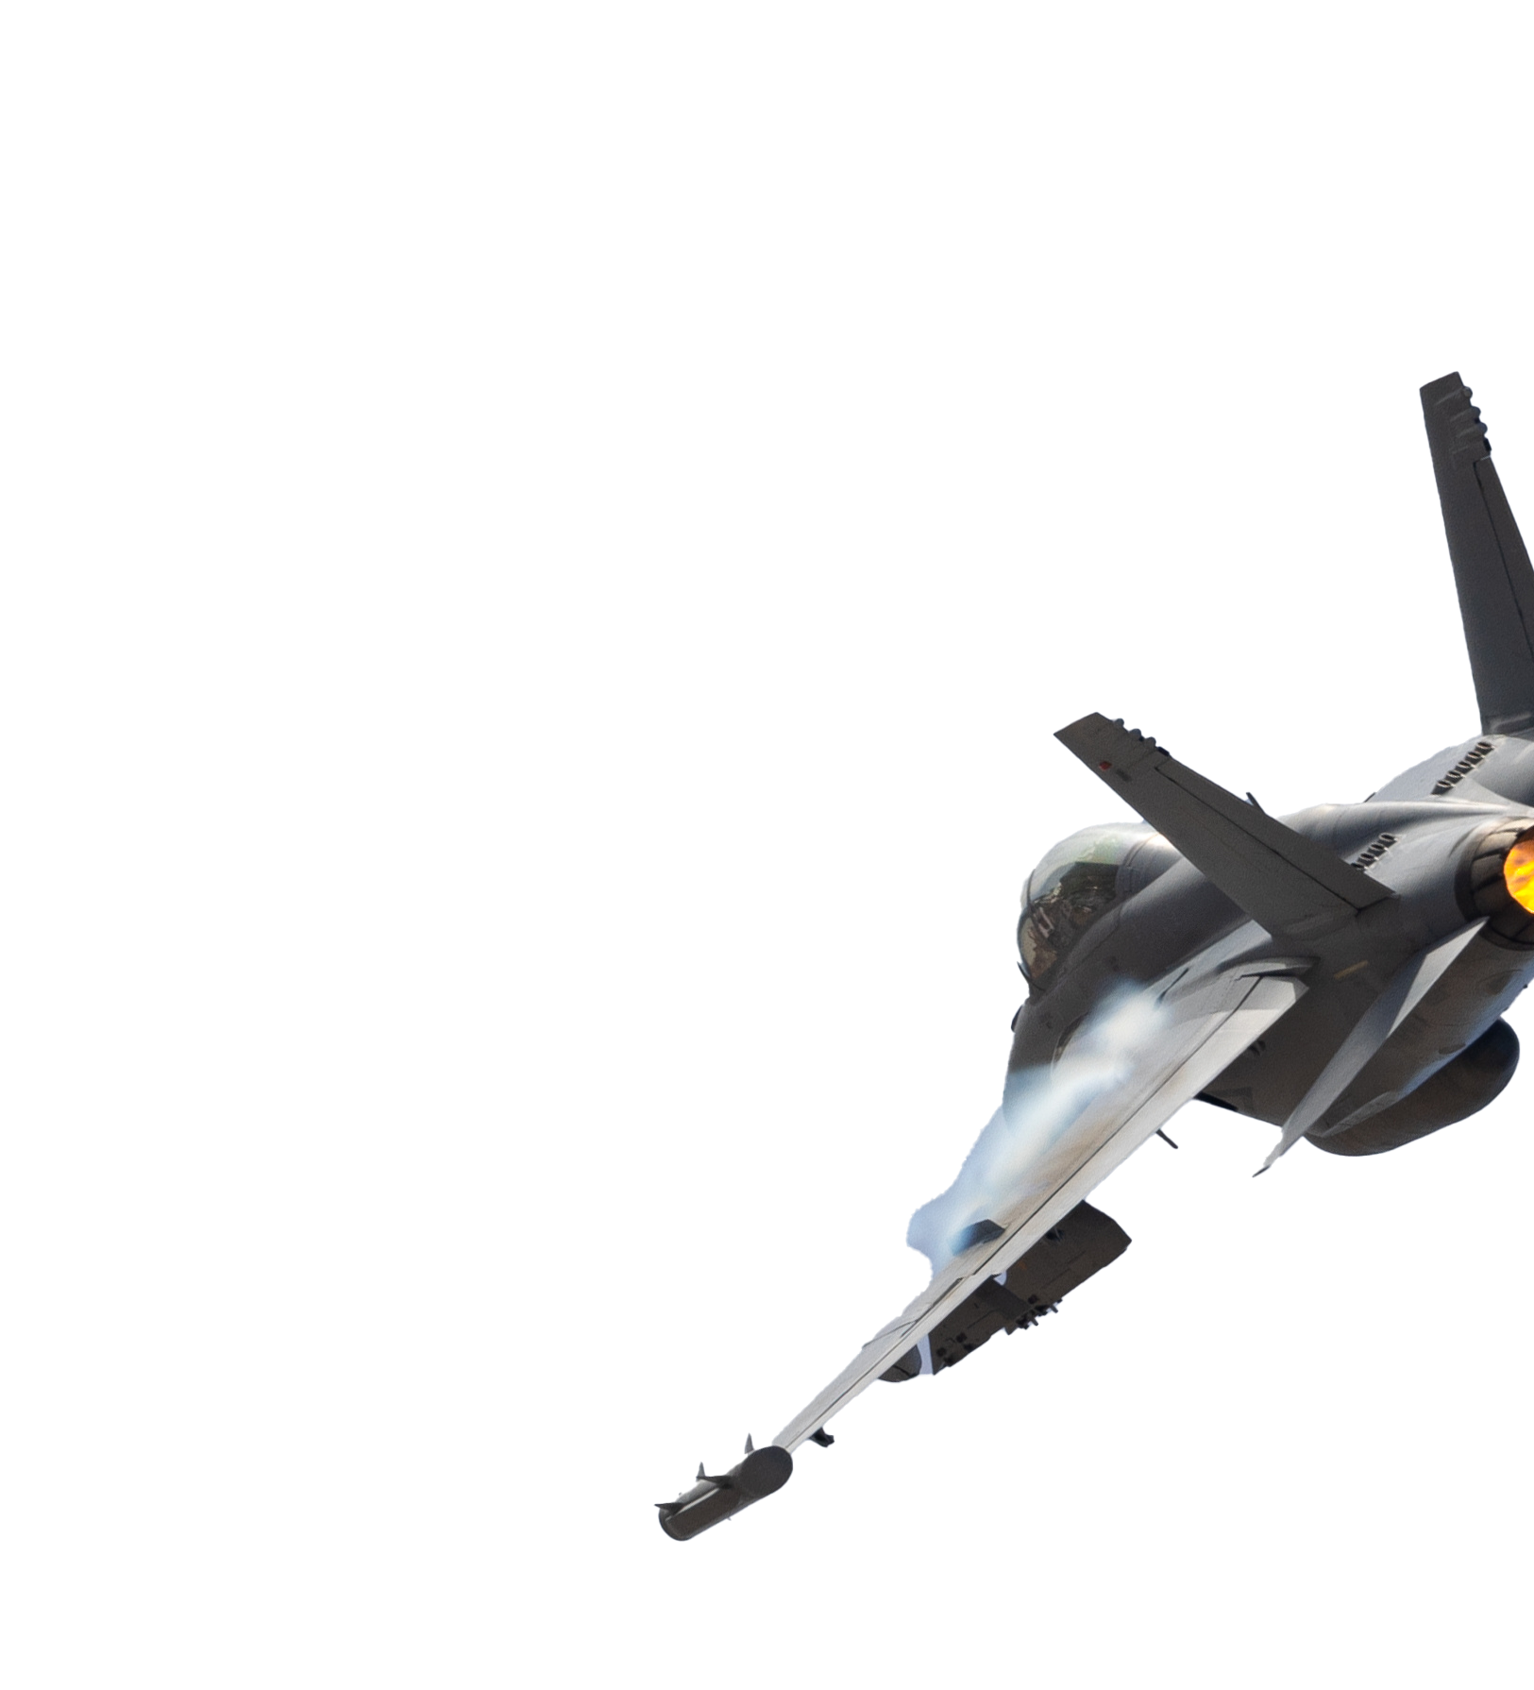
Statistical Validation of Fuel Savings using In-Flight Data Recordings
APRIL 18, 2024
Keltin Grimes, Kevin Player

Slide 2
Document Marking
Copyright 2024 Carnegie Mellon University.
This material is based upon work funded and supported by the Department of Defense under Contract No. FA8702-15-D-0002 with Carnegie Mellon University for the operation of the Software Engineering Institute, a federally funded research and development center.
The view, opinions, and/or findings contained in this material are those of the author(s) and should not be construed as an official Government position, policy, or decision, unless designated by other documentation.
NO WARRANTY. THIS CARNEGIE MELLON UNIVERSITY AND SOFTWARE ENGINEERING INSTITUTE MATERIAL IS FURNISHED ON AN "AS-IS" BASIS. CARNEGIE MELLON UNIVERSITY MAKES NO WARRANTIES OF ANY KIND, EITHER EXPRESSED OR IMPLIED, AS TO ANY MATTER INCLUDING, BUT NOT LIMITED TO, WARRANTY OF FITNESS FOR PURPOSE OR MERCHANTABILITY, EXCLUSIVITY, OR RESULTS OBTAINED FROM USE OF THE MATERIAL. CARNEGIE MELLON UNIVERSITY DOES NOT MAKE ANY WARRANTY OF ANY KIND WITH RESPECT TO FREEDOM FROM PATENT, TRADEMARK, OR COPYRIGHT INFRINGEMENT.
[DISTRIBUTION STATEMENT A] This material has been approved for public release and unlimited distribution. Please see Copyright notice for non-US Government use and distribution.
This material may be reproduced in its entirety, without modification, and freely distributed in written or electronic form without requesting formal permission. Permission is required for any other use. Requests for permission should be directed to the Software Engineering Institute at permission@sei.cmu.edu.
Carnegie Mellon® is registered in the U.S. Patent and Trademark Office by Carnegie Mellon University.
DM24-0407

Slide 3
Authors
Keltin Grimes
Assistant Researcher
Carnegie Mellon University
Software Engineering Institute
AI Division
kgrimes@sei.cmu.edu
Kevin Player
ML Research Scientist
Carnegie Mellon University
Software Engineering Institute
AI Division
kjplayer@sei.cmu.edu

Slide 4

Project Goals/Introductions
How do we validate whether upgrades to aircraft are actually saving fuel?
How do we know when something has gone wrong?
Successful solutions can have big impact
The Air Force uses ~2 Billion gallons ($6-8 Billion) of fuel annually
End goal: Detect interventions with as little as
0.5% fuel rate reduction.

Slide 5
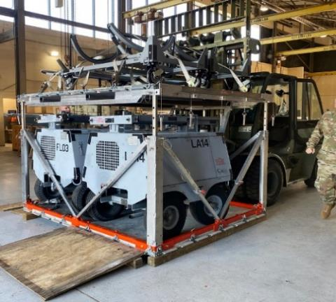
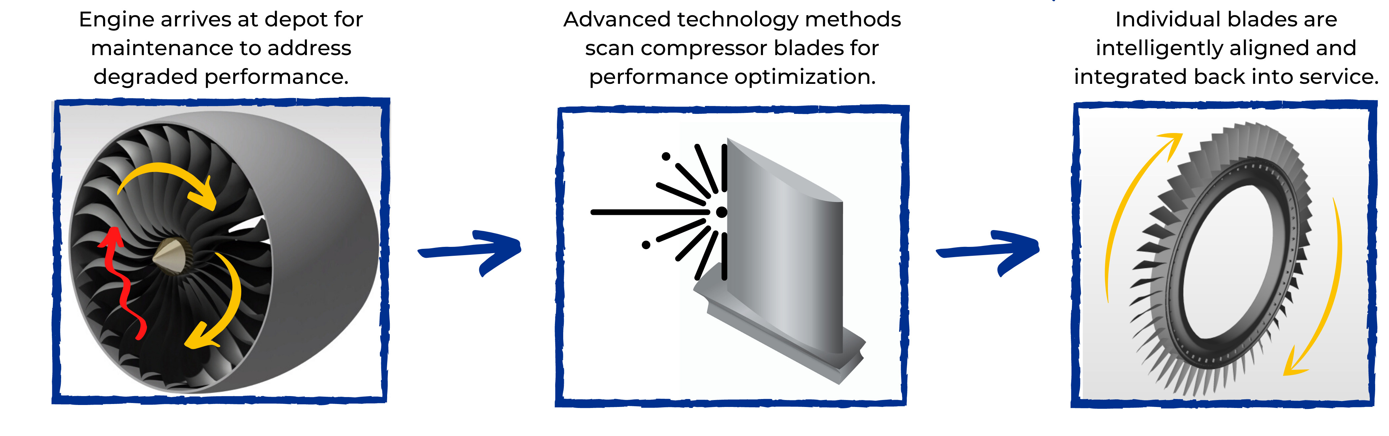
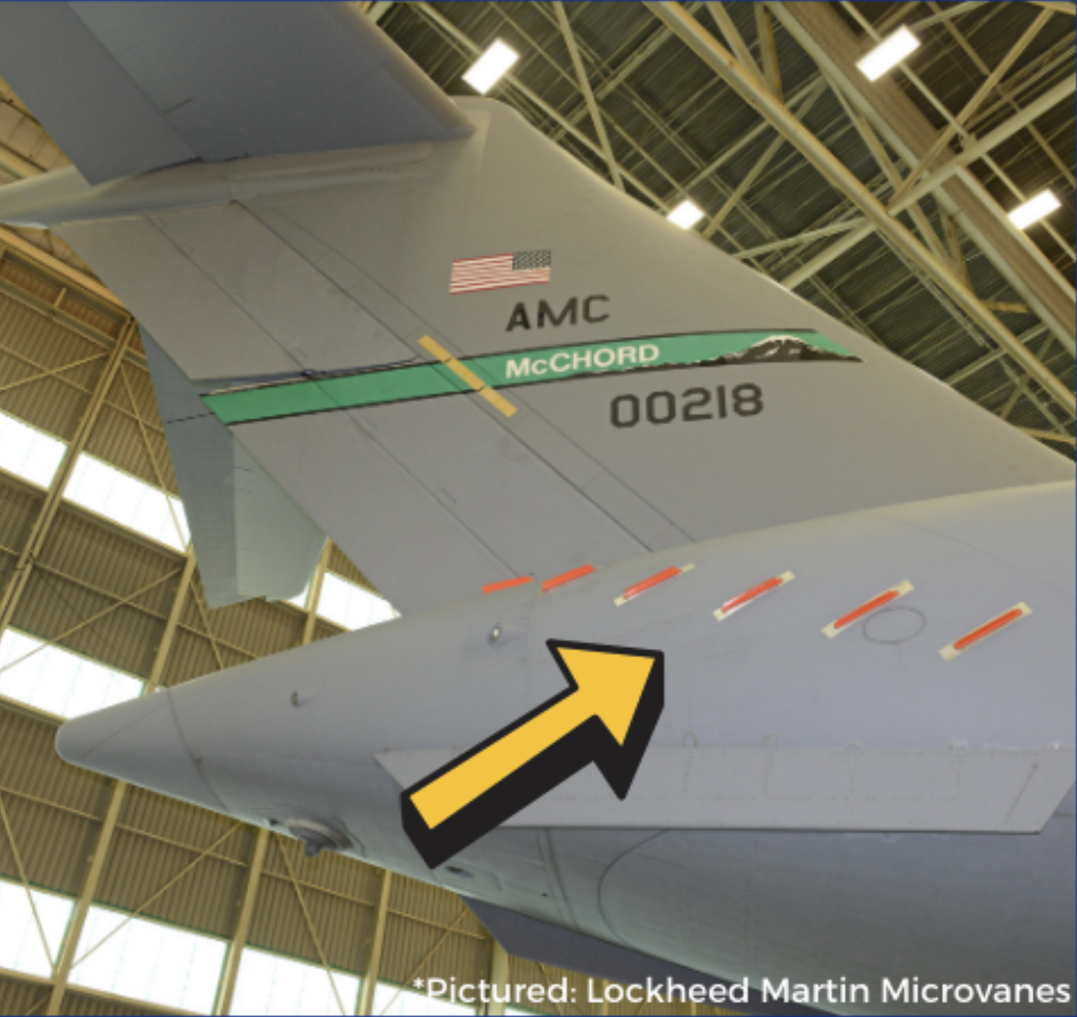
Interventions
Any modifications to the physical aircraft, its software, or its operation are in scope.
Just need a date and a tail number
Some examples:
Vertical Pallet Stacker
Microvanes

Slide 6
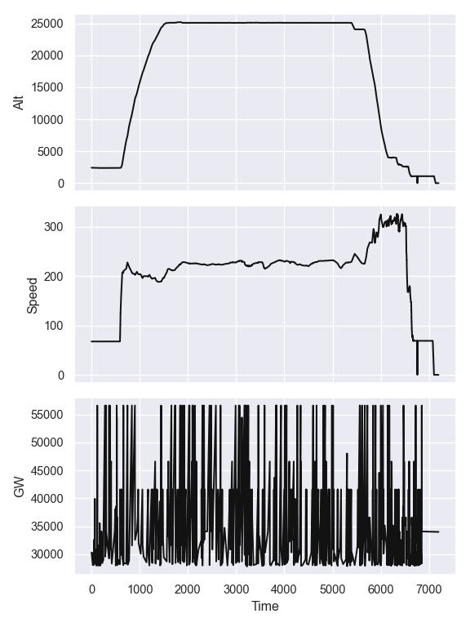
Data Processing
Challenges:
Different flight characteristics
Different sensors
Different data formats
This was one of our main time bottlenecks.
Future systems will need think carefully about how to maximize code reuse and automate processing/cleaning
We do find models are fairly robust to noise

Slide 7
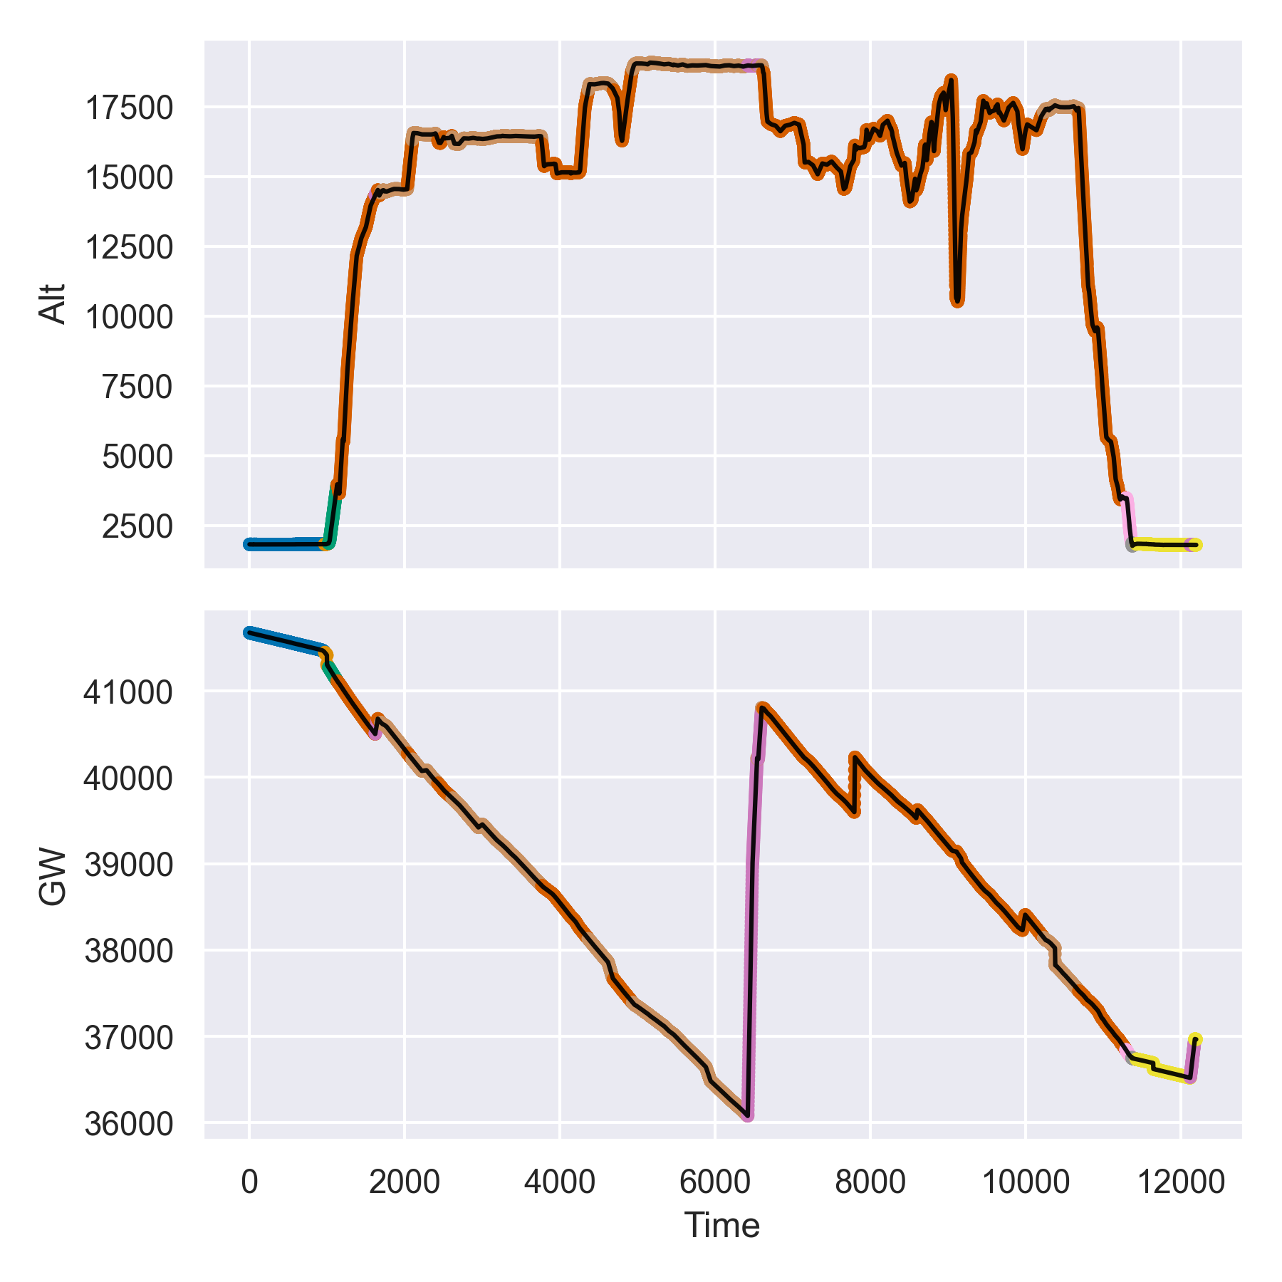
Segmenting
Isolation to specific portions of flight may be of interest
Use heuristics to segment sorties into taxi, takeoff, climb, cruise, descent, landing, and training/other
We developed heuristics parametrized for different aircraft characteristics (e.g. different speeds or cruising altitudes)
Works for aircraft we examined, but otherwise another bottleneck

Slide 8
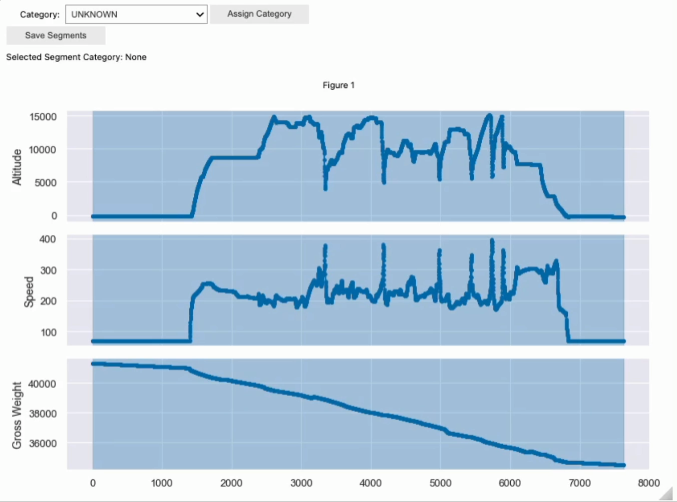
Segmenting
Having ground-truth segments could improve segmenting process
Prototyped an interactive labeling tool
Could automatically optimize segmenting based on labels

Slide 9
Simulations
Limited intervention data – requires the use of simulations to evaluate models
Approach for an intervention of size n:
Randomly select some number of tail numbers
Take n most recent sorties from selected tail numbers
Reduce fuel rate by some percent shift sampled from a gaussian
Other options:
Account for bases/locations
Account for causal relationships between variables
Digital twin-esque simulations

Slide 10
Modeling
Fit some model of fuel rate without knowledge of intervention
Linear
XGBoost
Other options (could imagine splines, RNNs/LSTMs, etc.)
Two-sample t-test for difference of means
For multiple interventions: a regression over indicator variables

Slide 11
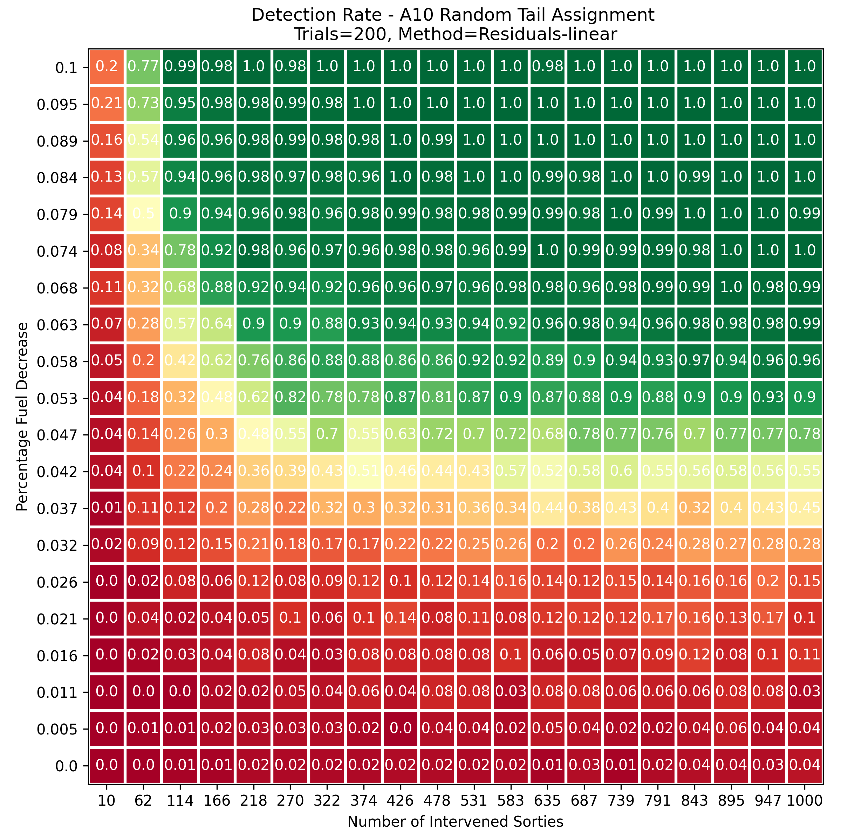
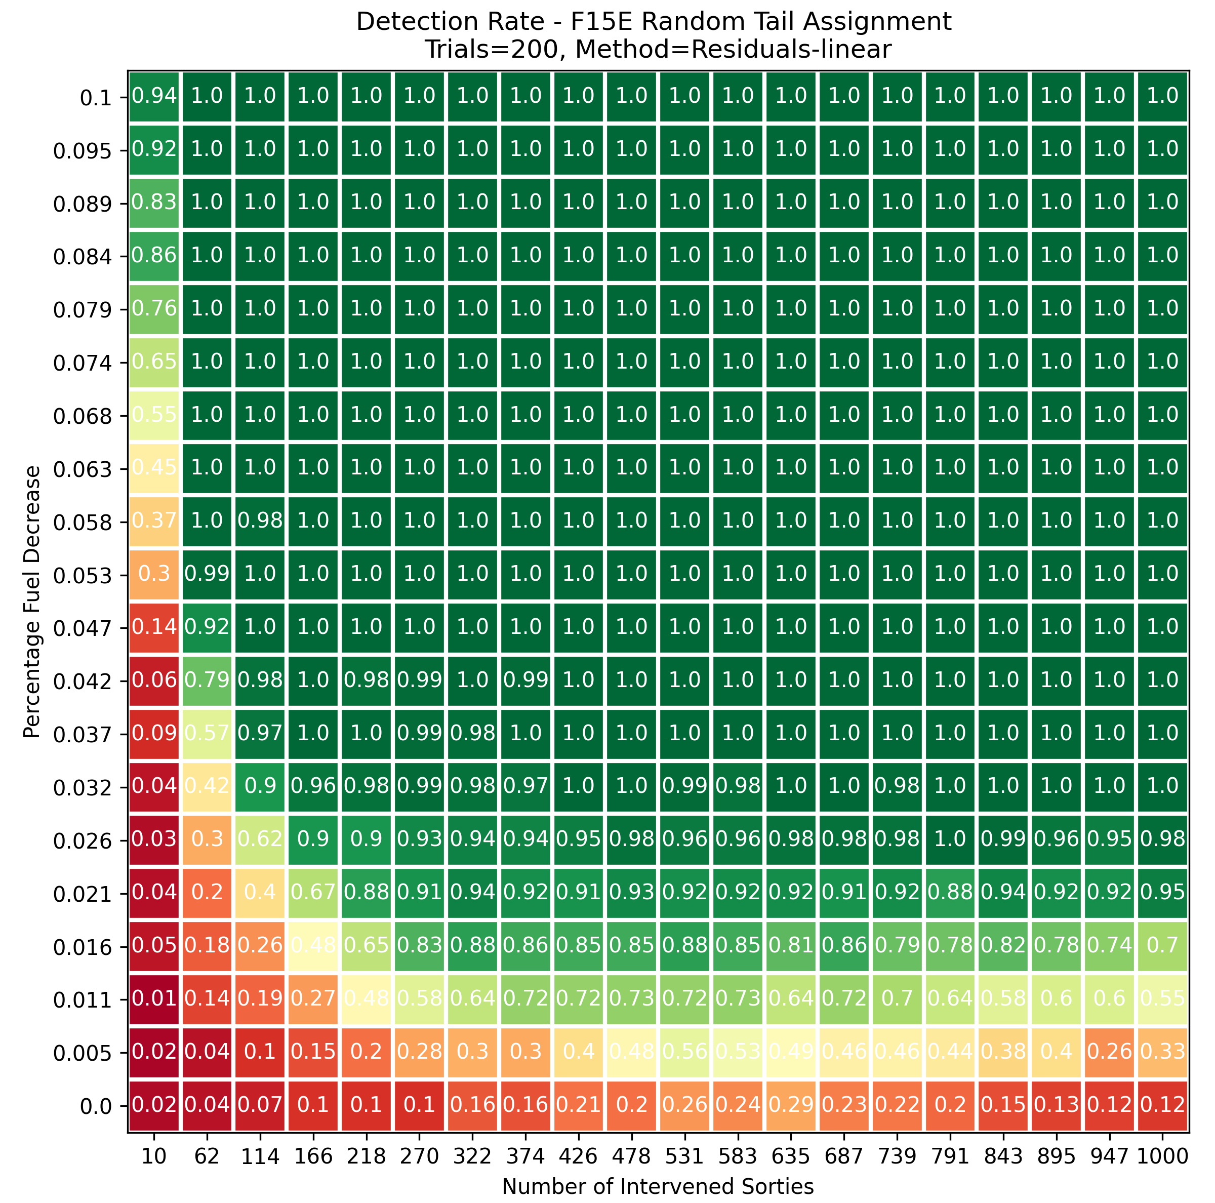
Results
A10
F15E

Slide 12
Real-World Results
KC-135 Engine Wash
Engine wash data dating back to 2013
SMEs estimate 0.5-1.0% fuel rate improvements
Our analysis:
54,000 sorties between 2021-23 – 2500 intervened sorties
Model coefficients right in line with SME estimates

Slide 13
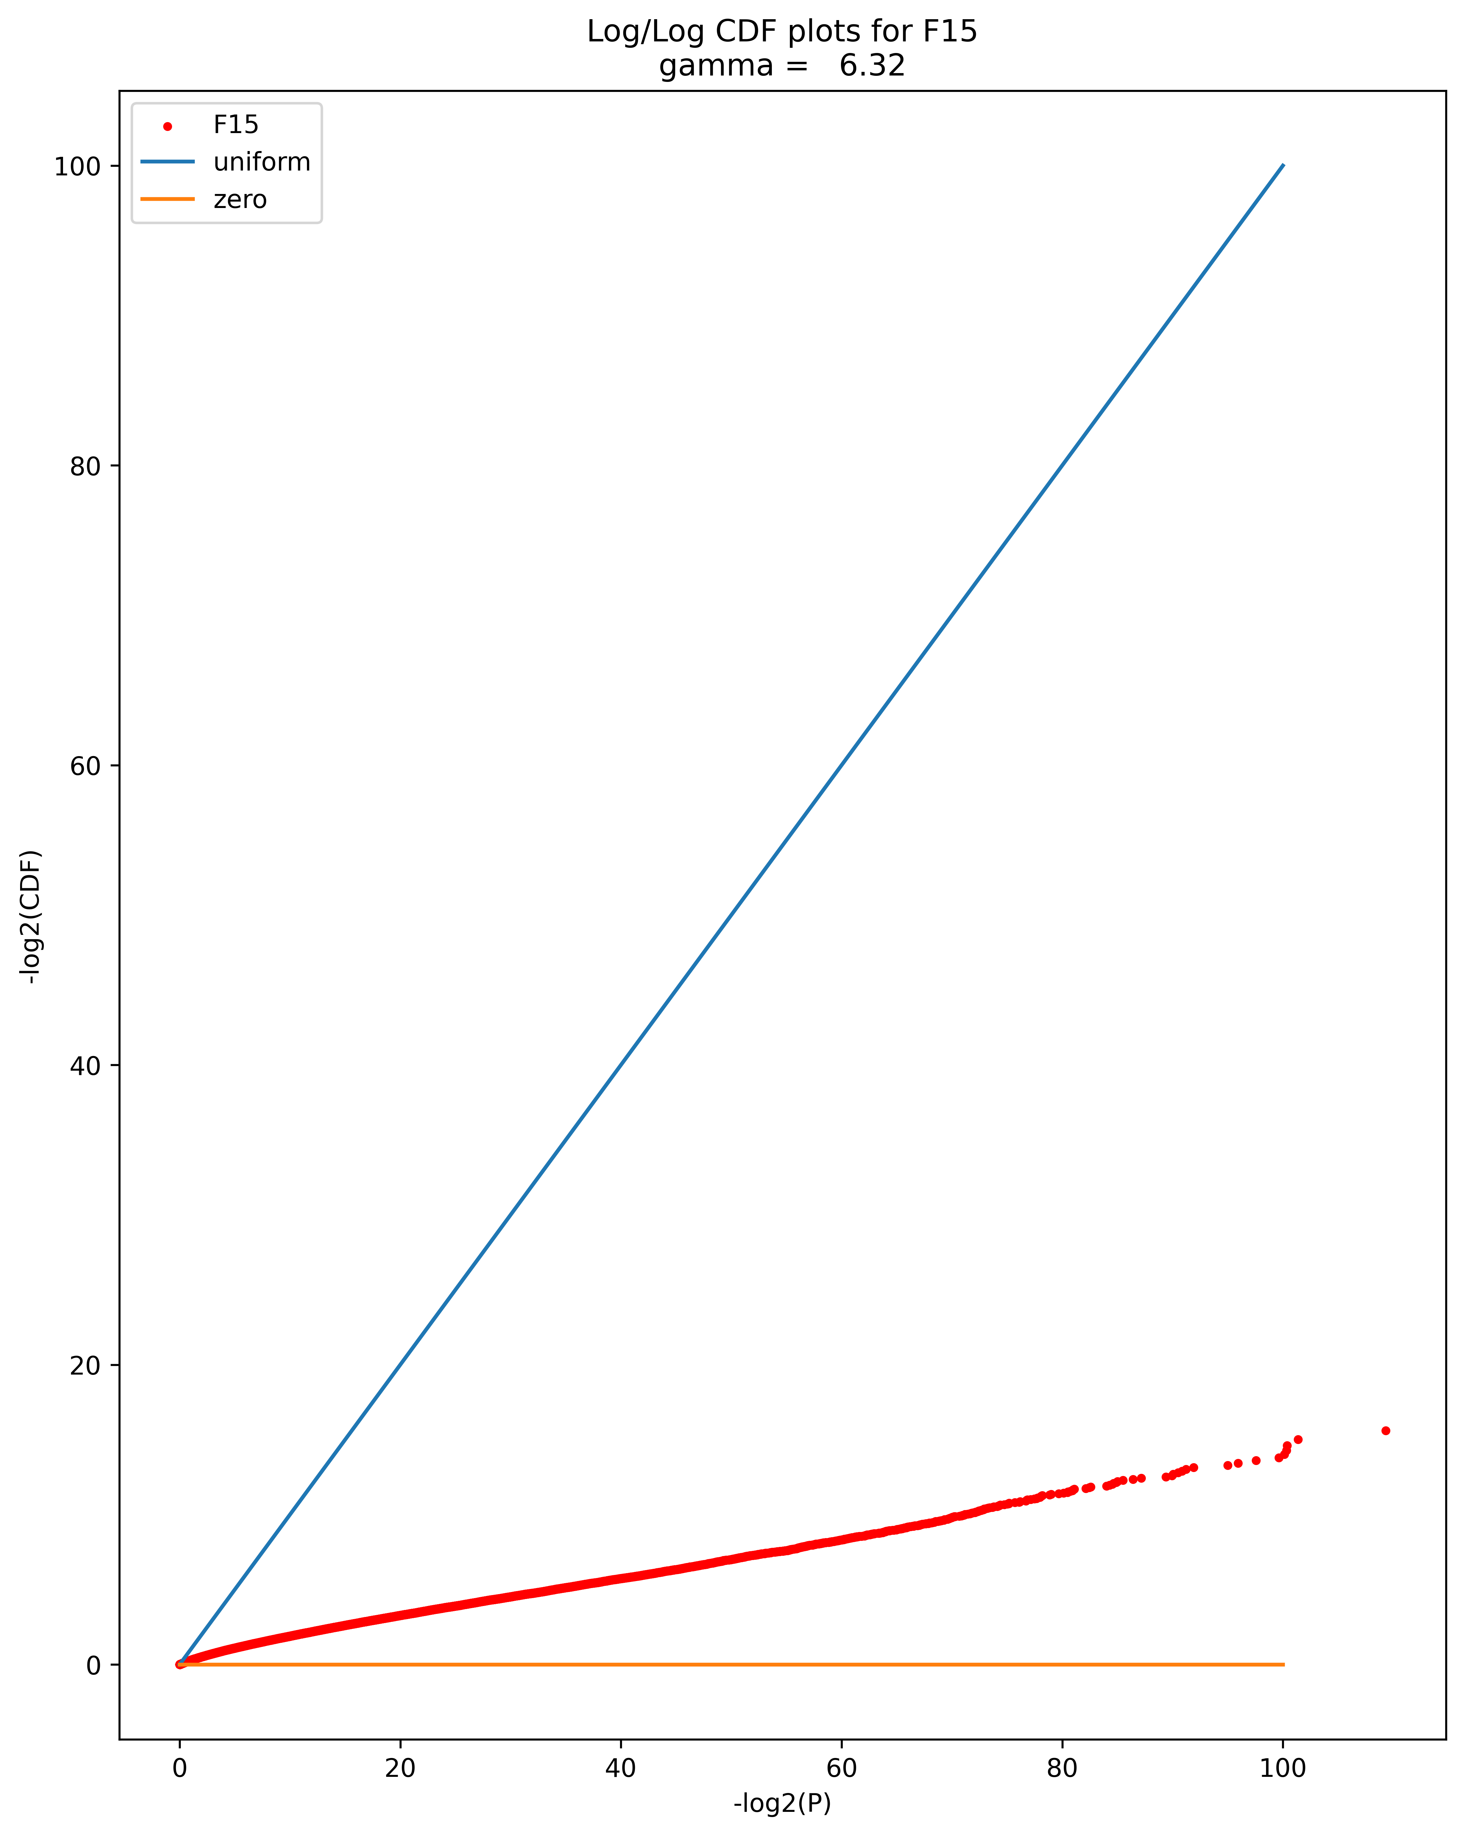
Issue: P-Value Calibration
Observations are not independent
When repeatedly simulating the null case, we find lower p-values than expected (higher confidence)
Likely due to dependence across sorties not captured by the model (e.g. Tail Number, Base Code, etc.)
Caveats:
Dependent on accurate simulations
Models work well without calibration
Notes:
Consider the null case, with no intervention. We can simulate our hypothesis testing to find out that our p-values are inflated:
When we do 2^10 tests we expect to see a p-value of 2^-10 but instead see around 2^-60 an inflation factor of around 6, see right.
The relationship is approximately log/log linear, see right (best fit 6.22). But even for nonlinear curves we can calibrate the p-values.
For various datasets, models, and intervention sizes we find different calibration curves inflated from 4.89 up to 64.02
We just do the calibration on case-by-case basis.

Slide 14
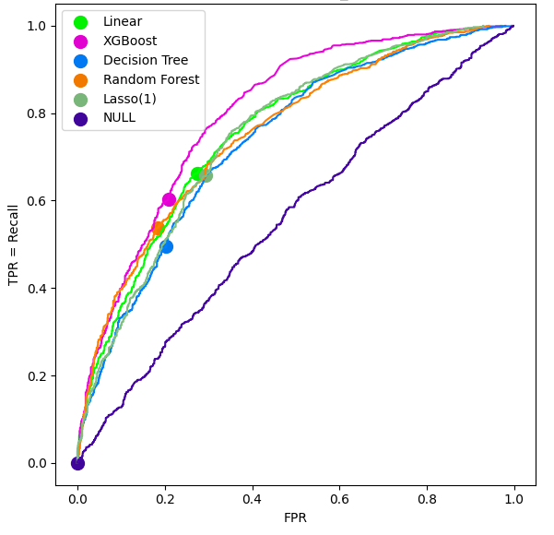
Business Metrics
Can reframe the analysis in terms of Precision/Recall/ROC metrics
Can no longer claim statistical significance or provide uncertainty estimates, but no concerns about calibration
Can tune thresholds to according to decision-maker preferences
We use ROC curves for model comparison and feature selection

Slide 15
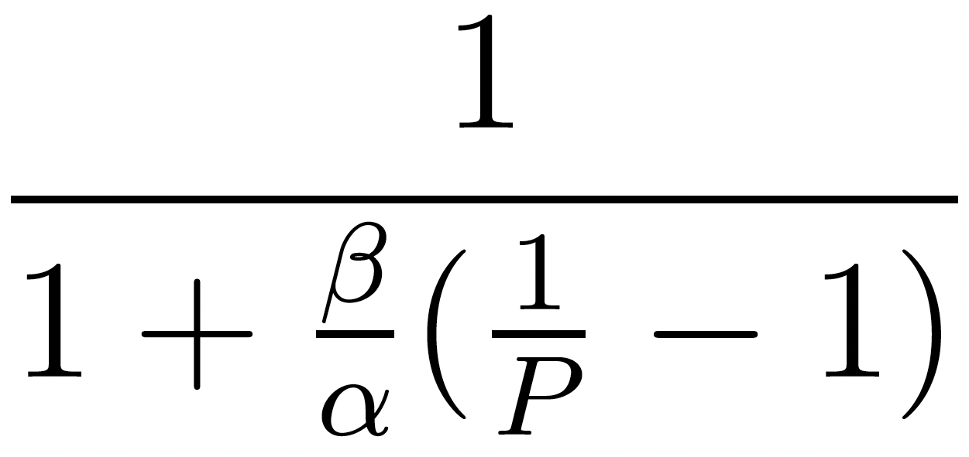
Priors
Interventions likely come with strong priors
A multi-million dollar fleet upgrade should (hopefully) have more than a 50% chance of success
Assuming a probability α of success and β = 1 - α of failure
All other metrics (recall, FPR, TPR, ROC Curve) remain constant, but with a strong positive prior the precision can increase greatly.
- i.e. if we say positive, can be very confident actually positive
 | Precision
α = 0.5 | 0.7
α = 0.8 | 0.91
α = 0.9 | 0.96
Adjusted Precision =
Linear Model, Recall = 0.633

Slide 16
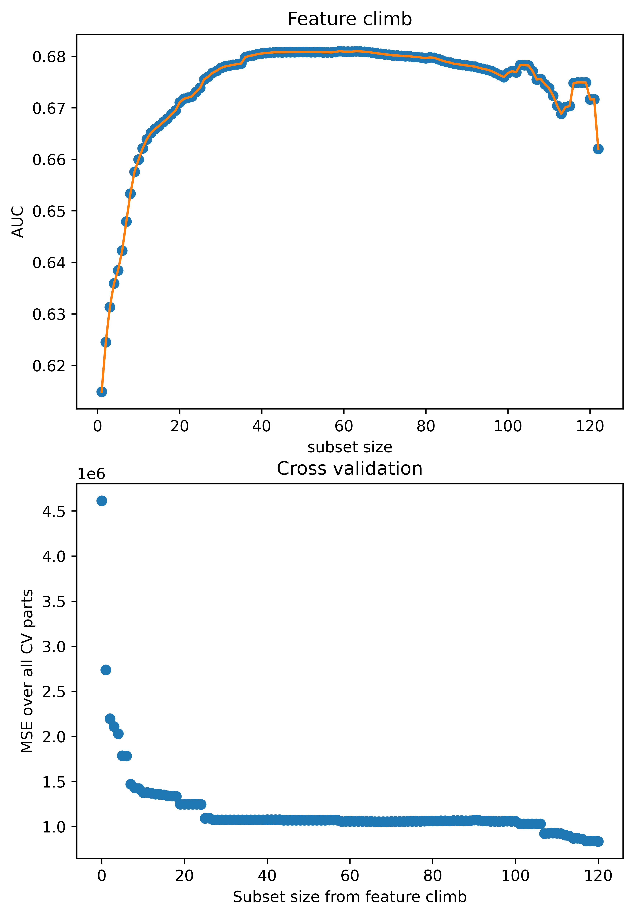
Modeling – Not Optimization
When running greedy feature selection
Cross Validation error decreases consistently (left)
AUC of intervention simulations peaks, then decreases (right)
Emphasizes need for thoughtful modeling

Slide 17
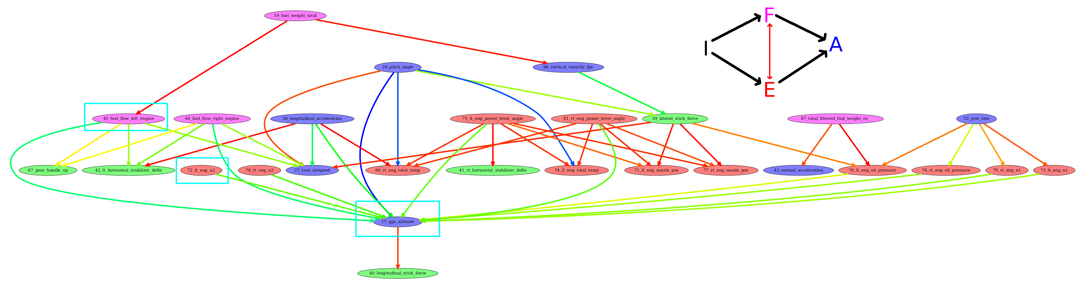
Future Work: Causal Modeling
Initial experiments with Granger “Causality” show interesting structure
Find high correlations between time-shifted features
Filter to a cycle-free graph
Lateral Stick Force
Altitude
Longitudinal Stick Force

Slide 18
Future Work
Improved simulations
Improved data processing workflows to streamline acquisition of new aircraft
New models
Continued study of
  P-value Calibration
  Causal Modeling
Engineering/process improvements

Slide 19
Questions?
Keltin Grimes
Assistant Researcher
Carnegie Mellon University
Software Engineering Institute
AI Division
kgrimes@sei.cmu.edu
Kevin Player
ML Research Scientist
Carnegie Mellon University
Software Engineering Institute
AI Division
kjplayer@sei.cmu.edu

