Slide 1

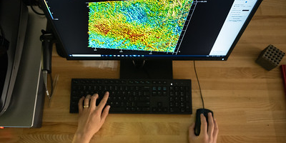
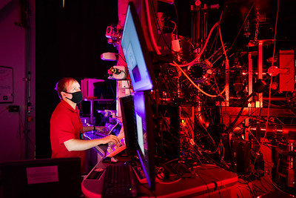
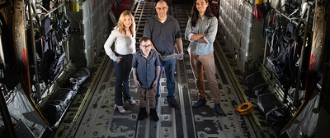

Lessons Learned for Study of Uncertainty Quantification in
Cyber-Physical System Emulation
Presented by Jamie Thorpe, jthorpe@sandia.gov
Defense and Aerospace Test and Analysis Workshop
Alexandria, Virginia
April 16-18, 2024
SAND2024-04014C

Slide 2
Contents
Motivation
Use Case Uncertainty Quantification problem
Methodological Design
Results and Analysis
Outcomes
Acknowledgement
This work was supported by the Laboratory Directed Research and Development program at Sandia National Laboratories. Sandia National Laboratories is a multi-mission laboratory managed and operated by National Technology & Engineering Solutions of Sandia, LLC (NTESS), a wholly owned subsidiary of Honeywell International Inc., for the U.S. Department of Energy’s National Nuclear Security Administration (DOE/NNSA) under contract DE-NA0003525. This written work is authored by an employee of NTESS. The employee, not NTESS, owns the right, title and interest in and to the written work and is responsible for its contents. Any subjective views or opinions that might be expressed in the written work do not necessarily represent the views of the U.S. Government. The publisher acknowledges that the U.S. Government retains a non-exclusive, paid-up, irrevocable, world-wide license to publish or reproduce the published form of this written work or allow others to do so, for U.S. Government purposes. The DOE will provide public access to results of federally sponsored research in accordance with the DOE Public Access Plan.

Slide 3
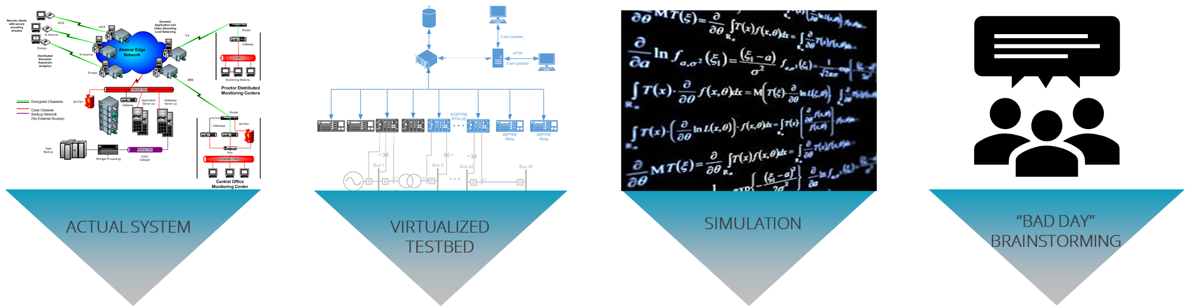
Scientific Rigor for Emulation
Approaches to Cyber Experimentation
Structure
Planning
Credibility
Increasing Realism
Decreasing Flexibility
Increasing Cost
Increasing Time
Increasing Abstraction
Increasing Flexibility
Decreasing Cost
Decreasing Time
Context
Scientific Rigor allows us to make more confident decisions based upon our models and experiments.
*Slide adapted from Sandia Emulation/SCEPTRE Training Material, SAND2023-05754PE

Slide 4
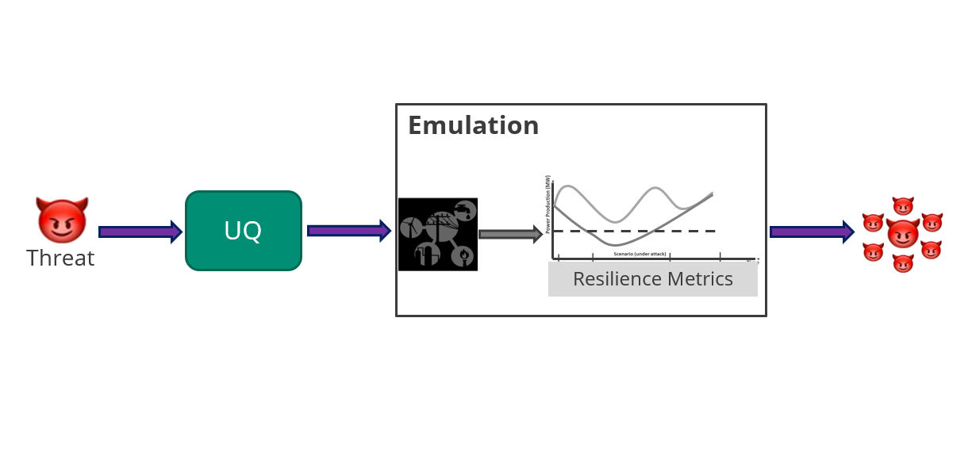
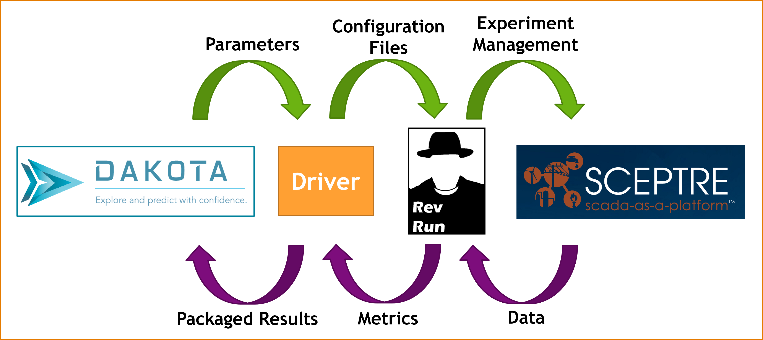
Uncertainty Quantification for Emulation
*Dakota: B. Adams, W. Bohnhoff, K. Dalbey, M. Ebeida, J. Eddy, M. Eldred, R. Hooper, P. Hough, K. Hu, J. Jakeman, M. Khalil, K. Maupin, J. Monschke, E. Ridgway, A. Rushdi, D. Seidl, J. Stephens, L. Swiler, and J. Winokur, “Dakota, a multilevel parallel object oriented framework for design optimization, parameter estimation, uncertainty quantification, and sensitivity analysis: Version 6.15 user’s manual,” Technical Report SAND2021-5822, 2021. [Online]. Available: https://doi.org/10.2172/1829573
*RevRun: M. Galiardi, A. Gonzales, J. Thorpe, E. Vugrin, R. Fasano, and C. Lamb, “Cyber resilience analysis of SCADA systems in nuclear power plants,” in Proceedings of the 2020 28th Conference on Nuclear Engineering & Joint With the ASME 2020 Power Conference, 2020.
*SCEPTRE: Sandia National Laboratories, “SCEPTRE,” 2016. [Online]. Available: https://www.osti.gov/servlets/purl/1376989

Slide 5
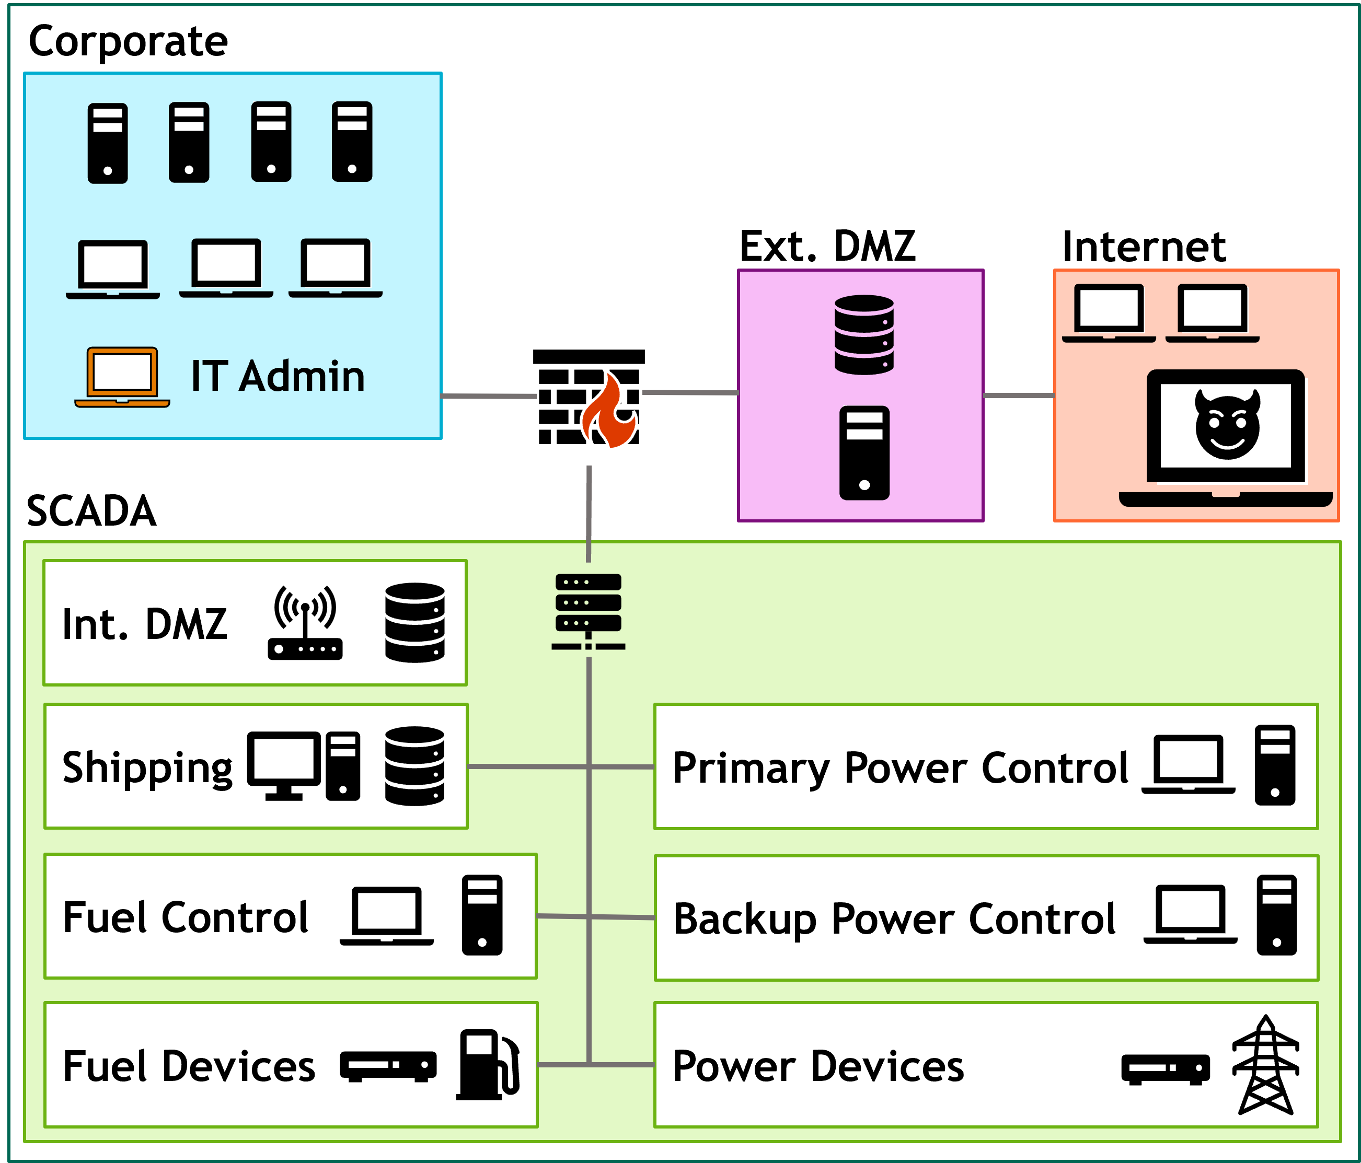

Use Case: UQ Problem
Question:
How does the attacker’s stealth impact the system’s resilience to the attack?
Parameter 1
Parameter 2

Slide 6


Use Case: Threat
Payload

Slide 7
Methodology
Select Input Parameters and Define Parameter Space
  Jitter: 0-15 seconds
  Beacon Down Time: 0-170 seconds
Design Output Metric*
  Traffic volume
  Time to reach target machine in SCADA system
  Magnitude of power system impact
Generate samples over the parameter space, run in emulation, compute metrics, and visualize results
For this specific test of our tools, why did we choose this use case?
*M. Galiardi, A. Gonzales, J. Thorpe, E. Vugrin, R. Fasano, and C. Lamb, “Cyber resilience analysis of SCADA systems in nuclear power plants,” in Proceedings of the 2020 28th Conference on Nuclear Engineering & Joint With the ASME 2020 Power Conference, 2020.
*J. Thorpe, R. Fasano, M. Galiardi Sahakian, A. Gonzales, A. Hahn, J. Morris, T. Ortiz, H. Reinbolt, and E. D. Vugrin, “A cyber-physical experimentation platform for resilience analysis,” in Proceedings of the 2022 ACM Workshop on Secure and Trustworthy Cyber-Physical Systems, ser. Sat-CPS ’22. New York, NY, USA: Association for Computing Machinery, 2022, p. 3–12. [Online]. Available: https://doi.org/10.1145/3510547.3517916

Slide 8
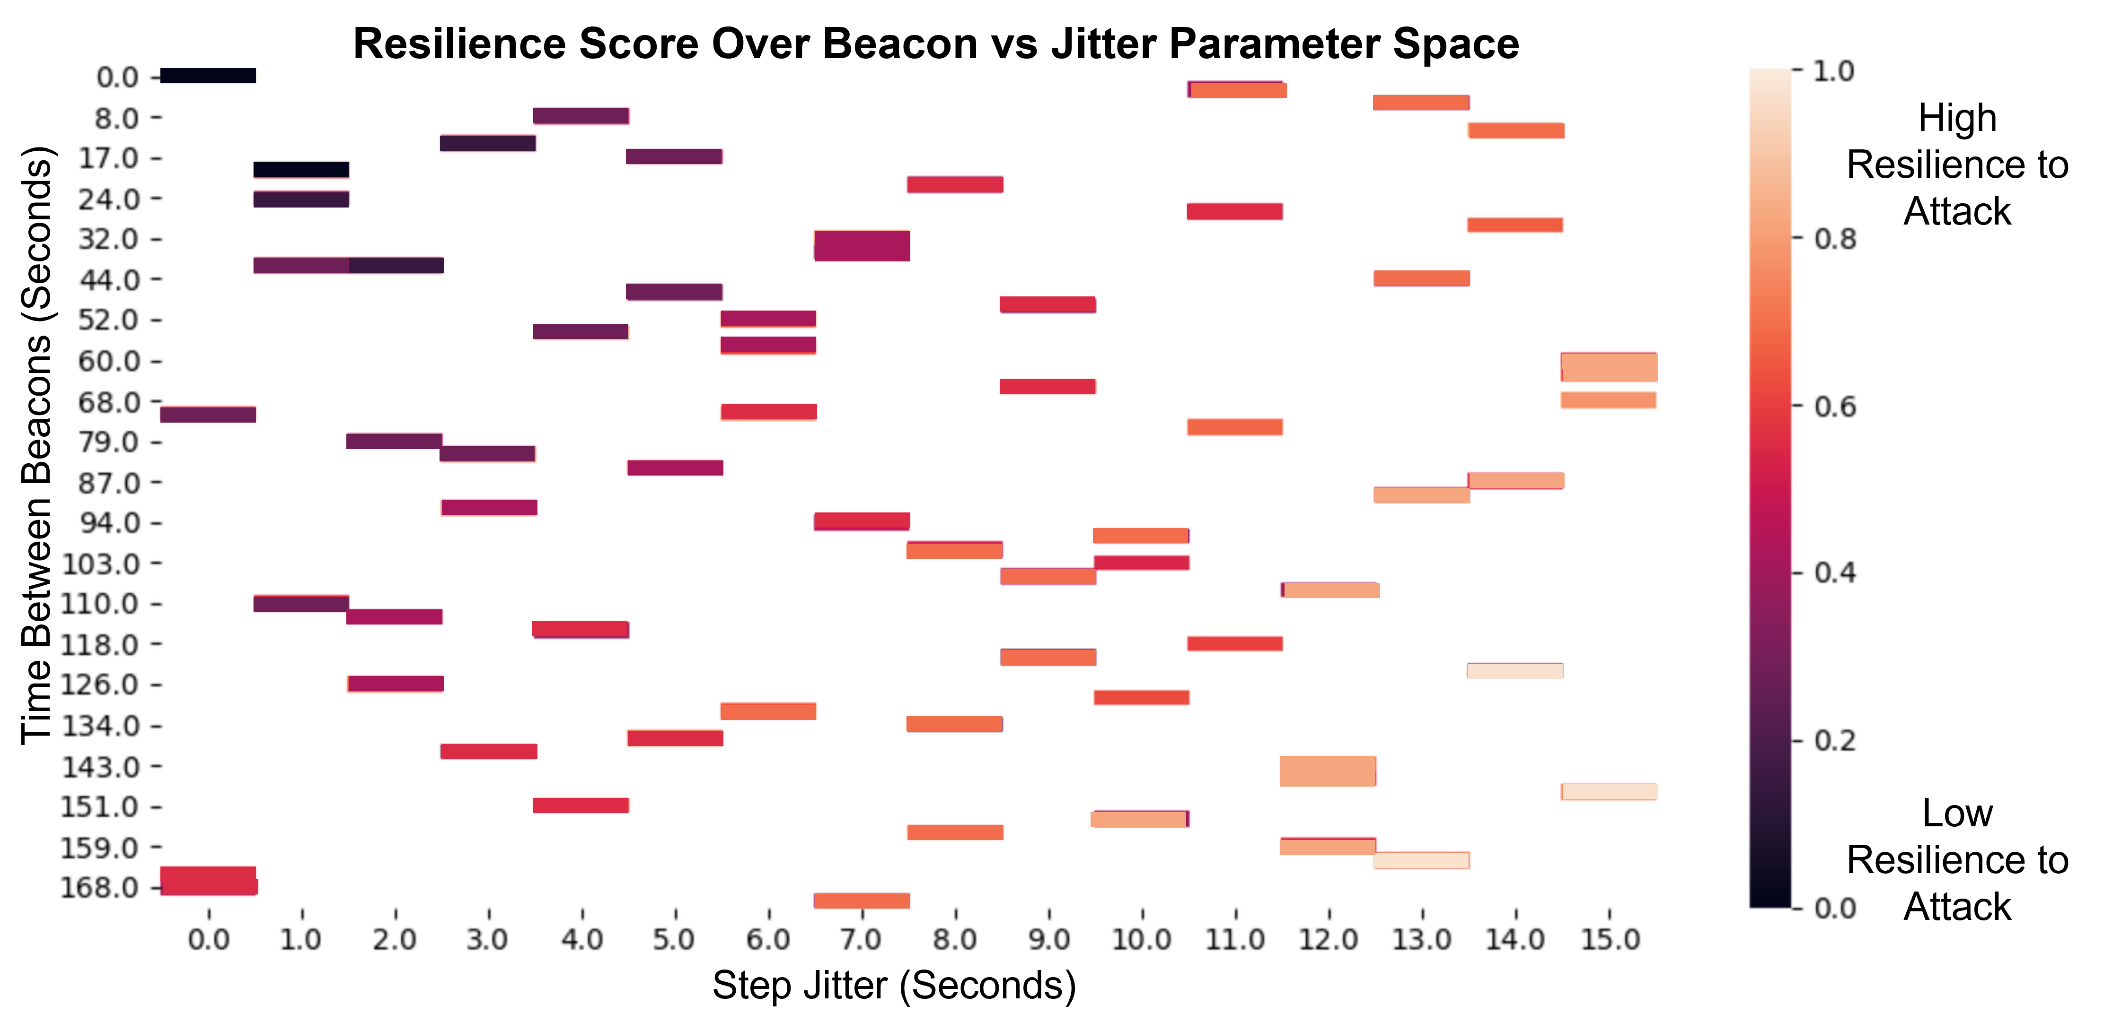
Initial Results: Expected
Hypothesis: Beacon and Jitter settings will have significant impact on the resilience of the system to the given attack.

Slide 9
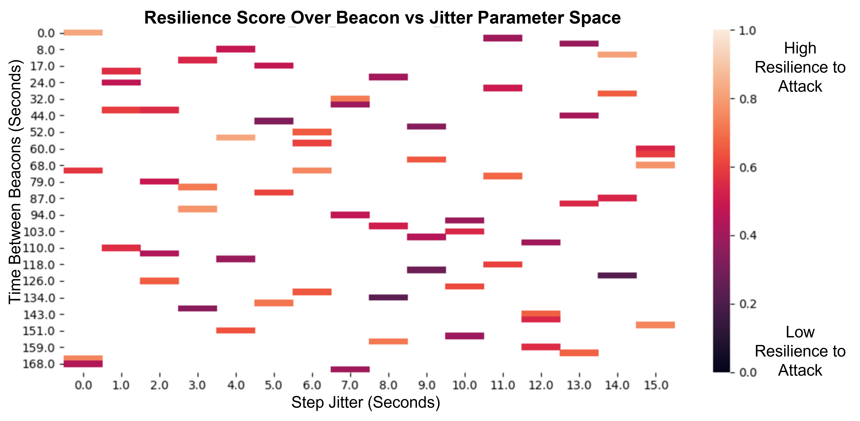
Initial Results: Actual
No such linear correlation exists!

Slide 10

Remaining Questions
Are we collecting the data we think we are?
At a technical level, are the input settings behaving as expected?
Are we calculating the “right” metrics?
Where is all this noise coming from?

Slide 11
Threat Communication Patterns (Server View)
Heartbeats = Client tells Server “Yes, I’m here”, Server responds
Command and Control (C2) = Server sends command to Client. Client sends result to Server.
Receive: Heartbeat 1
Send: Ack Heartbeat 1, Send Command 1
Receive: Heartbeat 2, Result of Command 1
Send: Ack Heartbeat 2, Send Command 2
Receive: Heartbeat 3
Send: Ack Heartbeat 3
Receive: Heartbeat 1
Send: Ack Heartbeat 1
Receive: Heartbeat 2
Send: Ack Heartbeat 2
Send: Send Command 1
Receive: Result of Command 1
Receive: Heartbeat 1
Send: Send Command 1
Send: Ack Heartbeat 1
Receive: Heartbeat 2
Send: Ack Heartbeat 2
Receive: Result of Command 1
Theory 1 – One Flow
Theory 2 – Two Flows, Synchronous
Theory 3 – Two Flows, Asynchronous

Slide 12
Remaining Questions
Are we collecting the data we think we are?
At a technical level, are the input settings behaving as expected?
  No, heartbeat setting will have little/no effect on attack speed
  Even after adjusting our analysis to account for this, we get similar results
Are we calculating the “right” metrics?
Where is all this noise coming from?

Slide 13
Metrics
Are some metrics noisier than others?
  This variability adds up in RevRun’s metrics, artificially reducing resilience scores
  Solution: Where we have the option, favor using less noisy data
Do the metrics that should intuitively “line up” actually do so?
  Example:
    Metric 1: Power system impact by end of attack experiment, measured using power available to loads
    Metric 2: Time between start of experiment and first C2/Heartbeat beacon from target SCADA machine
  Solution: If they don’t match, remove/reweight certain data streams until they do
Baseline
Value 1
Value 2

Slide 14
Remaining Questions
Are we collecting the data we think we are?
At a technical level, are the input settings behaving as expected?
  No, heartbeat setting will have little/no effect on attack speed
  Even after adjusting our analysis to account for this, we get similar results
Are we calculating the “right” metrics?
  Some stochasticity in payload metrics, but even after adjusting to account for this, we get similar results
  Sensitivity Studies revealed very weak correlation between ANY raw data and final metrics
Where is all this noise coming from?

Slide 15
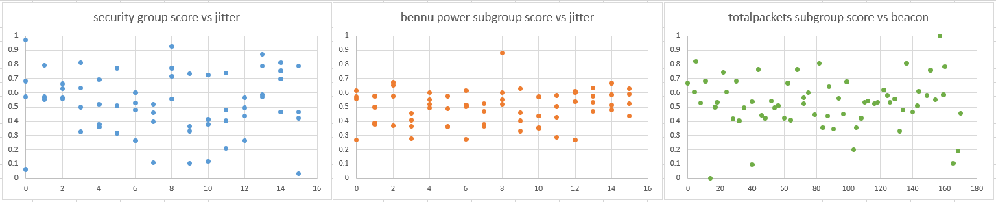
Select Metrics vs Logically Correlated Inputs
Graph | X-Axis | Y-Axis (Metric)
 | Jitter Input | How quickly does the attacker reach the target SCADA machine?
 | Jitter Input | How much impact does the attacker have overall on the power system performance by the end of the experiment?
 | Beacon Rate Input | How much impact does the attacker have overall on the volume of network traffic by the end of the experiment?

Slide 16
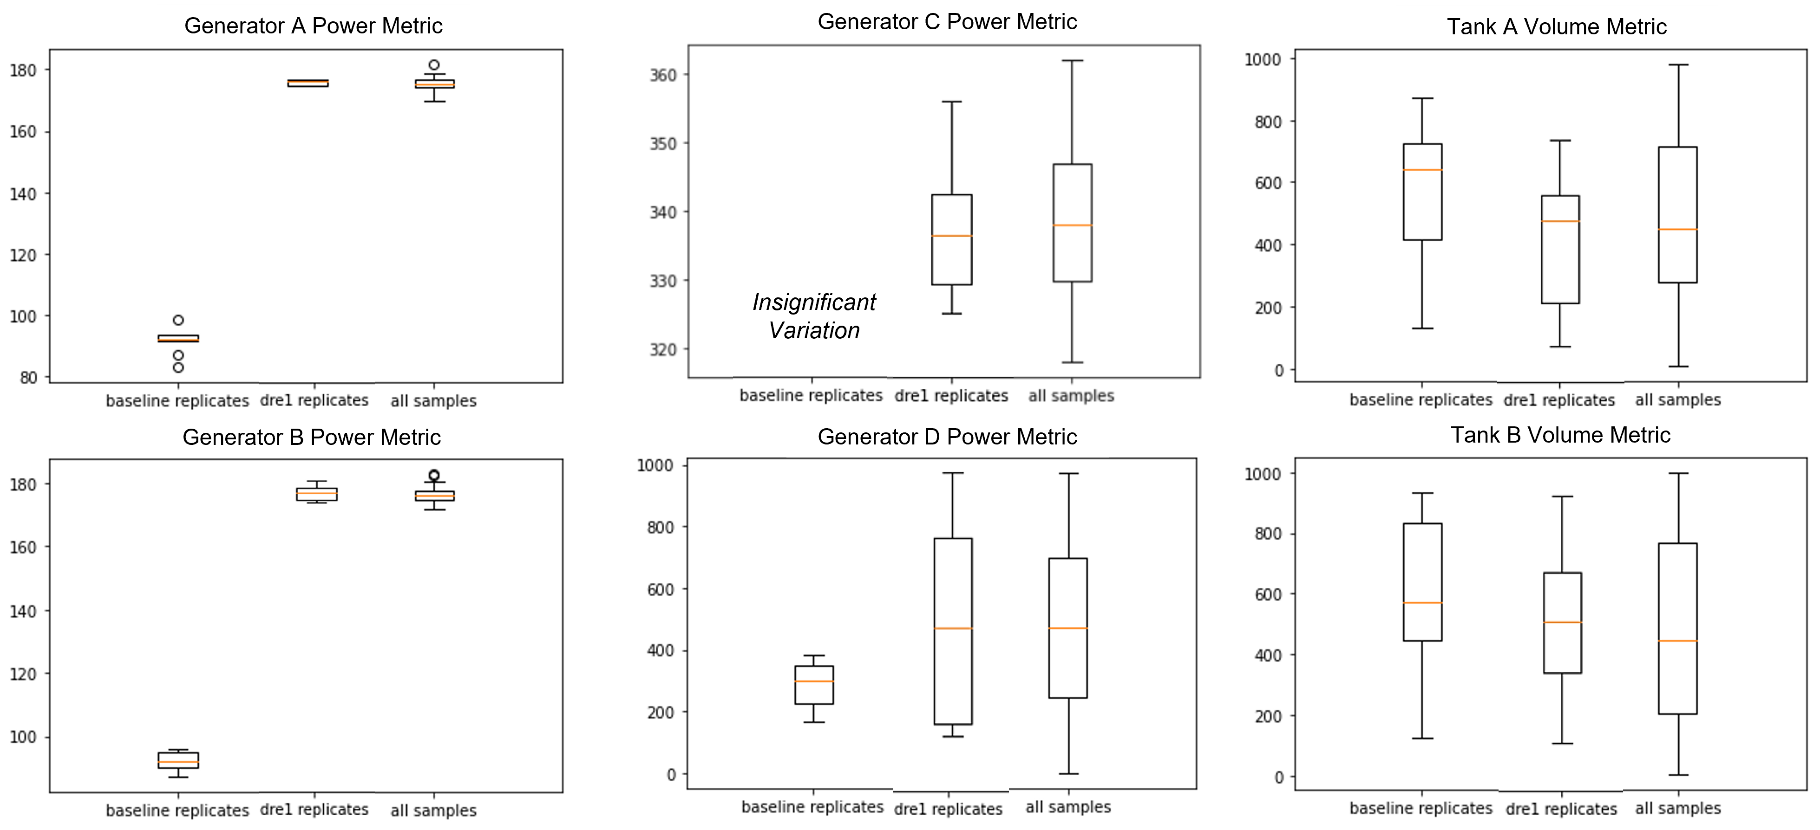
Noise Studies on Base Metric
Baseline -> 10 replicates, no attack
DRE1 -> 10 replicates, with attack
All Samples -> 64 replicates, with attack
Base Metric >> Cumulative difference to reference over time

Slide 17
Remaining Questions
Are we collecting the data we think we are?
At a technical level, are the input settings behaving as expected?
  No, heartbeat setting will have little/no effect on attack speed
  Even after adjusting our analysis to account for this, we get similar results
Are we calculating the “right” metrics?
  Sensitivity Studies revealed very weak correlation between ANY raw data and final metrics
  Some stochasticity in payload metrics, but even after adjusting to account for this, we get similar results
Where is all this noise coming from?
  Some from the baseline physical process simulation
  Some from the payload
  Some from the worm implementation
  Without accounting for these sources ahead of time, we don’t have what we need to make strong conclusions about noise attribution.

Slide 18
Reasoning about Sources of Stochasticity
Enough available data to start reasoning about stochasticity attribution…
  Additional studies
  Visualization
  All post-experimentation!
… But that’s not the ideal approach
  Recommended change in approach: Initial Noise Studies!
    Baseline model with no attack activity
    Model + Attack Activity with consistent parameters
    Repeat for other major components (e.g., defense tools)
  Understand how to mathematically attribute different sources

Slide 19
Conclusion
Let's talk about inherent variation...
  How would we perform similar analyses on models that we know are non-deterministic?
  How do we reduce variation in our sample set?
    Identify sources of variation and eliminate/limit/properly account for them in the model or mathematically
    Run more emulation samples or collect supporting data from other models or sources
What does this mean for emulation analyses in general?
  Need good understanding of the system and data BEFORE starting complex analyses
  "Just one experiment" isn't enough!
  "Just one number" isn't enough – Emulation, and other models, require nuance!
  How do we help users interpret these results to make effective decisions?
If we want to make confident decisions using models, we need to understand how confident we can be in those models!

Slide 20
Thank You!
Follow-up Discussion and Questions directed to
Jamie Thorpe (jthorpe@sandia.gov)

