Slide 1
Creating Workflows for Synthetic Data Generation for Advanced Military Image Classification
CDT Max Felter
CDT Charles Wheaton
CPT Javi Sustaita
COL Jim Starling
v2

Slide 2
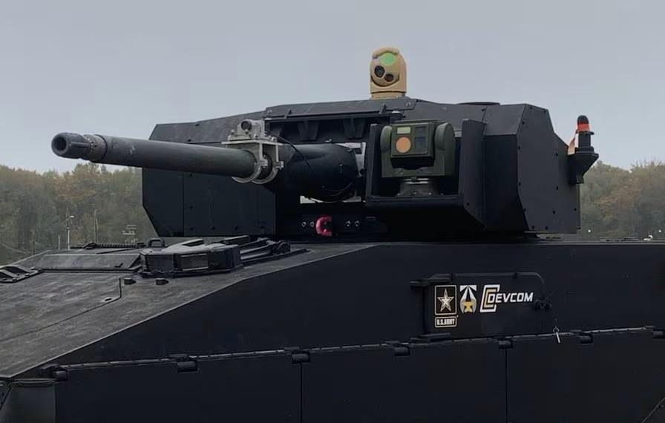
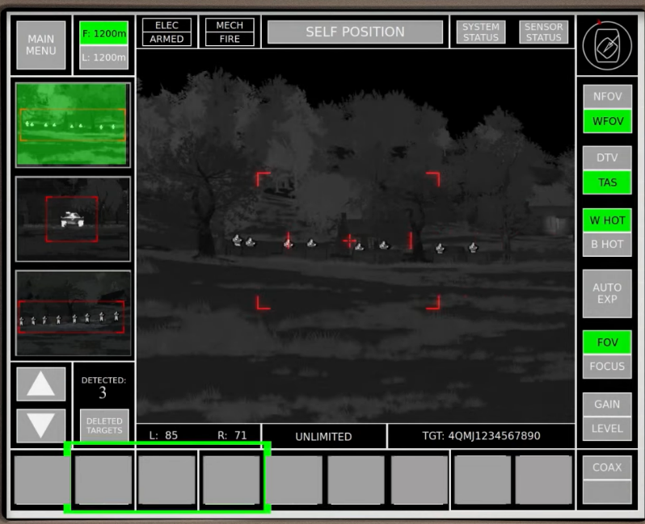
Background
Advanced Targeting and Lethality Aided System (ATLAS)
https://www.c4isrnet.com/artificial-intelligence/2020/10/29/how-the-army-plans-to-revolutionize-tanks-with-artificial-intelligence/
Notes:
AI target recognition (object detection and object classification) systems are increasingly prevalent in military technology.
Effective computer vision models serve as the backbone of these systems.

Slide 3
Project Scope
Future battlefield reliant on technology using AI for automation.
  Backbone = High-performing computer vision model
Data Issues:
  Limited quality footage of the battlefield.
  Lack of organized and labeled data.
  Challenging to create new data.
Viable solution → Synthetic Data?

Slide 4
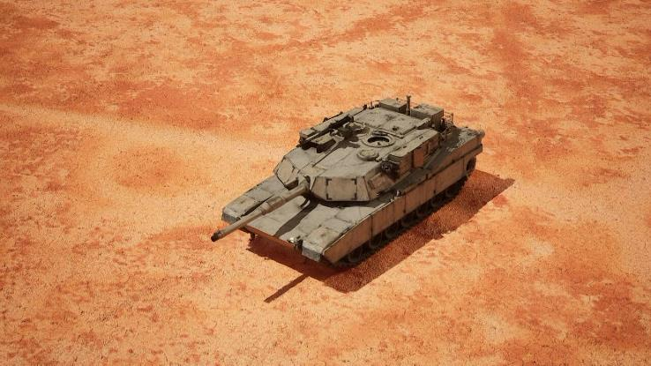
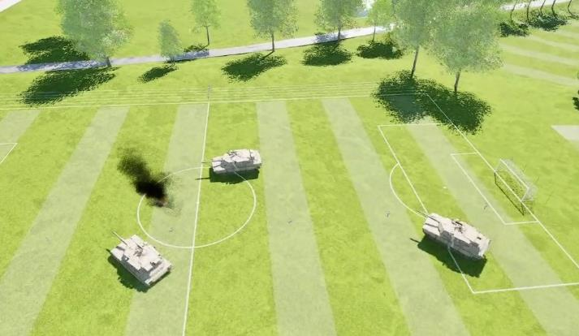
Research Question
Can synthetic data produced in UE5 improve model performance?
Unreal Engine (UE5).
YOLO (v5 and v8)
Target domain → military vehicles (UAV observer)

Slide 5
Synthetic Data Pipeline
Capture videos in UE
Label images from videos
  cvat.ai
Image storage
  Export labeled images to roboflow for storage. Use API to access.
Train YOLO v5/v8 model

Slide 6
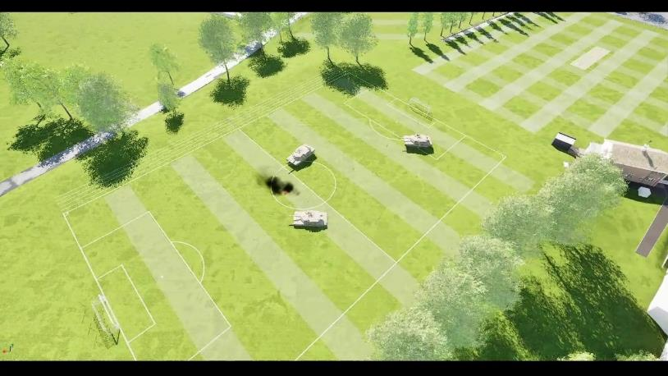
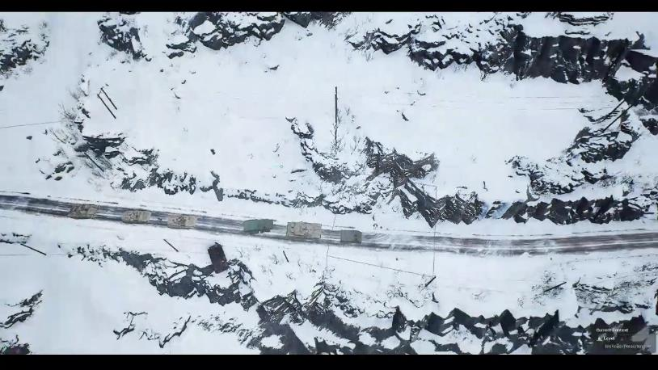
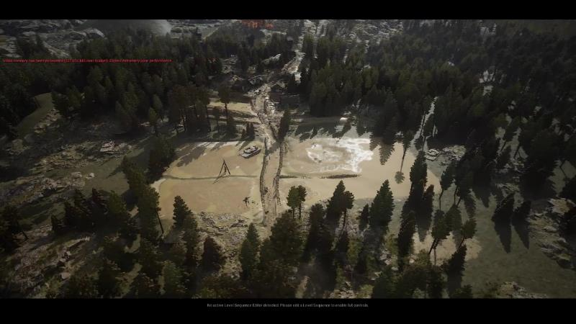
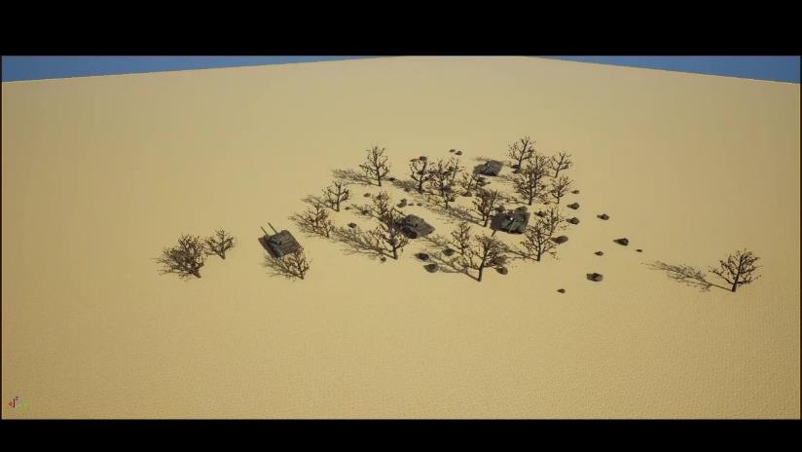

Slide 7
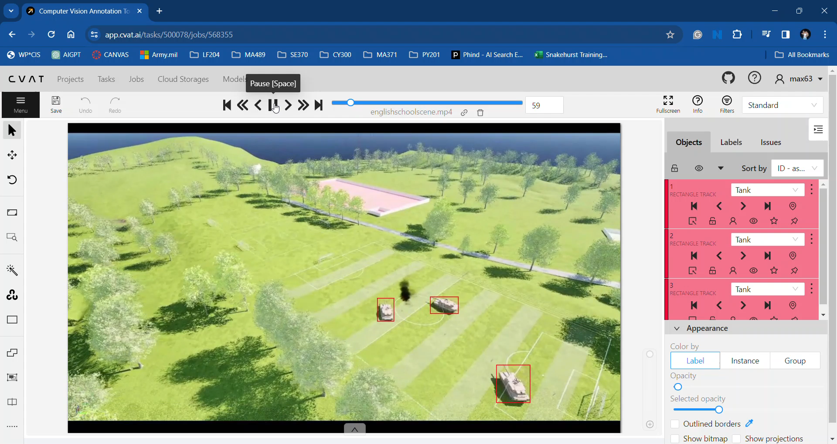
Synthetic Data Pipeline

Slide 8
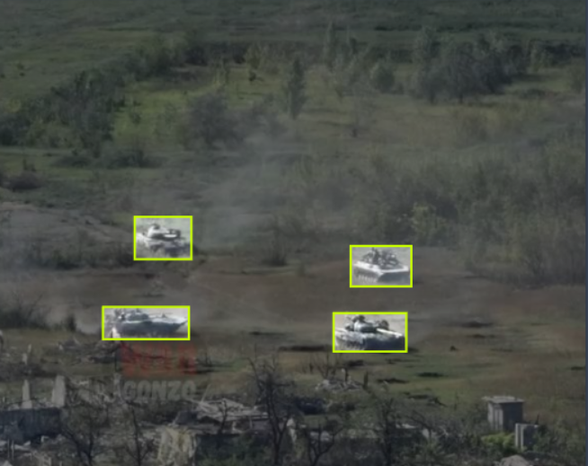
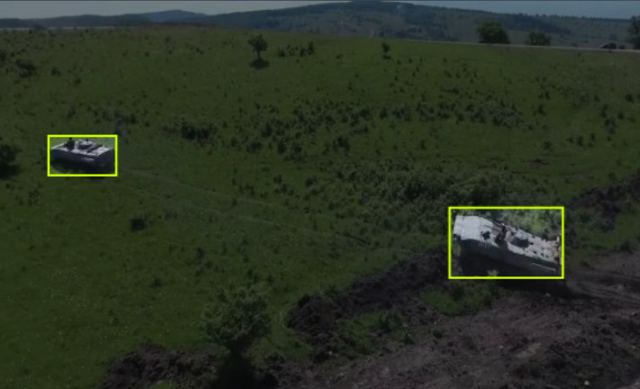
Real Dataset
Target Set Creation:
  roboflow.com
  +20k labeled tank images
Downsized to ~600 for initial testing

Slide 9
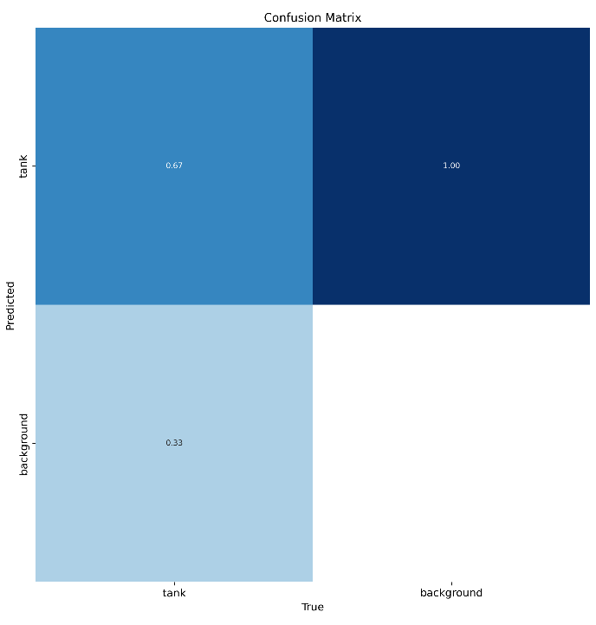
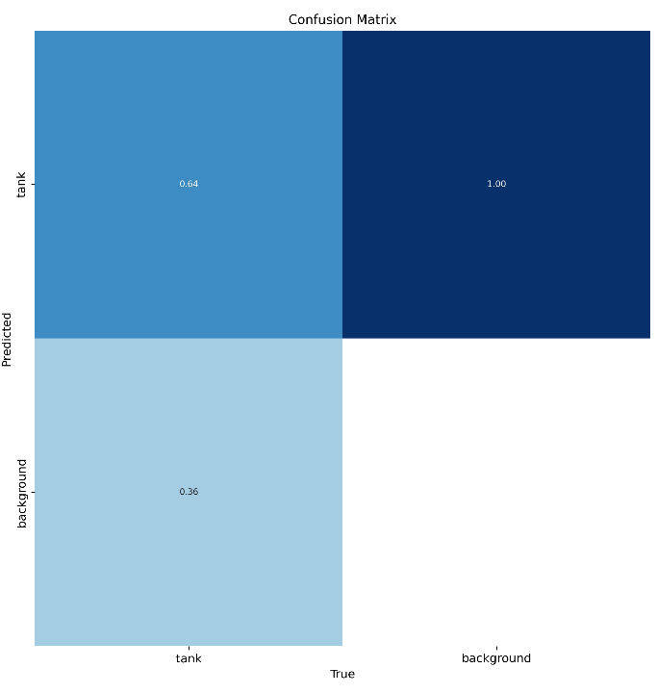






Proof of Concept
Trained on Real Only:
Trained on Real + Synthetic:

Slide 10
Proof of Concept
Reflection:
  Having “more” data doesn’t always solve your problem.
  This is a DOE problem (we only used 4 scenes)
  Better model needs to have examples like target set.
  But a robust model, needs more variation
Next steps:
    Improve/increase synthetic set + more variation
    Explore effects of distance, viewing angle, weather, etc.

Slide 11
Synthetic Data to Test Models
Synthetic data for model weaknesses:
Possible parameters to investigate:
    Viewing angle
    Distance
    Weather conditions
    Etc.

Slide 12
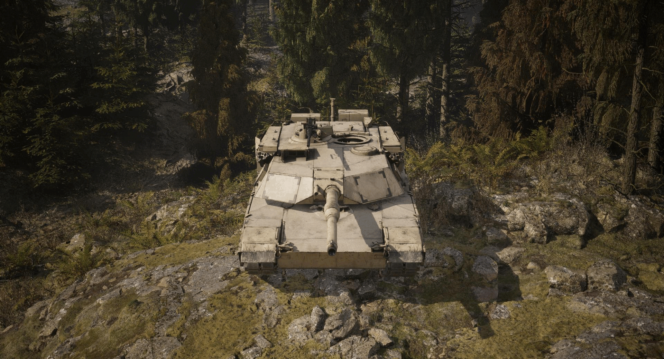
Synthetic Images
Variable 1: Rotation (0-180°)

Slide 13
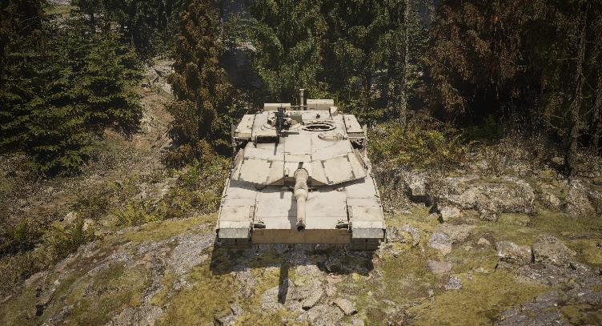
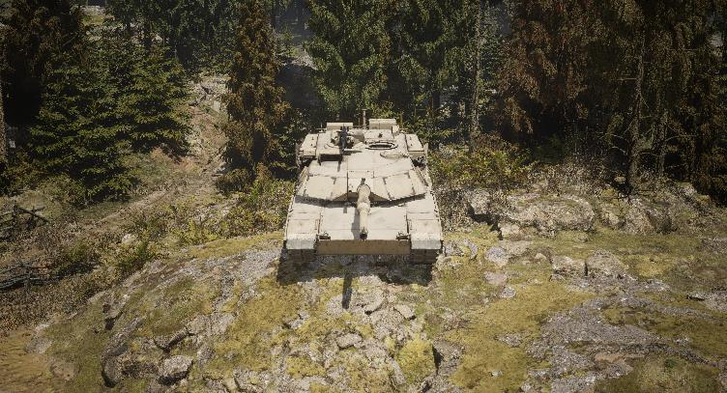
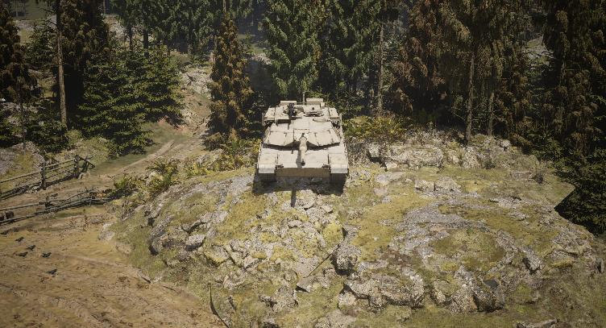
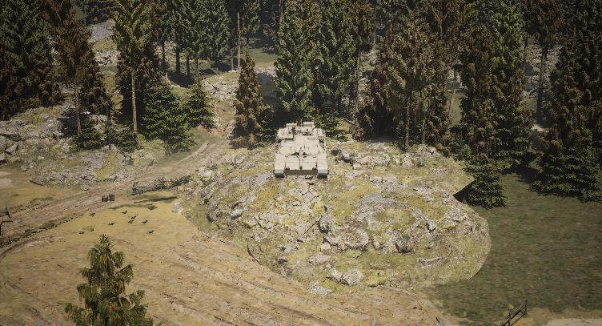
Synthetic Images
Variable 2: Camera Distance from Vehicle
1500 units
2000 units
2500 units
3500 units

Slide 14
Current Results

Slide 15
Current Results

Slide 16
Other Form of Synthetic Data
Are all synthetic images created equally?
  Introduce AI text-to-image photos to compare with UE data (after creating a robust UE dataset).
  Stable diffusion model used to create photos.
      Variation in prompts → variation in images.

Slide 17
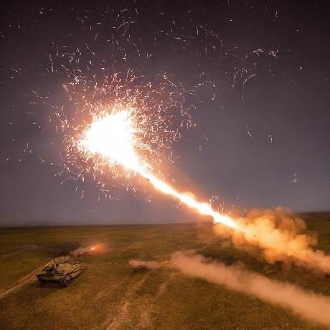
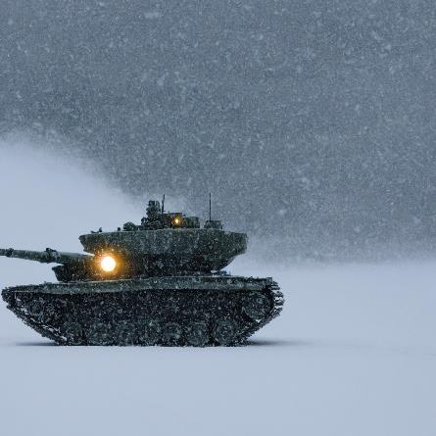
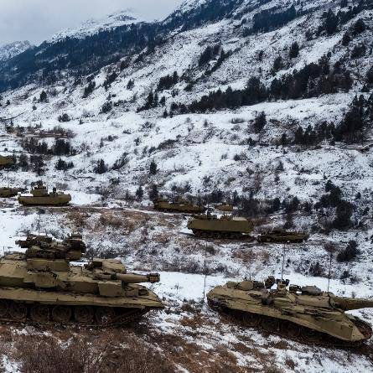
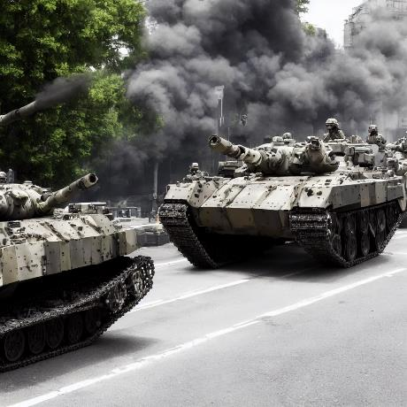
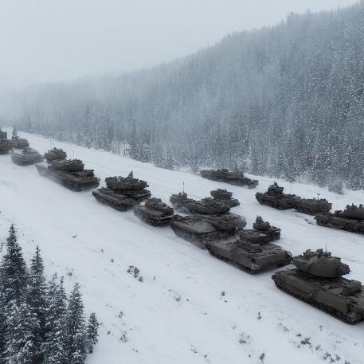
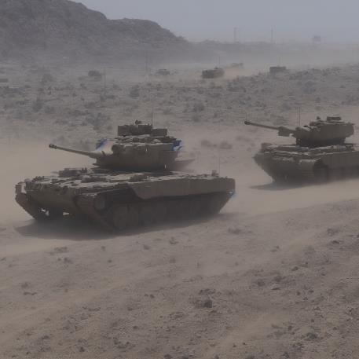
Stable Diffusion Examples

Slide 18
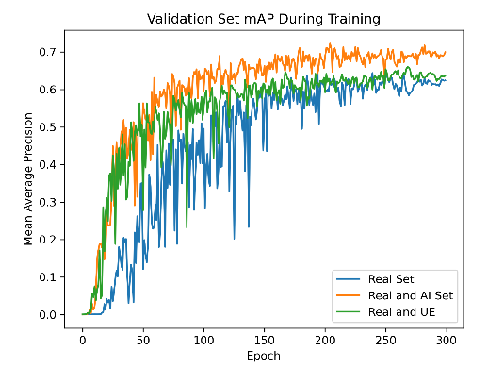
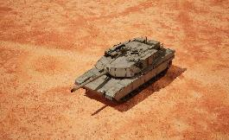
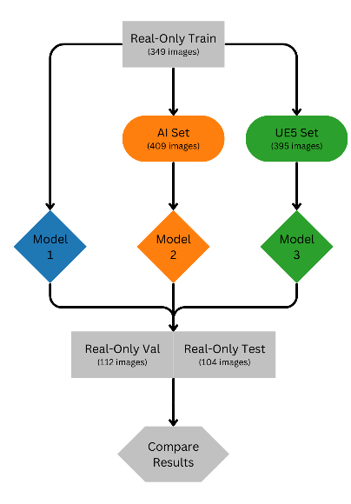
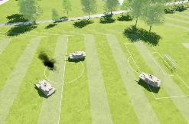
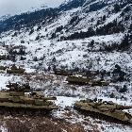
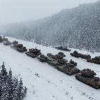
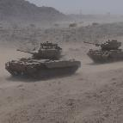
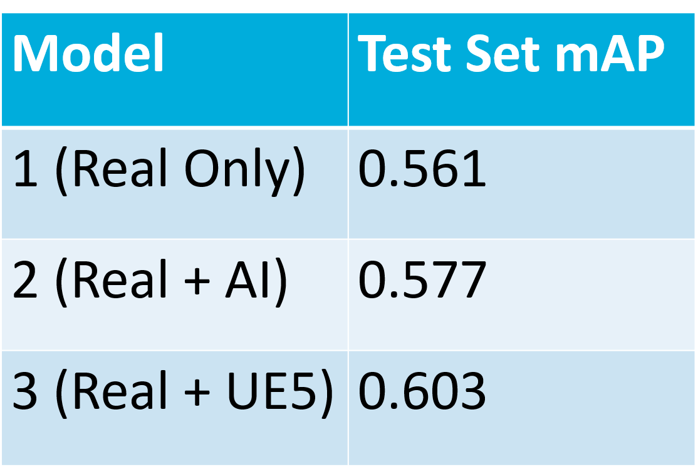
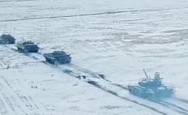
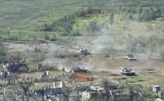
Other Form of Synthetic Data
UE5 + Stable diffusion?
Notes:
To create our UE5 set, we rendered various scenes including combat vehicles in the UE5 environment and took videos with varying angles captured. We uploaded our videos to cvat.ai for labeling and exported labeled frames to roboflow.com for storage.
Our AI image set was created using the stable diffusion model with standard pre-trained weights (v1-5). Prompts were produced in mass using ChatGPT with varying instructions so that a variety of images were produced. Roughly ~1000 images were produced and 405 were kept for labeling.

Slide 19
Pipeline: pretty standard… but can always be made more efficient
- CVAT is helpful but not a panacea. Labeling will continue to be time consuming.
Using synthetic data can be helpful. Need to include more variety to have robust model.
Stable diffusion models show potential to create more robust models.

