Slide 1


Machine Learning for Aircraft Identification
Cameron Liang
Paul Jones
Funded by CRP C1366

Slide 2
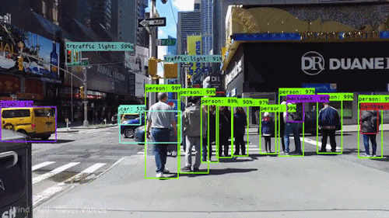
What does a self-driving car see?
Take a peak inside the Blackbox and demystify Artificial Intelligence (AI).

Slide 3
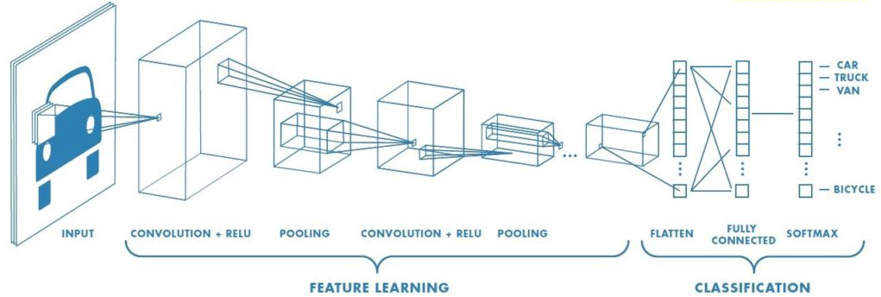


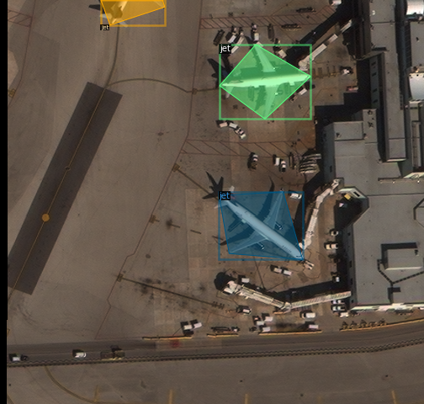
Outline
Conceptual and mathematical background on Machine learning and Deep learning
Tools, software libraries, computing resources, and the common hurdles we faced.
Data and Modeling
Notes:
This slide shows the outline of the briefing. The first third of the briefing will focus on conceptual and mathematical understanding of machine learning to bridge the gap and provide background for the hands-on modeling in the second half. The second focus is on the discussion of currently available tools, software, and computing resources. We also discuss the limitations and common hurdles we faced during this project. Finally, we will discuss the actual deep learning problem we attempt to tackle. We discuss in details a) the data properties and features published by CosmiQ Works, b) how we implement the data and features into a machine learning framework, c) the process of the model training and validation, d) application to external images and video processing.

Slide 4
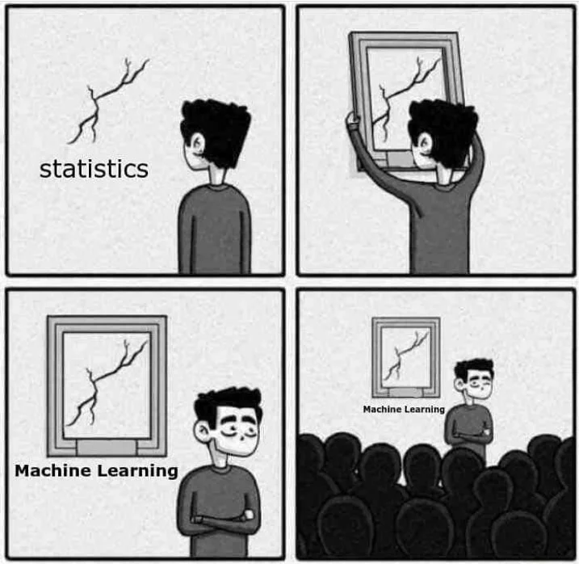
What is Machine Learning?
“Machine Learning is just Statistics!”
“Machine Learning relates to statistics the same way engineering relates to Physics”
(Hardware) Engineering | Physics
Building a car engine | Carnot Cycles / Statistical Mechanics
Electronic circuits | Maxwell Equations
Machine Learning | Statistics
Objection detection, recognition | Regression + optimization + …
… | …

Slide 5

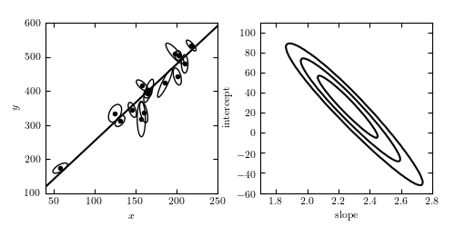
Starting from basic model fitting: fitting a line to data
The data x is our input. The output is y. Our model is a linear model (e.g., a straight line).
Writing in a “fancy” way, f(x | m, b) is our model given parameters m and b.
The goal is to learn what the slope (m) and the intercept (b) are given the data.
Strictly speaking, this is “machine learning”. But nobody calls it that, maybe because we can analytically find the best fit parameters (with some assumptions)
Notes:
In this slide, we discuss the basics for traditional model fitting in statistics. In this simple example, the data provided are a series of data points (x, y) with uncertainties represented in ellipses as shown in the figure in the bottom left of the page. The model in this example is a linear model (i.e., a straight line) with two parameters: slope (m) and intercept (b).
There are many methods in which one can derive a best estimate for this set of parameters. The bottom right figure shows the joint parameter space for these two parameters. In a Bayesian framework, the best-fit parameters carry uncertainties, represented as probability distributions. The contours show the confidence levels for the joint probability distribution. The main point of this slide is to connect with machine learning, in which one learns the best-fit parameters based on the data. In other words, the essence of traditional statistical model fitting and machine learning is the same.
However, while fitting a line to data share the same essence in more sophisticated machine learning practice, this is not commonly referred to as machine learning itself. This is partly due to a wide range of definition of “machine learning” and partly due to semantics. Nevertheless, there is one key difference. In the case of fitting a line to data points with Gaussian uncertainties, one can analytically derive the best fit parameters since the minimization of the chi square is analytic and straightforward. In more complicated cases, however, this might not be possible.

Slide 6
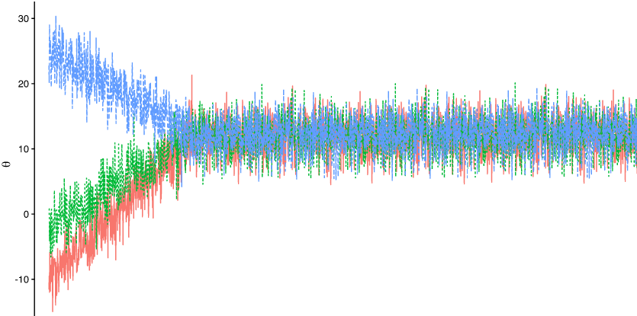
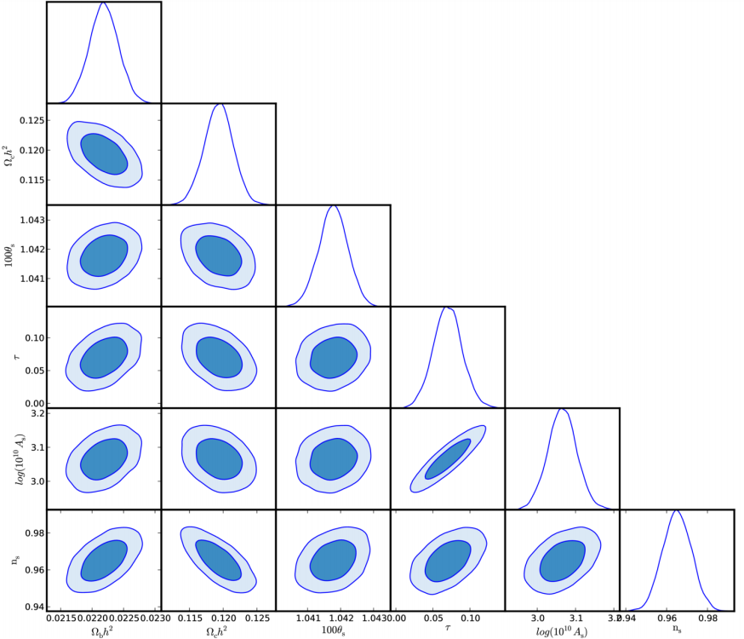
The concept of “learning” becomes more apparent in a more difficult problem: higher dimensions
Parameter converges to maximum likelihood
Number of steps
In high dimensions (e.g., high number of parameters), MCMC is one approach that we learn what the best parameters are by walking around the parameter space.
How the walkers walk depends on your algorithms. Randomly = Metropolis-Hasting Algorithm.
Optimization methods exist, such as Gradient Descent. This is commonly known as a “Machine Learning” technique/model.
When dimensions are high enough, even MCMC is insufficient or slow.
Notes:
In this slide, we show an example of a model fitting where a model has a large number of parameters. The model or data themselves are not important for this discussion. Fitting a linear model (with two parameters) can be straightforward in the previous example, where the best fit parameters can sometimes be estimated analytically. Therefore, the “learning” part of the machine learning become less apparent. However, a sophisticated model with a large number of parameters often cannot be estimated in the same way (analytically).
For high dimensional problem, a common method in searching/learning for the best-fit parameters and estimating their probability distributions is Monte Carlo Markov Chain (MCMC). With this method, the user first initialize the guesses of parameters in this high parameter space. Then using sampling algorithms, such as Metropolis-Hasting, one can direct how these initial guesses (called “walkers”) can “walk” around the space to new location and improve the likelihood of parameters. Another popular optimization algorithm in machine learning is called Gradient Descent. This optimize the path in which “walkers” approach the best-fit parameters. It is usually the first algorithm that one learns in a machine learning course.
The figure on the top right shows an example of the history of three “walkers” (blue, green and red). They start out randomly at three different places in the parameter space, but converge at a later time (or number of steps of walking) after learning what value of the parameter would best fit the data. The history of locations where the walkers have been can be constructed as the probability distribution of the parameters. An example is shown in the figure on the left hand side.
Note that the number of walkers and the steps correlates with the dimension of the space. As the volume of the parameter space grows as x^{n} power where n is the number of parameter (for a fixed length x in each dimension), the number of walkers and steps require for convergence grow quickly. Therefore, even such sampling technique would become computationally expensive and insufficient to explore the entire space for a representative sample.

Slide 7
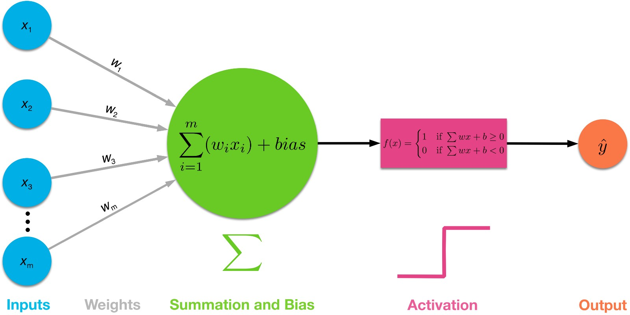
Artificial Intelligence/Deep Learning (1): what is it?
The data x is our input. The output is y. Our model is a linear model with a twist (sigmoid function). So it is nonlinear.
Writing in a “fancy” way, f(x | w_{i}) is our model given a set of parameters w_{i}
The goal is to learn what parameters w_{i} are given the data.
This is matrix multiplication! i.e linear! But linear functions doesn’t always get what we want.
Notes:
This slide shows the basic structure of a deep learning process. In particular, it lays out 1) how the data (x) gets multiplied by the weights (w) and the addition of biases, and 2) an operation called activation to get the prediction (y). Without the activation function, one can see that the operation is a linear combination of the data (x), hence the process is linear up to the activation function. The form of the equation is also similar to that discussed in the first example (mx+b). Note that the objective, again, is getting the correct weights, as parameters of a given model, to match the output y.
The activation function (sometimes, called the transfer function) of a node defines the output of that node, given an input or a set of inputs. Analogy is a standard integrated circuit can be seen as a digital network of activation functions that can be “ON” (1) or “OFF” (0), depending on the input. Only non-linear activation functions allow such networks to compute nontrivial problems using only small number of nodes. This nonlinear operation is required for a general prediction because linear combination of inputs do not necessarily produce all possible outputs.

Slide 8
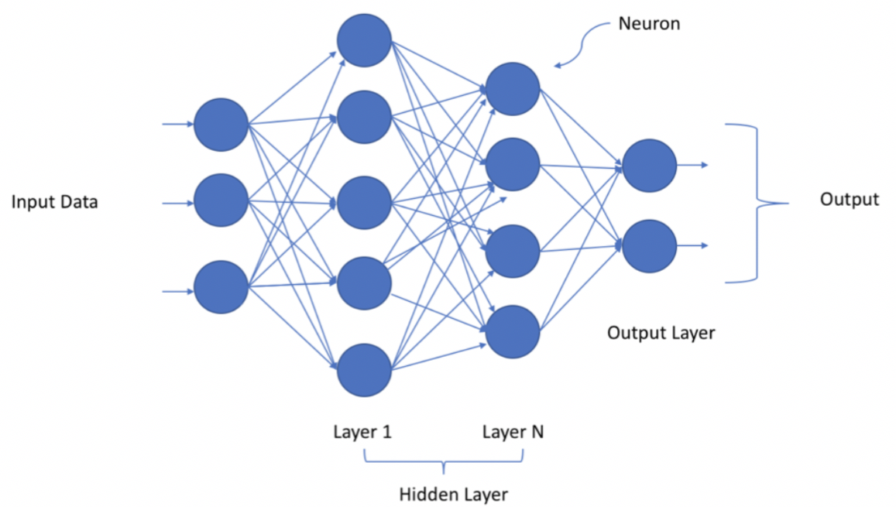
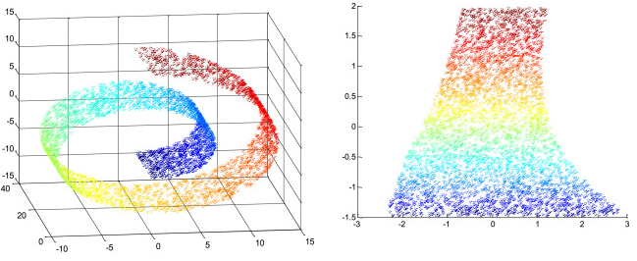
Artificial Intelligence/Deep Learning (3): Convolution Neural Network (CNN)
Deep because there are many layers. Typically it ranges from a few to tens
The number of parameters grows as Number of inputs x Number layers x number of nodes per layers. So it could be huge!
Every pixel in an image becomes an axis in the high dimensional space.
  High resolution image → high dimensional space → More parameters.
Hyperparameters (tuning): number of layers and number of nodes per layer provide flexibility of model to fit the output.
Geometric interpretation: Essentially, this is an exercise of manifold fitting in a high dimensional space
Notes:
This slides show a little more detailed structure of the deep learning framework. The left figure is a common diagram that illustrates deep learning architecture, consisting two key concepts: neurons and layers. The word “deep” stems from the fact that there are typically many layers in a given architecture. Compared to previous model fitting examples, the number of parameters here is mainly driven by the product of three ingredients: the number of input values (x), the number of layers, and the number of nodes/neurons per layer. Evan for a typical low resolution image, say 128x128 (=x), the final number of parameters can be extremely large.
From common practice / experience, a few layers and 64-256 nodes per layers are usually good enough for most image classification task. These are common practices, there is no established theorem that rigorously determines number of hyperparameters are the best. One can in principle repeat the experiments, and find out what parameters converges the fastest. But it may not be generalizable.
While this left figure is a diagram that illustrates the process, a helpful geometric interpretation of the problem is to visualize the problem fitting as a high-dimensional manifold folding. This is most similar to the example of fitting a line to data, except in this case, it is a manifold in high dimension (right figure)

Slide 9
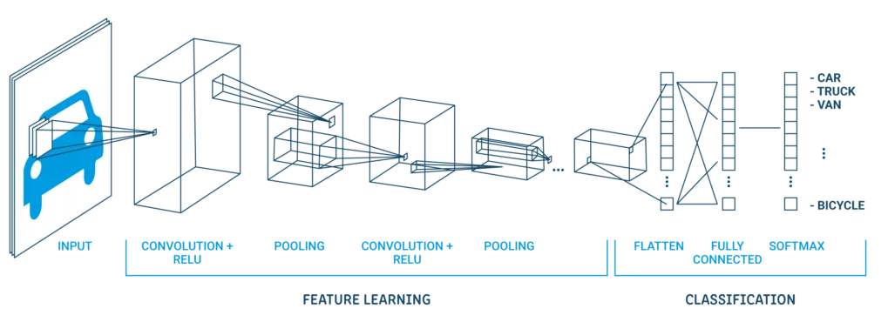
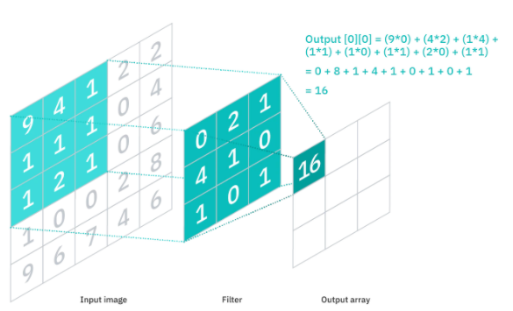
Artificial Intelligence/Deep Learning (4): Layers and Operations
Convolution Neural Network (CNN) is a type of deep learning. The name comes from what operations we are doing. i.e., convolution.
Matrix multiplication is filtering. One type of filter is convolution.
Notes:
This slide shows again similar diagram of a deep learning frame work. This time with emphasis on the operations in each layer. There are three typical layers with each of their unique operation and purpose:
Convolutional layer : This layer helps to abstract the input image as a feature map via the use of filters and kernels.
Pooling layer : This layer helps to downsample feature maps by summarizing the presence of features in patches of the feature map.
Fully connected layer: Fully connected layers connect every neuron in one layer to every neuron in another layer.
Why to use Pooling Layers?
Pooling layers are used to reduce the dimensions of the feature maps. Thus, it reduces the number of parameters to learn and the amount of computation performed in the network.
The pooling layer summarizes the features present in a region of the feature map generated by a convolution layer. So, further operations are performed on summarized features instead of precisely positioned features generated by the convolution layer. This makes the model more robust to variations in the position of the features in the input image.
These are called summarized features. Often that is good enough to get the information we need.

Slide 10
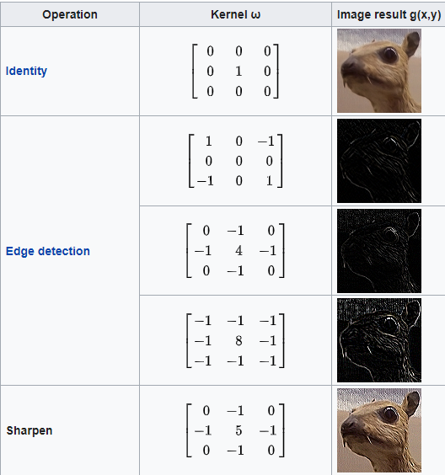
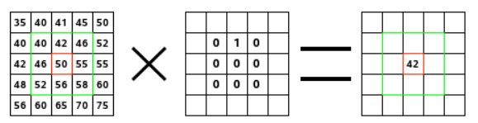
Artificial Intelligence/Deep Learning (5): Filtering from Image processing
The language comes from image processing. These are examples of such matrices.
Notes:
This slides show some example of the actual matrix operation in a given layer. In the nomenclature of image processing, these are called filtering. For example, the image on the right shows a specific filter operated on an image (in this case, it is represented by a matrix). The filter studies successively every pixel of the image. For each of them, which we will call the “initial pixel”, it multiplies the value of this pixel and values of the 8 surrounding pixels by the kernel corresponding value. Then it adds the results, and the initial pixel is set to this final result value.
Specifically, this is what happens when acted on the image: the filter read successively, from left to right and from top to bottom, all the pixels of the kernel action area. It multiplied the value of each of them by the kernel corresponding value and added results. The initial pixel has become 42: (40*0)+(42*1)+(46*0) + (46*0)+(50*0)+(55*0) + (52*0)+(56*0)+(58*0) = 42. Note that the filter does not work on the image but on a copy. As a graphical result, the initial pixel moved a pixel downwards.

Slide 11
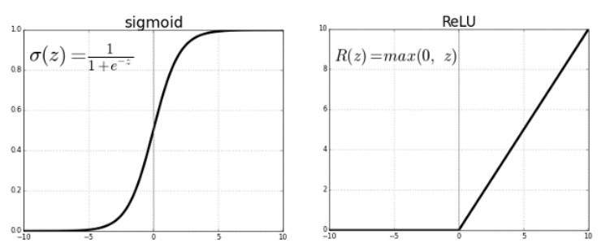
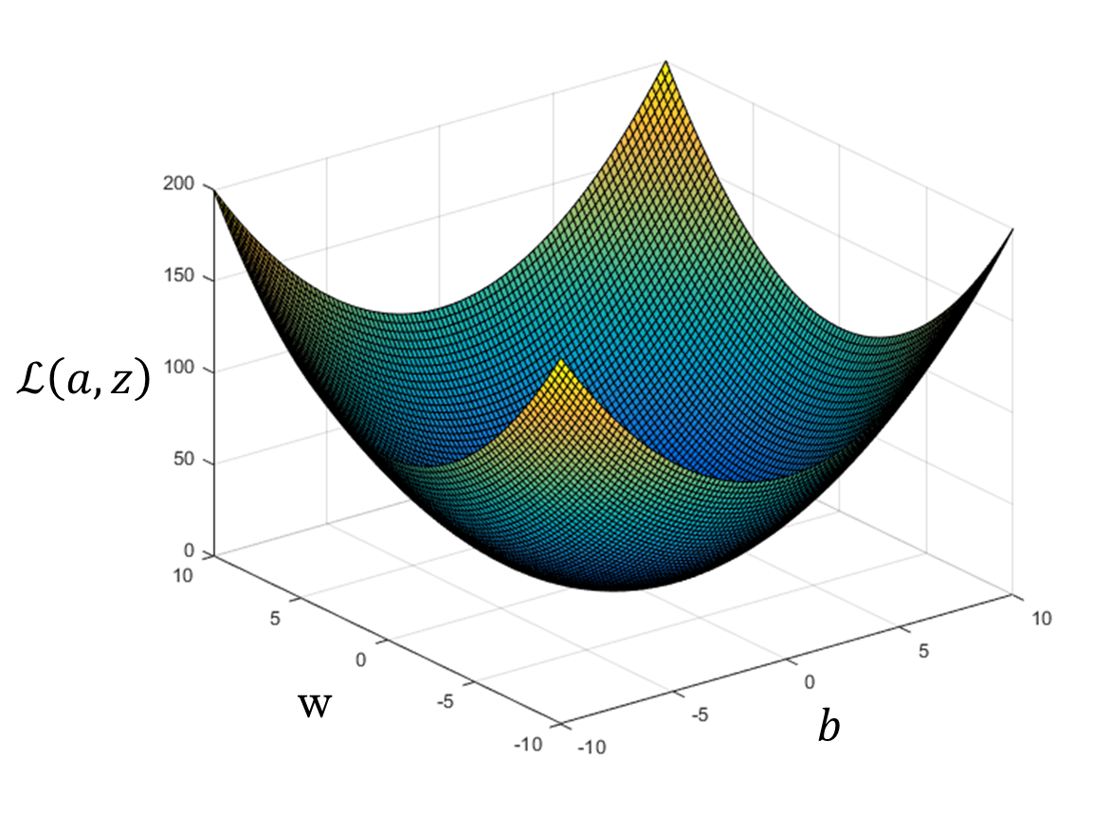




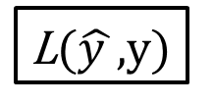
Artificial Intelligence/Deep Learning: learning the parameters (weights)
Predicted value
Loss function
$$y= w^{T}x+b$$
$$\hat{y}$$
L($\hat{y }$,y)
$$= σ(y)$$
e.g., old friend gradient descent
Minimize loss function
L($\hat{y} ,$y)
Gradient Descent
Notes:
This slide shows mathematical process of the deep learning model. In essence, it is a forward modeling technique. Specifically, this shows two examples of an activation functions. Again, the main reasons for Sigmoid and similar functions is its nonlinearity. Typically, the output value goes between 0 and 1. Because of this, it can often be interpreted as probabilities. This is useful for classification problem, for example, to interpret the probability that an object is a cat. With a training data (output like a cat or a dog), an optimization technique is used, such as gradient descent to vary the weights, in order to maximize the accuracy of prediction. During this process, what is being varied is the weights (w).
There are pros and cons for the choice of activation functions for a given problem. For a sigmoid function (left figure), the general issue is called “vanishing gradient problem”. This is evident as the value vary from 0 to 1, as the value reaches one is the gradient becomes vanishingly small. This introduces problems in convergence. Another example is the ReLU (Rectified Linear Unit) – half rectified (middle figure). Issue is that all negative values become zero immediately, which decreases the ability of the model to fit negative values.
To summarize, activation functions have pros and cons. They also have requirements for this deep learning process. The functions are at least one time differentiable. We need to know how much change or update depending on the slope.
Potential drawbacks:
sigmoid or tanh functions are the vanishing gradient problem.
Dead neurons in ReLU (when y <0, then the neuro could be dead, or stuck. for example)
The type of activation functions depends on the problems you have, which can be divided into two groups.
Regression – prediction value – in one node, linear activation.
Classification – There are three main types of classification problems. In all cases, we predict the probability of a class membership, where we can convert a crisp class label by rounding (for sigmoid) or argmax (for softmax).
Considerations:
How difficult is it to compute the derivative? Is it differentiable at all?
How quickly the network converges given the AF?
Preserves normalization?

Slide 12
Outline
Conceptual and mathematical background on Machine learning and Deep learning
Tools, software libraries, computing resources, and the common hurdles we faced.
Data and Coding

Slide 13


Practical Tools and Requirement: common open-source libraries
Fortunately, a lot of the mathematical background is abstracted away. Nowadays, even the various programming steps are abstracted away. Using common coding libraries, we can just “plug and chug”.
The two most popular open source libraries are: Tensorflow (Google), Pytorch (Facebook),
Popular Python Interface to these libraries are Keras (Tensorflow), and Detectron2 (Pytorch).
Continuing the engineering to physics analogy
“Nuts and bolts,
Wrenches, Transistors, capacitors”
“Pre-configured package of GPUs, SSDs”
Notes:
In this slide, we start the discussion for the common tools and software available to the public for deep learning. The two major publicly available libraries are TensorFlow and Pytorch, published by Google and Facebook, respectively. A couple of years ago, to develop a deep learning application, one would need to be familiar with either of these packages and directly work with them in Python. While it is still possible to do today, popular interface to these package have been developed to abstract away a lot of the background mathematics and data manipulation in the deep learning development process. These include Keras for TensorFlow and Detectron2 for PyTorch. However, using TensorFlow or PyTorch directly can still benefit one’s understanding of the details in the development process. Keras and Detectron2 provides the fastest way to a deep learning product. The entire codebase for a deep learning model and training using these interface libraries can be less than a few hundred lines in Python. Using these, the developer can focus on the data and model training itself without being distracted by other details.

Slide 14
Outline
Conceptual and mathematical background on Machine learning and Deep learning
Tools, software libraries, computing resources, and the common hurdles we faced.
Data and Modeling

Slide 15
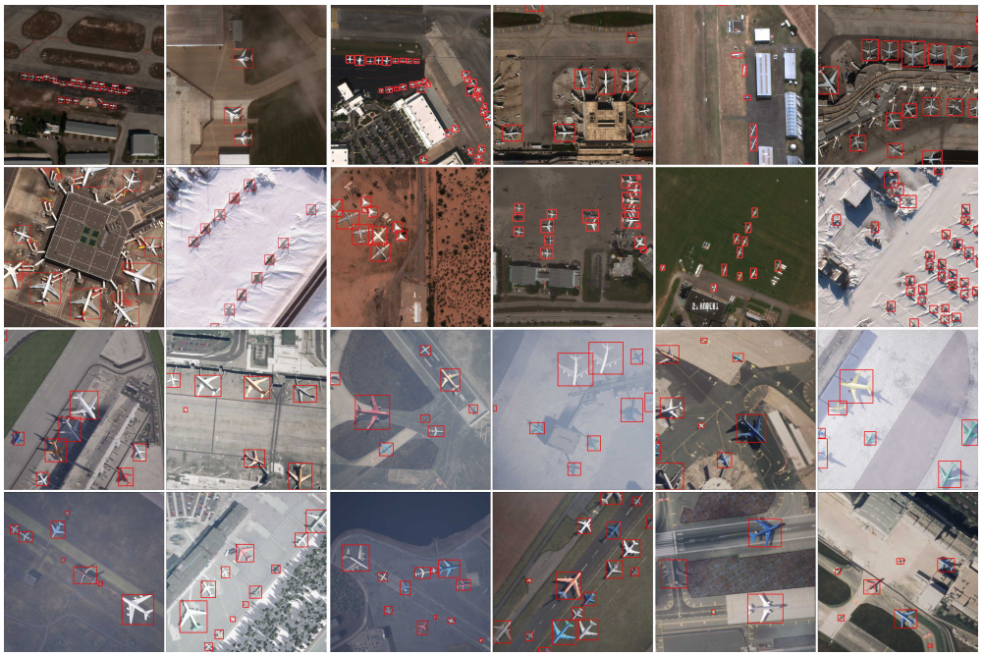
Dataset: overhead aircraft images – CosmiQ Works
Shermeyer et al. 2020
arXiv:2006.02963
Largest openly-available high resolution dataset
253 Maxar WorldView-3 satellite scenes, 112 locations, 2142 km², and 14,700 hand-annotated aircrafts.
50,000 synthetic satellite images, 630,000 aircraft annotations.
Notes:
In this slide, we discuss an overview of the dataset we will be using. CosmiQ Works provides a collection of overhead aircraft images, currently the largest openly-available high resolution dataset. The images are captured by Maxar WorldView-3 satellites, containing 253 scenes, 112 locations, with a total area of 2142 km². There are a total of 14,700 hand-annotated aircrafts. In addition to the real data, they also generated 50,000 synthetic images, containing 630,000 annotated aircrafts.

Slide 16
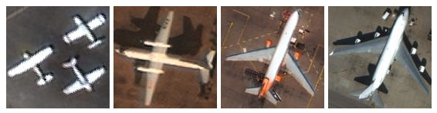
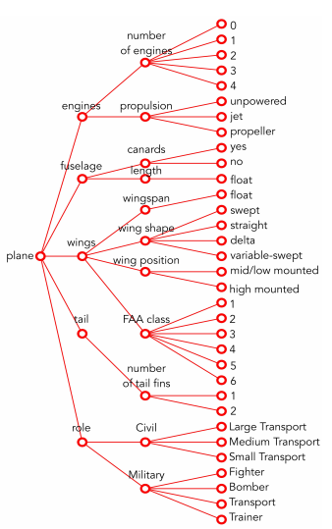
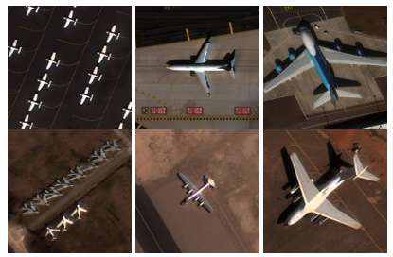
Dataset: Features and Annotations
5 Features, 10 attributes, 33 sub-attributes
Labeled data = bottleneck for most problems.
Engine Types
Single engine propeller
Two engine propeller
Three engine jet
Four engine jet
Roles
Small
Medium
Large
Civil Transport
Military
Fighter
Bomber
Transport
Notes:
In this slide, we show the features and annotations within the dataset. There are a total of 5 main features, 10 attributes, and 33 sub-attributes. For the main features in each aircraft in an image, they are engines, fuselage, wings, tail, and role. The attributes and sub-attributes are finer breakdown of those main features. The figure on the left hand side shows the organization and breakdown of the annotations. In the figures on the right, we show two examples of the annotations. Top right: this shows the example of different engine types, including propeller and jet. For each type of engine, there are the sub-attribute that indicates how many engines the aircraft have. Bottom right: this figure shows aircrafts of different sizes and different roles (civil vs. military).
It is worth pointing out that the data and annotations are always the bottleneck for this type of deep learning algorithm. It is popular to say that “data is the new oil”, but just as crude oil needs refinement and processing, the crude data also need be cleaned and annotated. Otherwise, it will be “garbage in, garbage out” no matter how advance the algorithms may be. It is estimated the data annotation will be billion dollars industry before 2030.

Slide 17
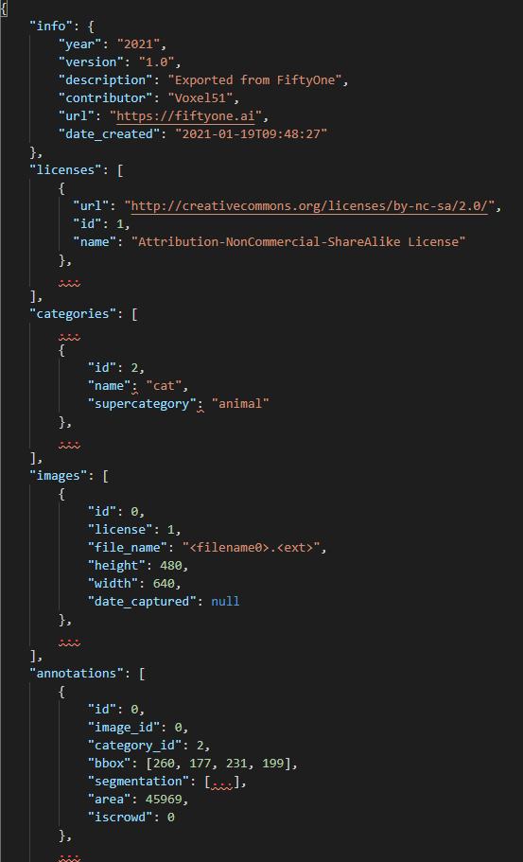
COCO (Common Objects in Context) data format
“categories” – the labeled categories of objects within each images (e.g., cat/dog, car, aircraft)
“images” – image specific info. The dimension, file name and its location, etc.
“annotations” – what object is contained in it? The bounding box, segmentation, etc.
Notes:
In this slide, we discuss the details how to uses and format the annotations and the data themselves. One of the industry standard data format is the Common Objects in Context (COCO) format. One of the goals is to understand the details of how to do deep learning. This involves understanding of how the data are labeled, in particular the data format of the annotations (e.g., COCO).
A COCO file is a json format file that record the key information of the datasets. These key information include five categories 1) info, which contains the year, version, general description of the data. 2) licenses of the data, 3) categories, which indicates the types or classes of objects (e.g., cat vs dog), and 4) images, which describes the filenames, location and sizes of the images, and 5) the annotations, which includes the id, image id, category id, bounding boxes, and segmentation that correspond to an object in a image. All of these information are stored in a dictionary format. The entire json file is a dictionary of dictionaries. A sample of the annotation COCO file is show on the figure in the right side of the page.
There are software and packages that can read the annotation files and display them visually. A common library is OpenCV. The figure on the left shows an example of three aircrafts in an image. The diamond shaded region is the segmentation specific to this dataset where the annotators have identified and drawn to capture the width and the length of the aircraft.

Slide 18
Model Training and Coding: the minimal baseline steps involved
Create Cloud instance with GPU
Install and import all relevant libraries (e.g., detectron2)
As always, most of the work is here, given everything else is sorted out.
(Pre-)process data and metadata
Train!
Evaluate model performance
Notes:
In this slide, we shows the general development process for a deep learning model. The diagram on the left shows the specific steps involved. In the following slides, we will discuss in details each of these steps. Note again, the data preprocessing involves most of the manual work, assuming other issues such as installing required libraries have been resolved.

Slide 19
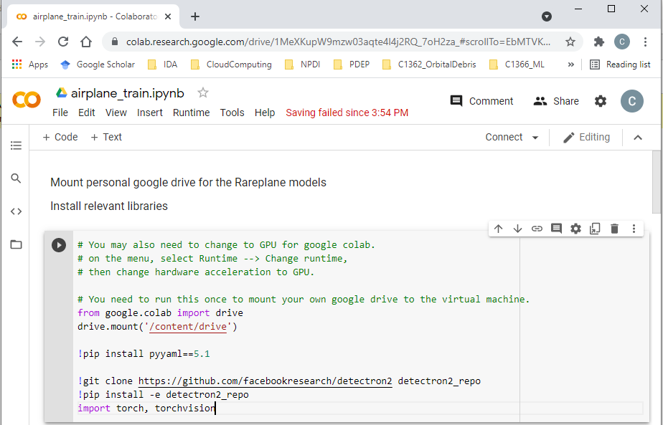
Model Training and Coding: Google Colab & install libraries
Notes:
This slide shows what it would look like when logging into Google colab: a Jupyter notebook here on a browser. Because it is a Jupyter notebook, users can make markdown as well as python codes. In first shell of the notebook, we show that one can install the detectron2 and other libraries as shown. Note that when installing within a notebook, a ‘!’ is required in front, otherwise everything would be similar to procedures done in a terminal. Note that every time when one logs on to Google colab, a new instance of a machine is used. The machine would be different every time. Therefore, it is required to reinstall the necessary libraries at each log in.

Slide 20

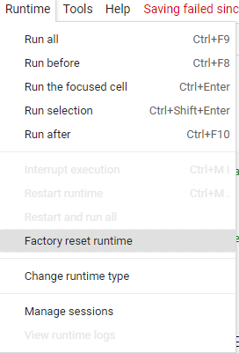
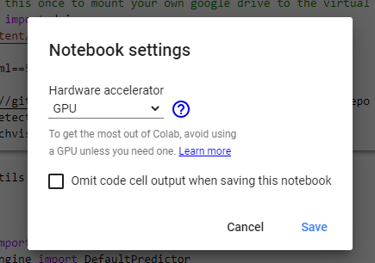
Model Training and Coding: Choosing GPU
By default, the Cloud instance uses CPU. We can change it to GPU by simply going to File > Runtime > Change Runtime type
Notes:
After logging in, especially the first time, one should change the hardware to be using GPUs since we will be using them to train our model. This is done by going to run time → Change runtime type → hardware accelerator → GPU.

Slide 21
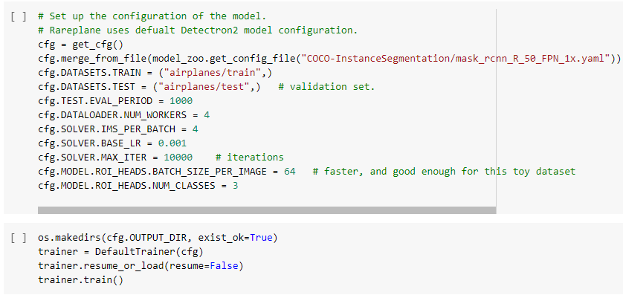
Few lines of code – Train!
Preset model configurations
(e.g., Fast-RCNN, Masked RCNN)
Hyperparameters in model configuration
Start the training!
Notes:
We have finally reach the point we are ready to train. To do so, we have to setup a model configuration. Templates for the models (e.g., Fast-RCNN as discussed earlier) can be loaded into the configuration. For a full list of models, one can visit the Github page of Detectron2. Notably, Mast-RCNN and RetinaNet are available.
Again, we have to define the training sets and validation sets in this stage. The division of the training and validation sets are done previously. One can simply divide the sets into two directories as it was done here. Note that it is stated as a ‘test’ set in cfg.DATASETS.TEST, it is technically more accurate to call this a validation set. In fact, one can divide the entire datasets into three partitions: training, validation, and testing. The ratio of how to divide this depends on many factors. Most typically, the training set should be the largest of the three.
There are additional hyperparameters one can set in the training phase. The first to mention is the MAX_ITER parameter. This is the maximum of iterations for the entire training phase. Each iteration is a change of parameters. In addition, we show the validation per period to be 1000. This parameter indicates that the model will perform on the validation set for every 1000 iterations of training. Finally, the number of classes is 3 in our case, because we have three engine types, namely unpowered, propeller, and jet. Many other parameters exists, the detailed documentation of what they do can be found the Detectron2 documentation.
It is worth noting that there exists good practice and general rule of thumb in tuning the hyperparameter. However, each problem is unique. Tuning hyperparameter is an exercise that one can do during multiple trials to get the best result (e.g., fast convergence, best accuracy, and so on). For a given problem, one can in principle repeat the experiment (training) many times to find the best hyperparameters. However, this is not guaranteed to be generalization for all problems or dataset.

Slide 22
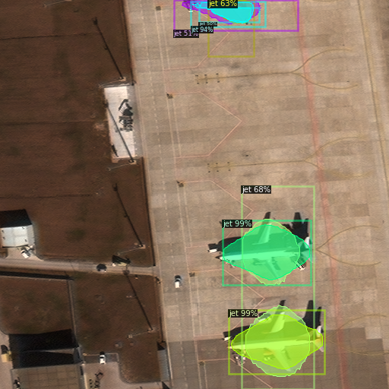
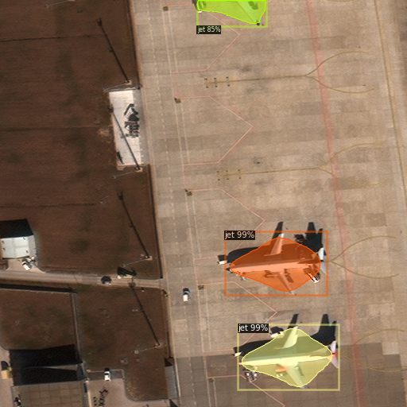
Results: Testing the model from random overhead images in airport
Performance at 10k iterations (3 hours training time)
Performance at 15k iterations (4 hours training time)
Interpretability? Black-box nature of Deep learning
Notes:
This slide shows two examples of model prediction with different length of training.
On the left figure, it shows the prediction on a test image with 10k iterations in training. As one can see, the model overpredicts the number of aircrafts (which may be caused by shadows of the aircraft). In the figure on the right, an additional of 5k iterations improved on this error.
Another point to make is on the interpretability / explanation of deep learning model. It is often times difficult to find out what is going on behind the scene. This is one example in which we do not know for certain why the model is double counting the objects.

Slide 23
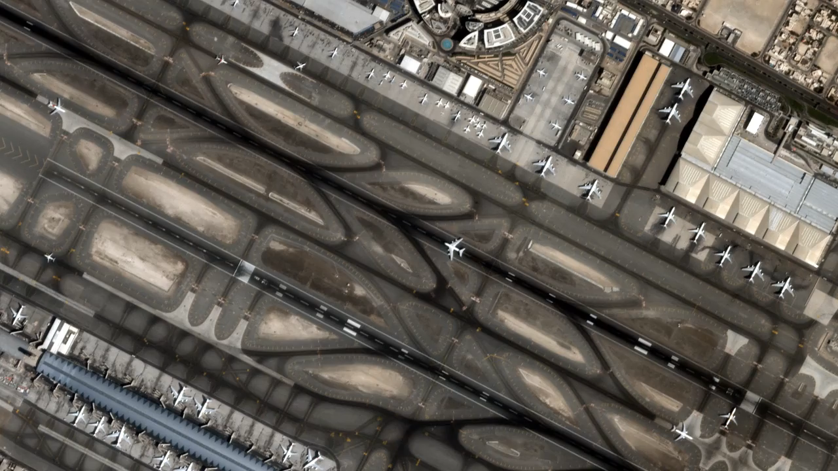
Results: Running model on a video (Dubai airport)
Notes:
This slides show an overhead video as an input to the model.

Slide 24
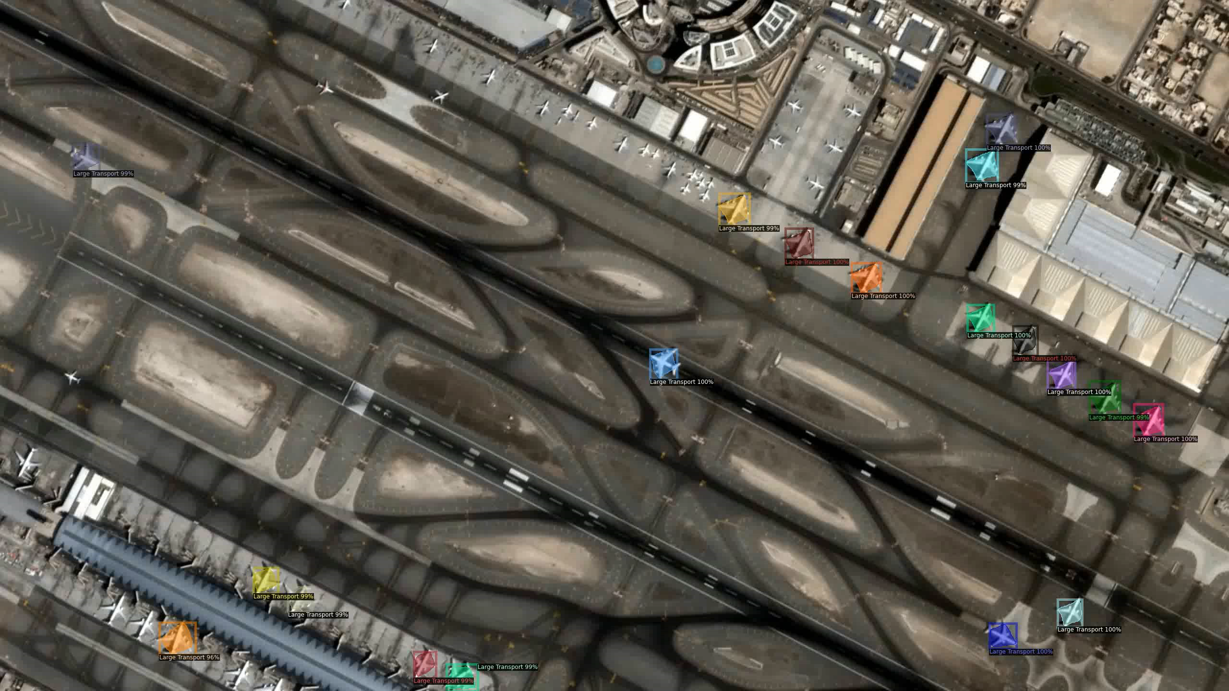
Results: Running model on a video (size of civil transport)
Notes:
To process the video, one has to make prediction the frame by frame. The scripts to parse the video into frames and processing is not shown here, but it is similar to that shown in previous slide. The specific application might not need frame by frame prediction since these are generally slow moving objects. Recall our earlier discussion on two-stage and one-stage methods, they process and make predictions at different speed. Although we can develop scripts to bundle the frame by frame prediction into a software for real-time application, we have not done so here since that is outside of the scope of the project. Note that this type of software development can be done, but the choice of the model should be one that can process a frame in sufficiently fast speed if the intent is real-time application that requires real-time reaction given the model prediction (e.g., self-driving car).

Slide 25
Thank you!

