Slide 1

LLMs for Structured Data Extraction from Long Form Documents
Patrick Bjornstad
JPL / California Institute of Technology
4/18/24
© Copyright 2024, California Institute of Technology
Government sponsorship acknowledged.

Slide 2
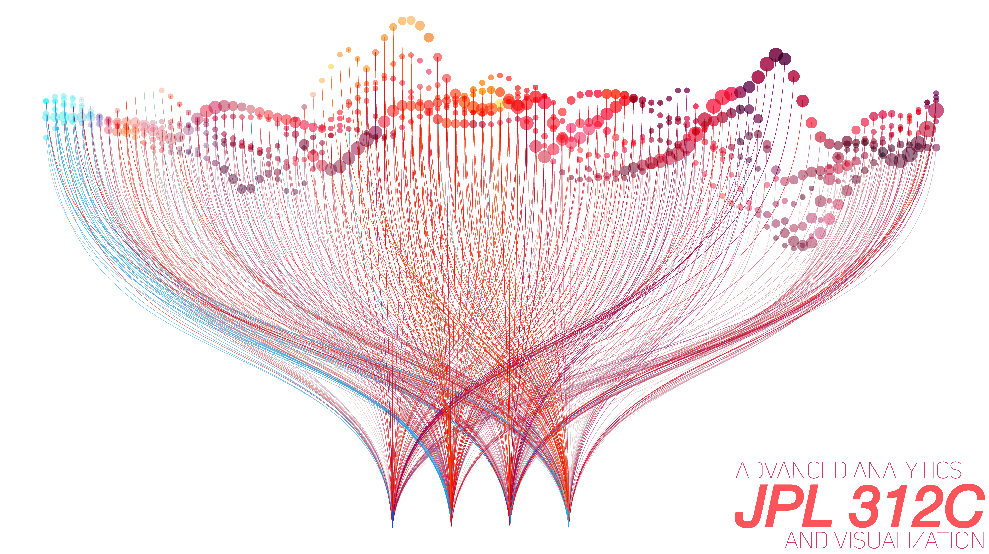
Overview
Why do we need structured data?
Case Study: NASA contract classification
  Exploration of LLM capabilities
From classification to structured data extraction
Knowledge Graphs as a promising data structure
Summary and long term goals
Special Thank You:
Managers/Sponsors | Colleagues
Dave Bearden Kelley Case Al Nash Andy Monro | Anto Kolanjian Robert Miller Kelli McCoy

Slide 3

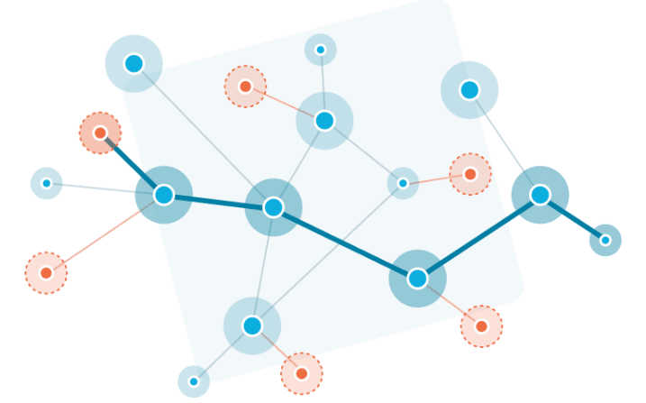
The Need for Structured Data Extraction
Aerospace projects are multidisciplinary, reliant on domain knowledge
Wealth of valuable information captured in long-form documents but unwieldy to access and consume due to unstructured format
  Proprietary documents: proposals, internal project documentation, engineering practices, etc.
  Public documents: journals/papers, textbooks, etc.
Current methods insufficient for integrating directly with models and tools
  Bag-of-Words (BoW), Retrieval-Augmented-Generation (RAG)
*How?
Queryable DB
Mathematical Models
Engineering Tools
Textual Information
Structured/Semi-Structured Format

Slide 4

Case Study: Classifying NASA Contracts
Dataset: active NASA work contracts written to commercial vendors
  23,000+ contracts with freeform textual descriptions, no labels
Goal: categorize according to JPL’s organizational structure
  Where are commercialization trends having the most impact?
Tool: JPL internally deployed GPT-4 instance
  Safe for proprietary data
LLM
“Classify this contract for me…”
NASA Contracts
Predefined categories: JPL work divisions
Opportunity to explore “text processing” capabilities of LLMs
Notes:
Make sure to relate back to main theme of presentation: this project gave us the opportunity to explore the “text processing” capabilities of language models
Could note here why BoW wasn’t super helpful → really large potential vocab size given technical nature + little to no training data

Slide 5

Classification via GPT
GPT’s pretraining minimizes need for labeled data
  Incorporating information from small set of labeled examples can improve performance
Key capabilities that enable classification:
  Function calling – enforce a specific output schema in LLM response
  Class descriptions + refinement – ”learn” from few-shot ground truth examples through prompts
Class Descriptions
LLM
Updated Descriptions
LLM
Output enforcement
{“class”: “Division 1”}
“Update with information from this example”
Contract + Label
“Classify to a category”
Unlabeled Contract
Repeat over “training” set
Notes:
Note opportunity for RAG too, may be cheaper or more expensive than categories depending on average length of input text

Slide 6
Classification via Text Embeddings
[0.1, -0.2, 0.5, …, -0.1]
LLM
Can be used to train a classifier if sufficient labels
[0.9, -0.6, 0.3, …, -0.2]
[0.2, -0.5, 0.9, …, -0.7]
Contracts
Alternative method: use LLM to produce text embedding vector
  Encode “meaning” of the sentence as a high dimensional vector
  Cheaper than text generation (at least for OpenAI API)
Use text embeddings as features in traditional classification model (e.g. SVM)
  Requires sufficient training data

Slide 7
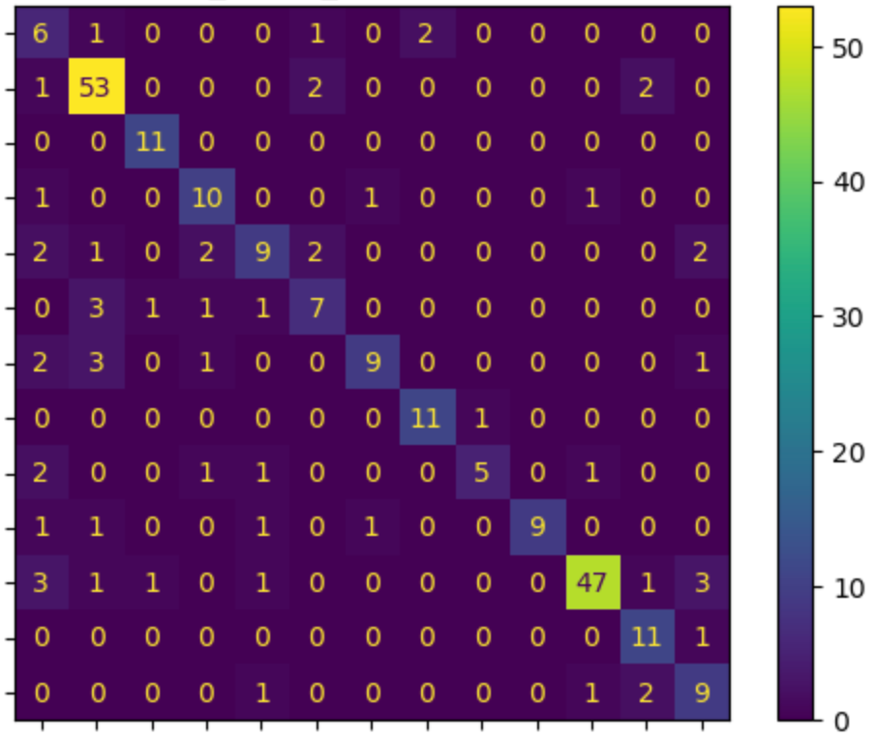
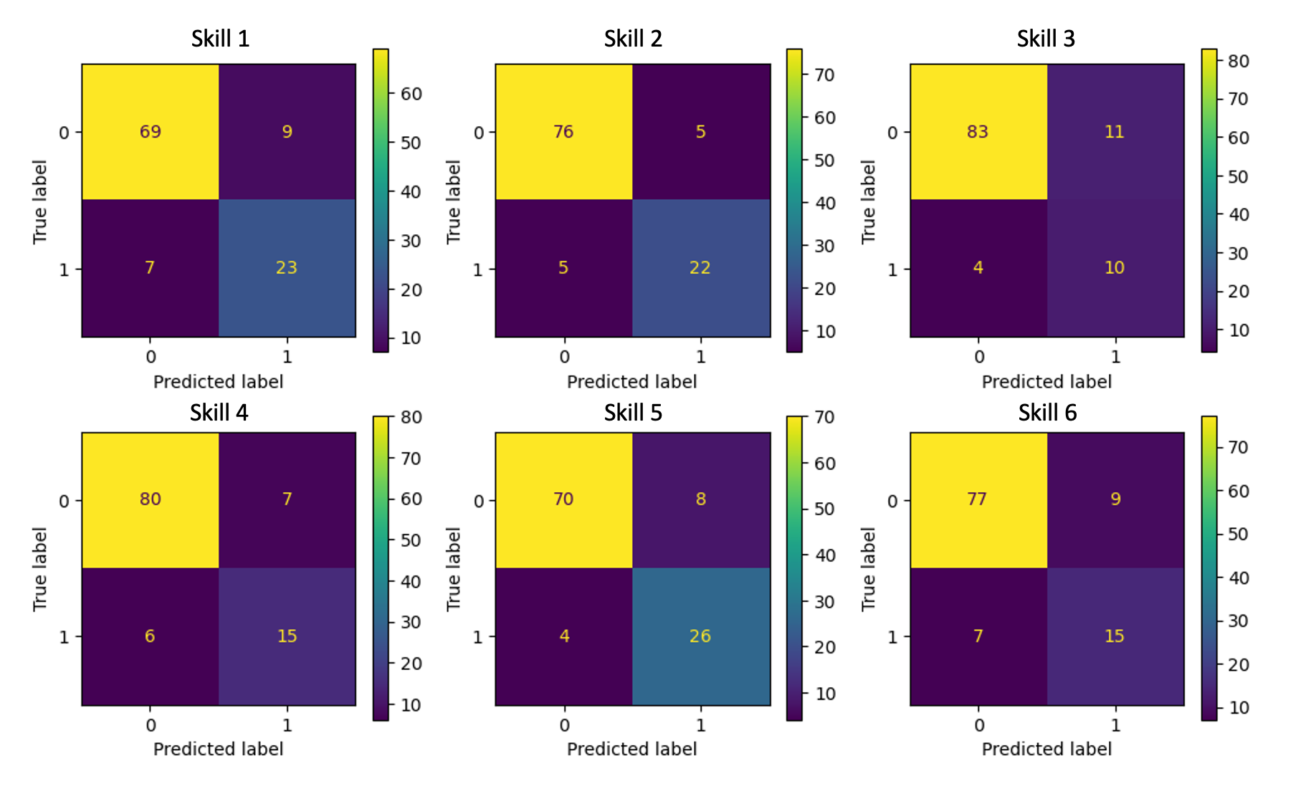
Results and Lessons Learned
GPT function calling promising for enforcing data structures
  Potential for extraction of more complex formats
Text embeddings useful as a general purpose way to encode text for statistical models
True JPL Division
Predicted JPL Division
GPT function calling classification for main work divisions
Text embedding “multilabel” classification for skillset tags

Slide 8
Scaling to General Purpose Text Extraction
Embeddings can be an effective solution for simple cases (e.g. RAG document search)
  Disadvantage: tend to represent the “average” of the input
GPT function calling presents opportunity for more complex data structures
  Read a document and extract information to our specifications
Tabular or graphical formats can capture relationships amongst elements of text
{
“instrument”: “Inst 1”, “num_units”: 1, “mass”: 25
}
LLM
Documents
Instrument | Num Units | Mass
Inst 1 | 1 | 25
Inst 2 | 2 | 41
{“instrument”: str, “num_units”: int, “mass”: float}
JSON Specs

Slide 9
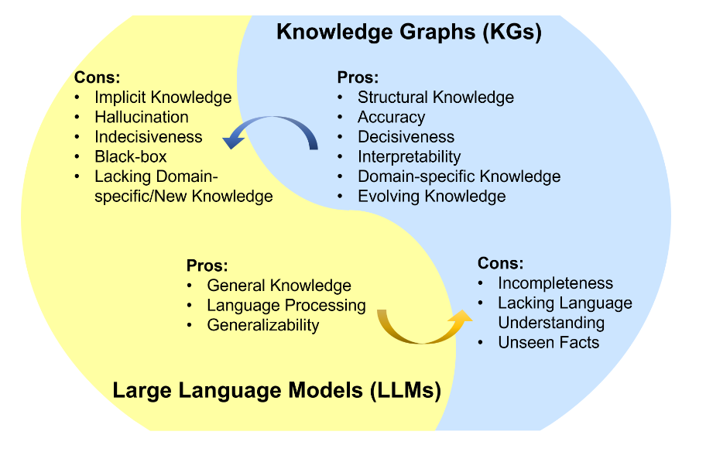
Knowledge Graphs + LLMs
Unifying Large Language Models and Knowledge Graphs: A Roadmap
Knowledge Graph: graphical structure connecting textual entities (nodes) using relationships (edges)
  E.g. ”Mars isDestinationOf MSL”
Potential LLM use cases:
  Generate KG vocabulary (set of choices for entities/relationships)
  Generate semantic triples (graph structure)
    {“subject”: str, “predicate”: str, “object”: str}
Why are knowledge graphs useful?
  Query-able knowledge (graph database)
  Integration with modeling languages
  Graph embeddings (rich vector representations for statistical models)
LLMs are adept at understanding the semantics of language but *not* the factual structure of the world
KGs represent the factual structure of the world but *rely* on understanding the semantics of language

Slide 10
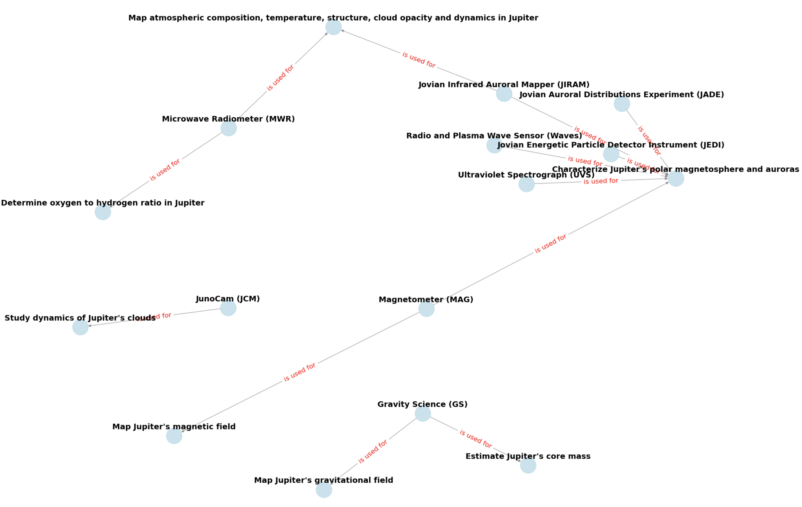
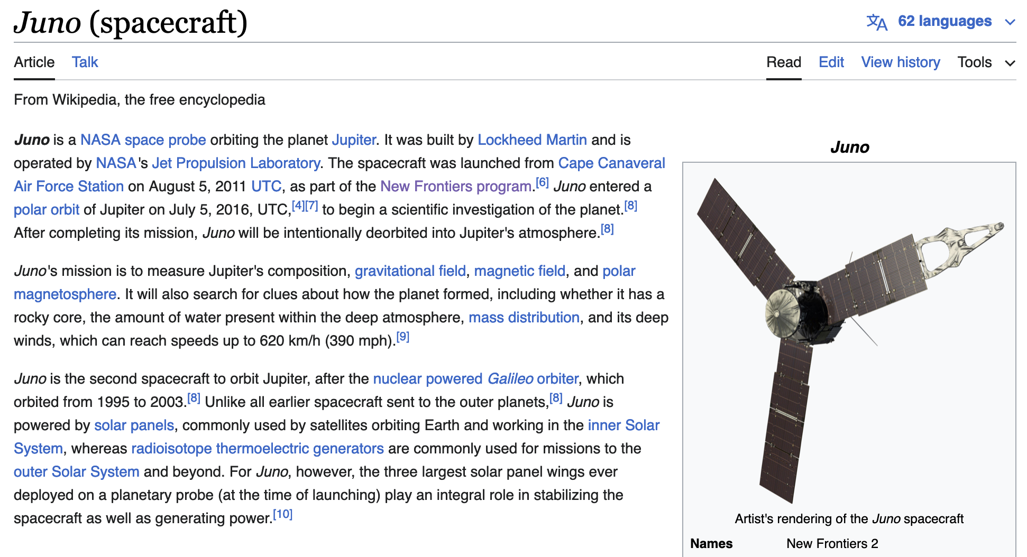
Example: Wikipedia → Science Objective KG
Prompt: “Transform the provided passage into a knowledge graph using semantic triples…”

Slide 11

Result Validation
Need for validation of LLM produced graphs
  Ontology reasoning engines: check consistency of graph with predefined rules + vocabulary
  Human in the loop: ensure entity-relationship-entity triple makes sense and is useful
Large efficiency improvement over manual graph creation
LLM
Graph Vocab/Triples
Documents
(optional) supply few-shot information to improve performance
Validated Graphs
Graph DB

Slide 12
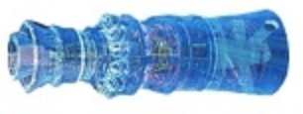
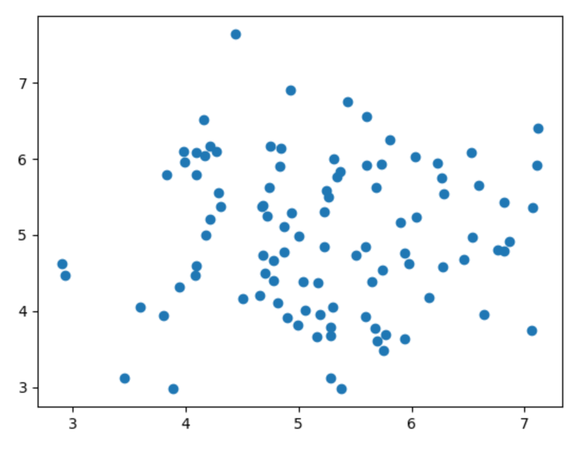
Summary & Looking Ahead
Structured Knowledge Base
Data as “information”, not just numbers
LLMs unlock huge volumes of text data
Graph data structure arbitrarily flexible
Structured + accessible knowledge base enables wide range of applications
  Both humans and models can interface with a KG
Open source language models
  Fine-tuning
  Customizability
  Cost efficiency, data security
Queries
Model-Based Engineering Tools
“What are the science requirements for the ‘FOO’ instrument?
FOO Instrument Model
Graph/Entity Embeddings
FOO = [0.1, …, 0.3]
Statistical Models

