Slide 1

The Best of Both Worlds: Combining Parametric Cost Risk Analysis with Earned Value Management Using Bayesian Parameter Learning
Murray Cantor
Cantor Consulting, LLC
Christian Smart
Jet Propulsion Laboratory
California Institute of Technology
Presented at 2024 DATAWorks and the 2024 NASA Cost and Schedule Symposium

Slide 2
Agenda
Cost and Earned Value
Probabilistic View
A Bayesian Approach to Combining Cost S-Curves and Earned Value Data
Examples

Slide 3
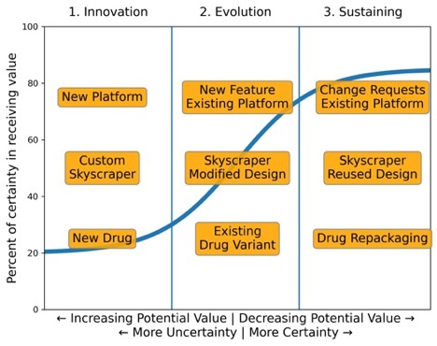
Risk Curve
Innovation Drives Uncertainty
Applies to innovative projects
Uncertainty is due to incomplete knowledge
NASA projects are highly innovative and typically take several years to develop

Slide 4
The Main Idea
To Reduce Uncertainty Requires Measuring It
"When you can measure what you are speaking about, and express it in numbers, you know something about it; but when you cannot measure it, when you cannot express it in numbers, your knowledge is of a meagre and unsatisfactory kind.”
− William Thomson, also known as Lord Kelvin (1889)
Today, we discuss a method for measuring the uncertainty in the cost to complete as the project proceeds.

Slide 5
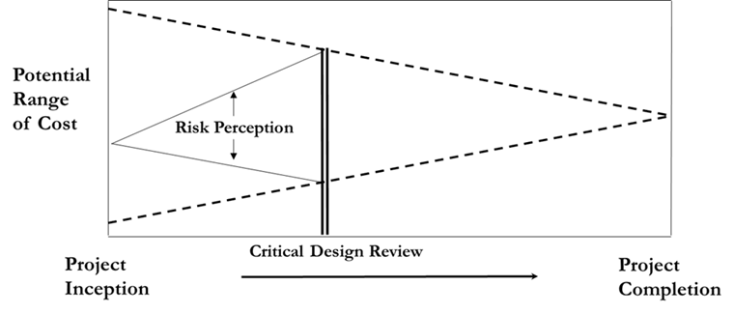
The Bayesian View
Why Bayesian Risk Analysis?
Motivating factor – with Bayes, project progress (or lack thereof) can be used to update cost and schedule risk analyses during a project
Helps us assess the cone of uncertainty
Bayesian analysis is the math of uncertainty
  Uncertain quantities are random variables specified by PDF’s
  Bayes Theorem: Random variables can be updated with new evidence
It works with small data.

Slide 6
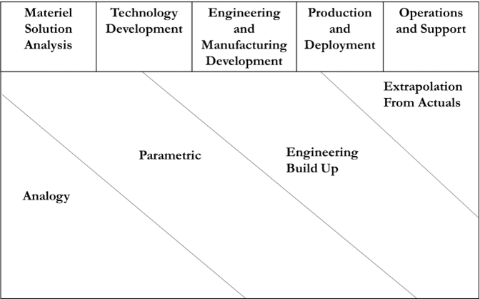
The Evolution of the Cost Estimating Process
As a project begins development, probabilistic parametric cost estimates are developed and updated
Later in development, earned value data is relied upon more

Slide 7
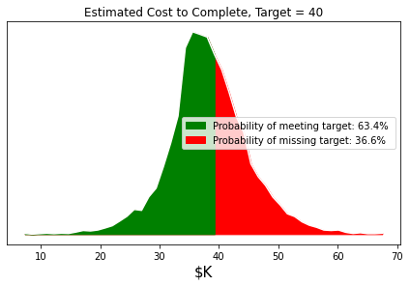
Using PDFs to Measure Risk
Green area is probability of success
Red area is risk of failure to meet the target
The target

Slide 8
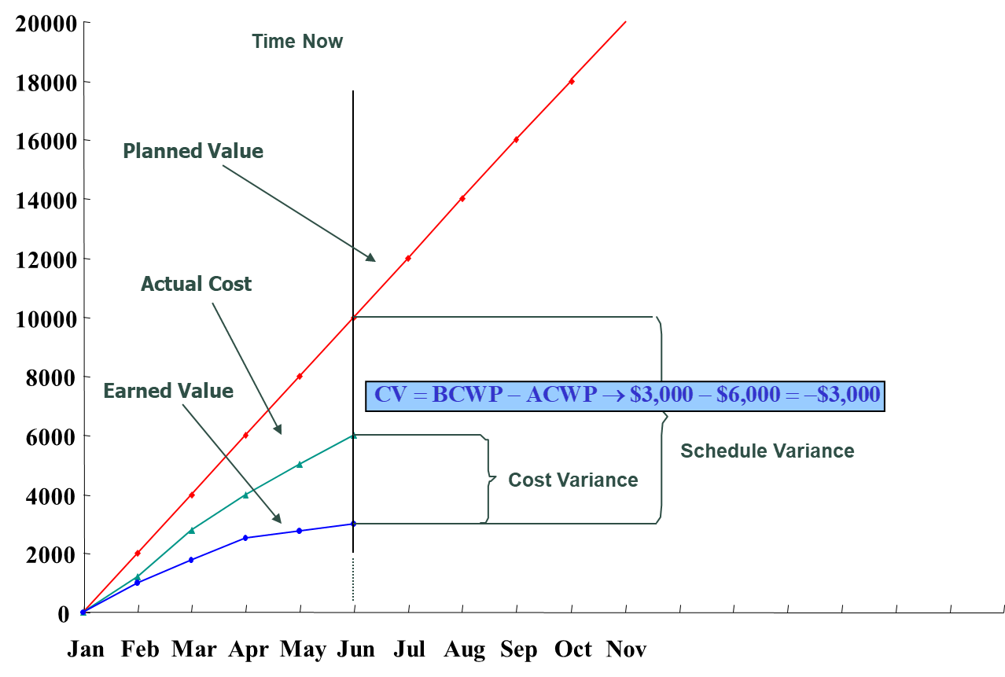

Parametrics or Earned Value? Yes, I’ll Take Both!
Parametric estimating and earned value statistics are often used by two different groups
There are a variety of informal methods for combining the two
Bayes’ Theorem provides a rigorous mathematical method to combine these two sources of information to improve the accuracy of probabilistic estimates at completion
+
=

Slide 9
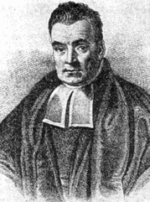
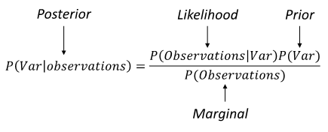
The Bayesian Approach
Parametric cost estimates form the prior
The evidence consists of expenditure and completion rates
The Rev. Thomas Bayes

Slide 10
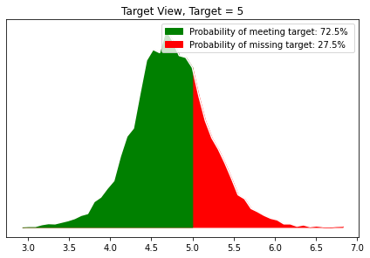
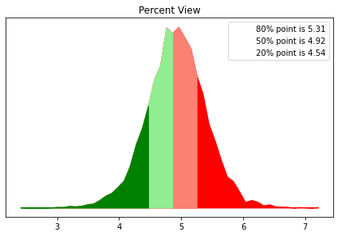
Two Ways to Visualize Uncertainty
Likelihood of meeting or beating the target
How much will you miss or beat the target

Slide 11
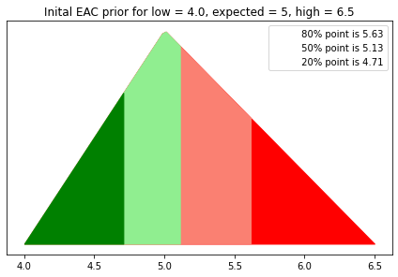
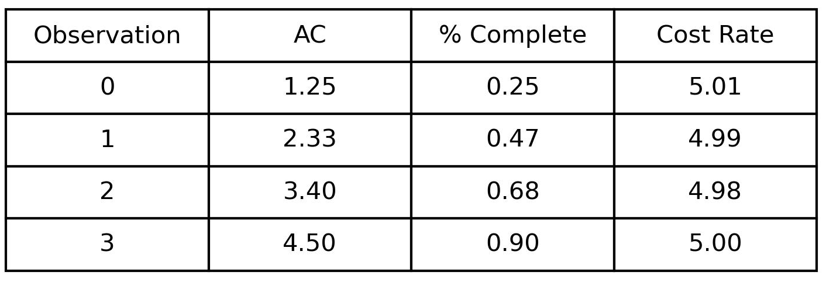
Examples
Example 1: Near Constant
Spending is close to the planned rate.

Slide 12
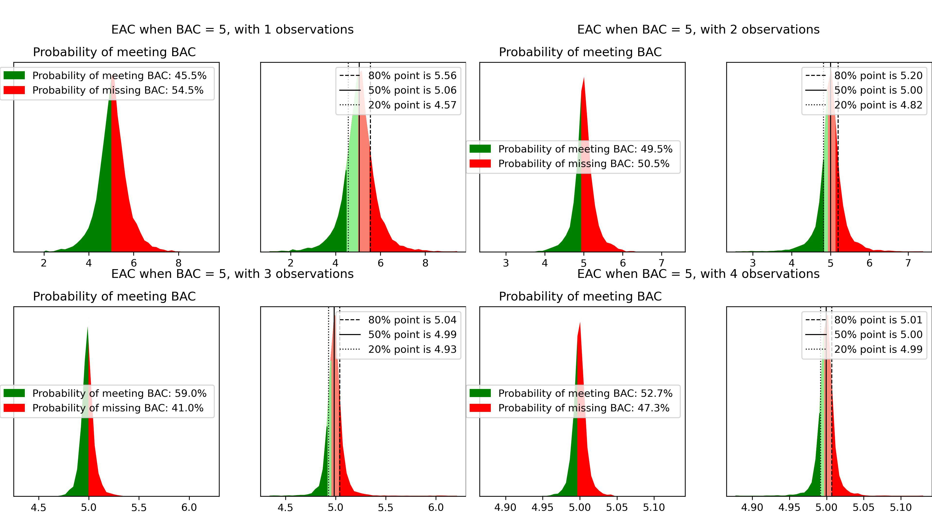
Example 1 Results

Slide 13
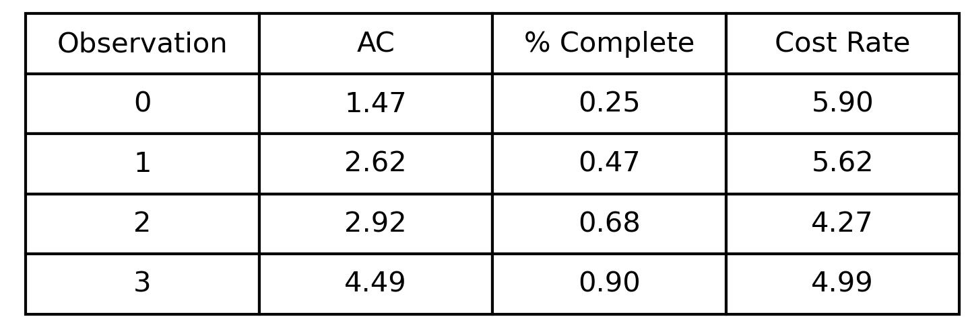
Examples
Example 2: Recovery
Spend is initially at an above-budget rate but ultimately gets on track.

Slide 14
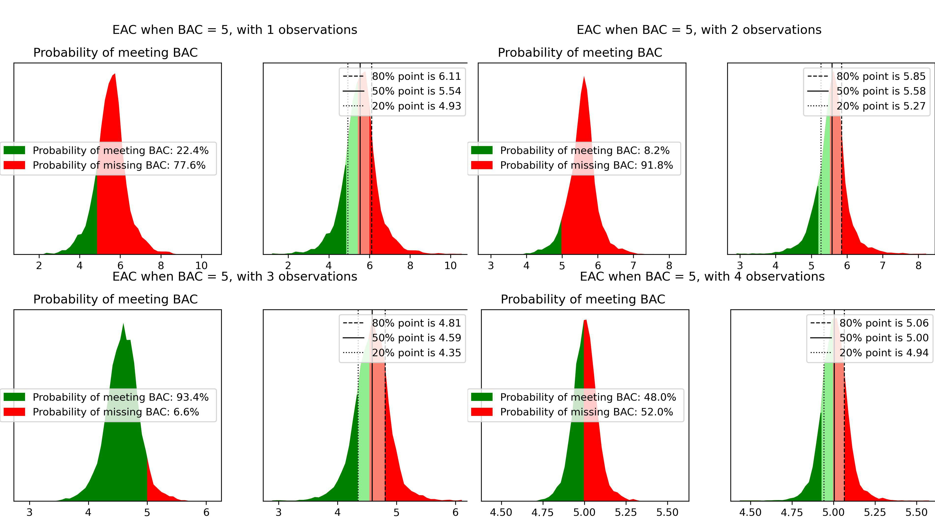
Example 2 Results

Slide 15
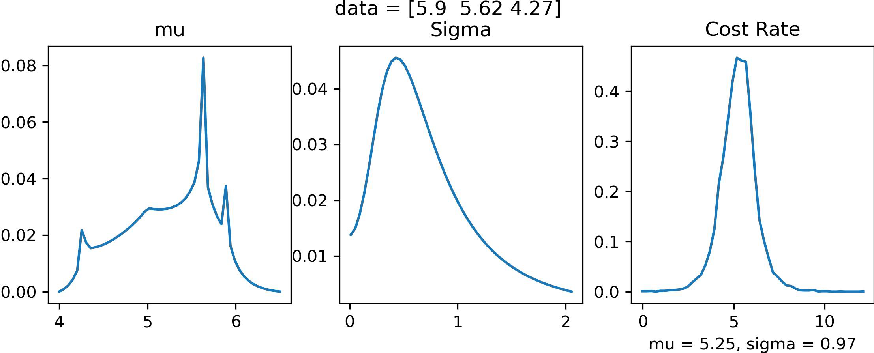
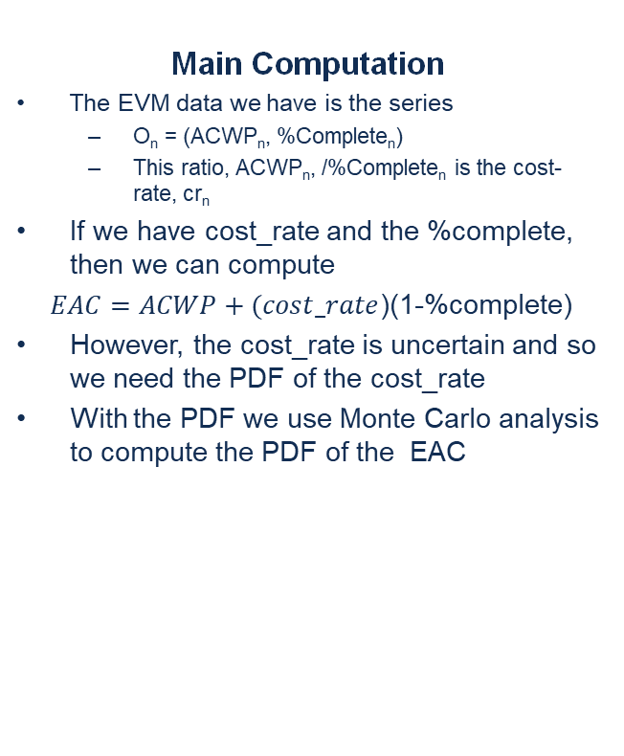
Bayesian Approach to EAC
Main Computation
The EVM data we have is the series
  O_{n} = (ACWP_{n}, %Complete_{n})
  This ratio, ACWP_{n}, /%Complete_{n} is the cost-rate, cr_{n}
If we have cost_rate and the %complete, then we can compute
$EAC=ACWP+(cost_rate$)(1-%complete)
However, the cost_rate is uncertain and so we need the PDF of the cost_rate
With the PDF we use Monte Carlo analysis to compute the PDF of the EAC
Computing the Cost_Rate
We model the cost_rate as a logistic PDF with loc parameter = u and scale parameter = 𝝈.
Note that both of these parameters are uncertain with their own PDFs.
We use a 2d version of Bayes theorem of Bayes theorem to learn their PDFs. This is called ‘Bayesian Parameter Learning’ (Cantor, 2023)
With these PDF’s, use Monte Carlo analysis to find the EAC PDF as an empirical PDF of the samples of u and 𝝈.
Internal Results

Slide 16
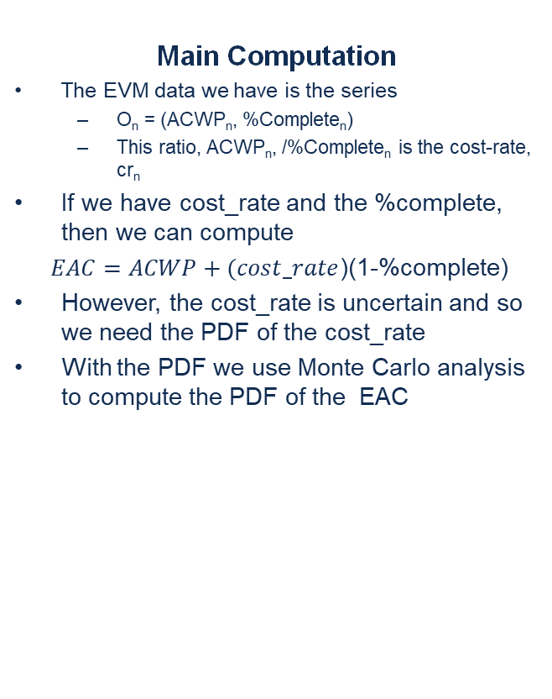
Bayesian Approach to EAC
Main Computation
The EVM data we have is the series
  O_{n} = (ACWP_{n}, %Complete_{n})
  This ratio, ACWP_{n}, /%Complete_{n} is the cost-rate, cr_{n}
If we have cost_rate and the %complete, then we can compute
$EAC=ACWP+(cost_rate$)(1-%complete)
However, the cost_rate is uncertain and so we need the PDF of the cost_rate
With the PDF we use Monte Carlo analysis to compute the PDF of the EAC
Computing the Cost_Rate
We model the cost_rate as a logistic PDF with loc parameter = u and scale parameter = 𝝈.
Note that both of these parameters are uncertain with their own PDFs.
We use a 2d version of Bayes theorem of Bayes theorem to learn their PDFs. This is called ‘Bayesian Parameter Learning’ (Cantor, 2023)
With these PDF’s, use Monte Carlo analysis to find the EAC PDF as an empirical PDF of the samples of u and 𝝈.
For a more complete explanation, see our paper, The Best of Both Worlds: Combining Parametric Cost Risk Analysis with Earned Value Management Using Bayesian Parameter Learning.
Internal Results

Slide 17
Strengths
Mathematically sound approach to combine cost risk analysis with earned value management
  Elementary probability theory
Use both subjective and objective information
Uses EVM data should be tracking
Early warning of a possible issue

Slide 18

Challenge - Requires Cultural Change
Need for the cost and earned value communities to unite
  Requires coordination across organizations
  Data sharing
  Single viewpoint
    Respond to questions about overruns
    One source of information

Slide 19
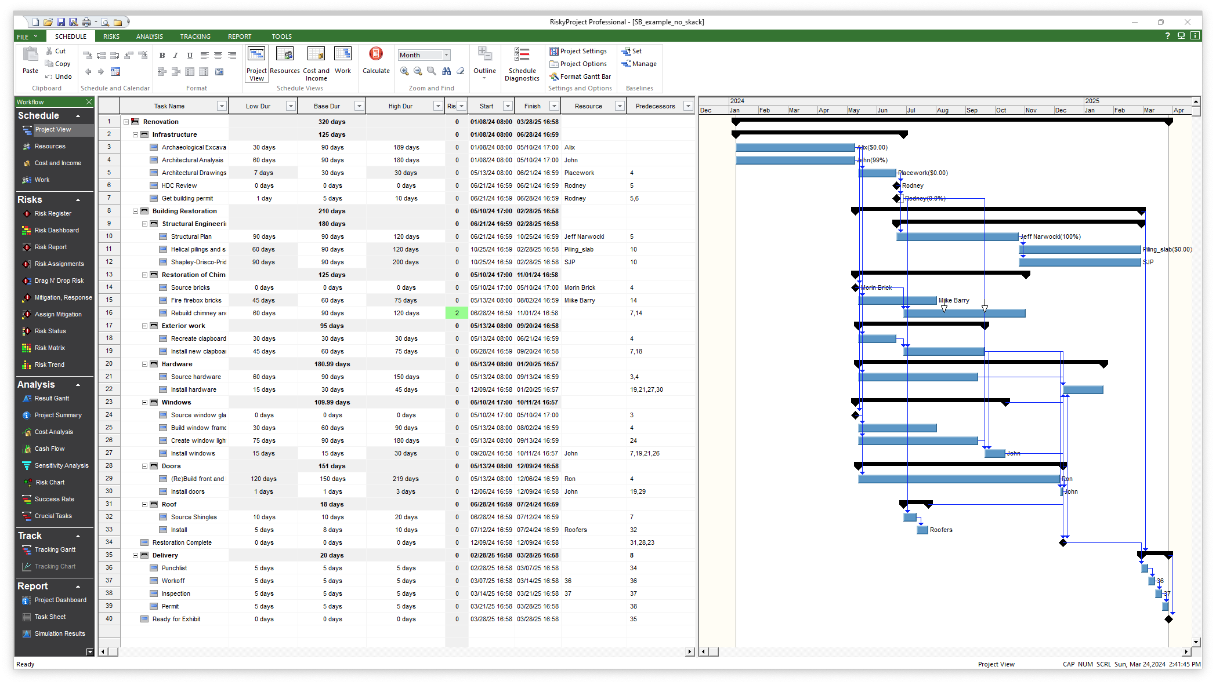
Final Points
We showed some simple textbook examples.
The technique scales up to large projects using various aggregation techniques.
This approach for managing schedule and cost uncertainty is being integrated into Intaver Institute’s RiskyProject tool.

Slide 20

Summary and Next Steps
With this approach, you can update risk analyses conducted not only at major milestones but also throughout delivery using project progress statistics
Next ideas
  Apply to schedule analysis
  Apply to JCL analysis updates
  Consider quantitative portfolio management across directorates and even all of NASA.
  Technical enhancements
    Nonlinear spending plans
    Include both fixed and variable costs
    Causal Bayesian net models to account for externalities.
The Wheel of Fortune in Carmina Burana

Slide 21
Thank you for your time and attention
Questions??

Slide 22
References
Cantor, M. (2023). "Bayesian Parameter Learning V2." Retrieved from Linkedin.com: https://www.linkedin.com/posts/murraycantor_intro-to-bayesian-parameter-learning-v2-activity-7117523872907677698-4Dry?utm_source=share&utm_medium=member_desktop
Cantor, M and Smart C (2024). "The Best of Both Worlds: Combining Parametric Cost Risk Analysis with Earned Value Management Using Bayesian Parameter Learning."
Smart, C. (2020). Solving for Project Risk Management: Understanding the Critical Role of Uncertainty in Project Management. McGraw Hill.

Slide 23
