Slide 1

Beyond the Matrix: The Quantitative Cost and Schedule Risk Management Imperative
Christian B. Smart, PhD, CCEA
christian.b.smart@jpl.nasa.gov

Slide 2
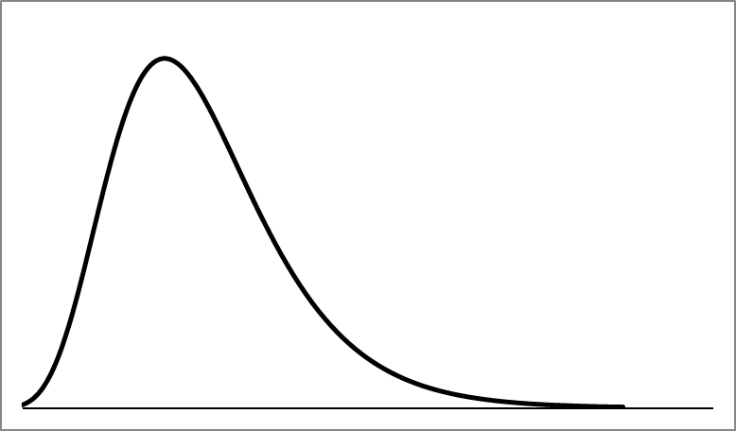

THE MEDIAN IS NOT THE MESSAGE
A SINGLE NUMBER DOES NOT SUFFICE IN THE FACE OF UNCERTAINTY!
STEPHEN JAY GOULD
Famous paleontologist, evolutionary biologist, and writer
Diagnosed with a rare form of cancer in 1982
“8 MONTHS TO LIVE”
Told he could expect 8 months to live
Gould researched the medical literature and discovered this expected value was a median and that it was significantly less than the mean
SKEW YOU
Gould lived for another 20 years and died from an unrelated illness – the number Gould was given was highly inaccurate

Slide 3
PROJECT RISK MANAGEMENT
OPPORTUNITY IN RISK
PROJECTS ARE INHERENTLY RISKY
Projects of all types, large and small, experience regular amounts of significant cost and schedule growth
This growth is strong evidence not only of risk, but lack of proper risk management
Risk is often considered just another a four-letter word
QUANTITATIVE RISK ASSESSMENT
Projects need to conduct quantitative cost and schedule risk analysis
The application of quantitative methods is fraught with obstacles
THIS PRESENTATION
The focus of this presentation is one aspect of the book, which focuses on the need for quantitative risk assessment
Read Chapter 1 for free:
https://bit.ly/3ggPZK2

Slide 4

1
ANOTHER FOUR-LETTER WORD
AGENDA
Despite its critical role in project success, risk is often ignored
Projects need to consider risk
2
THE FLAW OF AVERAGES
2
Averages are not sufficient to measure the impact of uncertainty We provide an example from the sport of baseball
Averages are not sufficient to measure the impact of uncertainty We provide an example from the sport of baseball
3
QUANTITATIVE RISK MANAGEMENT
Qualitative methods such as risk matrices underestimate risk – need to quantify it
Risk and uncertainty can be measured by probability distributions
4
COMPARISON
Plans based on averages are destined to be “behind schedule and beyond budget”
Sam Savage, The Flaw of Averages
Inspired by an example by the late Dr. Steve Book, we illustrate how riskless point estimates underestimate likely cost
5
Even when quantitative risk is done, it consistently underestimates the true extent of uncertainty
We discuss why and provide a remedy

Slide 5
COST AND SCHEDULE GROWTH
A LEGACY OF DISASTER
1
COMMON
3
HIGH
Multiple Industries Experience Significant Cost and Schedule Growth – Has Been a Problem for a Long Time
Cost: 50% or More on Average (Mean)
Schedule: 30% or More on Average (Mean)
2
FREQUENT
4
EXTREME (FOR COST)
70-80% of Projects Experience Cost and Schedule Growth
Cost Growth in Excess of 100% Is a Common Occurrence in Most Projects (1 in 6)

Slide 6

Why Cost and Schedule Growth Occur
1
OPTIMISM
Innate bias - Planning Fallacy
Prospect Theory - Project managers are risk-seeking
Numerous Reasons, Both Internal and External:
Optimism
Cost, Schedule, and Technical Misalignment
Errors in Estimation
Moore’s Law
Black Swans
2
COST, SCHEDULE, TECHNICAL MISALIGNMENT
Like a three-legged stool, all need to be consistent in order for a project to balance
3
MOORE’S LAW
Exponential growth in technology Paired with projects that take a decade or longer to complete means that either requirements must be continually updated or the product is obsolete on delivery
4
“The Non-Secret of Good Cost [and Schedule] Estimating:
Don’t Drink the Kool-Aid”-Lawrence Goeller, OSD Cost Analysis Improvement Group
BLACK SWANS
Unpredictable, rare, unprecedented events that have a huge impact
5
LAKE WOBEGON
Project managers and their staff are not like the children of Garrison Keillor’s fictional town – they are not all above average

Slide 7


EXAMPLES
JAMES WEBB SPACE TELESCOPE
CALIFORNIA HIGH-SPEED RAIL
MOSES
SYDNEY OPERA HOUSE
Next generation space telescope
Highly complex but leadership was optimistic
Venice’s flood prevention project – has taken so long to develop that it is already obsolete
Designed to link LA and SF, but now will only connect two small cities, a mega project that is a mega waste
Began construction without a detailed plan in place, one of the highest cost increases and longest schedule in history

Slide 8

COST GROWTH AND SCHEDULE DELAYS
EVEN WORSE THAN THEY APPEAR
LOOKING BEHIND THE DATA FACADE
As bad as cost growth and schedule delays are, these problems are even worse than they appear!
CETERIS PARIBUS
Latin for “everything else held constant,” this does NOT apply to cost overruns and schedule slips – many projects are descoped to mitigate these issues, and some are cancelled outright
PAYING MORE AND TAKING LONGER BUT GETTING LESS IN RETURN
While de-scoped projects are still able to achieve some objectives, many cancelled projects are a total waste – also applies to shelved projects such as the J2-X rocket engine
8

Slide 9
Engineering – Practical Risk Management
Focus on Quantitative Techniques
Economics – Theoretical Risk Management
Focus on Utility Theory, Measurable and Unmeasurable Uncertainty
Uncertainty Is The Indefiniteness About an Outcome
Risk Is The Chance and Consequence of Bad Events
Charles Hitch, RAND, An Appreciation of Systems Analysis (1955)
Steven Sobel, MITRE, A Computerized Technique to Express Uncertainty in Advanced Systems Cost Estimates (1965)
J.M. Keynes, A Treatise on Probability Theory (1921)
Frank Knight, Risk Uncertainty, and Profits (1929)
Diverse group – e.g., Laffont, N.N. Taleb,
John Kay and Mervyn King
Steve Book, Paul Garvey, Christian Smart, Douglas Hubbard, etc.

Slide 10
RISK AND OTHER FOUR-LETTER WORDS
UNCERTAINTY IS OFTEN TREATED AS THOUGH IT IS SOMETHING TO BE AVOIDED
WE ARE BLIND TO RISK
Many project managers’ attitude is like that of the Captain of the Titanic – before that ship’s fateful voyage: “I have never been in accident…of any sort worth speaking about. I never saw a wreck and never have been wrecked.”
F#*K
SH*T
COST AND SCHEDULE RISK ARE UNAPPRECIATED
I once heard a former NASA senior leader say: “Once a project is complete, no one remembers how much it cost or how long it took. All they remember is whether or not it worked.”
This extreme emphasis on performance to the exclusion of cost and schedule leads to spending more, doing less, and taking longer
R!SK
H#!*
D@*#
THE PLANNING FALLACY
An innate bias noted by psychologist Daniel Kahneman
People plan for the best case possible
Leads to systematic underestimation of cost, schedule, and risk

Slide 11

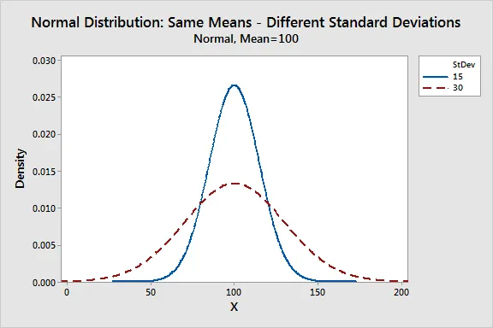
THE DISAPPEARANCE OF THE .400 HITTER
WHY AVERAGES CAN BE MISLEADING
BATTING AVERAGE
Percent of plate appearances (not counting walks or hit-by-pitch) that result in reaching base safely
Mark of an outstanding hitter is 30% or better (.300)
.400 HITTERS
Decades ago, best hitters occasionally hit .400 or better in a season
Last player to achieve that feat was Ted Williams in 1941
THE DIFFERENCE
Average has stayed relatively constant over time, what has changed is that the standard deviation has decreased
Chance of someone hitting .400 or better during the 1940s ~1 in 40,000
Chance of someone hitting .400 or better during the 2000s ~ 1 in 125,000
We Need to Consider More Than Just the Average

Slide 12
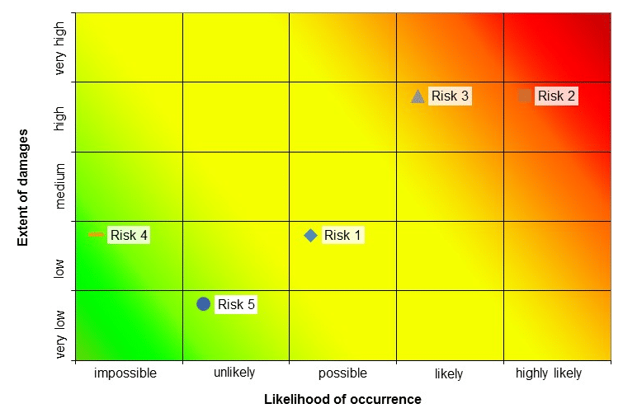
RISK: FREQUENCY VS. CONSEQUENCE
TWO DIMENSIONS OF RISK
Dimension 1: Likelihood of Occurrence
The frequency at which events occur is commonly referred to as the likelihood
Frequent event: cost growth and schedule delays in defense programs
Not-so frequent: catastrophic failure of a major system (e.g., Space Shuttle)
Rare: Extreme cost growth, pandemics, major wars
Dimension 2: Consequence
The impact of risks is often referred to as the consequence
Low consequence: minor technical problem that shuts down a system for a day
High consequence: significant schedule delay that prevents fielding a critical system for years; large number of deaths due to a pandemic
Bias is to Focus on Frequency
Overwhelming tendency is to focus on likelihood rather than consequence
However, consequence is more important than likelihood
12

Slide 13

THE IMPORTANCE OF CONSEQUENCE
MORE IMPORTANT THAN FREQUENCY
PASCAL’S WAGER
The seventeenth century mathematician Blaise Pascal argued that a rational person should bet on God’s existence: belief has limited downside but unlimited upside, while unbelief has limited upside but unlimited downside, regardless of likelihood.
ARE YOU FEELING LUCKY, PUNK?
“I know what you're thinking: 'Did he fire six shots or only five?' Well, to tell you the truth, in all this excitement, I've kinda lost track myself. But being this is a .44 Magnum, the most powerful handgun in the world, and would blow your head clean off, you've got to ask yourself one question: 'Do I feel lucky?' Well, do you, punk?” Dirty Harry
STILL OVERLOOKED
Despite its importance, consequence is under weighted
Innate bias to be right
“Probability neglect” term is one example
13

Slide 14

RISK MATRICES UNDERESTIMATE UNCERTAINTY
THEY SHOULD NOT BE USED FOR QUANTIFYING RISK!
RISK MATRIX
The use of risk matrices is a popular approach for modeling technical risk and is often applied to cost risk as well
Two axes – likelihood and consequence
However, there are issues with this approach in its use for risk quantification
UNDERESTIMATION OF RISK
The inclusion of a few discrete risks significantly underestimates the full extent of uncertainty that programs face
Numerous studies have shown that risk matrices underestimate risk
Risk matrices are a quasi-qualitative method
CONCLUSION
Risk matrices should not be used – true quantitative techniques should be applied to credibly analyze and assess risk

Slide 15
UNCERTAINTY IS A SHAPE
FOUR COMMONLY USED PROBABILITY DISTRIBUTIONS
1
GAUSSIAN
The “Normal” distribution is commonly used but not applicable to cost and schedule (skew; fat tails)
2
TRIANGULAR
Simple, but too simple Has no tail Can only model limited range
3
LOGNORMAL
Can model skew
Can model relatively fat tails
In-between thin tails and fat tails
4
PARETO
80/20 Rule
Used to model extreme risks

Slide 16
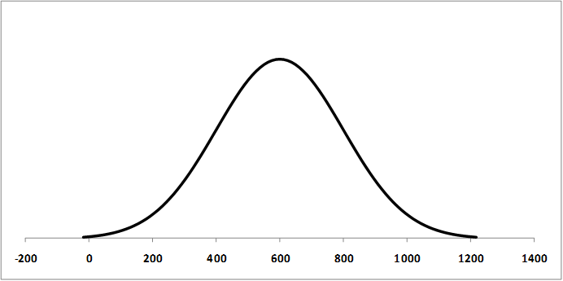

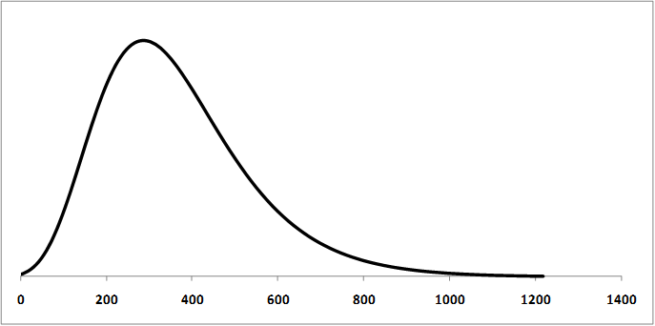
COST AND SCHEDULE RISK ARE NOT “NORMAL”
THE CENTRAL LIMIT THEOREM DOES NOT APPLY!
THE “NORMAL” DISTRIBUTION
Most widely used distribution in statistics
Only captures limited variation
CENTRAL LIMIT THEOREM
States if you sum independent distributions with limited variation, in the limit the result is normal
The problem is that the assumptions do not hold
We do not live in the limit, the real world is pre-asymptotic
Variation is not limited but is substantial
The distributions involved are not independent (significant correlation plus tail dependency)
LOGNORMAL IS A BETTER CHOICE
Lognormal represents the skew (more can go wrong than go right) and the fat right tail (potential for extreme cost growth and schedule delays) and fits the historical cost growth and schedule delay data well
Joint Agency Cost Risk and Uncertainty Handbook recommends as a default choice

Slide 17
QUANTITATIVE RISK ANALYIS VS. SUMMING POINT ESTIMATES
1
EXAMPLE
For the six WBS elements on the right with a mix of triangular and lognormal distributions
2
FOUR LOGNORMAL AND TWO TRIANGULAR DISTRIBUTIONS
The parameters for these distributions are provided in the table on the right
All WBS elements are correlated at 0.6
3
POINT ESTIMATES
The point estimates for each WBS element are $90, $50, $20, $40, $70, $30
The sum of these values is $300
What is the confidence level of the sum of the most likely values?

Slide 18
QUANTITATIVE RISK ANALYIS VS. SUMMING POINT ESTIMATES (2)
1
EXAMPLE
For the six WBS elements on the right with a mix of triangular and lognormal distributions
The sum of the median values is at the 20% confidence level of the total uncertainty distribution
2
POINT ESTIMATES ARE POINTLESS
Funding to levels below the mean for WBS elements results in low confidence level funding for a system
Funding Each WBS Element to Its 50% Confidence Level Results in a 20% Confidence Level for the System
3
CONNECTION WITH PORTFOLIO ANALYSIS
Just as with a WBS, funding individual projects below the mean results in a negative portfolio effect
Total organization is riskier than individual projects!
4
S-CURVES
Cost and schedule risk are typically displayed graphically as “S-curves”
Provides probability that cost/schedule will not exceed a specified value
Point Estimates Significantly Underestimate Cost and Schedule

Slide 19




ISSUES WITH THE CURRENT PRACTICE OF RISK ANALYSIS
RISK ANALYSIS FAILINGS
Even when quantitative risk analysis is conducted it is not implemented well
Variety of issues
RISK RANGES ARE NOT REALISTIC
Focus of the remainder of this presentation
In practice, most risk analysis results in tight ranges that do not reflect the true potential for cost or schedule growth
PORTFOLIO ANALYSIS IS NOT CONDUCTED
Risk analysis is typically conducted at the project level – but not at the portfolio level
BEYOND S-CURVES
These issues and more are addressed in my book, which is now available from Amazon, Barnes and Noble, and others
Read Chapter 1 for free: https://bit.ly/3ggPZK2
S-curve provide useful information, but do not provide critical information about the tails

Slide 20
TRACK RECORD FOR RISK ANALYSIS
1
SCARCE
The results of risk analysis are rarely compared to the actual outcome – like a darts player that turns away from the board after throwing a dart
WORSE THAN RANDOM
2
WHAT LITTLE EXISTS IS NOT GOOD
The limited data available is mainly for cost
The 90 percent confidence level means there is only a 10% probability that this level will be exceeded
3
OPPOSITE OF EXPECTED
For the 10 risk analyses in the table, the actual cost was less than the 90 percent confidence level for only one of the ten
It’s hard to improve if you don’t know how well you have done in the past.
4
EXTREMELY UNLIKELY
While a small data set, the odds of such an occurrence is extremely remote – 1 in 2.7 million
You are more likely to be struck by lightning

Slide 21
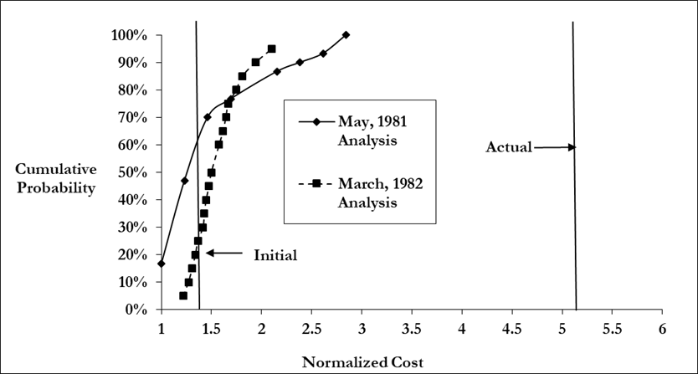
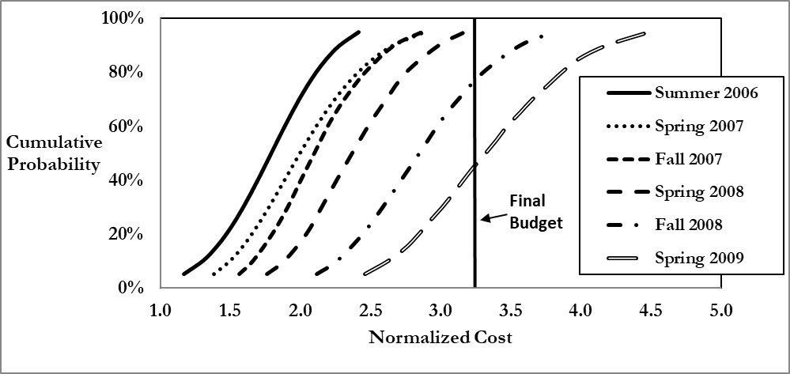
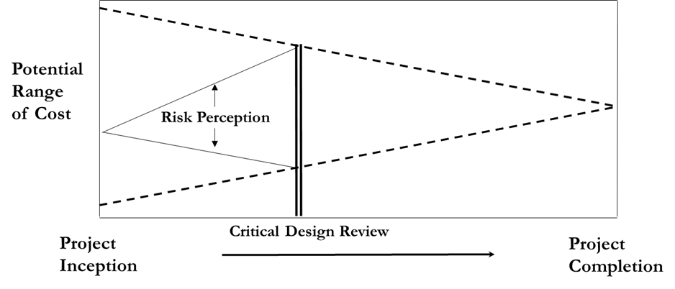
COVERED WITH OIL: REALISM IN RISK ANALYSIS
1
“ALL OF THOSE TOURISTS COVERED WITH OIL”
Jimmy Buffett, in writing the song Margaritaville, probably never imagined that beach goers would be covered with crude oil
Gulf of Mexico oil spill in 2010 set records
2
RISK UNDERESTIMATION IS PREVELANT
Variety of reasons – correlation, overreliance on normal distribution, etc.
We do not have a good track record of estimating risk
3
PERCEPTION VS. REALITY
Plato Vs. Diogenes
Home Economicus and the Iron Bowl
Notion is risk decreases over time, but risk perception increases up to critical design as risks are discovered/admitted, and then decreases as these risks are addressed
4
CALIBRATION IS THE ANSWER
It is always riskier than you think, even taking into account that it is riskier than you think.
Augustine’s Laws - “Unknown-unknowns cannot be specified in advance but their existence in the aggregate can be predicted with every bit as much confidence as insurance companies place in actuarial statistics.”

Slide 22
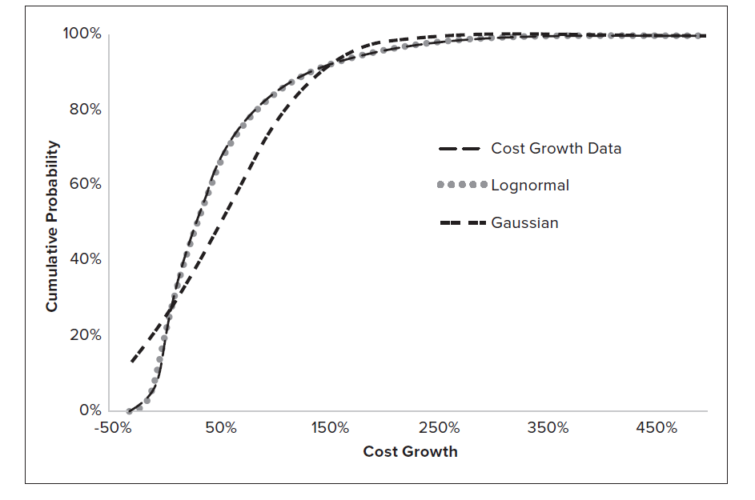
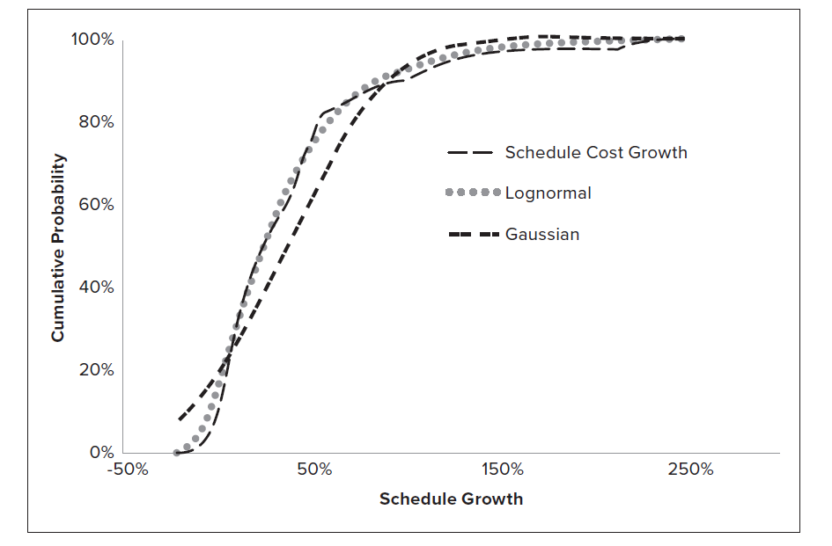
CALIBRATION TO HISTORY
As cost growth and schedule delays are instances of the realization of risk,
calibration to historical growth data provides a means to realistically assess risk
COST GROWTH DATA
SCHEDULE DELAY DATA
Both cost growth and schedule delay data closely follow a three-parameter lognormal distribution
22

Slide 23
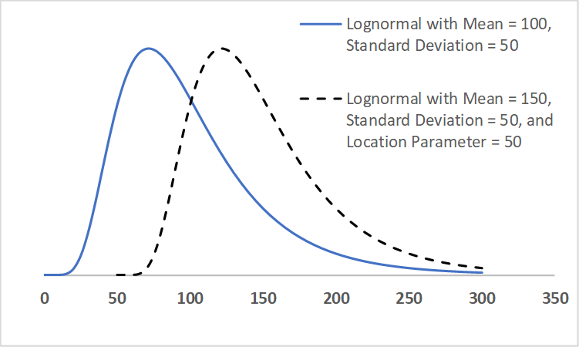
THREE-PARAMETER LOGNORMAL
MEAN, VARIANCE, AND LOCATION
MEAN
The expected value of the distribution, measures the center For a lognormal the mean is greater than the median, which in turn is greater than the mode (peak)
VARIANCE
Measures the dispersion around the mean
The higher the variance, the greater the uncertainty
LOCATION
A two-parameter lognormal distribution is bounded below by zero
Location parameter shifts this in one direction or the other
23

Slide 24
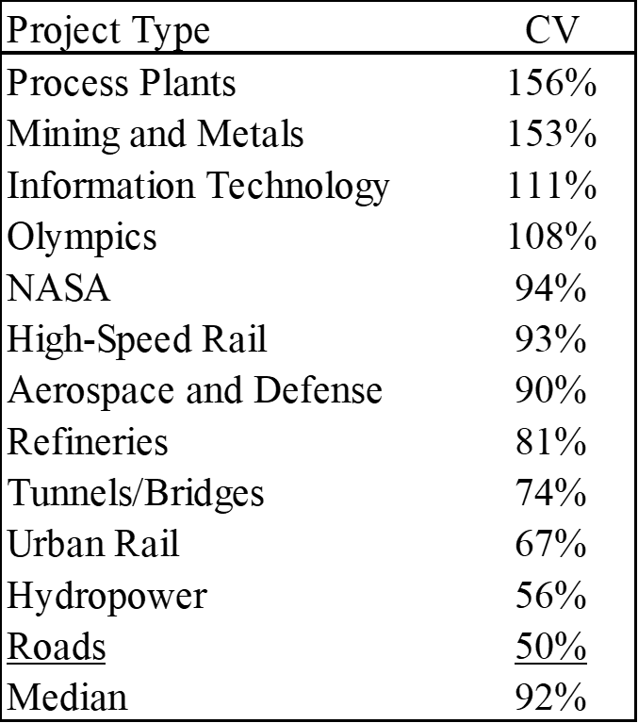
HISTORICAL BASIS
FOR EACH PARAMETER
LOCATION
Numerous studies show 80-90% of projects overrun, indicates typical point estimates of cost are between the 10th and 20th percentiles
VARIATION
Effective coefficient of variation for historical project overruns varies from 50% for roads to more than 150% for mining and metals and process plants
MINIMUM
The minimum value attainable (underrun) is typically 30-50% (without significant scope reductions)

Slide 25



RISK and ESTIMATING METHODS
ANALOGY
PARAMETRIC
ENGINEERING BUILD-UP
EXTRAPOLATION
Analogies can account for uncertainty in the similarity of the project to the precedent and in adjustment factors – will tend to underestimate risk
Incorporates input and estimating uncertainty (including historical unknown unknowns) - most uncertainty of any method, most realistic depiction of risk
Typically accounts for the least amount of risk as it often relies on subjective ranges
Can incorporate uncertainty via time series methods such as ARIMA

Slide 26
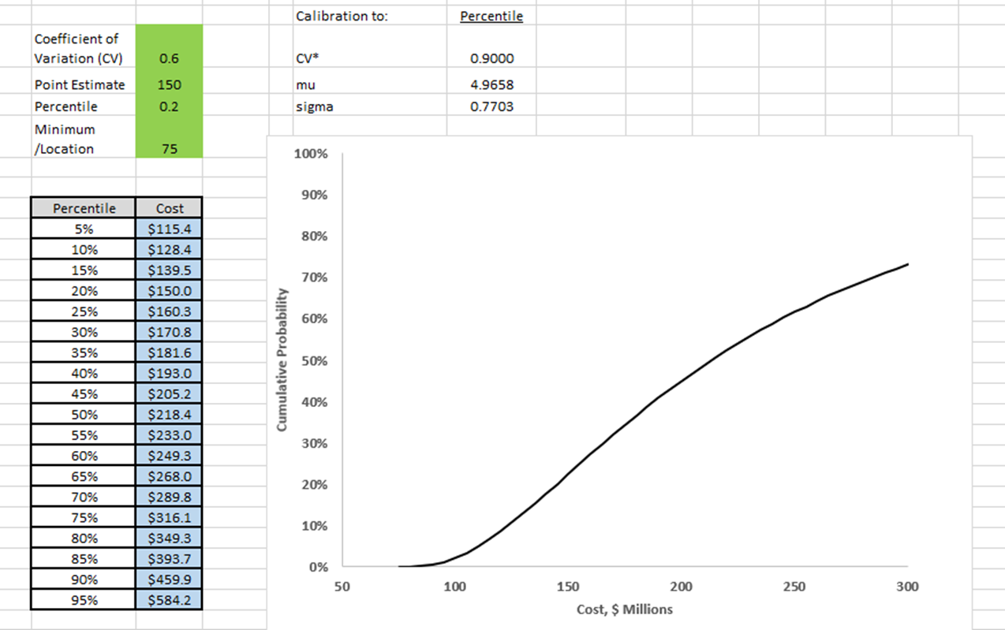
CALIBRATION IN EXCEL
FOUR DIFFERENT POINT ESTIMATES
Effective CV
PERCENTILE
Often applicable to engineering build-ups and project estimates that do not have an independent cross-check
Typical values are 10-20%
MEAN
Parametric models can produce mean estimates
MODE
Most likely estimate, could be produced by an analogy estimate or extrapolation
MAIMS (MONEY ALLOCATED IS MONEY SPENT)
With transparency, project manager will spend all available funds, this accounts for that tendency
26

Slide 27

WHAT CAN BE DONE
THREE KEYS TO SUCCESS
1: RECOGNIZE THE PROBLEM
2: MEASURE RISK MORE ACCURATELY
3: MANAGE RISK EFFECTIVELY
Recognize that lack of planning for risk hinders projects success Don’t plan for best case Realize that you are prone to biases such as optimism – don’t drink the Kool-Aid! Look for independent and critical input
Recognize that risk is underestimated, especially early in planning Quantitative risk measurement is a necessity – matrices and qualitative methods are not enough!
Use methods such as calibration to ensure realism
Measure risk coherently – S-curves are not sufficient! Take the right tail into account
Projects need to manage risk, not just measure it
Need a measure of risk plus ways to address significant growth
Calculate risk at the portfolio level
Assess the impact of potential new missions over a long time Think strategically
Projects must do things differently in risk management if they want to be more successful

Slide 28

WHAT IS THE POINT?
UNDERSTANDING CONTEXT: THE HEART OF RISK MANAGEMENT
Urban Legend: NASA spent millions to design a pen to write in low gravity environments while Russian cosmonauts used a pencil – the story is not exactly true (e.g., pencils are flammable) but it provides a valuable lesson: risk management also entails looking at the outcome you want to achieve and finding low risk way to achieve it.
Risk management is not about avoiding risk but understanding it in order to maximize the odds of success.

Slide 29

ABOUT THE AUTHOR
Senior Programmatic Risk Analyst with the Jet Propulsion Laboratory
Former Cost Director for Missile Defense Agency
Twenty years of experience with cost and schedule risk analysis, predictive analytics, probabilistic reliability analysis, and machine learning
Exceptional public service medal from NASA
Named Parametrician of the Year by the International Society of Parametric Analysts
Ph.D. in Applied Mathematics
Contact: christian.b.smart@jpl.nasa.gov

