Slide 1
Experimental Design for Usability Testing of LLMs
April 18, 2024
Jasmine Ratchford, Shannon Gallagher, Shing-hon Lau, Carol Smith, Tyler Brooks

Slide 2





The SEI Team
Jasmine Ratchford
Senior Machine Learning Research Scientist
Carol Smith
AI Trust Lab Technical Lead,
Principal Research Scientist, Human Computer Interaction
Shing-hon Lau
Senior AI Security Researcher
Shannon Gallagher
AI Engineering Team Lead, Senior Machine Learning Research Scientist
Tyler Brooks
AI Engineering Team Lead, Senior Machine Learning Engineer
And the contribution of many others!

Slide 3
Document Markings
Carnegie Mellon University 2024 This material is based upon work funded and supported by the Department of Defense under Contract No. FA8702-15-D-0002 with Carnegie Mellon University for the operation of the Software Engineering Institute, a federally funded research and development center. NO WARRANTY. THIS CARNEGIE MELLON UNIVERSITY AND SOFTWARE ENGINEERING INSTITUTE MATERIAL IS FURNISHED ON AN "AS-IS" BASIS. CARNEGIE MELLON UNIVERSITY MAKES NO WARRANTIES OF ANY KIND, EITHER EXPRESSED OR IMPLIED, AS TO ANY MATTER INCLUDING, BUT NOT LIMITED TO, WARRANTY OF FITNESS FOR PURPOSE OR MERCHANTABILITY, EXCLUSIVITY, OR RESULTS OBTAINED FROM USE OF THE MATERIAL. CARNEGIE MELLON UNIVERSITY DOES NOT MAKE ANY WARRANTY OF ANY KIND WITH RESPECT TO FREEDOM FROM PATENT, TRADEMARK, OR COPYRIGHT INFRINGEMENT. [DISTRIBUTION STATEMENT A] This material has been approved for public release and unlimited distribution. Please see Copyright notice for non-US Government use and distribution. This material may be reproduced in its entirety, without modification, and freely distributed in written or electronic form without requesting formal permission. Permission is required for any other use. Requests for permission should be directed to the Software Engineering Institute at permission@sei.cmu.edu. DM24-0366
DoD contract number FA8702-15-D-0002

Slide 4
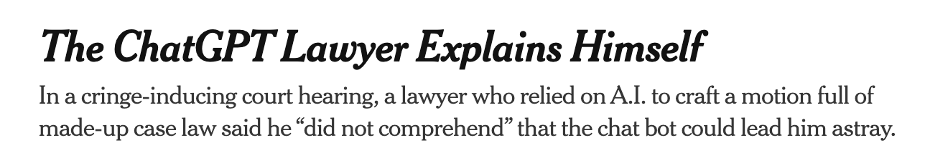
Generative AI: Ubiquitous, Convincing …Correct? Useful?
Limited capacity for error
B. Weiser and N. Schweber, “The ChatGPT Lawyer Explains Himself,” The New York Times, Jun. 08, 2023. Accessed: Mar. 29, 2024. [Online]. Available: https://www.nytimes.com/2023/06/08/nyregion/lawyer-chatgpt-sanctions.html

Slide 5

Generative AI: Ubiquitous, Convincing …Correct? Useful?
Limited capacity for error
B. Weiser and N. Schweber, “The ChatGPT Lawyer Explains Himself,” The New York Times, Jun. 08, 2023. Accessed: Mar. 29, 2024. [Online]. Available: https://www.nytimes.com/2023/06/08/nyregion/lawyer-chatgpt-sanctions.html
“New Tesla Autopilot Attention Study: Interesting, Not Surprising.” Accessed: Mar. 29, 2024. [Online]. Available: https://insideevs.com/news/533018/tesla-autopilot-attentiveness-study-results/
Value dependent on human-machine teaming

Slide 6
Generative AI: Ubiquitous, Convincing …Correct? Useful?
Limited capacity for error
B. Weiser and N. Schweber, “The ChatGPT Lawyer Explains Himself,” The New York Times, Jun. 08, 2023. Accessed: Mar. 29, 2024. [Online]. Available: https://www.nytimes.com/2023/06/08/nyregion/lawyer-chatgpt-sanctions.html
“New Tesla Autopilot Attention Study: Interesting, Not Surprising.” Accessed: Mar. 29, 2024. [Online]. Available: https://insideevs.com/news/533018/tesla-autopilot-attentiveness-study-results/
Value dependent on human-machine teaming
Understanding LLM usability for DoD Mission:
Challenges
Available solutions
Gaps and areas for improvement

Slide 7
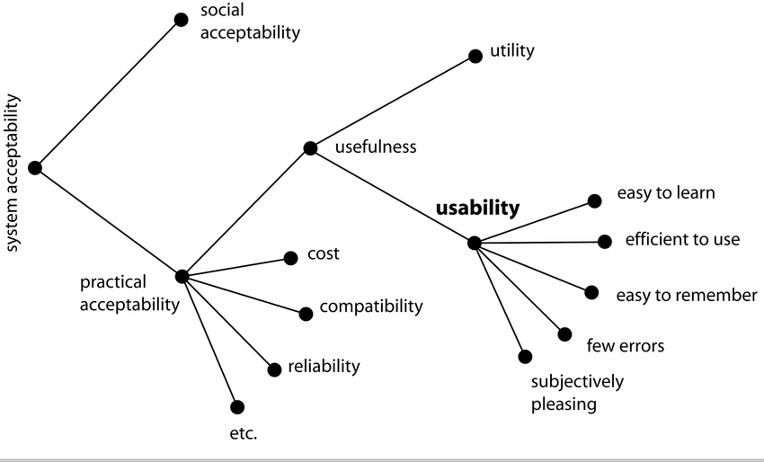
Usability
“… the extent to which a product can be used by specified users to achieve specified goals with effectiveness, efficiency and satisfaction in a specified context of use.”
ISO 9241-11
J. Nielsen, “Chapter 2 - What Is Usability?,” in Usability Engineering, J. Nielsen, Ed., San Diego: Morgan Kaufmann, 1993, pp. 23–48. doi: 10.1016/B978-0-08-052029-2.50005-X.
Usability and Human Centered Design (HCD) research are well established disciplines.

Slide 8
Usability for Generative AI
“… the extent to which a product can be used by specified users to achieve specified goals with effectiveness, efficiency and satisfaction in a specified context of use.”
ISO 9241-11
Bias
Fairness
Alignment
Knowledge
J. Nielsen, “Chapter 2 - What Is Usability?,” in Usability Engineering, J. Nielsen, Ed., San Diego: Morgan Kaufmann, 1993, pp. 23–48. doi: 10.1016/B978-0-08-052029-2.50005-X.
Explainability
Trustworthy
Robustness
Speed
Legal
Safety
Maintenance
Broadly applicable to the Generative AI challenges we encounter today.

Slide 9
Usability for Generative AI
“… the extent to which a product can be used by specified users to achieve specified goals with effectiveness, efficiency and satisfaction in a specified context of use.”
ISO 9241-11
Effective
Efficient
Satisfactory
Aligned
Fast (-er results)
Explainable
Robust
Learnable/Tolerant
Trustworthy
Examples of measures (not comprehensive)

Slide 10
Can we quantify usability?
Increasing subjectivity
For specified users with specified goals …
Effective
Efficient
Satisfactory
Aligned
Fast (-er results)
Explainable
Robust
Learnable/Tolerant
Trustworthy
Measures of AI, but dependent on users and goals
Evaluation of human-machine team and dependent on specified users and goals
Inherently subjective human assessment.
Notes:
https://www.quantamagazine.org/how-quickly-do-large-language-models-learn-unexpected-skills-20240213/

Slide 11
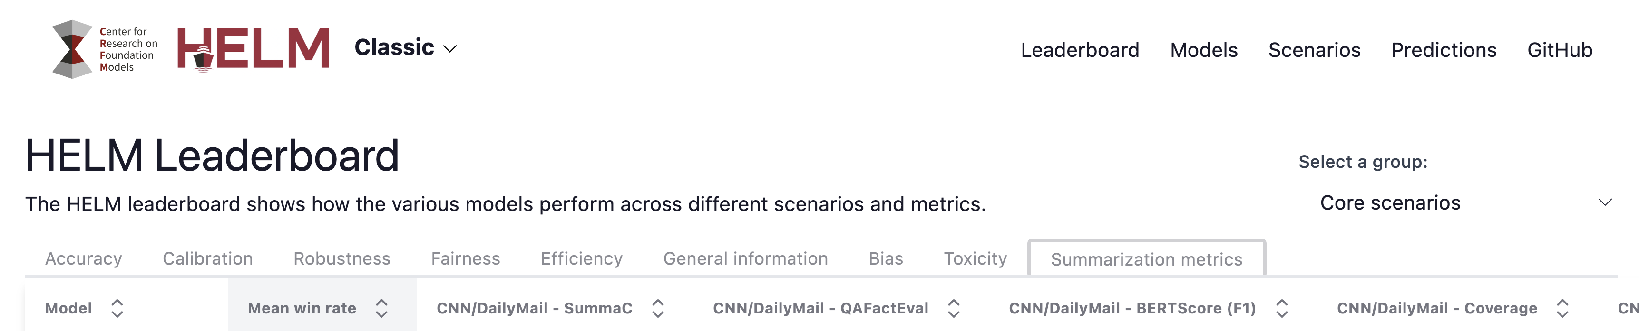
What about LLM benchmarks?
Center for Research on Foundation Models, https://crfm.stanford.edu/helm/lite/latest/#/leaderboard
From the authors:
“[HELM] exposes decision points for different stakeholders to prefer one [foundational] model over the other based on their values, preferences, and circumstances”
That is, it is not designed to address usability at all!

Slide 12
Benchmarks have value in decision making
Center for Research on Foundation Models, https://crfm.stanford.edu/helm/lite/latest/#/leaderboard
Identify foundational models with top performance on similar tasks
Recognize the limitations!
Training data coverage, overlap, and non-specificity
Simplified prompts and tasking
Difficult to assess custom model
Bare-bones system without chaining, retrieval augmentation, safety controls, etc.
LLM-only performance assessment, not in context of specified user and task.
Notes:
It is probably worth calling out that there are open questions about how much performance translates between different benchmarks or between a benchmark and an actual use case. I am sure there has been some work in the area, including on Mayflower and other SEI projects, but I don't know anything to cite off the top of my head.

Slide 13
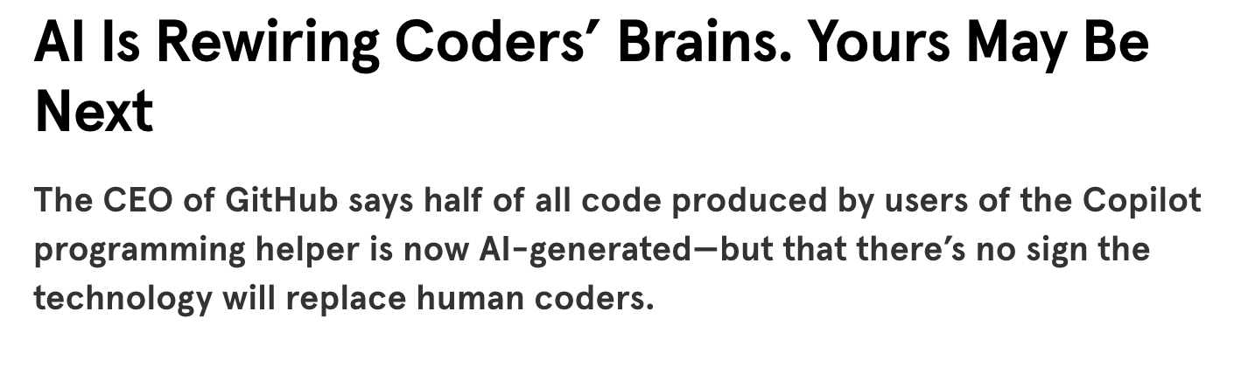
Baseline assessments missing, but adoption is in motion
This is true for common use cases (common with industry)
“[Users] followed the LLM’s suggestions verbatim, even if they were incorrect. This resulted … low task completion rates … Users remained unaware of inaccuracies in the LLM’s responses, indicating a gap between their lack of software expertise and their ability to evaluate the LLM’s assistance. ”
A. Khurana, H. Subramonyam, and P. K. Chilana, “Why and When LLM-Based Assistants Can Go Wrong: Investigating the Effectiveness of Prompt-Based Interactions for Software Help-Seeking.” Feb. 12, 2024. doi: 10.1145/3640543.3645200.
W. Knight, “AI Is Rewiring Coders’ Brains. Yours May Be Next,” Wired. Accessed: Apr. 01, 2024. [Online]. Available: https://www.wired.com/story/fast-forward-ai-rewiring-coders-brains-github-copilot/

Slide 14

Baseline assessments missing, but adoption is in motion
This is true for DoD & IC use cases (distinct from industry)
“…gaps in analytic tradecraft training were the top analytic tradecraft challenge and created the potential for inconsistent application of analytic tradecraft standards. This increases the risk of inconsistent approaches to objectivity, bias, politicization…”
“Evaluation of Controls over the Application of Analytic Standards by the Service Intelligence Centers and U.S. Cyber Command,” Department of Defense Office of Inspector General. Accessed: Mar. 29, 2024. [Online].
E. Dou, N. Tiku, and G. D. Vynck, “Pentagon explores military uses of large language models,” Washington Post, Feb. 21, 2024. Accessed: Apr. 06, 2024. [Online]. Available: https://www.washingtonpost.com/technology/2024/02/20/pentagon-ai-llm-conference/

Slide 15
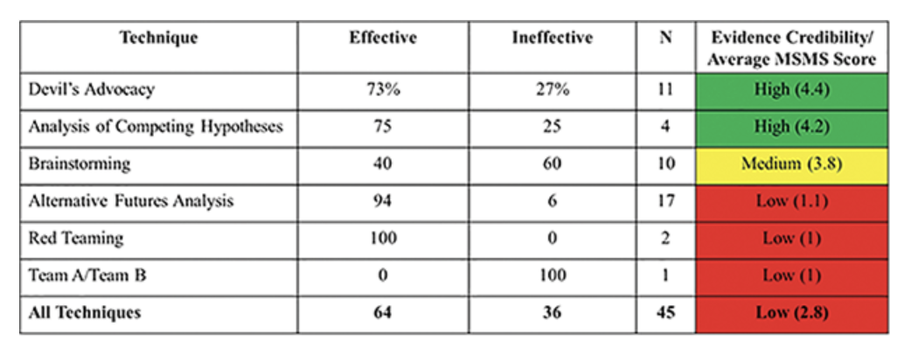
Baseline assessments missing, but adoption is in motion
Analytic Tradecraft
Creative Partner or Bias Reinforcer?
See: Structured Analytical Techniques
Calibrated Trust: when to trust LLMs
Other Stakeholders
Readers
Decision Makers
Downstream Impacts
Tactical and Kinetic Impacts
S. J. Coulthart, “An Evidence-Based Evaluation of 12 Core Structured Analytic Techniques,” International Journal of Intelligence and CounterIntelligence, vol. 30, no. 2, pp. 368–391, Apr. 2017, doi: 10.1080/08850607.2016.1230706.
However may be valuable for observational studies
Lessons learned may not benefit pioneers of LLM usage
Requires thoughtful observational study implementation!

Slide 16
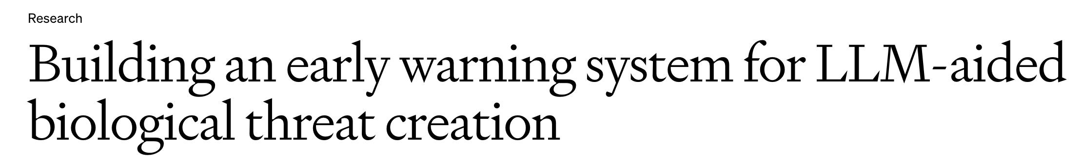
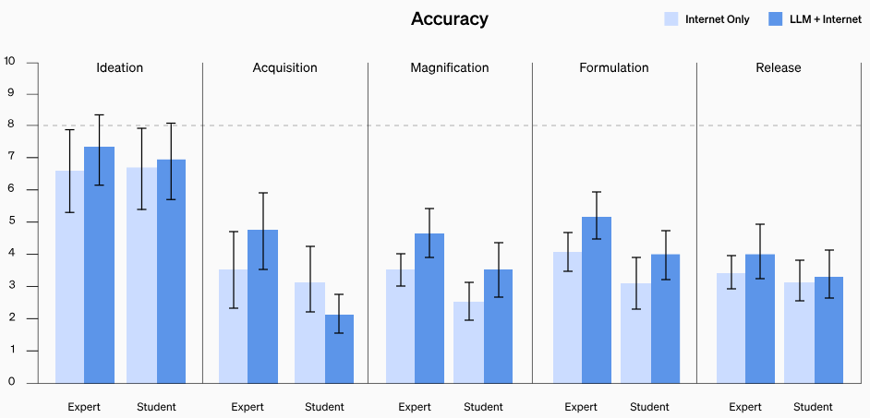
(Over) reliance on industry to build usable (and safe) tools
Even if industry is taking usability seriously, we can’t just rely on their tools.
Missing specified context for ”usability” as defined previously.
Missing specified users (e.g., analysts) for “usability”
May not be for specified goals (e.g. reporting) for “usability”
“Building an early warning system for LLM-aided biological threat creation.” Accessed: Apr. 07, 2024. [Online]. Available: https://openai.com/research/building-an-early-warning-system-for-llm-aided-biological-threat-creation
Notes:
Didn’t talk to the scientists –
Access to the materials.

Slide 17
A summary of tools at our disposal
Low-fidelity Prototyping
Clickable, no, or low-code experiences combined with a “Wizard of Oz” protocol
Pros: Inexpensive and powerful
Cons: Not fully functional. Multiple iterations may be needed.
Heuristic Evaluations
Initial reviews of the low-fidelity prototype by experts using heuristic evaluations can help to find initial issues prior to recruiting participants.
Pros: Catch obvious issues prior to full study
Cons: Need experts who are time constrained
User experience studies
By asking a representative participant to complete a task using the low-fidelity prototype, the team can confirm assumptions and identify issues early in the process. This helps to build the right thing and build it the right way.
Tool instrumentation
By monitoring how users are interacting with the system, potential issues can be identified for further study.
Pros: approximate required resources.

Slide 18










Our Work: Mayflower (Low-fidelity prototype)
H₀: AI is no worse at summarizing than amateur humans
Create DoD-like reporting
LLM base with human review and editing.
Depend on human expertise, mimic all source reporting
Generate summaries with and without LLMs
Short and long summaries
Specific prompts, Inquire about time to generate
Gather human ratings on different criteria.
Likert scale – compare to original report.
Overall, Accuracy, completeness, fluency, independence
Preliminary Analysis (not surprising):
LLMs performed no worse than humans on generating summaries that humans found usable.
LLMs made the process of generating summaries faster
Note! Small sample size of reports, reviews.
Notes:
Used ChatGPT with prompts like “Generate fictional intelligence reports”
Manually edited
We generated 15 reports
In retrospect, seemed to be too many for our reviewer pool
All reports took place in the future, so hopefully a good tip off to reviewers that these were fake.

Slide 19
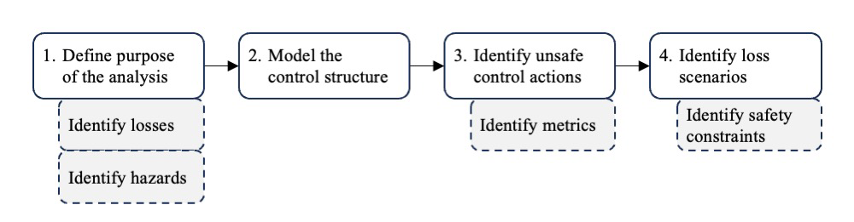
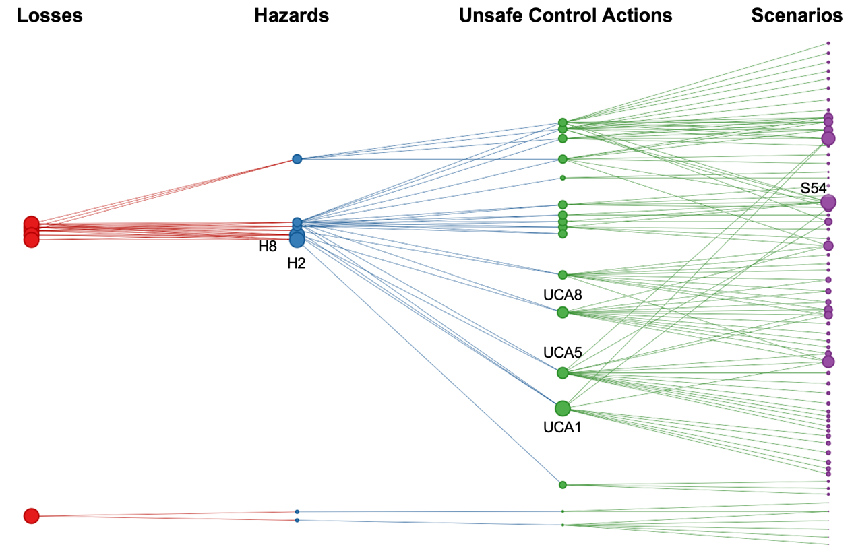
Final System Design - System Theoretic Process Analysis (STPA)
Takes all system components—hardware, software, and human users—into account
Ensure that evaluations can be traced to hazards and losses that must be avoided
Adopt safety constraints to avoid or mitigate loss scenarios (“theoretically safe”)
M. Walsh, D. Schulker, S. Lau, and R. Brower-Sinning, “System Theoretic Process Analysis for Large Language Model System Evaluation: Findings and Recommendations”. https://www.trmc.osd.mil/wiki/display/CDAOAWDWED/System+Theoretic+Process+Analysis

Slide 20
Summary
Challenges
Simultaneous rapid development and adoption of LLM-based tools.
Quantitative measures provide an incomplete assessment of usability (but are widely used)
Prevent complacency in building DoD-specific tools and evaluations.
Next Steps/Our Work
Tailored assessments & comparisons of LLMs
Mayflower (AID), Shannon Gallagher – skgallagher@sei.cmu.edu
Shannon Gallagher et al., “A Retrospective in Engineering Large Language Models for National Security.”
Calibrated trust, User-based TEVV, Acquisition Assessments
Trust Lab (AID), Carol Smith – cjsmith@sei.cmu.edu
Loss aligned system development and constraints (STPA)
CERT - Shing-hon Lau - slau@sei.cmu.edu
TRMC/Task Force Lima –Resources https://www.trmc.osd.mil/wiki/display/CDAOAWDWED/System+Theoretic+Process+Analysis

Slide 21
References
jratchford@sei.cmu.edu
“LLM Evaluation Framework - Task Force Lima - TRMC Website (Confluence).” Accessed: Apr. 10, 2024. [Online]. Available: https://www.trmc.osd.mil/wiki/display/CDAOAWDWED/LLM+Evaluation+Framework?sortBy=date&sortOrder=descending
M. Walsh, D. Schulker, S. Lau, and R. Brower-Sinning, “System Theoretic Process Analysis for Large Language Model System Evaluation: Findings and Recommendations,” 2023.
Shannon Gallagher et al., “A Retrospective in Engineering Large Language Models for National Security.” Accessed: Apr. 10, 2024. [Online]. Available: https://insights.sei.cmu.edu/library/a-retrospective-in-engineering-large-language-models-for-national-security
Douglas Schmidt and Robert, John, “Applying Large Language Models to DoD Software Acquisition: An Initial Experiment.” Accessed: Apr. 10, 2024. [Online]. Available: https://insights.sei.cmu.edu/blog/applying-large-language-models-to-dod-software-acquisition-an-initial-experiment/
Tyler Brooks, “Creating a Large Language Model Application Using Gradio.” Accessed: Apr. 10, 2024. [Online]. Available: https://insights.sei.cmu.edu/blog/creating-a-large-language-model-application-using-gradio
Carrier Gardner, Katie Robinson, Carol Smith, and Alex Steiner, “Contextualizing End-User Needs: How to Measure the Trustworthiness of an AI System.” Accessed: Apr. 10, 2024. [Online]. Available: https://insights.sei.cmu.edu/blog/contextualizing-end-user-needs-how-to-measure-the-trustworthiness-of-an-ai-system
“Scale AI Partners with DoD’s Chief Digital and Artificial Intelligence Office to Test and Evaluate LLMs.” [Online]. https://www.scale.com/blog/scale-partners-with-cdao-to-test-and-evaluate-llms
“Building an early warning system for LLM-aided biological threat creation.” https://openai.com/research/building-an-early-warning-system-for-llm-aided-biological-threat-creation
W. Knight, “AI Is Rewiring Coders’ Brains. Yours May Be Next,” Wired, Feb. 08, 2024. [Online]. https://www.wired.com/story/fast-forward-ai-rewiring-coders-brains-github-copilot/
A. Khurana, H. Subramonyam, and P. K. Chilana, “Why and When LLM-Based Assistants Can Go Wrong: Investigating the Effectiveness of Prompt-Based Interactions for Software Help-Seeking.” Feb. 12, 2024.
E. Dou, N. Tiku, and G. D. Vynck, “Pentagon explores military uses of large language models,” Washington Post, Feb. 21, 2024. [Online]. https://www.washingtonpost.com/technology/2024/02/20/pentagon-ai-llm-conference/
“Evaluation of Controls over the Application of Analytic Standards by the Service Intelligence,” Department of Defense Office of Inspector General. [Online]. https://www.dodig.mil/reports.html/article/3480460/evaluation-of-controls-over-the-application-of-analytic-standards-by-the-servic/
B. Weiser and N. Schweber, “The ChatGPT Lawyer Explains Himself,” The New York Times, Jun. 08, 2023. [Online]. https://www.nytimes.com/2023/06/08/nyregion/lawyer-chatgpt-sanctions.html
P. Liang et al., “Holistic Evaluation of Language Models.” arXiv, Oct. 01, 2023. Accessed: Mar. 29, 2024. [Online]. Available: http://arxiv.org/abs/2211.09110
“New Tesla Autopilot Attention Study: Interesting, Not Surprising.” [Online]. Available: https://insideevs.com/news/533018/tesla-autopilot-attentiveness-study-results/
S. J. Coulthart, “An Evidence-Based Evaluation of 12 Core Structured Analytic Techniques,” International Journal of Intelligence and CounterIntelligence, vol. 30, no. 2, pp. 368–391, Apr. 2017
J. NIELSEN, “Chapter 2 - What Is Usability?,” in Usability Engineering, J. NIELSEN, Ed., San Diego: Morgan Kaufmann, 1993, pp. 23–48.

Slide 22
THE END

