Slide 1
Case Study: Application of State Transition Map (STaMp) to Real System Resiliency Planning
Mr. Nicholas Jones, contractor
DATAWorks 2024
Sharing Analysis Tools, Methods, and Collaboration Strategies
DISTRIBUTION STATEMENT A. Approved for public release; distribution unlimited. Case number: 88ABW-2024-0228; CLEARED 2 Apr 2024

Slide 2
Outline
Motivation
Mission Based Risk Assessment
Overview of State Transition Map (STaMp)
Mission Resilience
Case Study: Application of STaMp
Lessons Learned from Application
Opportunities for Future Work
References

Slide 3
Motivation
The Department of Defense (DoD) is working to focus testing on mission risk and resilience
For cyber security, Mission Based Cyber Risk Assessment (MBCRA) is foundational to understanding cyber security risks and test planning
  MBCRA is the process of identifying, estimating, and prioritizing risks to DoD operational missions resulting from cyber effects on the system(s) being employed in support of the missions – DoD Cybersecurity Test and Evaluation Guidebook (2018)
Numerous MBCRA methods exist with varying degrees of rigor and depth
STAT COE conceptualized State Transition Map (STaMp), a tool for capturing mission-level MBCRA outputs
  Documenting system functions, threats, and effects
  Identifying targets for testing
  Directly supports mission modeling

Slide 4
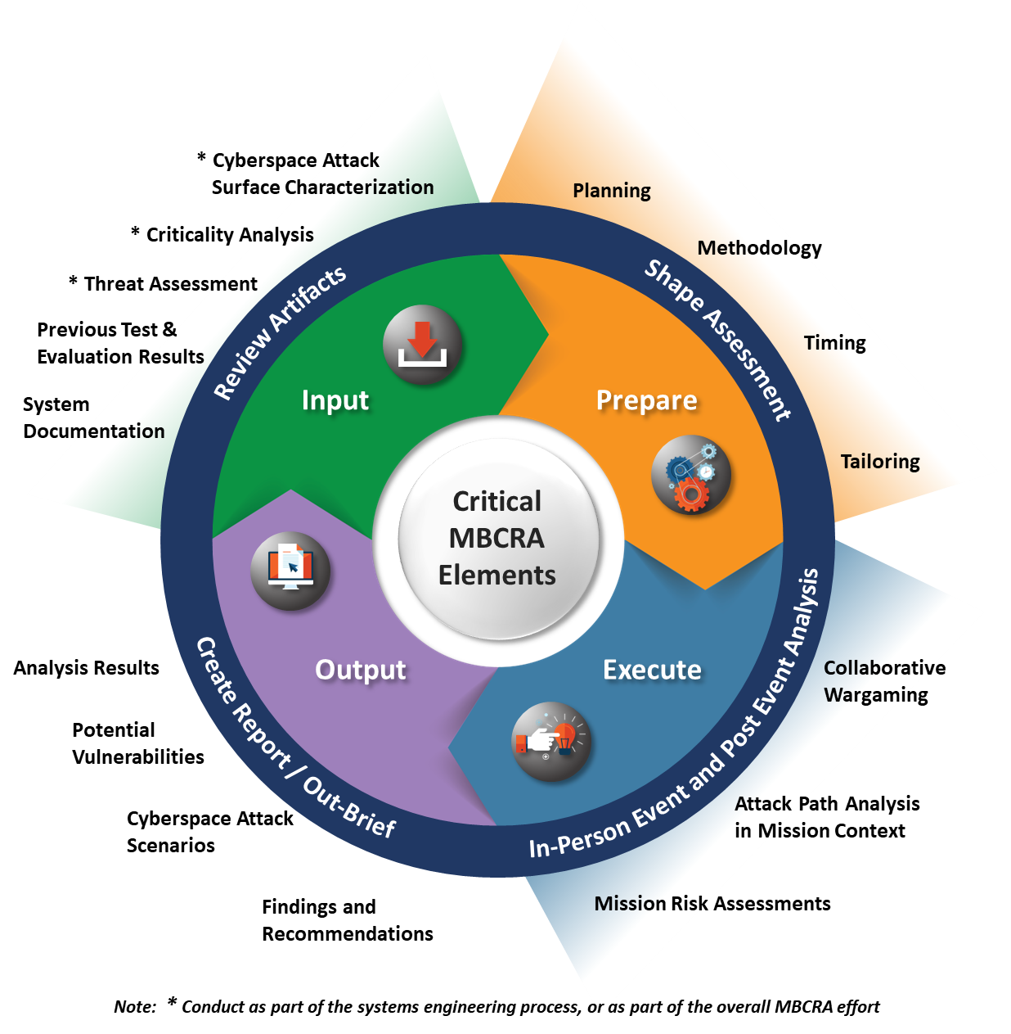
Mission Based Risk Assessment
DoD Cybersecurity Test and Evaluation Guidebook (2018) provides guidance for cybersecurity testing
DTE&A and DOT&E are jointly authoring an MBCRA Appendix to the guidebook
  MBCRA process is outlined as an iterative cycle of effort across program development
  Similar iterative process is used by STAT COE to assist programs with test planning and execution
Mission Based Risk Assessment (MBRA) extends use of the MBCRA concept and methods to hardware-driven mission risks
  Currently no formal MBRA guidance, but general tools to support MBRA and MBCRA may facilitate use
Image: DoD Cybersecurity Companion Guide, MBCRA Appendix (2024)

Slide 5
Overview of State Transition Map (STaMp)
Simplified Full Scope | Normal | Exploit Attempt | Successful Attack | Compromised | Notes
Normal (Start->) |  |  |  |  | Normal operation tends to remain Normal. It is always under threat, known and unknown
Exploit Attempt |  |  |  |  | Known threats have defense plans and can be recovered before becoming breaches
Successful Attack |  |  |  |  | Breached systems require resilience methods to recover, create new threats and lead to spills
Compromised |  |  |  |  | Spills are unrecoverable, create new threats, open new breaches and lead to further spills
State Transaction Map (STaMp) is a tool to help understand what can happen in a complex system
The states across the top indicate what can happen
The states on the left indicate the current state of the system
The colored intersections indicate possible states to which the current state can transition
Transition probabilities can be assigned to each intersection to create a finite-state automaton
Level of Consequence
Good
Not Good
Bad
STAT COE’s STaMp methodology succinctly documents likelihood and severity of specific mission risk chains to support test planning, and directly supports construction of state-based automata for mission modeling

Slide 6
Notional Example of Cybersecurity Decomposition
 |  | Result State
 | Notional STaMp for USB Exfiltration Threat in a Secure Area | Normal Operation | USB enters | USB Leaves before use | USB is Inserted into computer | USB insertion detected | USB insertion not detected | USB is Negated | USB Leaves after use | Secrets Revealed
Current State | Normal Operation | .9 | .1
 | USB enters |  |  | ? | ?
 | USB Leaves before use |  | ? |  |  |  |  | ?
 | USB is Inserted into computer |  |  |  |  | .9 | .1
 | USB insertion detected |  |  | ? |  |  |  | .9 | ?
 | USB insertion not detected |  |  |  | ? |  |  |  | ?
 | USB is Negated | 1
 | USB Leaves after use |  |  |  |  |  |  | ? |  | ?
 | Secrets Revealed (Go to Cleanup) |  |  |  |  |  |  |  |  | 1
Under Normal Operation, the secure area operates on the presumption that security in place prevents USB threats from entering the area
“USB enters” can transition to two states: “USB leaves before use” or “USB is inserted into computer”
If inserted, it will either be detected or not
  If detected, it will probably be negated
  If not detected, then it can remain inserted or leave after use
If the USB leaves after being used undetected, then a spill may be created
Negation of the threat by any means results in return to normal operations in the secure area
If a spill is created, a separate process for damage control will become active, which could be described by another STaMp
Level of Consequence
Good
Not Good
Bad

Slide 7
Mission Resilience
A key risk focus of both MBCRA and MBRA is resilience
  Resilience: The ability to prepare for and adapt to changing conditions and withstand and recover rapidly from disruptions. Resilience includes the ability to withstand and recover from deliberate attacks, accidents, or naturally occurring threats or incidents. – Presidential Policy Directive (PPD)-21 (2013)
Cyber resilience is a key focus for DoD software systems, and is of increasing interest for hardware systems
Many modern defense systems are cyber-physical systems, so assessing resilience must consider both physical and cyber resilience
  STAT COE applied prototype STaMp for combined cyber and physical system resilience as a proof-of-concept

Slide 8
Case Study: Application of STaMp
Applied STaMp to MBRA and resiliency test planning for a DoD program
  Goal: Characterize system resiliency in a contested environment
  Constructed STaMps for each of several resiliency scenarios
  Initial STaMps captured system functional states in normal and contested operation, and color-coded state transitions by severity
Initial goals for this effort were documentation and test planning, with state-chain modeling as a potential future activity
  State transition likelihoods were not estimated in this application
For releasability reasons, discussion of STaMp in this brief has been re-framed using notional data for a notional system

Slide 9
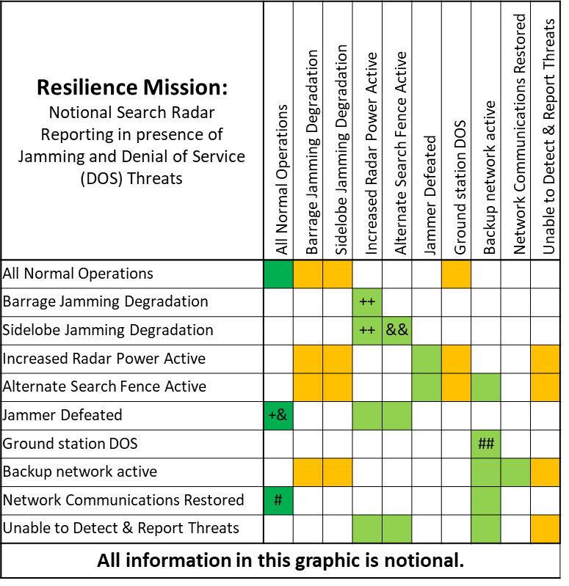
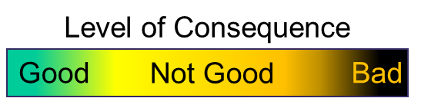
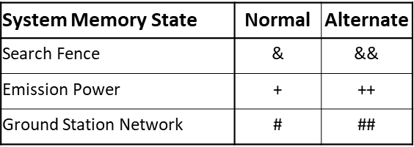
STaMp In Application to Notional Cyber-Physical System
Several state transition probabilities and severities were dependent on the previous states
Multiple memory states corresponding to specific system states and attributes were added to a separate table tied to each STaMp
  Symbols in STaMp cells denote memory state updates from those transitions
  *Note, all information on this slide is notional

Slide 10
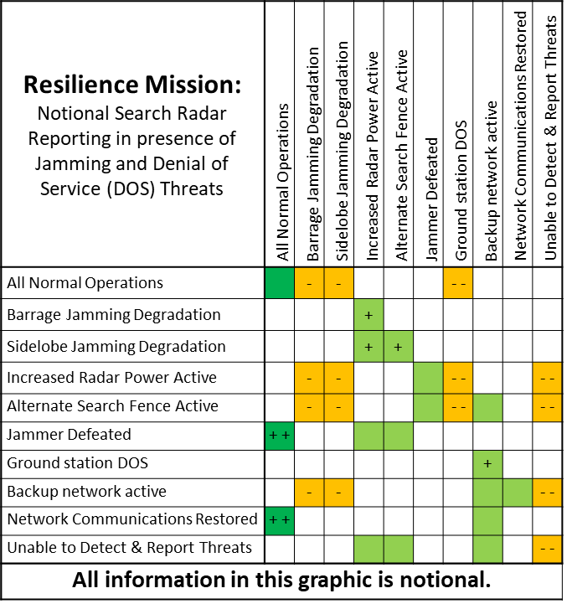

STaMp Development Outcomes
Operational Test community users found more value in showing resiliency in terms of Operations Capability (OPSCAP)
  Worked with SMEs to replace system function-specific memory states with a single summarized memory state capturing OPSCAP level transitions by color
  Each symbol in the STaMp indicates a step up or down the OPSCAP scale
Engineers found the severity scale to be too vague to interpret
  Refined state transition coloring scale to 5 discrete levels representing a combination of deviation from normal and recoverability
Working with System subject matter experts (SMEs), built complete STaMps to capture tactics, techniques, and procedures (TTPs) and risk states for 3 threat scenarios
State Transition Severity Levels
 | System operating normally
 | System fully operational in off-nominal configuration
 | System operation degraded but recoverable
 | System operation at risk of permanent degradation
 | Unrecoverable damage/degradation has occurred
OPSCAP Levels
+ | Green – Fully Mission Capable
 | Yellow – Partly Mission Capable
- | Red – Not Mission Capable

Slide 11
Lessons Learned
STaMp development is most effective as an iterative, collaborative effort
  STaMp development is currently labor intensive, so best done in multiple passes
STaMp transitions may depend on TTPs
  Useful for capturing TTPs and identifying possible other options
Value of STaMp as an elicitation tool depends on the level of knowledge already gathered
  STaMp is useful for documenting the interaction between mission risk and operational capability
Familiarization with STaMp method is necessary to facilitate ease of use
  STaMp layout is variable from case to case, so pattern identification can be difficult
  Separate study is necessary to understand each STaMp
Adding weights to STaMp for mission modeling best done as a follow-up exercise with a familiar group

Slide 12
Opportunities for Future Work
Develop a tool for structuring, building, and managing STaMps
  Could greatly improve their application
Use scaled numerical values in each row of STaMp to represent state transition probability
  Values would be a function of memory state (OPSCAP level)
  Would support state-chain modeling of system behavior
  Simple transition chains can be modeled as Markov chains while more complex ones require more complex concepts from automata theory and Bayesian statistics
Apply state-chain modeling to support identification of critical state transitions that impact system resiliency
  Identify poorly understood transition probabilities as targets for test
  Identify ways to improve resiliency by implementing new system controls or design updates
Apply STaMp to a Cyber-focused resiliency effort
  Cyber-only application may present unique challenges which differ from those encountered in this work

Slide 13
References
Department of Defense (DoD) (2018). DoD Cybersecurity Test and Evaluation Guidebook,
v 2.0. Office of the Undersecretary of Defense for Research and Engineering
(OUSD(R&E)).
Department of Defense (2019). DoD Instruction 8500.01. Cybersecurity. DoD Chief
Information Officer (CIO).
Department of Defense (2024). DoD Cybersecurity Companion Guide, MBCRA Appendix.
Office of the Director, Developmental Test, Evaluation, and Assessment (D(DTE&A)).
Presidential Policy Directive (PPD)-21 (2013). Critical Infrastructure Security and
Resilience. Office of the Press Secretary.

