Slide 1






®
Bringing No-Code Machine Learning to the average user
Optimize Assure Automate Integrate

Slide 2















ECI Overview
About Edaptive Computing
Customers & Partners
27 years pioneering innovative R&D solutions
Software/hardware solutions to optimize, assure, automate, and integrate complex systems/processes
  Enabling cost, time, security benefits
Processes Consistent with highest CMMI Maturity, Level 5
  Among top 3% of appraised companies in U.S.
  ECI quantitative techniques deliver quality solutions on time, within budget
Several Phase III SBIRs transitioning innovative ECI solutions
  No licensing fee for Government
KEYS TO SUCCESS: People, Processes, and Partnerships

Slide 3
AI/ML Challenges
Non-technical personnel face a significant barrier to entry to AI/ML
Use Case selection
Data quality and availability
Lack of educational resources
Practical and logistical limitations

Slide 4
AI/ML Challenges
Use Case Selection
Diagnostics
Attack Detection
Supervised Learning
Big Data Visualization
Feature Elicitation
Prediction
Unsupervised Learning
Classification
Process Automation
Forecasting
Dimensionality Reduction
Anomaly Detection
Content Generation
Computer Vision

Slide 5
AI/ML Challenges
Data Quality and Availability
Limited Access to Datasets
Sparse or incomplete data
Data Sensitivity and Privacy Concerns
Labeled Data Availability
Data Security Risks
Bias and Representativeness
Notes:
Limited Access to Datasets:Classified environments often impose strict access controls on datasets, limiting the availability of data for analysis and model training. This restricted access can hinder the development and validation of machine learning models, as researchers and practitioners may have limited visibility into relevant data sources.
Sparse or Incomplete Data:Data in classified environments may be sparse or incomplete due to restrictions on data collection and sharing. Missing data points can pose significant challenges for machine learning algorithms, leading to biased or unreliable model predictions.
Data Sensitivity and Privacy Concerns:Classified data typically contains sensitive information that must be protected from unauthorized access and disclosure. Privacy concerns may restrict the sharing and analysis of certain types of data, complicating efforts to develop machine learning models that rely on large, diverse datasets.
Data Labeling Challenges:Labeling data for supervised learning tasks can be particularly challenging in classified environments. Limited access to subject matter experts and restrictions on data labeling processes may result in incomplete or inaccurate labels, compromising the quality of training data and hindering model performance.
Data Security Risks:Data security is paramount in classified environments, where unauthorized access or data breaches can have severe consequences. Implementing robust security measures to protect classified data from cyber threats and insider risks is essential but can introduce additional complexities and overhead in data management and access control processes.
Compliance and Regulatory Requirements: Classified environments are subject to stringent compliance and regulatory requirements governing the collection, storage, and use of sensitive data. Ensuring compliance with these regulations while leveraging machine learning techniques may require specialized expertise and careful coordination between data custodians, legal experts, and technical practitioners.
Bias and Represntativeness:
Data Profiling and Analysis: The tool can perform comprehensive data profiling and analysis to identify potential biases and disparities in the dataset. This includes examining demographic distributions, class imbalances, and disparities in feature distributions across different groups.
Bias Detection Algorithms: Implementing bias detection algorithms within the tool can automatically identify patterns of bias in the dataset. These algorithms may include statistical tests, fairness metrics, and algorithmic fairness techniques that assess the fairness and equity of model predictions across different demographic groups.
Visualization of Bias Metrics: Visualizations can provide intuitive representations of bias metrics and disparities within the dataset. Visual aids such as histograms, heatmaps, and interactive charts can help users understand the extent and nature of bias present in the data.
Data Augmentation and Balancing Techniques: The tool can offer data augmentation and balancing techniques to mitigate bias and improve dataset representativeness. This may include oversampling or undersampling techniques, synthetic data generation, and augmentation methods that ensure equal representation of different demographic groups.
Fairness-aware Data Sampling: Incorporating fairness-aware data sampling methods can ensure that the dataset is representative of the target population and mitigates underrepresentation or overrepresentation of certain groups. These methods may prioritize sampling from underrepresented groups or adjust sampling weights to achieve balanced representation.

Slide 6
AI/ML Challenges
Data Quality and Availability
Automation of preprocessing
  Handling Missing Data
  Scaling and Normalization
  Categorical Variable Encoding
  Outlier Detection and Handing
  Feature transformation and combination
Feature Selection
  Understanding Relevance
  Dealing with High-Dimensional Data
  Correlation and Redundancy

Slide 7
AI/ML Challenges
Lack of Educational Resources
User-friendly educational resources
Tuning and Optimization assistance
Interpretability of models and explainability of predictions
Visual Representation of Results
Feedback Mechanisms
Notes:
Education and Training: Building users' knowledge and skills in interpreting machine learning results requires educational initiatives and training programs. Providing resources such as tutorials, case studies, interactive demos, and hands-on workshops can empower users to develop a deeper understanding of machine learning concepts and results interpretation techniques.
Visual Representation of Results: Visualizations play a crucial role in conveying complex information in a comprehensible manner. Designing effective visualizations that communicate key insights from machine learning results, such as performance metrics, feature importance rankings, and decision boundaries, requires consideration of user preferences, cognitive load, and accessibility requirements.
Feedback Mechanisms: Encouraging user feedback and engagement with machine learning results is essential for iterative improvement and user empowerment. Providing mechanisms for users to ask questions, provide input, and provide feedback on the relevance and usefulness of results can foster a collaborative relationship between users and machine learning systems.

Slide 8
AI/ML Challenges
Practical and Logistical Limitations
Data Transfer and Integration Challenges
Resource Intensiveness
Integration with existing workflows
Creation of new workflows
Verification and Testing
Notes:
Data Transfer and Integration Challenges: Transferring data between classified environments and external systems or integrating data from multiple classified sources can be challenging due to security restrictions and compatibility issues. Ensuring seamless data interoperability while maintaining security and confidentiality requires careful planning and coordination.
Resource Intensiveness: Running and training sophisticated AI models can be computationally demanding. Users without access to powerful hardware or cloud resources may find it challenging to execute resource-intensive tasks, limiting their ability to explore and experiment with AI algorithms.
Integration with Existing Workflows: The integration of AI technologies requires organizational change and adaptation to new tools, processes, and methodologies. Existing workflows may need to undergo change management initiatives to foster a culture of innovation, experimentation, and continuous learning. Training programs and educational resources should be provided to equip employees with the skills and knowledge necessary to leverage AI effectively and maximize its potential within their respective roles.

Slide 9
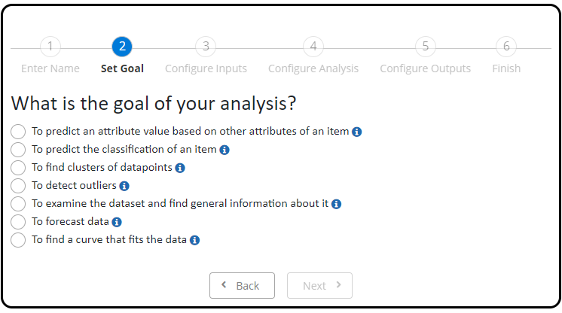

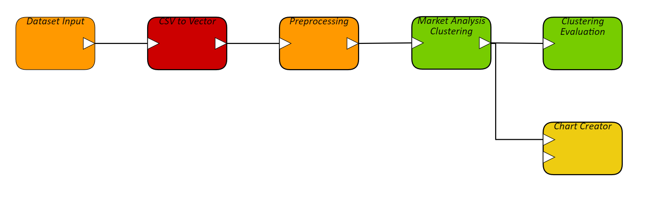
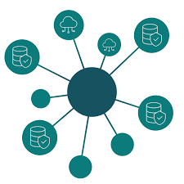

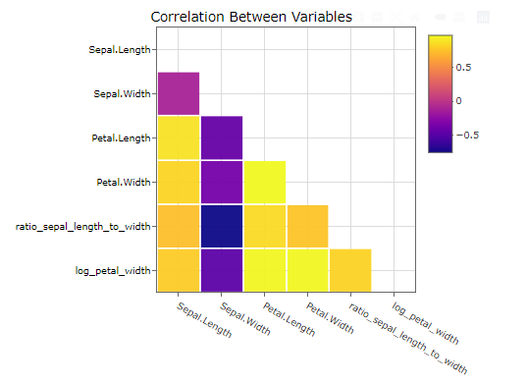
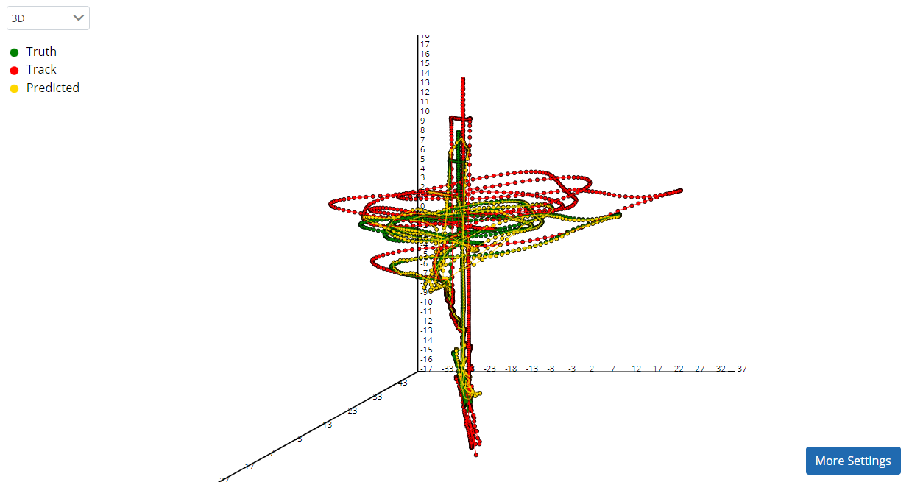

No Code/Low Code Analytics Process
1
User defines analysis goals
2
User specifies datasets
3
Tool generates AI/ML model
CSV files
Database data
Database data
3rd Party APIs
Real-Time analysis results are displayed via visualization dashboards, reports, and additional tools
4
User executes model
5
Automated Analytics Generation Brings AI/ML to Non-technical Users

Slide 10




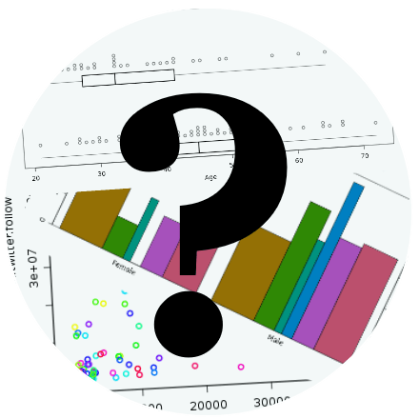

Implementing No Code/Low Code Process
ECI AWESOME bridges the gap
User-friendly graphical analytics environment where non-technical users can develop sophisticated analysis models with ease
Notes:
ECI Smart Documentation capability is founded upon ECI Automate. Automate is a process automation framework with several key common capabilities that can be inherited by applications built upon it. This includes features such as Workflows, real-time task management, notification and monitoring as well as CAC based electronic signatures. We can leverage these features within Automate to enable MBTEMP processes. For example, if review and electronic signatures are required as part of the process, we can easily enable that for Model Based TEMP documents.

Slide 11

ECI AWESOME
Developed through SBIR Program – No licensing fees for gov’t use
Built with DoD use-cases in mind
Framework enables rapidly building customized solutions for the DoD
Interoperability with existing systems
Customer engagement throughout entire customization cycle
Will be available soon on DISA Cloud for DoD users

Slide 12

Questions / Discussion
Q/A

