Slide 1
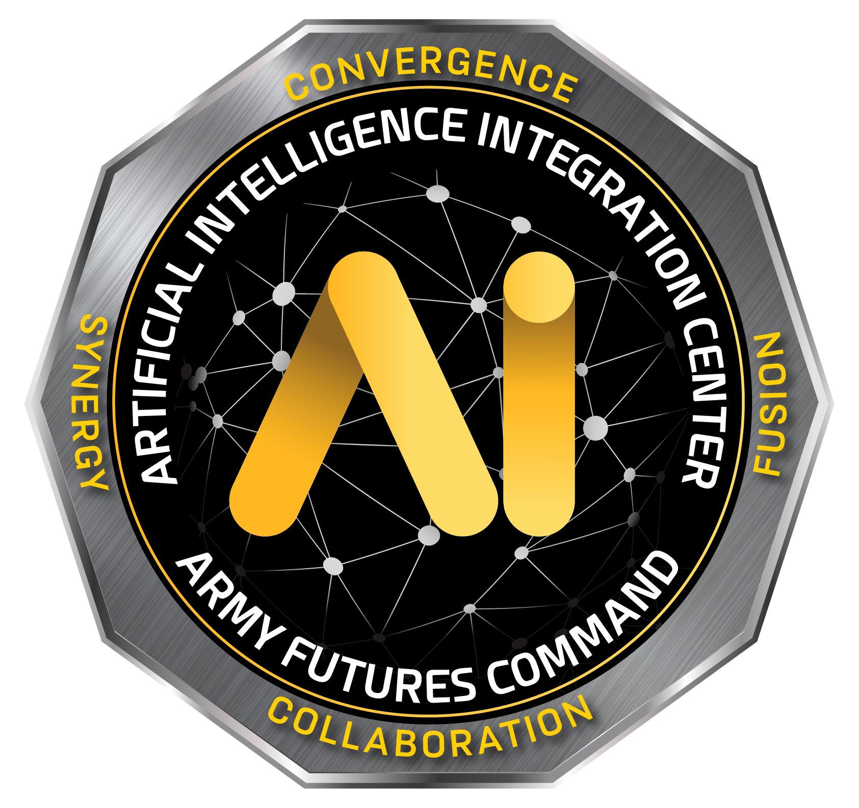

CPT Kate Maffey (AI2C) & Dr. Robert Edman (CMU SEI)
MLTE: Machine Learning Test & Evaluation

Slide 2
Copyright 2024 Carnegie Mellon University and U.S. Army Artificial Intelligence Integration Center (AI2C)
This material is based upon work funded and supported by the Department of Defense under Contract No. FA8702-15-D-0002 with Carnegie Mellon University for the operation of the Software Engineering Institute, a federally funded research and development center.
The view, opinions, and/or findings contained in this material are those of the authors and should not be construed as an official Government position, policy, or decision, unless designated by other documentation.
NO WARRANTY. THIS CARNEGIE MELLON UNIVERSITY AND SOFTWARE ENGINEERING INSTITUTE MATERIAL IS FURNISHED ON AN "AS-IS" BASIS. CARNEGIE MELLON UNIVERSITY MAKES NO WARRANTIES OF ANY KIND, EITHER EXPRESSED OR IMPLIED, AS TO ANY MATTER INCLUDING, BUT NOT LIMITED TO, WARRANTY OF FITNESS FOR PURPOSE OR MERCHANTABILITY, EXCLUSIVITY, OR RESULTS OBTAINED FROM USE OF THE MATERIAL. CARNEGIE MELLON UNIVERSITY DOES NOT MAKE ANY WARRANTY OF ANY KIND WITH RESPECT TO FREEDOM FROM PATENT, TRADEMARK, OR COPYRIGHT INFRINGEMENT.
[DISTRIBUTION STATEMENT A] This material has been approved for public release and unlimited distribution. Please see Copyright notice for non-US Government use and distribution.
This material was prepared for the exclusive use of DATAWorks 2024 and may not be used for any other purpose without the written consent of permission@sei.cmu.edu.
DM24-0410

Slide 3
Problem Statement
MLTE Overview
MLTE Framework
MLTE Python Package (Demonstration)
MLTE Long Term Plan
Contact Information
Questions

Slide 4
How do we ensure machine learning systems function in production as intended?

Slide 5



Framing the Problem
Failed Tests Attributed to Model Problems
Failed Tests
X
X
Failed Tests
X
Model Development
Contractor Testing (CT)
Developmental Testing (DT)
Operational Testing (OT)
ML Capabilities
ML-Enabled System
Operationally- Ready ML-Enabled System
Iterative Model Evaluation and Testing
Comprehensive Testing before Delivery
Component, System and Integration Testing
Field Testing
Contractor
Government

Slide 6
Machine Learning Test & Evaluation (MLTE)
A framework and Python package
Helps teams negotiate, evaluate, and document model and system qualities
Accomplishments:
  Presented at the International Conference on Software Engineering (ICSE) in May 2023 in Melbourne, Australia and at the 2023 AI2C Research Symposium
  Released two major updates in 2023 with significantly expanded functionality
  Extension and transition selected for SEI long-term funding from FY25-FY28

Slide 7
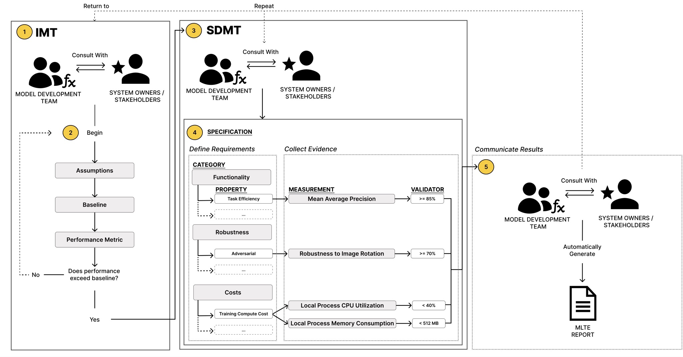
MLTE Framework

Slide 8
MLTE Framework 1: IMT Negotiation
1. Negotiate Model Quality Requirements (IMT Negotiation)
Team negotiates model goals and suitable evaluation metrics
Requirements definition directly informs how a model is evaluated
After this negotiation, development ensues

Slide 9
MLTE Framework 2: Internal Model Testing
2. Internal Model Testing (IMT)
Teams evaluate their model with regard to the negotiated requirements (assumes that teams have a trained model), including the selected performance metric(s)
Determine if model performance exceeds the baseline

Slide 10
MLTE Framework 3: SDMT Negotiation
3. Negotiate Model Requirements Beyond Task Efficacy (SDMT Negotiation)
Teams negotiate, reconsidering their previous requirements based on updated information from the preliminary model
Teams then design a specification by selecting and prioritizing system-dependent model requirements (properties)
After properties are selected, teams must decide on the measurement they will use to ensure the property is satisfied by the model

Slide 11
MLTE Framework 4: System Dependent Model Testing
4. System Dependent Model Testing (SDMT)
Model developers and software engineers evaluate the specification defined during the SDMT negotiation (MLTE step ➂) using measurements
This allows the collection of evidence in support of how a model meets (or fails to meet) its requirements

Slide 12
MLTE Framework 5: Communicate Results
5. Communicate ML Evaluation Results
Teams use the MLTE automated report functionality to encapsulate all knowledge gained about the model and the system as a consequence of the evaluation process

Slide 13
MLTE Python Package
Demo

Slide 14
MLTE Long Term Plan — Motivation
DoD T&E State of the Practice
OT, DT, and CT organizations and activities are segregated and disconnected
Limited by static, document-centric T&E processes
Current push for Integrated T&E — more digital, tool-supported and iterative
AI/ML T&E State of the Practice
T&E mostly focuses on model performance
System-relevant properties are ignored or pushed to discovery in operations
Data quality evaluation criteria and tools are limited
Continuum
Extend MLTE to support faster fielding of ML-enabled capabilities by developing and transitioning a repeatable, system-centric, quality-attribute driven, semi-automated process and infrastructure for integrated testing of ML capabilities across CT, DT, and OT

Slide 15
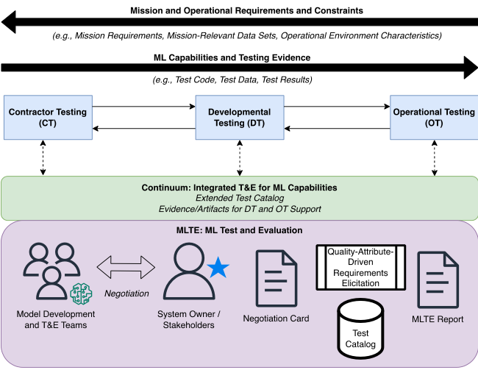
Continuum — Technical Approach
Work with policy organizations to inform DoD-wide policies that will support the flow of information required for ML Integrated T&E
Extend MLTE outputs to produce testing evidence artifacts
Extend test catalog to include data quality properties
Work with DoD ML development and T&E organizations to transition and measure the practice of ML Integrated T&E
Extend test catalog to a larger set of DoD-relevant quality attributes

Slide 16
Integrated T&E Supported by Continuum
Model Development
Contractor Testing (CT)
Developmental Testing (DT)
Operational Testing (OT)
ML Capabilities
ML-Enabled System
Operationally-Ready ML-Enabled System
Iterative Model Evaluation and Testing
Comprehensive Testing before Delivery
Component, System and Integration Testing
Field Testing
Contractor
Government
Model and system requirements and constraints are discussed, documented, and negotiated from the beginning of the project
Test catalog enables test code reuse
Results of CT provide evidence of testing activities
Tests can be rerun and extended on the government side
Automated regression testing
CT of ML capabilities is done based on operationally-relevant scenarios, requirements, and data
Automated regression testing
Results of CT and DT inform and prioritize OT test planning

Slide 17
Continuum — Expected Impact
Test artifact sharing (test results, test code, and test data) will enable DT and OT organizations to make better informed decisions on where to direct their testing efforts for ML capabilities, which will shorten DT and OT times.
Access to realistic systems and operational requirements will lead to ML capabilities that meet mission needs and are less likely to fail during DT and OT, which in turn means less delays due to rework.
Shorter DT and OT times, and less delays due to failures detected during DT and OT, will enable more responsive and timelier ML-enabled capability delivery to meet warfighter needs.
To maintain an advantage over potential adversaries, the US must increase the pace of capability delivery — one way to accomplish this is through Integrated T&E.

Slide 18



Contact Information
CPT Kate Maffey
Data Scientist
Artificial Intelligence Integration Center
katherine.r.maffey.mil@army.mil
Dr. Rob Edman
ML Research Scientist
CMU Software Engineering Institute
rbedman@sei.cmu.edu
GitHub
github.com/mlte-team/mlte
mlte.team.info@gmail.com
Thanks to the rest of our team:
Dr. Grace Lewis (CMU SEI), Sebastian Echeverria (CMU SEI), Alex Derr (CMU SEI), CPT Jenny Niemann (AI2C), CPT Kyle Dotterrer (AI2C), Rachel Brower-Sinning (CMU SEI)

Slide 19
Machine Learning Test & Evaluation (MLTE)
Questions

