Slide 1
U.S. ARMY COMBAT CAPABILITIES DEVELOPMENT COMMAND ARMAMENTS CENTER
Novel Statistical Batch Weighing Methodology Using Machine Learning and Monte Carlo Simulation – DATAWorks 2025
24 APRIL 2025
Controlled by:
DEVCOM-AC
Controlled by:
FCDD-ACE-SA
CUI Category:
UNCLASSIFIED
Distribution Statement:
A
POC:
Christopher Drake

Slide 2
Agenda
Order: | Information: | slide:
01 | SUMMARY AND MOTIVATION | 3-4
02 | PROBLEM STATEMENT AND OBJECTIVE | 5
03 | STATISTICAL METHODOLOGY DETAIL AND CASE STUDY | 6-13
04 | INTERPRETATION AND GUIDELINES | 14-18
05 | REMEDIAL METHODS FOR EXCESSIVE MISCLASSIFICATION | 19-23
06 | CONCLUSION AND RECOMMENDATIONS | 24
07 | FUTURE WORK | 25

Slide 3
Summary
Batch weighing provides a way to gain efficiency and save money when routing many parts simultaneously, avoiding the need to count each part individually while maintaining rough visibility on the total number of parts per batch.
When the parts are sensitive, critical, or users wish to be more precise with their counts, a more rigorous statistical approach was needed.
Reliable counting machinery can be very expensive, and hand counting individual parts is a time consuming and inefficient process that can be prone to human error.
The methodology proposed in this paper outlines a rigorous and flexible statistical approach to quantify the risk of batch weight misclassification using Monte Carlo simulation and Linear Discriminant Analysis (LDA), a supervised machine learning modeling approach.
Before the methodology proposed in this paper, the error risks of batch weighing were not quantified, and there was no rigorous way to know if batch weighing could be reliably applied for any given situation.
Successful application of this methodology coupled with continuous process monitoring of individual part weights will result in less misclassification error and more confidence when implementing batch weighing, while still saving precious time and money.

Slide 4
Case study motivation
The team had been having some issues internally delivering batches of parts to testers with extra or unaccounted for items using their standard batch weighing approach and laser counting machines.
This was of concern due to the sensitive nature of this specific program.
The team tried a laser counting system and was consistently having issues with missing or extra parts.
The team has since been hand counting parts individually for deliveries, which has drastically increased the required man hours and inefficiency in the process, while also creating a new bottleneck.
The team was hoping for a way to return to batch weighing in a more rigorous way that provided the ability to quantify the risk of each batch having unexpected quantities of parts.
Using a recently acquired robust set of weight data for individual parts, drawing tolerances, and scale specifications, this methodology was developed to provide the team with the tools they needed to accomplish their goal.
This paper also demonstrates the power of Monte Carlo simulation, generating all this information from a single mean and standard deviation.

Slide 5
Problem statement and objective
PROBLEM STATEMENT: There currently exists no statistically rigorous methodology to specifically assess batch weighing feasibility, misclassification risk, or quantitative weight limits based on risk.
OBJECTIVE: Provide an analysis approach for batch weighing applications which gives users the ability to quantify the risk of misclassification of an individual or many batches, allowing for the assessment of feasibility for any given batch weighing application, and reducing the risk of error regarding the number of parts in each batch.

Slide 6
STATISTICAL METHODOLOGY DETAIL
Conceptually, quantifying misclassification risks of batches requires distributions of batch sums be assessed side-by-side on the axis of interest. To accomplish this:
Monte Carlo simulation is used to generate individual part weight distributions using parameters from prior data or subject matter expertise
From here, consider the worst-case misclassification scenarios: one extra part (n+1) or one fewer part (n-1) than desired
Monte Carlo simulation is used to generate columns of sums of size n-1, n, and n+1 parts
This data is then stacked and LDA model is fit
LDA model outputs used to estimate probability of misclassification of individual batch
Use formula provided to quantify misclassification risk over life of program if desired
Apply remedial measures discussed if misclassification risks are too large for program needs

Slide 7
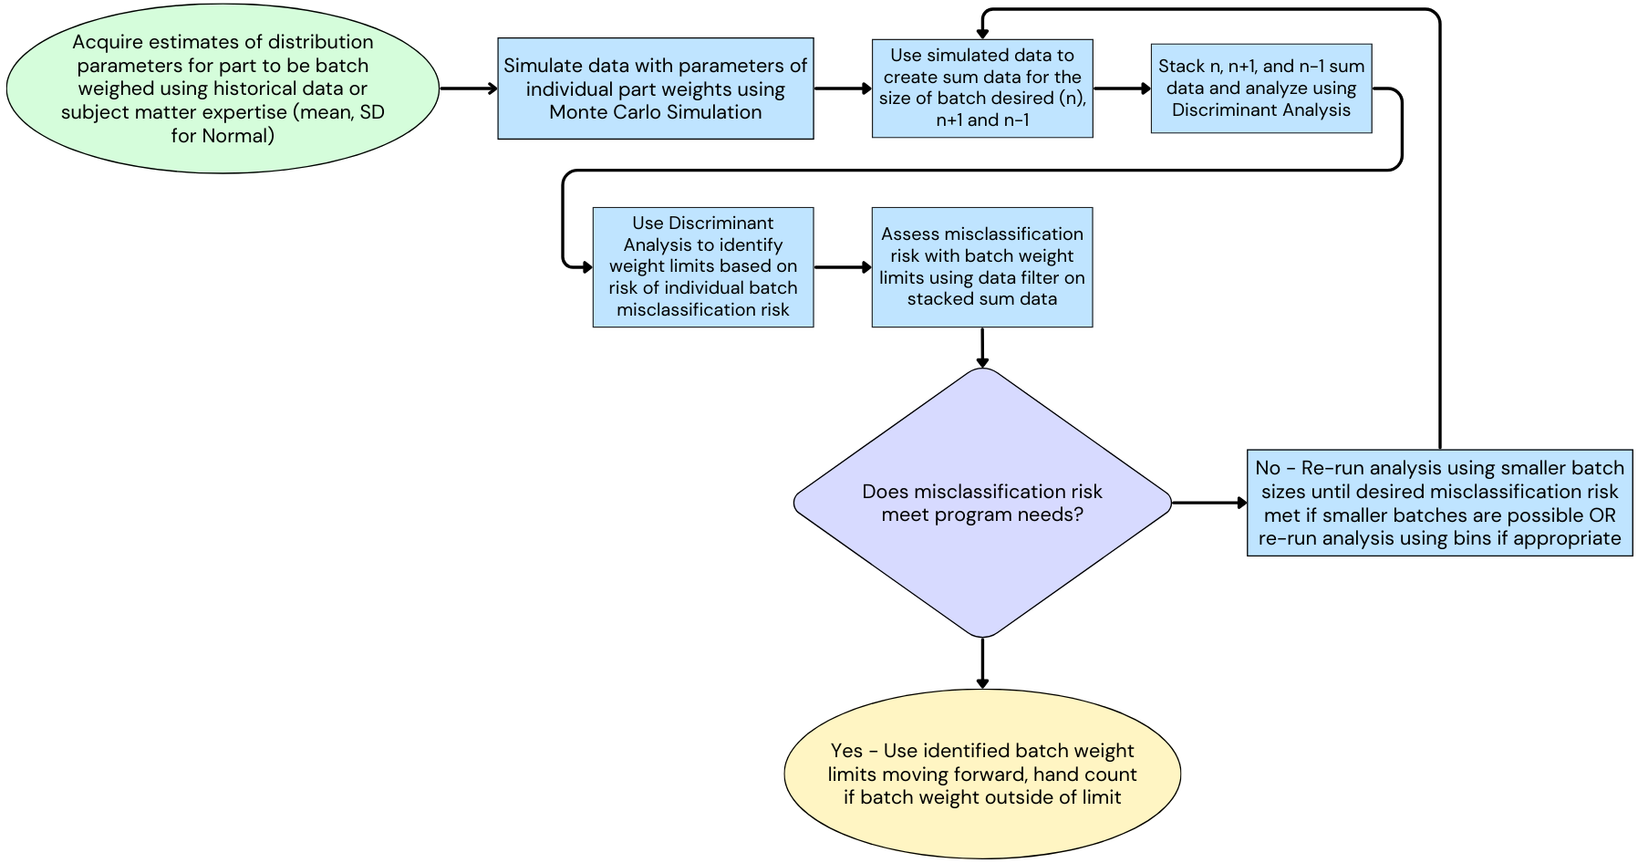
Flowchart of methodology

Slide 8
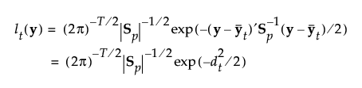

Linear discriminant analysis DETAIL
Linear Discriminant Analysis (LDA) is a supervised machine learning model-based approach to solve classification problems with multiple classes.
In essence, a ‘statistical distance’ is calculated for each observation from the class means while also considering the group variability in a way similar to a Z-score.
This ‘statistical distance’ also considers correlation between the predictors.
The output of this model gives probabilities of class membership for any given input, and outputs a confusion matrix of misclassification rates.
One limitation to LDA is that it operates on the assumptions of normality and homoscedasticity, so although some overlap calculations and misclassification rates can still be generated using the proposed methodology for non-normal data, the LDA model assumptions would be violated (Shmueli, 2017).
There are some robust LDA options proposed to deal with assumption violations of normality and homoscedasticity using trimmed means that may be helpful (Yahaya, 2016).
Mahalanobis Distance
Likelihood for Observation y in Group t

Slide 9
TABLE 1 Misclassification Error Types for Case Study Example
H₀: Batch size = 1000 Parts H_{A}: Batch size ≠ 1000 Parts |  | Predicted
 |  | H₀ is true | H_{A} is true
Actual | H₀ is true | 1-α = Confidence Predict batch contains 1000 parts and batch contains 1000 parts | α = Type I Error (False Positive) Predict batch does not contain 1000 parts and batch contains 1000 parts
 | H_{A} is true | β = Type II Error (False Negative) Predict batch contains 1000 parts and batch does not contain 1000 parts | 1-β = Power Predict batch does not contain 1000 parts and batch does not contain 1000 parts

Slide 10
Measurement system considerations
An important step to succesfully implenting the methodology discussed in this paper is to understand and characterize the measurement systems that will be used for individual part data collection and batch data collection.
Some areas to consider regarding the measurement systems used are: repeatability (pure error), reproducibility (if using multiple scales), bias (accuracy), linearity (accuracy over the scale‘s range), maximum capacity, and readability (resolution).
Many of these items can be found in the scale‘s specifications, but conducting a Gage Repeatability & Reproducibility (R&R) study with standards spanning the scale’s usable range (to capture bias and linearity) is highly recommended.
If any of these metrics differ from the scale used for individual part collection and scale to be used for batch weight collection, some adjustment may be needed to make the analysis more robust.
In summary, without a well understood measurement system enviornemnt, the methodloogy proposed in this paper may suffer irregularities when verified with real world data, and these consdierations must be taken into account beforehand.

Slide 11
Process monitoring considerations
It is important to note that this methodology can be sensitive to changes in the individual part parameters due to the nature of error and noise stacking over many parts.
Implementing this methodology should only be considered robust on a stable process where continuous process monitoring is in place.
If changes in the mean or standard deviation of the individual part weights are observed prior to batch weighing, changes may be required for the batch weighing exercise to maintain cohesion with the initial analysis.
If there is a mean change but no standard deviation change, applying a simple correction factor may be appropriate.
If there is a standard deviation difference however, the methodology will need to be re-run and new LDA models fit for best results.

Slide 12
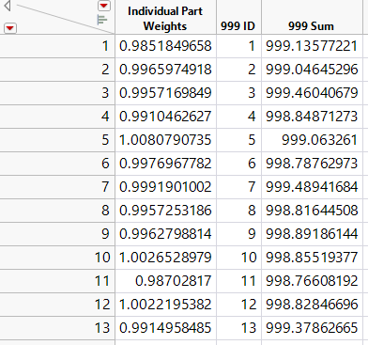
CASE STUDY EXAMPLE SETUP AND MONTE CARLO SIMULATION
In the case study example discussed throughout this paper, batches of size 1000 parts were desired (n=1000).
In an attempt the understand the ability of the batch weighing operation to be successful, one needs to assess the desired batch size against the worst case missclassification situation: one extra part or one less part.
To accomplish this, use Monte Carlo simulation to generate three distributions of sums of parts for 999, 1000, and 1001 parts.
The Monte Carlo size is somewhat arbritrary, but should be enough that probability estimates can achieve higher resolution.
For this example, Monte Carlo simulation size of 10000 was targetted, as any more would have encountered memory issues due to the size of the datasets (would require data tables of 100M+ rows).

Slide 13
CASE STUDY EXAMPLE sum distributions, overlap, Stacked Sums, and LDA FIT
To do this in JMP®, simulate a column of data for the individual part to be batch weighed, in this example a part of weight 1 gram mean, and standard deviation of 0.007 grams.
For the 999 sum, simulate this column with 9,990,000 rows, 10,000,000 for the 1000 sum, and 10,010,000 for the 1001 sum.
Create an ID column in sequence from 1-10000, and repeat this sequence to the end of the table.
Then take column sums by this identifyer column to generate 10000 Monte Carlo sums of 999, 1000, and 1001 parts.
Estimates for the overlap of the three distributions can be calculated using the script found in the backup slides after normalizing the data.
Stack the three sum columns into one column to allow for statistical modeling.
A histogram and Normal 3 Mixture distribution fit of this stacked sum data is shown.
With this stacked sum data, fit a Linear Discriminant Analysis model to the data and interpret the results.

Slide 14
INTERPRETATION AND GUIDELINES LDA MODEL outputs and profiler
When interpreting the outputs of the methodology, one can consider a few options to make assessments:
Overall misclassification, Type I misclassification, & Type II misclassification
Probability of class membership
Misclassification given weight limits
Misclassification over multiple batches
The least desireable outcome and most objective relavant output in this case is Type II misclassification, where the user concludes there are the desired number of parts in the batch when in reality there are not.
Overall misclassification can also be used as a good tool for comparison, which is linked to the overlap of the distributions and probability of each weight occuring (PDF).
Probability of class membership is given by the model, and can be directly used to assess each batch weight for risk
Misclassification with weight limits and over multiple batches are invaluable tools to make application of the methodology streamlined and relevant over the life of a program.

Slide 15
INTERPRETATION AND GUIDELINES profiler with pdf of stacked sums
To help visualize the model one step further, the probability density function of the normal 3 mixture fit of stacked sums can be added.
One can see that the area of overlap in both overlapping regions (0.0472) is larger than the misclassification percent (0.0159), and that is because the weights in this area of overlap are less likely to occur.
When both are considered, the overall misclassification rate can roughly be thought of as the combination of the likelihood of any given weight occurring combined with the LDA classification probabilities over the input space.
To validate the LDA approach further, the same LDA model using a hold-out validation and test data set are shown in the back-up slides, with results that closely mirrored the initial analysis.

Slide 16
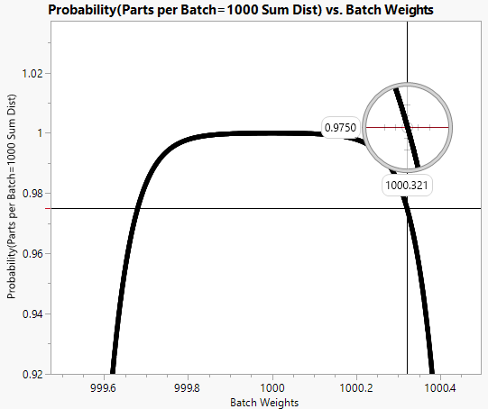
INTERPRETATION AND GUIDELINES identifying upper and lower weight bounds
Perhaps the most valuable tool the LDA provides is the statistical model itself, shown visually in the prediction profiler tool.
Using this tool, the user can make assessments in real time if the risk level is low enough to assume it has the correct number of parts, or if they want to hand count.
We can also use this model to help identify upper and lower weight limits that meet our acceptable level of risk.
To illustrate using this case study, assume the acceptable level of risk for each batch was 5% total, leaving 2.5% for each tail.
We can roughly approximate the upper and lower weights using the profiler tool cursor, but to more precisely approximate the values a random output table can be queried using the model to generate this table.
Plotting this random table and adding a reference line at 0.975, we identify the approximate upper and lower weights as 999.681 and 1000.321 respectively.
Using the MC distribution of sums for 1000 parts and adding these limits, we can approximate the percentage of the time we would have parts outside of this window at about 14.66% as shown.
If the user cannot reach the desired weight window by adding or substracting parts, a hand count would be recommended.

Slide 17
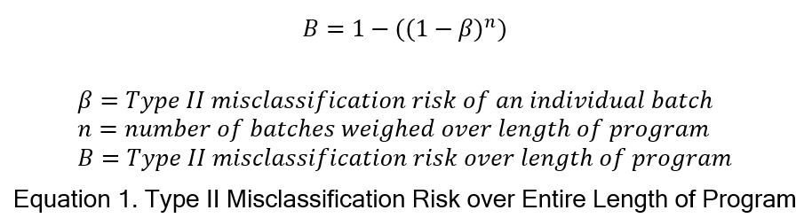
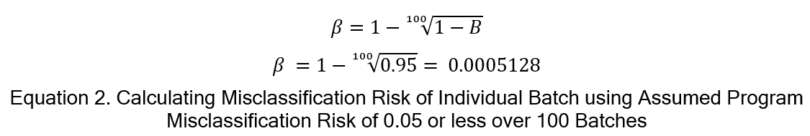
INTERPRETATION AND GUIDELINES assessing misclassification risk of multiple batches
A more large-scale approach to evaluate the problem is to consider the lifetime of the program, and the approximate number of batches to be weighed during the entirety of the program.
One can then determine what an approximate acceptable level of risk is with regard to the overall timeline, and calculate the resulting indivudal batch weight Type II risk.
The user starts by identifying this acceptable risk over the lifetime of the program, in this case 5% is used as an example.
Solving for β when the number of batches (n) and misclassification risk over length of program (B) are known or assumed (in this case 100 batches, 5% lifetime risk) we arrive at Equation 2.

Slide 18
INTERPRETATION AND GUIDELINES assessing misclassification risk of multiple batches Cont.
Now armed with the information that an individual batch misclassification risk of 0.05% is required to reach our program needs, we can identify upper and lower weight limits for individual batches that give us this approximate individual batch misclassification risk.
The results of this iterative process are shown, where the Type II risk can be approximated by filtering data for the weight limits on the stacked MC sum distribution data used to generate the LDA model.
We arrive at a Type II risk of approximately 0.45% with limits (999.8, 1000.2), satisfying our overall program risk of at most 5% as shown in Equation 3.
As mentioned previously, if the user fails to reach the desired weight window after attempting to add or subtract parts, a hand count is recommended.

Slide 19
REMEDIAL METHODS overview
In the case study example shown thus far, the overlap of the three distributions proved to be manageable, allowing us to arrive at values that could accomplish both our individual batch risk or overall program risk.
In certain cases where noise is excessive, this may not be possible without remedial action.
This slide shows the resulting LDA on example noisy data, with an overlap of 85.53%, an overall misclassification risk of 35.44%, and a very uncertain model even given optimal conditions.
This would be an example where this methodology would determine that batch weighing would be a highly risky option unless some remedial measures were taken.

Slide 20
REMEDIAL METHODS smaller batch sizes
The three options proposed to alleviate excess misclasification concerns include: smaller batch sizes, binning parts per batch, or a hypbrid approach where both are used in unison.
The first and likely preferrable option would be to decrease the batch size.
By decreasing the number of parts in each batch, the overall distributions suffer from less noise stacking, resulting in distributions with smaller standard deviations and less sensitive batches.
In Table 2 approximate improvement percentages are provided for the smaller batch sizes analyzed in this paper, showing a roughly 30% improvment with batch sizes of 500, and 60% improvement with batch sizes of 250.

Slide 21
REMEDIAL METHODS binning
The second remedial option would be to bin adjacent batches together, forfeiting granularity on individual parts to improve the distribution standard deviations.
This may not be appropriate in many cases were losing track of any number of parts would be concerning but may be possible in situations where having exactly precise counts of parts is not needed.
In this case, the bin size is chosen first (size 3 in this example), and the batch weight sums are then stacked and considered one batch sum.
For the example shown, distributions of part sums for bins 996-998, 999-1001, and 1002-1004 are generated.
Treating each group of 3 as an individual distribution, the process of creating the LDA model is repeated as before.
Summary Table 2 shows an approximate improvement of 64% from size 3 binning alone.

Slide 22
REMEDIAL METHODS Hybrid approach
The final option to consider if using only one option will not achieve the desired misclassification risk is to use a hybrid approach.
Users can deploy any combination of binning and smaller batch sizes to leverage the beneficial effects from both simultaneously.
Shown as an example, size 3 binning is incorporated alongside smaller batch sizes of 500, showing an approximate misclassification improvement of 75%.

Slide 23
TABLE 2 Approximate Remedial Measure Improvements for Excessive Overlap Example
Remedial Measure | % Distribution Overlap | Overall Misclassification Rate of LDA | % Misclassification Improvement | % Overlap Improvement
None, 1000 Batch Size | 0.8553 | 0.3447 | n/a | n/a
Smaller Batch, 750 | 0.7798 | 0.3086 | 0.1046 | 0.0883
Smaller Batch, 500 | 0.675 | 0.2494 | 0.2765 | 0.2108
Smaller Batch, 250 | 0.3986 | 0.1364 | 0.6042 | 0.5340
Smaller Batch, 100 | 0.0914 | 0.0305 | 0.9114 | 0.8931
Smaller Batch, 50 | 0.0101 | 0.0034 | 0.9903 | 0.9882
Binning only, Size 3 | 0.3688 | 0.1256 | 0.6357 | 0.5688
Smaller Batch, 500 & Binning, Size 3 | 0.2562 | 0.0861 | 0.7502 | 0.7005

Slide 24
Conclusion and recommendations
When users wish to utlize batch weighing to save time and money, the methodology proposed provides a rigorous analytical approach to quantify the risks involved.
With a thorough understanding of the measurement systems involved and continuous process monitoring of individual part weights, successful application of the methodology is robust.
The methodology proposed provides users with the ability to streamline their batch weighing process with the ability to establish upper and lower weight limits.
Users are also able to assess the risk of misclassification of each batch using the LDA model, and the overall program risk of misclassification with the provided equation.
Remedial methods provided can help users when excess noise prevents desired risk levels from being met.

Slide 25
Future work
Current plans for future work include researching possible extensions and other applications outside of batch weighing, where noise stacking and misclassification are a concern.
Another area of future reseach includes exploring the consistency of the effects of the remedial methods to identify if there are underlying truths that govern the magnitudes of the improvement relationships across many different distribution widths, shapes, and locations.
Correction factor application instructions when process drift is observed during process monitoring.

Slide 26
references
Data Mining for Business Analytics: Concepts, Techniques, and Applications with JMP PRO® [Book] / auth. Shmueli G., Bruce, P., Stephens, M., Patel, N.. - Hoboken, New Jersey : J. Wiley Print, 2017.
Robust Linear Discriminant Analysis [Journal] / auth. Yahaya S., Lim, YF., Omar, A., Omar, Z.. - [s.l.] : Journal of Mathematics and Statistics, 2016.

Slide 27
Contact Information:
Email: christopher.g.drake4.civ@army.mil
Teams: Data Analytics and Statistical Sciences | General | Microsoft Teams

Slide 28
Backup slides JMP® OVERLAP AND INTEGRATION GRAPHIC SCRIPT EXAMPLE

Slide 29
Backup slides discriminant with validation column

