Slide 1
A Quantified Approach to Synthetic Dataset Evaluation
April 24, 2025
Jeffery Hansen
Senior Machine Learning Research Scientist

Slide 2
Copyright 2025 Carnegie Mellon University.
This material is based upon work funded and supported by the Department of Defense under Contract No. FA8702-15-D-0002 with Carnegie Mellon University for the operation of the Software Engineering Institute, a federally funded research and development center.
The view, opinions, and/or findings contained in this material are those of the author(s) and should not be construed as an official Government position, policy, or decision, unless designated by other documentation.
NO WARRANTY. THIS CARNEGIE MELLON UNIVERSITY AND SOFTWARE ENGINEERING INSTITUTE MATERIAL IS FURNISHED ON AN "AS-IS" BASIS. CARNEGIE MELLON UNIVERSITY MAKES NO WARRANTIES OF ANY KIND, EITHER EXPRESSED OR IMPLIED, AS TO ANY MATTER INCLUDING, BUT NOT LIMITED TO, WARRANTY OF FITNESS FOR PURPOSE OR MERCHANTABILITY, EXCLUSIVITY, OR RESULTS OBTAINED FROM USE OF THE MATERIAL. CARNEGIE MELLON UNIVERSITY DOES NOT MAKE ANY WARRANTY OF ANY KIND WITH RESPECT TO FREEDOM FROM PATENT, TRADEMARK, OR COPYRIGHT INFRINGEMENT.
[DISTRIBUTION STATEMENT A] This material has been approved for public release and unlimited distribution. Please see Copyright notice for non-US Government use and distribution.
This material may be reproduced in its entirety, without modification, and freely distributed in written or electronic form without requesting formal permission. Permission is required for any other use. Requests for permission should be directed to the Software Engineering Institute at permission@sei.cmu.edu.
DM25-0506

Slide 3
Outline
Synthetic Data for ML
Motivating Scenario
Why Synthetic Data?
Taxonomy
Experiment Setup
Dataset – Oxford Flower Dataset 102
Model – ResNet50V2 + custom layers
Experimental Plan/Results
Binary
Replacement
Augmentation
Test
Conclusions

Slide 4
Motivating Scenario
+
?
You have an ML problem you would like build a solution for, and you would like to know when and how to use synthetic data to train and test your model. Your key questions are:
How good is your synthetic data compared to your real data on your model?
Can you quantify the difference in terms of model performance?
Where should you use your real data when you have a limited amount?
+
Synthetic
Data
Real
Data
We will demonstrate our approach to answering these questions using:
Model: Transfer learning /w ResNet50V2
Real Data: Oxford 102 Flower Dataset
Synthetic Data: Dall-E-2 and SD-1.4

Slide 5
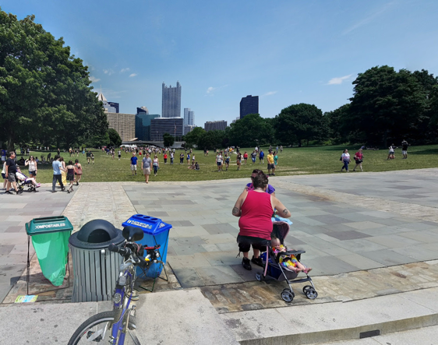
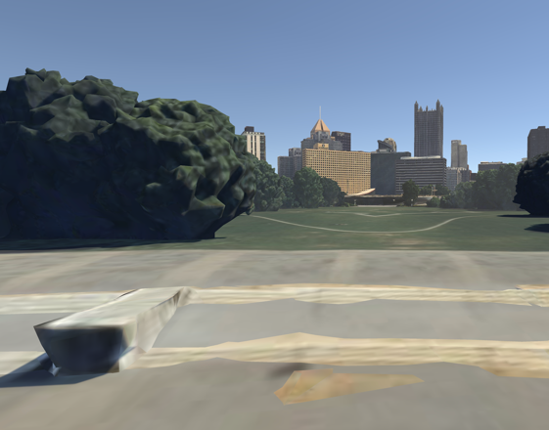
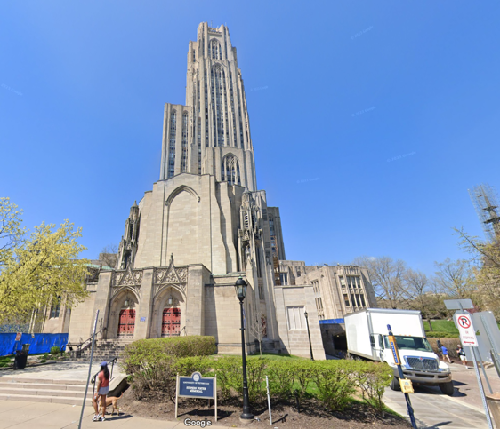
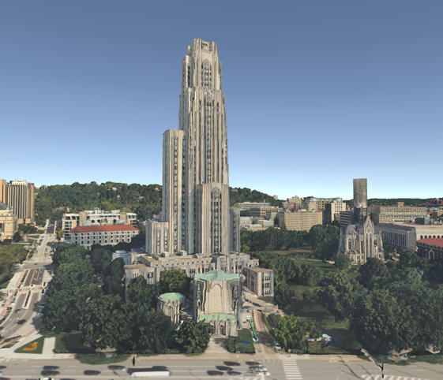
Why Use Synthetic Data
Claims
Photo
Synthetic
1. Synthetic Data can produce photo realistic datasets.
2. Using synthetic data is a waste of time, if it can’t be used for model training because it doesn’t generalize to real data.
3. Data collection and data labeling are the most expensive and time consuming part of every machine learning project

Slide 6
When might we use synthetic data?
Some reasons include:
Data Scarcity – Real world data might be limited, expensive or difficult to collect.
Cost-Effective – Synthetic data may be cheaper to generate.
Data Privacy – Real data may include PII or other sensitive information.
Class Balancing – Some classes may lack enough real data and synthetic data can be used to “top off” those classes.
Label Availability – Real data requires effort in labeling which may be expensive and potentially error-prone. Synthetic data automatically comes with ground truth.
Domain Randomization – Synthetic data can be used increase the diversity of background and domains in which a subject appears.
R&D Speedup – Synthetic data can be used to “bootstrap” experiments with an initial dataset that can be replaced as real data is acquired.

Slide 7
Taxonomy of synthetic data
Type | Description | Risks | Common Uses
Augmented | Transforms and composites of existing data | Unrealistic Data | Targeted creation of datasets based on metadata
Toy data | Proxy objects and data | Unrealistic data | Proof of concept and prototyping, low TRL examples
Generative | Describe your data to generative AI | Lack of control of data, known data issues | Dataset augmentation
Soft Simulation | Data from a non-validated simulation engine | Unrealistic assumptions get baked into the model | Privacy/Security Concerns, large scale dataset generation
Hard Simulation | Data from a validated numerical simulation (e.g. CFDs) | Known approximations, changes in assumptions | Privacy/Security of data, hard to acquire data

Slide 8









Image Classifier: Oxford 102 Flower Dataset
Number of Categories: 102
Total Images: 8,189
Images per Class:
40 to 258 images/class
40 – 80 images/class typically
Labels: single label per image
Split:
Test: 10 images
Validation: 10 images
Training: remaining available*
Magnolia
Azalea
Blanket Flower
Tree Poppy
California Poppy
Hibiscus
*Number of training imaged used in each experiment limited based on the synthetic data set size and for class balancing.
Daffodil
Primrose
Canterbury Bells

Slide 9








Dall-E-2
Synthetic (Dall-E-2)
Real
Total of 4,206 synthetic images produced using Dall-E-2 through openai API
35-50 images per class
Resolution of 512x512
Locations: "garden","city","office"
Saved image metadata
Generation model and date
Prompt: "A {flower_class} flower in a {location}."
Cost: $0.014/image
Daffodil
Primrose
Canterbury
Bells

Slide 10






Stable-Diffusion (SD-1.4)
Synthetic (SD-1.4)
Real
Total of 3371 synthetic images produced using huggingface CompVis/stable-diffusion-v1-4 model run locally
33 images per class
Resolution of 512x512
Locations: "garden","city","office"
Saved image metadata
Generation model and date
Prompt: "A {flower_class} flower in a {location}."
Cost: only electricity
Daffodil
Primrose
Canterbury
Bells

Slide 11

Model Architecture
224 x 224
Classifier Implemented in Keras/Tensorflow
Trained in 3 phases:
Phase 1: ResNet pre-trained weights are frozen. Learning rate η=0.01
Phase 2: ResNet unfrozen Learning rate η=0.001
Phase 3: ResNet unfrozen Learning rate η=0.0001
Number of Epochs per Phase: 15
Loss: sparse_categorical_crossentropy
Batch Size: 64
Binary Classifier for Real vs Synthetic Experiments
Same architecture as 102 category classifier but replacing the final dense layer with a binary output dense layer.
Loss: binary_crossentropy
ResNet50V2
(7,7, 2048)
GlobalAveragePooling 2D
Dropout
Rate: 0.6
Dense
1024, relu
Dropout
Rate: 0.2
Dense
102, softmax
Primrose

Slide 12


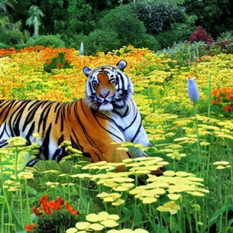


Binary Classification Experiment
Dall-E-2
Real
Stable Diffusion
As first step, simply build a binary classifier to distinguish between real and synthetic data
All available data used with 80/10/10 split
Average of 5 runs with randomly selected splits
Lower accuracy on classifier → better synthetic data (harder to distinguish from real)
We predict that the Dall-E-2 synthetic data will perform better in the more detailed experiments.
is_real?
is_real?
Dall-E-2:
0.776 Accuracy
(better data)
SD-1.4:
0.855 Accuracy
(worse data)
Tiger Lilly
(Stable Diffusion)
Prince of Wales Feather
(Stable Diffusion)
Tiger Lilly
(Dall-E-2)

Slide 13
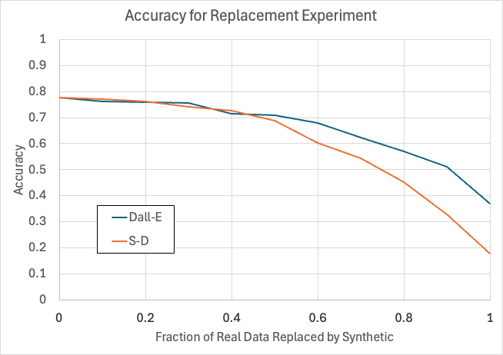
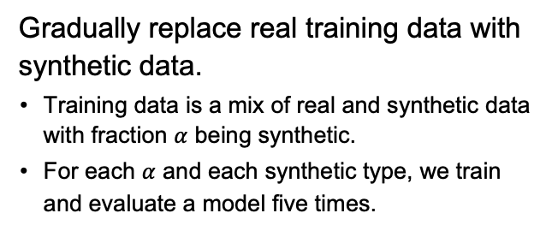


Replacement Experiment
Training
Valid.
Test
fixed size
$$α$$
Real
Synthetic
Gradually replace real training data with synthetic data.
Training data is a mix of real and synthetic data with fraction $α$ being synthetic.
For each $α$ and each synthetic type, we train and evaluate a model five times.
Dall-E
SD-1.4
Outcomes
As expected, the accuracy goes down as we increase the fraction of synthetic data used.
Also as expected, Dall-E-2 outperforms the SD-1.4 data.
$$α:$$

Slide 14
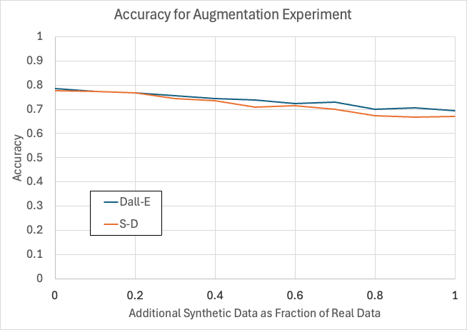
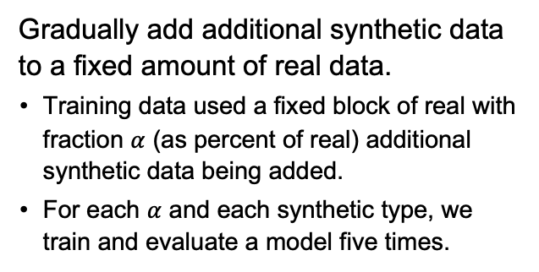

Augmentation Experiment Results
Training
Valid.
Test
fixed size
$$α$$
Real
Synthetic
Gradually add additional synthetic data to a fixed amount of real data.
Training data used a fixed block of real with fraction $α$ (as percent of real) additional synthetic data being added.
For each $α$ and each synthetic type, we train and evaluate a model five times.
Dall-E
SD-1.4
Outcomes
Accuracy actually goes down by adding synthetic training data
Again, as expected, Dall-E-2 outperforms the SD-1.4 data (but only by a bit).
$$α:$$

Slide 15
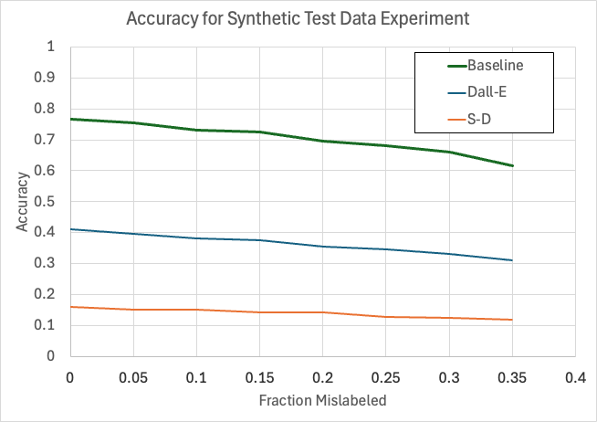
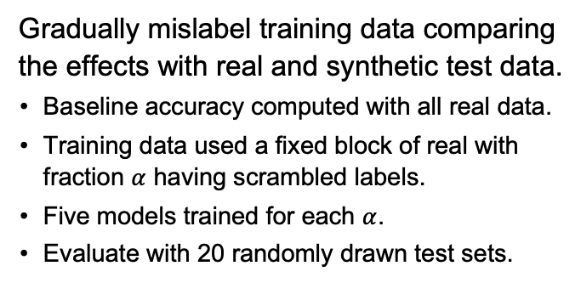
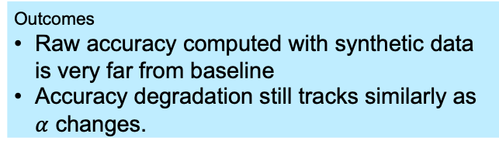

Test Data Experiment
Training
Valid.
Test
exper.
$$α$$
Baseline
Dall-E
SD-1.4
baseline
Real
Synthetic
Mislabeled
Gradually mislabel training data comparing the effects with real and synthetic test data.
Baseline accuracy computed with all real data.
Training data used a fixed block of real with fraction $α$ having scrambled labels.
Five models trained for each $α$.
Evaluate with 20 randomly drawn test sets.
Outcomes
Raw accuracy computed with synthetic data is very far from baseline
Accuracy degradation still tracks similarly as $α$ changes.
$$α:$$

Slide 16
Summary – Two main Types of Results
Question | Data and model chosen for our experiments | Your model and data
How good is your synthetic data compared to your real data on your model? | Visually, the synthetic data ”looked” realistic But both the Dall-E and the SD-1.4 synthetic data sets performed worse than the real data. Dall-E performed slightly better than SD-1.4 More is not always better. Augmentation experiments indicate adding synthetic data to existing real training data may decrease your accuracy. | Specific results will depend on the model and how you generate your synthetic data. ”Looks good” to the human eye may not be enough. More is not always better. You need to evaluate your data. May be worthwhile for initial development.
Can you quantify the difference in terms of model performance? | Initial binary discrimination experiments yielded 0.776 for Dall-E and 0.855 for SD-1.4 indicating the Dall-E data is harder to distinguish from real data. Relative difference predicted actual drops in accuracy on the training and test experiments. | Begin by building real-vs-synthetic binary discriminator to compare the quality of proposed synthetic data sets. Expect accuracy for test and training with synthetic data to degrade more quickly for data that scores “high” on binary discriminator.
Where should you use your real data when you have a limited amount? | The impact of using synthetic data on the test experiments was much higher than for the training experiments. This suggests use real data on your test experiments first. | Expect real data to be more useful for test. Synthetic data may be useful for training if real data is hard to obtain, and you are tolerant of the decrease in accuracy.

