Slide 1
A Reliability Assurance Test Planning and Analysis Tool
Presenter: Emma Mitchell
Co-Authors: John Haman, Rebecca Medlin, Curtis Miller, Dhruv Patel, and Keyla Pagán-Rivera
DATAWorks 2025

Slide 2



Bottom Line Up Front
?
Motivation
Problem
Project Goal
We would like to size a test for evaluating system reliability.
We would like to incorporate prior knowledge of the system.
It is often difficult to scope a test that is long enough to ensure adequate assessment of system reliability.
No user-friendly software to implement prior data into reliability assurance test.
Develop an R Shiny app for the Test Science website
Planning: Use Bayesian methods to leverage supplementary data when determining appropriate test length, which may reduce testing.
Analysis: Use Bayesian methods to combine information and better quantify uncertainty through credible intervals.
Outcome
A Bayesian reliability tool for T&E community to use in reliability planning and analysis.

Slide 3


Big Picture – What is Reliability and Why is it Important to T&E?
Reliability
Probability that a system performs its intended function under operating conditions for a specified period of time.
The reliability quantity of interest is typically the MTBF.
Example: We want an elevator to be reliable, meaning it should consistently operate without getting stuck during normal usage over time.
Definition
Importance
MTBF – Mean Time Between Failures

Slide 4
Big Picture – What is Reliability and Why is it Important to T&E?
Reliability
An unreliable system may impact the mission, resulting in errors, delays, or even accidents.
Unreliable systems also increase system costs over time.
Planning a test with reliability in mind will inform us which systems are robust, cost-effective, and capable of meeting operational demands.
Definition
Importance
MTBF – Mean Time Between Failures
Notes:
If we plan a test with reliability in mind we can hopefully prevent against having an unreliable system as out end product

Slide 5


Case Study: Testing a New Variant of a Cargo Helicopter
Supports a variety of operations, such as:
Air movement (e.g., carry cargo, personnel)
Casualty evacuation
Aerial recovery
Area resupply

Slide 6




Case Study: Testing a New Variant of a Cargo Helicopter
Reliability requirement of 35 flight hours MTBF.
Reliability objective of 70 flight hours MTBF.
Prior developmental testing included 329 flight hours and 7 mission failures.
Some system changes might imply an estimated 10 to 30 percent decrease in reliability from DT to OT.
How long should we test the helicopter, and what should be the maximum number of failures allowed when demonstrating the requirement with confidence?
MTBF – Mean Time Between Failures

Slide 7
Reliability Demonstration Test – The Traditional Approach to Test Planning
A reliability demonstration test assumes we will use only the data from the current test to assess whether the reliability quantity of interest (e.g., MTBF) meets or exceeds the requirement.
An Operating Characteristics Curve is a useful tool for determining and comparing reliability plans.
The test length is informed by:
The reliability requirement
The system’s true reliability
The risk we are willing to accept in making an incorrect statement about the system’s reliability
A Reliability Demonstration Test often requires lengthy testing periods or a very high true MTBF. (Unlikely!)
MTBF – Mean Time Between Failures
Notes:
If we choose the shortest test plan which requires 105 hours of testing, we can see we would need a true MTBF of around 95 flight hours to have a high probability of demonstrating reliability. However a true MTBF of 95 flight hours is unlikely since it is larger than even our objective (70). In order to avoid making an unlikely assumption about the true reliability we would require a much longer testing period.

Slide 8
Reliability Assurance Test – A Bayesian Approach to Test Planning
A Bayesian reliability assurance test uses all contextual information with the goal of reducing the required amount of testing.
Contextual information includes:
- Earlier test results on the same or similar systems
- Expert judgment regarding performance
- Knowledge of the environmental conditions under which the systems are used
- Prior knowledge of possible failures
A Bayesian reliability assurance test often works best when…
- Minimal system changes expected between testing
- Longer previous testing periods
- Proposed test length from a reliability demonstration test is not feasible

Slide 9
Bayesian Reliability Assurance test plans are more efficient than traditional Reliability Demonstration Plans in this case study.
Comparing Traditional and Bayesian Test Plans: Prescribed Flight Hours by Number of Allowed Failures
Bayesian Test Length
Traditional Test Length
Test Plan Prescribed Flight Hours
Notes:
Now that we have talked about both the RDT and BAT, we can compare the approaches using our helicopter case study

Slide 10
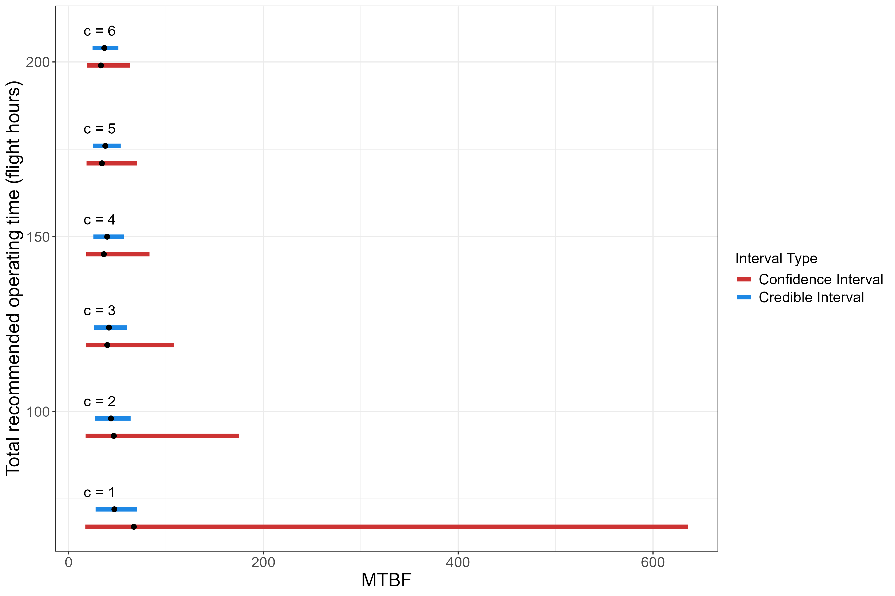
Comparing the Expected Bayesian and Traditional Reliability Estimates with 80% Intervals for each Specified Test Plan
(199 fh, 6)
Bayesian Interval
Traditional Interval
(171 fh, 5)
(145 fh, 4)
Bayesian Reliability Test Plans (flight hours (fh), failures)
(119 fh, 3)
(93 fh, 2)
(67 fh, 1)
0 100 200 300 400 500 600
MTBF
Incorporating previous test data reduces uncertainty around the MTBF estimates.
MTBF: Mean Time Between Failure
Notes:
If we observe a test exactly like what we planned for, the interval produced by incorporating previous test data shown in blue is always contained within the interval constructed using traditional methods. This means incorporating previous testing data reduced uncertainty around the MTBF estimates and gives a better understanding of the helicopter's reliability.

Slide 11
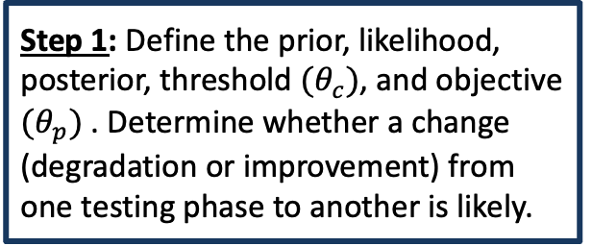
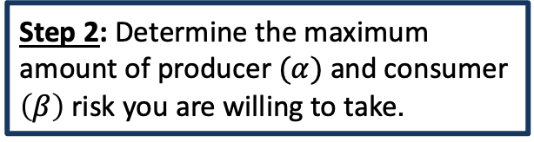
Bayesian Reliability Assurance Test – What are the steps?
Step 1: Define the prior, likelihood, posterior, threshold $(θ_{c})$, and objective $(θ_{p})$ . Determine whether a change (degradation or improvement) from one testing phase to another is likely.
Step 4: Compute the unconditional probability of passing for each test plan.
Reliability Assurance Test
Step 2: Determine the maximum amount of producer $(α)$ and consumer $\left(β\right)$ risk you are willing to take.
Step 3: Solve for test plans.

Slide 12
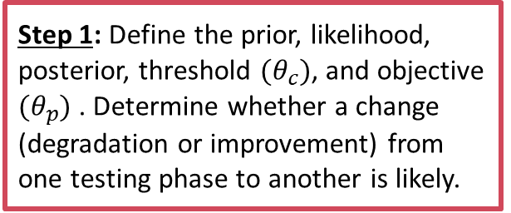
Bayesian Reliability Assurance Test – What are the steps?
Step 1: Define the prior, likelihood, posterior, threshold $(θ_{c})$, and objective $(θ_{p})$ . Determine whether a change (degradation or improvement) from one testing phase to another is likely.
Step 4: Compute the unconditional probability of passing for each test plan.
Reliability Assurance Test
Step 2: Determine the maximum amount of producer $(α)$ and consumer $\left(β\right)$ risk you are willing to take.
Step 3: Solve for test plans.

Slide 13
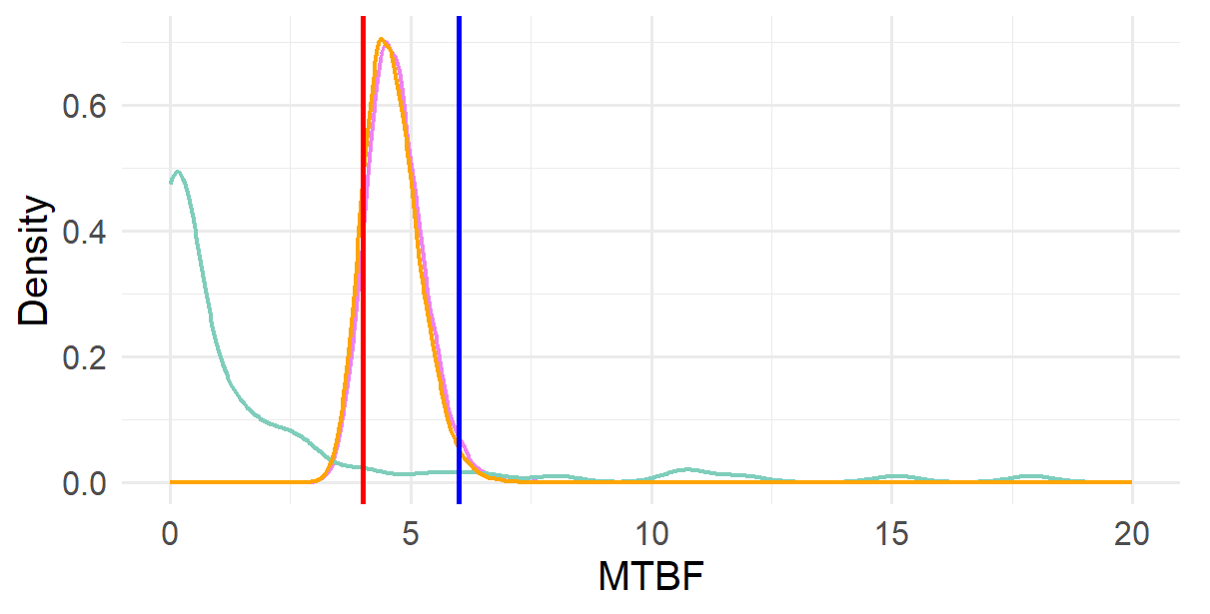
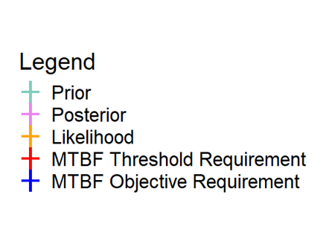
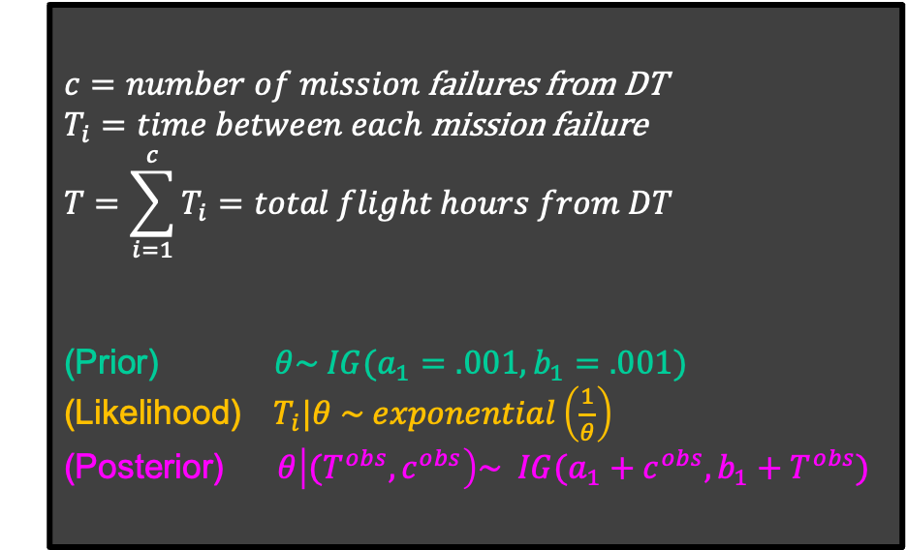

First, define the Prior, Likelihood, and Posterior…
$c=number of mission$ failures from DT
$T_{i}=time between each$mission failure
$$T=\sum_{i=1}^{c}{T_{i}=total flight hours from DT}$$
(Prior) $θ\sim IG(a_{1}=.001,b_{1}=.001)$
(Likelihood) $T_{i}|θ \sim exponential\left(\frac{1}{θ}\right)$
(Posterior)$θ\left|{(T}^{obs},c^{obs}\right)\sim IG(a_{1}+c^{obs}, b_{1}+T^{obs})$
i.i.d.
$$(θ)$$
The posterior is the updated distribution of MTBF given our supplemental data and will serve as our prior belief about MTBF when we solve for a test plan.
DT – Developmental Testing; MTBF – Mean Time Between Failures

Slide 14
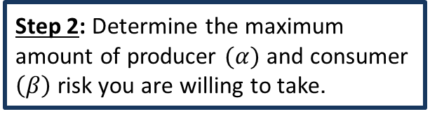
Bayesian Reliability Assurance Test – What are the steps?
Step 1: Define the prior, likelihood, posterior, threshold $(θ_{c})$, and objective $(θ_{p})$ . Determine whether a change (degradation or improvement) from one testing phase to another is likely.
Step 4: Compute the unconditional probability of passing for each test plan.
Reliability Assurance Test
Step 2: Determine the maximum amount of producer $(α)$ and consumer $\left(β\right)$ risk you are willing to take.
Step 3: Solve for test plans.

Slide 15
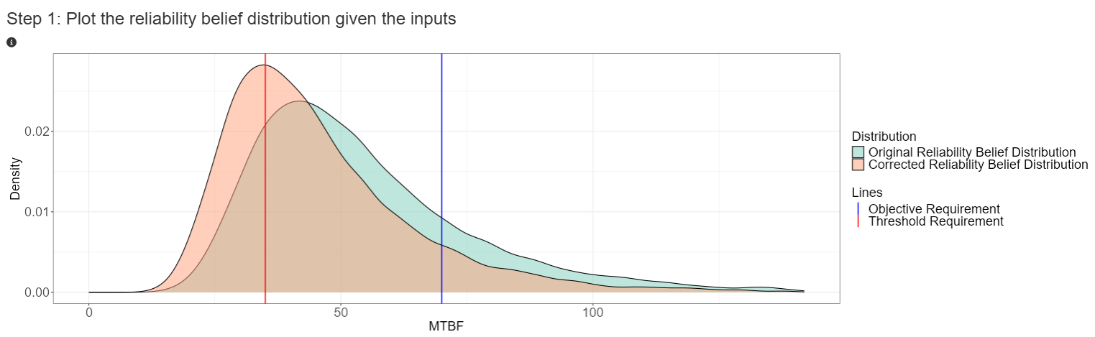
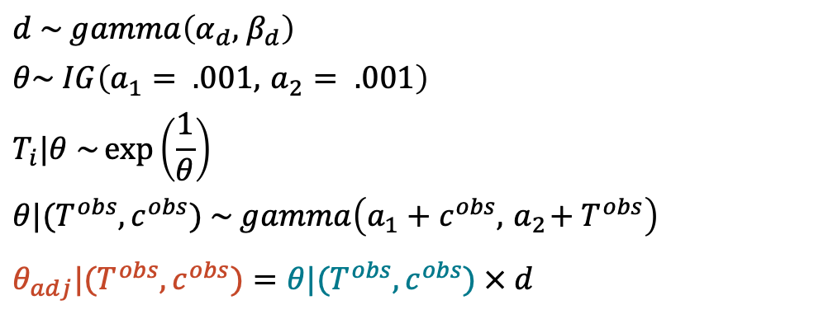
… And determine whether a change (i.e., a degradation or improvement) from one test phase to another is likely.
$$d \sim gamma\left(α_{d}, { β}_{d}\right)$$
$$θ\sim IG\left(a_{1}= .001, { a}_{2} = .001\right)$$
$$T_{i}|θ \sim \exp\left(\frac{1}{θ}\right)$$
$$θ|(T^{obs},c^{obs}) \sim gamma\left(a_{1}+c^{obs}, { a}_{2}+ T^{obs}\right)$$
$$θ_{adj}|(T^{obs},c^{obs})=θ|(T^{obs},c^{obs}) × d$$
Deg./Imp. Factor
Example Phases: DT to OT
Original MTBF Prior
Developmental Testing (DT):
Usually conducted in a more controlled environment.
Tested by non-operationally representative users.
Testing is often longer, with a focus on verifying system requirements.
i.i.d.
Original Likelihood
Original MTBF Posterior
Adjusted MTBF
Legend
Original Posterior
Operational Testing (OT):
Production-representative systems.
Conducted in operationally realistic environment.
Tested by real users.
Duration of testing is often limited.
Adjusted Posterior
Density
Threshold Requirement
Objective Requirement
MTBF
Failing to incorporate a degradation factor could lead to inadequate test plans.
Source: Gilman, J. F., Fronczyk, K. M., & Wilson, A. G. (2018). Bayesian modeling and test planning for multiphase reliability assessment. Quality and Reliability Engineering International, 35(3), 750-760. https://doi.org/10.1002/qre.2406

Slide 16
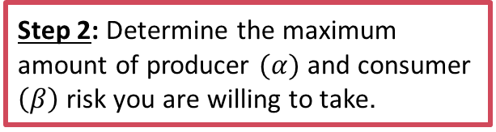
Bayesian Reliability Assurance Test – What are the steps?
Step 1: Define the prior, likelihood, posterior, threshold $(θ_{c})$, and objective $(θ_{p})$ . Determine whether a change (degradation or improvement) from one testing phase to another is likely.
Step 4: Compute the unconditional probability of passing for each test plan.
Reliability Assurance Test
Step 2: Determine the maximum amount of producer $(α)$ and consumer $\left(β\right)$ risk you are willing to take.
Step 3: Solve for test plans.

Slide 17
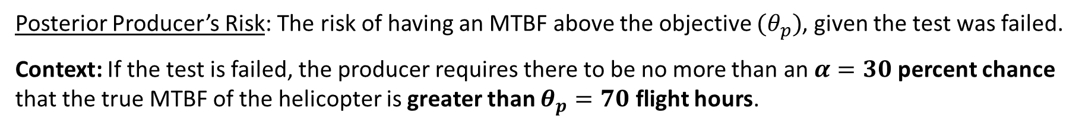
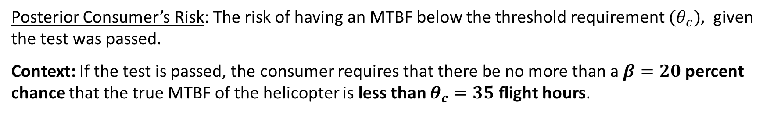
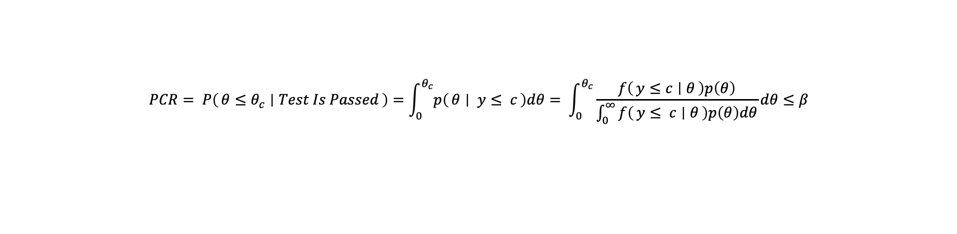
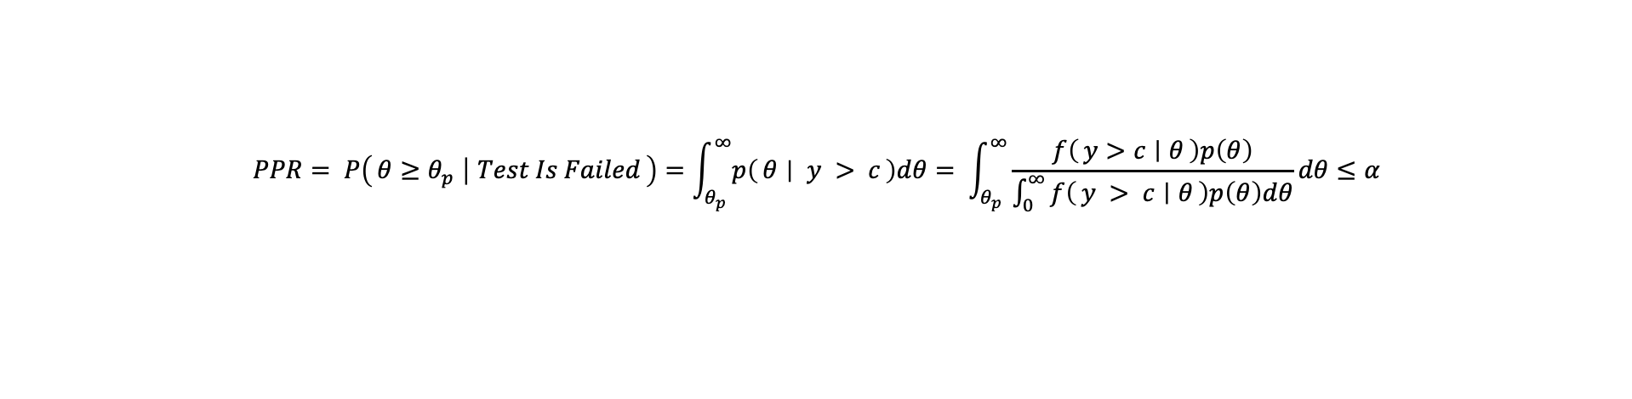
Second, choose the maximum amount of risk you are willing to take.
Posterior Producer’s Risk: The risk of having an MTBF above the objective $(θ_{p})$, given the test was failed.
Context: If the test is failed, the producer requires there to be no more than an $α=30$percent chance that the true MTBF of the helicopter is greater than $θ_{p}=70$ flight hours.
$$PPR= P\left(θ≥θ_{p} ∣ Test Is Failed\right)=\int_{θ_{p}}^{∞}{p\left(θ ∣ y > c\right)dθ}= \int_{θ_{p}}^{∞}{\frac{f\left(y>c ∣ θ\right)p\left(θ\right)}{\int_{0}^{∞}{f\left(y > c ∣ θ\right)p\left(θ\right)dθ}}dθ}≤α$$
Posterior Consumer’s Risk: The risk of having an MTBF below the threshold requirement $(θ_{c})$, given the test was passed.
Context: If the test is passed, the consumer requires that there be no more than a $β=20$percent chance that the true MTBF of the helicopter is less than $θ_{c}=35$flight hours.
$$PCR= P\left(θ≤θ_{c} ∣ Test Is Passed\right)=\int_{0}^{θ_{c}}{p\left(θ ∣ y≤ c\right)dθ}= \int_{0}^{θ_{c}}{\frac{f\left(y≤c ∣ θ\right)p\left(θ\right)}{\int_{0}^{∞}{f\left(y≤ c ∣ θ\right)p\left(θ\right)dθ}}dθ}≤β$$
The system passes the test if we observe c or fewer failures in total operating time T.
MTBF – Mean Time Between Failures

Slide 18
Bayesian Reliability Assurance Test – What are the steps?
Step 1: Define the prior, likelihood, posterior, threshold $(θ_{c})$, and objective $(θ_{p})$ . Determine whether a change (degradation or improvement) from one testing phase to another is likely.
Step 4: Compute the unconditional probability of passing for each test plan.
Reliability Assurance Test
Step 2: Determine the maximum amount of producer $(α)$ and consumer $\left(β\right)$ risk you are willing to take.
Step 3: Solve for test plans.

Slide 19
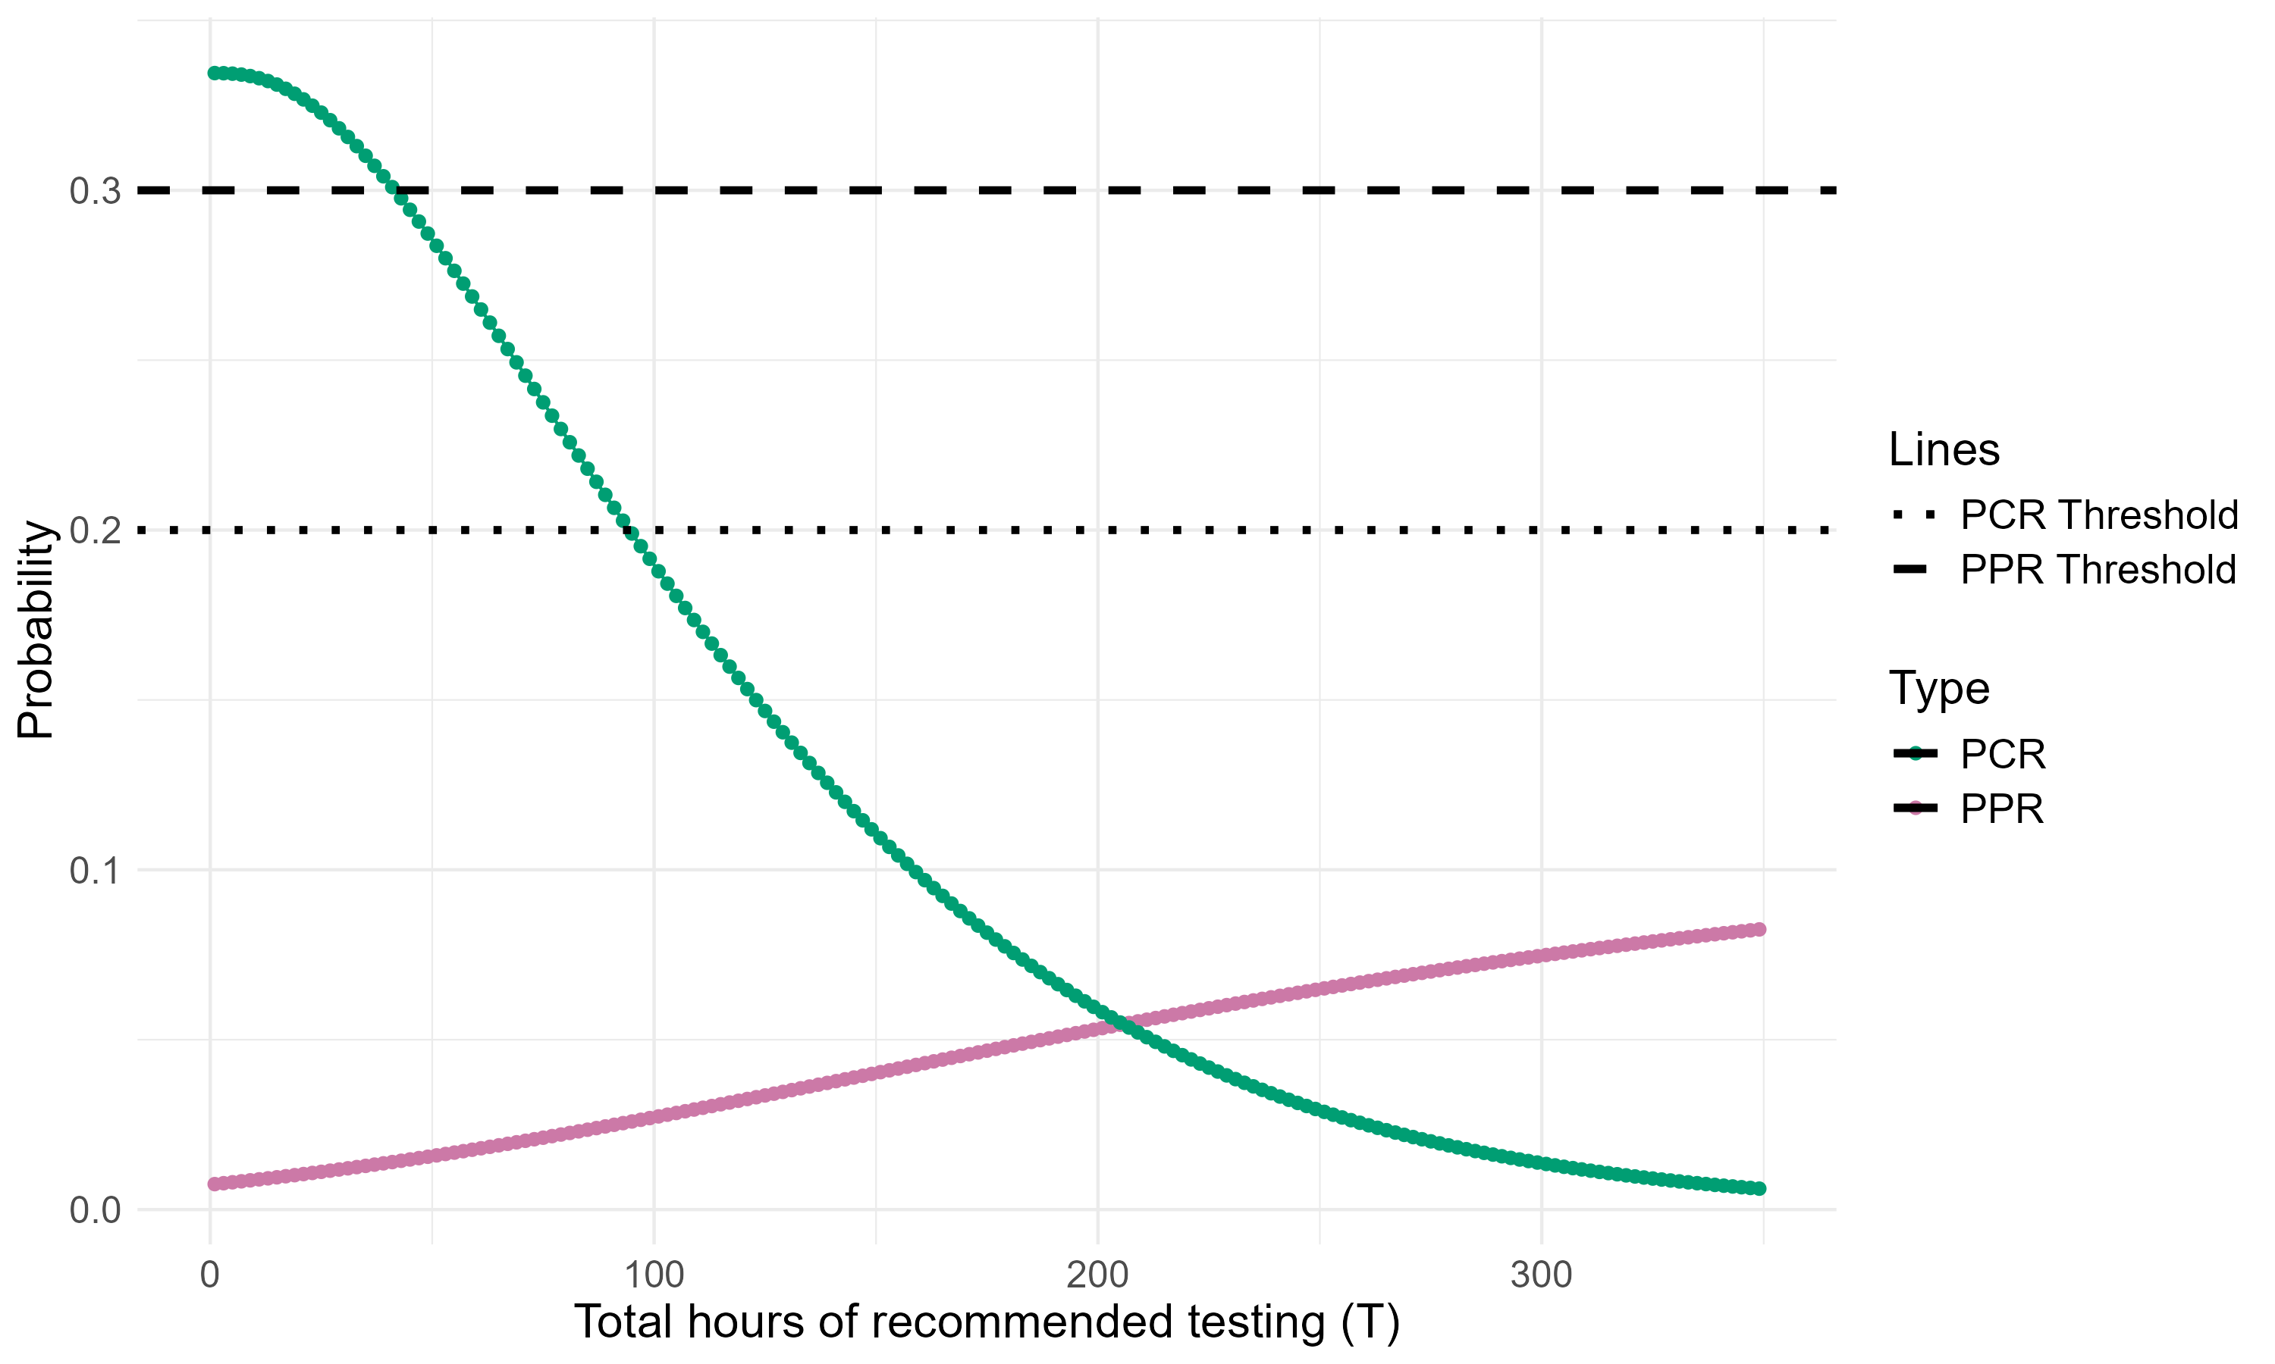
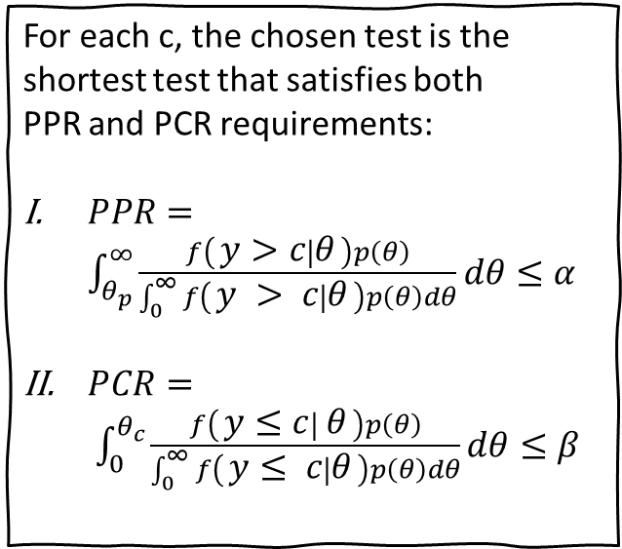


Solve for a Test Plan
PPR and PCR Plot for a 2 Failure Test
For each c, the chosen test is the shortest test that satisfies both PPR and PCR requirements:
$PPR=\int_{θ_{p}}^{∞}{\frac{f\left(y>c ∣ θ\right)p\left(θ\right)}{\int_{0}^{∞}{f\left(y > c ∣ θ\right)p\left(θ\right)dθ}}dθ}≤α$
$PCR= \int_{0}^{θ_{c}}{\frac{f\left(y≤c ∣ θ\right)p\left(θ\right)}{\int_{0}^{∞}{f\left(y≤ c ∣ θ\right)p\left(θ\right)dθ}}dθ}≤β$
$$(α)$$
$$(β)$$
Probability
Chosen T for a c = 2 failure test
Operating Time (T)
C – Maximum allowed number of failures; PCR – Posterior Consumer’s Risk; PPR – Posterior Producer’s Risk

Slide 20
Bayesian Reliability Assurance Test – What are the steps?
Step 1: Define the prior, likelihood, posterior, threshold $(θ_{c})$, and objective $(θ_{p})$ . Determine whether a change (degradation or improvement) from one testing phase to another is likely.
Step 4: Compute the unconditional probability of passing for each test plan.
Reliability Assurance Test
Step 2: Determine the maximum amount of producer $(α)$ and consumer $\left(β\right)$ risk you are willing to take.
Step 3: Solve for test plans.

Slide 21
UPPT determines how likely your system is to pass
UPPT can be used to help the evaluator choose a test plan in a situation where multiple test plans meet both PPR and PCR thresholds.
Low UPPT is bad: The system will likely fail future tests.
Historical data indicate low reliability.
Test plan is inadequate.
Requirements are stringent.
High UPPT is suspicious: The system will likely pass future tests.
Historical data indicate high reliability.
Test plan requires lots of testing.
Requirements are lenient.
Low UPPT (<.5)
Good UPPT (between .5 and .9)
High UPPT (>.9)
OT – Operational Testing; DT – Developmental Testing; UPPT – Unconditional Probability of Passing Test

Slide 22






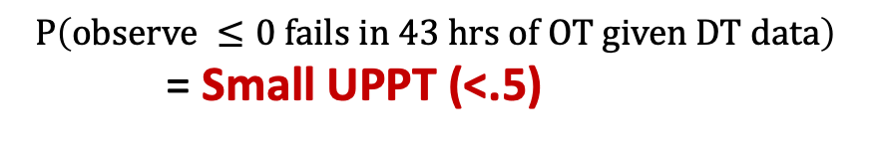

Low UPPT Example
If …
Test Plan
DT Data
Requirement
$$+$$
$$+$$
$$implies$$
$$P\left(observe ≤0 fails in 43 hrs of OT given DT data\right)$$
= Small UPPT (<.5)
0 allowed MF
43 hours
7 MF
329 hours
35 hours (MTBF)
OT Data
Decision
Then regardless of …
FAIL
$$you will likely$$
1 MF in 43 hours = 43 hours (MTBF)
DT – Developmental Testing; MF – Mission Failures; MTBF – Mean Time Between Failures; OT – Operational Testing; UPPT – Unconditional Probability of Passing Test

Slide 23
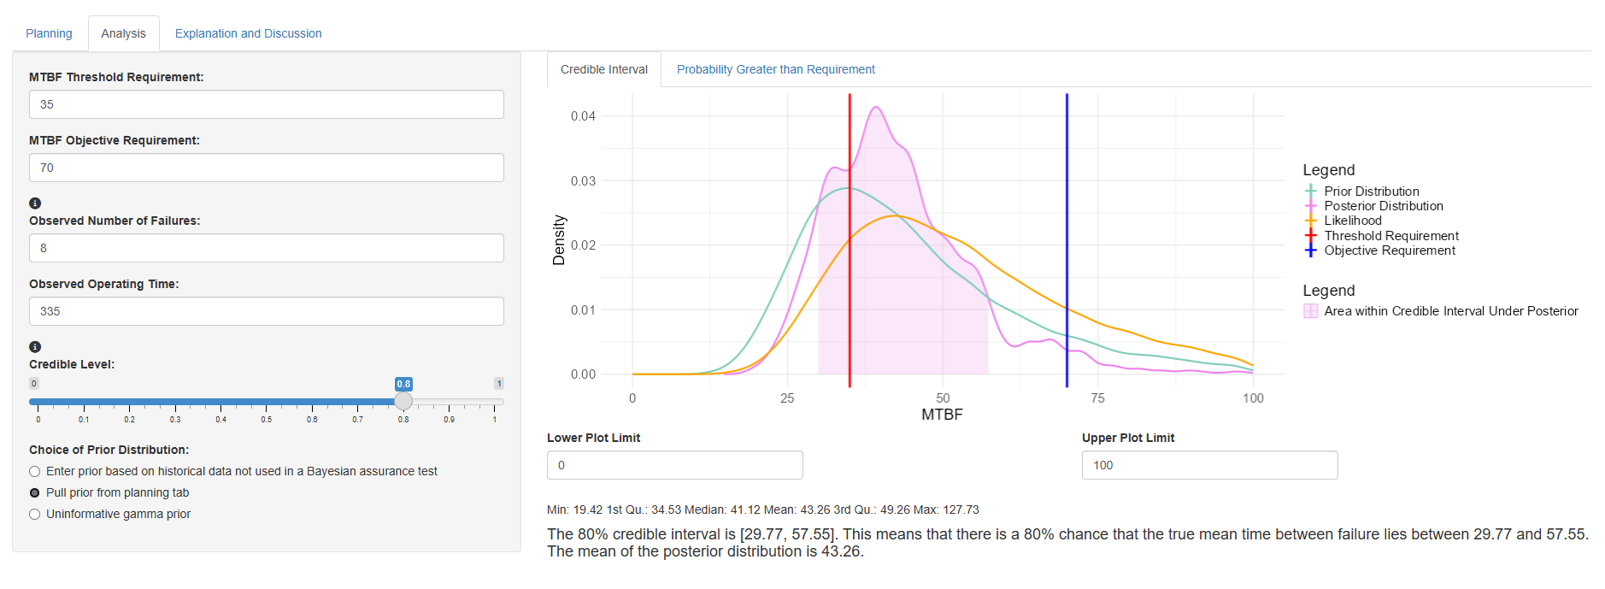
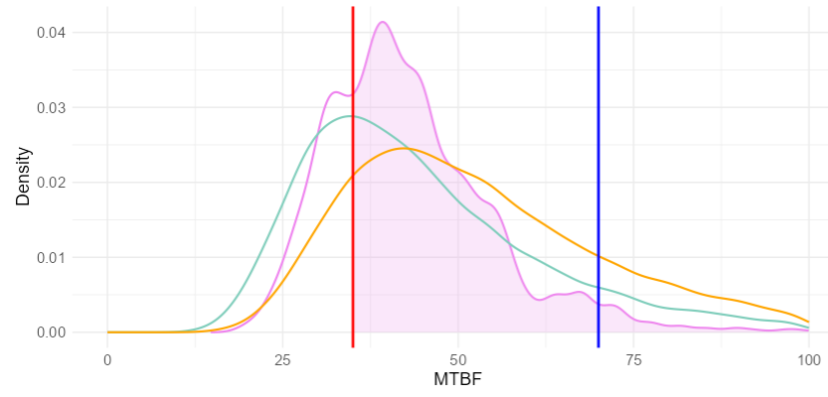
What does analyzing data from a Bayesian Assurance Test Provide Evaluators?
Credible Interval
Once the prior is defined, my app provides evaluators with:
Credible intervals that define the range within which the true MTBF is likely to lie
A probabilistic assessment of whether the system meets the established requirements
Probability Greater than Requirement
MTBF – Mean Time Between Failure

Slide 24
Plan with Ease

Slide 25
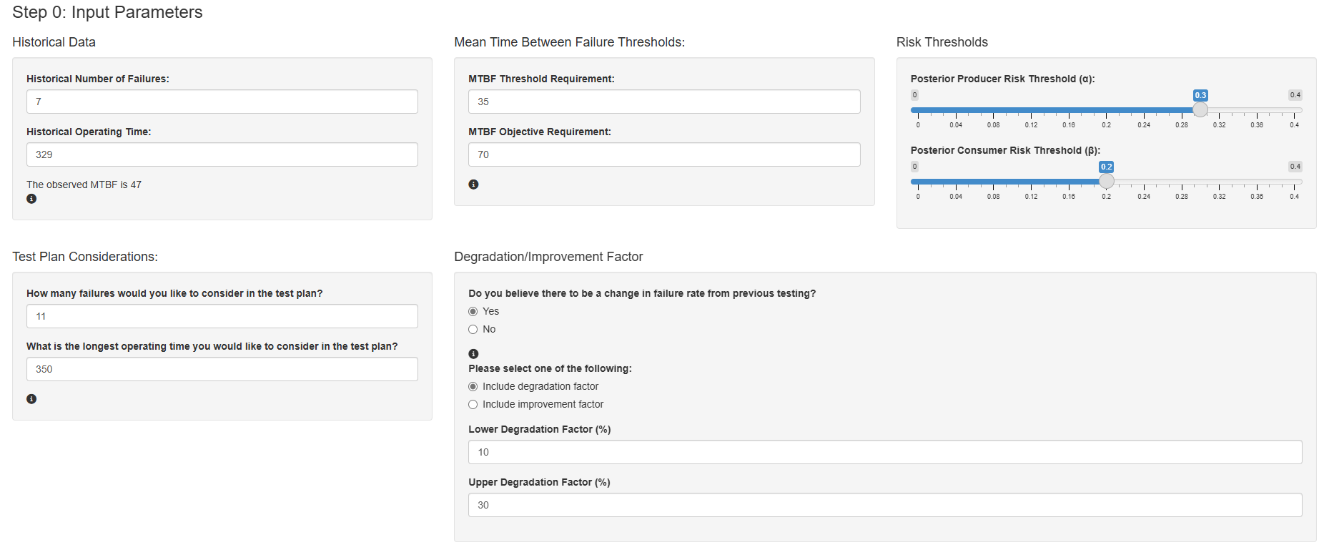
Plan with Ease – Perform a Bayesian Assurance Test using my app
DT Data
DT – Developmental Testing ; MTBF – Mean Time Between Failures

Slide 26
Plan with Ease – Perform a Bayesian Assurance Test using my app
Minimum acceptable reliability and desired reliability
DT Data
DT – Developmental Testing ; MTBF – Mean Time Between Failures

Slide 27
Plan with Ease – Perform a Bayesian Assurance Test using my app
Amount of risk we are willing to accept for making a wrong decision
Minimum acceptable reliability and desired reliability
DT Data
DT – Developmental Testing ; MTBF – Mean Time Between Failures

Slide 28
Plan with Ease – Perform a Bayesian Assurance Test using my app
Amount of risk we are willing to accept for making a wrong decision
Minimum acceptable reliability and desired reliability
DT Data
What is the longest test time and largest number of failures you are willing to consider in the test plan?
DT – Developmental Testing ; MTBF – Mean Time Between Failures

Slide 29
Plan with Ease – Perform a Bayesian Assurance Test using my app
Amount of risk we are willing to accept for making a wrong decision
Minimum acceptable reliability and desired reliability
DT Data
We know there are some system changes from DT to OT
What is the longest test time and largest number of failures you are willing to consider in the test plan?
DT – Developmental Testing ; MTBF – Mean Time Between Failures

Slide 30
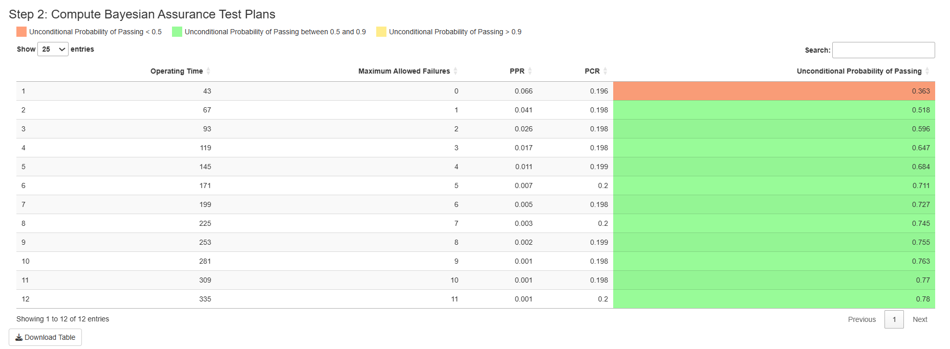
Plan with Ease – Perform a Bayesian Assurance Test using my app
All test plans have PPR less than .3
PPR – Posterior Producer’s Risk ; PCR – Posterior Consumer’s Risk; UPPT – Unconditional Probability of Passing Test

Slide 31
Plan with Ease – Perform a Bayesian Assurance Test using my app
All test plans have PPR less than .3
…and PCR less than .2
PPR – Posterior Producer’s Risk ; PCR – Posterior Consumer’s Risk; UPPT – Unconditional Probability of Passing Test

Slide 32
Plan with Ease – Perform a Bayesian Assurance Test using my app.
Tradeoff between long test plans with little risk and shorter test plans with higher risk
All test plans have PPR less than .3
…and PCR less than .2
PPR – Posterior Producer’s Risk ; PCR – Posterior Consumer’s Risk; UPPT – Unconditional Probability of Passing Test

Slide 33
Plan with Ease – Perform a Bayesian Assurance Test using my app.
Not all test plans have a good UPPT
Tradeoff between long test plans with little risk and shorter test plans with higher risk
All test plans have PPR less than .3
…and PCR less than .2
PPR – Posterior Producer’s Risk ; PCR – Posterior Consumer’s Risk; UPPT – Unconditional Probability of Passing Test

Slide 34
Analyze with Ease

Slide 35
Analyze with Ease – Analyze Data from a Bayesian Assurance Test using my app
PPR – Posterior Producer’s Risk ; PCR – Posterior Consumer’s Risk; UPPT – Unconditional Probability of Passing Test

Slide 36
Analyze with Ease – Analyze data from a Bayesian Assurance Test using my app
Statistical Interpretation:
There is an 80 percent probability the true MTBF falls within 29.77 and 57.55.
There is a 73 percent chance the true MTBF is greater than the threshold requirement.,
The estimated MTBF (mean of posterior) is 43.26.
MTBF – Mean Time Between Failures

Slide 37
Closing Remarks
Bayesian assurance test plans can be more efficient than traditional reliability demonstration test plans.
Incorporating previous testing data can reduce uncertainty for the MTBF estimate.
The app I developed provides OED researchers a simple and convenient way to implement Bayesian assurance testing.
Comparing the Expected Bayesian and Traditional Reliability Estimates with 80% Intervals for each Specified Test Plan
(199 fh, 6)
Bayesian Interval
Traditional Interval
(171 fh, 5)
Comparing Traditional and Bayesian Test Plan Prescribed Flight Hours by Number of Allowed Failures
(145 fh, 4)
Bayesian Test Length
Bayesian Reliability Test Plans (flight hours (fh), failures)
Traditional Test Length
(119 fh, 3)
(93 fh, 2)
(67 fh, 1)
0 100 200 300 400 500 600
MTBF
RDT – Reliability Demonstration Test; BAT – Bayesian Assurance Test; MTBF – Mean Time Between Failures

Slide 38
Future Work
Publish R Shiny Application on Test Science Website.
Author a paper for The ITEA Journal of Test and Evaluation to increase awareness of method/application.
Extend to additional failure time distributions (e.g., Weibull).

Slide 39
References
Gilman, J. F., Fronczyk, K. M., & Wilson, A. G. (2018). Bayesian modeling and test planning for multiphase reliability assessment. Quality and Reliability Engineering International, 35(3), 750-760. https://doi.org/10.1002/qre.2406
Hamada, M. S., Wilson, A. G., Reese, C. S., & Martz, H. F. (2008). Bayesian reliability. Springer. https://doi.org/10.1007/978-0-387-77950-8

Slide 40
Backup

Slide 41



So the second step is to decide on the maximum allowable producer and consumer risk you would like to take
Posterior Consumer’s Risk: The probability the system’s reliability is worse than the MTBF requirement, given the test is passed and historical data on the system’s reliability.
$$=P\left(λ≥λ_{1} | Test is Passed,x\right)$$
$≈\frac{\sum_{j=1}^{N}{\left[\sum_{y=0}^{c}{\frac{{\left(λ^{(j)}T\right)}^{y}\exp\left(−λ^{(j)}T\right)}{y!}}\right]}I\left(λ^{(j)}≥λ_{1}\right)}{\sum_{j=1}^{N}{\left[\sum_{y=0}^{c}{\frac{{\left(λ^{(j)}T\right)}^{y}\exp\left(−λ^{(j)}T\right)}{y!}}\right]}}$ $≤β$
Where $x$ is available historical data and $λ^{(j)}$ is the number of draws from the posterior given our historical data
PCR
PPR
Source: Michael S. Hamada et al., Bayesian Reliability, 2008, Chapter 10.
Note: The expression Test is Failed means that the number of observed failures is larger than the maximum number of allowed failures. That is, $y>c$. Similarly, Test is Passed means that $y≤c$.

Slide 42
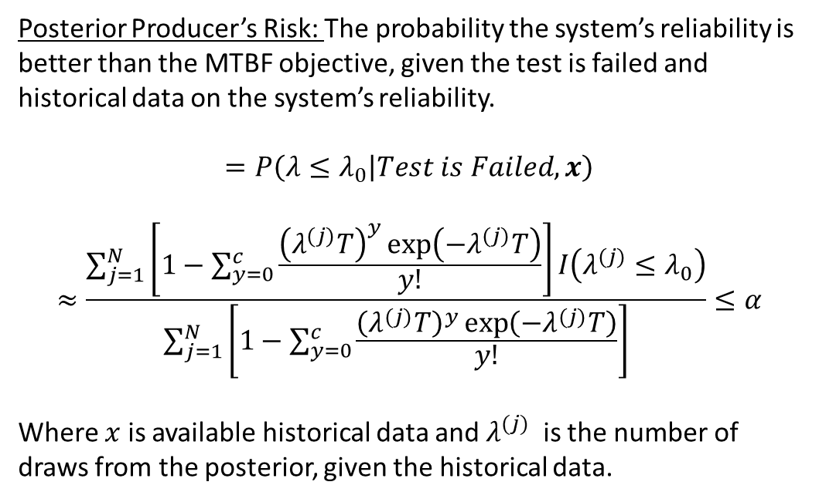
So the second step is to decide on the maximum allowable producer and consumer risk you would like to take
Posterior Producer’s Risk: The probability the system’s reliability is better than the MTBF objective, given the test is failed and historical data on the system’s reliability.
$$=P\left(λ≤λ_{0} | Test is Failed,x\right)$$
$$≈\frac{\sum_{j=1}^{N}{\left[1−\sum_{y=0}^{c}{\frac{{\left(λ^{(j)}T\right)}^{y}\exp\left(−λ^{(j)}T\right)}{y!}}\right]}I\left(λ^{(j)}≤λ_{0}\right)}{\sum_{j=1}^{N}{\left[1−\sum_{y=0}^{c}{\frac{{\left(λ^{(j)}T\right)}^{y}\exp\left(−λ^{(j)}T\right)}{y!}}\right]}}≤α$$
Where $x$ is available historical data and $λ^{(j)}$is the number of draws from the posterior, given the historical data.
PCR
PPR
Source: Michael S. Hamada et al., Bayesian Reliability, 2008, Chapter 10.
Note: The expression Test is Failed means that the number of observed failures is larger than the maximum number of allowed failures. That is, $y>c$. Similarly, Test is Passed means that $y≤c$.

Slide 43
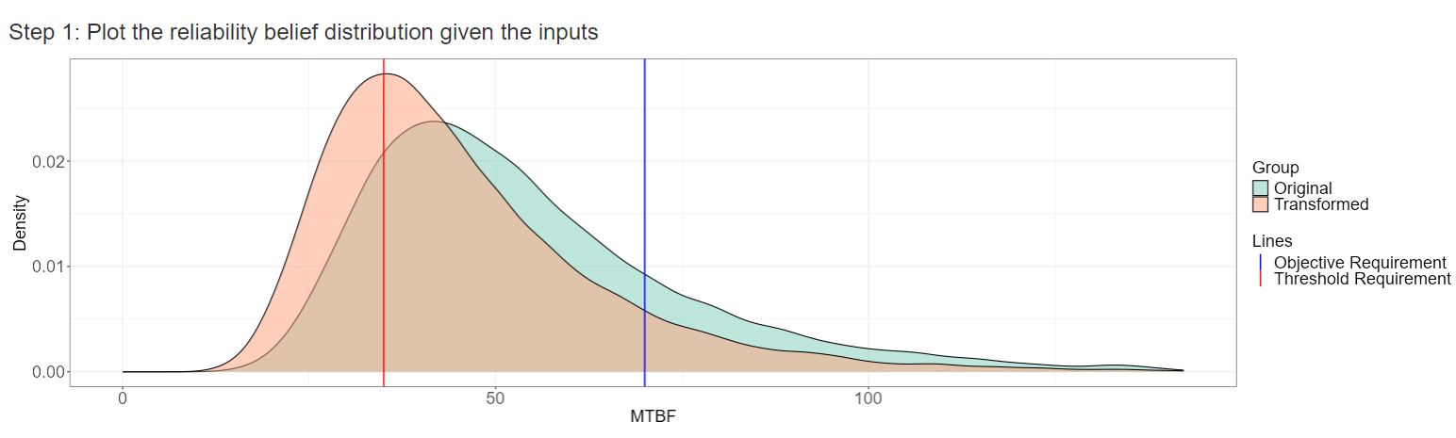
What does the Reliability Belief Distribution indicate?
Transformed = 10-30% degradation
Updated distribution of mean time between failure, given DT data
Previous testing suggests reasonable reliability after degradation. A reliability assurance test may be useful.

Slide 44
What can we say about the true MTBF if we implement one of these test plans?
The analysis tab of the app allows the user to...
Quantify uncertainty around the true MTBF with credible intervals
Determine the probability of meeting the minimal acceptable reliability and desired reliability
Characterize the distribution of the MTBF given our prior beliefs/data
Compare the uncertainty around the estimated MTBF across multiple test plans and/or prior beliefs
MTBF – Mean Time Between Failures

Slide 45

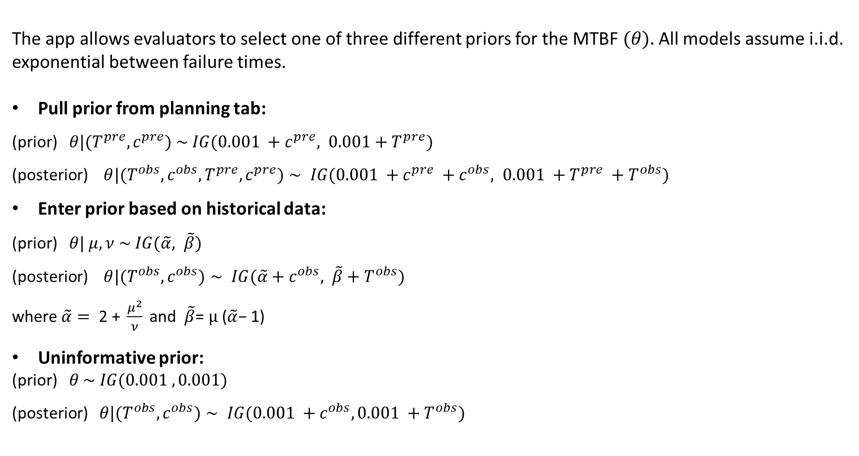
How to analyze data from a Bayesian Assurance Test
The app allows evaluators to select one of three different priors for the MTBF $(θ).$All models assume i.i.d. exponential between failure times.
Pull prior from planning tab:
(prior) $θ|(T^{pre}, c^{pre}) \sim IG(0.001 +c^{pre}, 0.001+T^{pre})$
(posterior) $θ|(T^{obs},c^{obs}, T^{pre}, c^{pre})∼ IG(0.001 +c^{pre} +c^{obs}, 0.001 +T^{pre} +T^{obs})$
Enter prior based on historical data:
(prior) $θ| μ, ν \sim IG(\tilde{α}, \tilde{β})$
(posterior) $θ|(T^{obs},c^{obs})∼ IG(\tilde{α}+c^{obs}, \tilde{β}+T^{obs})$
where$\tilde{α}= \text{2 + }\frac{μ^{2}}{ν} \text{and} \tilde{β}\text{= }μ \text{(}\tilde{α}\text{− 1)}$
Uninformative prior:
(prior) $θ \sim IG(0.001 , 0.001)$
(posterior) $θ|(T^{obs}, c^{obs})∼ IG(0.001 +c^{obs}, 0.001 +T^{obs})$
+ Observe test data
Prior
Posterior
+ Update for next test phase

