Slide 1


High, Hot, and Humid: On the Impacts of Extreme Conditions on Aviation
Dr. Cameron Liang
Dr. Jennifer Bewley
Dr. Abe Holland
April 24, 2025

Slide 2


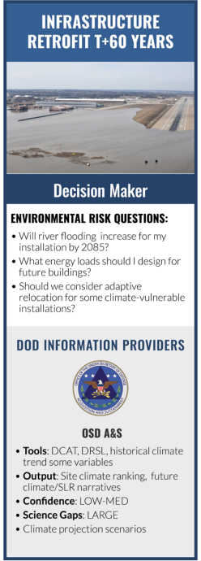
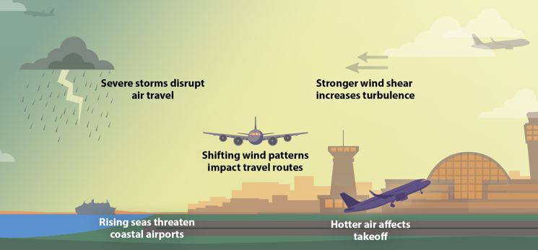
Environmental Resilience Planning: From Urban Infrastructure to Aviation
Rising global temperatures and increasing weather variability are making previously rare extreme events more common. An event that in the past would have occurred once every 100 years may occur once every 10 years.
Communities worldwide have developed adaptation strategies to cope with these more frequent extreme weather conditions.
Environmental risks pose significant threats to the Department of Defense and national security, impacting military operations, infrastructure, and readiness.
Air travel has become more challenging as changing atmospheric conditions affect aircraft performance and operational costs across civil and military aviation.
It will be harder to fly aircraft in the future. Estimates suggest it will cost billions of dollars annually to maintain the same flying capacity.
Hurricane Sandy flooded the subway system in NYC (2012);
restorations cost $4.6B.
25 ton floodgates were installed in NYC (2017); this project cost $64M (floodgates and more).
Image source: https://www.climatecentral.org/
Source: https://www.sustainability.gov/pdfs/dod-2024-cap.pdf
Why are extreme events more frequent? Why is the cost so high?

Slide 3

On the Takeoff Problem: High, Hot and Humid – Air Density in Environmental Shifts
High elevation = thinner air
Warm air = thinner air
Humid air = thinner air
These three factors compound the density reduction.
Aircraft performance decreases in thinner air.
Cold Air
Hot Air
Nitrogen (N₂)
Oxygen (O₂)
Water (H₂O)
Dry Air
Humid Air
The mean molecular weight is smaller.
The more volume the water vapor takes up, the less
mass per volume (i.e., air is less dense).

Slide 4



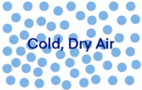
Understanding Density Altitude: A Pilot's Perspective
High DA
14,000 ft
Density altitude (DA) represents the effective altitude an aircraft "feels" it is operating at (low pressure at high altitude).
Dry DA accounts for air temperature's effect on atmospheric pressure.
Moist DA incorporates both temperature and humidity effects.
Standard Atmosphere
10,000 ft
Low DA
6,000 ft
Hot, humid conditions at sea level can create performance challenges equivalent to high-altitude operations.
Equal Pressure Altitude
At runway, the lower the density and higher the DA, the harder it is to takeoff.

Slide 5
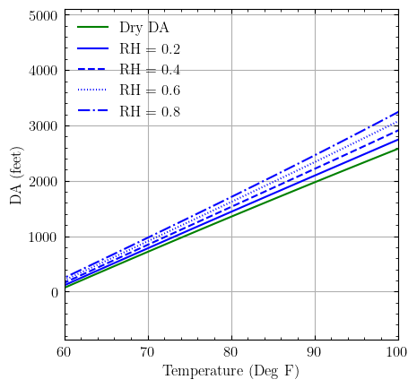
Temperature and Humidity Effects on Density Altitude
DA is the altitude aircraft "feels" it is flying at.
Relative Humidity (RH) significantly affects density altitude.
  Green line: dry air
  Blue lines: increasing humidity (RH = 0.2 to 0.8)
Example at 90°F:
  Dry air DA ≈ 2,000 ft
  At 80% RH, DA ≈ 2,500 ft
  500 ft increase from humidity alone

Slide 6
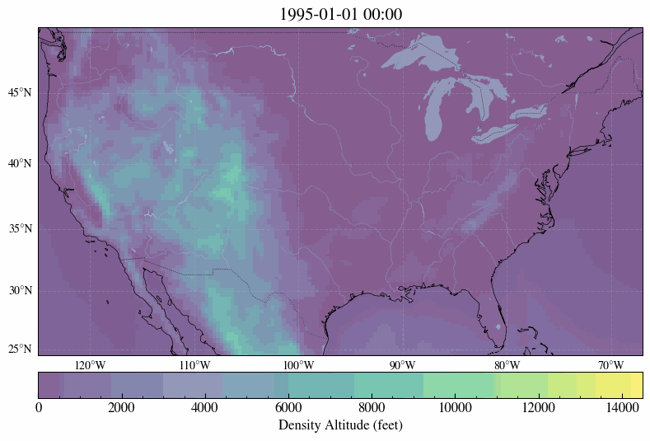
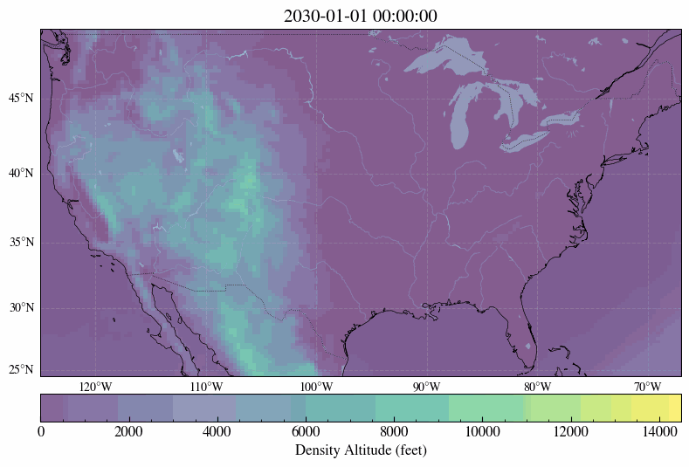
Density Altitude at Ground Level: Historical Observations and Future Projections
Historical
Projection
We used state-of-the-art hydrodynamic simulations to model and project atmospheric conditions into the future.

Slide 7
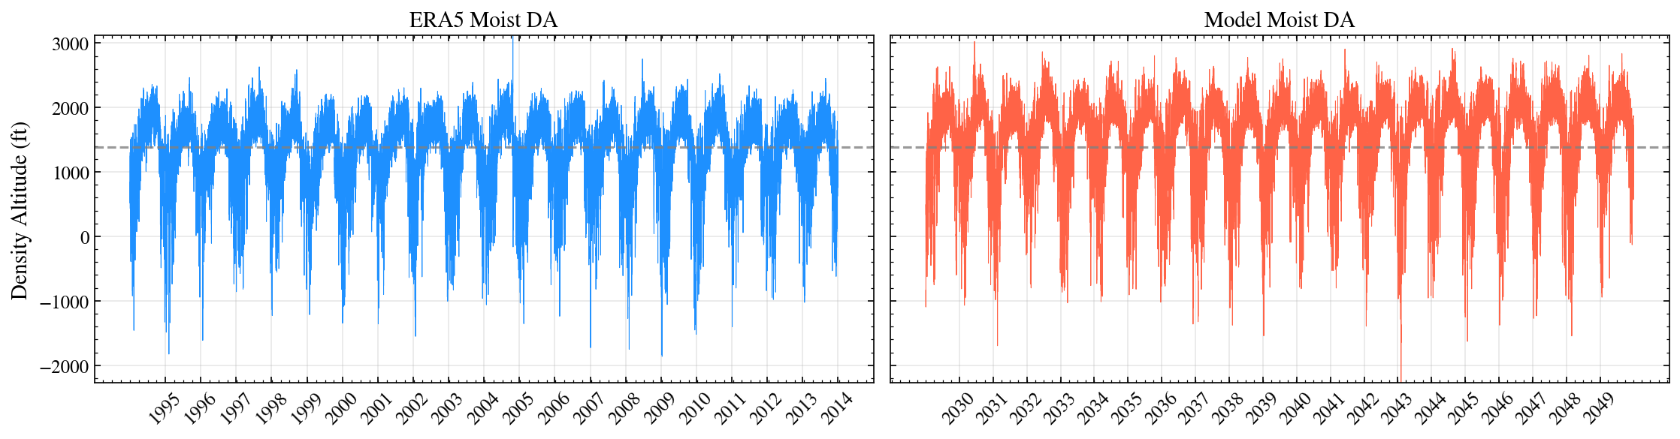

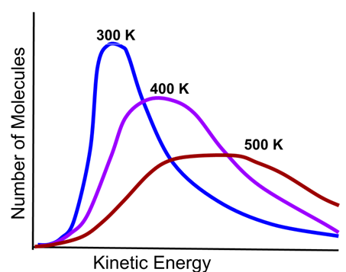
Changes in Density Altitude Over Time (Miami International Airport)
Extremes are more common
Historical Moist DA
Projected Moist DA
Average is higher
Physics 101: As the temperature of a system increases, both the average kinetic energy per molecule and the spread of kinetic energies rise.

Slide 8
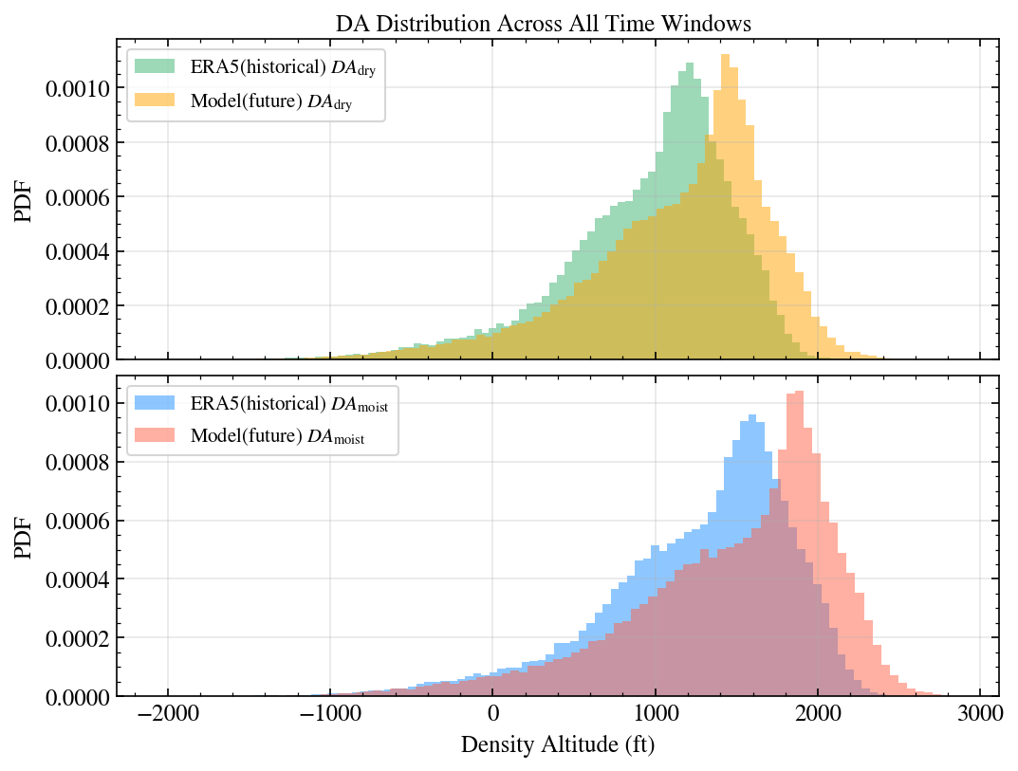
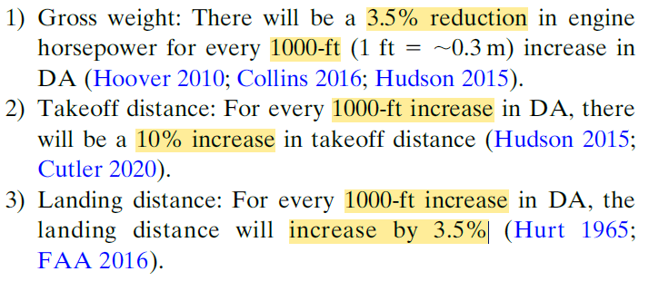
Shifting Distributions of Density Altitude (Miami International Airport)
From Extremes to New Normals
Future projections indicate:
  Increasing mean density altitude
  Widening distributions (more frequent extremes)
  Greater impact when including humidity
Impacts on aviation:
Distributions of Density Altitude (Past & Future)
“General Aviation Rules of Thumb,” McRae et al. 2021

Slide 9
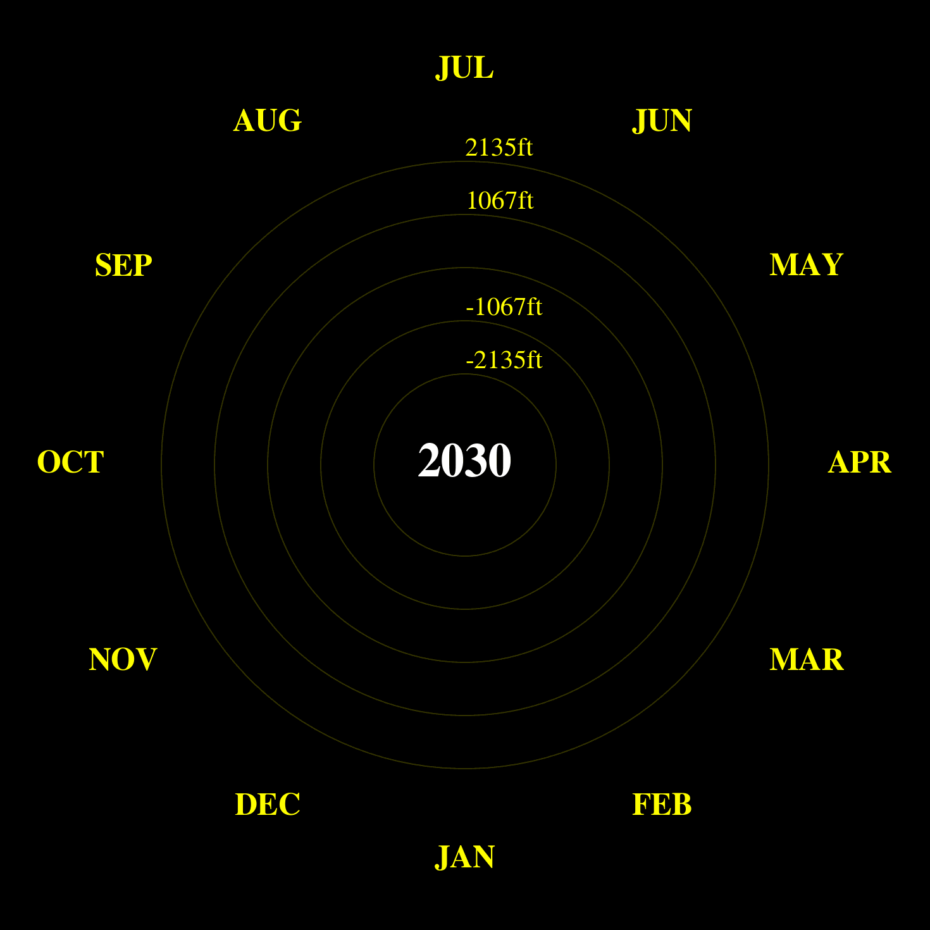
Seasonal Pattern of Density Altitude Changes
(Miami International Airport)
Each ring shows monthly changes (future minus historical).
Red indicates higher future density altitude.
The largest increases occur in the summer and fall.
Change in Moist Density Altitude (Monthly Means)

Slide 10
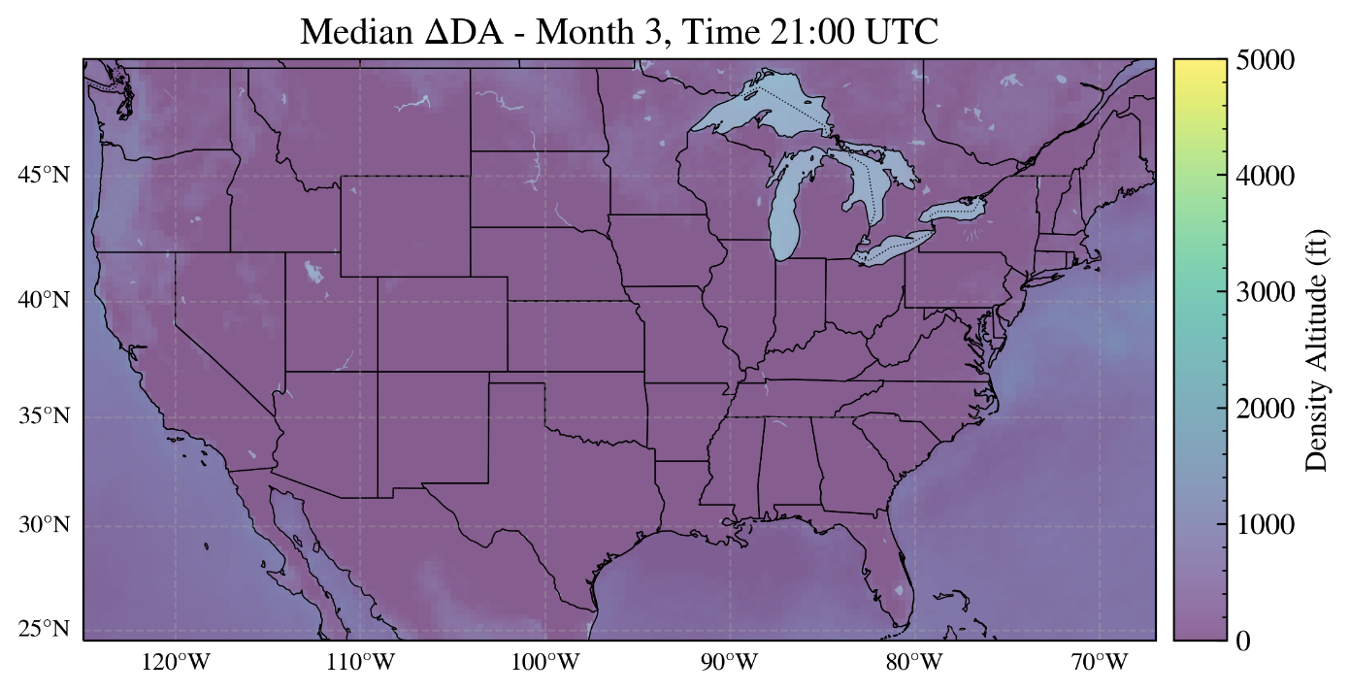
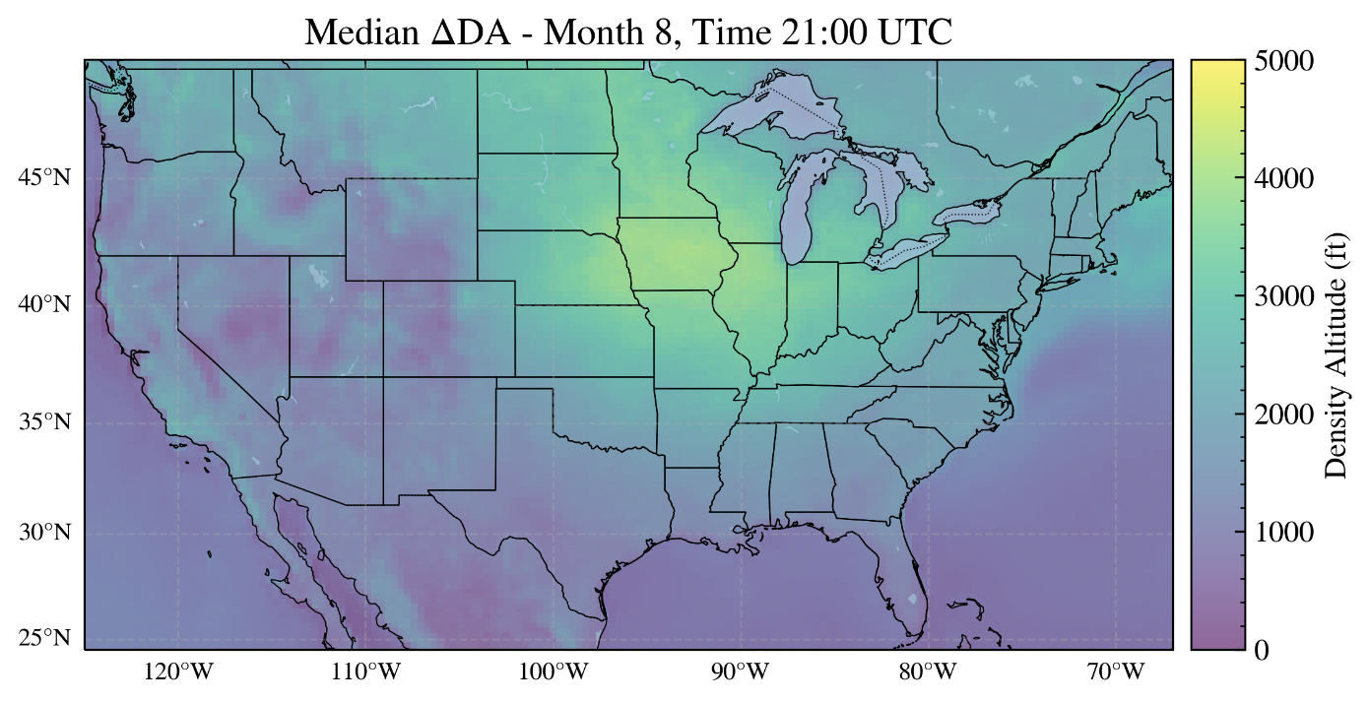
Seasonal and Daily Patterns of Density Altitude Changes
The maps show future DA minus historical DA at a given month and at a given time window.
Difference between projected future (2030–2050) and historical (1995–2014) density altitude:
The increase in DA is higher in the summer and fall.

Slide 11
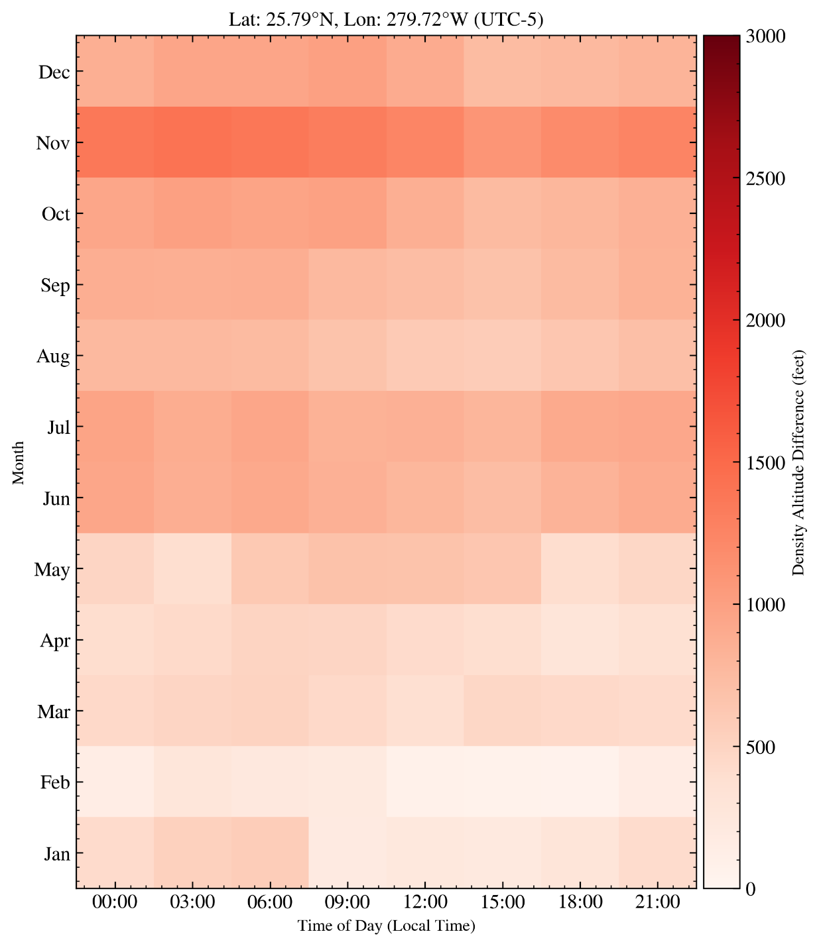
Weather Calendar: Daily and Seasonal Patterns (Miami International Airport)
Difference between projected future (2030–2050) and historical (1995–2014) density altitude:
Bracket implies median; the extremes (e.g., 95th percentiles) are more severe.
For the average ΔDA = 1,400 ft (~Nov):
4.9% reduction in engine horsepower (e.g., cargo weight reduction)
  14% increase in runway length requirement

Slide 12
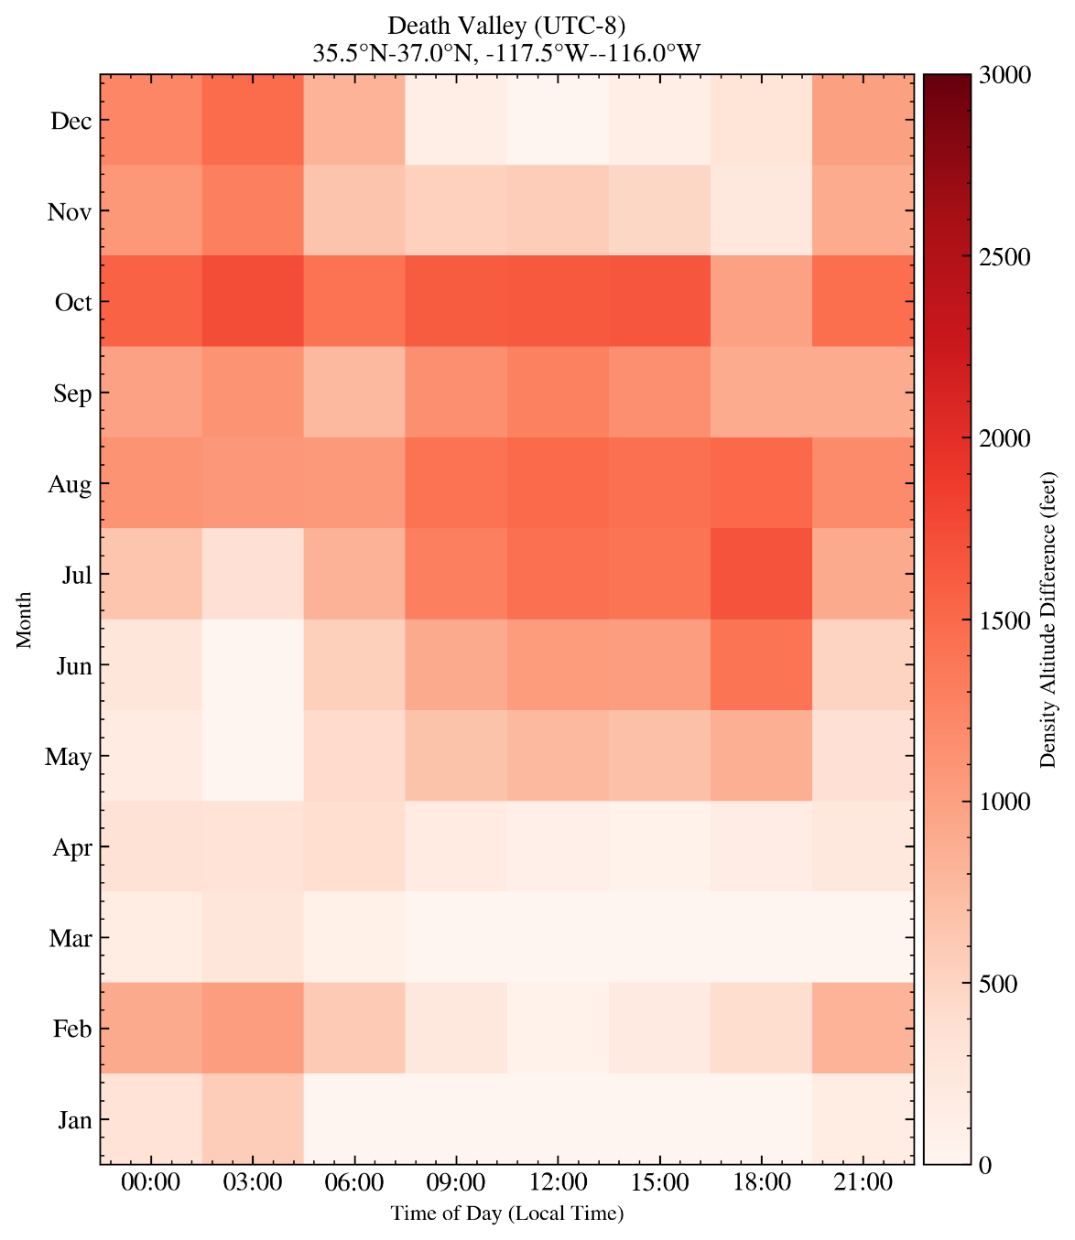
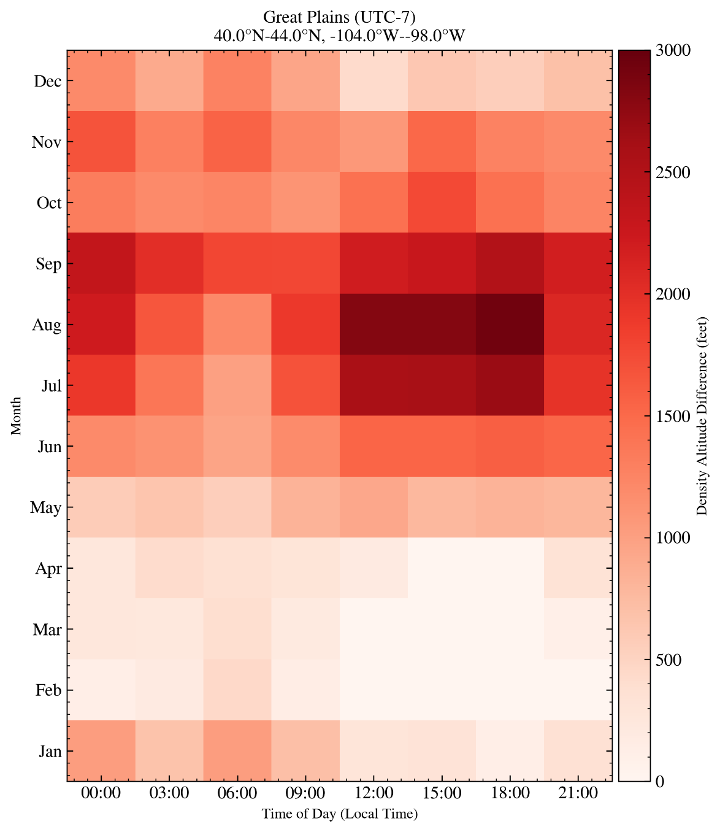
Diverse Geographic Variations in Daily and Seasonal Patterns
ΔDA = 2,500 ft → requires 25% longer runway

Slide 13
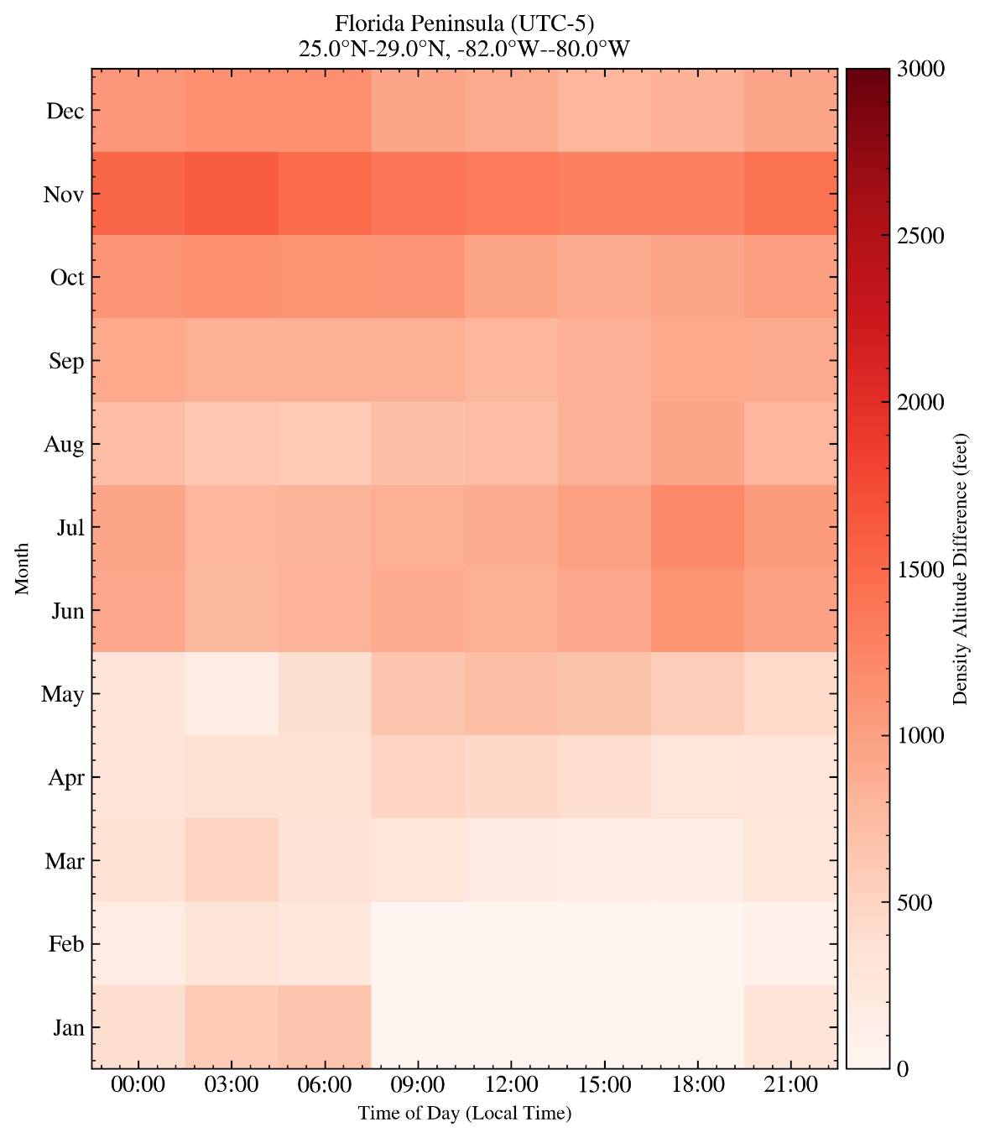
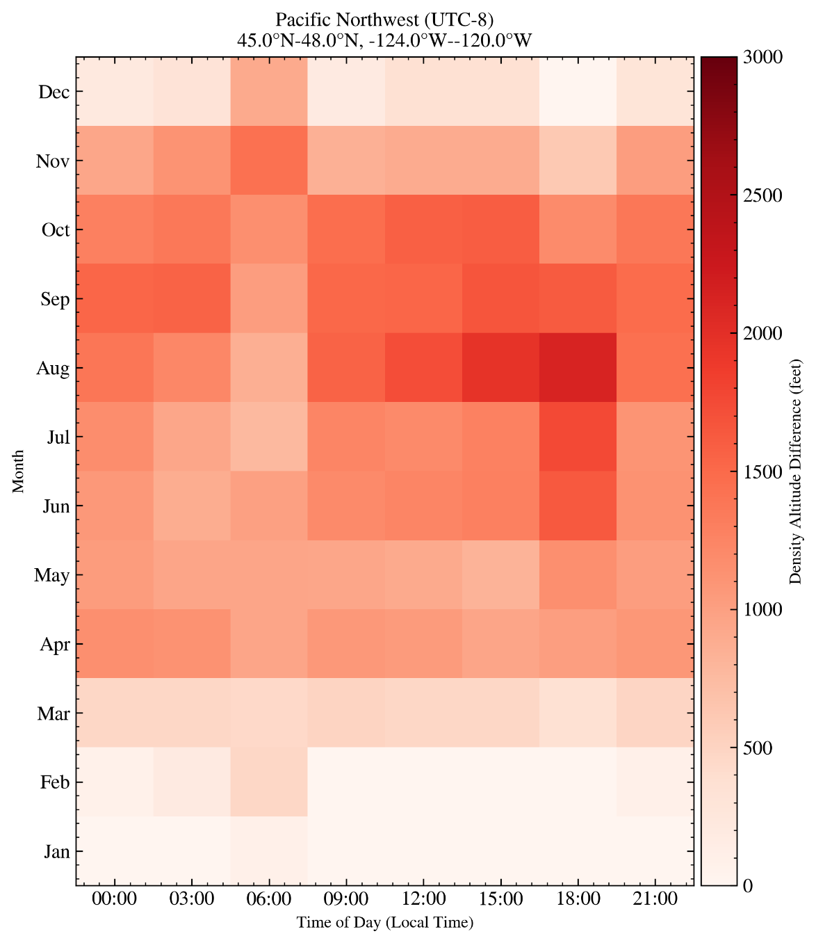
Diverse Geographic Variations in Daily and Seasonal Patterns (cont.)

Slide 14
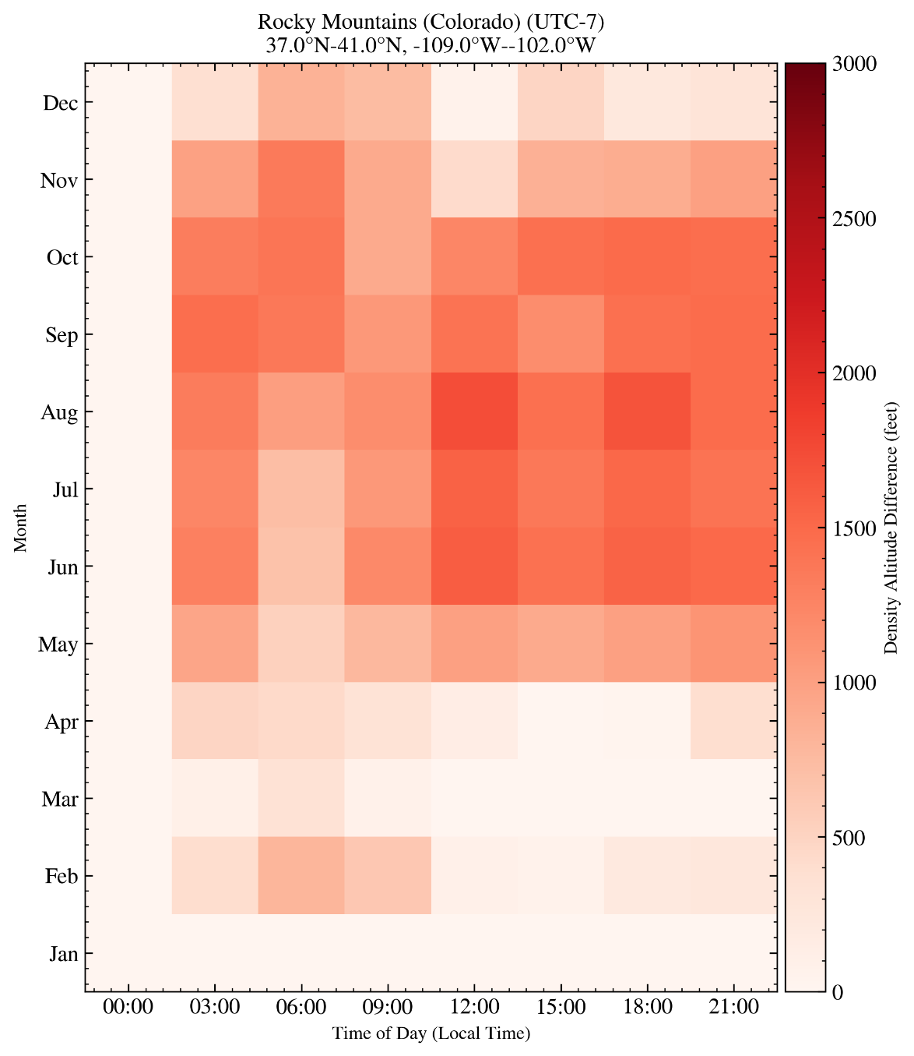
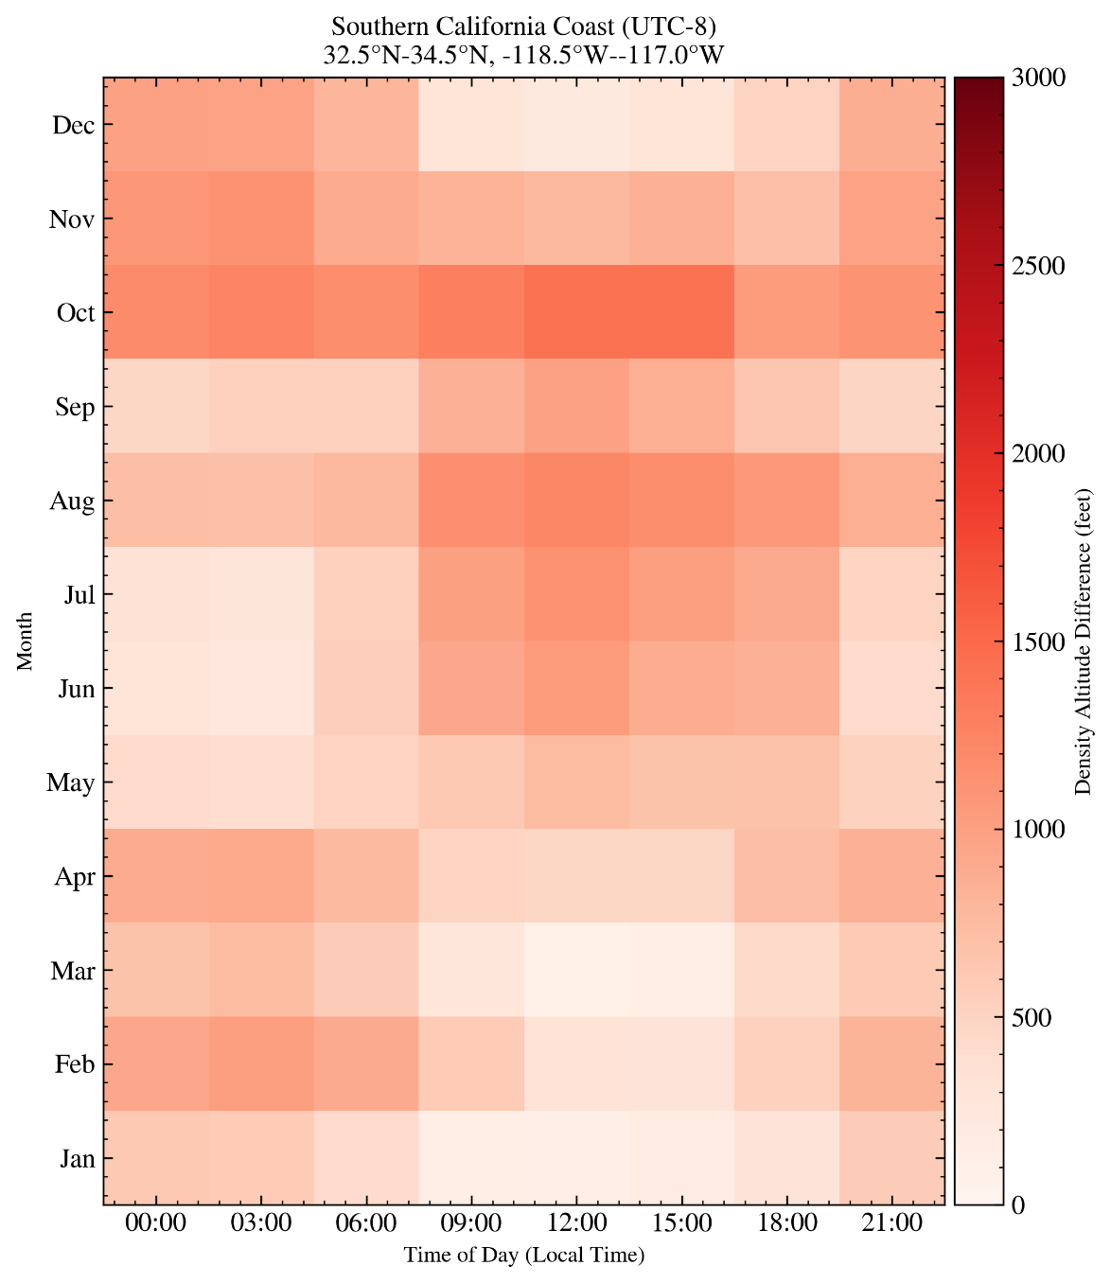
Diverse Geographic Variations in Daily and Seasonal Patterns (cont.)

Slide 15
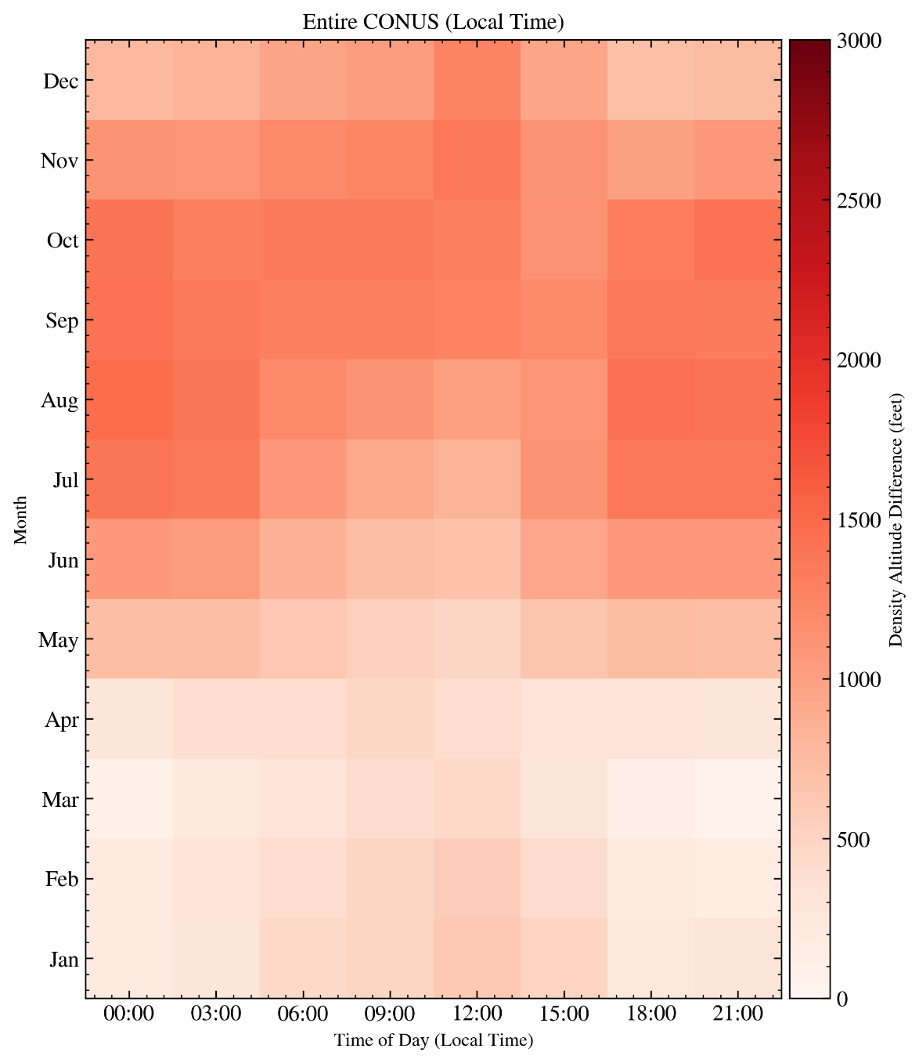
Effects Averaged Across the Entire CONUS
Across CONUS, average density altitude increases by 1,400 ft, with strong regional variations.
Summer and fall months show the strongest impacts.
Spring and winter impacts peak during the afternoon, while summer/fall effects are strongest from midnight to early morning.
As a rough estimate on economical impact:
  In 2023, approximately 10 million commercial flights, average of ~1,500 gallons of fuel per flight.
  For $3 per gallon, 10 million x 1,500 x 3 = $45 billion per year.
  5% of weight reduction (~1,000 ft increase of DA) can translate to $2.25 billion per year!)

Slide 16
Future Aviation Challenges: Density Altitude Impacts
Density altitude is projected to increase in the future.
Projected increases in density altitude will require:
  Longer runways to maintain current capabilities.
  More engine power to compensate for performance loss.
Most severe impacts expected:
  During the afternoon hours.
  Throughout summer and fall months.
Specific impacts on the aircraft and runway will require additional research
These environmental challenges may cost billions of dollars per year to overcome.
The aviation sector must adapt operations and infrastructure for resilience.

Slide 17
Backup

Slide 18

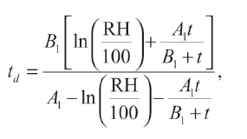



The moist density altitude calculation process involves multiple steps
1
Specific Humidity (SH)
Relative Humidity (RH)
2
Relative Humidity (RH)
Dew Point Temperature
Dry Air Temperature
3
Dew Point Temperature
Actual Vapor Pressure
Actual Vapor Pressure
Virtual Temperature
4
Dry Air Temperature
+
Moist DA
Pressure
Pressure
Box Legend:
Climate Model Primitive
Derived Metric
Final Metric

